Slide 1
Bloom Filter
R09921132 劉彥甫
Lab B

Slide 2
Agenda
Bloom filter
01
What is a Bloom filter?
Where can I use it?
Code analysis
02
How to do hash function?
Loop for hash functionality
How to do score computing?
Overall design
Performance evaluation
03
The issue on porting from DDR to HBM
Does the function actually speed up?
Application time line and resource utilization
Using split buffers

Slide 3
Bloom filter
01
What is a Bloom filter?
Where can I use it?

Slide 4
What is a Bloom filter?
The bloom filter uses a hash table-based data structure that determines when an element is present in the document.
False-positive matches are possible for this approach, but false-negative matches are not; in other words, a query returns either "possibly in the set" or "definitely not in the set".
The advantage of using Bloom filter is that is space-efficient and reduced the number of expensive database queries for data that is not in the set. In most use, bloom filter is used as first-pass document filtering.

Slide 5
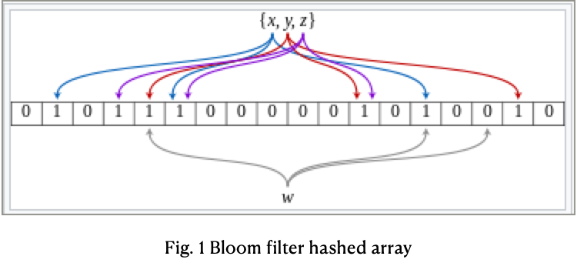
What is a Bloom filter?
The following figure shows a bloom filter example representing the set {x,y,z}.

Slide 6
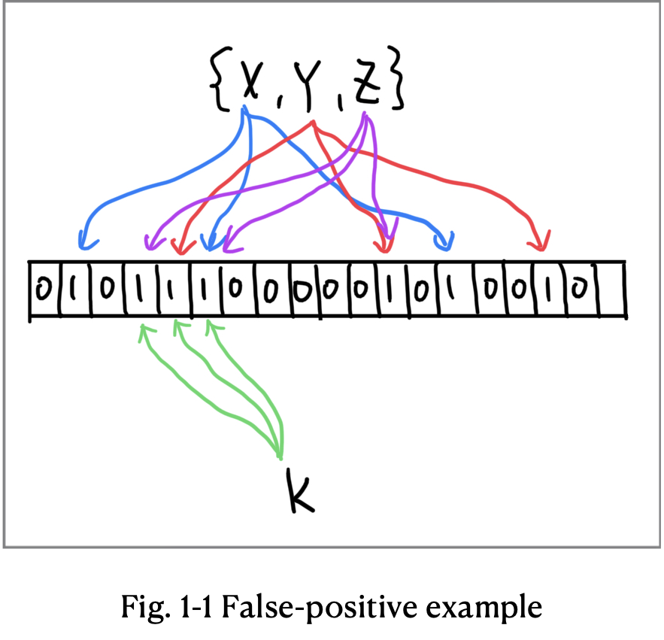
What is a Bloom filter?

Slide 7

Where can I use it?
A bloom filter is also useful in applications to implement search engines and database management systems, such as Cassandra, where it can reduce the number of disk queries and increase performance.

Slide 8
Code analysis
02
How to do hash function?
Loop for hash functionality
How to do score computing?
Overall design

Slide 9
How to do hash function?
unsigned int MurmurHash2 ( const void * key, int len, unsigned int seed )
{
const unsigned int m = 0x5bd1e995;
// Initialize the hash to a 'random' value
unsigned int h = seed ^ len;
// Mix 4 bytes at a time into the hash
const unsigned char * data = (const unsigned char *)key;
switch(len)
{
case 3: h ^= data[2] << 16;
case 2: h ^= data[1] << 8;
case 1: h ^= data[0];
h *= m;
};
// Do a few final mixes of the hash to ensure the last few
// bytes are well-incorporated.
h ^= h >> 13;
h *= m;
h ^= h >> 15;
return h;
}

Slide 10
Loop for hash functionality
// Compute output flags based on hash function output for the words in all documents
for(unsigned int doc=0;doc<total_num_docs;doc++)
{
profile_score[doc] = 0.0;
unsigned int size = doc_sizes[doc];
for (unsigned i = 0; i < size ; i++)
{
unsigned curr_entry = input_doc_words[size_offset+i];
unsigned word_id = curr_entry >> 8;
unsigned hash_pu = MurmurHash2( &word_id , 3,1);
unsigned hash_lu = MurmurHash2( &word_id , 3,5);
bool doc_end = (word_id==docTag);
unsigned hash1 = hash_pu&hash_bloom;
bool inh1 = (!doc_end) && (bloom_filter[ hash1 >> 5 ] & ( 1 << (hash1 & 0x1f)));
unsigned hash2 = (hash_pu+hash_lu)&hash_bloom;
bool inh2 = (!doc_end) && (bloom_filter[ hash2 >> 5 ] & ( 1 << (hash2 & 0x1f)));
if (inh1 && inh2) {
inh_flags[size_offset+i]=1;
} else {
inh_flags[size_offset+i]=0;
}
}
size_offset+=size;
}

Slide 11
How to do score computing?
for(unsigned int doc=0, n=0; doc<total_num_docs;doc++)
{
profile_score[doc] = 0.0;
unsigned int size = doc_sizes[doc];
for (unsigned i = 0; i < size ; i++,n++)
{
if (inh_flags[n])
{
unsigned curr_entry = input_doc_words[n];
unsigned frequency = curr_entry & 0x00ff;
unsigned word_id = curr_entry >> 8;
profile_score[doc]+= profile_weights[word_id] * (unsigned long)frequency;
}
}
}

Slide 12
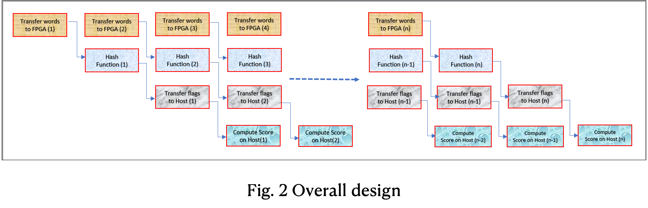
Overall design

Slide 13
Performance evaluation
03
The issue on porting from DDR to HBM
Does the function actually speed up?
Application time line and resource utilization

Slide 14
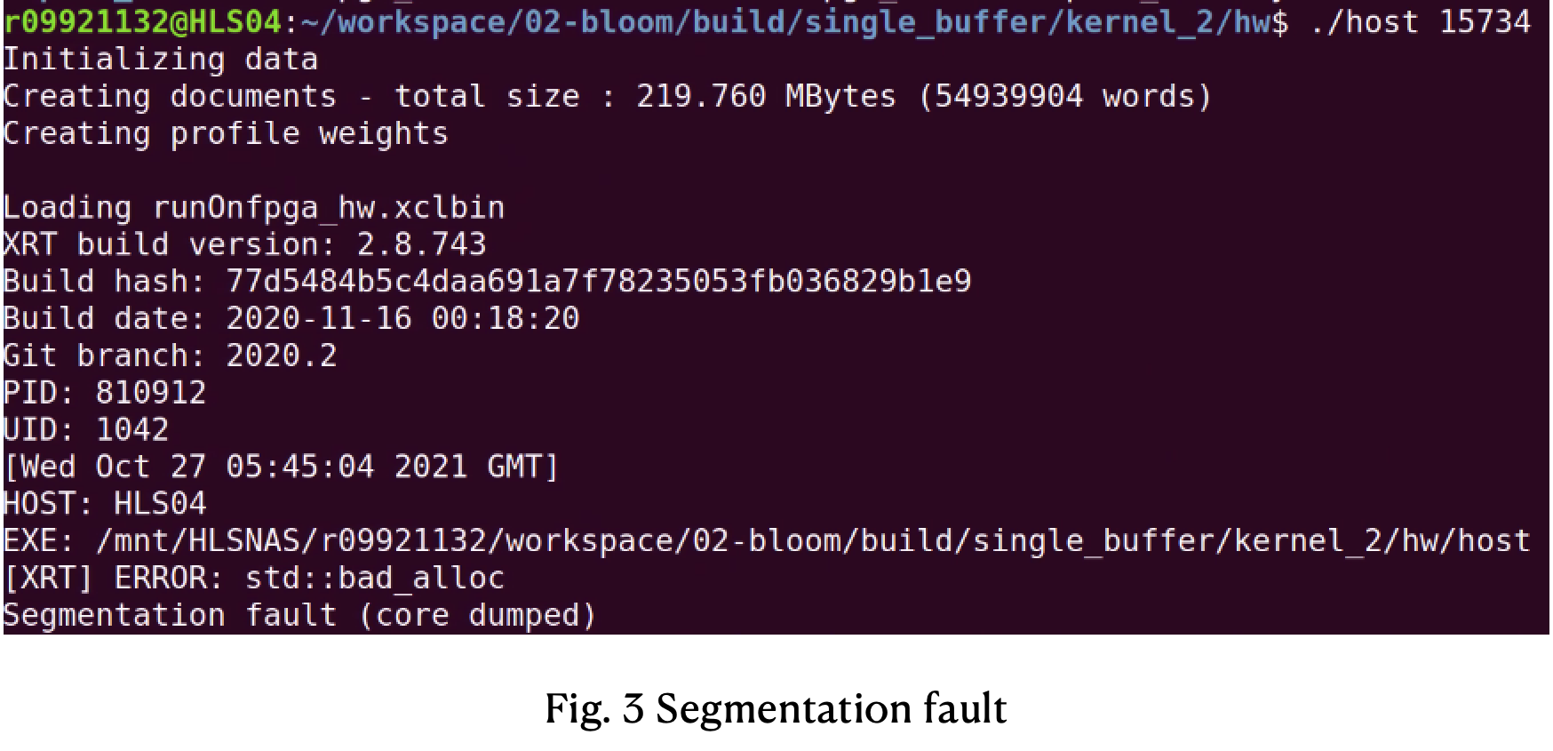
The issue on porting from DDR to HBM

Slide 15
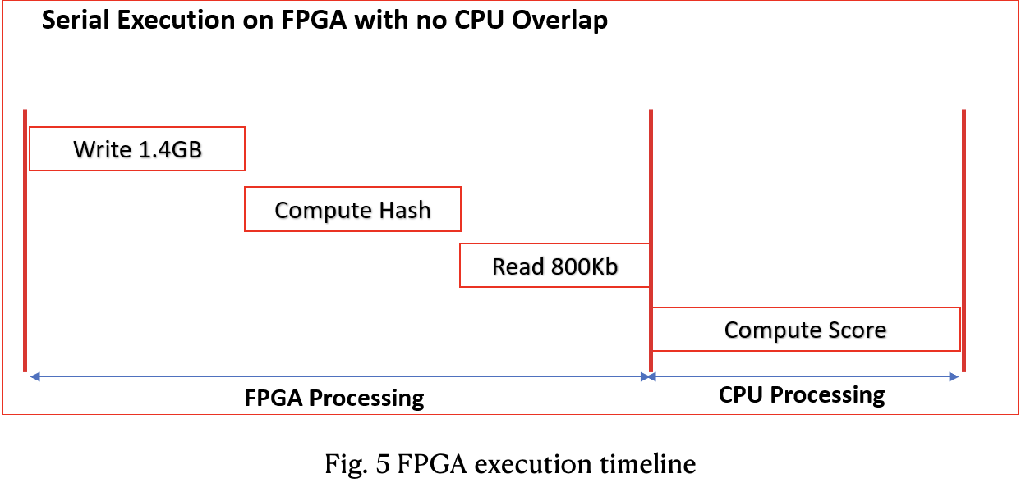
Single buffer execution timeline

Slide 16
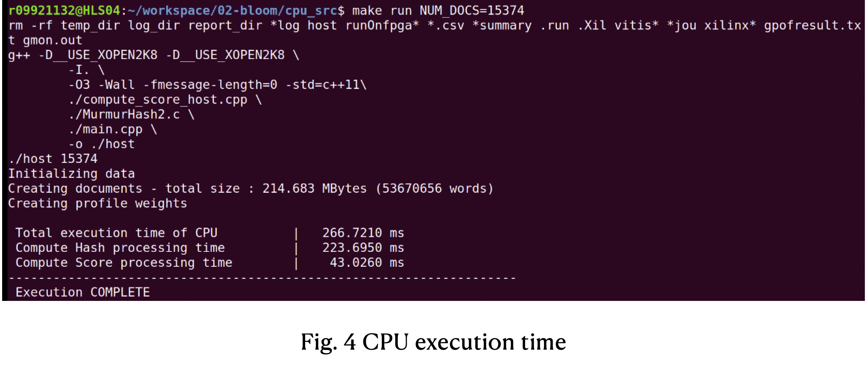
Does the function actually speed up?

Slide 17
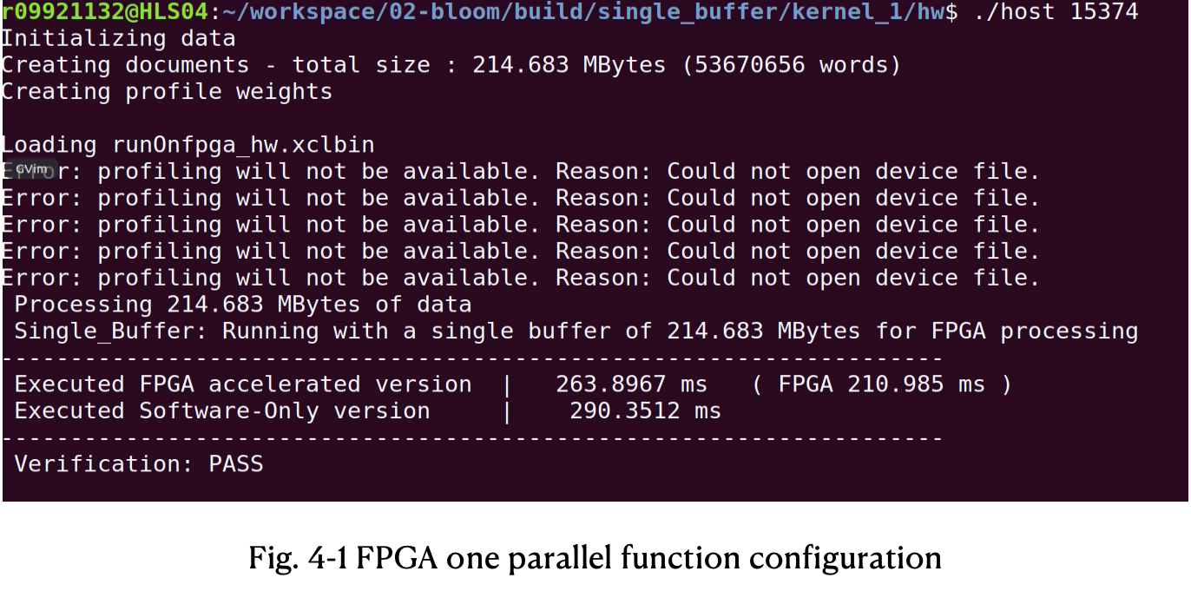
Does the function actually speed up?

Slide 18
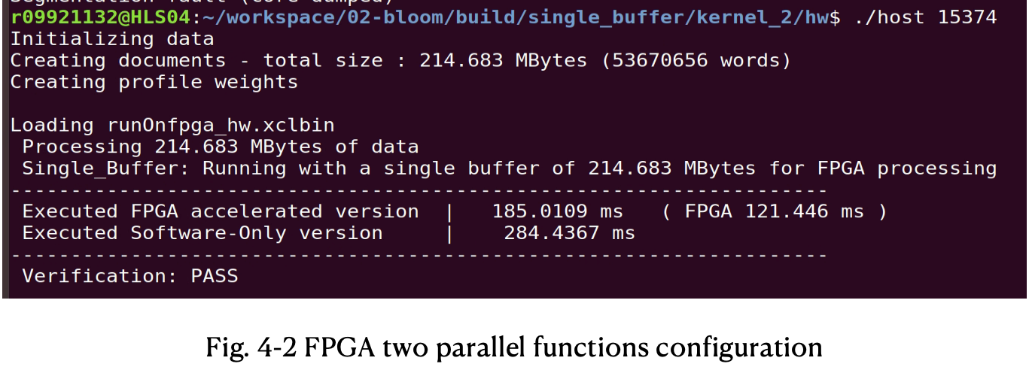
Does the function actually speed up?

Slide 19
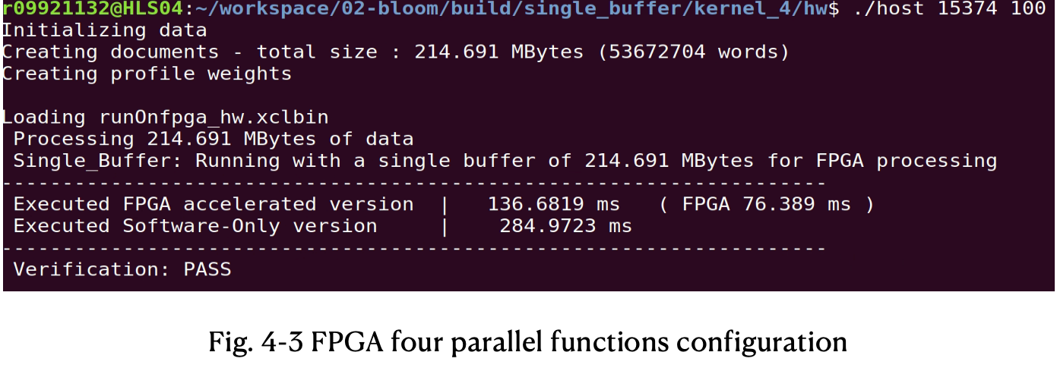
Does the function actually speed up?

Slide 20
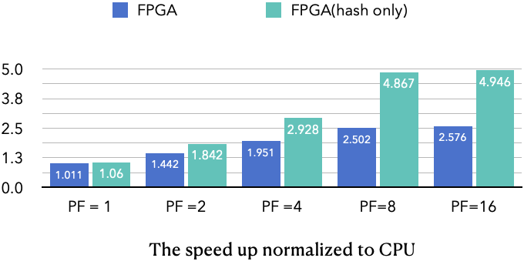
Does the function actually speed up?

Slide 21
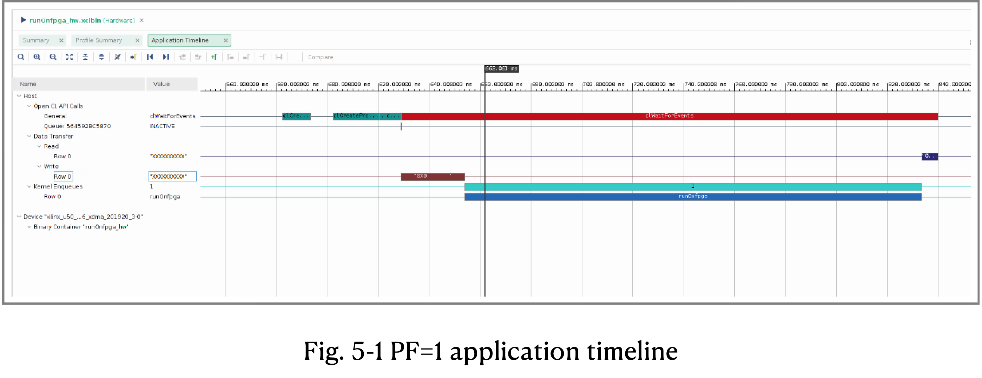
Application timeline and resource utilization

Slide 22
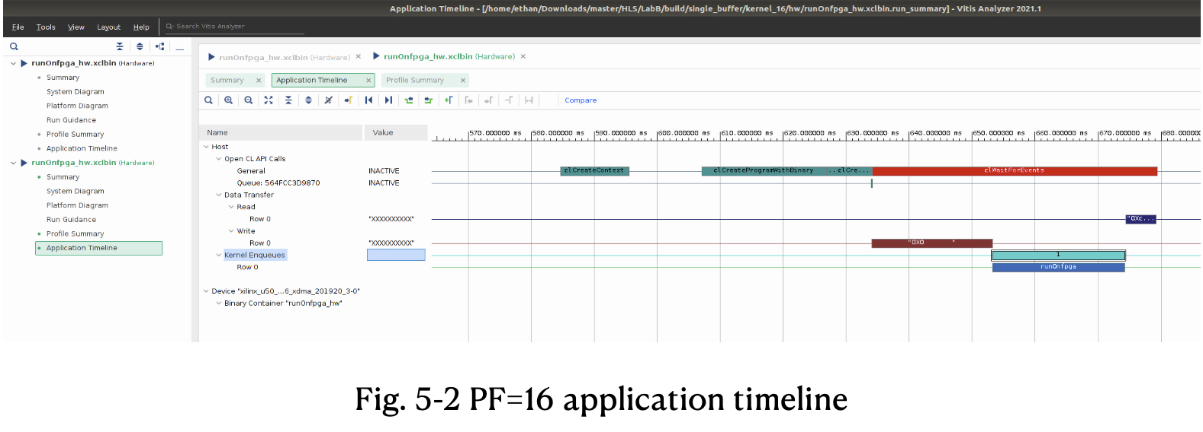
Application timeline and resource utilization

Slide 23
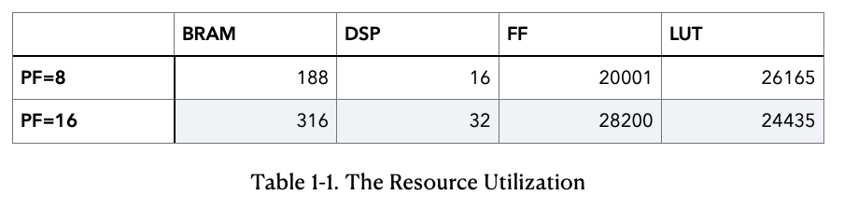
Application time line and resource utilization

Slide 24
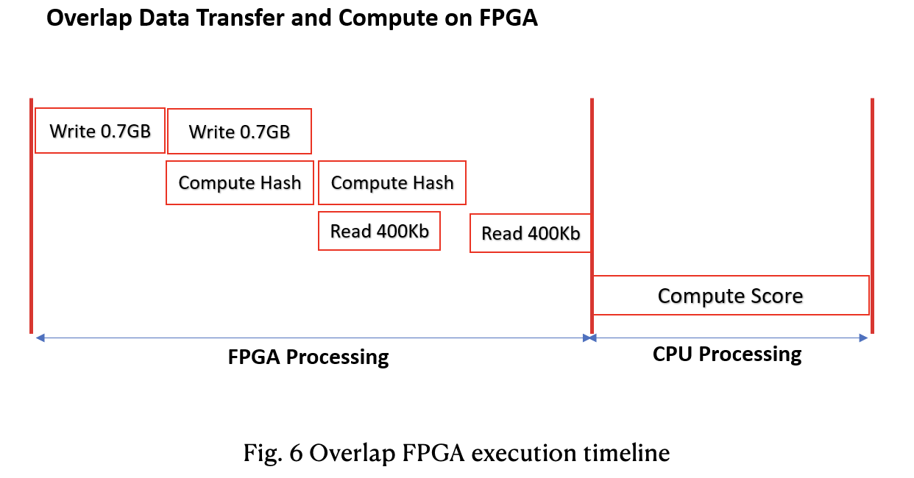
Using split buffers

Slide 25
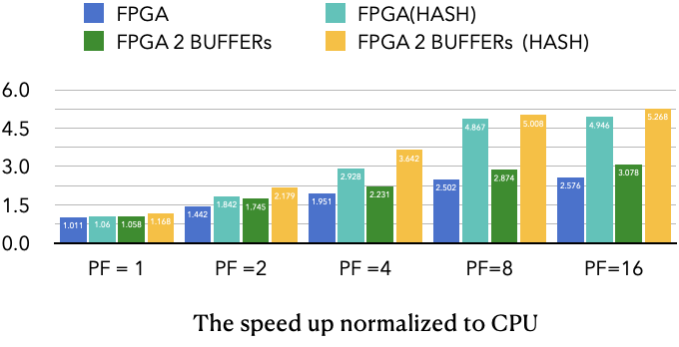

Slide 26
GitHub
# The file hierarchy is:
├── 02-bloom
│ ├── 1_overview.md
│ ├── 2_experience-acceleration.md
│ ├── 3_architect-the-application.md
│ ├── 4_implement-kernel.md
│ ├── 5_data-movement.md
│ ├── 6_using-multiple-ddr.md
│ ├── README.md
│ ├── build
│ ├── cpu_src
│ ├── images
│ ├── makefile
│ └── reference_files
└── report_and_slides
├── Lab_3_R09921132_劉彥甫.pptx
└── R09921132_report.pdf
7 directories, 9 files
https://github.com/Waxpple/HLS_2021_FALL_LABB

Slide 27
THANK YOU

