Slide 1
Lab C : Corner Tracking with Optical Flow
柯宗賢, 黃意堯, 劉彥甫
INSTRUCTOR: Professor Jiin Lai

Slide 2
Outline
Background Introduction
What is an optical flow?
How do we estimate optical flow?
Pipeline Applications : Corner Tracking with Harris corner detector
Main function of the OpenCL host function
Kernel functions
Performance Analysis
The result of cornertracker
Suggestion for Improvement

Slide 3
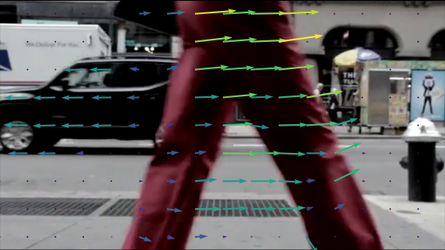
What is an Optical Flow?
Optical flow is a pattern of apparent motion of objects, edges in a visual scene caused by the relative motion between an observer and a scene.
Optical flow can be used by roboticist, encompassing related techniques from imaging processing and control of navigation including motion detection, object segmentation, motion compensated ending, and stereo disparity measurement.

Slide 4
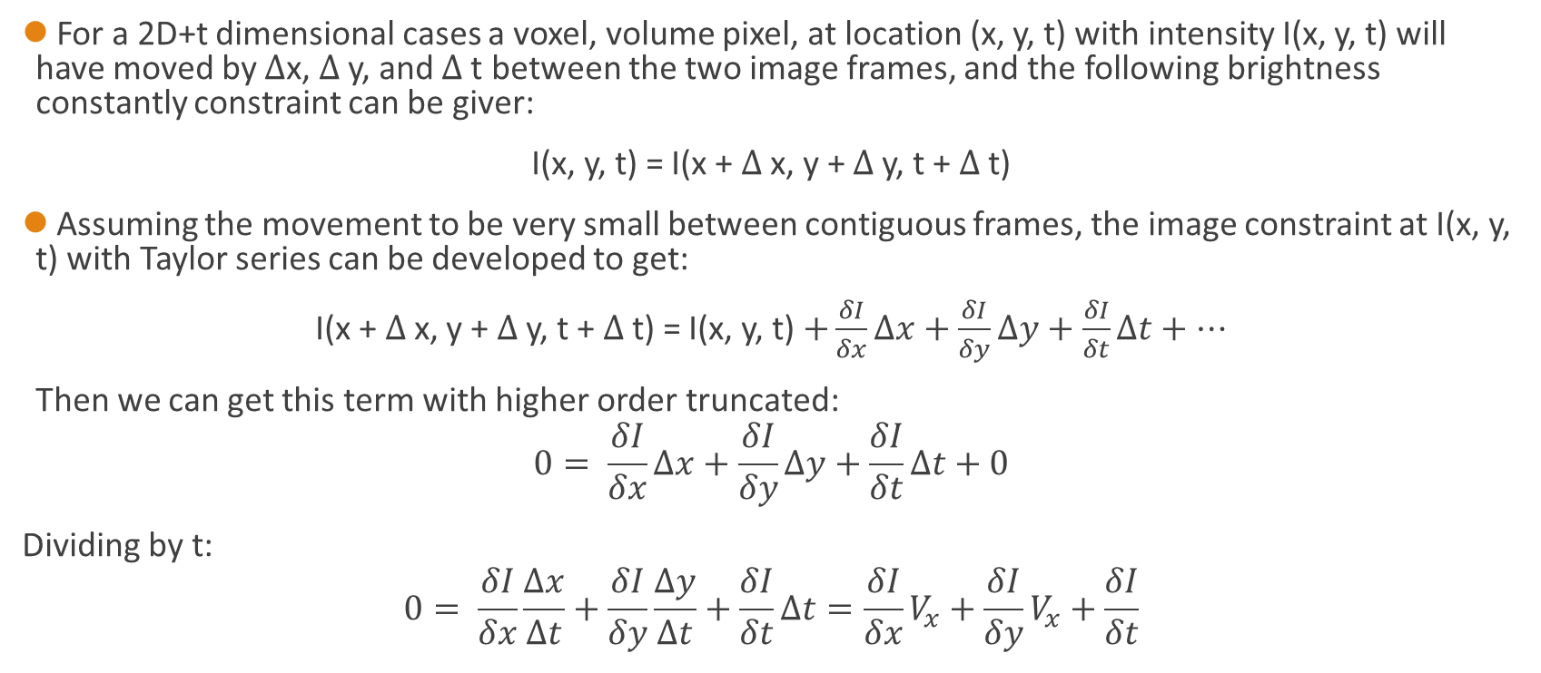
How do we Estimate Optical Flow
For a 2D+t dimensional cases a voxel, volume pixel, at location (x, y, t) with intensity I(x, y, t) will have moved by $∆$x, $∆$y, and $∆$t between the two image frames, and the following brightness constantly constraint can be giver:
I(x, y, t) = I(x + $∆$x, y + $∆$y, t + $∆$t)
Assuming the movement to be very small between contiguous frames, the image constraint at I(x, y, t) with Taylor series can be developed to get:
I(x + $∆$x, y + $∆$y, t + $∆$t) = I(x, y, t) $+\frac{δI}{δx}∆x+\frac{δI}{δy}∆y+\frac{δI}{δt}∆t+⋯$
Then we can get this term with higher order truncated:
$$0= \frac{δI}{δx}∆x+\frac{δI}{δy}∆y+\frac{δI}{δt}∆t+0$$
Dividing by t:
$$0= \frac{δI}{δx}\frac{∆x}{∆t}+\frac{δI}{δy}\frac{∆y}{∆t}+\frac{δI}{δt}∆t=\frac{δI}{δx}V_{x}+\frac{δI}{δy}V_{x}+\frac{δI}{δt}$$

Slide 5
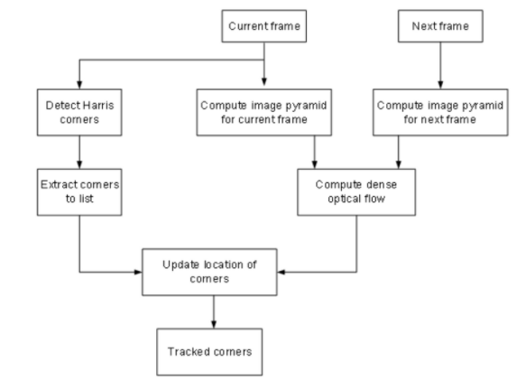
Corner Tracking with Harris Corner Detector
The structure of OpenCL host function is:
1) Read Video
2) Corner tracking for each frame
Detect harris corner
Computer dense optical flow for current frame and next frame
Update locations of corners

Slide 6
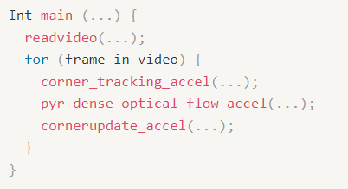
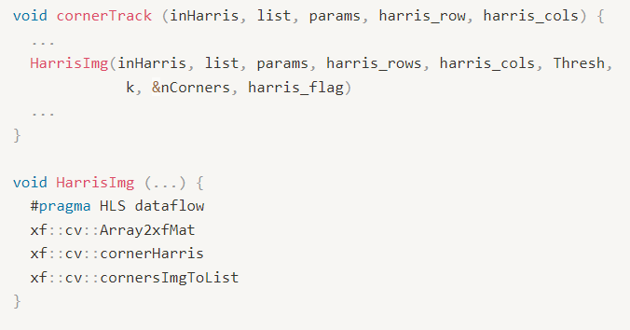
Main Function of the OpenCL Host Function
host function:
Corner Tracking Accelerator:
In the corner tracking function, we use dataflow to accelerate the pipeline of three kernel functions: Array2xfMat, cornerHarris and cornersImgToList.

Slide 7
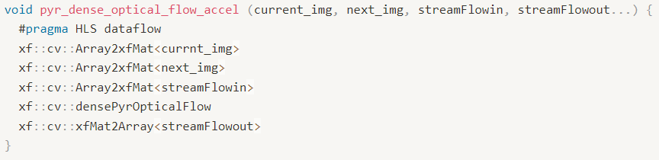

Main Function of the OpenCL Host Function
Pyramid Dense Optical Flow Accelerator:
In the pyramid dense optical flow function, we use dataflow to accelerate the pipeline of three kernel functions: Array2xfMat, densePyrOpticalFlow and xfMat2Array.
Corner Update Accelerator:

Slide 8
Kernel Functions
Array2xfMat
CornerHarris
CornersImgToList
Dense Optical Flow Computation

Slide 9
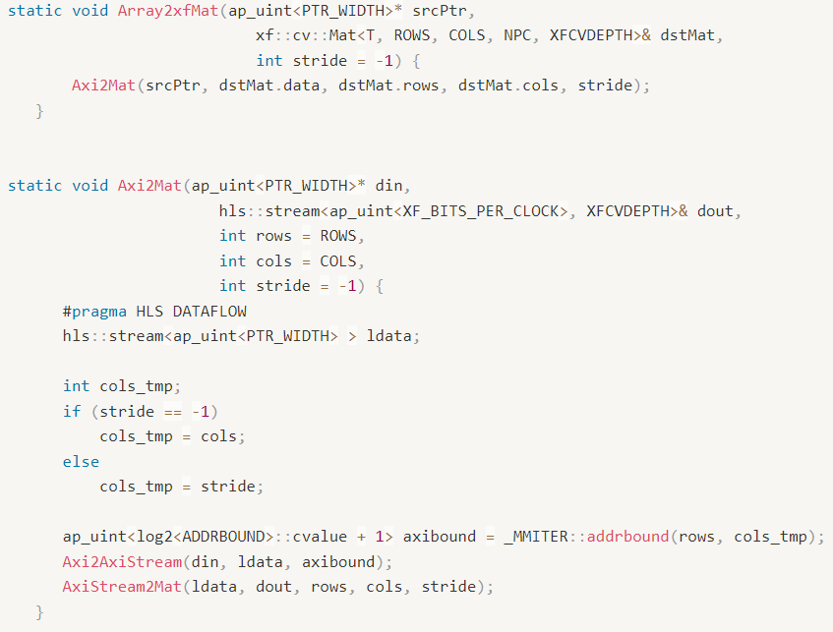
Array2xfMat
There are two type of NPC, number of pixels to be processed per cycle.
Possible option are XF_NPPC1 and XF_NPPC8 for 1-pixel and 8-pixel operations respectively.
In our Lab C, we use XF_NPPC1 for our NPC.
The first thing here is to transfer Array into xfMat format with above function.

Slide 10
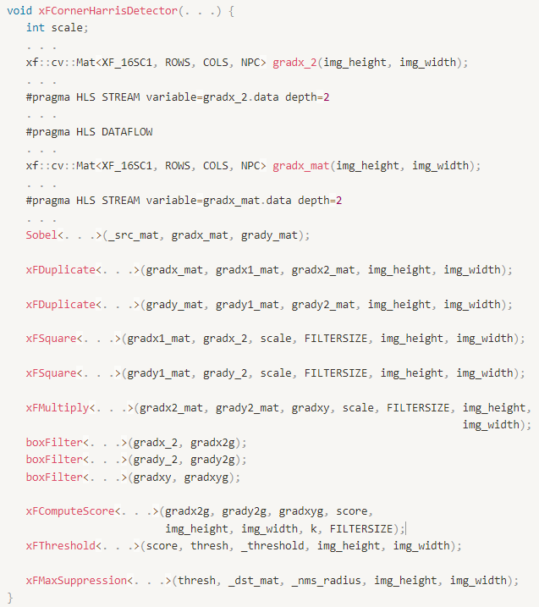

CornerHarris
After perform sobel filter, we can get gradient of x and y direction.
In sobel filter, it already use #pragma array partition complete dim=1. It is very similar to FIR computation if we flatten the sobel filter operation.
After getting gradients, we first duplicate them with xFDuplicate.
And we perform gradient_x * gradient_y with xFMultiply.
And then perform three mean filter, box filter, on the gradient_x/y square and gradient_x*y.

Slide 11
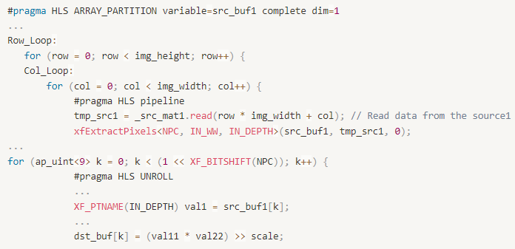
CornerHarris
Array partition in Sobel filter:

Slide 12
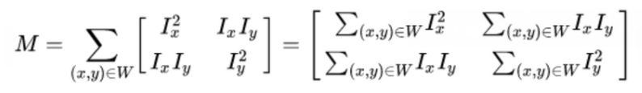
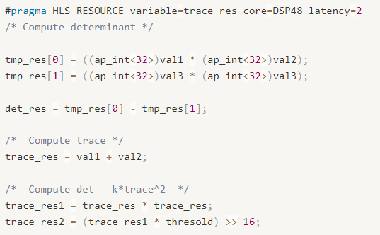
CornerHarris
With these three array, we now have M matrix as following.
After we have M matrix, we can calculate “Harris response” with following formula
$$R=\det\left(M\right)−k{\left(trace\left(M\right)\right)}^{2}=λ_{1}λ_{1}−k{(λ_{1}+λ_{2})}^{2}$$

Slide 13
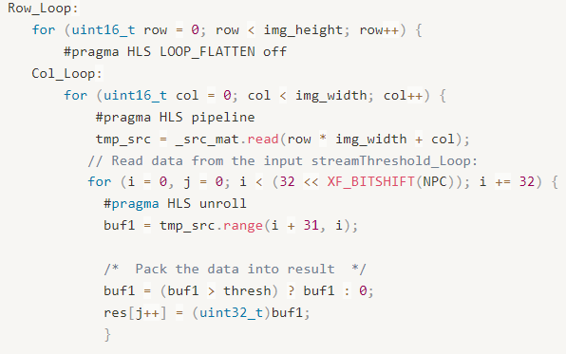
CornerHarris
And K in the xFComputeScore is an empirical constant which is usually range form 0.04 to 0.06. After score computation, we need to do a max suppression. Before max suppression, we first perform an activation function with threshold.
Basically what the CornerHarris does is to reduce maxima into only one local maxima point.
This will makes us to find a corner which can represent this area. And we need to add those corner coordinates into a list.
Last task is Max suppression.

Slide 14
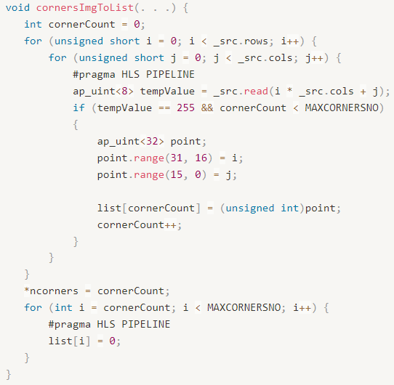
CornersImgToList
tempValue is 255 if there is a corner

Slide 15
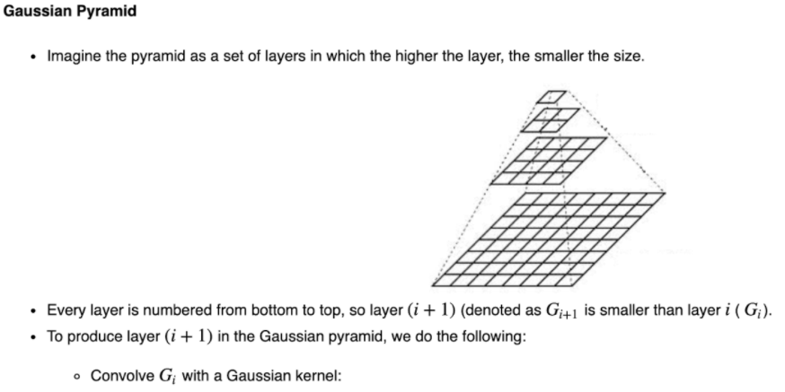
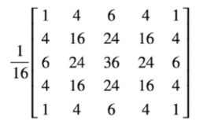
Dense Optical Flow Computation
Compute feature map with convolution on cur_frame and nxt_frame with 5x5 Gaussian filter as following figure.

Slide 16
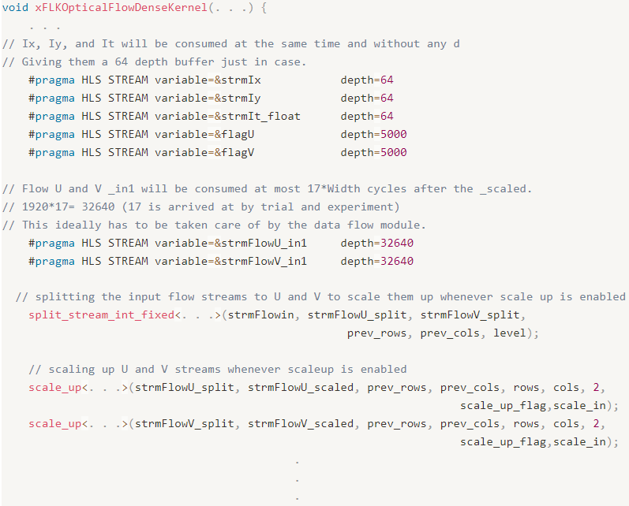
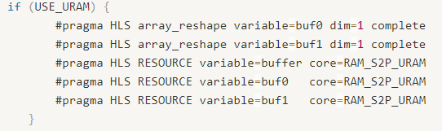
Dense Optical Flow Computation
First, we split the u and v vector from stream data using split_stream_int_fixed.
And we can perform scale up if vector is scale down before by scale_up.

Slide 17
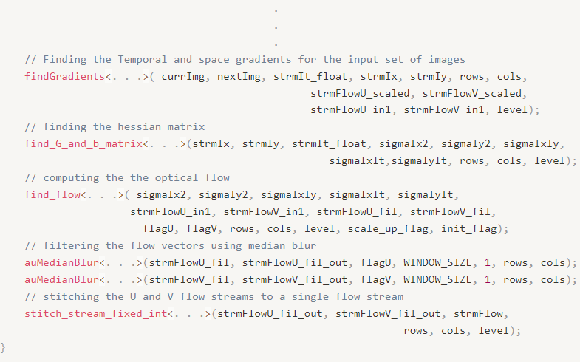
Dense Optical Flow Computation
And first thing we should find the intensity by findIntensity.
After we find the intensity, we can then substrate it from the equation below by findGradients.

Slide 18
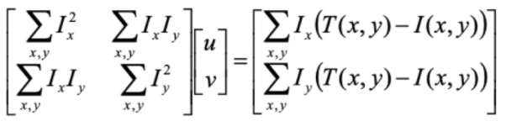
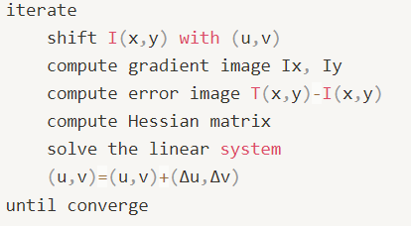
Dense Optical Flow Computation
The next step is to compute hessian matrix by find_G_and_b_matrix.
After computing u,v, we apply a median filter on both vectors.
Then stitched the u,v vector into same data array and stream it out.
On the top function, we perform following iterated algorithm until it converge.
Now we can perform corner coordinates update. In this case, we can track the corner.

Slide 19
Performance Analysis
cornerTracker
pyr_down_accel
pyr_dense_optical_flow_accel
cornerupdate_accel

Slide 20
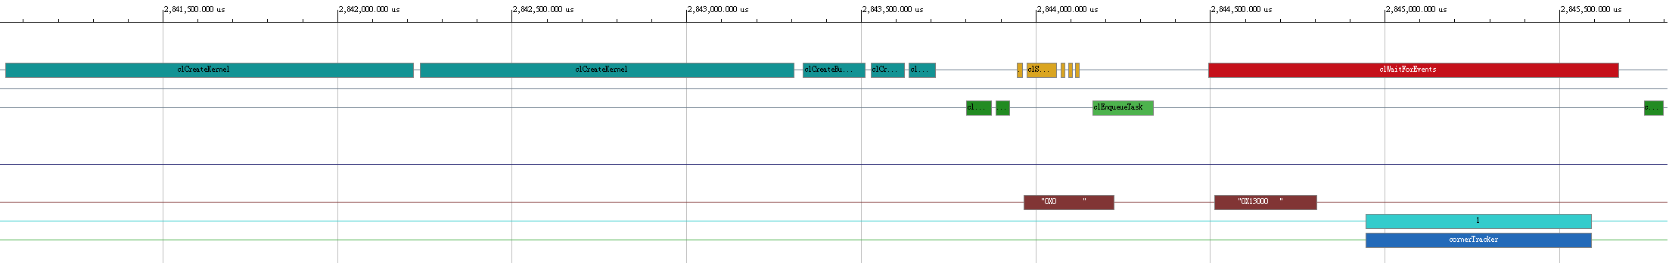
CornerTracker
clCreateBuffer
clEnqueueMigrateMemObjects
clSetKernelArg
clEnqueueTask
clWaitForEvents
In the cornertracker, the code is following the flow:
cl::Buffer
q.enqueueMigrateMemObjects
krnl.setArg
q.enqueueTask
clWaitForEvents
q.enqueueMigrateMemObjects
We can see that the flow is the same as the application timeline.

Slide 21
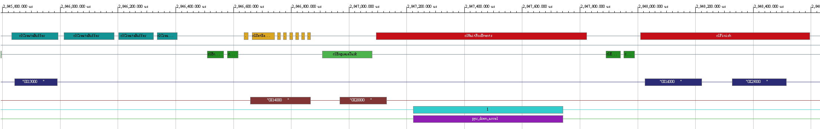
Pyr_down_accel
In pyr_down_accel, the timeline is similar to cornerTracker. The only different is clFinish in pyr_down_accel which is add behind q.enqueueMigrateMemObjects.

Slide 22
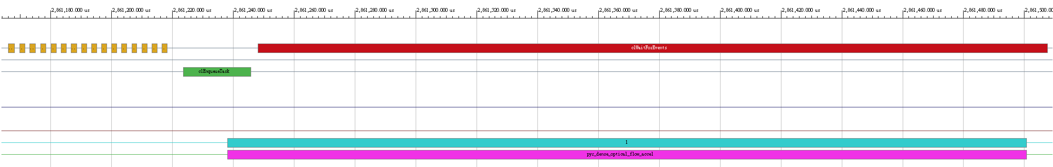
Pyr_dense_optical_flow_accel
clSetKernelArg
clEnqueueTask
clWaitForEvents
In a pyr_dense_optical_flow_accel, there have 16 of _krnl.setArg in application timeline which is the same as we defined in the code.

Slide 23
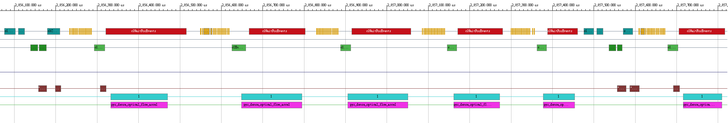
Pyr_dense_optical_flow_accel
In a complete pyr_dense_optical_flow_accel, we can see that it used a q.enqueueMigrateMemObjects before five kernel of pyr_dense_optical_flow_accel.

Slide 24
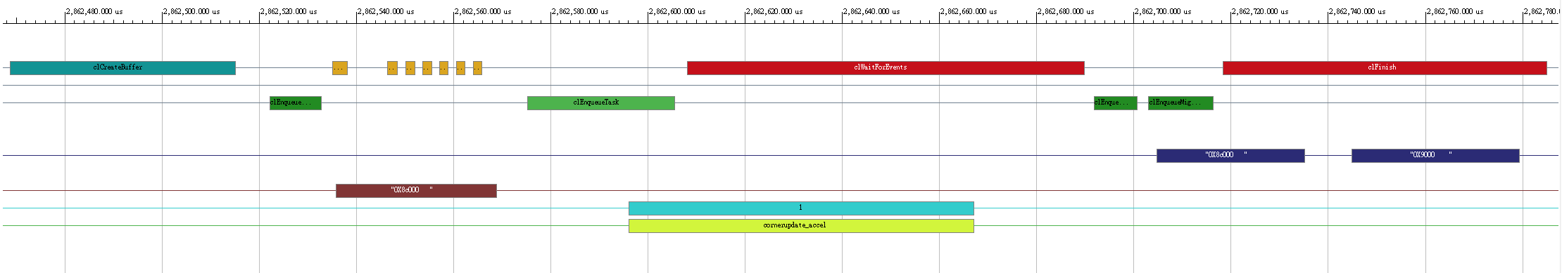
Cornerupdate_accel
clCreateBuffer
clEnqueueMigrateMemObjects
clSetKernelArg
clEnqueueTask
clWaitForEvents
clFinish

Slide 25
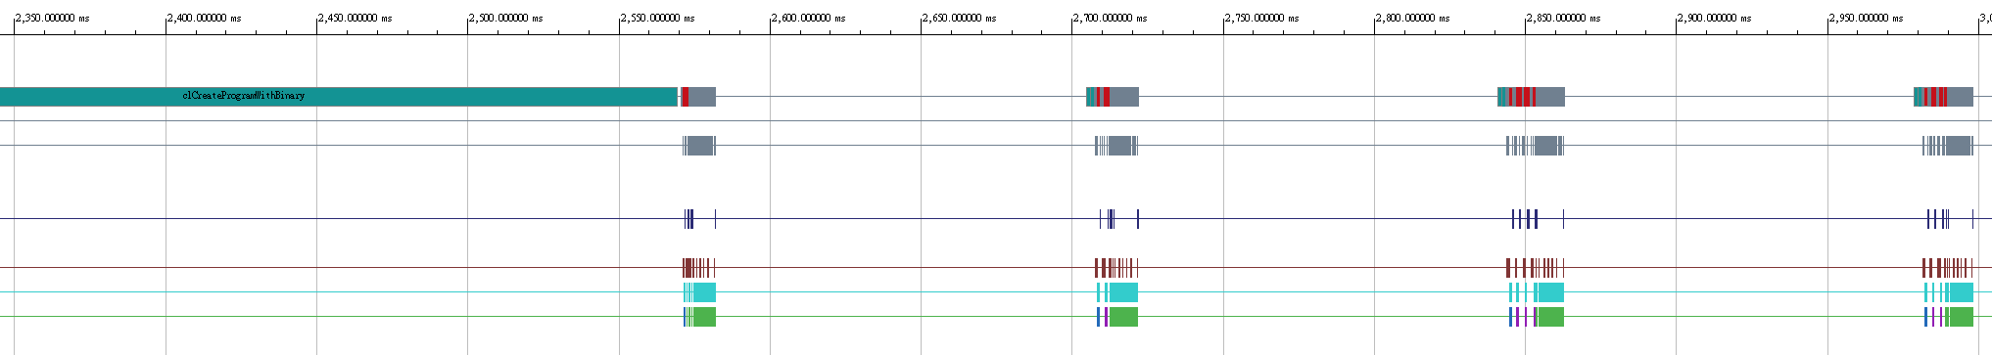
The Whole Application Timeline in Vitis HW
Run through four kernels
Lab C in vitis hardware, first we should read the data from binary_file. Then we can begin to corner tracking. Then we do four times corner tracking, so we can see four parts in the application timeline.

Slide 26
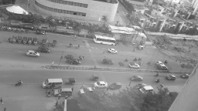


The Result of Cornertracker
In the lab, first we will build a pyramid of input photo. And then go through the whole system, we can get the result.

Slide 27
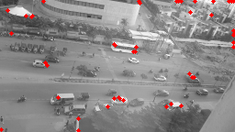
The Result of Cornertracker
We can see the result have some mark which is the corner which we find by the code.

Slide 28
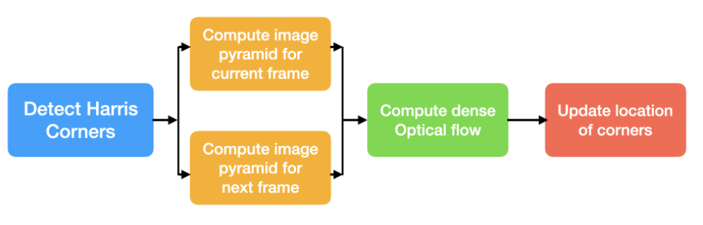
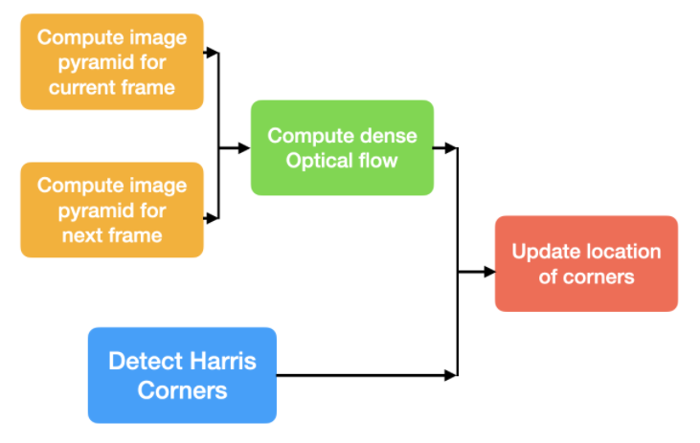
Suggestion for Improvement
For the current implementation:
However, detect Harris corners can be executed parallel with compute dense optical flow to accelerate the applications. This optimization can be done in OpenCL host code.

Slide 29
GitHub
The GitHub link : https://github.com/Waxpple/HLS_2021_FALL_LABC

Slide 30
Thanks for listening！

