Slide 1
Lab C
Group 2
B06901178 蔡易霖 R10943005 楊宗賢 R10943118 林宥陞

Slide 2
L1 Primitive Functions
•In L1 of BLAS library provided various primitive functions to apply in custom BLAS application
•Mainly divided into four categories
Arithmetic function
Vector operations
Matrix and vector multiplication
Helper function
•In the next I will briefly introduce these function

Slide 3
Arithmetic function
All of these function are Stream in one or two vector that return a vector
Amax
Stream in a vector that returns the position of the vector element that has the maximum magnitude
Amin
Stream in a vector that returns the position of the vector element that has the minimum magnitude
Asum
Stream in two vector that returns the sum of the magnitude of vector elements

Slide 4
Vector operations
All of these function are Stream in one or two vector that return or stream out a vector
Copy
copy function stream out the vector copy from input
Dot
returns the dot product of input vector x and y
Nrm2
returns the Euclidean norm of the input vector x
Swap
swap function stream out the vector swap from input
Scal
scal function stream out vector Y which Y = alpha * X
Axay
axay function stream out vector Y which Y = alpha*X + Y

Slide 5
Matrix and vector multiplication
All of these function are stream in a vector and a matrix that stream out a vector
Gbmv
stream out a vector of general banded matrix-vector multiplication y = alpha * M * x + beta * y
Gemv
stream out a vector of the multiplication of a matrix and a vector y = alpha * M * x + beta * y
Symv
stream out a vector of the multiplication of a symmetric matrix and a vector y = alpha * M * x + beta * y
Trmv
stream out a vector of the multiplication of a triangular matrix and a vector y = alpha * M * x + beta * y

Slide 6
Helper function
Which is the common module used by several primitives.
Datamover module : move diverse kind of matrix and vector from memory to stream or move diverse kind of matrix and vector from stream to memory
Function module: basic function
Datatype module: define various data type using in streaming matrix and vector

Slide 7
L1 testing phase
In L1 testing phase, the goal is to confirming the correction of primitive function
Four step in testing
1.Starting with blas_gen_bin, the golden data and input data is generated
2.C-sim executes the function with input data than compare to golden data
3.Synthesize the function when c-sim has passed
4.Co-sim executes the function in simulator with input data than compare to golden data
The library path must be specific before testing which user guide is omitted
LIBRARY_PATH=/usr/lib/x86_64-linux-nu:$LIBRARY_PATH
export LIBRARY_PATH

Slide 8
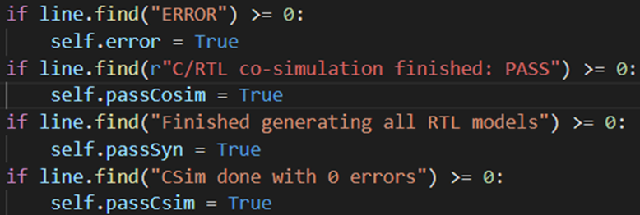
Different in English case
After the phase of synthesis, the testbench will looking for the appearance of the string "Finished generating all RTL models" in the run log of Vitis HLS to deduce whether the synthesis succeeded
Lowercase “g” using in the string
Testbench : hls.py

Slide 9
Different in English case
However, the tool version 2020.2 we used produces the string "Finished Generating all RTL models" in log file which leads to the failure of the L1 test
Uppercase “G” using in the string
Logfile

Slide 10
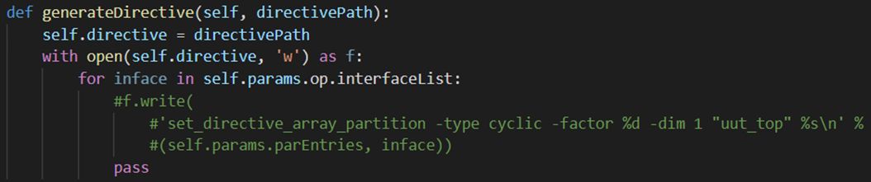
The directive of array_partition
This problem will be encountered in Synthesis
Logfile
To solve this problem, the flag set_directive_array_partition generated by generateDirective() in L1/tests/sw/python/hls.py needed to be commented out
hls.py

Slide 11
The directive of array_partition
Why this problem will happen, first of all, 2020.2 does not support arrays of top-level functions to be partitioned completely.
When the array is not partitioned at the top interface of the function, the protocol ap_memory is used, which means that the IP will be connected to the BRAM.
The old version of the HLS tool before will forcibly break them into single registers and then use the simplest protocol ap_none to encapsulate them.
Such operations are eliminated in Vitis HLS because they waste resources and are not conducive to system integration.

Slide 12
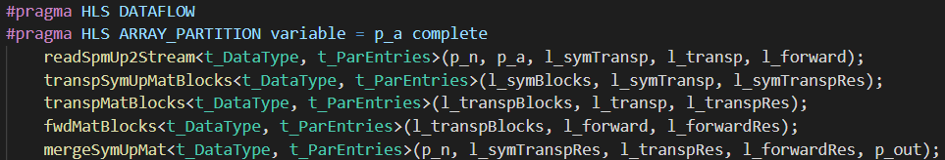
Set array partition pragma
What happens if commented the directive of array_partition ?
Can imagine array will not performance in parallel
It can be noted that only in the top function can not do array partition
So we can apply the pragma of array partition to each sub-function to achieve parallelism

Slide 13
Compare the result
In the report of this primary function with array partition, resource utilization and performance are identical compare to without array partition
As we can see it has not used
BRAM in this design, so that with
or without array partition
are not different
I think because this function just uses few memory that no needed to using BRAM

Slide 14
L2 Kernel

Slide 15
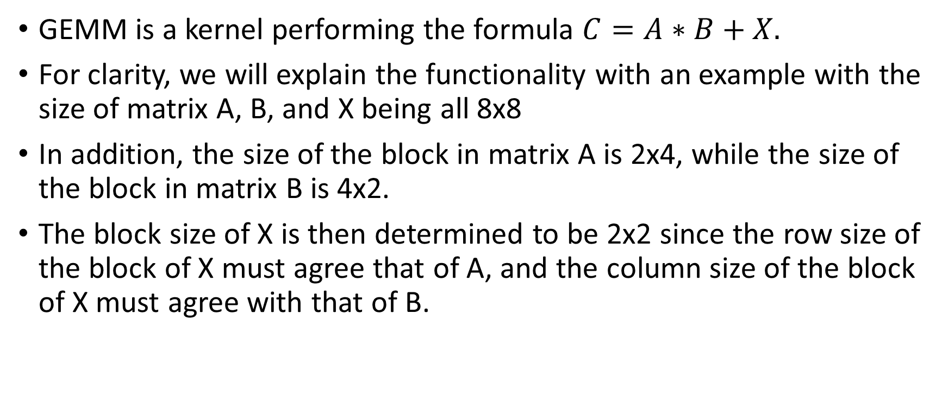
Preliminary

Slide 16
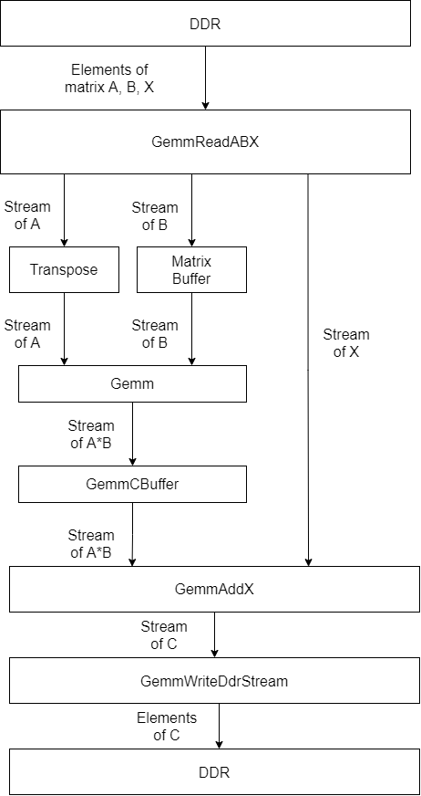
Structure of GEMM

Slide 17
GemmReadABX
In this function, the kernel reads the elements of matrix A, B, X from DDR and write them to the output stream.
A block in matrix A contains 2x4 elements.
A block in matrix B contains 4x2 elements.
A block in matrix X contains 2x2 elements, which is determined by the row size of a block in matrix A and the column size of a block in matrix B.
The kernel writes the data to the output stream right after it is read, so no extra buffer is needed to store the data.

Slide 18
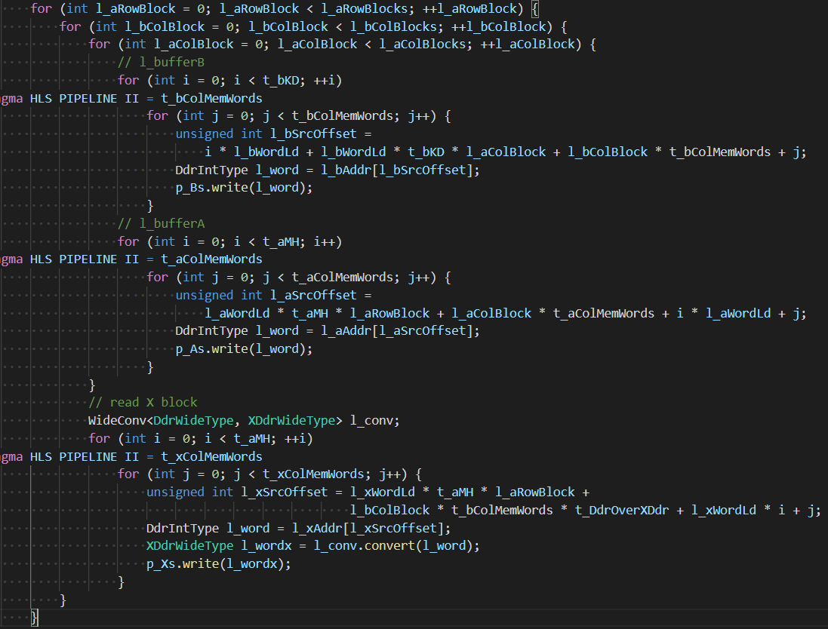
Analysis of Reading DDR

Slide 19
Matrix A
l_aRowBlocks * l_bColBlocks * l_aColBlocks * t_aMH * t_aColMemWords
l_aRowBlocks: number of blocks in a column of matrix A (4)
l_bColBlocks: number of blocks in a row of matrix B (4)
l_aColBlocks: number of blocks in a row of matrix A (2)
t_aMH = t_DdrWidth * t_aRowMemWords: number of elements in one column of the matrix A buffer (2)
t_aColMemWords: number of memory words in one row of the matrix A buffer (4)
l_aRowBlocks * l_bColBlocks : number of blocks in matrix C
t_aMH * t_aColMemWords: number of memory access to read all elements in a block in matrix A

Slide 20
Matrix B
l_aRowBlocks * l_bColBlocks * l_aColBlocks * t_bKD * t_bColMemWords
l_aRowBlocks: number of blocks in a column of matrix A (4)
l_bColBlocks: number of blocks in a row of matrix B (4)
l_aColBlocks: number of blocks in a row of matrix A (2)
t_bKD = t_DdrWidth * t_aColMemWords: number of elements in one row of the matrix A buffer (4)
t_bColMemWords: number of memory words in one row of the matrix B buffer (2)
l_aRowBlocks * l_bColBlocks : number of blocks in matrix C
t_bKD * t_bColMemWords : number of memory access to read all elements in a block in matrix B

Slide 21
Matrix X
l_aRowBlocks * l_bColBlocks * t_ aMH * t_xColMemWords
l_aRowBlocks: number of blocks in a column of matrix A (4)
l_bColBlocks: number of blocks in a row of matrix B (4)
t_aMH = t_DdrWidth * t_aRowMemWords: number of elements in one column of the matrix A buffer
t_xColMemWords: number of memory words in one row of the matrix X buffer (2)
l_aRowBlocks * l_bColBlocks : number of blocks in matrix C
t_ aMH * t_xColMemWords: number of memory access to read all elements in a block in matrix X

Slide 22
The writing order of elements in a block in matrix A in GemmReadABX
A block contains 2x4 elements.
The kernel reads the elements from left to right, from top to down.

Slide 23
The writing order of blocks of matrix A in the first row in GemmReadABX
Below is the writing order of the block in the first row.
The kernel repeats on the 2nd, 3rd, 4th row in the same order, so total 256 accesses to DDR for data of A.

Slide 24
The writing order of elements of a block of matrix B in GemmReadABX
Below is the reading order of elements in a block.

Slide 25
The writing order of blocks in matrix B in GemmReadABX
kernel writes the block from top to down, from left to right.
The kernel repeat the operations below four times, so total 256 accesses to DDR for data of matrix B.

Slide 26
The writing order of elements of a block of matrix X in GemmReadABX
The kernel writes the elements from left to right, from top to down.

Slide 27
The writing order of blocks in matrix X in GemmReadABX
The kernel writes the blocks from left to right, from top to down to the output stream.
The number in the blank means the order.
The kernel accesses to DDR 64 times for data of X.
1 | 2 | 3 | 4
5 | 6 | 7 | 8
9 | 10 | 11 | 12
13 | 14 | 15 | 16

Slide 28
Transpose
The function Transpose double the number of data in the stream.
The kernel only reads 256 data of matrix A in the GemmReadABX, but 8x8x8 = 512 data will be operators of GEMM.

Slide 29
The writing order of elements of a block of matrix A in Transpose
A block contains 2x4 elements.
The kernel reads the elements from left to right, from top to down.
1,5 | 2,6 | 3,7 | 4,8
9,13 | 10,14 | 11,15 | 12,16

Slide 30
The writing order of blocks in matrix A in Transpose
The kernel writes the blocks from left to right, from top to down.
Now there are 512 data in the output stream.
1,3,5,7 | 2,4,6,8
9,11,13,15 | 10,12,14,16
17,19,21,23 | 18,20,22,24
25,27,29,31 | 26,28,30,32

Slide 31
Matrix Buffer
Similarly, we need to double the number of the data in the stream.
Also, this function changes the order of the element in a block to align the order of operators from matrix A and B.
To change the order of elements in a blocks, we need a buffer whose size is identical to that of a block to store the data in the block.

Slide 32
The writing order of elements of a block of matrix B in Matrix Buffer
A block contains 2x4 elements.
The kernel reads the elements from left to right, from top to down.
1 | 5
2 | 6
3 | 7
4 | 8

Slide 33
The writing order of blocks of matrix B in Matrix Buffer
The kernel writes the blocks from from top to down, from left to right, and then repeats four times.
Now there are 512 data in the output stream.
1,2,17,18,33,34,49,50 | 5,6,21,22,37,38,53,54 | 9,10,25,26,41,42,57,58 | 13,14,29,30,45,46,61,62
3,4,19,20,35,36,51,52 | 7,8,23,24,39,40,55,56 | 11,12,27,28,43,44,59,60 | 15,16,31,32,47,48,63,64

Slide 34
First half of GEMM (block)
We take the computation of the first half of the first block of matrix A*B as an example.
Below are the blocks of A and B needed for the computation of the first half of A*B.
A
B
A*B
SUM
=
*

Slide 35
First half of GEMM (elements)
A block of A*B contains 2x2 elements.
Below are the order of the computation.
A
1 | 2 | 3 | 4
5 | 6 | 7 | 8
9 | 10 | 11 | 12
13 | 14 | 15 | 16
*
*
*
*
B
1
2
3
4
 | 5
 | 6
 | 7
 | 8
9
10
11
12
 | 13
 | 14
 | 15
 | 16
SUM
SUM
SUM
=
SUM
=
=
=
C
1
 | 2
3
 | 4

Slide 36
Second half of GEMM (block)
Below are the blocks of A and B needed for the computation of the second half of A*B.
A
B
C
SUM
=
*

Slide 37
Second half of GEMM (elements)
Below are the order of the computation, the order of elements in the block of the first and the second half are the same.
A
17 | 18 | 19 | 20
21 | 22 | 23 | 24
25 | 26 | 27 | 28
29 | 30 | 31 | 32
*
*
*
*
B
17
18
19
20
 | 21
 | 22
 | 23
 | 24
25
26
27
28
 | 29
 | 30
 | 31
 | 32
SUM
SUM
SUM
=
SUM
=
=
=
C
5
 | 6
7
 | 8

Slide 38
The order of blocks of A*B
We compute the block of A*B from left to right, from top to down.
1 | 2 | 3 | 4
5 | 6 | 7 | 8
9 | 10 | 11 | 12
13 | 14 | 15 | 16

Slide 39
GemmCBuffer
In this function, the kernel adds the first half and the second half of blocks to obtain full blocks.
Again, we take the first block of A*B as an example.

Slide 40
Elements of the first block of A*B in GemmCBuffer
Here we add up the first and the second half of the first block of A*B to obtain the full first block.
We need a 2x2 buffer to store the first four data.
1
 | 2
3
 | 4
First half
+
+
+
+
5
 | 6
7
 | 8
Second half
=
=
=
=
1
 | 2
3
 | 4
Full block

Slide 41
Writing order of the block of A*B in GemmCBuffer
In GemmCBuffer, the kernel writes the blocks of A*B from left to right, from top to down to the output stream.
1 | 2 | 3 | 4
5 | 6 | 7 | 8
9 | 10 | 11 | 12
13 | 14 | 15 | 16

Slide 42
GemmAddX
In this function, the kernel adds A*B and X to obtain C.
We take the first block of C as an example.

Slide 43
Elements of the first block of C in GemmAddX
Here we add up the first and the second half of the first block of A*B to obtain the full first block.
1
 | 2
3
 | 4
A*B
+
+
+
+
1
 | 2
3
 | 4
X
=
=
=
=
1
 | 2
3
 | 4
C

Slide 44
Writing order of the block of A*B in GemmAddX
In GemmAddX, the kernel writes the blocks of A*B from left to right, from top to down to the output stream.
1 | 2 | 3 | 4
5 | 6 | 7 | 8
9 | 10 | 11 | 12
13 | 14 | 15 | 16

Slide 45
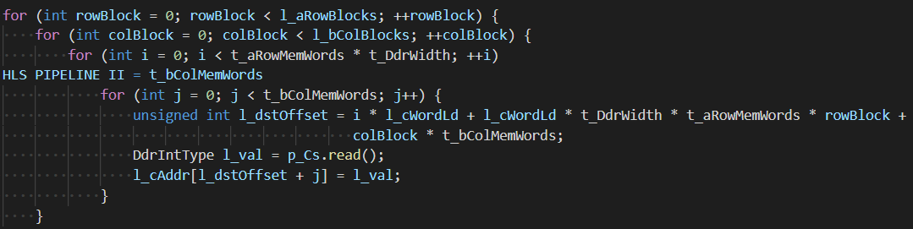
Analysis of Writing DDR

Slide 46
Analysis of Writing DDR
l_aRowBlocks * l_bColBlocks * t_Amh * t_xColMemWords
l_aRowBlocks: number of blocks in a column of matrix A (4)
l_bColBlocks: number of blocks in a row of matrix B (4)
t_aMH = t_DdrWidth * t_aRowMemWords: number of elements in one column of the matrix A buffer (2)
t_xColMemWords: number of memory words in one row of the matrix X buffer (2)
l_aRowBlocks * l_bColBlocks : number of blocks in matrix C
t_aMH * t_xColMemWords: number of memory access to read all elements in a block in matrix C

Slide 47
GemmWriteDdrStream
After we obtain matrix C, the kernel writes it out to the DDR.
In this function, the kernel reads the data from the input stream, calculate the address of the data, and write it to the DDR.
Since the kernel writes out the data right after it reads it, no extra buffer is needed.

Slide 48
The writing order of elements of a block of matrix C in GemmWriteDdrStream
The kernel writes the elements from left to right, from top to down.

Slide 49
Writing order of the block of C in GemmWriteDdrStream
The kernel writes the blocks of C from left to right, from top to down to the output stream.
1 | 2 | 3 | 4
5 | 6 | 7 | 8
9 | 10 | 11 | 12
13 | 14 | 15 | 16

Slide 50
II of Read
Read: read DDR every cycle

Slide 51
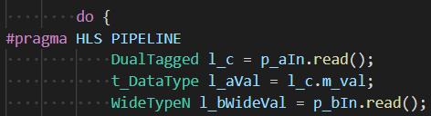
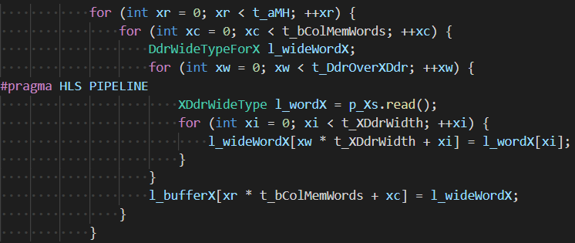
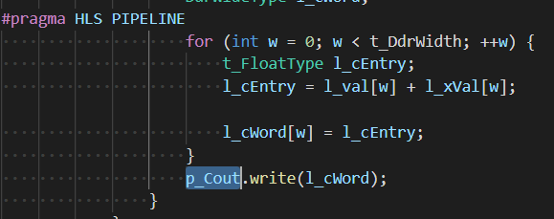
II of Macs and Add X
Mac: read the stream every cycle
AddX: add a memory word of X every cycle

Slide 52
II of Write
Write: write to DDR every cycle

Slide 53
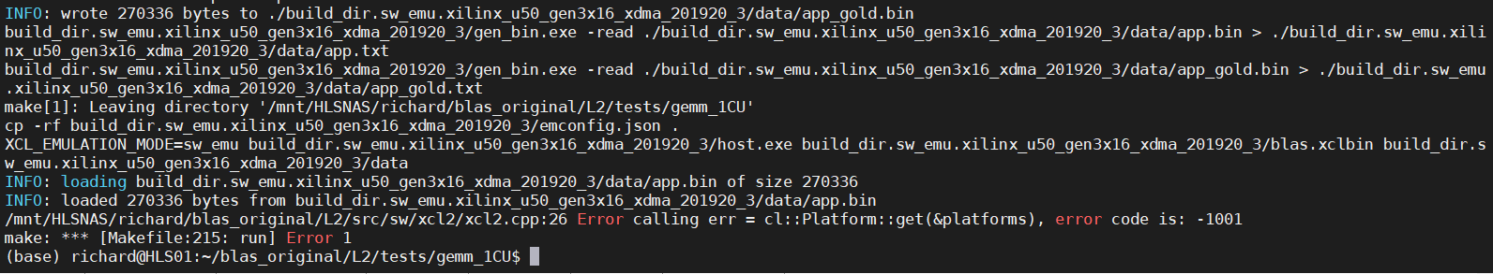
Tool specific issues
If we execute the makefile at ./blas/L2/tests/gemm_1CU directly, the error will occur as shown in the figure below.

Slide 54
My solution
To solve this problem, I wrote a shell script.
The shell script contains every command required for software emulation, hardware emulation, and hardware.
Use the command ./run.sh to finish all executions.
Of course, if you want to execute only a part of them, just comment out the commands of other parts in the shell script.

Slide 55
L3 Software API
•L3 of the BLAS library aims to provide a software-friendly API that allows users to execute GEMM operations by calling the functions.
•Three forms of API are provided:
Included C++ library
Shared Object (Dynamic Link Library)
Python Module
•All the helper functions and the operation functions provided by BLAS Software API have the prefix xfblas

Slide 56
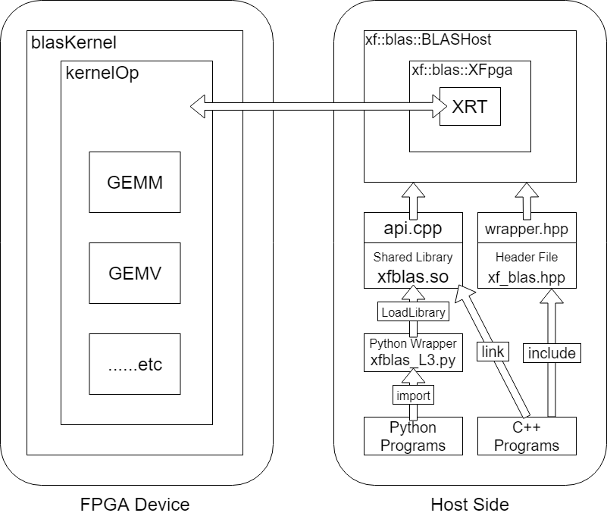
Structure of BLAS Software API

Slide 57
Difference between wrapper.hpp and api.cpp
xfblasStatus_t xfblasExecute(
unsigned int kernelIndex = 0,
unsigned int deviceIndex = 0 ) {
if (
ConfigDict::instance().m_dict.find("not_initialized") != ConfigDict::instance().m_dict.end()
) {
return XFBLAS_STATUS_NOT_INITIALIZED;
}
xfblasStatus_t l_status = BLASHostHandle::instance().m_handlePtr[deviceIndex][kernelIndex]->execute();
return l_status;
}
bool xfblasExecute(
unsigned int kernelIndex,
unsigned int deviceIndex
) {
xfblasStatus_t l_status = BLASHostHandle::instance().m_handlePtr[deviceIndex][kernelIndex]->execute();
if (l_status != XFBLAS_STATUS_SUCCESS) {
return false;
}
return true;
}
1. wrapper has default argument value
2. wrapper performs additional checking
3. wrapper returns status code; api returns boolean value

Slide 58
Difference between wrapper.hpp and api.cpp
void xfblasExecuteAsync(
unsigned int numKernels = 1,
unsigned int deviceIndex = 0
) {
vector<future<xfblasStatus_t> > fuStatus;
for (unsigned int i = 0; i < numKernels; i++) {
fuStatus.push_back(
async(launch::async,
xfblasExecute,
i,
deviceIndex
)
);
}
for (auto& fu : fuStatus) {
fu.wait();
}
}
void xfblasExecuteAsync(
unsigned int numkernels,
unsigned int deviceIndex
) {
#pragma omp parallel
{
omp_set_dynamic(0);
omp_set_num_threads(numkernels);
#pragma omp for
for (unsigned int i = 0; i < numkernels; i++) {
BLASHostHandle::instance().m_handlePtr[deviceIndex][i]->execute();
}
}
}
4. wrapper uses std::future to realize asynchronous execution; api uses OpenMP to realize it

Slide 59
Difference between wrapper.hpp and api.cpp
Header File (wrapper.hpp) | Shared Library (api.cpp)
xfblasMallocRestricted | xfblasSend
xfblasSetMatrixRestricted xfblasSetVectorRestricted
xfblasGetMatrixRestricted xfblasGetVectorRestricted xfblasGetByPointer | xfblasGet
xfblasMalloc xfblasMallocManaged | None
xfblasSetMatrix xfblasSetVector
xfblasDeviceSynchronize
xfblasGetMatrix xfblasGetVector
xfblasGemmByAddress
5. api merges malloc + send steps and eliminates rarely used functions

Slide 60
Mismatch of GCC Name Mangling ABI
This problem will be encountered when compiling the Host Program
/usr/bin/ld: /tmp/ccuGgV3Y.o: in function `xf::blas::xfblasCreate(char const*,
std::string, xf::blas::xfblasEngine_t, unsigned int, unsigned int)':
gemm_test.cpp:(.text+0x1a8a):
undefined reference to `xrt::device::load_xclbin(std::string const&)'
/usr/bin/ld: gemm_test.cpp:(.text+0x1acc):
undefined reference to `xrt::xclbin::xclbin(std::string const&)'
/usr/bin/ld: gemm_test.cpp:(.text+0x1ae9):
undefined reference to `xrt::xclbin::get_cu_names() const'
/usr/bin/ld: /tmp/ccuGgV3Y.o: in function `xf::blas::XHost::XHost(char const*,
xf::blas::xfblasStatus_t*, unsigned int, unsigned int)':
gemm_test.cpp:(.text._ZN2xf4blas5XHostC2EPKcPNS0_14xfblasStatus_tEjj
[_ZN2xf4blas5XHostC5EPKcPNS0_14xfblasStatus_tEjj]+0x1cf): undefined reference to `xrt::kernel::kernel(xrt::device const&, xrt::uuid const&, std::string const&, xrt::kernel::cu_access_mode)'
collect2: error: ld returned 1 exit status
make: *** [Makefile:190: build_dir.hw.xilinx_u50_gen3x16_xdma_201920_3/gemm_test.exe] Error 1
To solve this problem, the flag _GLIBCXX_USE_CXX11_ABI in Makefile should be set to 1 to enable the new glibc C++11 Name Mangling rules

Slide 61
Mismatch of GCC Name Mangling ABI
For example, the function xrt::device::load_xclbin(std::string const&) will be mangled to different names under different rules:
C++03 ABI: _ZN3xrt6device11load_xclbinERKSs (xrt::device::load_xclbin(std::string const&))
C++11 ABI: _ZN3xrt6device11load_xclbinERKNSt7__cxx1112basic_stringIcSt11char_traitsIcESaIcEEE (xrt::device::load_xclbin(std::__cxx11::basic_string<char, std::char_traits<char>, std::allocator<char> > const&))

Slide 62
Mismatch of GCC Name Mangling ABI
For example, the function xrt::xclbin::get_cu_names() const will be mangled to different names under different rules:
C++03 ABI: _ZNK3xrt6xclbin12get_cu_namesEv (xrt::xclbin::get_cu_names() const)
C++11 ABI: _ZNK3xrt6xclbin12get_cu_namesB5cxx11Ev (xrt::xclbin::get_cu_names[abi:cxx11]() const)

Slide 63
L3 testing phase
In L3 testing phase, the goal is to confirming the correction of the API functions
The host program multiplies two 128 × 128 matrices with floating point entries together
The host program generates the input and output directly in the program, and perform the output comparison by itself

Slide 64
API function calls
xfblasEngine_t engineName = XFBLAS_ENGINE_GEMM;
xfblasStatus_t status = xfblasCreate(l_xclbinFile.c_str(), l_configFile, engineName, l_numKernel);
if (status != XFBLAS_STATUS_SUCCESS) {
cout << "Create Handle failed with error code: " << status << "\n";
return EXIT_FAILURE;
}
posix_memalign((void**)&a, 4096, m * k * sizeof(BLAS_dataType));
status = xfblasMallocRestricted(m, k, sizeof(*a), a, k, l_numKernel - 1);
if (status != XFBLAS_STATUS_SUCCESS) {
cout << "Malloc memory for matrix A failed with error code: " << status << "\n";
return EXIT_FAILURE;
}
status = xfblasSetMatrixRestricted(a, l_numKernel - 1);
if (status != XFBLAS_STATUS_SUCCESS) {
cout << "Set Matrix failed with error code: " << status << "\n";
xfblasDestroy();
return EXIT_FAILURE;
}

Slide 65
API function calls
status = xfblasGemm(XFBLAS_OP_N, XFBLAS_OP_N, m, n, k, 1, a, k, b, n, 1, c, n, l_numKernel - 1);
if (status != XFBLAS_STATUS_SUCCESS) {
cout << "Matrix Multiplication failed with error code: " << status << "\n";
xfblasDestroy();
return EXIT_FAILURE;
}
status = xfblasGetMatrixRestricted(c, l_numKernel - 1);
if (status != XFBLAS_STATUS_SUCCESS) {
cout << "Get Matrix failed with error code: " << status << "\n";
xfblasDestroy();
return EXIT_FAILURE;
}
xfblasFree(a, l_numKernel - 1);
free(a);
xfblasDestroy(l_numKernel);

