Slide 1
Lab C Vitis library
Group 3: 黃友杉, 王皓仁, 張鶴騰

Slide 2
About vision library
Vision library functions
https://xilinx.github.io/Vitis_Libraries/vision/2020.2/index.html
Vision library examples
https://xilinx.github.io/Vitis_Libraries/vision/2020.2/overview.html
Open CV functions can almost find their counterparts in Vision
in namespace xf::cv
i.e., hardware accelerated Open CV
Open CV is often used in NN training framework
Darknet etc.

Slide 3

Overview
Get familiar with Vision library
NN applications
Goal: implement a function augmenting training images
Images are slightly modified in NN training process
Increase model robustness -> reduce overfitting
Components:
Vitis vision L3 “blobfromimage”
Migrates functions from 2021 to 2020.2
Implement corresponding functions in testbench

Slide 4

Utilities
resize
crop
flip
Ex: xfMat2Array<OUTPUT_PTR_WIDTH, OUT_TYPE, MAX_HEIGHT, MAX_ WIDTH, NPC>( … )
Arguments | Functionality | Example
OUTPUT_PTR_WIDTH | The unit width of output ap type data | ap_uint<OUTPUT_PTR_WIDTH>
OUT_TYPE | Width of output bit and channel | XF_8UC3
MAX_HEIGHT | Max height of an image
MAX_ WIDTH | Max width of an image
NPC | Pixels processed per cycle | XF_NPPC1

Slide 5
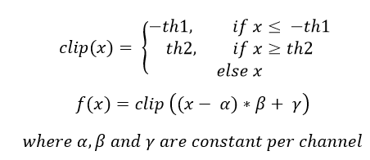
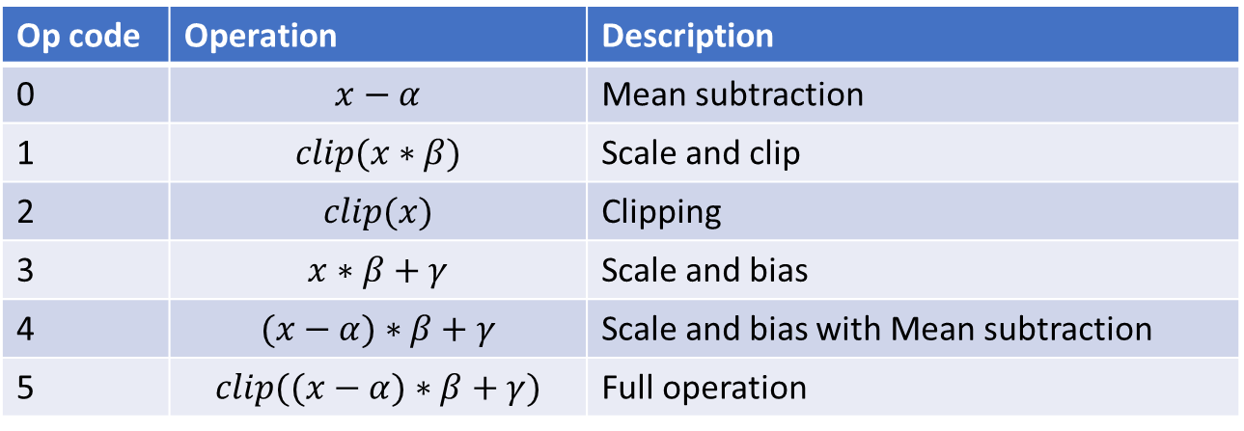
xf::cv::preProcessing
Op code | Operation | Description
0 | $$x−α$$ | Mean subtraction
1 | $$clip(x∗β)$$ | Scale and clip
2 | $$clip(x)$$ | Clipping
3 | $$x∗β+γ$$ | Scale and bias
4 | $$(x−α)∗β+γ$$ | Scale and bias with Mean subtraction
5 | $$clip((x−α)∗β+γ)$$ | Full operation

Slide 6
Observations
Synthesis report:
Estimated clock period: 3.271 ns.
Latency: min: 0.304 ms, max: 7.025 ms.
Utilization:
Software latency v.s. hardware latency:
Software: 50.849 ms.
Hardware: 1.92512 ms.
26x speed up by using FPGA accelerators
W/WO stream
Only differs in 9 FFs usage.
Other metrices are the same, such as delay
W/WO dataflow:
kernel seems to halt mysteriously when dataflow is deactivated
BRAM | DSP | FF | LUT
100 | 20 | 19611 | 34058

Slide 7
Suggestions for improvement
Option 1: improve current kernel’s internal streaming
Some of invoked functions might not support stream
Option 2: host level parallelism
Instead of invest more resource improving a kernel
We may instantiate multiple kernel instances
Dispatch jobs parallelly
Similar to multi-threading. But now a thread corresponds to a kernel instance

Slide 8
Supplement
Compatibility issues between Vitis and system libraries:
Problem: v++ 2020.2 does not provide up-to-date stdc++ library required by third-party packages
Solution: it’s safe to replace the libstdc++ used by v++ with a newer version
Basic functions in 2021 may be absent in 2020.2
e.g., xf::cv::flip
Check compiler’s error message
It’s safe to manually update infrastructure defined in “L1/include/”

