Slide 1
LabB Presentation Bloom Filter
Speaker：Chang Shu (r09943161)
Advisor：Prof. Jiin Lai
Date：2022.10.27

Slide 2
Outline
Bloom filter
Introduction
Run on CPU (baseline)
Partition among CPU and FPGA
Object
Improving skills
Multi-kernel
Multi-buffer
Multi-DDR
Conclusion

Slide 3
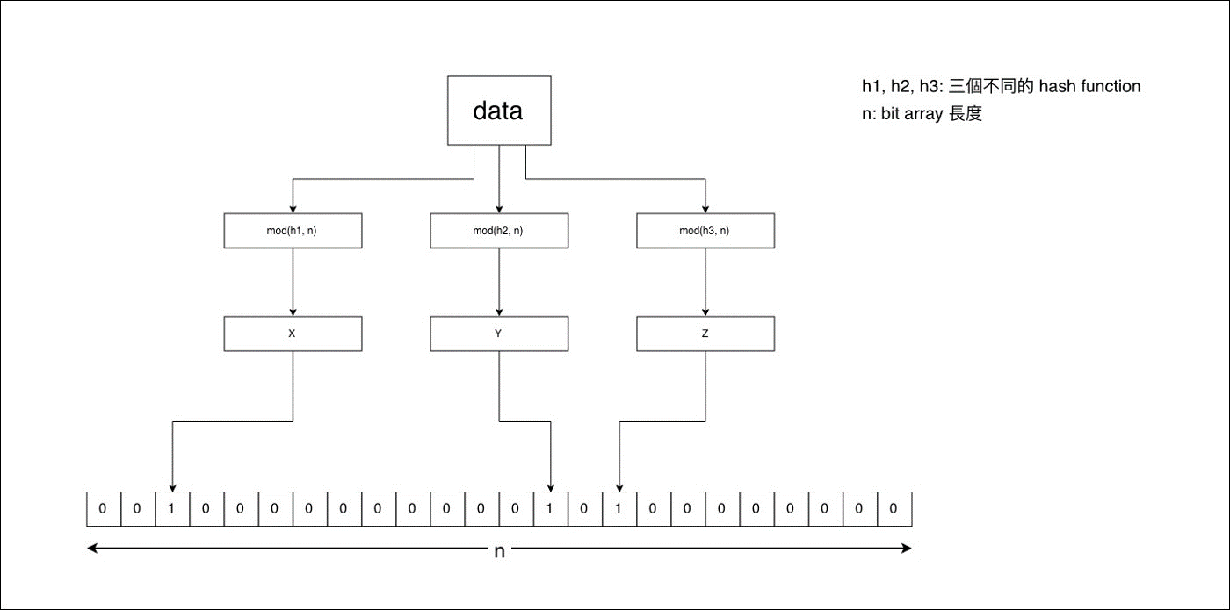
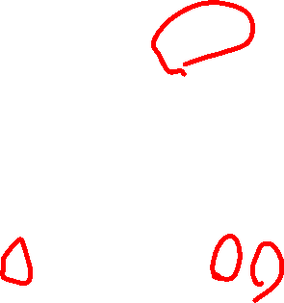
Bloom Filter
Check whether an element is present in the dataset
Use a hash table-based data structure
space efficient
reduces the number of database queries
query returns
possibly in a set(False-positive matches are possible)
definitely not in set

Slide 4
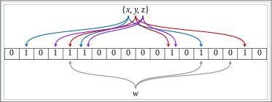

Bloom Filter
The colored arrows show each set element map to bit array
The element w is not in the set {x, y, z}
hashes to a one bit-array position containing 0

Slide 5
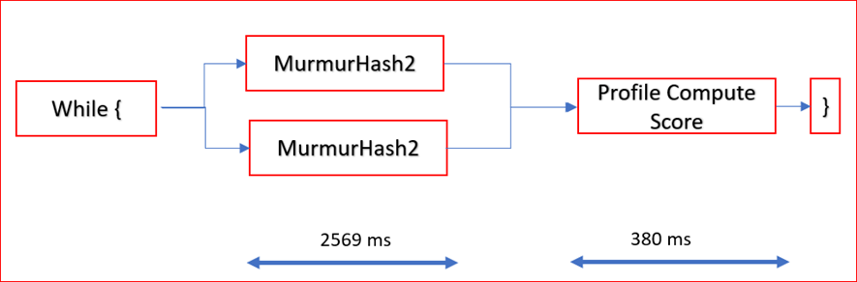
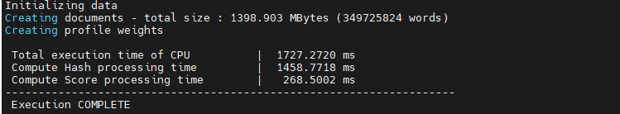
Bloom Filter
Consist of two parts
Compute hash function
Compute score
Computing hash value takes 1458.8ms (84.5% of total run time)
Computing score takes 268.5ms (15.5% of total run time)

Slide 6
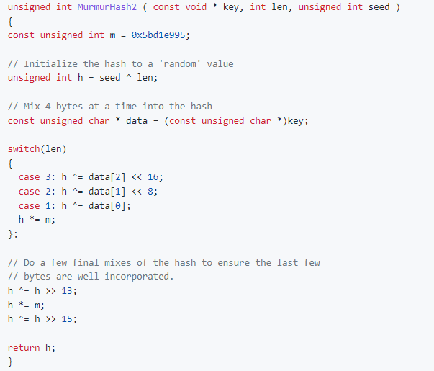

Partition among CPU and FPGA
The compute of the hash for a single word ID consists of:
4 XORs
3 arithmetic shifts
2 multiplication
The 3 arithmetic operations
Shift 44-bits totally when
len = 3
requires 44 cycles on CPU
requires 3 cycles on FPGA

Slide 7
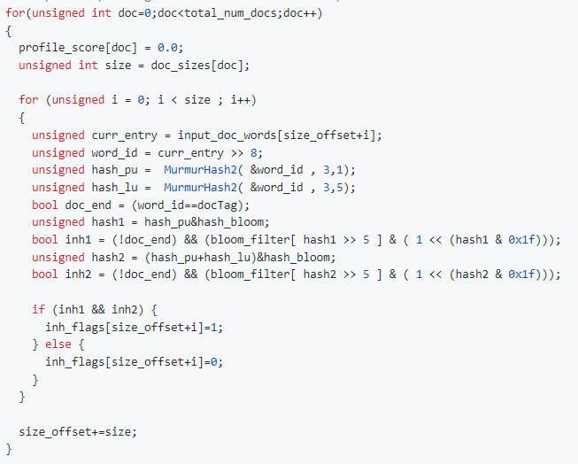
Partition among CPU and FPGA
One word is independent of other words
Unroll
Accesses to the “input_doc_words” array sequentially
Access DDR in burst mode
Run on FPGA

Slide 8
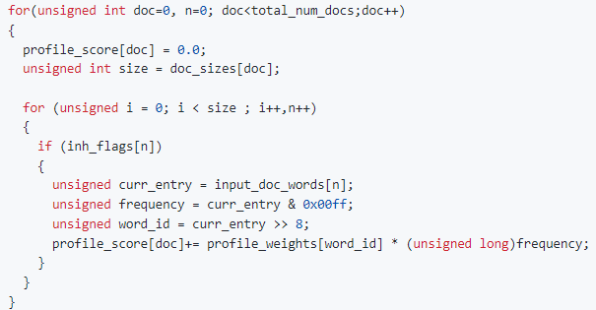
Partition among CPU and FPGA
takes only about 15.5% of the total running time
Provide little performance benefit
Memory Access depend on the “word_id”
Access DDR randomly in non-burst mode
Run on host CPU

Slide 9
Object
FPGA Processing
Write DDR (1400 MB/9.5 GBps = ~147 ms)
Compute Hash
Read DDR (350 MB/12 GBps = ~30 ms)
Host CPU Processing
Compute Score (268.5 ms)
Write DDR
Compute Hash
Read DDR
Compute Score
FPGA Processing
CPU Processing

Slide 10
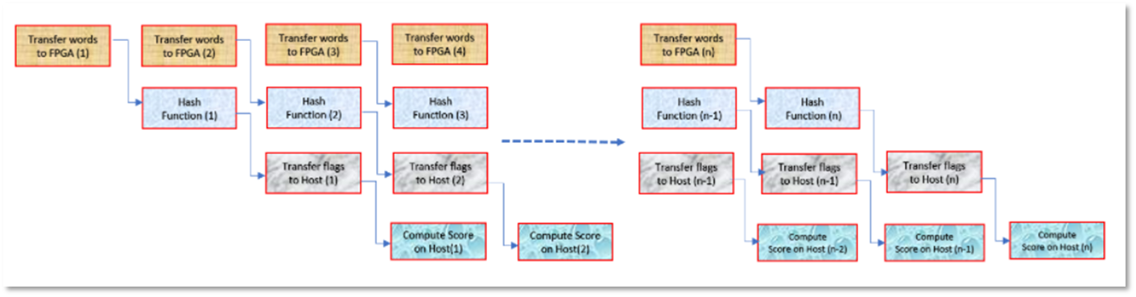
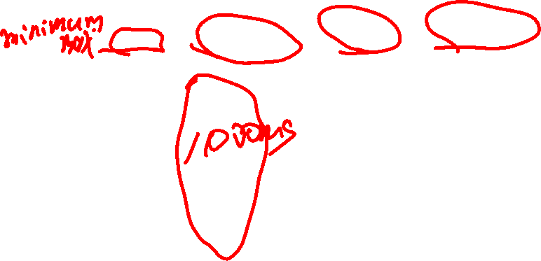
Object
Should be executed in pipeline
Latency of the Compute on FPGA will become invisible
Maximum Throughput
Min(write DDR, Compute on FPGA, read DDR, Compute on CPU)

Slide 11
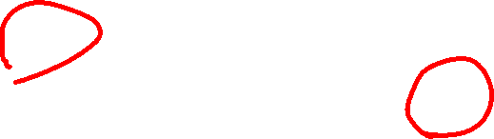
Object
Overlap processing time
Write DDR
Compute Hash
Read DDR
Compute Score
Improving technique
Multi-kernel
Multi-buffer (batch splitting)
Multi-DDR
Write DDR
Compute Hash
Read DDR
Compute Score
FPGA Processing
CPU Processing

Slide 12
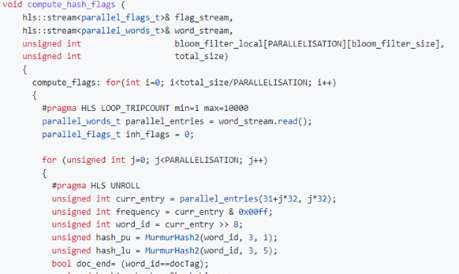

Multi-Kernel
Process multiple words every clock cycle
Ex. # of kernel is 4,8,16……
PARALLELISATION = 4
# of Kernel = 4
Compute 4 words in parallel

Slide 13
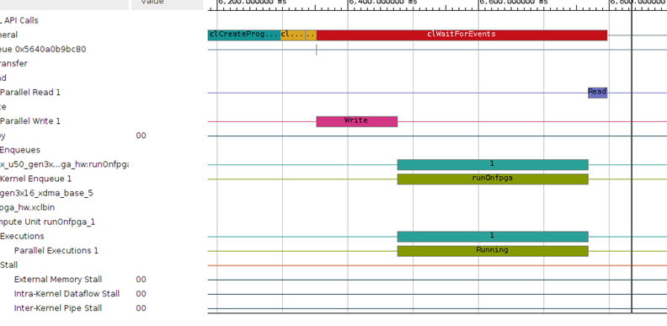
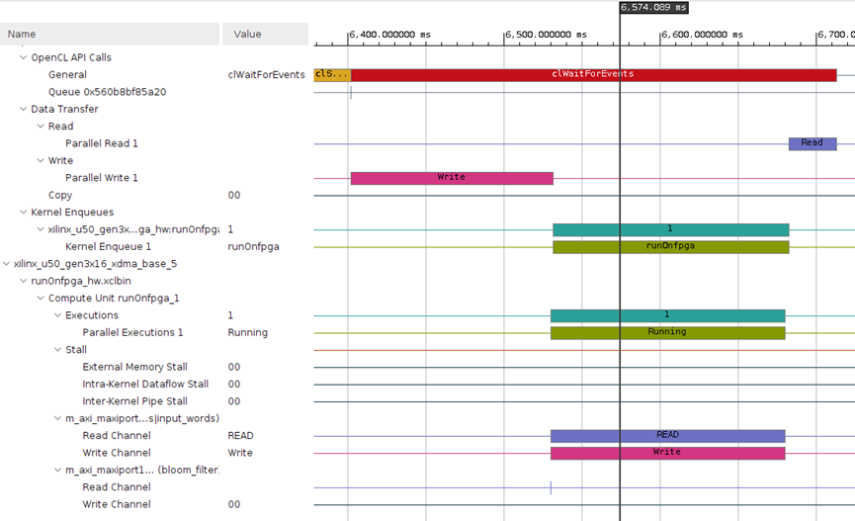
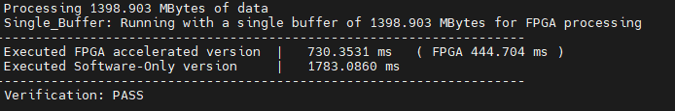
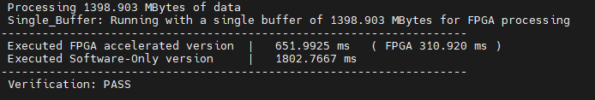

Multi-Kernel
Process more multiple words every clock cycle achieve less FPGA compute time
4x Kernel
8x Kernel

Slide 14
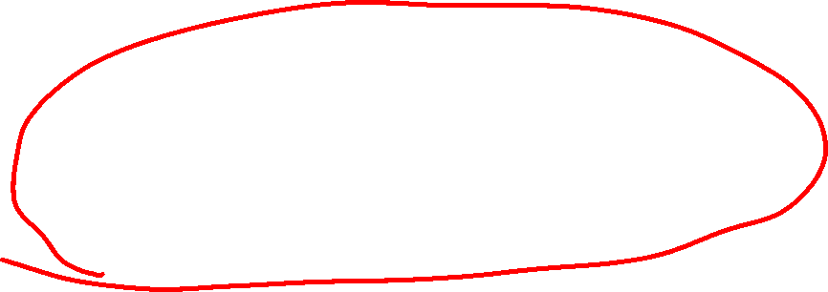
Multi-Kernel
Write DDR
Compute Hash
Read DDR
Compute Score
FPGA Processing
CPU Processing
Write DDR
Compute Hash
Read DDR
Compute Score
FPGA Processing
CPU Processing

Slide 15
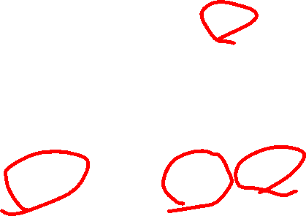
Data bandwidth
Reading 16 words per DDR access
DDR bandwidth / word size = 512bits / 32bits = 16
Unroll = 4
Send 128 bits for 4 words to process in parallel
DDR
Buffer
Resize
32bits
FPGA
32bits
512 bits
512 bits
32bits
32bits

Slide 16

Data bandwidth
Reading 16 words per DDR access
DDR bandwidth / word size = 512bits / 32bits = 16
Unroll = 8
Send 256 bits for 8 words to process in parallel
32bits
DDR
Buffer
Resize
FPGA
32bits
32bits
512 bits
512 bits
32bits
32bits
32bits
32bits
32bits

Slide 17
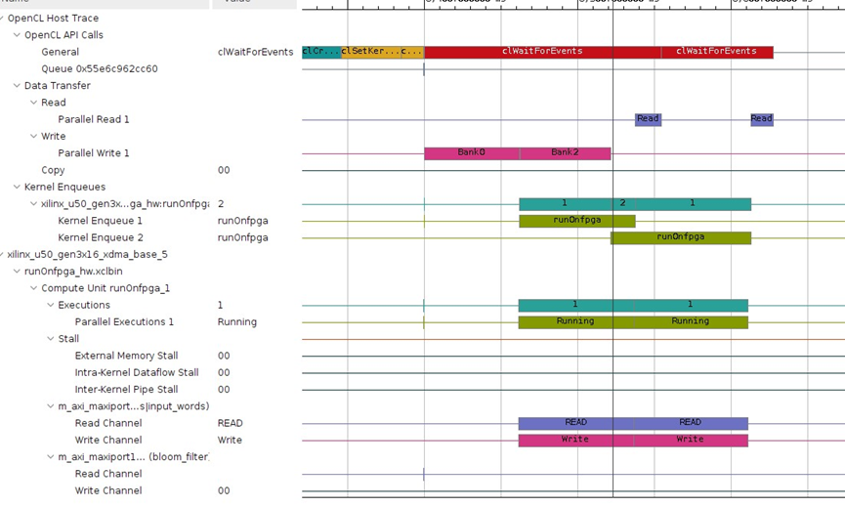
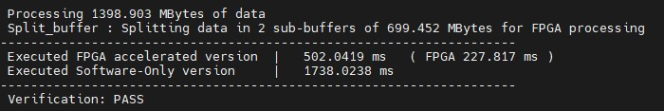

Multi-Buffer
Timeline And Performance
2x Buffer + 8x Kernel

Slide 18
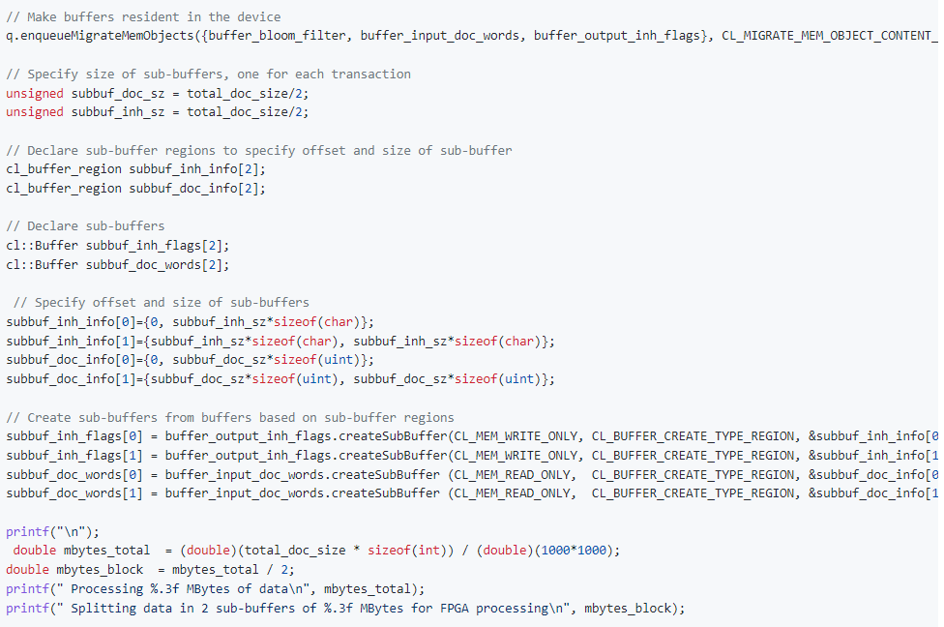

Multi-Buffer
Overlap of data transfer and compute on FPGA with split buffers
Split the documents and send them to the FPGA in two iterations
The kernel can start the compute as soon as the data for the corresponding iteration is transferred to the FPGA.

Slide 19

Multi-Buffer
Overlap of data transfer and compute on FPGA with split buffers
Split the documents and send them to the FPGA in two iterations
The kernel can start the compute as soon as the data for the corresponding iteration is transferred to the FPGA.
Exist boundary for Kernel parallelisation
Write DDR
Write DDR
Compute Hash
Compute Hash
Read DDR
Read DDR
Compute Score
FPGA Processing
CPU Processing

Slide 20
Multi-Buffer
Overlap of host data transfer and compute with multiple buffers
Splitting the documents into 2, 4, 8, 16, 32 and 64 chunks
Exist boundary

Slide 21
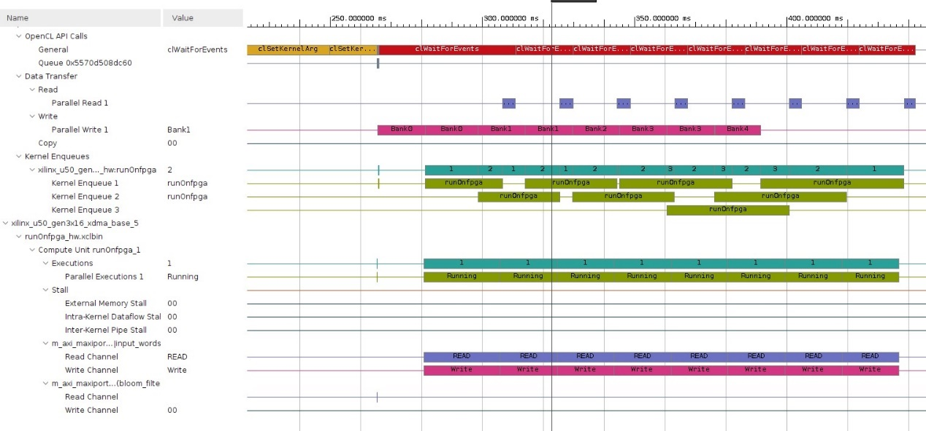
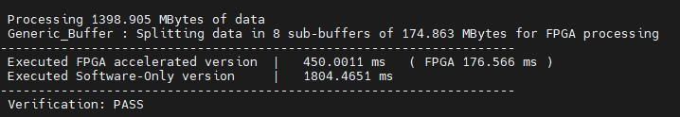

Multi-Buffer
Timeline And Performance
8x Buffer + 8x Kernel

Slide 22
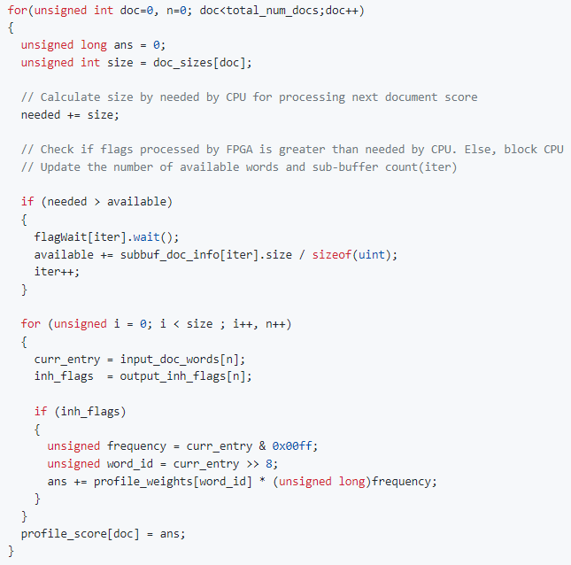
Multi-Buffer
Overlap data transfer from host, compute on FPGA and profile score on the CPU
Enables the host to start profile scores as soon as the flags are received
Check if flags processed by FPGA is greater than needed by CPU. Else, block CPU

Slide 23

Multi-Buffer
Overlap data transfer from host, compute on FPGA and profile score on the CPU
Enables the host to start profile scores as soon as the flags are received
Write DDR
Write DDR
Write DDR
Write DDR
Compute Hash
Compute Hash
Compute Hash
Read DDR
Read DDR
FPGA Processing
Compute Score
CPU Processing

Slide 24
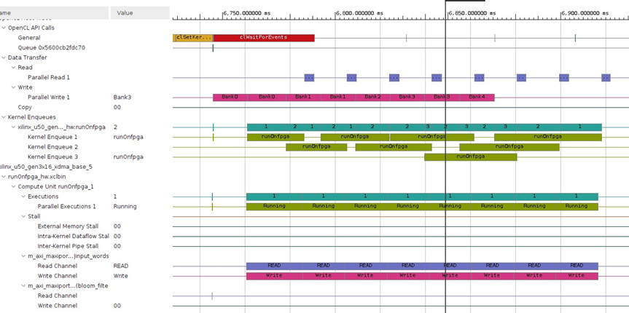
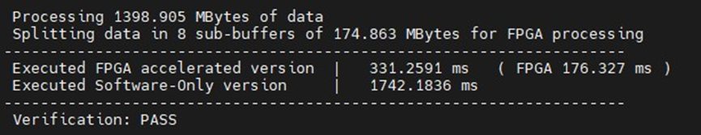

Multi-Buffer
Timeline And Performance
8x Buffer + 8x Kernel

Slide 25
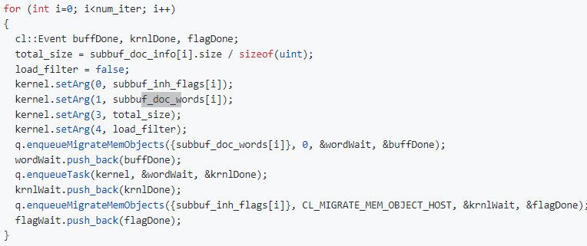

Multi-DDR
Use multiple banks in ping-pong fashion to minimize the contention
CPU write DDR bank1, FPGA read DDR bank2
CPU write DDR bank2, FPGA read DDR bank1
CPU&FPGA can access DDR at the same time
input word is set to array of sub-buffers created from buffer_doc_words[0] and buffer_doc_words[1] alternatively; hence, data is sent to DDR bank 1 and 2 alternatively in each kernel execution

Slide 26

Multi-DDR
Use multiple banks in ping-pong fashion to minimize the contention
CPU write DDR bank1, FPGA read DDR bank2
CPU write DDR bank2, FPGA read DDR bank1
CPU&FPGA can access DDR at the same time
Write DDR
Write DDR
Write DDR
Write DDR
Compute Hash
Compute Hash
Compute Hash
Read DDR
Read DDR
FPGA Processing
Compute Score

Slide 27

Conclusion
Performance
Throughput improved form 0.81Gbs to 4.22Gbs
Achieve faster computing speed
Overlap Processing time
Technique Applied
Pipeline
Parallelisation
Ping-pong buffer

Slide 28
Thank You

