Slide 1
Oct 27, 2022
Lab B-pp4fpgas: CORDIC
https://pp4fpgas.readthedocs.io/en/latest/project2.html
工科海洋所 R10525034 許家維

Slide 2
Agenda
Project Target
CORDIC
Concept
Kernel Code-baseline
Comparison
Questions
CORDIC_LUT
Kernel Code
Questions

Slide 3
Project Targets
Learn how to use arbitrary precision data types.
Understand how arbitrary precision data types affect accuracy, performance, and resource consumption.

Slide 4
1. CORDIC
An efficient method for calculating trigonometric and hyperbolic functions.

Slide 5
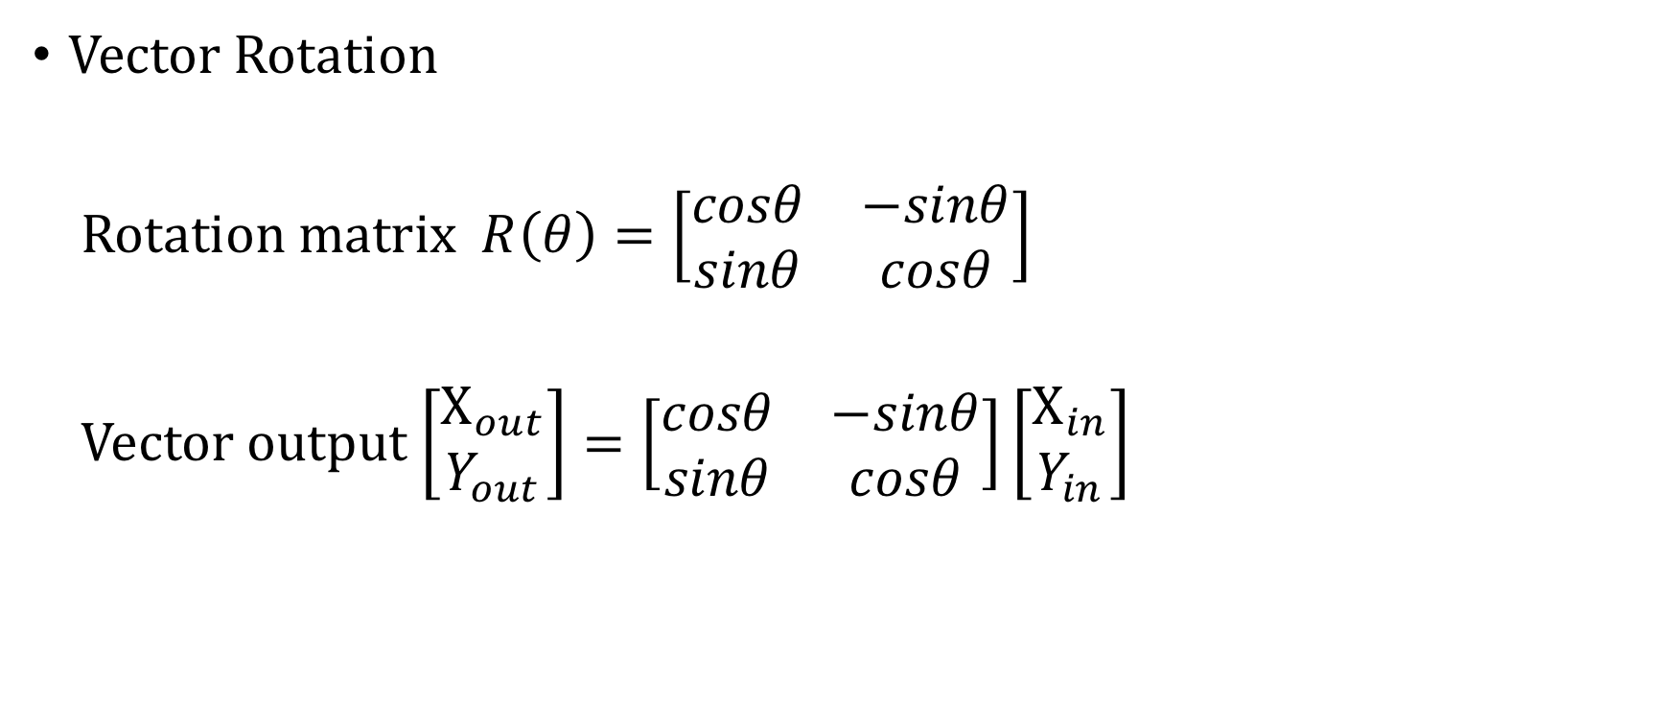
Concept (1/3)
Vector Rotation
Rotation matrix $R\left(θ\right)=\left[\begin{matrix}cosθ & −sinθ \\ sinθ & cosθ\end{matrix}\right]$
Vector output $\left[\begin{aligned}X_{out} \\ Y_{out}\end{aligned}\right]=\left[\begin{matrix}cosθ & −sinθ \\ sinθ & cosθ\end{matrix}\right]\left[\begin{aligned}X_{in} \\ Y_{in}\end{aligned}\right]$

Slide 6

Concept (2/3)
$R_{i}\left(θ\right)=$ $\left[\begin{matrix}cosθ_{i} & −sinθ_{i} \\ sinθ_{i} & cosθ_{i}\end{matrix}\right]$
$=\frac{1}{\sqrt{1+{\tan{{(θ}_{i})}}^{2}}}×\left[\begin{matrix}1 & −tanθ_{i} \\ tanθ_{i} & 1\end{matrix}\right]$
$= \frac{1}{\sqrt{1+2^{−2i}}}×\left[\begin{matrix}1 & −2^{−i} \\ 2^{−i} & 1\end{matrix}\right]$ (limit $tanθ_{i}$ to $2^{−i}$)

Slide 7
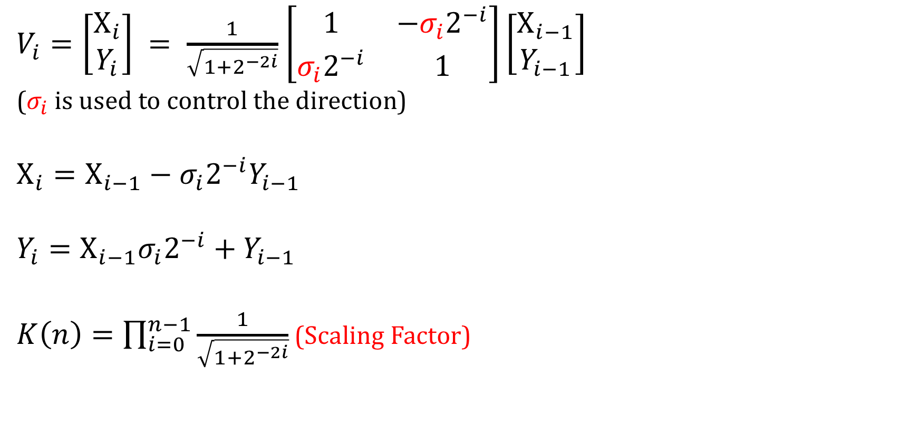
Concept (3/3)
$V_{i}=\left[\begin{aligned}X_{i} \\ Y_{i}\end{aligned}\right] = \frac{1}{\sqrt{1+2^{−2i}}}$ $\left[\begin{matrix}1 & −{σ_{i}2}^{−i} \\ {σ_{i}2}^{−i} & 1\end{matrix}\right]\left[\begin{aligned}X_{i−1} \\ Y_{i−1}\end{aligned}\right]$
($σ_{i}$ is used to control the direction)
$$X_{i}=X_{i−1}−{σ_{i}2}^{−i}Y_{i−1}$$
$$Y_{i}=X_{i−1}{σ_{i}2}^{−i}+Y_{i−1}$$
$K\left(n\right)=\prod_{i=0}^{n−1}{\frac{1}{\sqrt{1+2^{−2i}}}}$ (Scaling Factor)

Slide 8
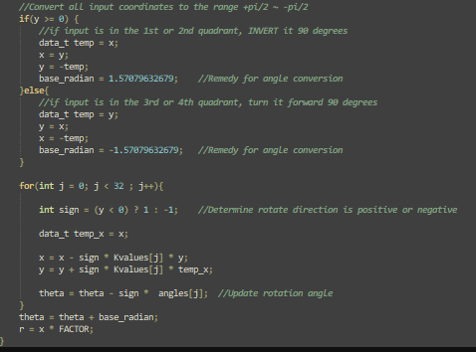
Kernel Code-baseline
Convert the input vector to the 1st or 4th quadrant.
Rotate the vector to be close to X-axis (y value close to 0).
Accumulate the rotation angle of each iteration to get theta value.
Divide the final x value by the CORDIC gain to get r.

Slide 9
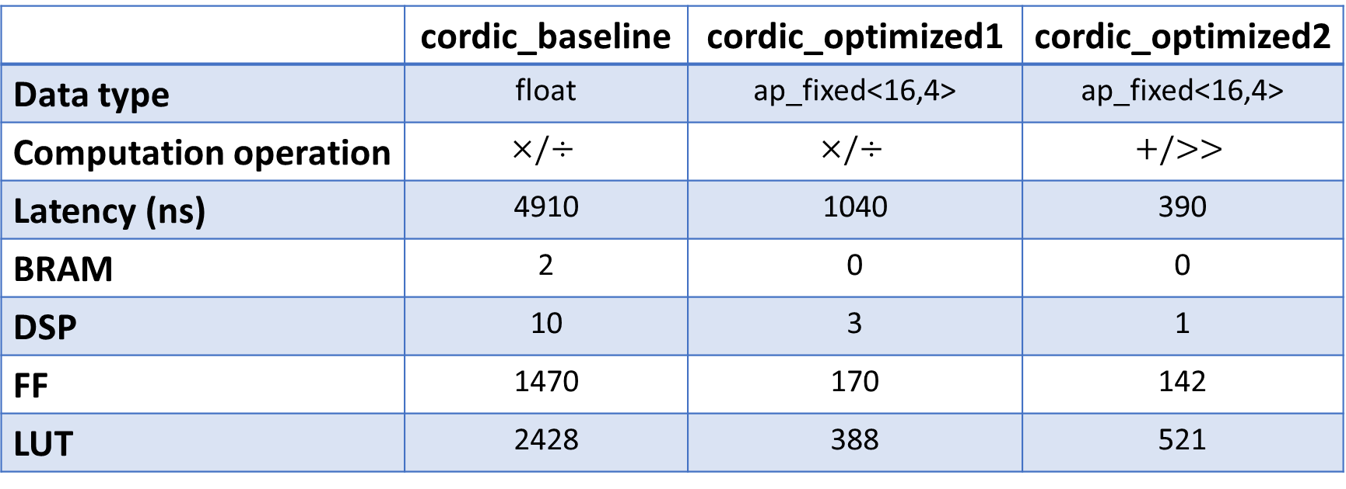
Comparison
 | cordic_baseline | cordic_optimized1 | cordic_optimized2
Data type | float | ap_fixed<16,4> | ap_fixed<16,4>
Computation operation | $$×/÷$$ | $$×/÷$$ | $$+/>>$$
Latency (ns) | 4910 | 1040 | 390
BRAM | 2 | 0 | 0
DSP | 10 | 3 | 1
FF | 1470 | 170 | 142
LUT | 2428 | 388 | 521

Slide 10
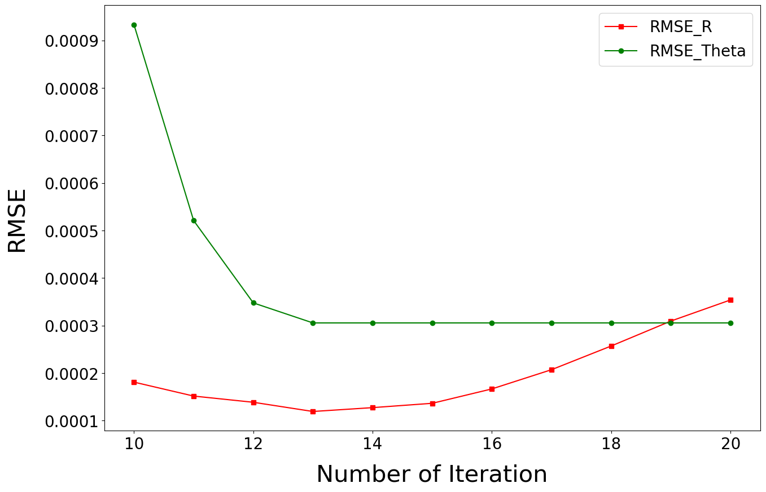
Question1: One important design parameter is the number of rotations. Change that number to numbers between 10 and 20 and describe the trends. What happens to performance? Resource usage? Accuracy of the results? Why does the accuracy stop improving after some number of iterations? Can you precisely state when that occurs?
#iteration | Starting Angle | Rotation Angle | Final Angle
1 | 30 | 45(-) | -15
2 | -15 | 26.565(+) | 11.525
3 | 11.525 | 14.036(-) | -2.511
4 | -2.511 | 7.125(+) | 4.614
5 | 4.614 | 3.576(-) | 1.038

Slide 11
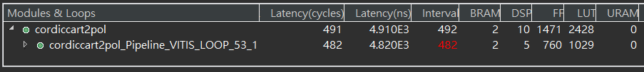
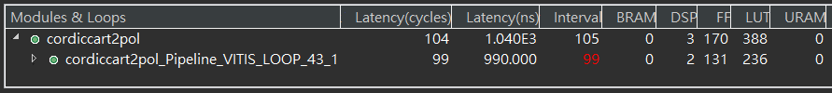
Question2: Another important design parameter is the data type of the variables. Is one data type sufficient for every variable or is it better for each variable to have a different type? Does the best data type depend on the input data? What is the best technique for the designer to determine the data type(s)?
 cordic_baseline (RMSE_R: 2.19e-7, RMSE_Θ: 5.98e-4)
 cordic_opt1 (RMSE_R: 4.39e-4, RMSE_Θ: 3.99e-4)

Slide 12

Question3: What is the effect of using simple operations (add and shift) in the CORDIC as opposed to multiply and divide? How does resource usage change? Performance? Accuracy?
 cordic_opt1 (RMSE_R: 4.39e-4, RMSE_Θ: 3.99e-4)
 cordic_opt2 (RMSE_R: 2.06e-3, RMSE_Θ: 6.36e-4)

Slide 13
2. CORDIC_LUT
An architecture using memory to save computational resources.

Slide 14
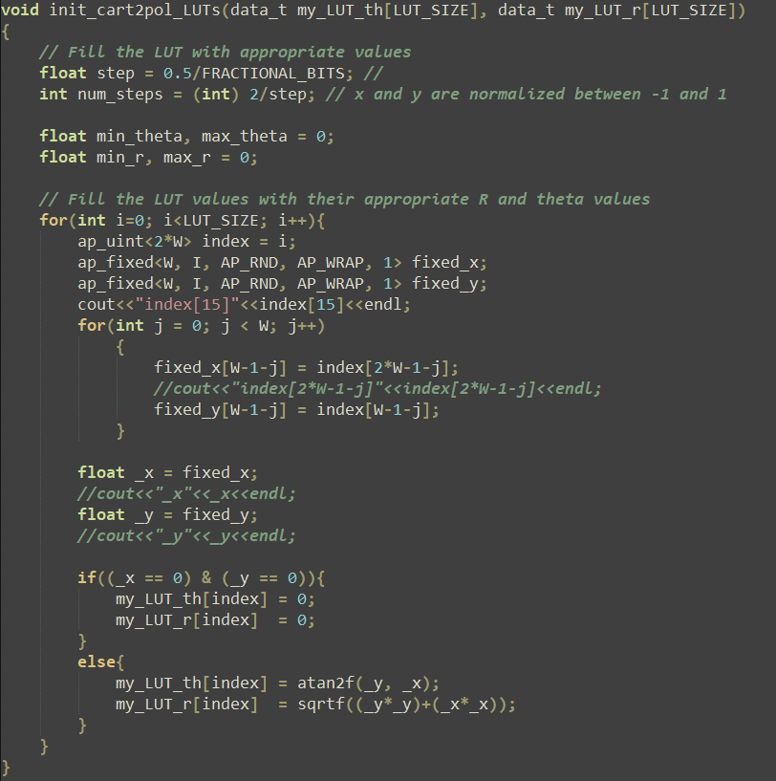
Kernel Code (1/2)
1
2

Slide 15
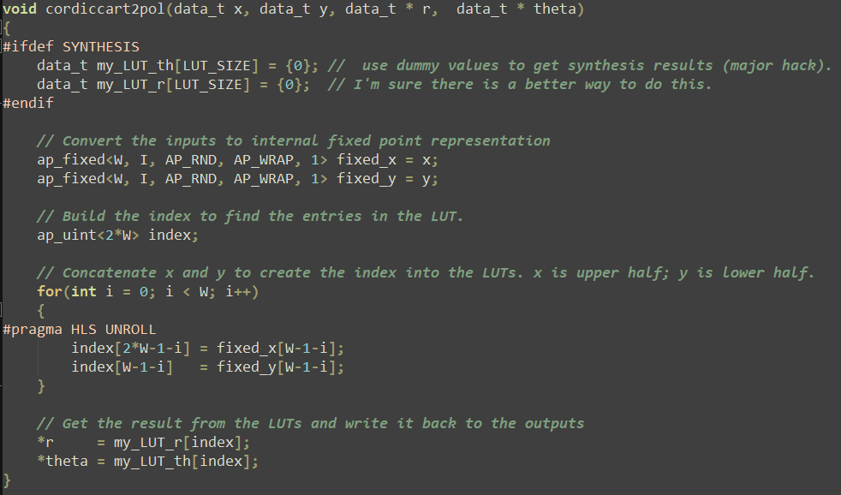
Kernel Code (2/2)
1
2
3

Slide 16
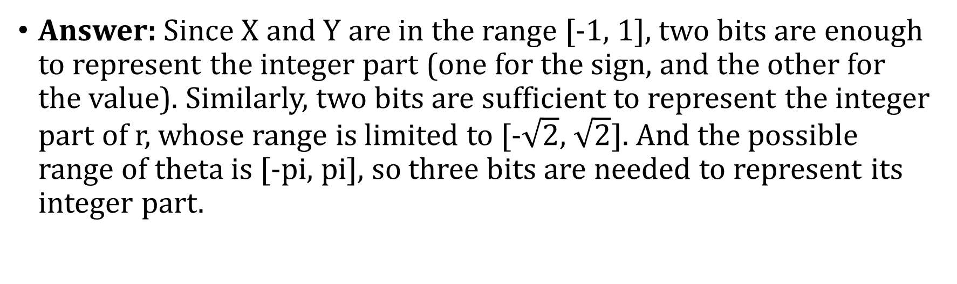
Question1: The testbench assumes that the inputs x, y are normalized between [-1,1]. What is the minimum number of integer bits required for x and y? What is the minimal number of integer bits for the output data type R and Theta?
Answer: Since X and Y are in the range [-1, 1], two bits are enough to represent the integer part (one for the sign, and the other for the value). Similarly, two bits are sufficient to represent the integer part of r, whose range is limited to [-$\sqrt{2}$, $\sqrt{2}$]. And the possible range of theta is [-pi, pi], so three bits are needed to represent its integer part.

Slide 17


Question2: Modify the number of fractional bits for the input and output data types. How does the precision of the input and output data types affect the accuracy (RMSE) results?
Answer: Reducing the number of bits used to represent the fractional part will lead to larger arithmetic errors。
 5 bits for fractional
 4 bits for fractional

Slide 18


Question3: What is the performance (throughput, latency) of the LUT implementation? How does this change as the input and output data types change?
Answer: The LUT method does not require real-time computation, so the latency is short. The data types of input/output has nothing to do with performance, but the fewer the data bits, the smaller size of LUT, which directly affects the amount of BRAM used.
 5 bits for fractional
 4 bits for fractional

Slide 19
Question4: What advantages/disadvantages of the CORDIC implementation compared to the LUT-based implementation?
 | CORDIC | CORDIC_LUT
Latency | Longer | Shorter
Accuracy | Better | Worse
DSP Usage | Higher | Lower
FF Usage | Higher | Lower
LUT Usage | Higher | Lower
BRAM Usage | Lower | Higher

Slide 20
Thanks for your attention.
This is the end of my presentation.

