Slide 1
High Accuracy Image Classifier Inference on PYNQ-Z2
Team 8
B07901073 吳秉軒 R11943012 曾維雋 R11943043 潘奕亘
Advisor: Professor Lai-Jin
Dec 8th, 2022

Slide 2
Outline
Problem Statement
Project Scope
Project Plan

Slide 3
Outline
Problem Statement
Project Scope
Project Plan

Slide 4
Image Classifier
Image classification has been widely used in many applications, such as medicine image, face recognition, and defect detection
CNN has demonstrated excellent results in computer vision tasks
Model
VGG introduces deep CNN with small kernel
ResNet resolves gradient vanishing and uses deeper CNN

Slide 5
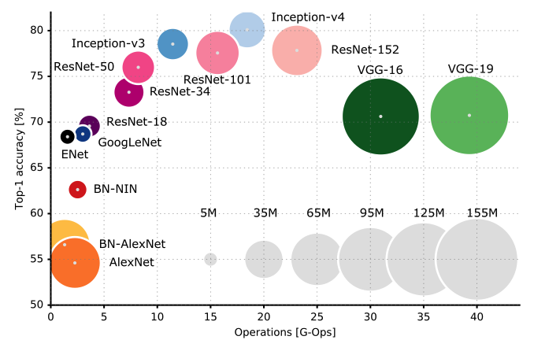
Model Selection
Dataset
Start from relatively small dataset (e.g., cifar10)
VGG vs. ResNet
Top-5 accuracy on ImageNet
VGG16: 92.3%
ResNet152: 95.51%
Top-1 [1]
Ref: An Analysis of Deep Neural Network Models for Practical Applications, 2016

Slide 6
Model Selection
Model analysis
Comparison between VGG and ResNet
Using same size of models: VGG5 and ResNet10
Result: ResNet achieve better accuracy (70% vs. 81%)
Model setting
ResNet10
Adam optimizer (learning rate: 0.001)
Batch size: 16

Slide 7
Objective
Implement 2 version:
1. Lightweight ResNet based on baseline accuracy
2. Maximize the utilization of resources on PYNQ-Z2 (or KV260) to approach best performance
Design a methodology of tuning model’s parameter
(option)Finish an End-to-end image classifier application accelerated with FPGA

Slide 8
Outline
Problem Statement
Project Scope
Project Plan

Slide 9
Software
Image preprocessing
RGB to grayscale
Data augmentation (e.g., ColorJitter, RandomFlip)
Layer reduction
Fit large model into PYNQ
Bit precision of intermediate layers
Tradeoff between accuracy and resources
Methodology of tuning
Several factors: # of layer, size & bit width of each layer
Record the increase of resource and accuracy
Follow the trend
More during the process …

Slide 10
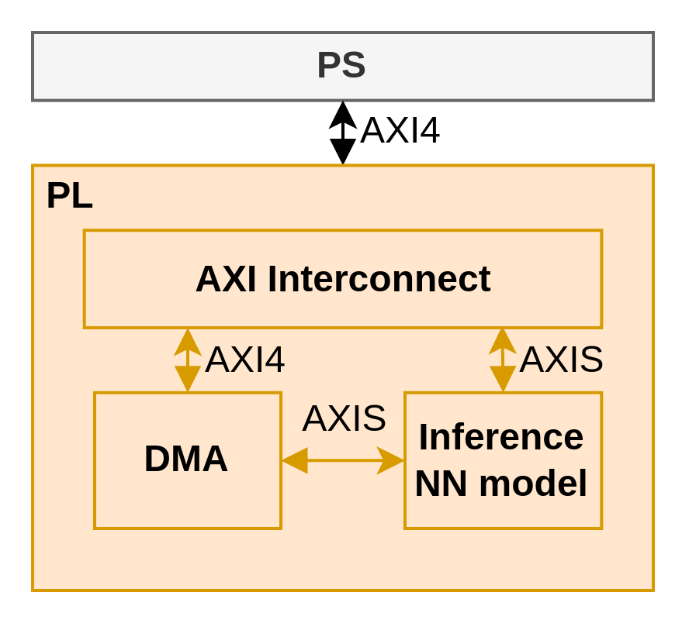
Operation Flow
Host
Generate data
Preprocessing
Accuracy result
Kernel
Inference computing
Dataflow – FIFO depth
Folding factor

Slide 11
Target
Throughput
[2] achieved 21.9 kFPS with 80.1% accuracy for the binary weight VGG on ZC706
Accuracy (on cifar10)
Resnet-50: 98.3%
VGG-19: 94.71%
Achieve compatible throughput by lightweight model on Resnet with acceptable accuracy
Maximize the utilization of resources on PYNQ-Z2 (or KV260) to approach the accuracy of 90%

Slide 12
Outline
Problem Statement
Project Scope
Project Plan

Slide 13
Workflow
Implement & improve Pytorch code on Brevitas (1 – 1.5w)
Data preprocessing
Scaling model
FINN implementation & performance analysis
Throughput
Accuracy
Layer-by-layer resource usage
Testing
Vitis-HLS analysis
Resource utilization

Slide 14
reference
[1] Canziani, A., Adam Paszke and Eugenio Culurciello. “An Analysis of Deep Neural Network Models for Practical Applications.” ArXiv abs/1605.07678 (2016): n. pag.
[2] Y. Umuroglu, N. J. Fraser, G. Gambardella, M. Blott, P. Leong, M. Jahre, and K. Vissers, ‘‘FINN: A framework for fast, scalable binarized neural network inference,’’ in Proc. ACM/SIGDA Int. Symp. Field-Program. Gate Arrays, Feb. 2017, pp. 65–74

