Slide 1
LabB: Systolic Array
Speaker: Edan
Advisor: Prof. Jiin Lai
Date: 2022/10/27

Slide 2
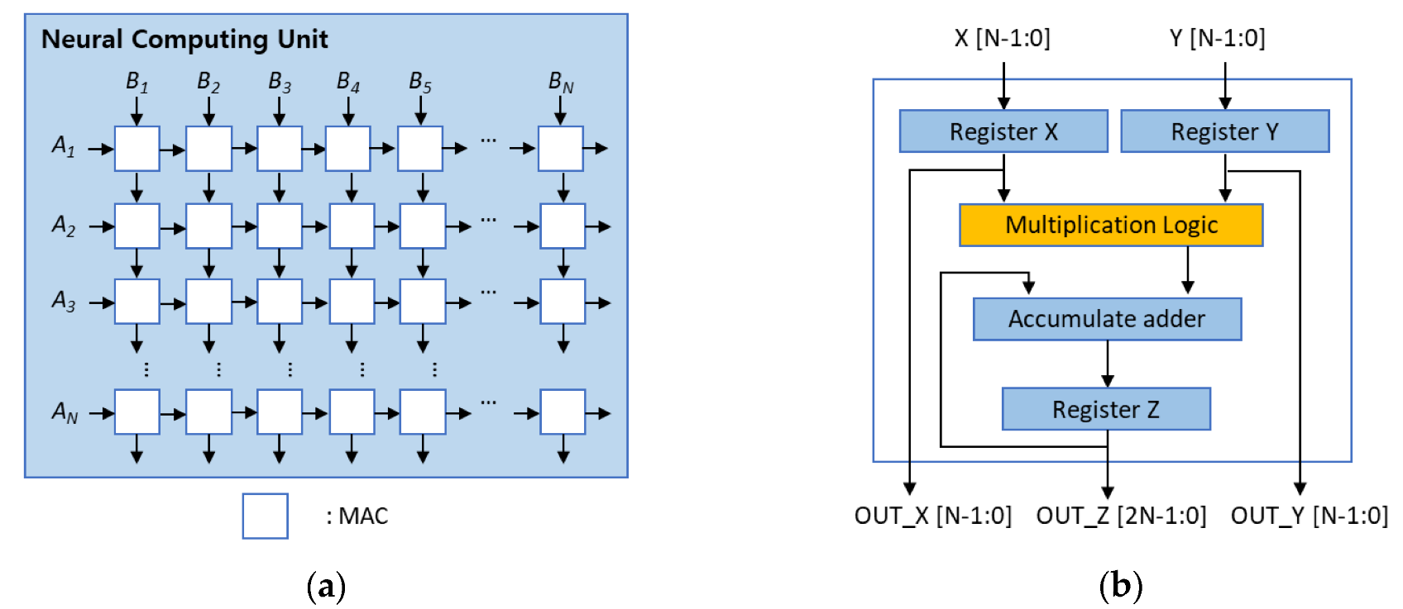

Systolic Array
Applications
Solving linear systems: QR-decomposition
DNN inferencing: TPU
Advantages
Reduce time complexity
From O(n³) to O(n) in QRD
Modules
Processing element
Multiply-and-accumulate
Rotations
PE array

Slide 3
Overall System in LabB
Matrix multiplication with systolic array
localA: MAX_SIZE*MAX_SIZE
localB: MAX_SIZE*MAX_SIZE
localC: MAX_SIZE*MAX_SIZE
localC = localA*localB
Systolic array in this lab
PE array with size of MAX_SIZE*MAX_SIZE
Output stationary manner
Move both arrays and accumulate the output in the same PE

Slide 4
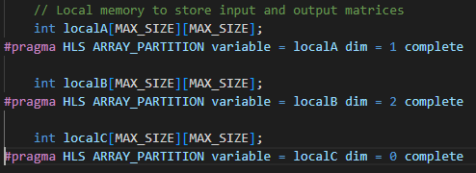
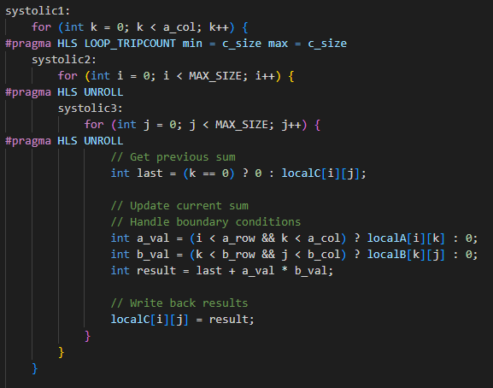
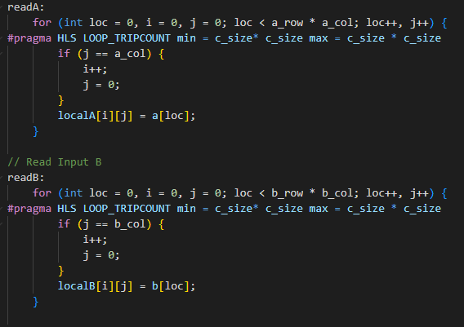
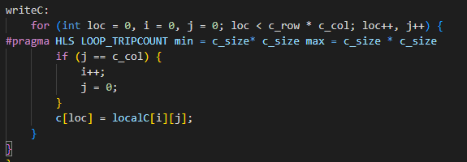
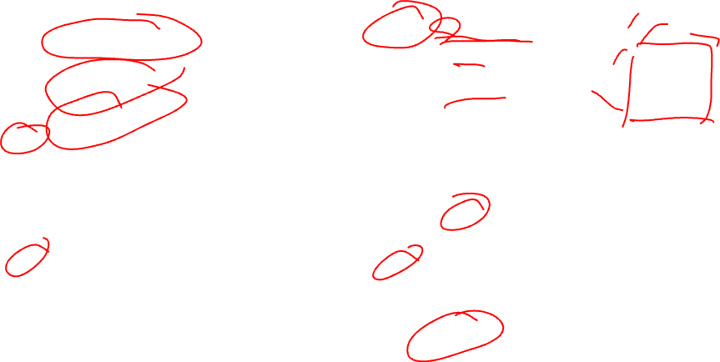
Kernel Code

Slide 5
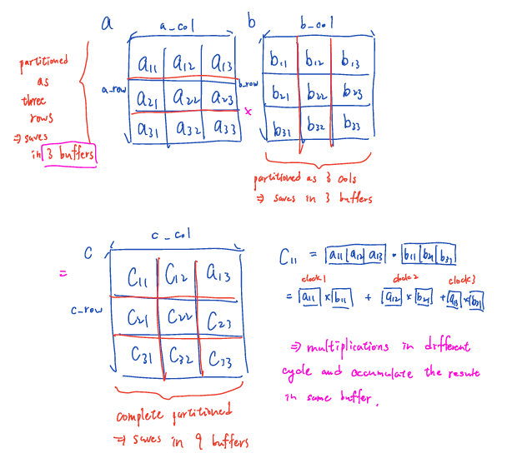
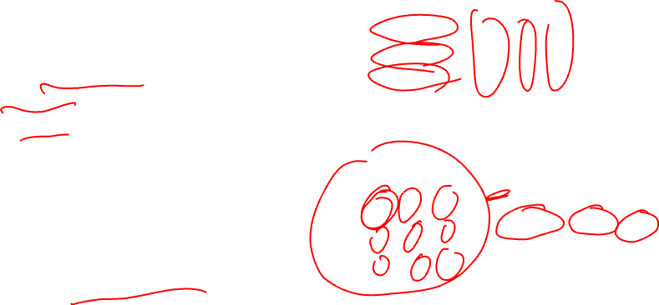
Using 3x3 Matrices to Illustrate
Pragma
localA, localB, localC
Array partition: shown in red line
Systolic1
Unroll: create 9 PEs to work in parallel
Every item in c uses 3 cycles to accumulate the result
Output stationary
Every element in localA and localB are broadcasted

Slide 6
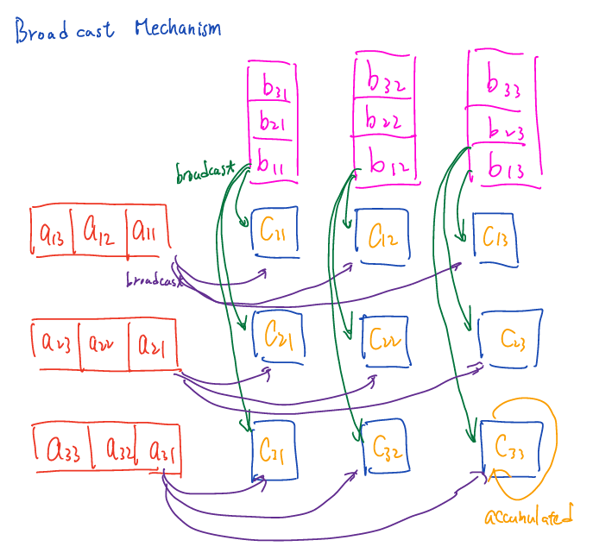
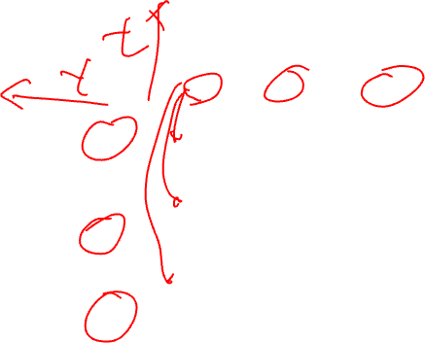
Broadcast Mechanism
Every PE accumulates the partial sum from the inner product of two vectors.
Array partitioned can be explained as turn an array into vectors

Slide 7
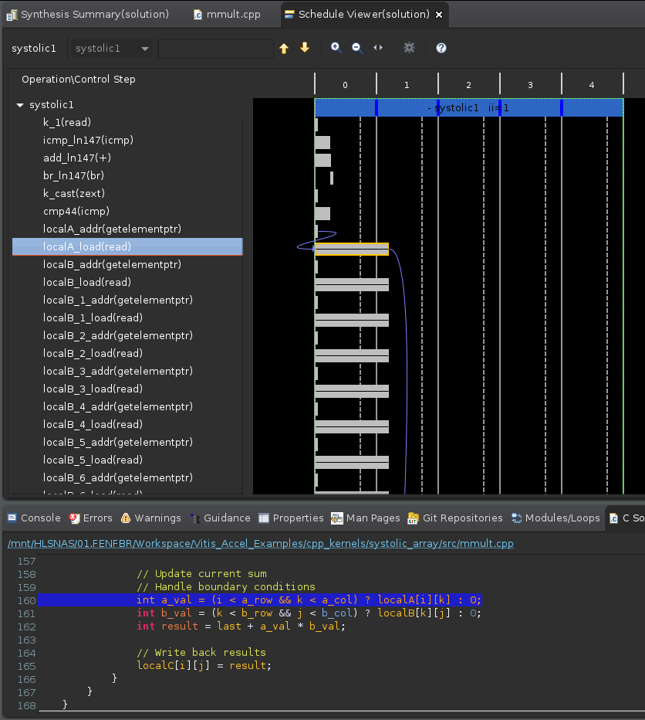

From Code to Time Sequence (1/6)
readA, readB

Slide 8
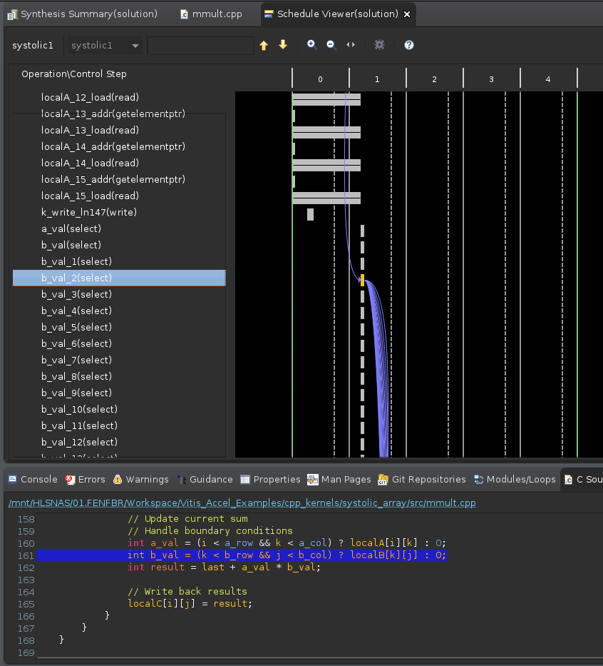

From Code to Time Sequence (2/6)
Mux
Can be optimized

Slide 9
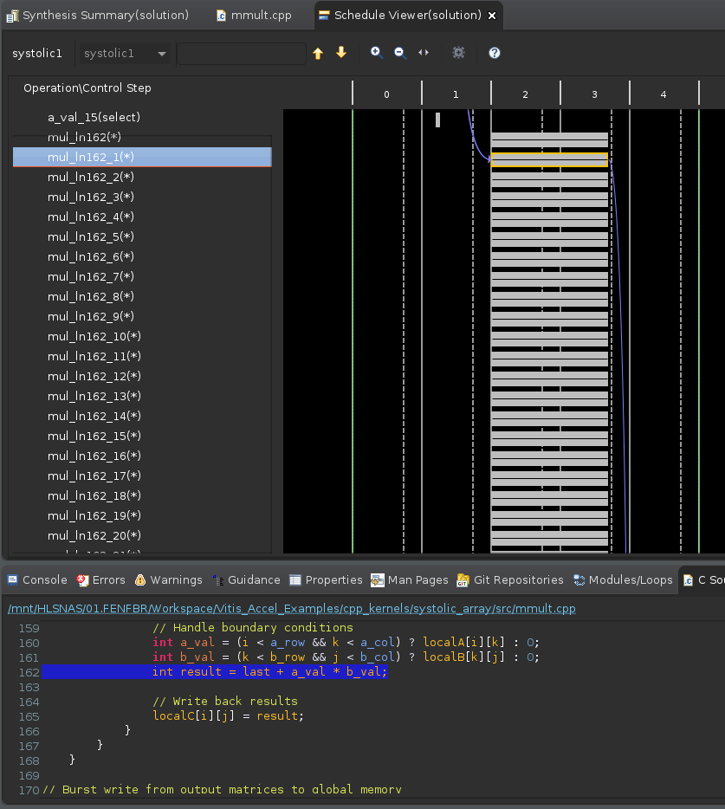

From Code to Time Sequence (3/6)
Multiplication

Slide 10
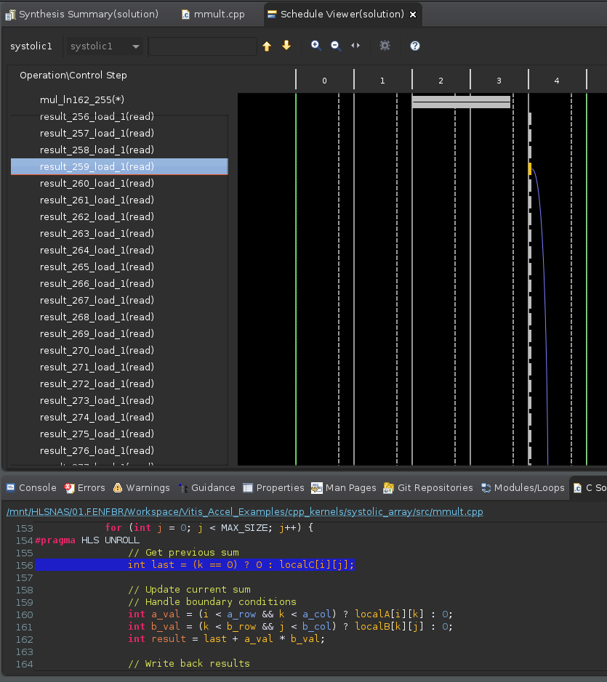

From Code to Time Sequence (4/6)
Load last value

Slide 11
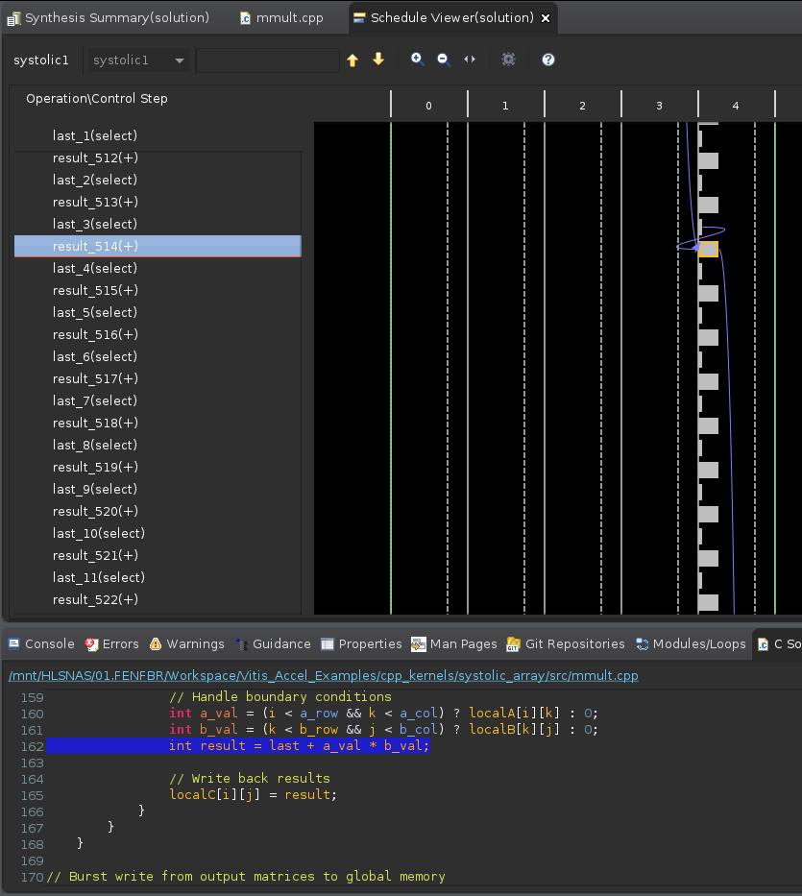

From Code to Time Sequence (5/6)
Accumulate

Slide 12
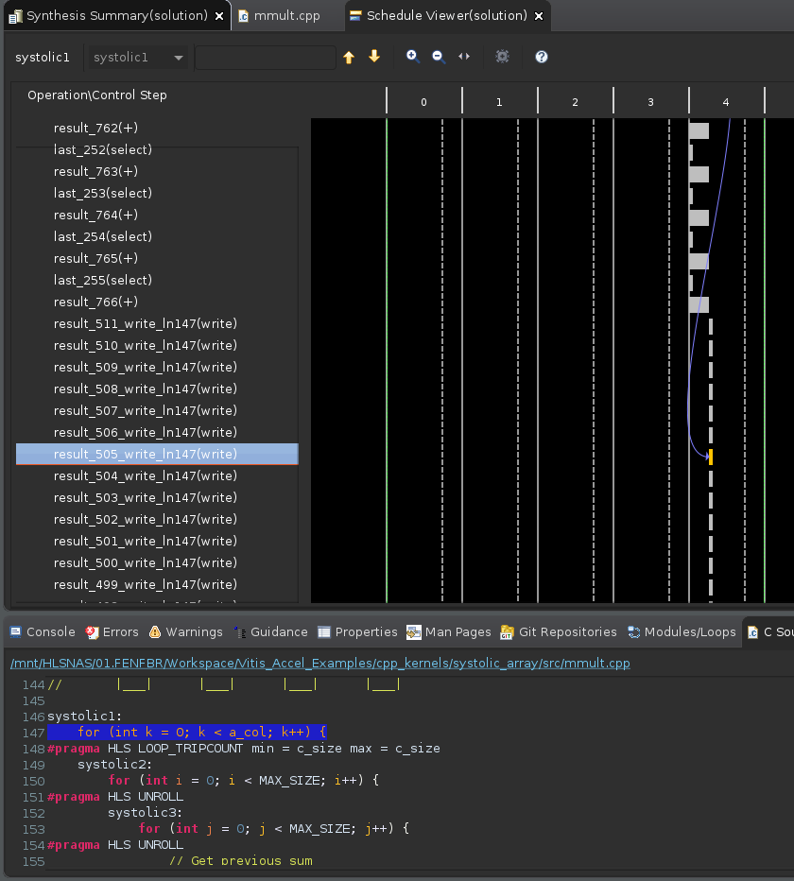

From Code to Time Sequence (6/6)
Write back

Slide 13
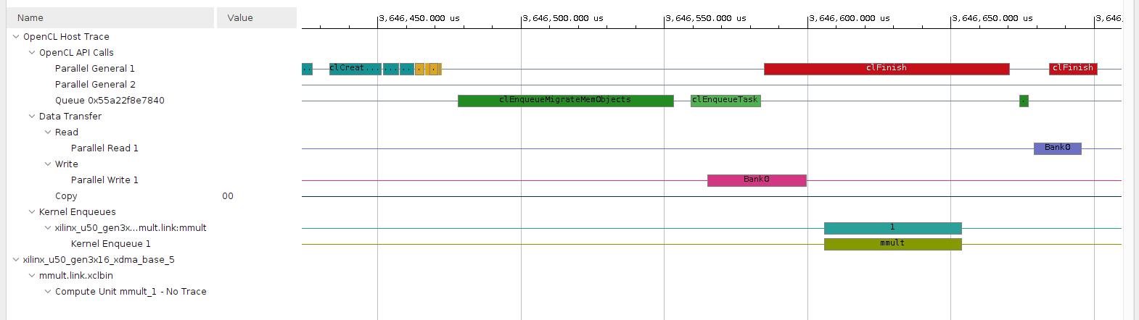

Timeline Analysis (1/2)
w/ array partition
Kernel time: 47.83us

Slide 14
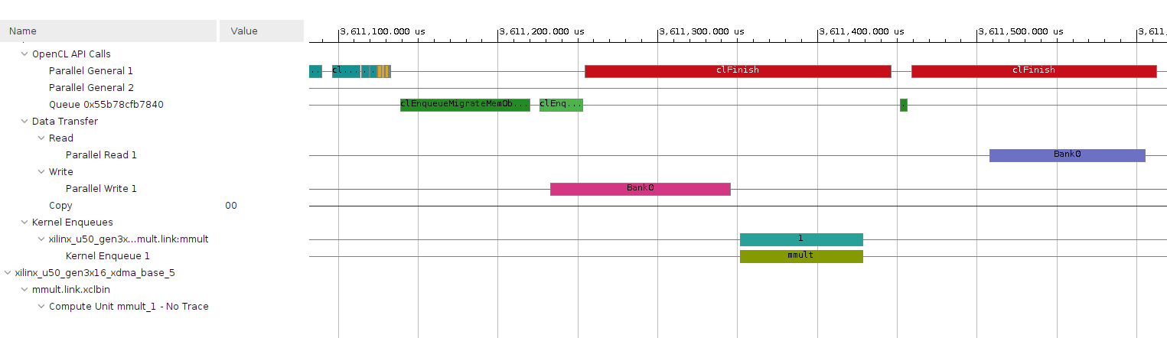

Timeline Analysis (2/2)
w/o array partition
Kernel time: 76.824us

Slide 15
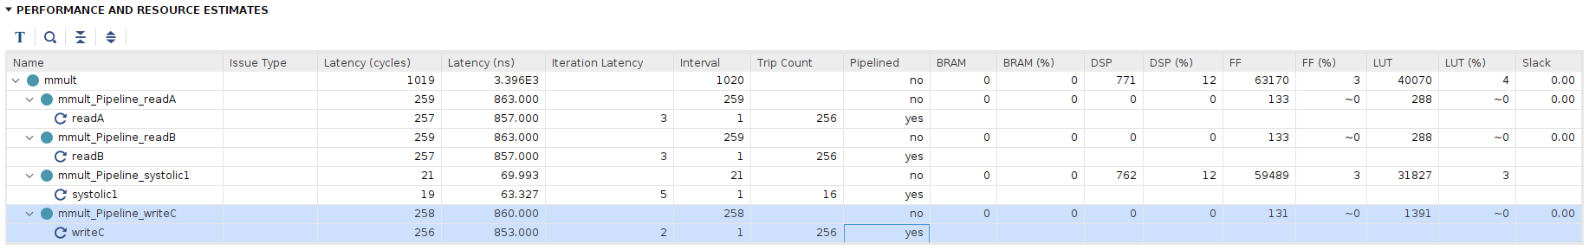
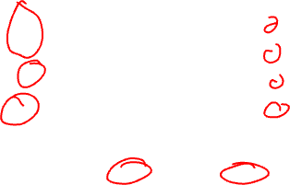
Time and Resource Analysis (1/2)
With array partition

Slide 16
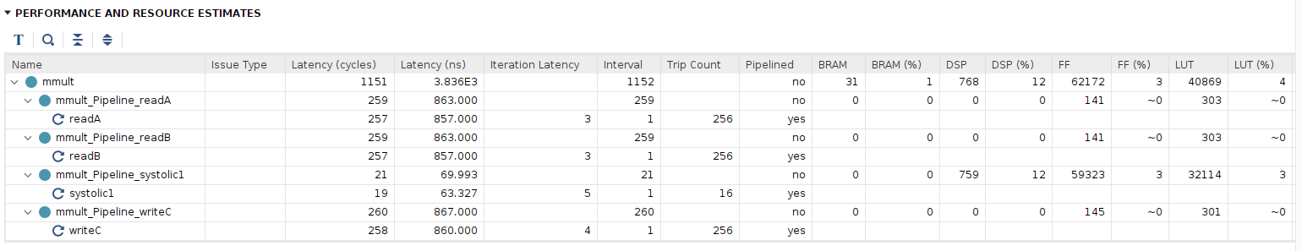

Time and Resource Analysis (2/2) **
w/o array partition

Slide 17
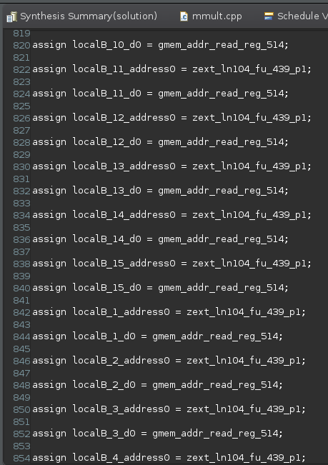
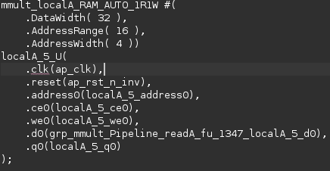

Generated Verilog Code (1/2)
w/ array partition
Generate several rams for partitioned arrays (vectors)

Slide 18
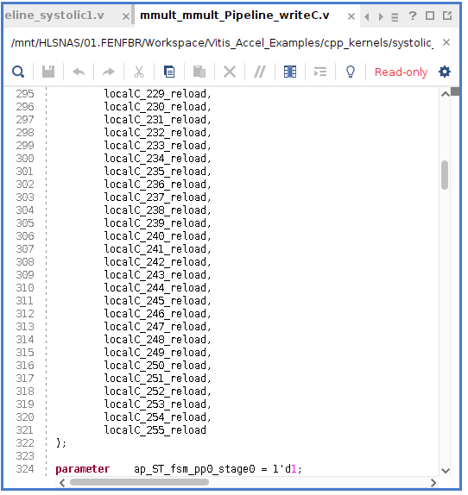
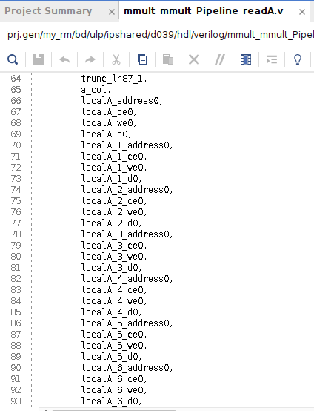

Generated Verilog Code (1/2)
w/ array partition
Several addresses and data channel for pipeline readA, readB, writeC

Slide 19
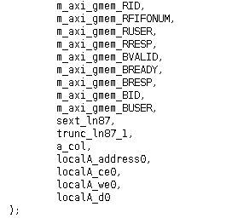
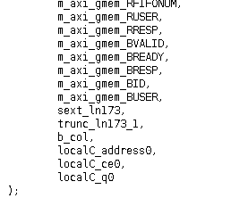

Generated Verilog Code (1/2)
w/o array partition
Only one address and data channel for pipeline readA, readB, writeC

Slide 20

Summary
In this example, w/ and w/o array partition takes almost the same latency
w/ array partition, it uses the FF to store the arrays
w/o array partition, it uses the FF and BRAM to store the arrays
Although no pipeline pragma, the readA, readB, writeC are automatically pipelined
Optimized by HLS

Slide 21
BUT!!!

Slide 22
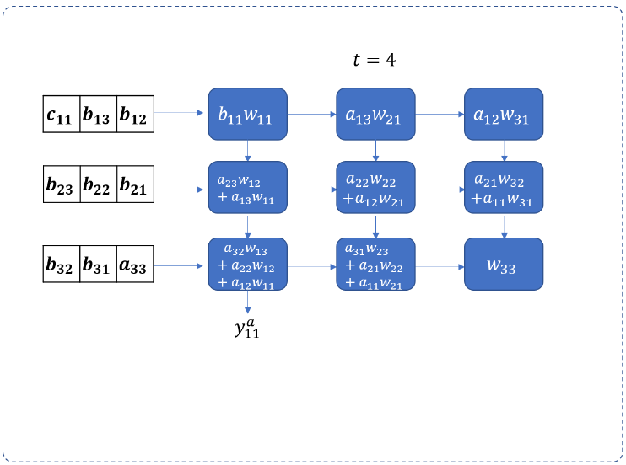
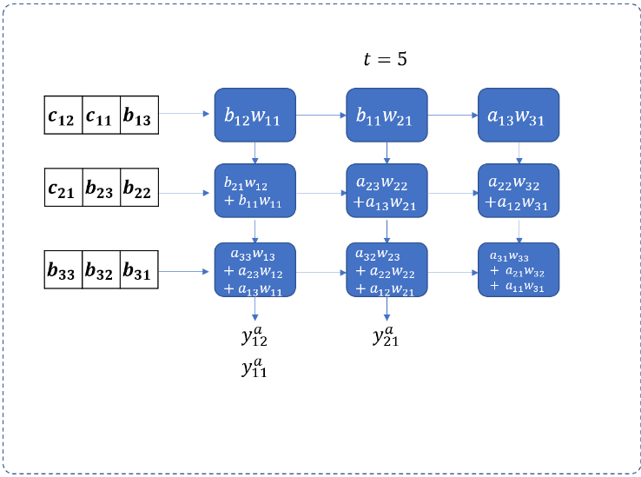
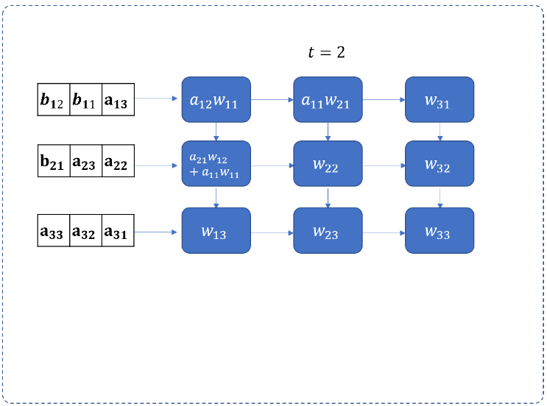
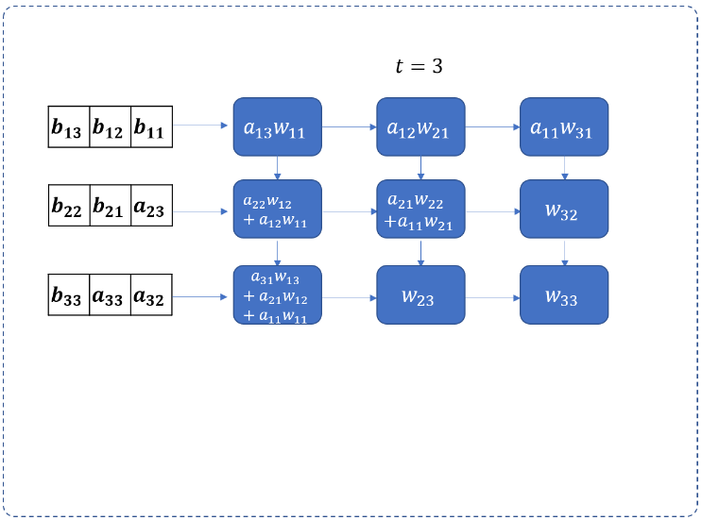

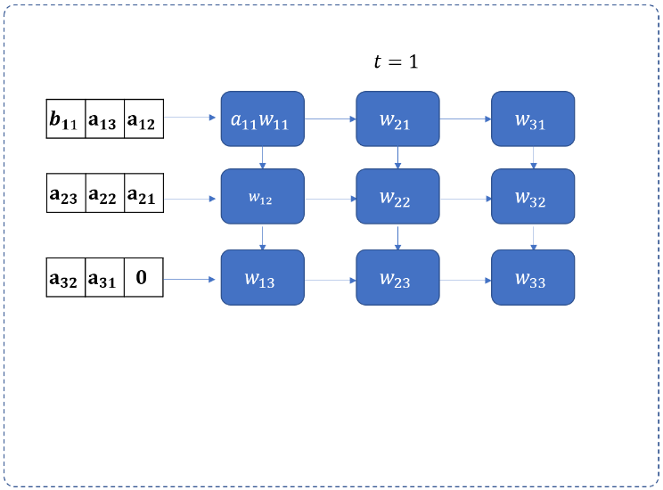
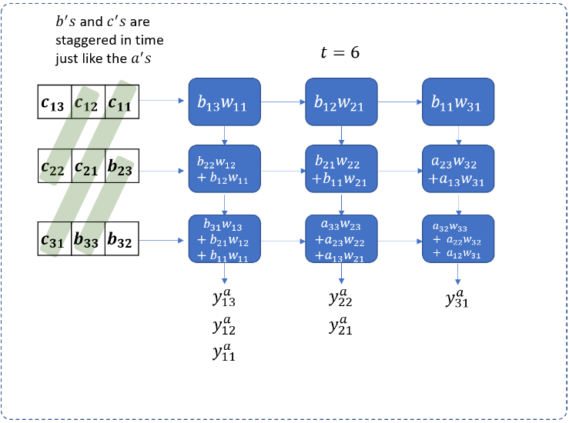
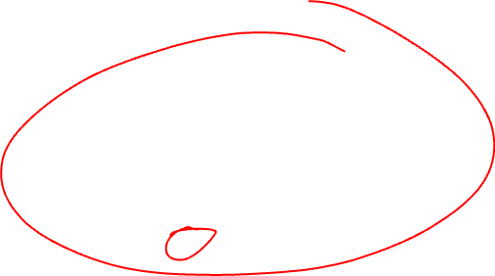
A Real Systolic Array
The aforementioned implementation is not a real systolic array
No communications between PEs
A real systolic array example for matrix multiplication _{[1]}

Slide 23
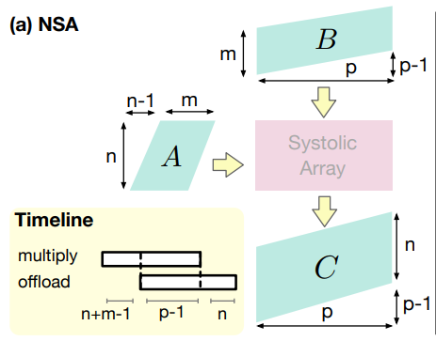

Example Mentioned on the LabB-note
Non-stationary Systolic Array (NSA) Design _{[2]}
Only difference
C is exported in left sequentially
C is directly exported from the systolic array in right

Slide 24
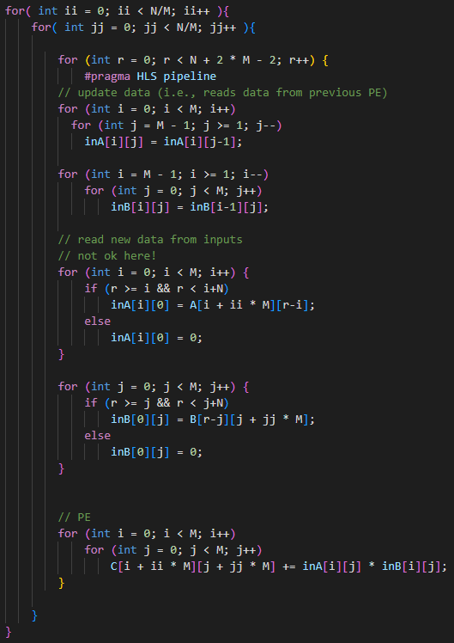

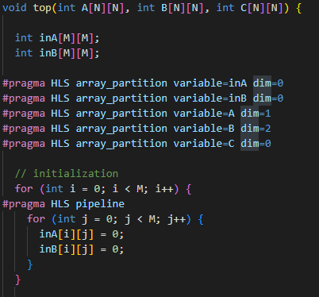

Code for Real SA
Tiling
Tiling
SA: 3x3
A: 6x6
B: 6x6
C: 6x6
Propagating in SA
Register in SA
Input new values from the original array
SA Init
Parallel calculation and accumulation

Slide 25
Tiling
A
B
C
SA
*
=

Slide 26
Operation in One Tile
…
…
…
B20
B11
B02
B10
B01
0
A
B00
0
0
r=0
…
A02
A01
A00
0 | 0 | 0
0 | 0 | 0
0 | 0 | 0
0 | 0 | 0
0 | 0 | 0
0 | 0 | 0
Shift
…
A11
A10
0
B
…
A20
0
0
C

Slide 27

Operation in One Tile
…
…
…
B30
B21
B12
B20
B11
B02
A
B10
B01
0
r=0
…
A03
A02
A01
A00 | 0 | 0
0 | 0 | 0
0 | 0 | 0
B00 | 0 | 0
0 | 0 | 0
0 | 0 | 0
Input
…
A12
A11
A10
B
…
A21
A20
0
C

Slide 28
Operation in One Tile
…
…
…
B30
B21
B12
B20
B11
B02
A
B10
B01
0
r=0
…
A03
A02
A01
A00 | 0 | 0
0 | 0 | 0
0 | 0 | 0
B00 | 0 | 0
0 | 0 | 0
0 | 0 | 0
Cal.
…
A12
A11
A10
B
…
A21
A20
0
A00*B00
C

Slide 29
Operation in One Tile
…
…
…
B30
B21
B12
B20
B11
B02
A
B10
B01
0
r=1
…
A03
A02
A01
0 | A00 | 0
0 | 0 | 0
0 | 0 | 0
0 | 0 | 0
B00 | 0 | 0
0 | 0 | 0
Shift
…
A12
A11
A10
B
…
A21
A20
0
A00*B00
C

Slide 30
Operation in One Tile
…
…
…
B40
B31
B22
B30
B21
B12
A
B20
B11
B02
r=1
…
A04
A03
A02
A01 | A00 | 0
A10 | 0 | 0
0 | 0 | 0
B10 | B01 | 0
B00 | 0 | 0
0 | 0 | 0
Input
…
A13
A12
A11
B
…
A22
A21
A20
A00*B00
C

Slide 31
Operation in One Tile
…
…
…
B40
B31
B22
B30
B21
B12
A
B20
B11
B02
r=1
…
A04
A03
A02
A01 | A00 | 0
A10 | 0 | 0
0 | 0 | 0
B10 | B01 | 0
B00 | 0 | 0
0 | 0 | 0
Cal.
…
A13
A12
A11
B
…
A22
A21
A20
A00*B00+A01*B10 | A00*B01
A10*B00
C

Slide 32
Operation in One Tile
…
…
…
B40
B31
B22
B30
B21
B12
A
B20
B11
B02
r=2
…
A04
A03
A02
0 | A01 | A00
0 | A10 | 0
0 | 0 | 0
0 | 0 | 0
B10 | B01 | 0
B00 | 0 | 0
Shift
…
A13
A12
A11
B
…
A22
A21
A20
A00*B00+A01*B10 | A00*B01
A10*B00
C

Slide 33

Operation in One Tile
…
…
…
B50
B41
B32
B40
B31
B22
A
B30
B21
B12
r=2
…
A05
A04
A03
A02 | A01 | A00
A11 | A10 | 0
A20 | 0 | 0
B20 | B11 | B02
B10 | B01 | 0
B00 | 0 | 0
Input
…
A14
A13
A12
B
…
A23
A22
A21
A00*B00+A01*B10 | A00*B01
A10*B00
C

Slide 34
Operation in One Tile
…
…
…
B50
B41
B32
B40
B31
B22
A
B30
B21
B12
r=2
…
A05
A04
A03
A02 | A01 | A00
A11 | A10 | 0
A20 | 0 | 0
B20 | B11 | B02
B10 | B01 | 0
B00 | 0 | 0
Cal.
…
A14
A13
A12
B
…
A23
A22
A21
A00*B00+A01*B10+ A02*B20 | A00*B01+A01*B11 | A00*B02
A10*B00+A11*B10
A20*B00
C

Slide 35
Operation in One Tile
……

Slide 36

Operation in One Tile
A
r=9
0 | 0 | 0
0 | 0 | 0
0 | 0 | A25
0 | 0 | 0
0 | 0 | 0
0 | 0 | B25
Shift
B
A00*B00+A01*B10+ A02*B20+A03*B30+ A04*B40+A05*B50 | A00*B01+A01*B11+ A02*B21+A03*B31+ A04*B41+A05*B51 | A00*B02+A01*B12+ A02*B22+A03*B32+ A04*B42+A05*B52
A10*B00+A11*B10+ A12*B20+A13*B30+ A14*B40+A15*B50 | A10*B01+A11*B11+ A12*B21+A13*B31+ A14*B41+A15*B51 | A10*B02+A11*B12+ A12*B22+A13*B32+ A14*B42+A15*B52
A20*B00+A21*B10+ A22*B20+A23*B30+ A24*B40+A25*B50 | A20*B01+A21*B11+ A22*B21+A23*B31+ A24*B41+A25*B51 | A20*B02+A21*B12+ A22*B22+A23*B32+ A24*B42
C

Slide 37
Operation in One Tile
A
r=9
0 | 0 | 0
0 | 0 | 0
0 | 0 | A25
0 | 0 | 0
0 | 0 | 0
0 | 0 | B25
Input
B
A00*B00+A01*B10+ A02*B20+A03*B30+ A04*B40+A05*B50 | A00*B01+A01*B11+ A02*B21+A03*B31+ A04*B41+A05*B51 | A00*B02+A01*B12+ A02*B22+A03*B32+ A04*B42+A05*B52
A10*B00+A11*B10+ A12*B20+A13*B30+ A14*B40+A15*B50 | A10*B01+A11*B11+ A12*B21+A13*B31+ A14*B41+A15*B51 | A10*B02+A11*B12+ A12*B22+A13*B32+ A14*B42+A15*B52
A20*B00+A21*B10+ A22*B20+A23*B30+ A24*B40+A25*B50 | A20*B01+A21*B11+ A22*B21+A23*B31+ A24*B41+A25*B51 | A20*B02+A21*B12+ A22*B22+A23*B32+ A24*B42
C

Slide 38
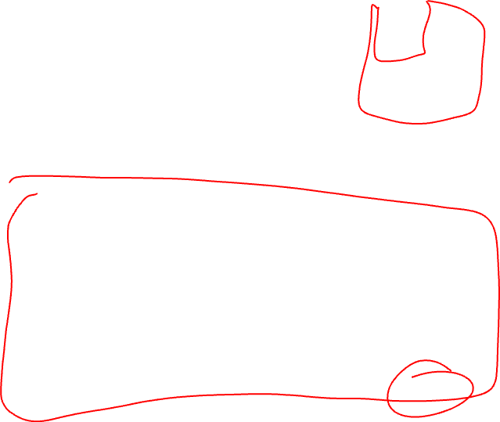
Operation in One Tile
A
r=9
0 | 0 | 0
0 | 0 | 0
0 | 0 | A25
0 | 0 | 0
0 | 0 | 0
0 | 0 | B25
Cal.
B
A00*B00+A01*B10+ A02*B20+A03*B30+ A04*B40+A05*B50 | A00*B01+A01*B11+ A02*B21+A03*B31+ A04*B41+A05*B51 | A00*B02+A01*B12+ A02*B22+A03*B32+ A04*B42+A05*B52
A10*B00+A11*B10+ A12*B20+A13*B30+ A14*B40+A15*B50 | A10*B01+A11*B11+ A12*B21+A13*B31+ A14*B41+A15*B51 | A10*B02+A11*B12+ A12*B22+A13*B32+ A14*B42+A15*B52
A20*B00+A21*B10+ A22*B20+A23*B30+ A24*B40+A25*B50 | A20*B01+A21*B11+ A22*B21+A23*B31+ A24*B41+A25*B51 | A20*B02+A21*B12+ A22*B22+A23*B32+ A24*B42+A25*B52
C

Slide 39
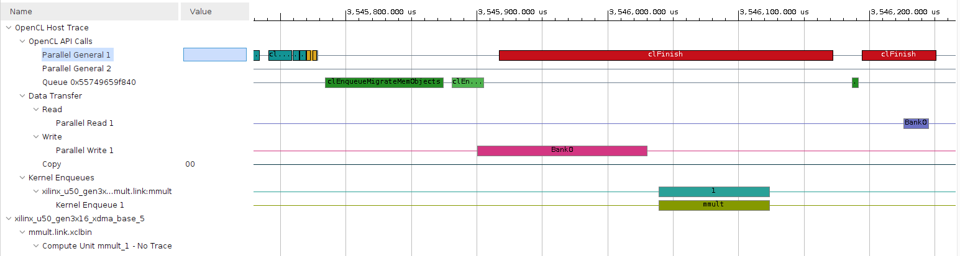

Timeline Analysis
Kernel time: 84.414us
47.83 -> 84.414

Slide 40
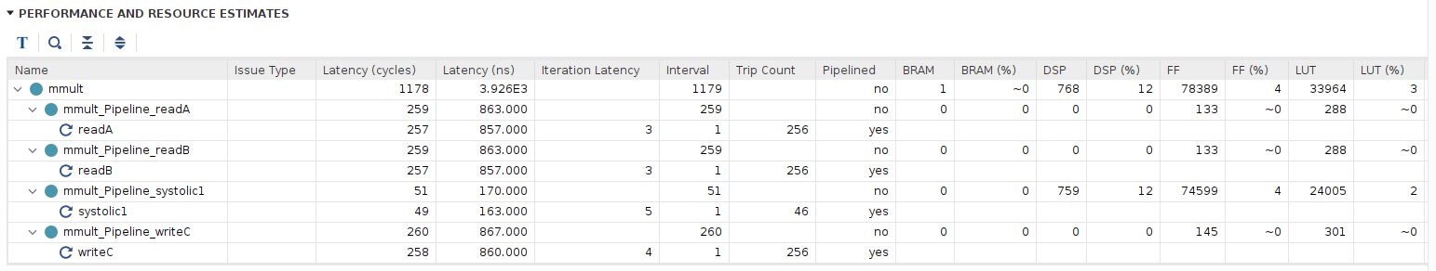

Time and Resource Analysis
Latency of SA
21 -> 51
LUT
40k -> 33k
FF
63k -> 78k

Slide 41

Summary
Total cycles per tile
N+2M-2
Why not ok?
A complicate mux
Real SA vs Not Real SA
Not Real SA
Require only 3 cycles per tile -> latency is shorter
High routing resource due to broadcasting -> larger LUT usage
Real SA
Require 7 cycles per tile -> longer latency
Use additional registers for propagations between PEs -> Larger FF usage

Slide 42
Q&A
In the NSA design, if all matrix size are 5, and the size of the SA is also 5. Using the real SA design, how many cycles we need to finish one tile?
13

Slide 43
Reference
[1] https://www.telesens.co/2018/07/30/systolic-architectures/
[2] Asgari, Bahar, Ramyad Hadidi, and Hyesoon Kim. "Meissa: Multiplying matrices efficiently in a scalable systolic architecture." 2020 IEEE 38th International Conference on Computer Design (ICCD). IEEE, 2020.

