Slide 1
HLS Lab B: Fast Fourier Transform
Speaker: 王景平
Date: 2022/10/27

Slide 2
Lab Goal
To design a FFT IP
Latency smaller than 2000 cycles
Verify functionality on PYNQ

Slide 3
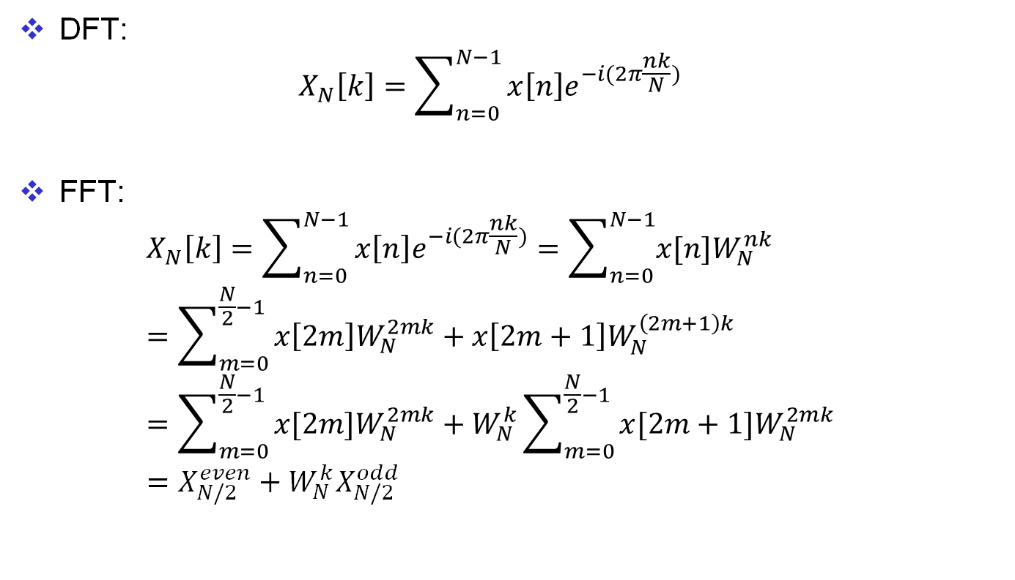
DIT-FFT Algorithm
DFT: $X_{N}\left[k\right]=\sum_{n=0}^{N−1}{x\left[n\right]e^{−i(2π\frac{nk}{N})}}$
FFT: $X_{N}\left[k\right]=\sum_{n=0}^{N−1}{x\left[n\right]e^{−i(2π\frac{nk}{N})}}=\sum_{n=0}^{N−1}{x[n]W_{N}^{nk}}$ $=\sum_{m=0}^{\frac{N}{2}−1}{x\left[2m\right]W_{N}^{2mk}}+x\left[2m+1\right]W_{N}^{\left(2m+1\right)k}$ $=\sum_{m=0}^{\frac{N}{2}−1}{x[2m]W_{N}^{2mk}}+W_{N}^{k}\sum_{m=0}^{\frac{N}{2}−1}{x[2m+1]W_{N}^{2mk}}$ $=X_{N/2}^{even}+W_{N}^{k}X_{N/2}^{odd}$

Slide 4
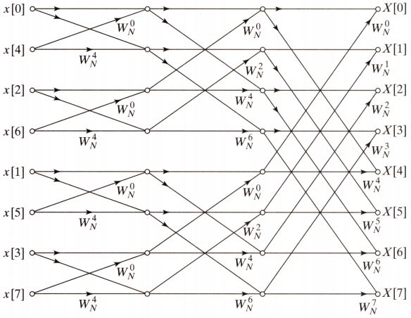
Data Flow Graph
N=8

Slide 5
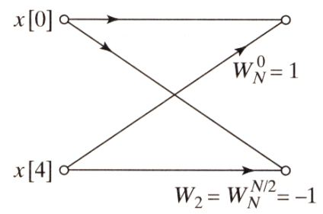
Butterfly Operation
Minimum operation unit

Slide 6
Bit Reversal
000(0) ➝ 000(0)
001(1) ➝ 100(4)
010(2) ➝ 010(2)
011(3) ➝ 110(6)
100(4) ➝ 001(1)
101(5) ➝ 101(5)
110(6) ➝ 011(6)
111(7) ➝ 111(7)

Slide 7
Bit Reversal Implementation
N is fixed to 1024
Reversal order is fixed
Index can be precomputed
Remove dependency since each element is guaranteed to be access at most once
void bit_reverse(DTYPE X_R[SIZE], DTYPE X_I[SIZE]){
#pragma HLS DEPENDENCE dependent=false type=inter variable=X_I
#pragma HLS DEPENDENCE dependent=false type=inter variable=X_R
All_Loop: for (unsigned short n = 0; n < R_N; n++) {
unsigned short idx = reversible_idx[n];
unsigned short ridx = reversed_idx[n];
DTYPE tmp;
tmp = X_R[idx];
X_R[idx] = X_R[ridx];
X_R[ridx] = tmp;
tmp = X_I[idx];
X_I[idx] = X_I[ridx];
X_I[ridx] = tmp;
}
}

Slide 8
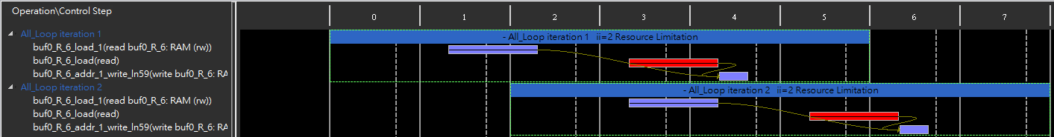
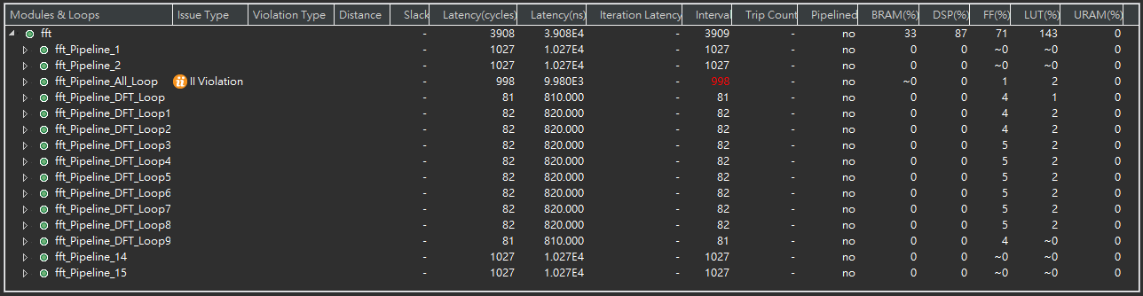
Bit Reversal Lookup Table
Minimum II can only be 2 due to resource limitation
Memory access pattern of reversed index is chaotic, hard to perform optimization
Latency of load operation exceed 1 cycle
Swap operation required two load
Bit reversal requires at least 2*496=992 cycles

Slide 9
FFT Software Implementation
Possible improvement
Sin, Cos lookup table
Deterministic loop bound
Memory access order
Array partition
Loop unrolling
stages: for(stage=1; stage<= M; stage++) {
DFTpts = 1 << stage;
numBF = DFTpts/2;
e = -6.283185307178/DFTpts;
a = 0.0;
butterfly: for(j=0; j<numBF; j++) {
c = cos(a);
s = sin(a);
a = a + e;
DFTpts: for(i=j; i<SIZE; i += DFTpts) {
i_lower = i + numBF;
temp_R = X_R[i_lower]*c- X_I[i_lower]*s;
temp_I = X_I[i_lower]*c+ X_R[i_lower]*s;
X_R[i_lower] = X_R[i] - temp_R;
X_I[i_lower] = X_I[i] - temp_I;
X_R[i] = X_R[i] + temp_R;
X_I[i] = X_I[i] + temp_I;
}
}
}

Slide 10

Cosine, Sine Lookup Table
From FFT
$W_{N}^{k}=W_{\frac{N}{m}}^{\frac{k}{m}}=e^{−i(2π\frac{k}{N})}=\cos\left(2π\frac{k}{N}\right)−isin(2π\frac{k}{N})$
Lookup table
$\cos\left(2π\frac{k}{N}\right) for k∈[0, 1023]$
$\sin\left(2π\frac{k}{N}\right) for k∈[0, 1023]$
stages: for(stage=1; stage<= M; stage++) {
DFTpts = 1 << stage;
numBF = DFTpts/2;
butterfly: for(j=0; j<numBF; j++) {
c = W_real[1024*j/DFTpts];
s = W_imag[1024*j/DFTpts];
DFTpts:for(i=j; i<SIZE; i += DFTpts) {
i_lower = i + numBF;
temp_R = X_R[i_lower]*c- X_I[i_lower]*s;
temp_I = X_I[i_lower]*c+ X_R[i_lower]*s;
X_R[i_lower] = X_R[i] - temp_R;
X_I[i_lower] = X_I[i] - temp_I;
X_R[i] = X_R[i] + temp_R;
X_I[i] = X_I[i] + temp_I;
}
}
}

Slide 11
Loop Flattening
512 butterfly operations for all stage
void fft_stage(DTYPE X_R[SIZE], DTYPE X_I[SIZE],
DTYPE OUT_R[SIZE], DTYPE OUT_I[SIZE]) {
const unsigned short numPts = 1 << stage;
const unsigned short numBF = numPts >> 1;
DFT_Loop: for (unsigned short i = 0; i < SIZE2; i++) {
#pragma HLS UNROLL factor=factor
unsigned short wi = i % (1 << (stage-1));
DTYPE c = W_real[wi << (M-stage)];
DTYPE s = W_imag[wi << (M-stage)];
unsigned short k = i + (i / (1 << (stage-1)) * (1 << (stage-1)));
unsigned short k_lower = k + numBF;
DTYPE R = X_R[k];
DTYPE I = X_I[k];
DTYPE R_lower = X_R[k_lower];
DTYPE I_lower = X_I[k_lower];
DTYPE t_R = R_lower*c - I_lower*s;
DTYPE t_I = I_lower*c + R_lower*s;
OUT_R[k_lower] = R - t_R;
OUT_I[k_lower] = I - t_I;
OUT_R[k] = R + t_R;
OUT_I[k] = I + t_I;
}
}

Slide 12
Pragma Dataflow
Result
stages are executed in sequential order, dataflow doesn’t cause overlapped execution
Reason
When applying dataflow, data transitions between stages are implemented into one of the two types: fifo and pipo
fifo: two function read/write array in sequential order
pipo: otherwise
FFT can be implemented in sequential order with buffers
Negative time slack occurs
Lack of resource(all stages are uniquified)

Slide 13
Memory Access Order
The memory access order is different between stages
To optimize the memory access order, each stage needs to be uniquify, the function instance cannot be shared between stages
Solution
Function template
template<int stage>
void fft_stage(DTYPE X_R[SIZE], DTYPE X_I[SIZE], DTYPE OUT_R[SIZE], DTYPE OUT_I[SIZE]);
void fft(DTYPE X_R[SIZE], DTYPE X_I[SIZE], DTYPE OUT_R[SIZE], DTYPE OUT_I[SIZE]) {
bit_reverse (X_R, X_I);
fft_stage<1> (X_R, X_I, Stage1_R, Stage1_I);
fft_stage<2> (Stage1_R, Stage1_I, Stage2_R, Stage2_I);
fft_stage<3> (Stage2_R, Stage2_I, Stage3_R, Stage3_I);
fft_stage<4> (Stage3_R, Stage3_I, Stage4_R, Stage4_I);
fft_stage<5> (Stage4_R, Stage4_I, Stage5_R, Stage5_I);
fft_stage<6> (Stage5_R, Stage5_I, Stage6_R, Stage6_I);
fft_stage<7> (Stage6_R, Stage6_I, Stage7_R, Stage7_I);
fft_stage<8> (Stage7_R, Stage7_I, Stage8_R, Stage8_I);
fft_stage<9> (Stage8_R, Stage8_I, Stage9_R, Stage9_I);
fft_stage<10>(Stage9_R, Stage9_I, OUT_R, OUT_I);
}

Slide 14
Parallel Circuit
To perform FFT in parallel fashion, loop unrolling and array partition are required
Memory access pattern is partially sequential, array partition type should be cyclic
Each element will only be accessed once, the dependency can be removed

Slide 15
Ping-Pong Buffer
Since each stage is executed in sequential order, the data buffer between stages can be reused to reduce memory usage
Saved resource can help increase parallel factor(array partition, loop unrolling)
void fft(DTYPE X_R[SIZE], DTYPE X_I[SIZE], DTYPE OUT_R[SIZE], DTYPE OUT_I[SIZE]) {
…
DTYPE buf0_R[SIZE], buf0_I[SIZE];
DTYPE buf1_R[SIZE], buf1_I[SIZE];
#pragma HLS ARRAY_PARTITION variable=buf0_R type=cyclic factor=8
#pragma HLS ARRAY_PARTITION variable=buf0_I type=cyclic factor=8
#pragma HLS ARRAY_PARTITION variable=buf1_R type=cyclic factor=8
#pragma HLS ARRAY_PARTITION variable=buf1_I type=cyclic factor=8
bit_reverse (buf0_R, buf0_I);
fft_stage<1> (buf0_R, buf0_I, buf1_R, buf1_I);
fft_stage<2> (buf1_R, buf1_I, buf0_R, buf0_I);
fft_stage<3> (buf0_R, buf0_I, buf1_R, buf1_I);
fft_stage<4> (buf1_R, buf1_I, buf0_R, buf0_I);
fft_stage<5> (buf0_R, buf0_I, buf1_R, buf1_I);
fft_stage<6> (buf1_R, buf1_I, buf0_R, buf0_I);
fft_stage<7> (buf0_R, buf0_I, buf1_R, buf1_I);
fft_stage<8> (buf1_R, buf1_I, buf0_R, buf0_I);
fft_stage<9> (buf0_R, buf0_I, buf1_R, buf1_I);
fft_stage<10>(buf1_R, buf1_I, buf0_R, buf0_I);
…
}

Slide 16
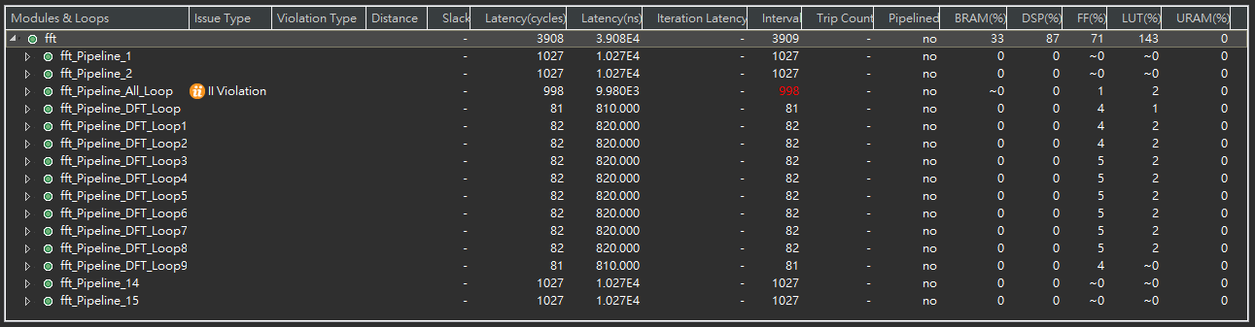
Result - Summary
Latency of FFT computation = 1816 cycles
Resource usage exceeds 100%(LUT: 143%)
Would be fine since the cycle time is set to 10ns, but on the FPGA, the cycle time is actually 20ns

Slide 17
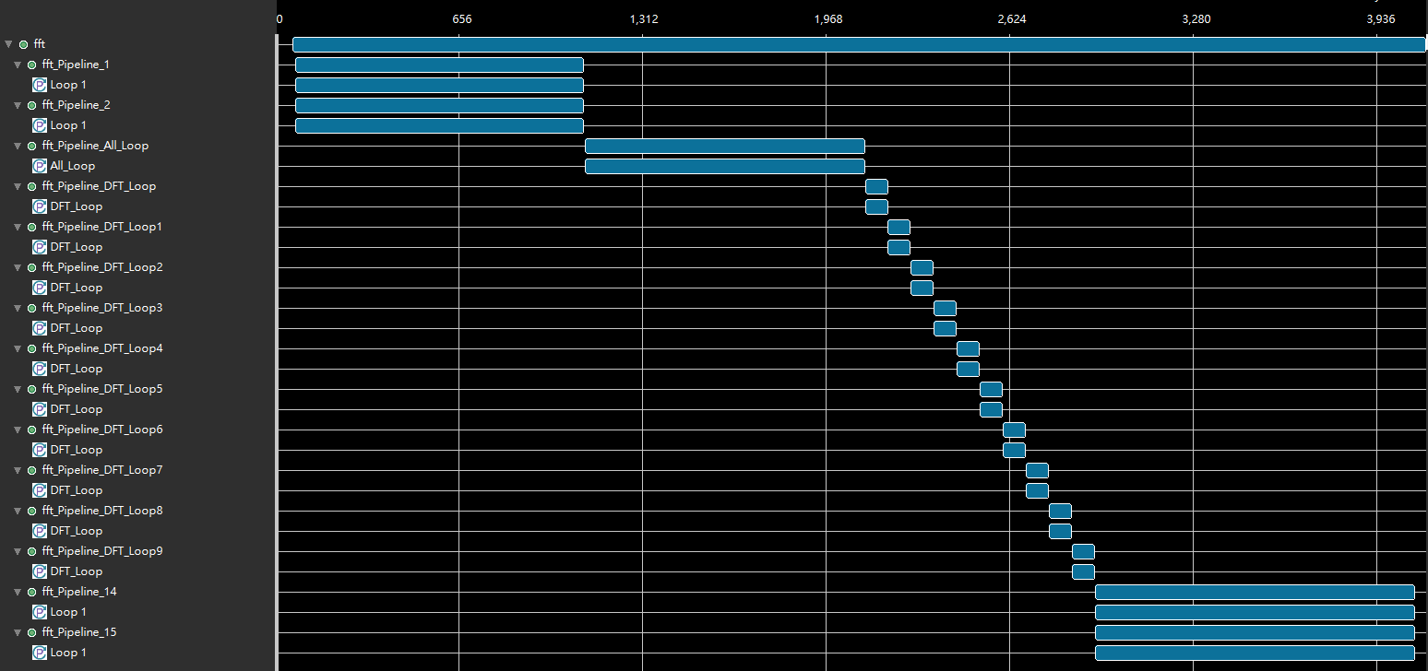
Result - Timeline
Each stage are executed in sequential order
Data transfer by MAXI are parallel

Slide 18
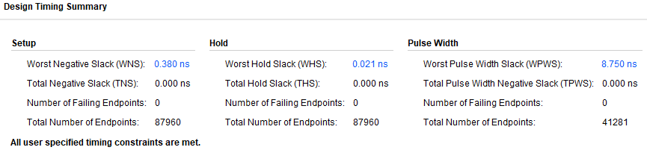
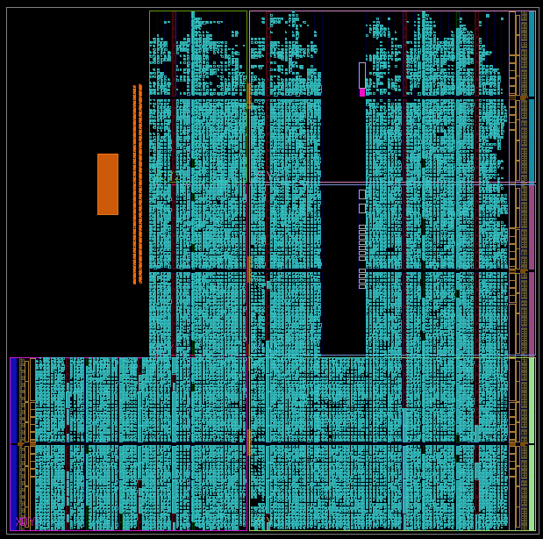
Result - Implementation
Timing met, resource usage met
Cycle time is set to 20ns

Slide 19
Conclusion
For function with random access memory, dataflow pragma won’t help and might cause more resource usage
Dataflow might consider all functions are executed in parallel, no hardware sharing can be enabled
Regular memory access pattern can be optimized with array partition
Require uniquify for each stage
An FFT IP that runs with latency of 1816 cycles is created

Slide 20
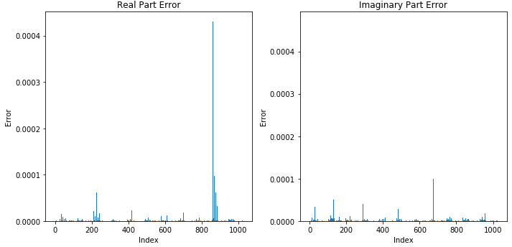
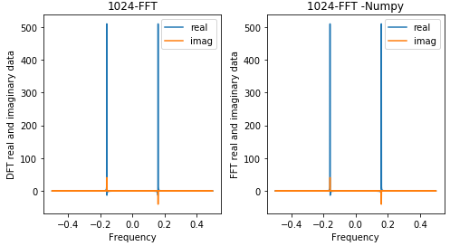
On-Board Verification
Latency comparison
Numpy FFT: 2.024 ms
FPGA accelerated FFT: 0.824 ms
RMSE
Real part: 2.045 e-5
Imag part: 1.801 e-5

