Slide 1
High Level Synthesis
Lab-B: FIR Optimization
Speaker: 蔡岳峰
Advisor: Prof. Jiin Lai
Date: 2022/10/27

Slide 2
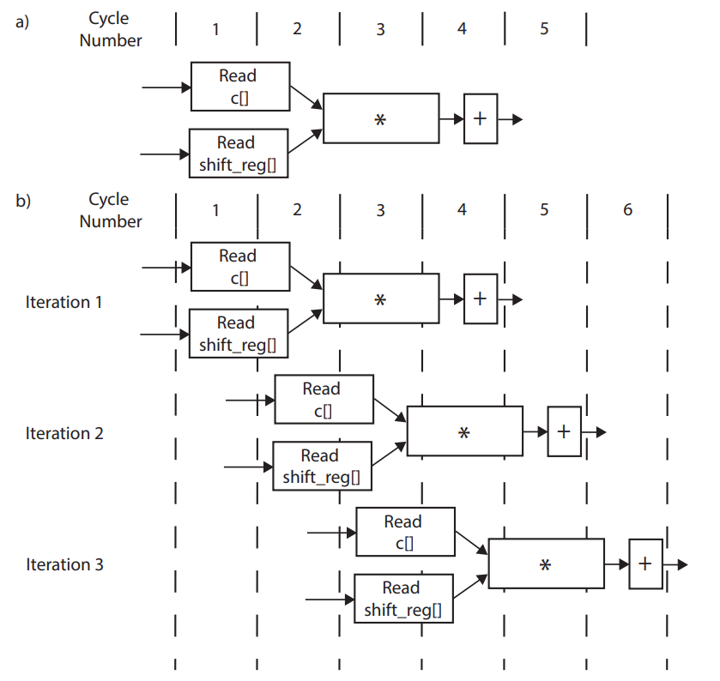
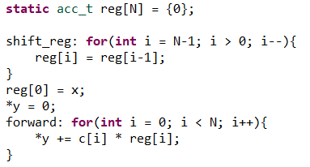
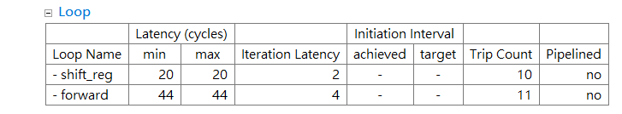
Project: FIR Filter Design
Objective: parallel programming of high quality FIR architecture
Design an 11 tap FIR filter
Correctness of the HLS functionality
Design and optimize a 128 tap FIR filter
FIR functionality – 2 for loops version

Slide 3
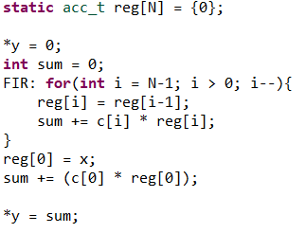
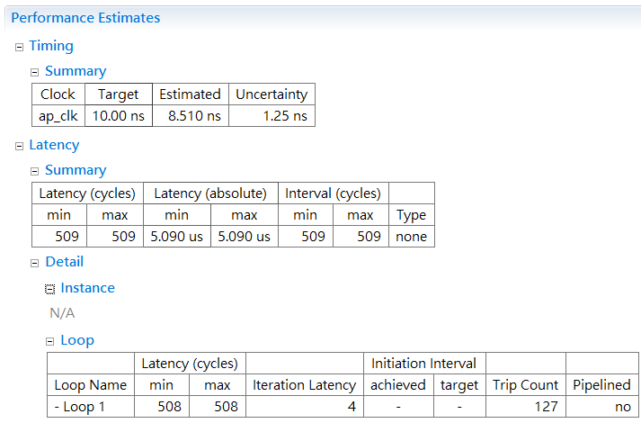
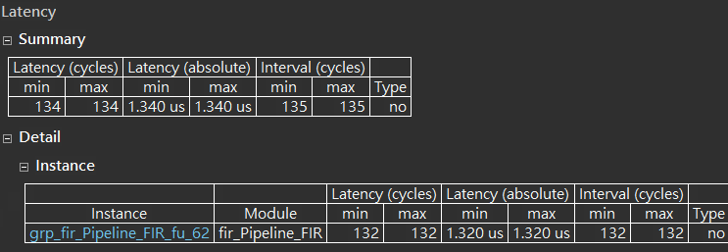
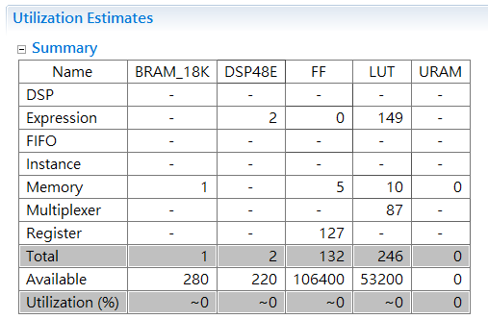
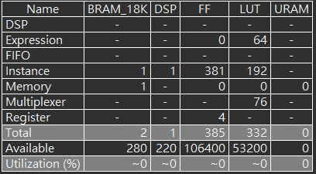

FIR-128 Baseline
Single for loop functionality
Hide register shifting behind MAC operation
Latency = 4$×$127 = 508 cycles
 | Vivado 2020.1 | Vitis 2022.1
Perf.
Util.

Slide 4
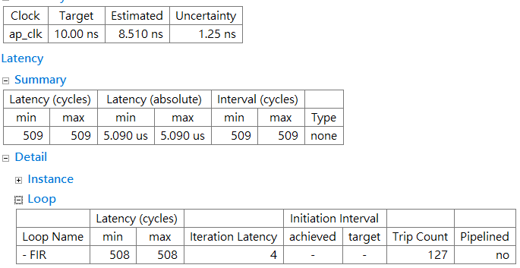
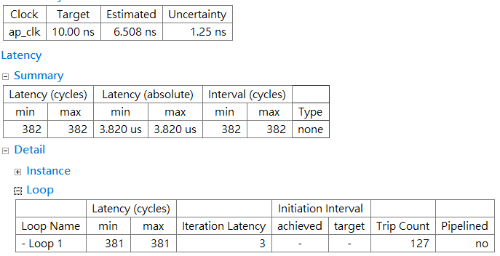

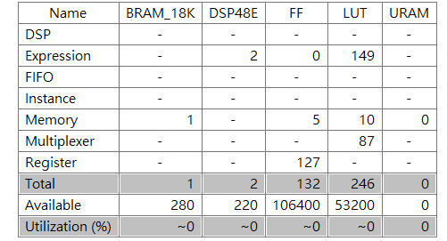
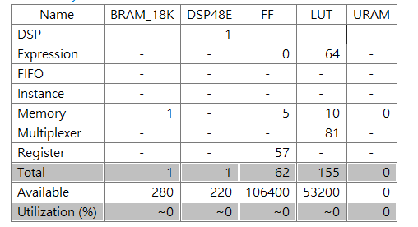
FIR-128 Variance Data Types
Critical path: MAC operation
Data width determines speed of the circuit
Dtype | Integer (32 bits) | Long long (64 bits) | AP best (8 bits)
Perf.
Util.
Data type (2’s) | Integer (32 bits) | Long long (64 bits) | AP best (8 bits)
Iteration latency | 4 cycles | 4 cycles | 3 cycles
Total latency | 509 cycles | 509 cycles | 382 cycles
FF | 132 | 132 | 62
LUT | 246 | 246 | 155
Int is same as long long type due to optimization by DC.
AP reduces critical path and hardware cost.
AP: arbitrary precision, DC: design compiler

Slide 5

FIR-128 Variance Data Types (Cont.)
Critical path: MAC operation
Floating point operation
Data type | Integer (32 bits) | AP best (8 bits) | Float (32 bits) | Double (64 bits)
Iteration latency | 4 cycles | 3 cycles | 13 cycles | 15 cycles
Total latency | 509 cycles | 382 cycles | 1663 cycles | 1919 cycles
FF | 132 | 132 | 1023 | 1705
LUT | 246 | 246 | 2466 | 4225
Iteration latency increases in both floating operation
Double is more complex than float operation

Slide 6
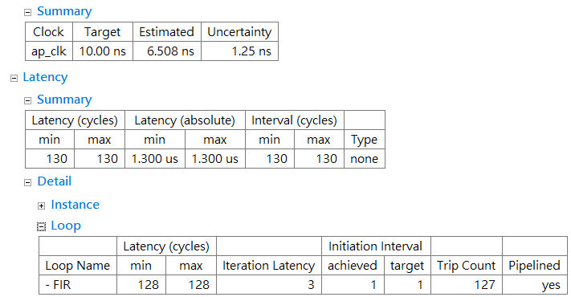
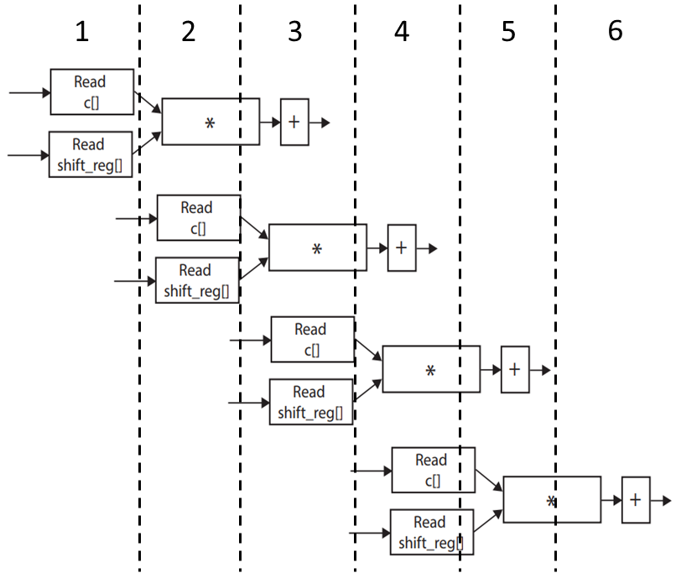
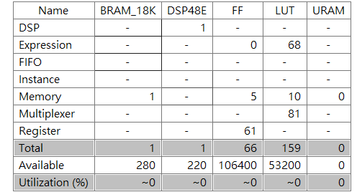
FIR-128 Pipeline
Set Initiation Interval to 1

Slide 7
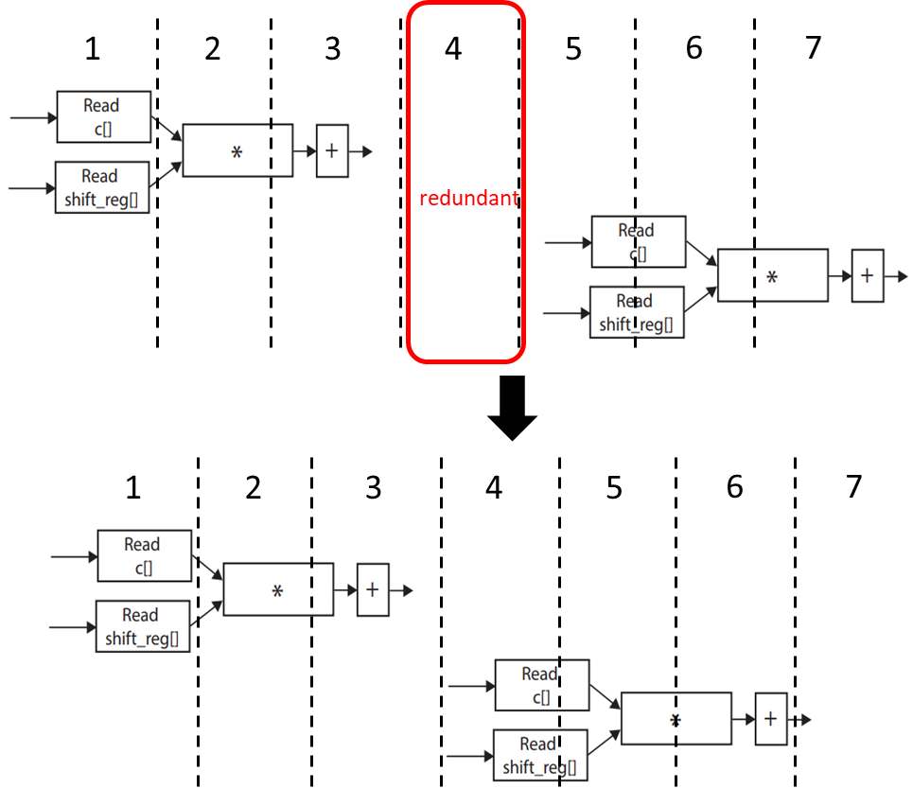
FIR-128 Pipeline (Cont.)
Incrementally increase II constraint
 | II=1 | II=2 | II=3 | II=4
Iteration latency | 1 cycles | 2 cycles | 3 cycles | 3 cycles
Total latency | 130 cycles | 256 cycles | 383 cycles | 383 cycles
FF/LUT | 66/159 | 65/175 | 63/161 | 63/161
Stall cycle is automatically removed by HLS

Slide 8
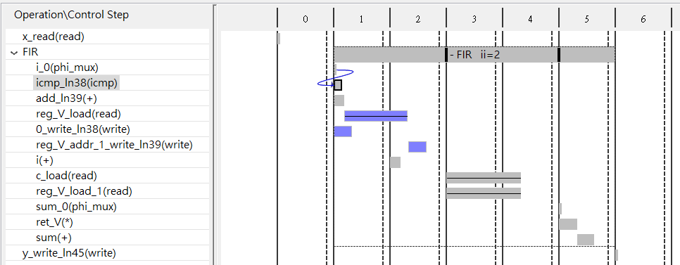
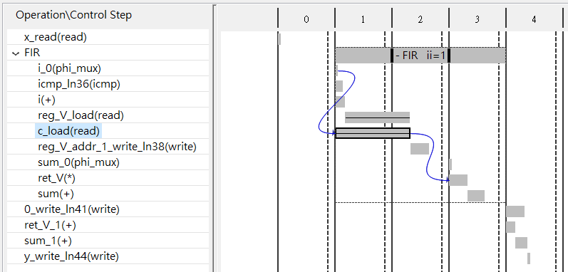
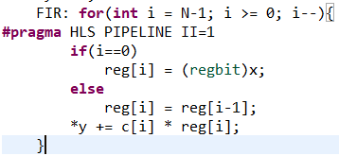
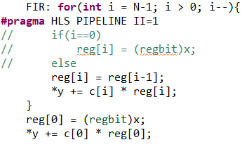
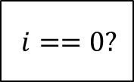
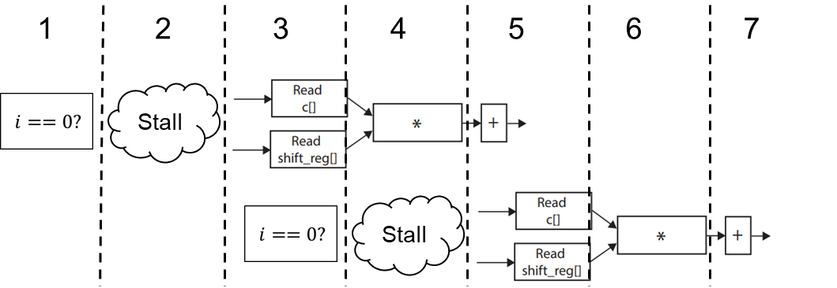
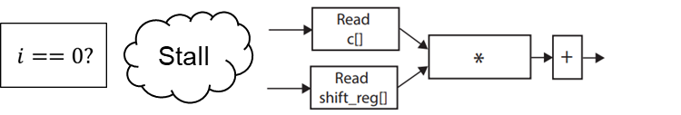

FIR-128 Conditional Statements
Conditional branch would cause control hazard
With if condition
Without if condition
Stall
$$i==0?$$
1
2
3
4
5
6
7
Iteration latency: 5 cycles
Total latency: 260 cycles
FF/LUT: 71/163
Iteration latency: 3 cycles
Total latency: 130 cycles
FF/LUT: 66/159

Slide 9
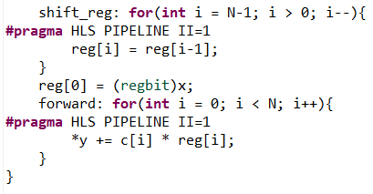
FIR-128 Loop Partition
Unmerge loop then try using loop unrolling
 | Unmerge | Unmerge+unroll | Merged | Merged+unroll | Merged+unroll=2
II/Trip count | 1/128 |  | 1/127 |  | 2/64
Total latency | 260 cycles | 126 cycles | 130 cycles | 126 cycles | 132 cycles
FF/LUT | 72/219 | 1575/5234 | 66/159 | 1575/5222 | 171/257
Two loops
Decompose loops & instances → Almost the same
1) Duplicates hardware in twice. 2) Reduce trip count in half

Slide 10
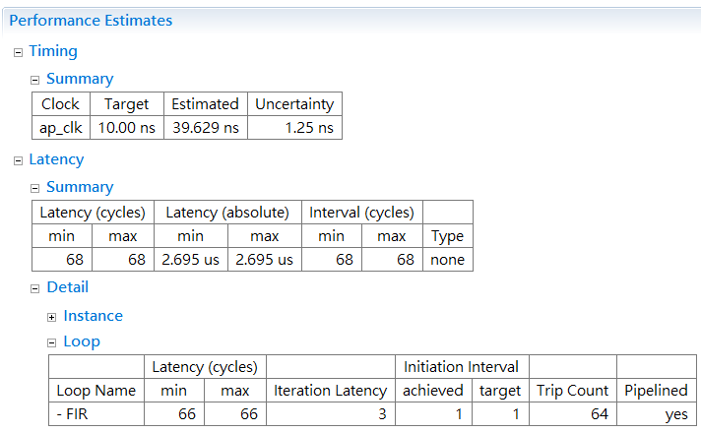
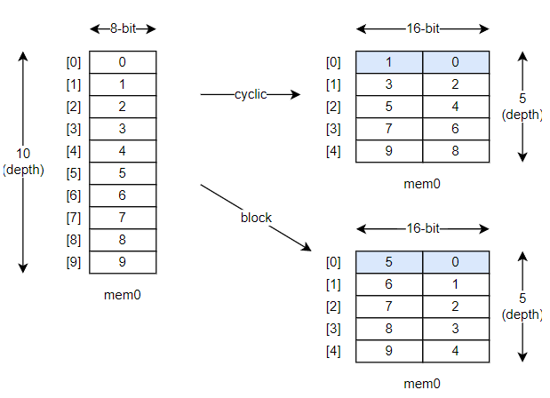
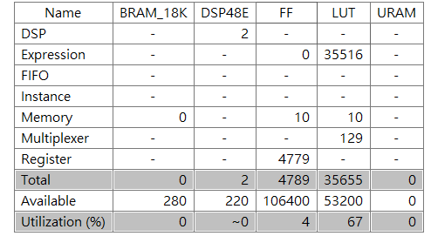
FIR-128 Memory Partition
Reshape the array to fully utilize parallel structure (factor = 2)
Set directive: cyclic ARRAY_RESHAPE factor = 64
May cause timing violation
Achieves II=1

Slide 11
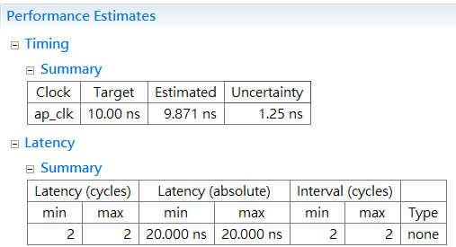
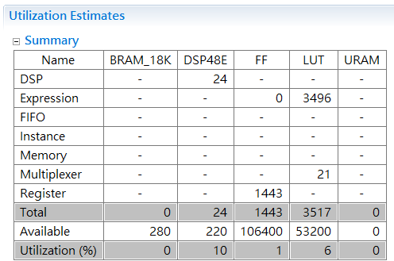
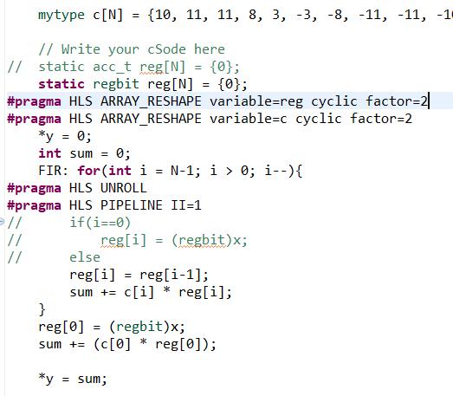
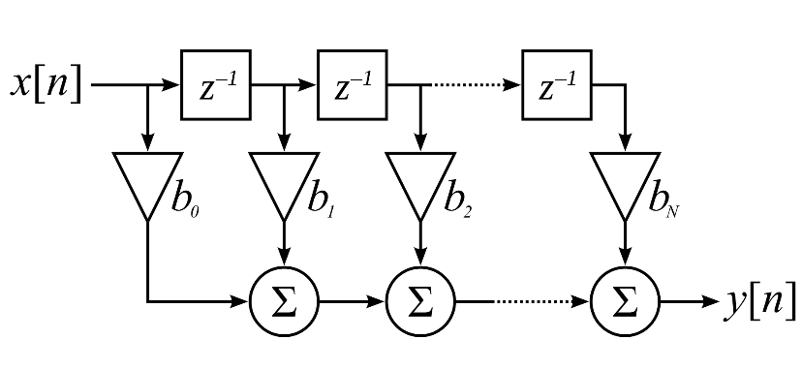
FIR-128 Best Design
Set the correct directives
Achieves direct from of FIR filter
Decent latency and FF/LUT usage

Slide 12
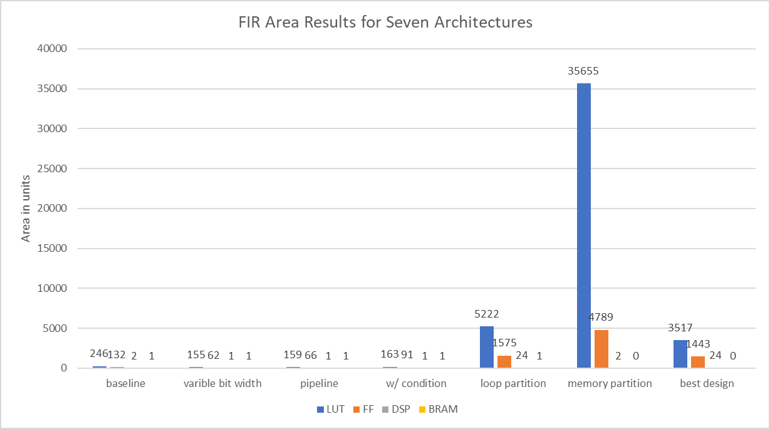
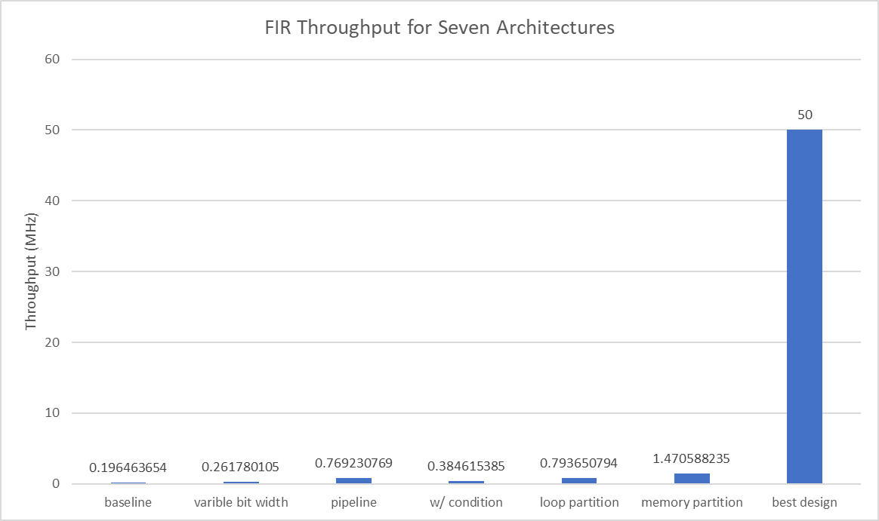

Comparison and Conclusion
For the first 4 optimization methods
Roughly the same area and low throughput
Partition methods
Loop partition has reasonable utilization
Characteristics of the best design
Expand whole circuit and ideally partition memory achieves highest throughput

Slide 13
Question Answering
Why data type can affect total latency?
Char operation is simpler than int operation, thus decreases iteration latency and increase throughput
As pipelining II increases, at what value would it not make sense anymore?
When II reaches the iteration latency. The HLS would automatically removes the stall cycles.

