Slide 1


High Level Synthesis
Nov 3, 2022
LabB: Discrete Fourier Transform (DFT)
Presenter: Yi-Chen Chu
Advisor: Prof. Jiin Lai​
Graduate Institute of Electronics Engineering, National Taiwan University

Slide 2


DFT Algorithm
DFT
Real
Image

Slide 3
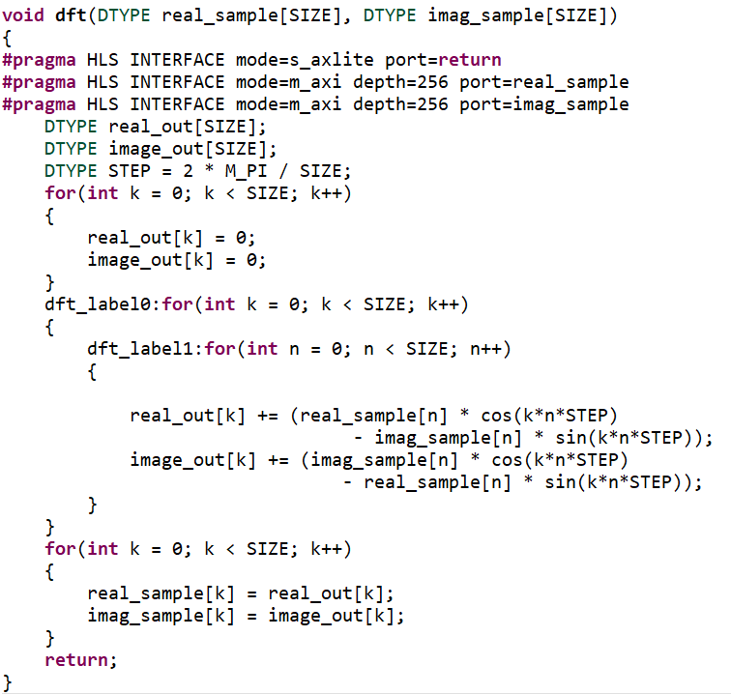
DFT-256 Software Implementation
Possible improvement
Sin, Cos lookup table
Storage minimization
Pipeline II = 1
Initialization
Two Loop
Calculation
In-place
DFT

Slide 4
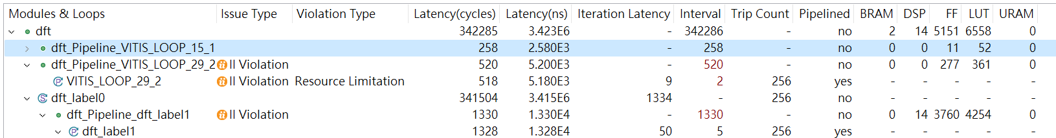
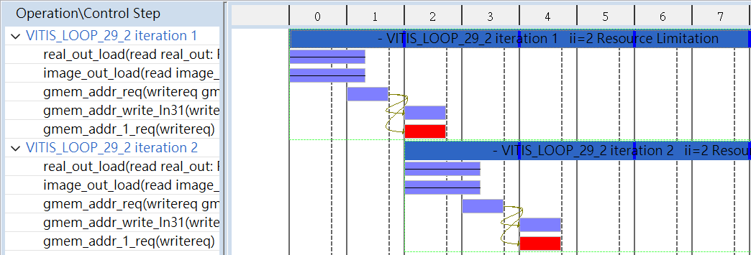
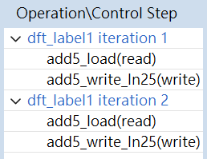
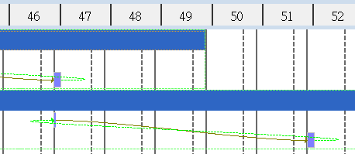
DFT-256 Direct-mapped Design
Performance
Inner pipeline loop: 50 + 5 * 256 = 1330
Outer loop: 256 * 1334 = 341504
Two II violation
Resource Limitation, II=2
Memory Dependency, II=5

Slide 5
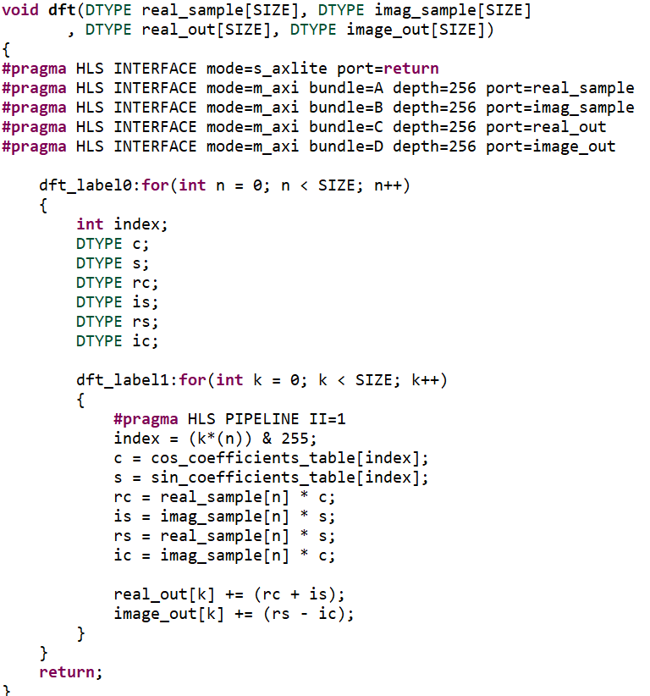

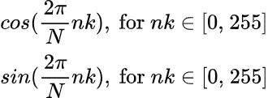
Cosine, Sine Lookup Table
From DFT
Look up table

Slide 6
Storage Minimization
Separate I/O ports -> reduce two BRAM

Slide 7
Pipeline II = 1
Use different m_axi adapter
No resource limitation
Loop interchange
No memory dependence
#pragma HLS PIPELINE II = 1

Slide 8
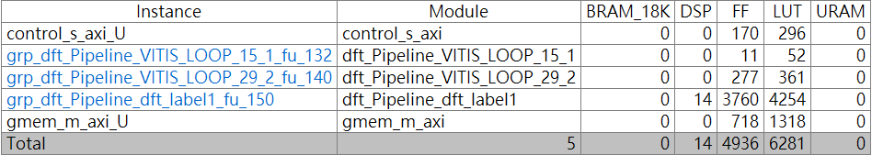
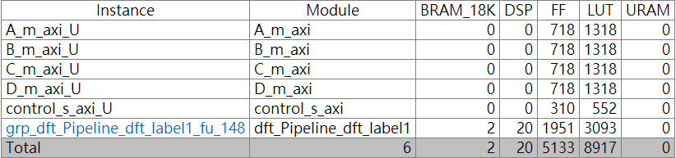
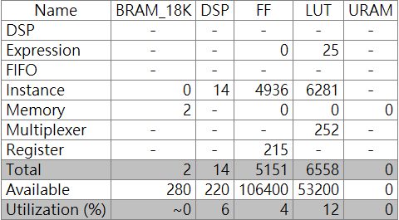
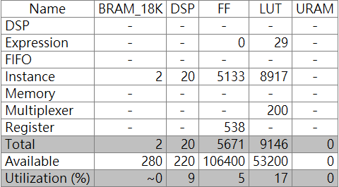
DFT-256 Optimization
Performance
342285 cycles -> 73480 cycles
Utilizations and instances

Slide 9
Comparison and Conclusion
Comparison Table
Conclusion
By using pipeline method, process time can be reduced by 4.65x.
By loop interchange and more m_axi adapter, II violation can be solved.
 |  | Direct-mapped | This work
Process Time (cycles) |  | 342285 | 73480
I/O ports |  | 2 | 4
m_axi Adapter |  | 1 | 4
Hardware Resource | BRAM | 2 (Data buffer) | 2 (cos, sin coefficient buffer)
 | DSP | 14 | 20
 | FF | 5151 | 5671
 | LUT | 6558 | 9246

Slide 10
Questions
How to calculate loop latency?
Loop latency = Iteration latency + (N - 1) * Initiation Interval
What is “bundle” in #pragma HLS INTERFACE mode=m_axi port=in bundle=gem_0
Groups function arguments into AXI interface ports.

