Slide 1
LabB Cholesky Factorization
Speaker: Chi-Tse Huang
Adiviser: Prof. Jiin Lai
Date: 2022/10/26

Slide 2
Outline
Introduction to Cholesky Factorization
Vitis HLS
Baseline
Pipeline
Pipeline – II = 1
Datatype
Unroll
Vitis Runtime

Slide 3
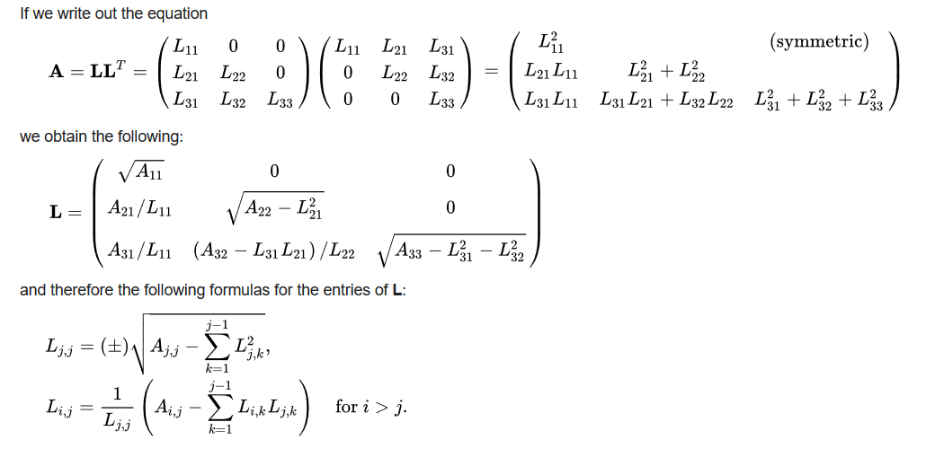
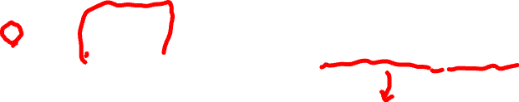
Introduction to Cholesky Factorization
Decomposition of a Hermitian, positive-definite matrix
the product of a lower triangular matrix and its conjugate transpose.
Application
Monte Carlo simulations

Slide 4
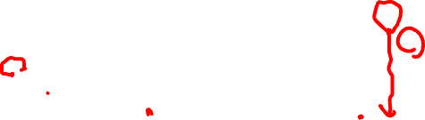
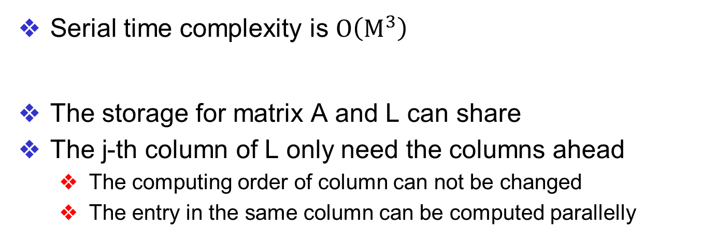


Cholesky Algorithm
$$j$$
$$i$$
Matrix A
Sharing
Matrix L
Serial time complexity is $O\left(M^{3}\right)$
The storage for matrix A and L can share
The j-th column of L only need the columns ahead
The computing order of column can not be changed
The entry in the same column can be computed parallelly
Stage | Dimension | 16 | 32 | 64 | 128 | 256 | 512
CPU code | Run Time (CPU) | 1us | 3us | 25us | 195sus | 1694us | 16013us

Slide 5
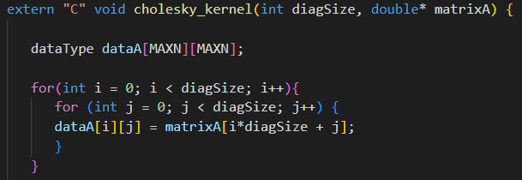
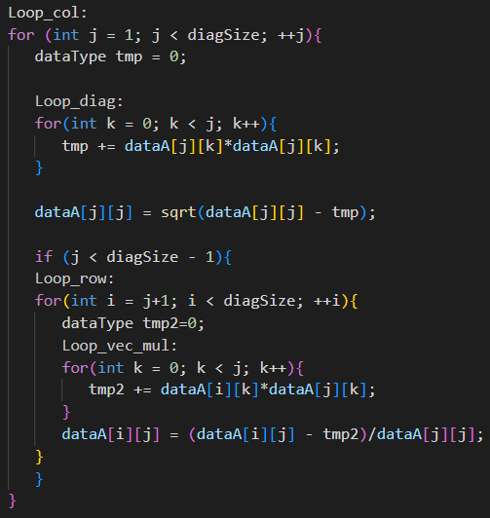
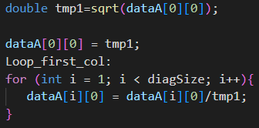
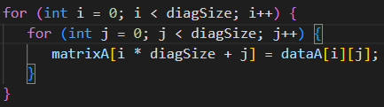

Baseline
Cal Cols
Read Data
Cal First Col
Write Data

Slide 6
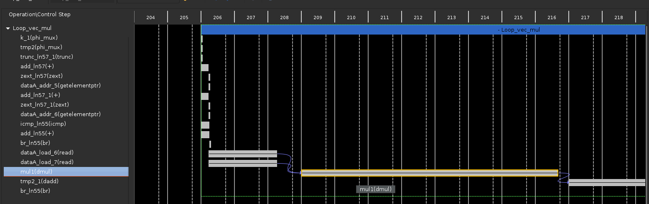
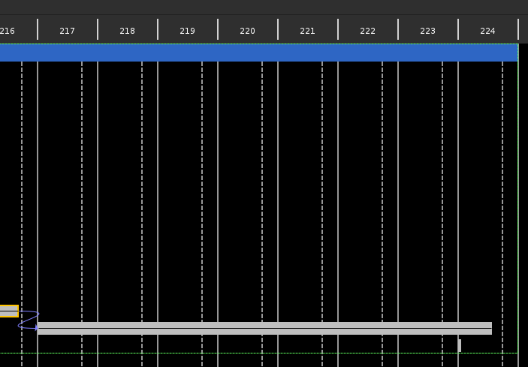
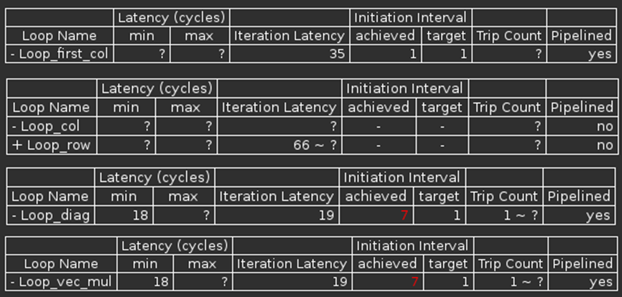
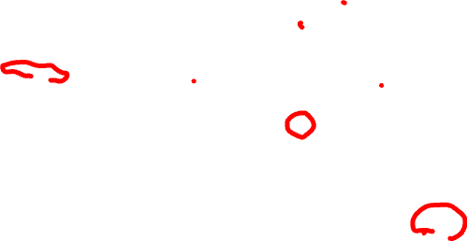
Pipeline -- II=7
Multiplication IL=8
Addition IL=8
Read Data IL=3
Data dependency
Create more buffer to separate the operations in the different loop

Slide 7
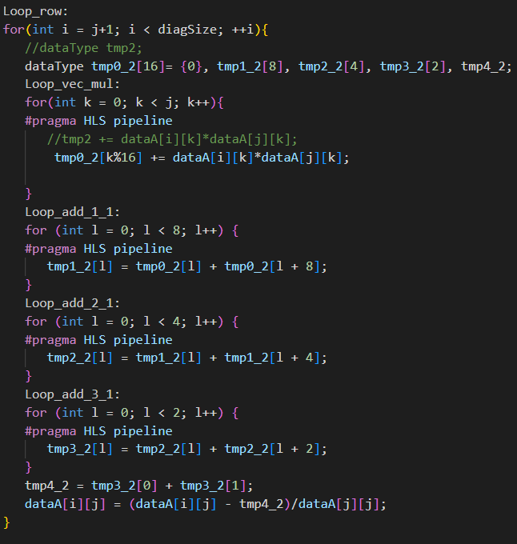
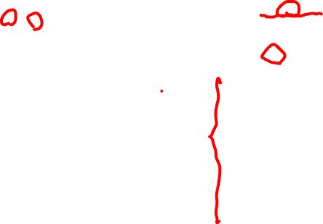
Pipeline – Buffer
Buffer Size > Original II
→ II should can be reduced to 1
tmp0
Adder Tree
tmp
Assign different times of loop to different buffers
Break the data dependency
Use pipelined adder tree to calculate the final sum.

Slide 8

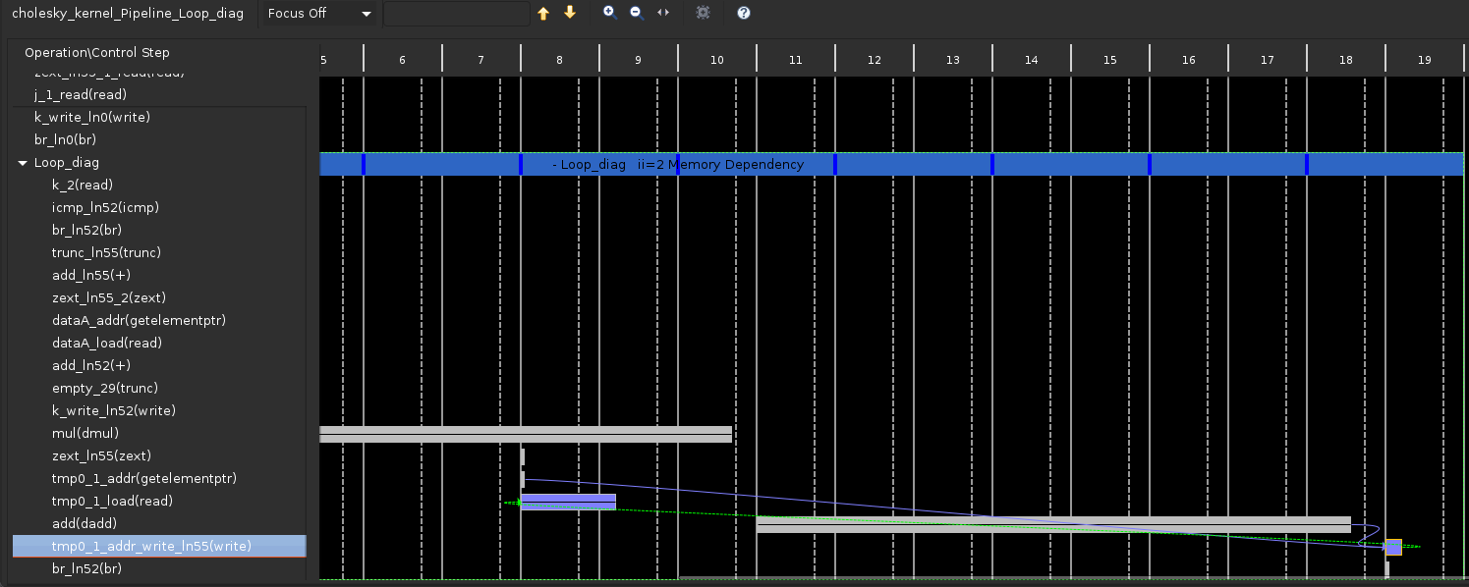
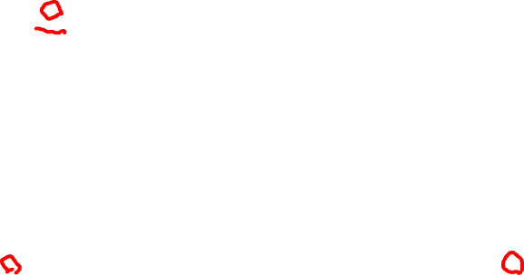
Pipeline – Buffer
Buffer Size = 8
Need at least 9 buffers to reduce II=1 → 16 buffers

Slide 9







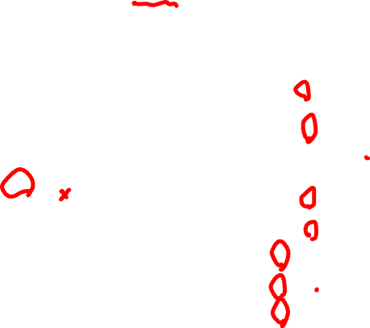
Pipeline – II=2 / II=1
Buffer Size = 8
Name | BRAM_18K | DSP | FF | LUT
DSP | 0 | 0 | 0 | 0
Expression | 0 | 0 | 0 | 298
FIFO | 0 | 0 | 0 | 0
Instance | 0 | 20 | 4041 | 4824
Memory | 32 | 0 | 0 | 0
Multiplexer | 0 | 0 | 0 | 1982
Register | 0 | 0 | 1183 | 0
Total | 32 | 20 | 5224 | 7104
Buffer Size = 16
Name | BRAM_18K | DSP | FF | LUT
DSP | 0 | 0 | 0 | 0
Expression | 0 | 0 | 0 | 298
FIFO | 0 | 0 | 0 | 0
Instance | 0 | 20 | 4041 | 4824
Memory | 32 | 0 | 0 | 0
Multiplexer | 0 | 0 | 0 | 1982
Register | 0 | 0 | 1183 | 0
Total | 32 | 20 | 5224 | 7104

Slide 10
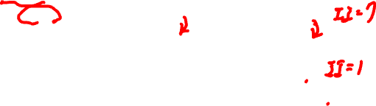
Comparison
Stage | Dimension | 16 | 32 | 64 | 128 | 256 | 512
CPU code | Run Time (CPU) | 1us | 3us | 25us | 195sus | 1694us | 16013us
Module1 Baseline Pipeline Off | Vitis EMU-HW (Kernel) | 75us | 434us | 3110us | 23477us
Module2 Pipeline | Vitis EMU-HW (kernel) | 53us | 241us | 1436us | 9826us
Module2 Pipeline Adder Tree=8 II=2 | Vitis EMU-HW (kernel) | 60us | 226us | 1010us | 5212us | 30204us
Module2 Pipeline Adder Tree=16 II=1 | Vitis EMU-HW (kernel) | 67us | 245us | 1059us | 4809us
-58%
-51%
When dimension=16, the overhead of pipelined adder tree is larger than the benefits.
As the dimension grows
The benefit of pipelining is more significant
Separating the loop into the 16 groups can make II=1
More groups(>16) induce more overhead

Slide 11
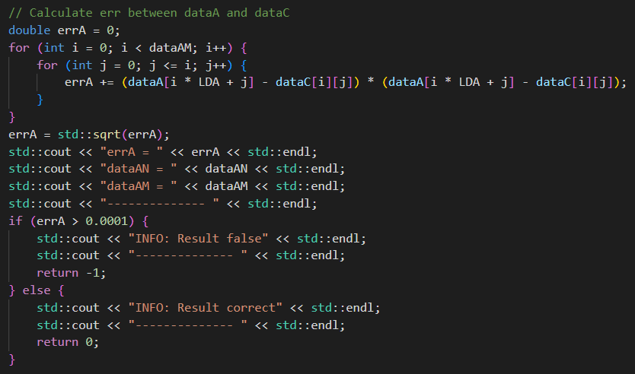
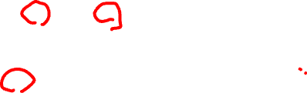
Datatype
Error Tolerance
Host program can tolerance some error
Convert the double variable to the float variable
Reduce the precision

Slide 12

Comparison
Double
Name | BRAM_18K | DSP | FF | LUT | URAM
DSP | 0 | 0 | 0 | 0 | 0
Expression | 0 | 0 | 0 | 298 | 0
FIFO | 0 | 0 | 0 | 0 | 0
Instance | 0 | 20 | 4041 | 4824 | 0
Memory | 32 | 0 | 0 | 0 | 0
Multiplexer | 0 | 0 | 0 | 1982 | 0
Register | 0 | 0 | 1183 | 0 | 0
Total | 32 | 20 | 5224 | 7104 | 0
Dimension | 16 | 32 | 64 | 128
Pipeline Off | 75us | 434us | 3110us | 23477us
Pipeline On II=7 | 53us | 241us | 1436us | 9826us
Float
Name | BRAM_18K | DSP | FF | LUT | URAM
DSP | 0 | 0 | 0 | 0 | 0
Expression | 0 | 0 | 0 | 298 | 0
FIFO | 0 | 0 | 0 | 0 | 0
Instance | 0 | 14 | 2784 | 3406 | 0
Memory | 16 | 0 | 0 | 0 | 0
Multiplexer | 0 | 0 | 0 | 1663 | 0
Register | 0 | 0 | 996 | 0 | 0
Total | 16 | 14 | 3780 | 5367 | 0
Dimension | 16 | 32 | 64 | 128
Pipeline Off | 60us | 285ns | 2094us | 15899us
Pipeline On II=7 | 43us | 198us | 1275us | 9113us

Slide 13
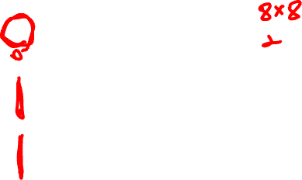
Unroll -- Concept
Splits the matrix L to multiple tiles
Matrix L
Tile 0
Tile 1
Executed Simultaneously
Tile 2
The entries of the same col have no dependencies
Tile 3
NCU=2

Slide 14
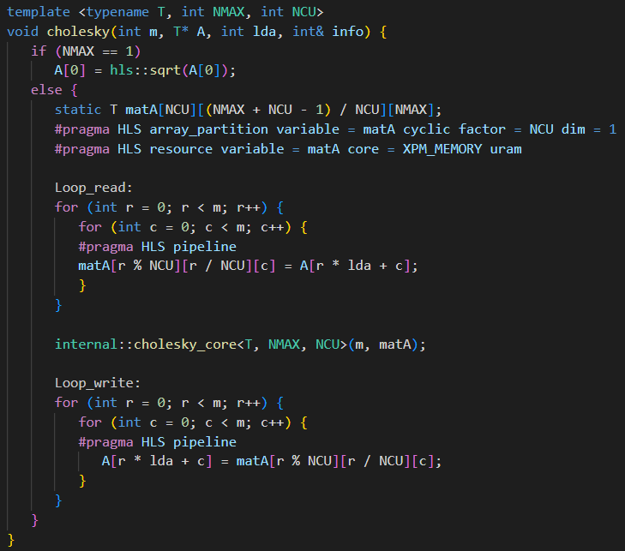
Unroll -- Code
Matrix A Cyclic Partition
Array Partition
Read Data
Cholesky
Write Data

Slide 15
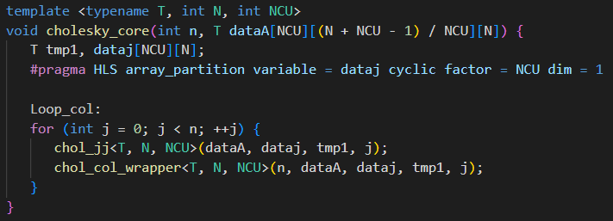
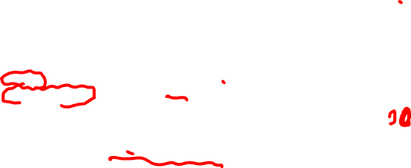
Unroll -- Core
Compute the diagonal entry and store row j
Compute the column entries
Data A has been partition
dataj is to duplicate the j-th row data NCU times

Slide 16
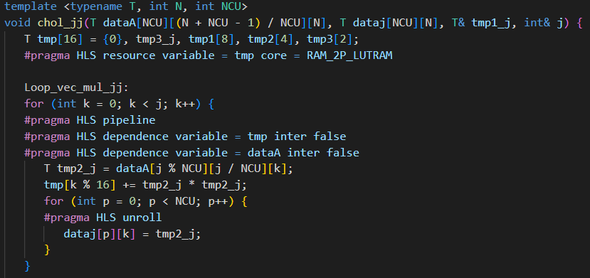
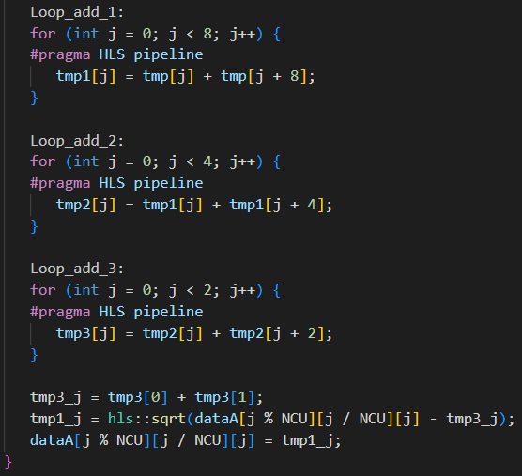
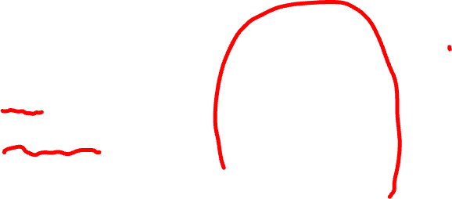
Unroll – chol_jj unit
Store the j-th row for other entries of the same column

Slide 17
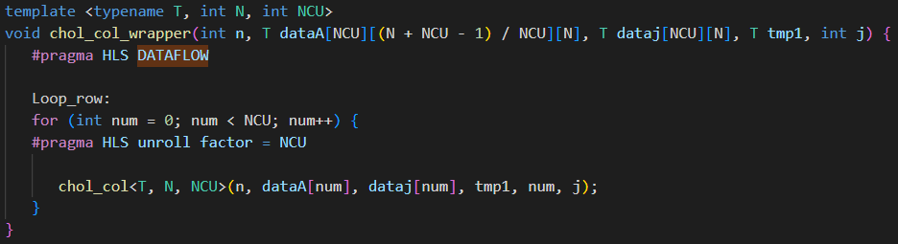
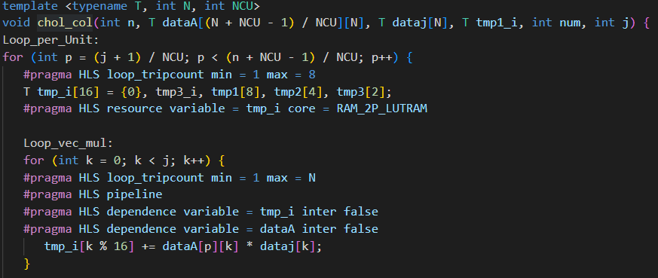
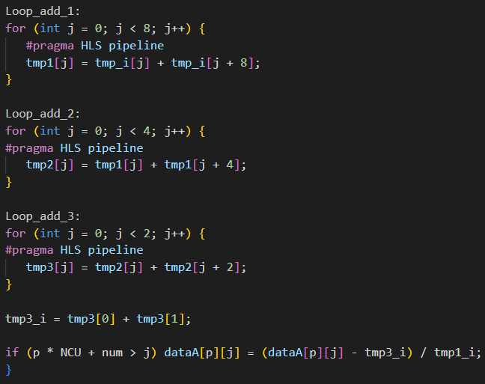

Unroll – chol_col
dataj need to store in advance

Slide 18
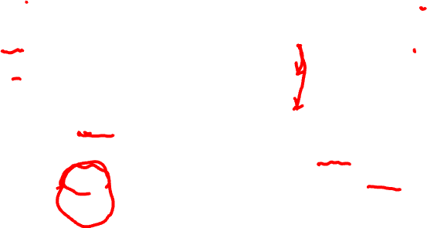
Experimental Result
Stage | Dimension | 16 | 32 | 64 | 128 | 256 | 512
CPU code | Run Time (CPU) | 1us | 3us | 25us | 195sus | 1694us | 16013us
Baseline Pipeline Off | Vitis EMU-HW (Kernel) | 75us | 434us | 3110us | 23477us
Pipeline (II=7) | Vitis EMU-HW (kernel) | 53us | 241us | 1436us | 9826us
Pipeline Adder Tree=8 II=2 | Vitis EMU-HW (kernel) | 60us | 226us | 1010us | 5212us | 30204us
Pipeline Adder Tree=16 II=1 | Vitis EMU-HW (kernel) | 67us | 245us | 1059us | 4809us | 23925us
Unroll Factor=16 | Vitis EMU-HW (kernel) | 19us | 49us | 149us | 543us | 2283us
Unroll Factor=32 | Vitis EMU-HW (kernel) | 20us | 41us | 118us | 393us | 1537us
Unroll Factor=16 | Vitis HW (Run) | 138us | 152us | 304us | 812us | 2824us | 13004us
Unroll Factor=16 | Vitis HW (kernel) | 87us | 102us | 245us | 731us | 2716us | 12912us
After these optimizations, the runtime can be reduced under CPU

