Slide 1
Group 8: Scalable Matrix Multiplication Accelerator
羅允辰, 李冠霈, 王睿瑄
高階合成技術於應用加速-Final Project

Slide 2
Outline
Motivations
Introduction
Optimization Goals
Optimization Models
Hardware Architecture

Slide 3
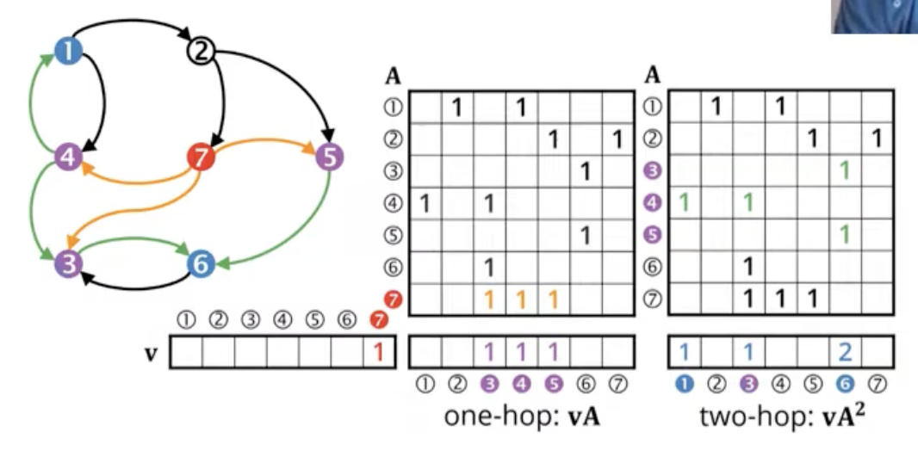
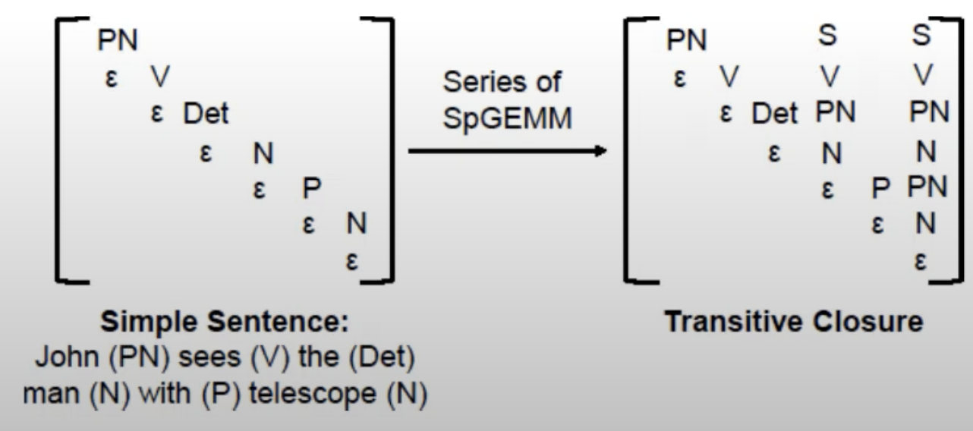
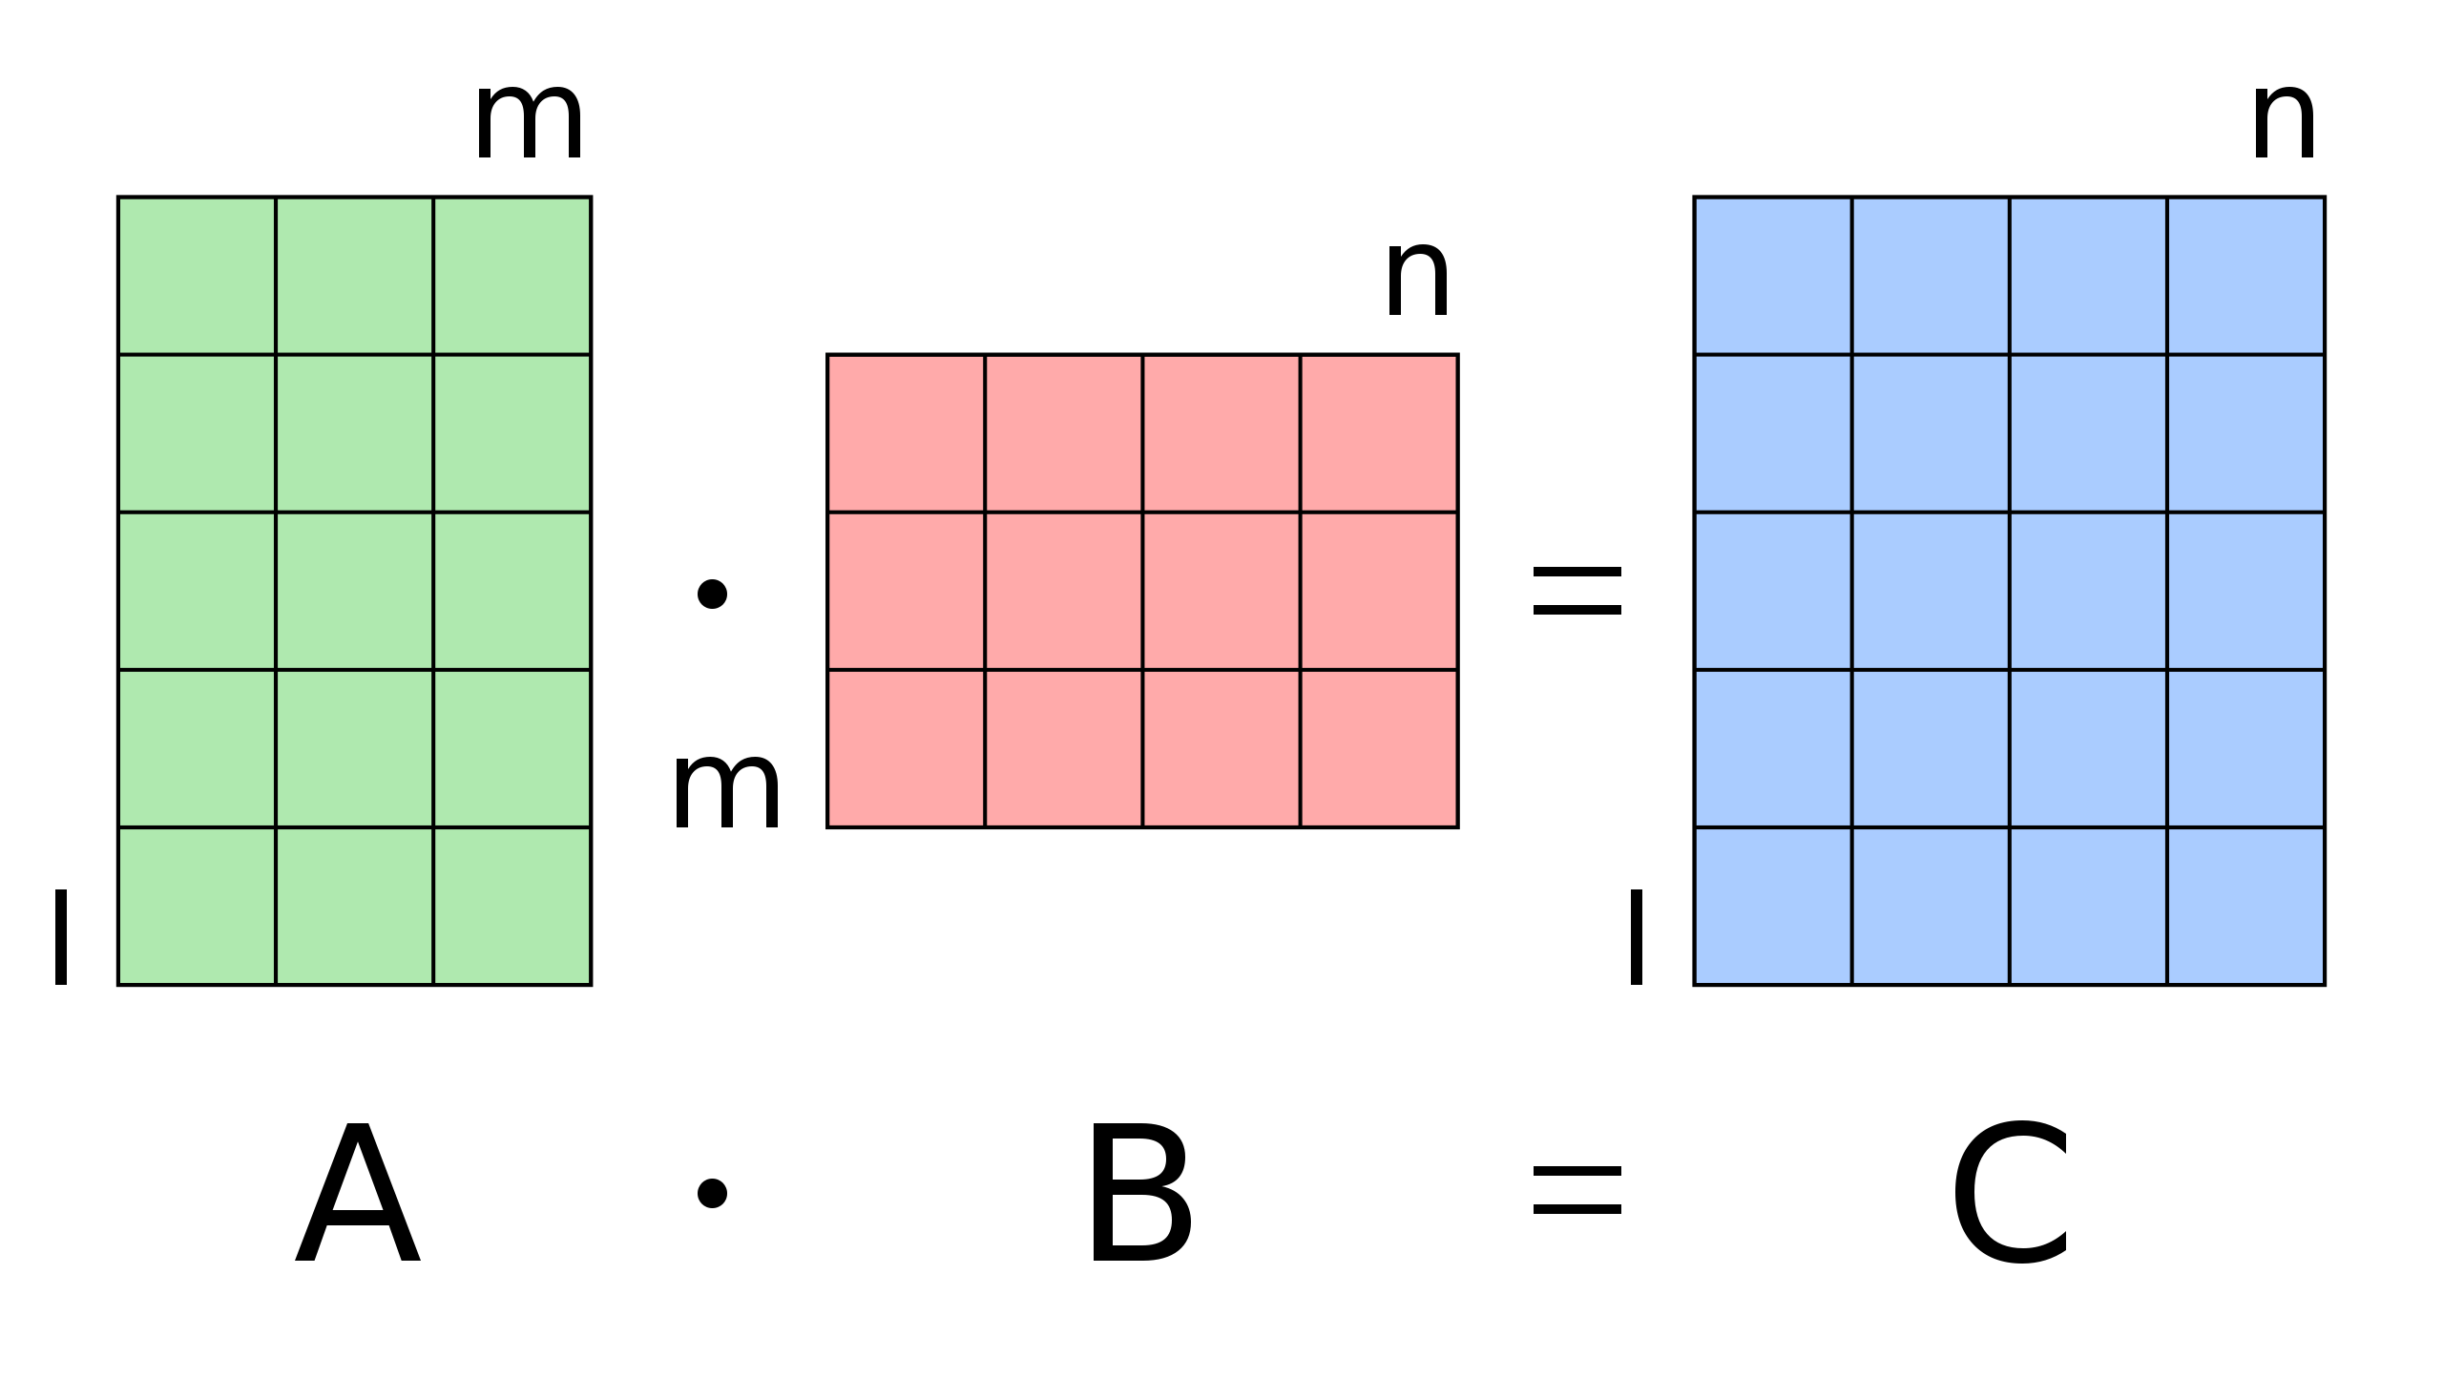
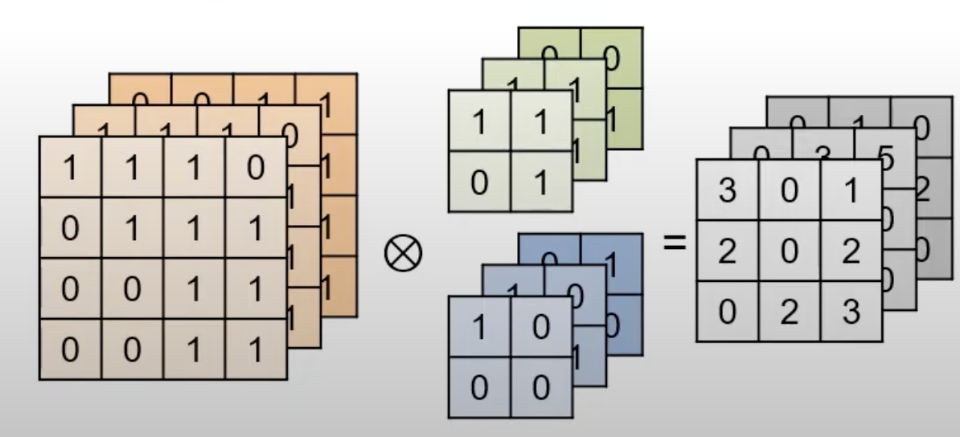
Motivations
Matrix multiplication is the key to wide range of applications
Neural Networks, Graph Traversal, Database, and more
Matrix multiplication is a compute-intensive problem O(N³) and requires larger matrix size
Develop a scalable matrix multiplication FPGA-based accelerator!

Slide 4
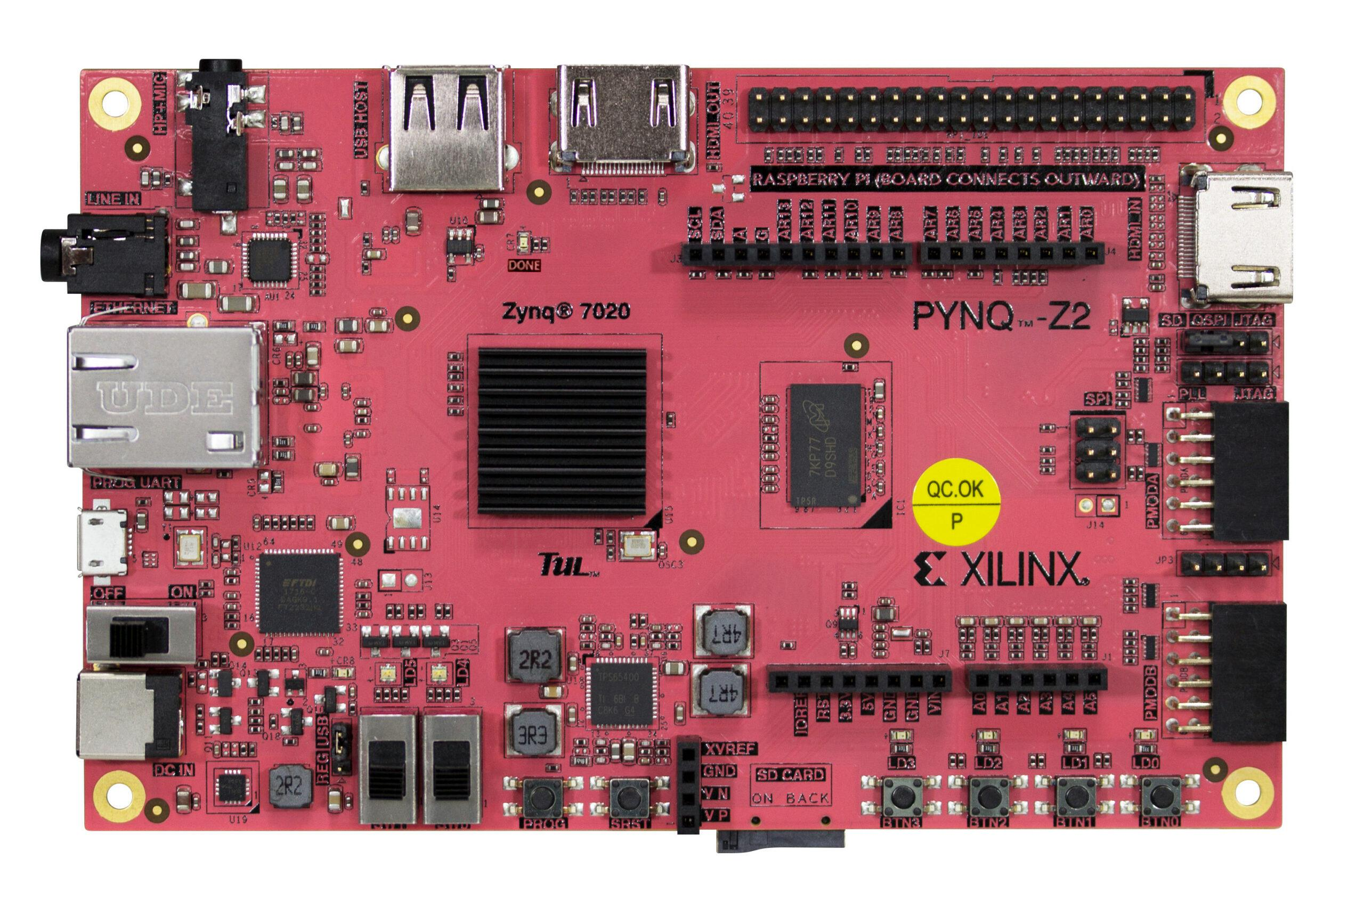
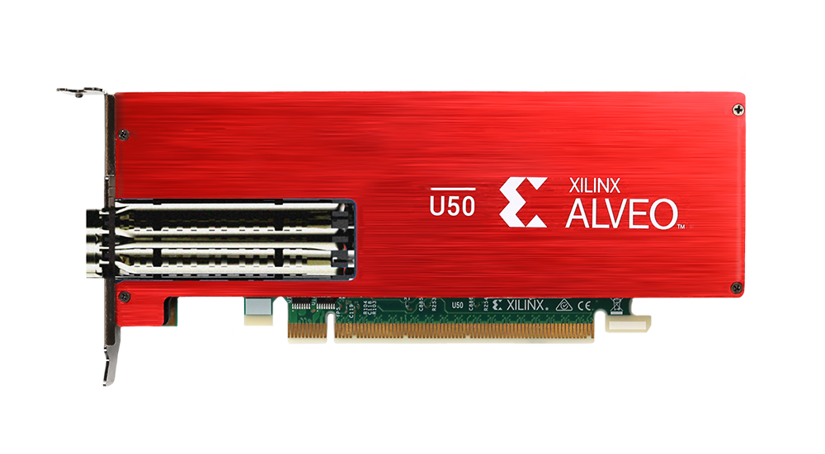
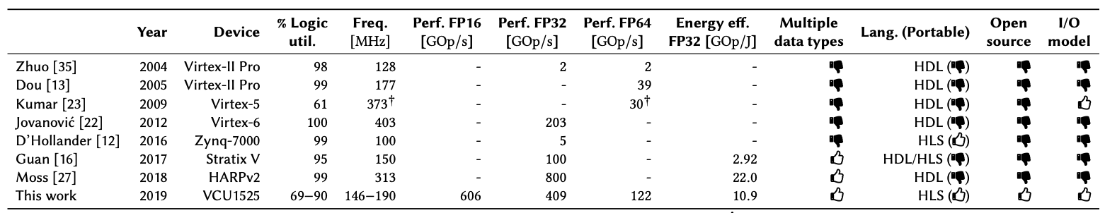
Introduction: What we will do?
Need of HLS-based matrix multiplication
Numerous low-precision and exotic data types
HDL-based accelerators are hard to extend and modify
These designs are not open-source
We want to study the first open-source, HLS-based, FPGA matrix multiplication acceleraor[1] and run it on FPGA
Study the code structure
Deploy the accelerator to U50/PYNZ-Z2
Run extensive experiments to summarize insights
[1] https://github.com/spcl/gemm_hls

Slide 5
Introduction: What we will do?
Need of HLS-based matrix multiplication
Numerous low-precision and exotic data types
HDL-based accelerators are hard to extend and modify
These designs are not open-source
We want to study the first open-source, HLS-based, FPGA matrix multiplication acceleraor[1] and run it on FPGA
Study the code structure
Deploy the accelerator to U50/PYNZ-Z2
Run extensive experiments to summarize insights
(Optional) Further optimize the throughput
[1] https://github.com/spcl/gemm_hls

Slide 6
Optimization Goals
Optimal scheduling should achieve
Highest performance
Lowest number of I/O operations
Use all of the FPGA’s resources
Interesting Insights
Remember to design friendly routing pattern for FPGA
Avoid 1-to-N or N-to-1 topology
Regulate the size of the PEs
More severe in Chiplet-based FPGA

Slide 7
Optimization Models
Computation Model
I/O Model
Resource Model
Algorithm

Slide 8
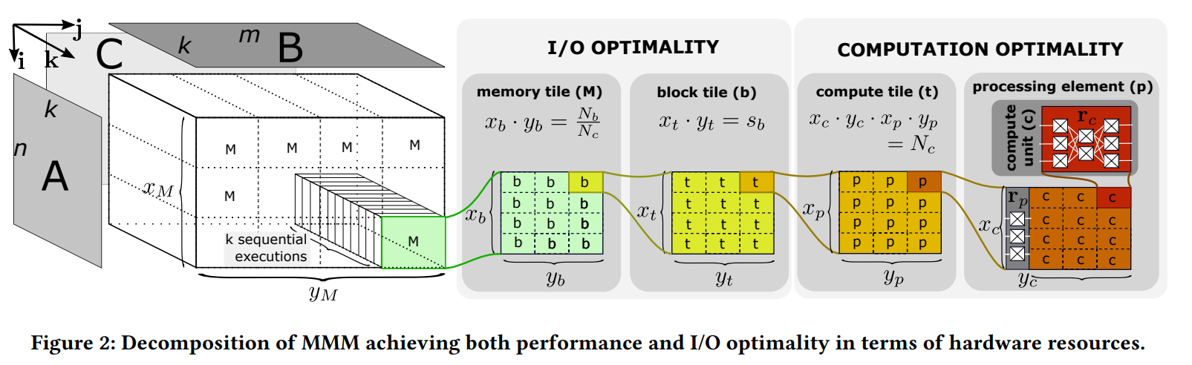

Computation Model
Minimize the total execution runtime -> maximize achieved parallelism
$minimize T = \frac{mult−add ops}{f∙N_{c}}=\frac{F}{f∙N_{c}}=\frac{mnk}{f∙N_{p}∙x_{c}y_{c}}$

Slide 9
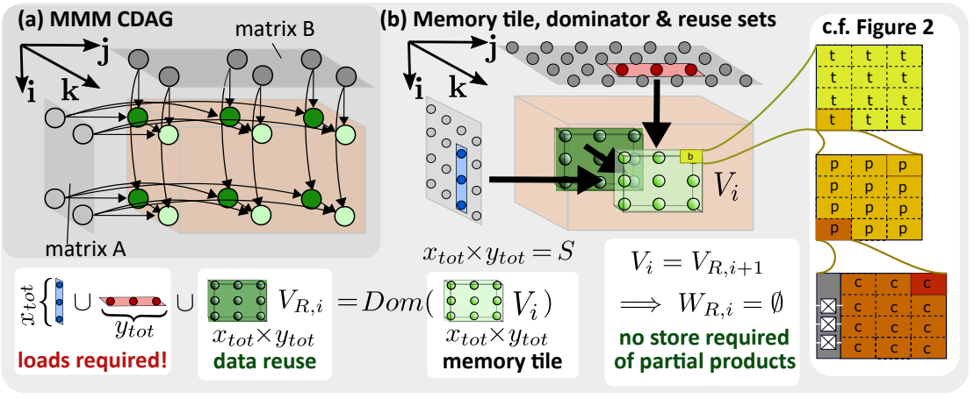

I/O Model
Maximize computational intensity
Input: $m×k$, $k×n$; intermediate partial sum: $mnk$; output: $m×n$

Slide 10

I/O Model
Maximize on-chip memory utilization
$maximize \frac{\left|V_{i}\right|}{\left|Dom\left(V_{i}\right)\right|−\left|V_{R,i}\right|+\left|W_{B,i}\right|}⇒maximize\frac{x_{tot}y_{tot}}{x_{tot}+y_{tot}}$

Slide 11
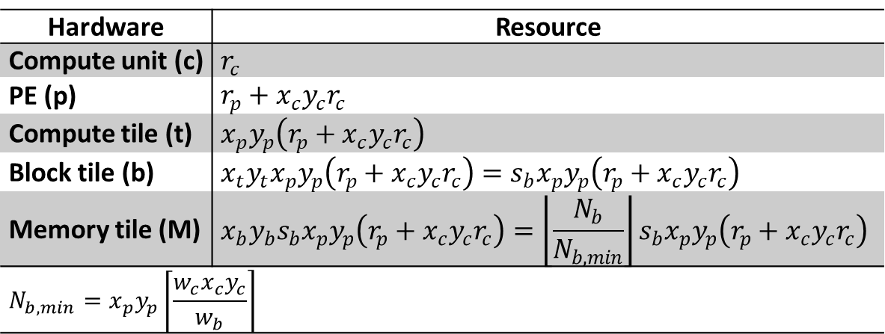
Resource Model
Hardware | Resource
Compute unit (c) | $$r_{c}$$
PE (p) | $$r_{p}+x_{c}y_{c}r_{c}$$
Compute tile (t) | $$x_{p}y_{p}\left(r_{p}+x_{c}y_{c}r_{c}\right)$$
Block tile (b) | $$x_{t}y_{t}x_{p}y_{p}\left(r_{p}+x_{c}y_{c}r_{c}\right)=s_{b}x_{p}y_{p}\left(r_{p}+x_{c}y_{c}r_{c}\right)$$
Memory tile (M) | $$x_{b}y_{b}s_{b}x_{p}y_{p}\left(r_{p}+x_{c}y_{c}r_{c}\right)=\left\lfloor \frac{N_{b}}{N_{b,min}}\right\rfloor s_{b}x_{p}y_{p}\left(r_{p}+x_{c}y_{c}r_{c}\right)$$
$$N_{b,min}=x_{p}y_{p}\left\lceil \frac{w_{c}x_{c}y_{c}}{w_{b}}\right\rceil$$

Slide 12
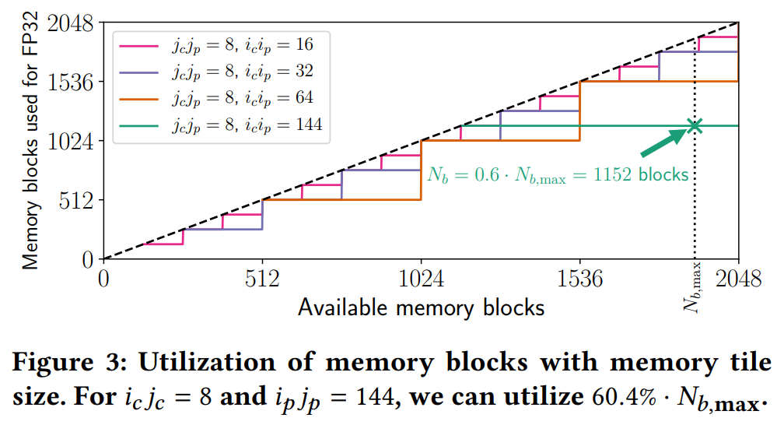

Resource Model
$N_{b}= \left\lfloor \frac{N_{b,max}}{N_{b,min}}\right\rfloor N_{b,min}$
We have
8 compute units
144 PEs
1920 memory block tiles

Slide 13
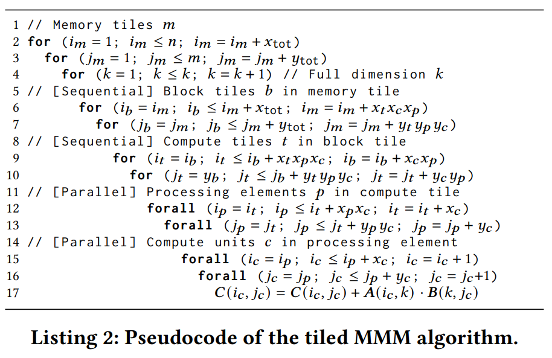
Algorithm

Slide 14

Hardware mapping
Performing $x_{p}\text{·}y_{p}\text{·}x_{c}\text{·}y_{c}$ calculations in parallel

Slide 15
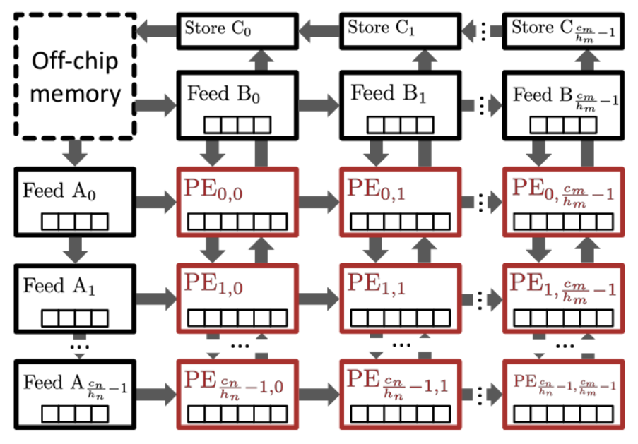


2D grid PE array
Each PE perform $\frac{x_{tot}∙y_{tot}}{N_{p}}$calculations

Slide 16
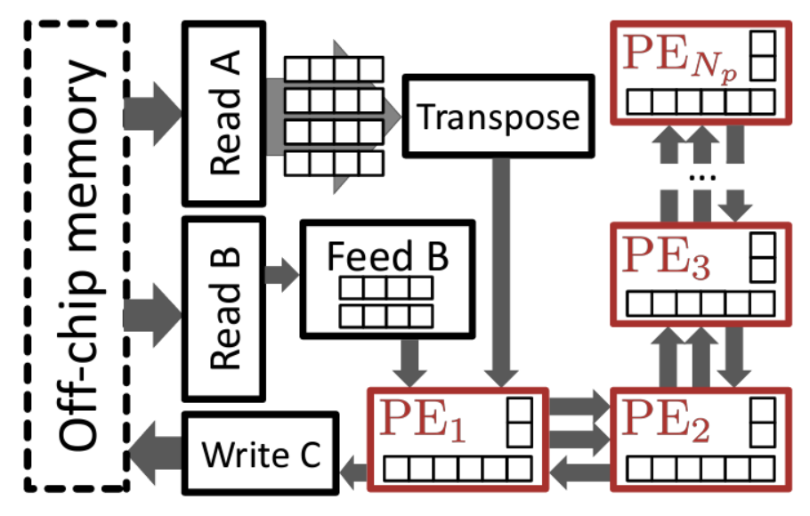
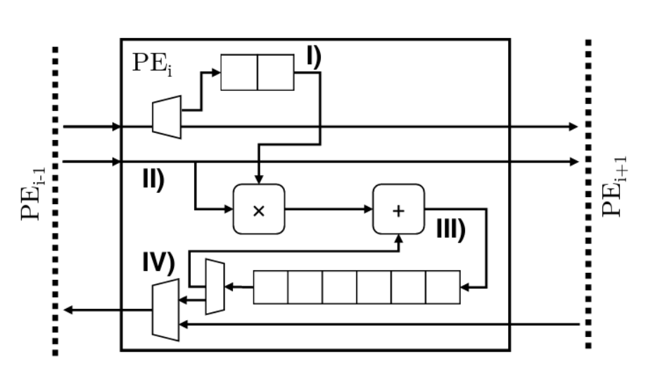

1D PE array
Each PE perform $\frac{x_{tot}∙y_{tot}}{N_{p}}$ calculations and store $\frac{x_{tot}∙y_{tot}}{N_{p}}$ outputs

Slide 17
References
https://github.com/spcl/gemm_hls
Flexible Communication Avoiding Matrix Multiplication on FPGA with High-Level Synthesis

