Slide 1
Using HLS IP in IP integrator fft – use block to integrate IP
107061107 周沛毅

Slide 2
Outline
Key Steps of the Lab #A no.4
Introduction of Algorithm and System
Explanation of HLS Codes
Simulation Results
Performance Analysis

Slide 3
Key Steps of the Lab #A no.4 (1/2)
Construct the IPs of real2xfft and xfft2real in Vitis HLS.
Integrate the above 2 IPs with fft IP in Vivado block design.
Generate output products.
HDL wrapper.
Run Simulation Results in Vivado. (Run 30-40us)

Slide 4
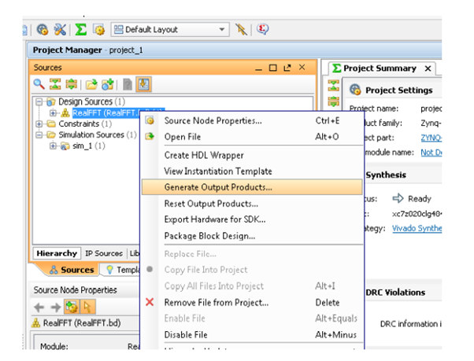
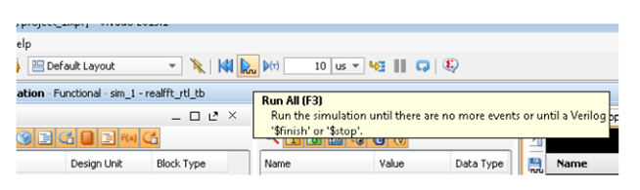
Key Steps of the Lab #A no.4 (2/2)

Slide 5
Outline
Key Steps of the Lab #A no.4
Introduction of Algorithm and System
Explanation of HLS Codes
Simulation Results
Performance Analysis

Slide 6
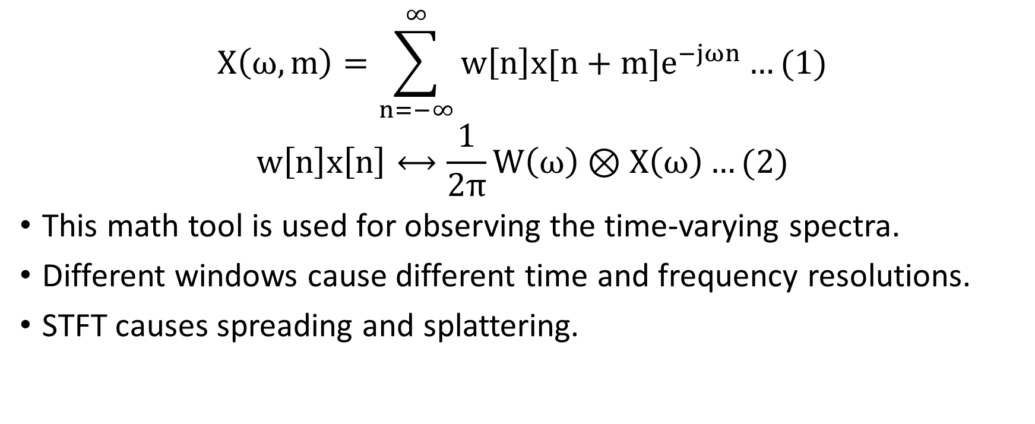
Short-Time Fourier Transform (1/2)
$$X\left(ω,m\right)=\sum_{n=−∞}^{∞}{w\left[n\right]x[n+m]e^{−jωn}}…(1)$$
$$w\left[n\right]x\left[n\right]⟷\frac{1}{2π}W\left(ω\right)⊗X\left(ω\right)…(2)$$
This math tool is used for observing the time-varying spectra.
Different windows cause different time and frequency resolutions.
STFT causes spreading and splattering.

Slide 7
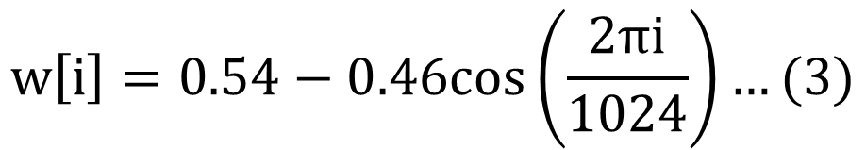
Short-Time Fourier Transform (2/2)
We adopt Hamming window in this lab, whose window size is 1024.
$$w\left[i\right]=0.54−0.46cos\left(\frac{2πi}{1024}\right)…(3)$$

Slide 8
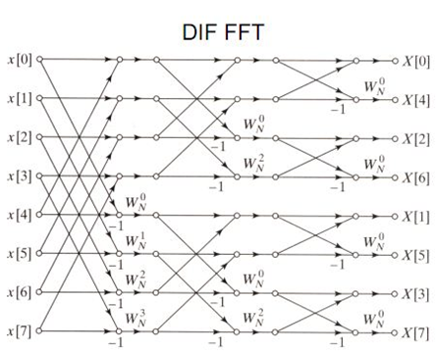
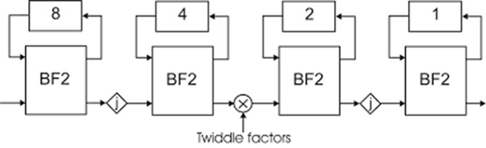

Fast Fourier Transform
$$\left\{\begin{aligned}\left[\begin{matrix}X[0] \\ \begin{matrix}X[1] \\ ⋮ \\ X[\frac{N}{2}−1]\end{matrix}\end{matrix}\right]=\left[\begin{matrix}Y[0] \\ \begin{matrix}Y[1] \\ ⋮ \\ Y[\frac{N}{2}−1]\end{matrix}\end{matrix}\right]+\left[\begin{matrix}1 & e^{−j\frac{2π}{N}×1} & \begin{matrix}… & e^{−j\frac{2π}{N}×(\frac{N}{2}−1)}\end{matrix}\end{matrix}\right]\left[\begin{matrix}Z[0] \\ \begin{matrix}Z[1] \\ ⋮ \\ Z[\frac{N}{2}−1]\end{matrix}\end{matrix}\right] \\ \left[\begin{matrix}X[\frac{N}{2}] \\ X[\frac{N}{2}+1] \\ \begin{matrix}⋮ \\ X[N−1]\end{matrix}\end{matrix}\right]=\left[\begin{matrix}Y[0] \\ \begin{matrix}Y[1] \\ ⋮ \\ Y[\frac{N}{2}−1]\end{matrix}\end{matrix}\right]−\left[\begin{matrix}1 & e^{−j\frac{2π}{N}×1} & \begin{matrix}… & e^{−j\frac{2π}{N}×(\frac{N}{2}−1)}\end{matrix}\end{matrix}\right]\left[\begin{matrix}Z[0] \\ \begin{matrix}Z[1] \\ ⋮ \\ Z[\frac{N}{2}−1]\end{matrix}\end{matrix}\right]\end{aligned}\right.…(3)$$
Twiddle factor
+/-
Bit-reverse
Notes:
<提點重點>
1.Twiddle factor
2.+/-
3.Bit-reverse

Slide 9
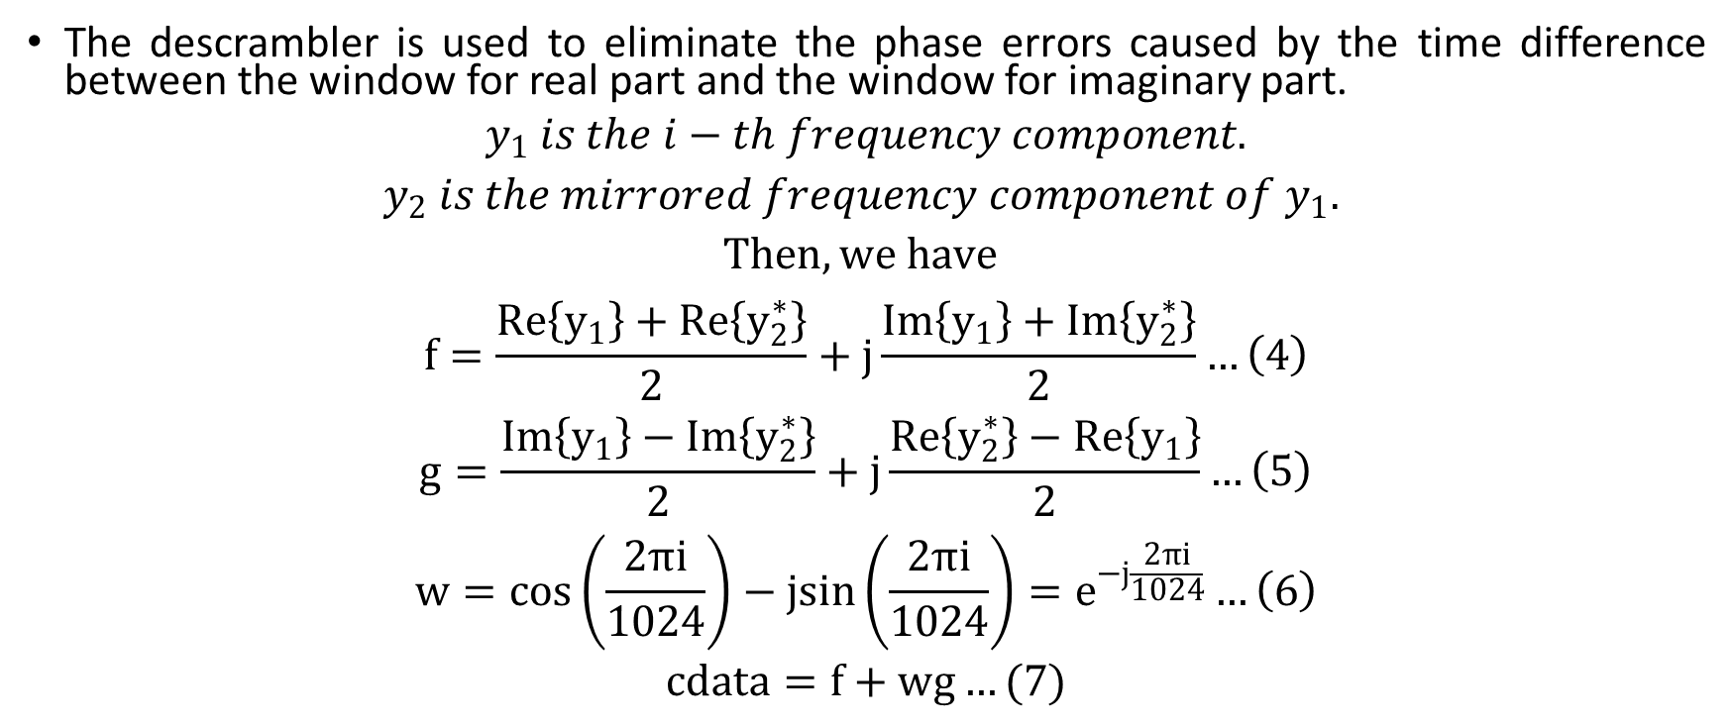
Descrambler
The descrambler is used to eliminate the phase errors caused by the time difference between the window for real part and the window for imaginary part.
$$y_{1} is the i−th frequency component.$$
$$y_{2} is the mirrored frequency component of y_{1}.$$
$$Then, we have$$
$$f=\frac{Re\left\{y_{1}\right\}+Re\left\{y_{2}^{∗}\right\}}{2}+j\frac{Im\left\{y_{1}\right\}+Im\left\{y_{2}^{∗}\right\}}{2}…\left(4\right)$$
$$g=\frac{Im\left\{y_{1}\right\}−Im\left\{y_{2}^{∗}\right\}}{2}+j\frac{Re\left\{y_{2}^{∗}\right\}−Re\left\{y_{1}\right\}}{2}…\left(5\right)$$
$$w=\cos\left(\frac{2πi}{1024}\right)−jsin\left(\frac{2πi}{1024}\right)=e^{−j\frac{2πi}{1024}}…\left(6\right)$$
$$cdata=f+wg…(7)$$

Slide 10
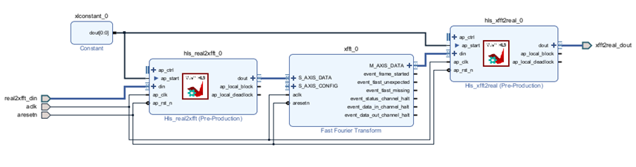
System Architecture

Slide 11
Outline
Key Steps of the Lab #A no.4
Introduction of Algorithm and System
Explanation of HLS Codes
Simulation Results
Performance Analysis

Slide 12
The Testbench on HLS
Generate signals
real2xfft
fft (in HLS, we need to do fft by ourselves)
xfft2real

Slide 13
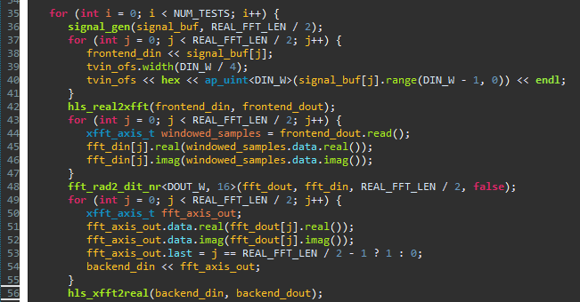

Slide 14
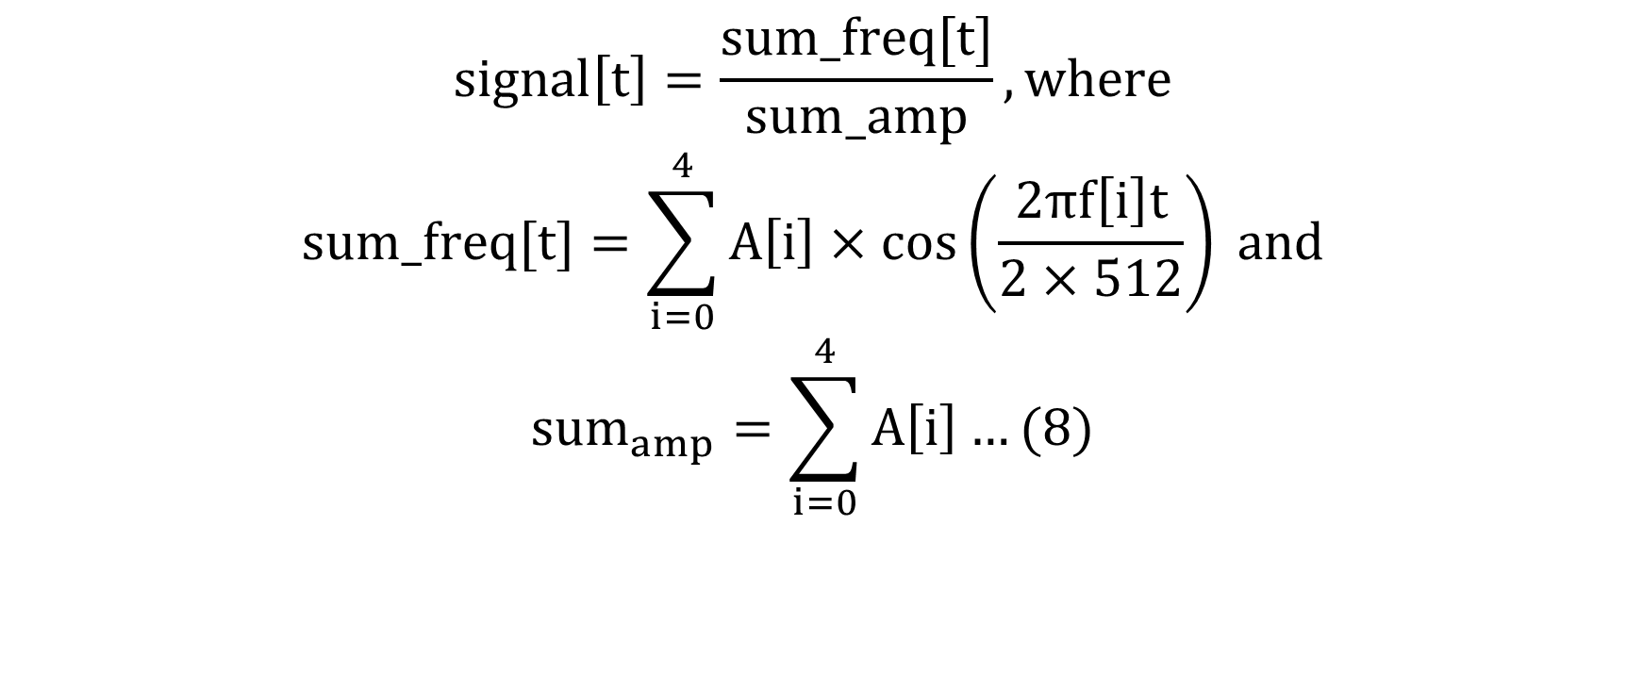
Generate Signals
$$signal\left[t\right]=\frac{sum_freq[t]}{sum_amp}, where$$
$$sum_freq[t]=\sum_{i=0}^{4}{A\left[i\right]×\cos\left(\frac{2πf\left[i\right]t}{2×512}\right)} and$$
$${sum}_{amp}=\sum_{i=0}^{4}{A\left[i\right]}…(8)$$

Slide 15
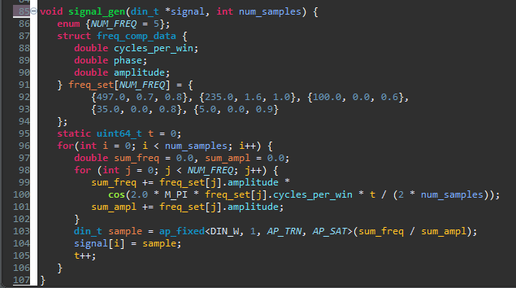

Slide 16
The Function real2xfft
AXI Stream protocols
Two subfunctions : sliding_win_1in2out and window_fn

Slide 17
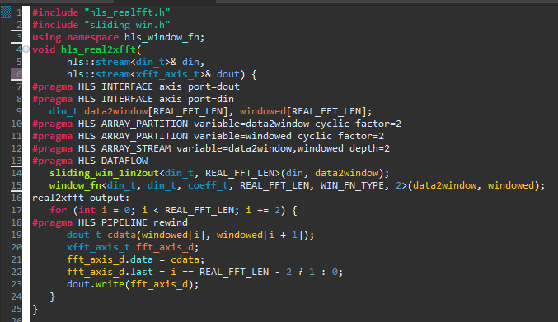

Slide 18
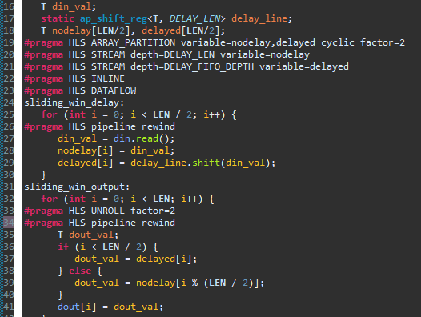

Slide 19
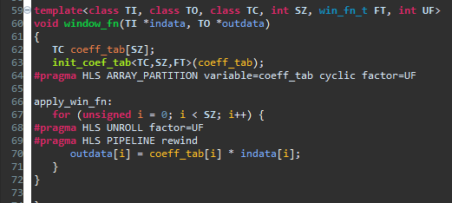

Slide 20
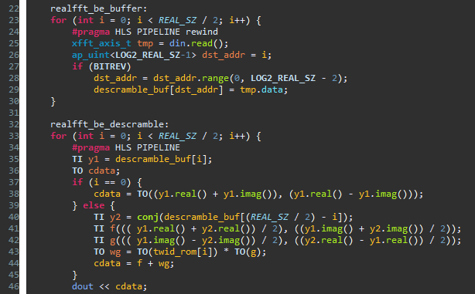

Slide 21
Outline
Key Steps of the Lab #A no.4
Introduction of Algorithm and System
Explanation of HLS Codes
Simulation Results
Performance Analysis

Slide 22
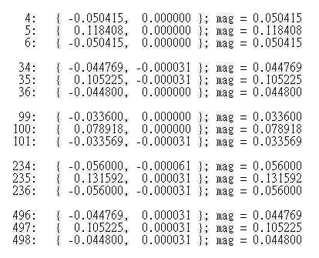
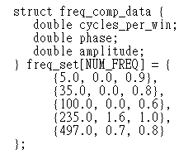
CSim Simulation Results

Slide 23
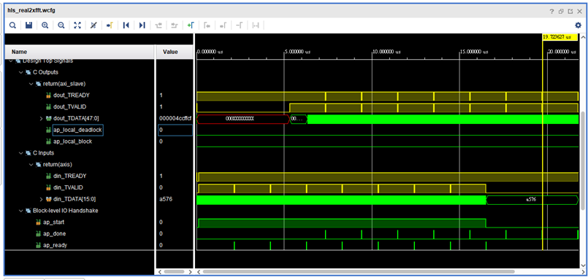
CoSim Waveforms (Front-End)

Slide 24
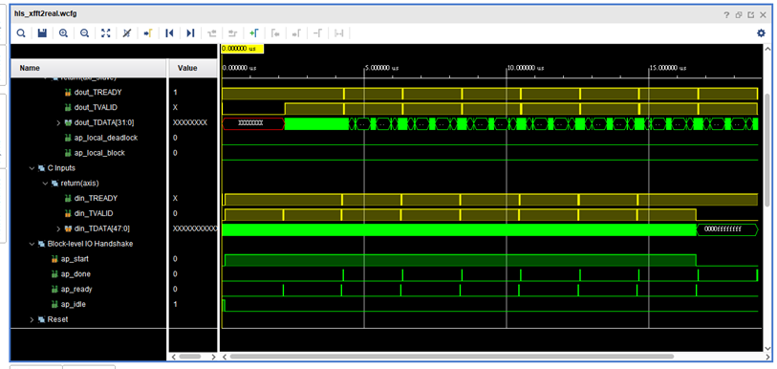
CoSim Waveforms (Back-End)

Slide 25
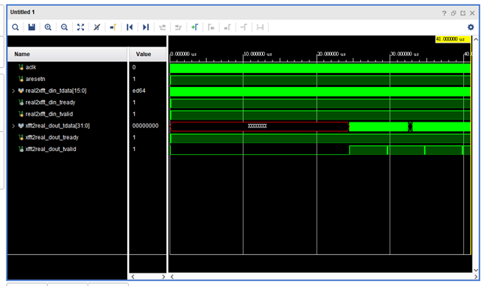
Waveforms on Vivado

Slide 26
Outline
Key Steps of the Lab #A no.4
Introduction of Algorithm and System
Explanation of HLS Codes
Simulation Results
Performance Analysis

Slide 27
Hardware Utilization of real2xfft
Name | BRAM_18K | DSP | FF | LUT | URAM
DSP | - | - | - | - | -
Expression | - | - | 0 | 26 | -
FIFO | 4 | - | 640 | 312 | -
Instance | 2 | 2 | 881 | 724 | -
Memory | 4 | - | 64 | 0 | 0
Multiplexer | - | - | - | 36 | -
Register | - | - | 4 | - | -
Total | 10 | 2 | 1589 | 1098 | 0
Available | 280 | 220 | 106400 | 53200 | 0
Utilization(%) | 3 | ~0 | 1 | 2 | 0

Slide 28
Hardware Utilization of xfft2real
Name | BRAM_18K | DSP | FF | LUT | URAM
DSP | - | - | - | - | -
Expression | - | - | 0 | 42 | -
FIFO | - | - | - | - | -
Instance | - | 4 | 1638 | 11909 | -
Memory | 12 | - | 192 | 0 | 0
Multiplexer | - | - | - | 72 | -
Register | - | - | 8 | - | -
Total | 12 | 4 | 1838 | 12023 | 0
Available | 280 | 220 | 106400 | 53200 | 0
Utilization(%) | 4 | 1 | 1 | 22 | 0

Slide 29
Latency Reports
Latency(cycles) |  | Latency(absolute) |  | Interval |  | Pipeline Type
min | max | min | Max | min | Max
1549 | 1552 | 6.196 | 6.208 | 512 | 512 | dataflow
Latency(cycles) |  | Latency(absolute) |  | Interval |  | Pipeline Type
min | max | min | Max | min | max
1041 | 1042 | 4.164 | 4.168 | 530 | 530 | dataflow

Slide 30
Reference
老師上課講義
WORKBOOK內容

