Slide 1

EE5218 Application Acceleration with High-Level Synthesis Lab#A No.6 VitisTM Analyzer
Speaker: Jie-Yun Ma
Date: Mar. 30th, 2022

Slide 2
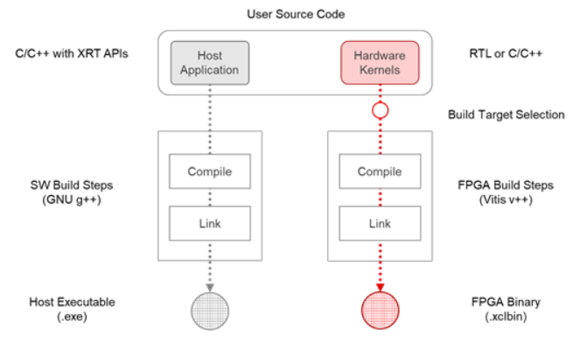
Outline
For individual kernels, Compile Summary.
For device binary, Link Summary.
For application execution, Run Summary.

Slide 3
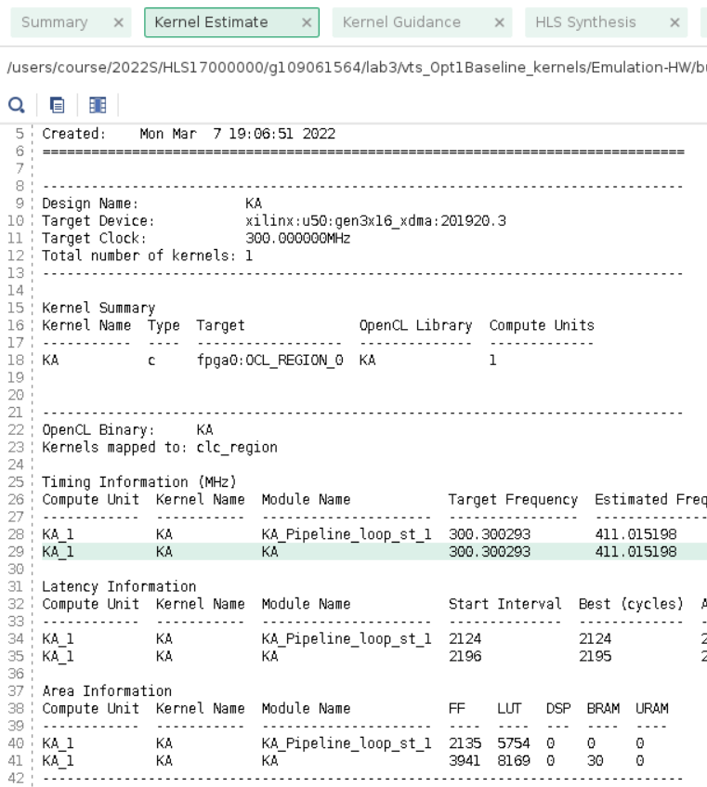
Open summary – Compile summary
$k.xo.compile_summary
Generated by V++
Kernels Estimate
Kernel Guidance
HLS Synthesis
compilation log

Slide 4
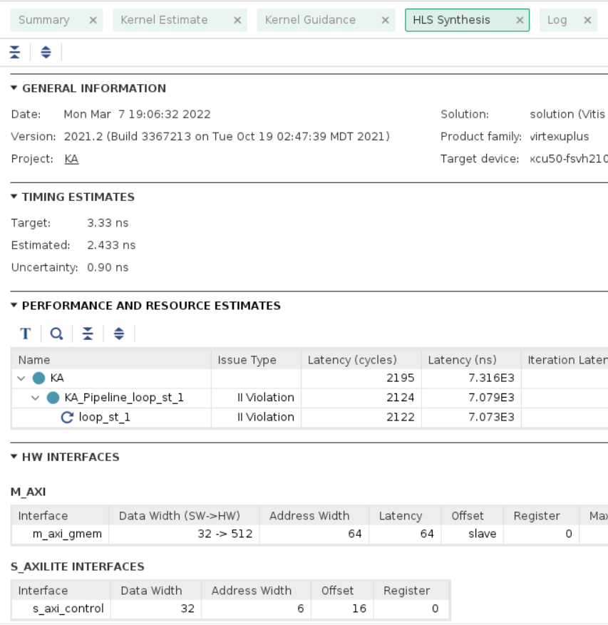
Open summary – Compile summary
$k.xo.compile_summary
Generated by V++
Kernels Estimate
Kernel Guidance
HLS Synthesis
compilation log

Slide 5
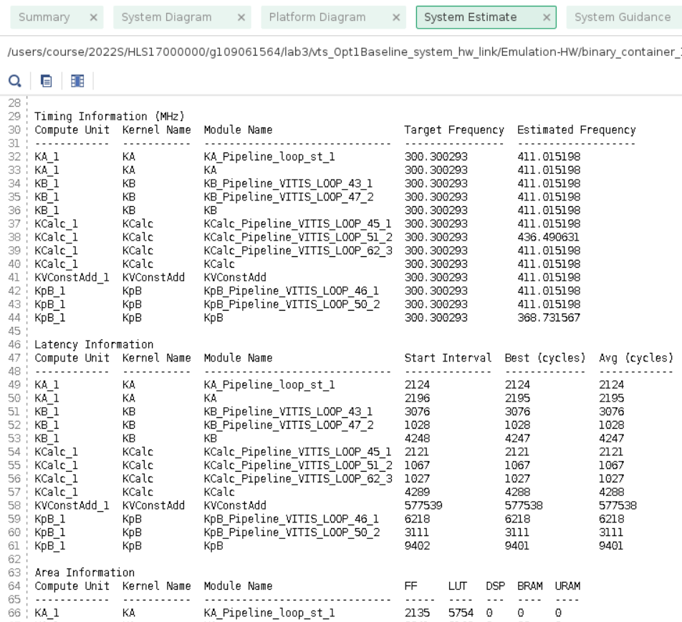
Open summary – Link Summary
$cname.xclbin.link_summary
Generated by V++ during linking and creation of the .xclbin
System Estimation
System Guidance
Timing Summary
Utilization
Platform and System Diagrams
Linking log

Slide 6
Open summary – Link Summary
$cname.xclbin.link_summary
Generated by V++ during linking and creation of the .xclbin
System Estimation
System Guidance
Timing Summary
Utilization
Platform and System Diagrams
Linking log

Slide 7
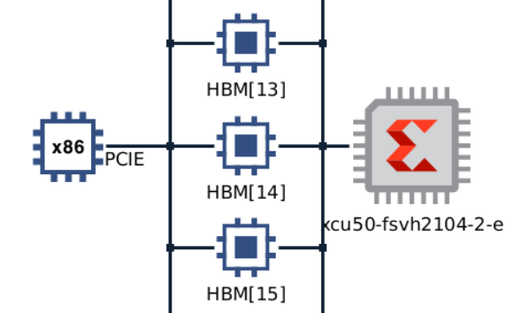

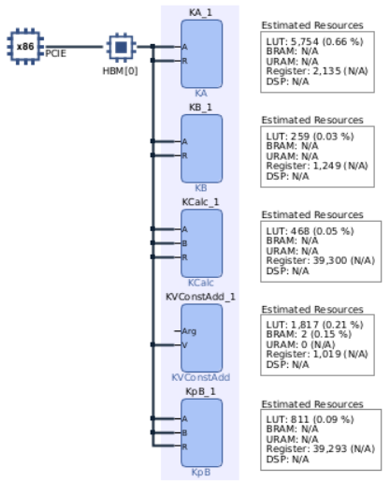
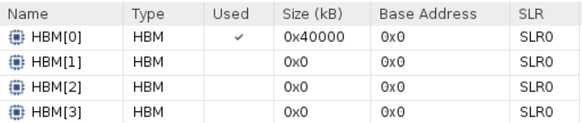
Open summary – Link Summary
$cname.xclbin.link_summary
Generated by V++ during linking and creation of the .xclbin
System Estimation
System Guidance
Timing Summary
Utilization
Platform and System Diagrams
Linking log

Slide 8
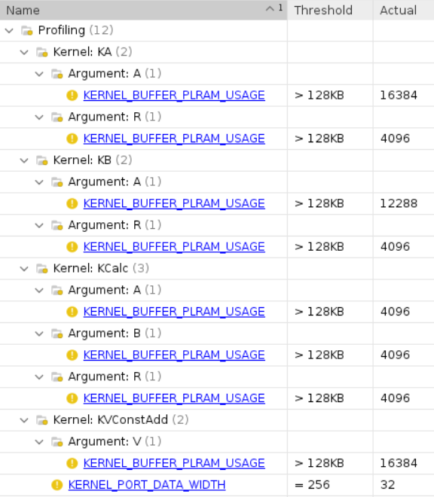
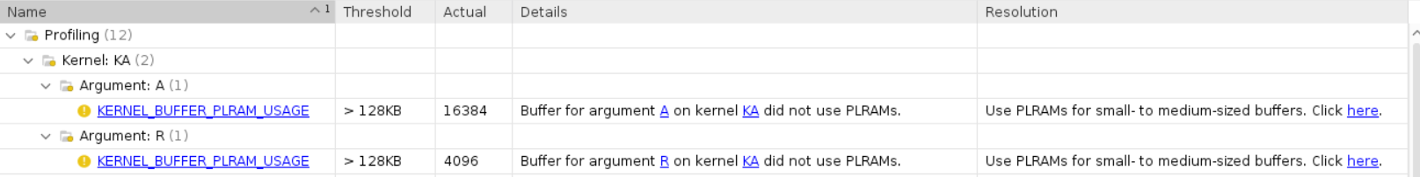
Open summary – Run summary
xrt.run_summary
Created by XRT library
Guidance
Profile Summary
Timeline Trace
Platform and System Diagrams
Simulation Waveforms

Slide 9
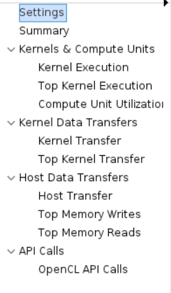
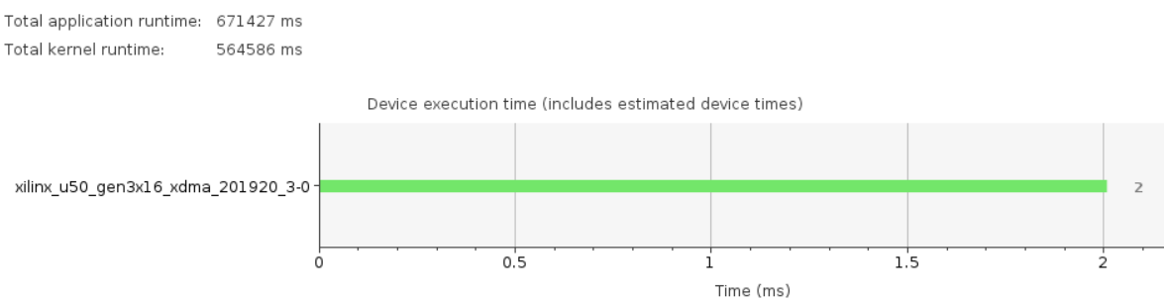
Open summary – Run summary
xrt.run_summary
Created by XRT library
Guidance
Profile Summary
Timeline Trace
Platform and System Diagrams
Simulation Waveforms

Slide 10
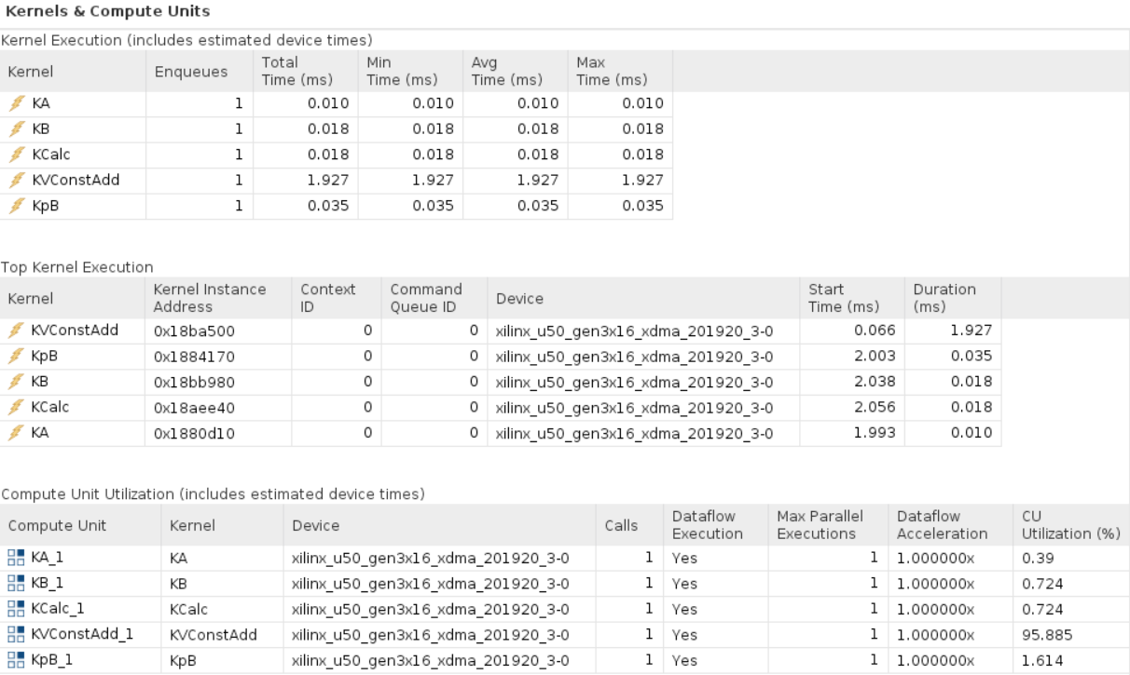
Open summary – Run summary

Slide 11
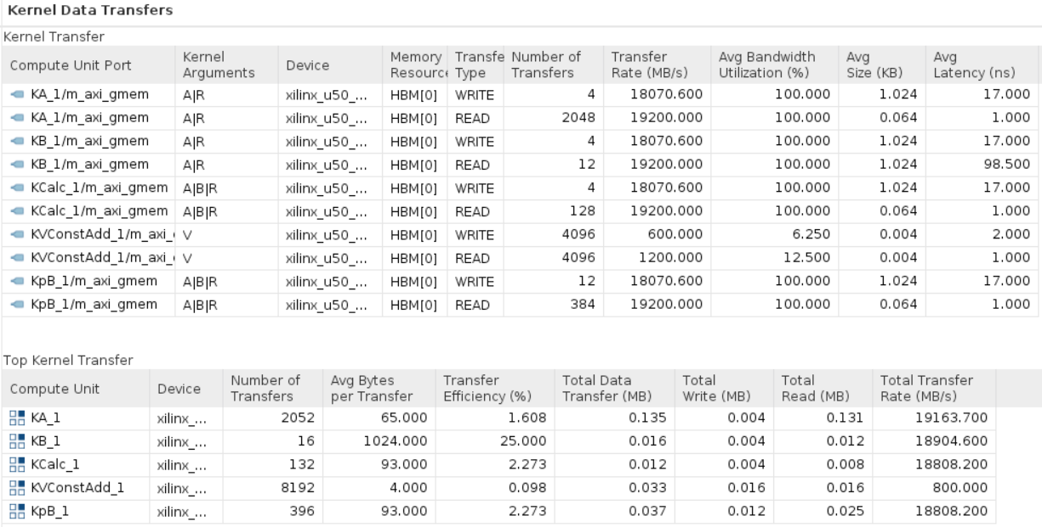
Open summary – Run summary

Slide 12
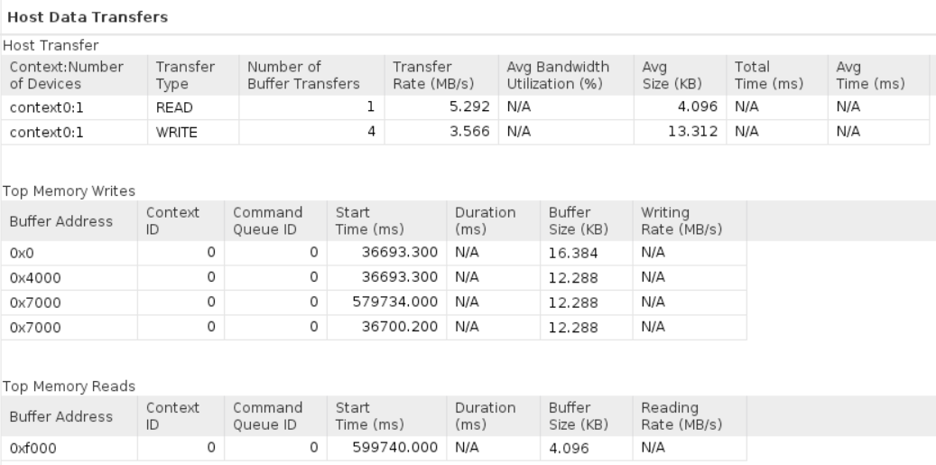
Open summary – Run summary

Slide 13
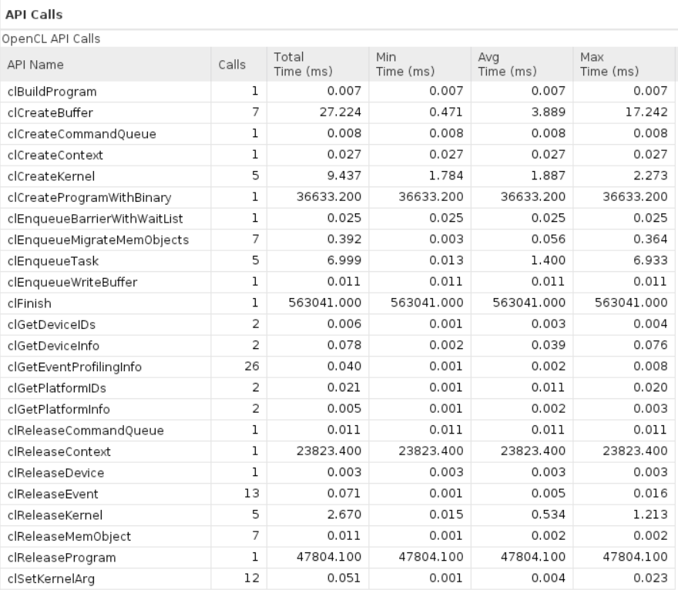
Open summary – Run summary

Slide 14
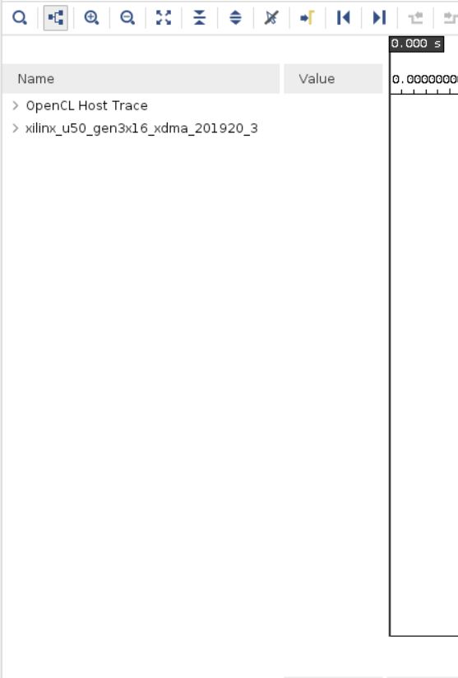
Open summary – Run summary
xrt.run_summary
Created by XRT library
Guidance
Profile Summary
Timeline Trace
Platform and System Diagrams
Simulation Waveforms

Slide 15
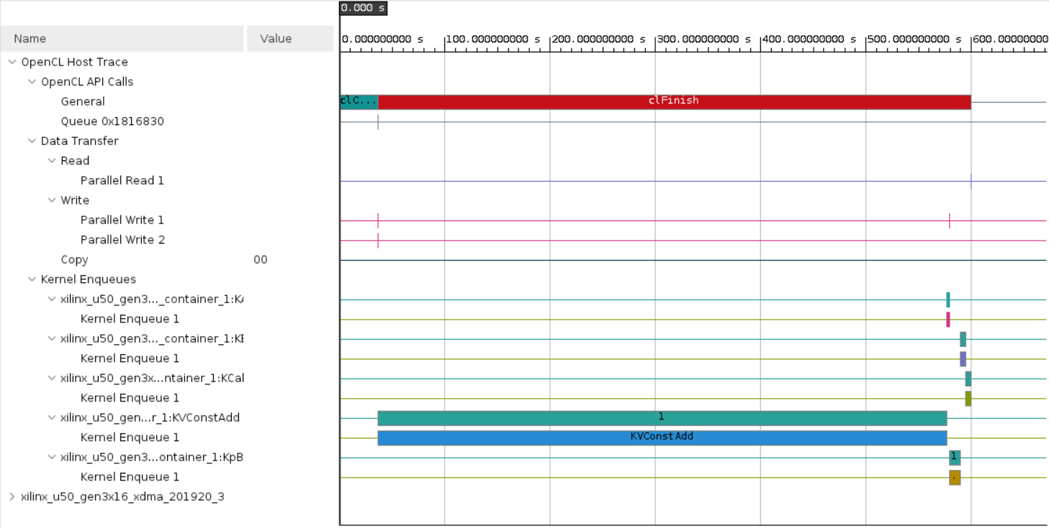
Open summary – Run summary

Slide 16
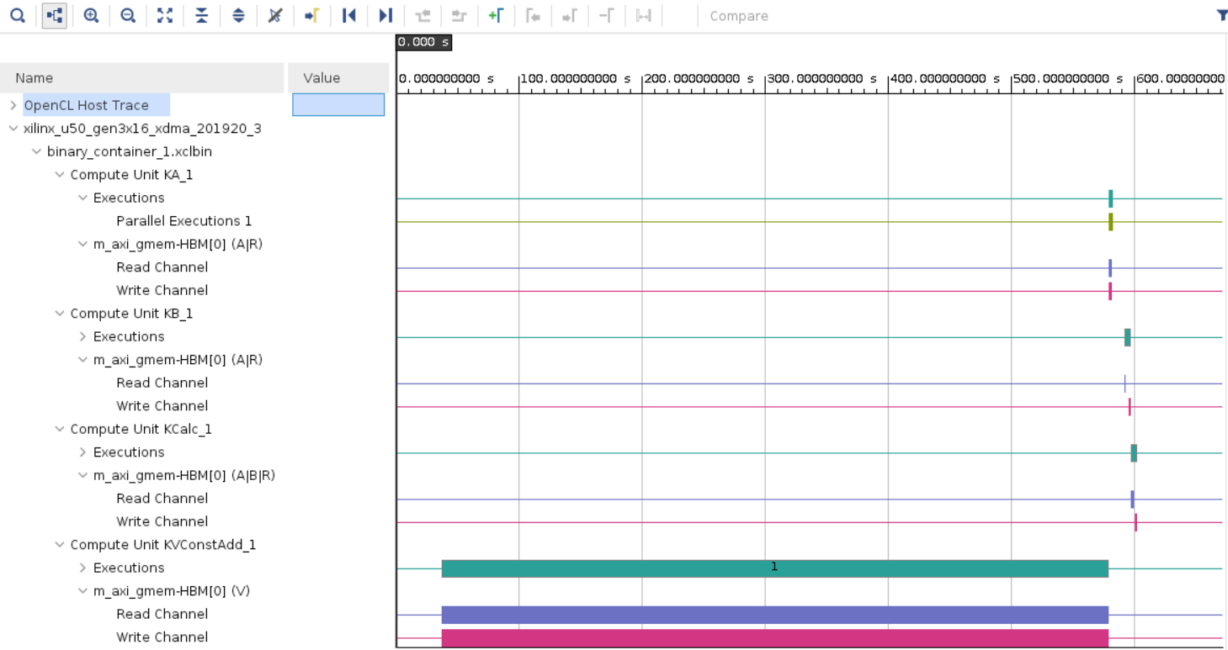
Open summary – Run summary

Slide 17
Quiz
Which of the following can help check kernel resource usage?
Compile Summary
Link Summary
Package Summary
Run Summary

Slide 18
Quiz
Which of the following can help check kernel resource usage?
Compile Summary
Link Summary
Package Summary
Run Summary

Slide 19
Quiz
After optimizing kernel data movement and computation codes, which of the following report should be analyzed?
Kernel Compilation Reports
Profile Summary
Timeline Trace
Package Summary
Device Hardware Transactions

Slide 20
Quiz
After optimizing kernel data movement and computation codes, which of the following report should be analyzed?
Kernel Compilation Reports
Profile Summary
Timeline Trace
Package Summary
Device Hardware Transactions

Slide 21
Q & A
https://github.com/jieyunma/AAHLS_LabA

