Slide 1
Lab B Bloom Filter
National Tsing Hua University
110061639 林致佑

Slide 2
TABLE OF CONTENTS
01
02
03
PERFORMACE EVALUTION
INTRO
CODE ANALYSIS

Slide 3
BLOOM FILTER INTRODUCTION
What is Bloom Filter?
Blomm Filter Example
Prons & Conds
Use Case

Slide 4
What is Bloom Filter?
A Probabilistic data structure
Test whether an element is a member of a set
Query return
False positive (possibly in set)
False negatives (definitely not in set)
Nothing related to flower blooming
Notes:
如果我們拿到另一個數字 A，要判斷這個數字 A 有沒有在 array 裡面，那我們勢必得跟 array 裡的元素一個個比較，時間複雜度是 O(n)。
(先做過 sorting 的話，就可以用二分搜尋法比較快地找到，但還是需要 O(logn) 的時間複雜度)
false positive 假陽性
False positive matches are possible, but false negatives

Slide 5
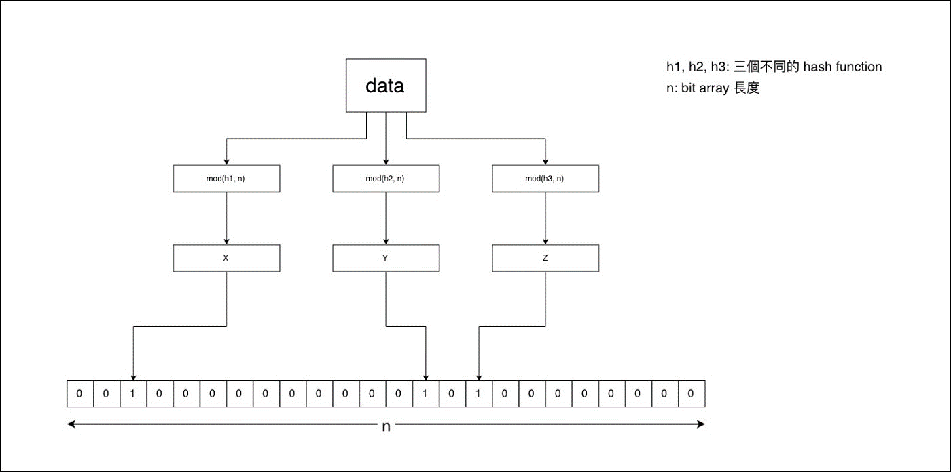
What is Bloom Filter?
Notes:
長度為 n 的 bit array
m 個獨立的 hash function
寫入x 用所有的 hash function 對 x 進行 hash 後 mod n 得到位置index(XYZ)
把 bit array 這些位置的 bit 設為 1

Slide 6
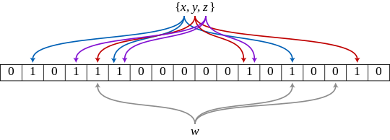
Bloom Filter Example
Notes:
An example of a Bloom filter, representing the set {x, y, z} . The colored arrows show the positions in the bit array that each set element is mapped to. The element w is not in the set {x, y, z} , because it hashes to one bit-array position containing 0. For this figure, m = 18 and k = 3.

Slide 7
Bloom Filter Example
1
Notes:
An example of a Bloom filter, representing the set {x, y, z} . The colored arrows show the positions in the bit array that each set element is mapped to. The element w is not in the set {x, y, z} , because it hashes to one bit-array position containing 0. For this figure, m = 18 and k = 3.

Slide 8
Pros & Cons
Pros
Cons
Space and time complexity
Linked list O(n)
Tree/Binary search O(logn)
Clean architecture to present set
Easy implementation (Only need multiple hash)
Give false positive result
Not good for few elements (Use hash table is enough)
Notes:
the more items added, the larger the probability of false positives.
false positive rate 是可以透過調整 bit array 的大小和 hash function 的數量來控制的
Bloom Filter is memory efficient than a Hash Map with the same performance

Slide 9


Use Case
Useful in applications to implement search engines and database management systems
Apache Cassandra (Distributed NoSQL DB)
Tinder Suggestion (Dating APP)
Notes:
Cassandra -> reduce the number of disk queries and increase performance.
Tinder 會搜尋離 user 一定範圍內的用戶來作為給 user 配對的對象，但怎麼避免已經配對或是拒絕過的呢
-> user 配對或是拒絕過的對象放進 bloom filter，在搜尋時確認是否在 bloom filter 中，如果有就不要回傳給 client

Slide 10
CODE ANALYSIS
Hash function
Loop for hash functionality
Profile compute score
SW Profiling
Conceptional Application

Slide 11
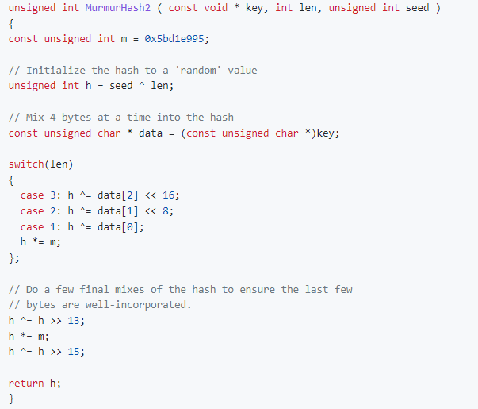
Hash Function
4 XORs
3 arithmetic shifts
2 multiplication
Each shift takes 1 clk cycle on CPU
Shift 44-bits when len=3
Good candidate for FPGA acceleration
Notes:
On the FPGA, you can create an accelerator that will shift the data by an arbitrary number of bits in a single clock cycle.
The FPGA also has dedicated DSP units that perform multiplications faster than the CPU. Even though the CPU runs at a frequency eight times higher than the FPGA, the arithmetic shift and multiplication operations can perform faster on the FPGA because of the customizable hardware architecture.
Therefore, this function is a good candidate for FPGA acceleration.

Slide 12
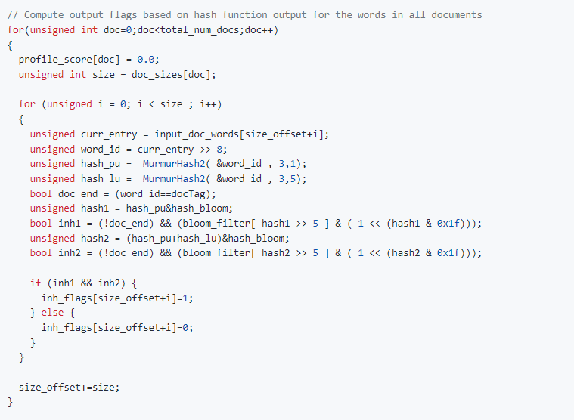
Loop for hash functionality
Nested for loop (2)
# of Document
# of Words in Document
Hash function is independent (One word to other words)
Sequentially accesses to the input_doc_words array
Good candidate for FPGA acceleration
Notes:
The hash is independent -> can be done in parallel which improves the execution time.
sequentially access -> it allows for very efficient accesses to HBM

Slide 13
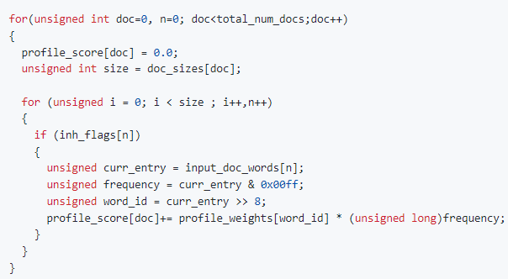
Profile Compute Score
1 random memory access
1 accumulation
1 multiplication
keep this function on the host CPU
Non-sequential access
11 % of total runtime (SW version)
Notes:
each document consists of an array of words
each word is a 32-bit unsigned integer comprised of a 24-bit word ID and an 8-bit integer representing the frequency.

Slide 14
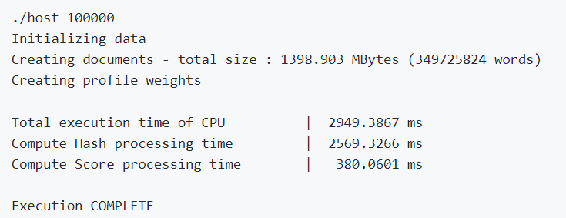
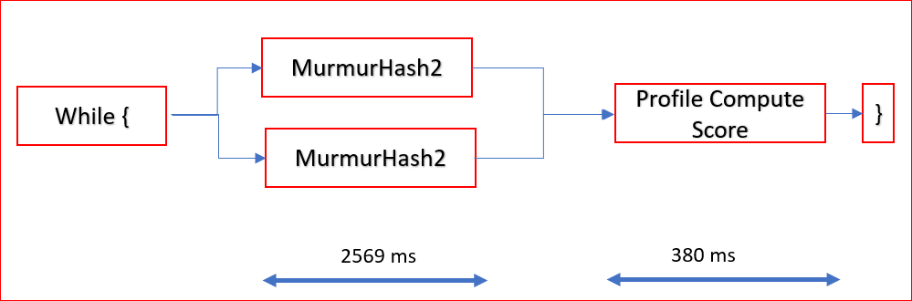
SW Profiling

Slide 15
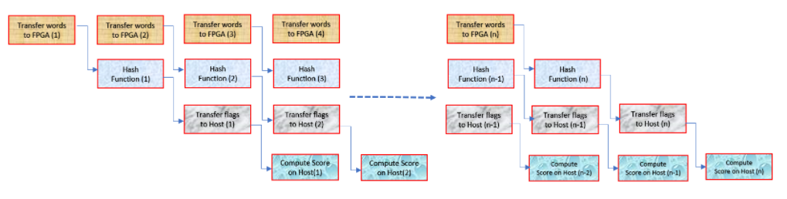
Conceptual Application
Based on earlier analysis, we should process hashes as fast as possible by processing multiples of these words every clock cycle.
Notes:
based on the established goal in previous lab, you should process hashes as fast as possible by processing multiples of these words every clock cycle.

Slide 16
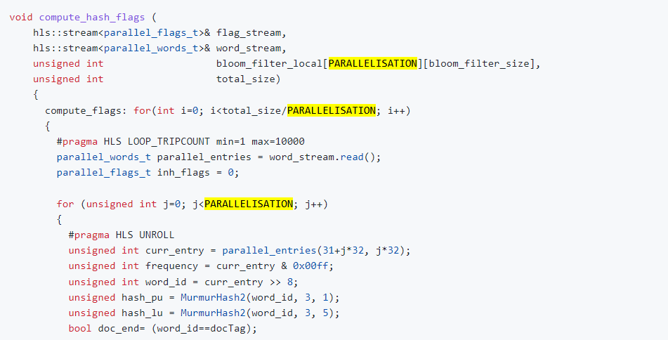
Kernel w/ Parallelism
Process multiple words every clock cycle
Implement kernel ex: kernel =4, 8, 16…
Kernel = 4
PARALLELISATION=4
Compute 4 words in parallel
(#pragma HLS UNROLL)
Notes:
Added #pragma HLS UNROLL
Unrolls internal loop to make four copies of the Hash functionality.
Vitis HLS will try to pipeline the outer loop with II=1. With the inside loop unrolled, you can initiate the outer loop every clock cycle, and compute 4 words in parallel.
Added #pragma HLS LOOP_TRIPCOUNT min=1 max=3500000`
Reports the latency of the function after HLS Synthesis.

Slide 17
PERFORMANCE EVALUATION
SW Version
HW versions w/ # kernels
Application Timeline
Utilization Comparision
Notes:
Review the application's access patterns, data movements, CPU and FPGA idle time, and update the host code to meet your performance goals.

Slide 18
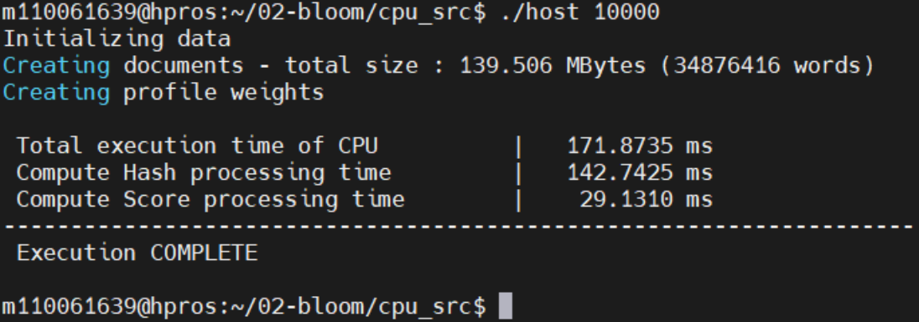
SW Version
Throughput = Total data/Total time
= 139.506 MB / 171.8735ms = 811.68 MBps
Notes:
Document 10000

Slide 19
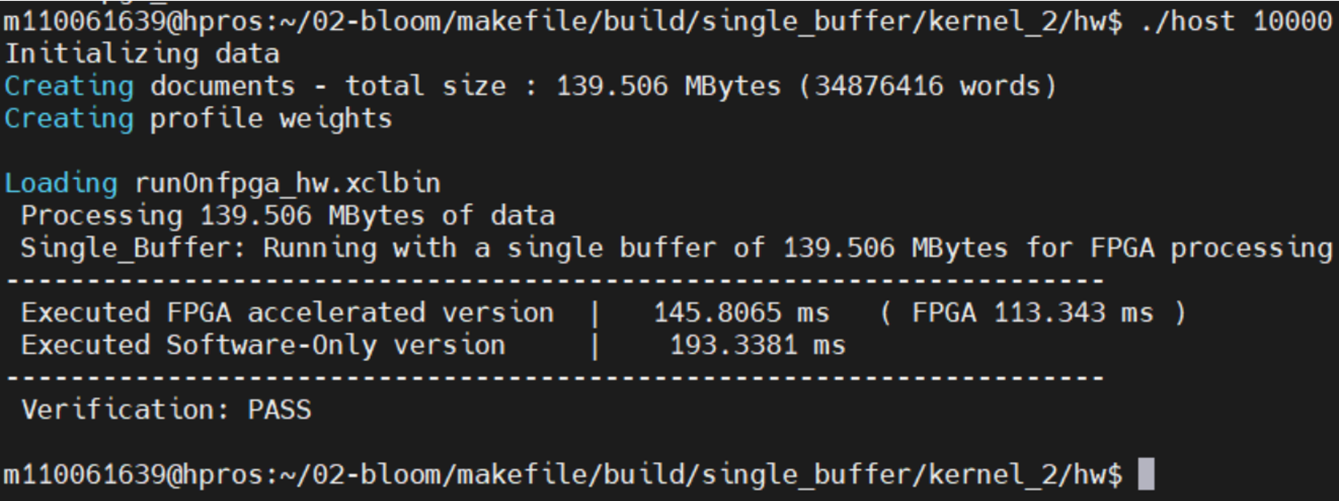
HW Kernel=2
Throughput = Total data/Total time
= 139.506 MB / 145.8065ms = 956.79 MBps
Notes:
Total FPGA time is 113 ms. This includes the host to mem transfer, Total Compute on FPGA and mem to host transfer.

Slide 20
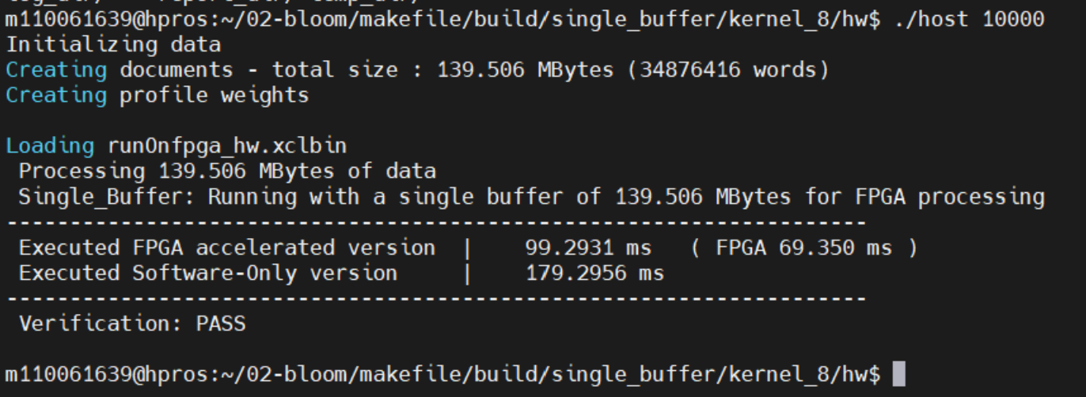
HW Kernel=8
Throughput = Total data/Total time
= 139.506 MB / 99.2931ms = 1404.99 MBps

Slide 21
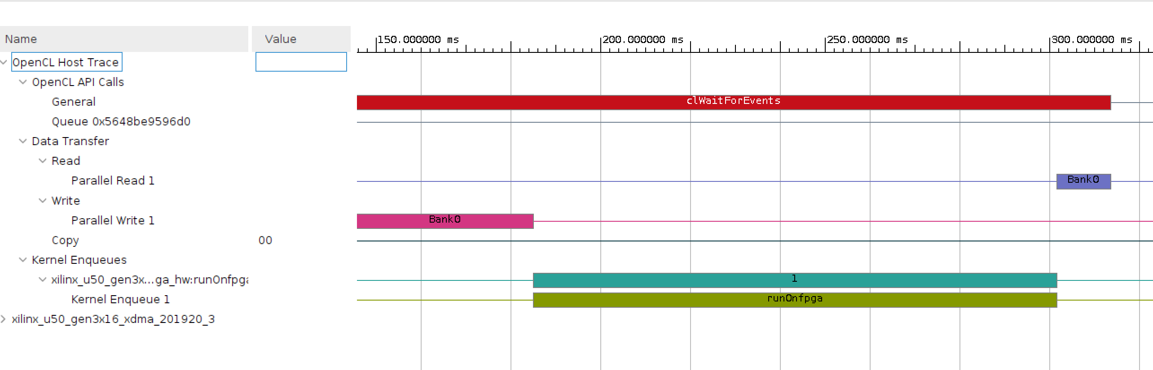
Application Timeline (kernel=2)

Slide 22
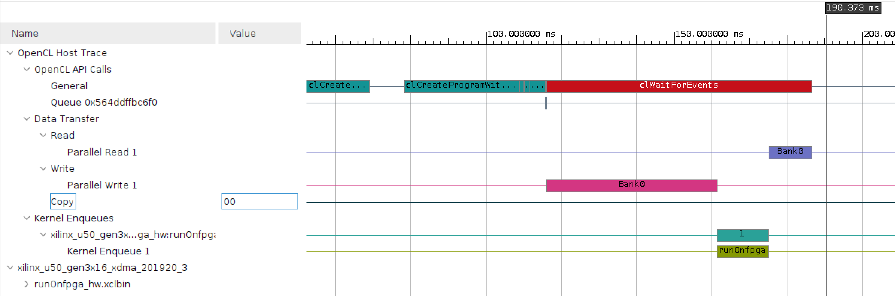
Application Timeline (kernel=16)

Slide 23
Comparison

Slide 24
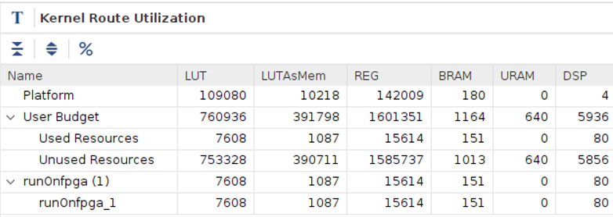
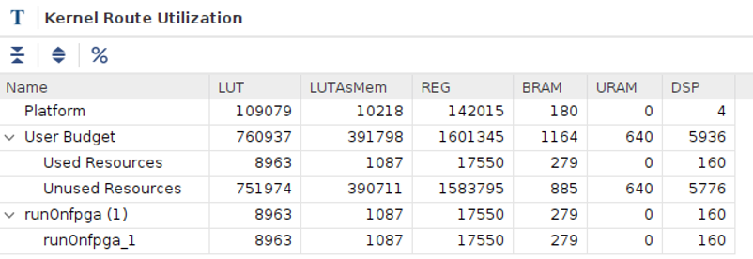
Utilization Comparison (Kernel 8 vs 16)
Used Resource:
DSP * 2
BRAM * 1.85
REG * 1.13
LUT * 1.18
Kernel size = 8
Kernel size = 16

Slide 25
Thank you!
GitHub Repo:
https://github.com/ChihyuLin0211/Lab_B_Vitis_Tutorials_02_Bloom

Slide 26
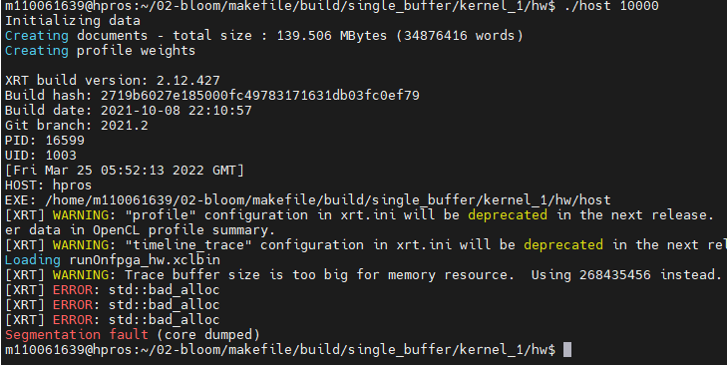
Issue – Memory Bad Alloc

