Slide 1


HLS LAB#B
Cholesky Algorithm
110061638 呂政和

Slide 2
CONTENTS
01
Introduction
Briefly introduce Cholesky Algorithm
02
CPU_SRC
Emulation Result on CPU
03
Module 1 Baseline
Emulation Result of baseline
04
Module 2 pipeline
Emulation Result of pipeline
05
Module 3 datatype
Emulation Result of datatype
06
Module 4 dataflow
Emulation Result of dataflow

Slide 3

1
Introduction
St
What is Cholesky algorithm
Calculation
Application

Slide 4
What is Cholesky algorithm
Cholesky-Banachiewicz演算法
在線性代數中，Cholesky decomposition是將一個正定的Hermitian矩陣分解成一個下三角矩陣與其共軛轉置之乘積。
優點：提高代數運算效率、Monte Carlo方法等十分有用。
實際應用中，Cholesky在求解線性方程組中的效率約為LU分解的兩倍。

Slide 5

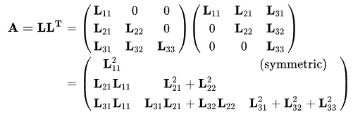
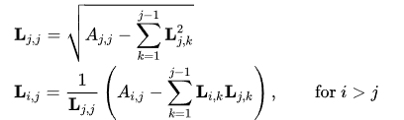
Calculation
1
寫出等式A=LL*
2
則得到矩陣L的元素的計算公式如下：
3

Slide 6
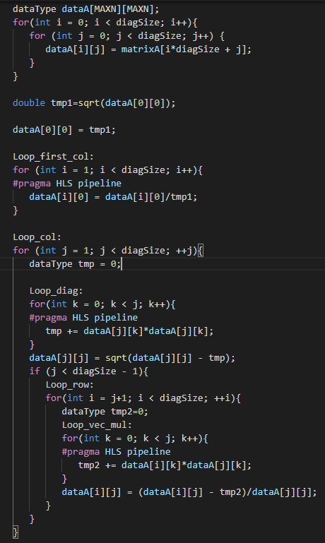




Calculation
$$L_{j,j}= \sqrt{A_{j,j}−\sum_{k=1}^{j−1}{L_{j,j}^{2}}}$$
$L_{i,j}=$ $\frac{1}{L_{j,j}}(A_{j,j}−\sum_{k=1}^{j−1}{L_{i,k}L_{i,k}}$)

Slide 7



Application
線性方程式求解
如果A是對稱正定，可以先求A=L$L^{T}$，隨後借向後替換法對y求解 ，再以向前替換法對x求解 即得最終解。
01
01
02
02
矩陣求逆
若要對Hermitian矩陣直接求逆，可以通過cholesky 分解，類似求解線性方程組一般求出逆矩陣。

Slide 8

2
CPU_SRC
nd
Run on CPU result
Error in size

Slide 9
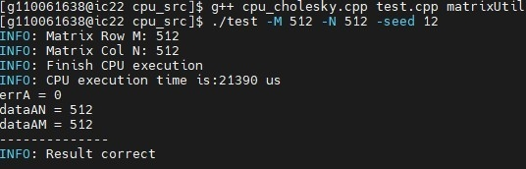

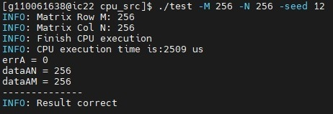
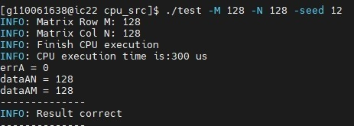
Run on CPU result
Size of 512*512
CPU execution time is 21390us
Size of 256*256
CPU execution time is 2509us
Size of 128*128
CPU execution time is 300us

Slide 10

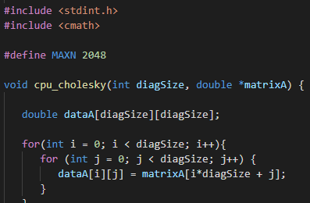
Run on CPU result
Size of 1024*1024
Segmentation fault
可以從C++檔看出，Size最大其實能給到2048*2048，
但當我設定到1024時就出現錯誤，這可能是因為學校
的server有stack size 限制，所以沒辦法超過512*512，
不過從趨勢可以發現，隨著size越大，execution time
會越長。

Slide 11
3
Module 1 Baseline
rd
Understanding code set up
Timeline
Profile Summary

Slide 12
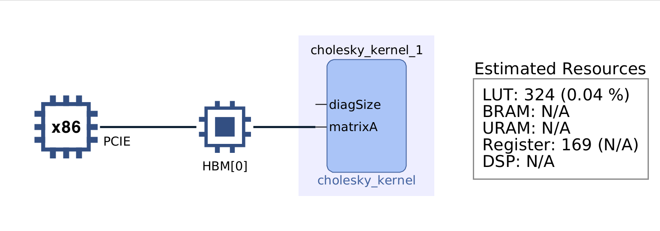
Understanding code set up
Host 會將kernel所需要用到的Data透過Alveo Data Center accelerator card上的PCIe通道或AXI bus送至global memory
The host program會根據輸入參數去設定kernel
The host program會觸發kernel function進行執行
The kernel performs the required computation while reading data from global memory, as necessary.
執行結束會，kernel會將資料寫回並通知host已完成任務。
The host program會將資料從global memory讀回host memory。

Slide 13
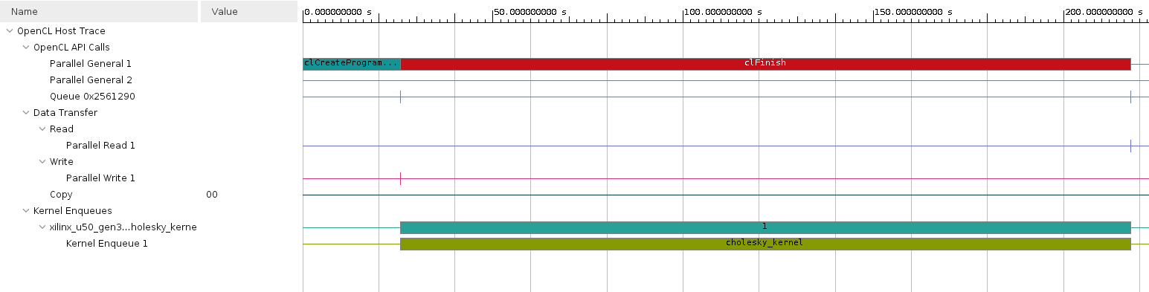
Timeline
1
Data transfer
這欄會記錄DMA transfers from the host to the memory。
The data transfer from the host to the device appear under Write as they are written by the host, and the transfers from device to host appear under Read.
2
Kernel Enqueues
The kernels enqueued by the host program are shown here. Multiple kernels can be scheduled to be executed at the same time, and they are traced from the point they are scheduled to run until the end of the kernel execution. Multiple entries would be shown in different rows depending on the number of overlapping kernel executions.

Slide 14
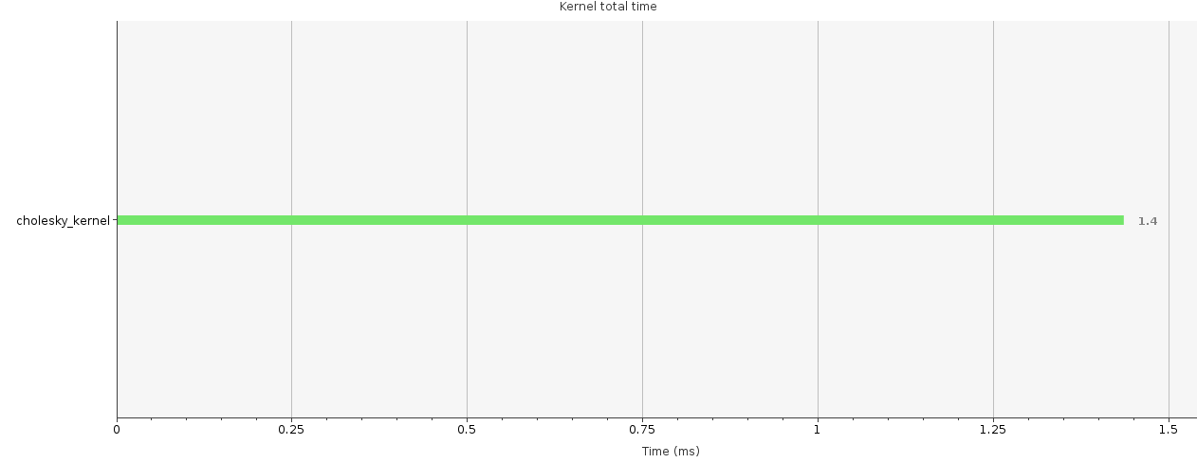
Profile Summary
Kernel | Enqueues | Total time | Min time | Avg time | Max time
Cholesky_kernel | 1 | 1.436 | 1.436 | 1.436 | 1.436

Slide 15
4
Module 2 pipeline
th
Introduction
Timeline
Profile Summary

Slide 16
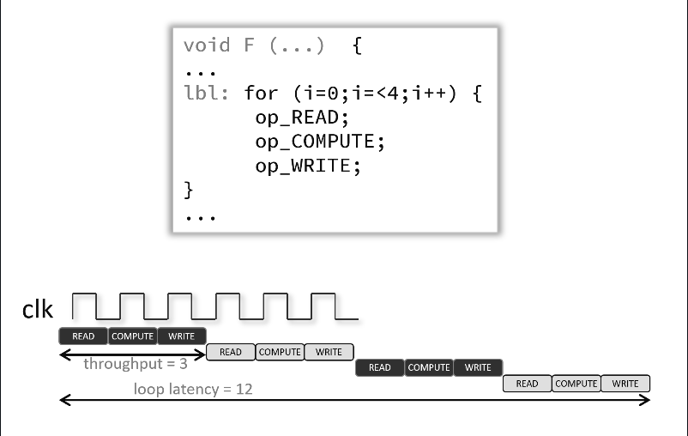
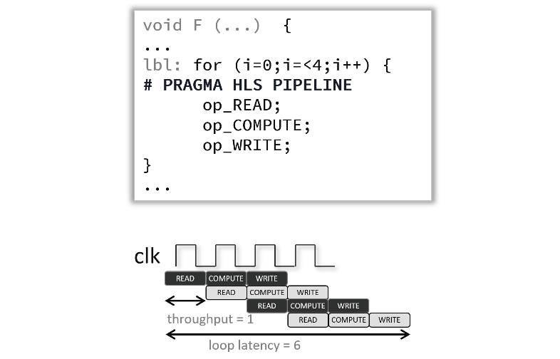
Introduction
TITLE HERE
Difference between pipeline
This module is meant to focus on the pipeline pragma and go through the description below. The kernel source code with the loops annotated with the pragma will produce the same results as in module 1, that's because since simple loops and inner loops (for nested loops) are automatically pipelined by the tool.

Slide 17
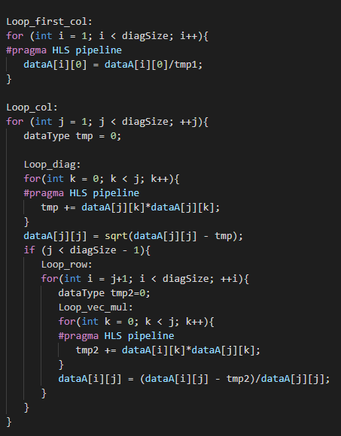
Introduction
TITLE HERE

Slide 18
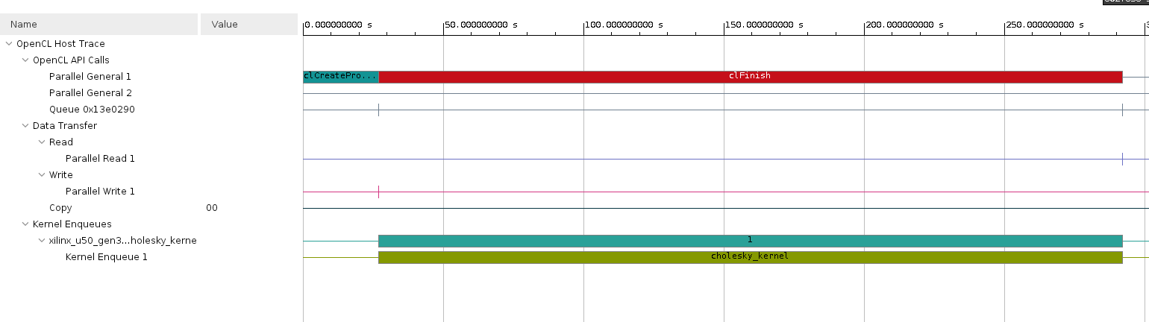
Timeline
1
Data transfer
這欄會記錄DMA transfers from the host to the memory。
The data transfer from the host to the device appear under Write as they are written by the host, and the transfers from device to host appear under Read.
2
Kernel Enqueues
The kernels enqueued by the host program are shown here. Multiple kernels can be scheduled to be executed at the same time, and they are traced from the point they are scheduled to run until the end of the kernel execution. Multiple entries would be shown in different rows depending on the number of overlapping kernel executions.

Slide 19
Profile Summary
Kernel | Enqueues | Total time | Min time | Avg time | Max time
Cholesky_kernel | 1 | 1.436 | 1.436 | 1.436 | 1.436

Slide 20
5
Module 3 datatype
th
Introduction
Timeline
Profile Summary

Slide 21

Introduction
Difference between datatype
In this module both the kernel and host code are modified to use 32-bit floating point data types(float) instead of the 64-bit floating point(double) to show the performance and Xilinx utilization beneficial impact of downsizing data types.
Kernel Resources Used (regular floating point versus double):
Name | LUT | LUTAsMem | REG | BRAM | DSP
Kernel with double | 10190 | 799 | 10191 | 514 | 18
Kernel with float | 5071 | 746 | 5124 | 258 | 12
As expected, the resource utilization comes down across for both logic and storage

Slide 22
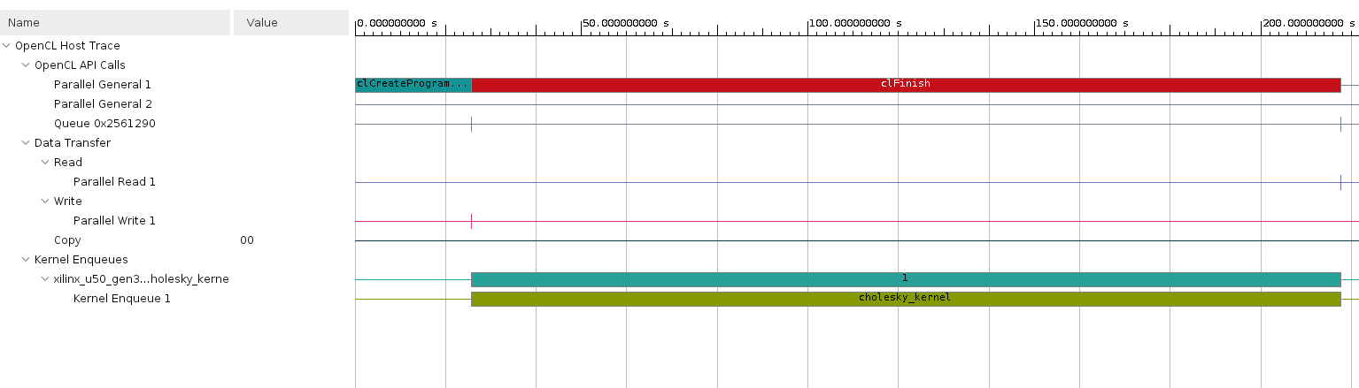
Timeline
1
Data transfer
這欄會記錄DMA transfers from the host to the memory。
The data transfer from the host to the device appear under Write as they are written by the host, and the transfers from device to host appear under Read.
2
Kernel Enqueues
The kernels enqueued by the host program are shown here. Multiple kernels can be scheduled to be executed at the same time, and they are traced from the point they are scheduled to run until the end of the kernel execution. Multiple entries would be shown in different rows depending on the number of overlapping kernel executions.

Slide 23
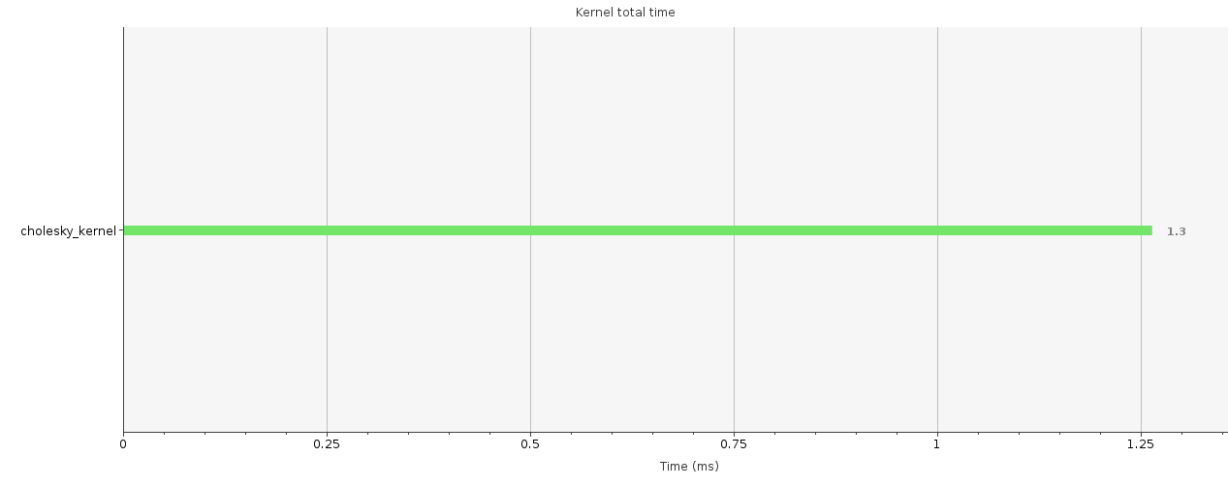
Profile Summary
Kernel | Enqueues | Total time | Min time | Avg time | Max time
Cholesky kernel | 1 | 1.264 | 1.264 | 1.264 | 1.264

Slide 24
6
Module 4 dataflow
th
Introduction
Timeline
Profile Summary

Slide 25
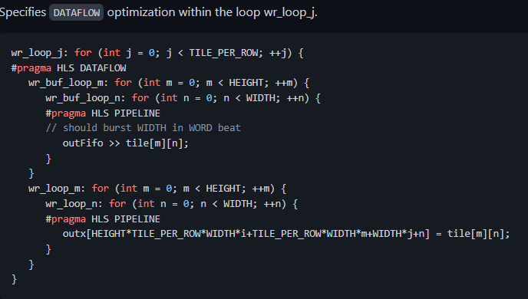
Introduction
Difference between dataflow
The DATAFLOW pragma enables task-level pipelining, allowing functions and loops to overlap in their operation, increasing the concurrency of the register transfer level(RTL) implementation, and increasing the overall throughput of the design.
When the DATAFLOW pragma is specified, the HLS tool analyzes the data flow between sequential functions or loops and creates channels (based on ping pong RAMs or FIFOs) that allow consumer functions or loops to start operation before the producer functions or loops have completed. This allows functions or loops to operate in parallel, which decreases latency and improves the throughput of the RTL.
左圖為範例，在function中加入#pragma HLS DATAFLOW讓HLS能優化其迴圈。

Slide 26
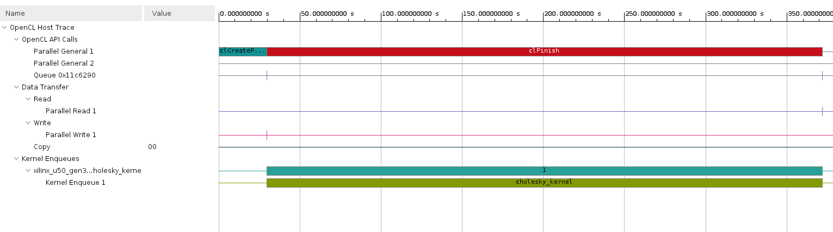
Timeline
1
Data transfer
這欄會記錄DMA transfers from the host to the memory。
The data transfer from the host to the device appear under Write as they are written by the host, and the transfers from device to host appear under Read.
2
Kernel Enqueues
The kernels enqueued by the host program are shown here. Multiple kernels can be scheduled to be executed at the same time, and they are traced from the point they are scheduled to run until the end of the kernel execution. Multiple entries would be shown in different rows depending on the number of overlapping kernel executions.

Slide 27
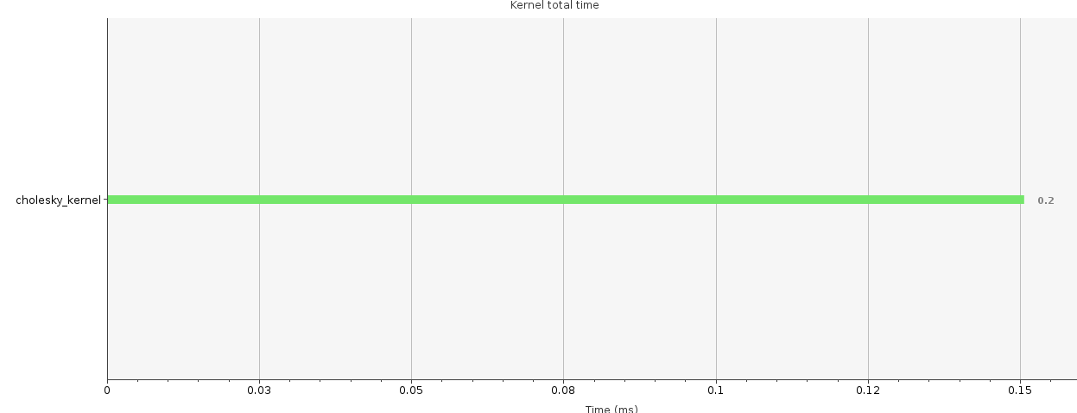
Profile Summary
Kernel | Enqueues | Total time | Min time | Avg time | Max time
Cholesky kernel | 1 | 0.151 | 0.151 | 0.151 | 0.151

Slide 28
7
Conclusion
th

Slide 29
Conclusion
Actual results comparing the runs for all modules including execution on the CPU(*):
Module | CPU | Module1 | Moduel2 | Module3 | Module4
Exe. Time | 21461 | 793950 | 793732 | 536784 | 11698
Speed up(cpu) | 1 | 0.03x | 0.03x | 0.04x | 1.83x
Speed up | N/A | 1 | 1 | 1.48x | 68x
Github ：https://github.com/hank871116/HLS_LAB_B_5

Slide 30


THANKS
Thank you for watching

