Slide 1
CORDIC
110064513 陳思熙
2022/3/29

Slide 2
Outline
CORDIC
Algorithm
Rotation & Vector mode
Generate IP by C++
Performance
Verify on FPGA
Github Link
Question

Slide 3
Outline
CORDIC
Algorithm
Rotation & Vector mode
Generate IP by C++
Performance
Verify on FPGA
Github Link
Question

Slide 4
CORDIC
Coordinate Rotation Digital Computer (CORDIC) is a simple and efficient algorithm for trigonometric functions based on vector rotations
Can be used for polar-to-rectangular and rectangular-to-polar conversions
Using only shifts and adds to performing vector rotations

Slide 5
Outline
CORDIC
Algorithm
Rotation & Vector mode
Generate IP by C++
Performance
Verify on FPGA
Github Link
Question

Slide 6
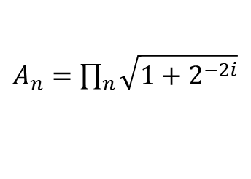
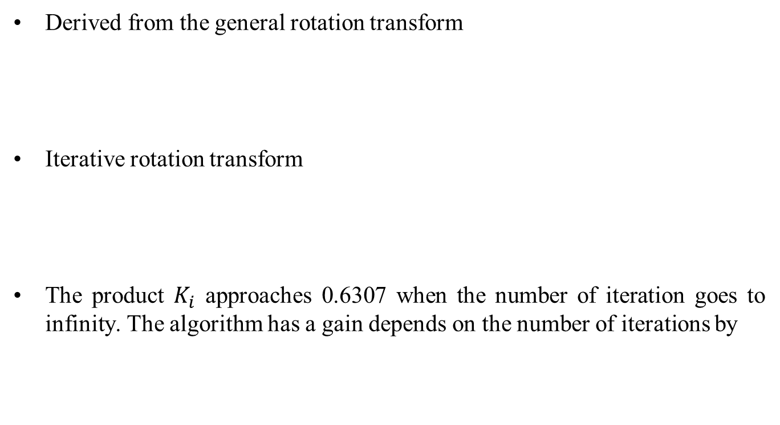

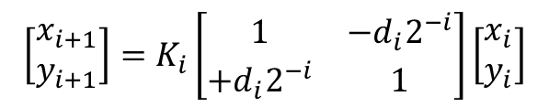
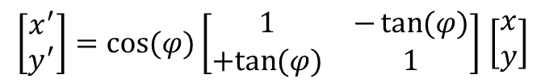
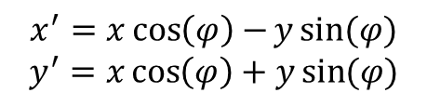
Algorithm
Derived from the general rotation transform
Iterative rotation transform
The product $K_{i}$ approaches 0.6307 when the number of iteration goes to infinity. The algorithm has a gain depends on the number of iterations by
$x^{′}=x\cos\left(φ\right)−y\sin{(φ)}$
$$y^{′}=x\cos\left(φ\right)+y\sin{(φ)}$$
$\left[\begin{matrix}x^{′} \\ y^{′}\end{matrix}\right]=\cos{(φ)\left[\begin{matrix}1 & −\tan{(φ)} \\ +tan{(φ)} & 1\end{matrix}\right]}$ $\left[\begin{matrix}x \\ y\end{matrix}\right]$
$\left[\begin{matrix}x_{i+1} \\ y_{i+1}\end{matrix}\right]=K_{i}\left[\begin{matrix}1 & −d_{i}2^{−i} \\ +d_{i}2^{−i} & 1\end{matrix}\right]\left[\begin{matrix}x_{i} \\ y_{i}\end{matrix}\right]$
$K_{i}=\cos\left(\tan^{−1}\left(2^{−i}\right)\right)=\frac{1}{\sqrt{1+2^{−2i}}}$
$A_{n}=\prod_{n}{\sqrt{1+2^{−2i}}}$

Slide 7
Outline
CORDIC
Algorithm
Rotation & Vector mode
Generate IP by C++
Performance
Verify on FPGA
Github Link
Question

Slide 8
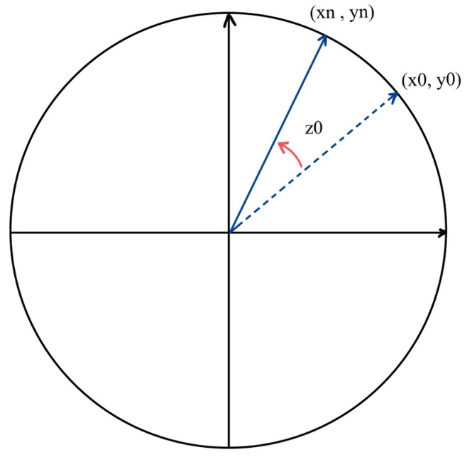
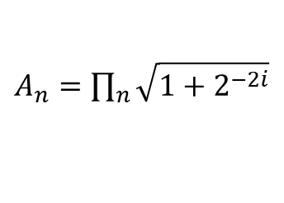


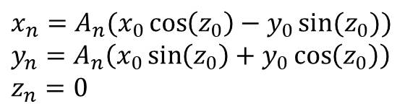
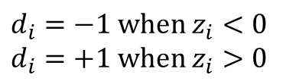

Rotation mode
Given $x_{0}$, $y_{0}$ and desired rotation angle $z_{0}$
Final result of rotation mode is the vector
position $(x_{n}, y_{n})$ with zero angle accumulator
$x_{i+1}=x_{i}−y_{i}∙d_{i}∙2^{−i}$
$y_{i+1}=y_{i}+x_{i}∙d_{i}∙2^{−i}$
$z_{i+1}=z_{i}−d_{i}∙\tan^{−1}{(2^{−i})}$
$x_{n}=A_{n}(x_{0}\cos\left(z_{0}\right)−y_{0}\sin{(z_{0})})$
$y_{n}=A_{n}\left(x_{0}\sin\left(z_{0}\right)+y_{0}\cos\left(z_{0}\right)\right)$
$z_{n}=0$
$$where$$
$A_{n}=\prod_{n}{\sqrt{1+2^{−2i}}}$
$$d_{i}=−1 when z_{i}<0$$
$$d_{i}=+1 when z_{i}>0$$

Slide 9
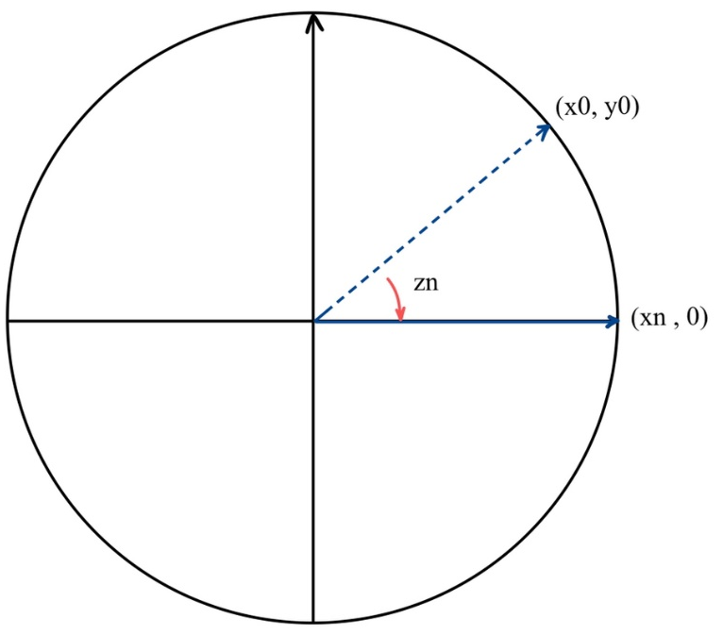
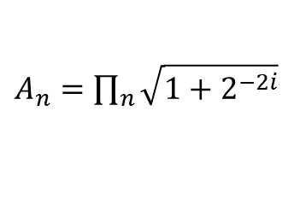

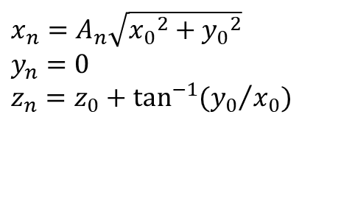
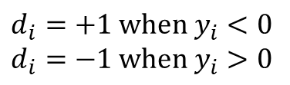
Vector mode
Given $x_{0}$and $y_{0}$
Final result of vector mode is rotated angle with
x-coordinate aligned vector
$x_{i+1}=x_{i}−y_{i}∙d_{i}∙2^{−i}$
$y_{i+1}=y_{i}+x_{i}∙d_{i}∙2^{−i}$
$z_{i+1}=z_{i}−d_{i}∙\tan^{−1}{(2^{−i})}$
$x_{n}=A_{n}\sqrt{{x_{0}}^{2}+{y_{0}}^{2}}$
$y_{n}=0$
$z_{n}=z_{0}+\tan^{−1}{({y_{0}}/{x_{0}})}$
$$where$$
$A_{n}=\prod_{n}{\sqrt{1+2^{−2i}}}$
$$d_{i}=+1 when y_{i}<0$$
$$d_{i}=−1 when y_{i}>0$$

Slide 10
Outline
CORDIC
Algorithm
Rotation & Vector mode
Generate IP by C++
Performance
Verify on FPGA
Github Link
Question

Slide 11
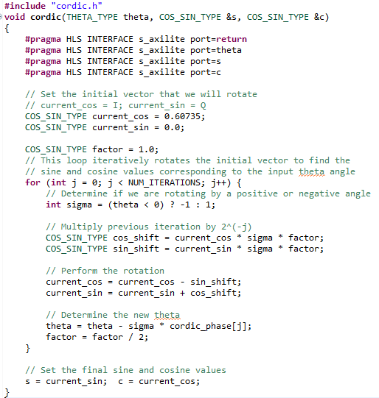


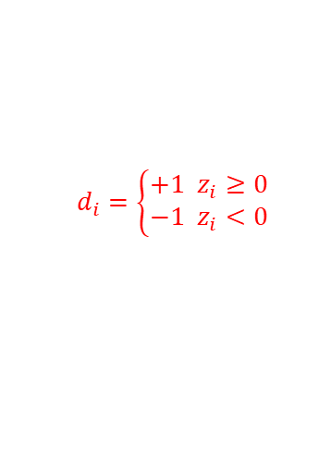
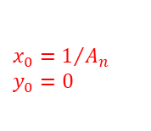
Generate IP by C++
cordic.cpp
Protocol of data and control signals
$x_{0}=1/{A_{n}}$
$y_{0}=0$
$$d_{i}=\left\{\begin{aligned}+1 z_{i}≥0 \\ −1 z_{i}<0\end{aligned}\right.$$
$\left\{\begin{aligned}x_{i+1}=x_{i}−y_{i}∙d_{i}∙2^{−i} \\ y_{i+1}=y_{i}+x_{i}∙d_{i}∙2^{−i} \\ z_{i+1}=z_{i}−d_{i}∙\tan^{−1}\left(2^{−i}\right)\end{aligned}\right.$
calculate $2^{−i}$

Slide 12
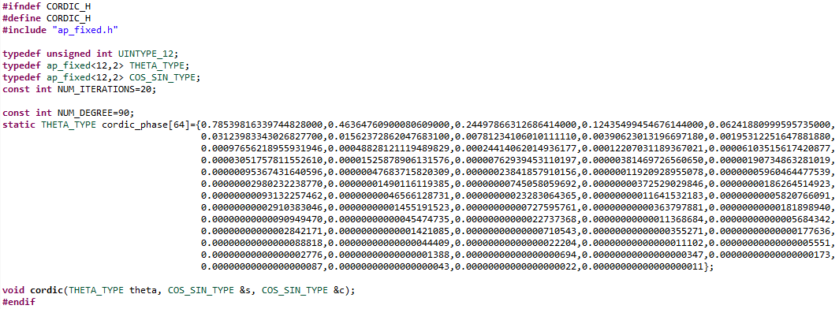

Generate IP by C++
cordic.h
Set the iteration of cordic
LUT of $\tan^{−1}{2^{−i}}$ in radiation

Slide 13
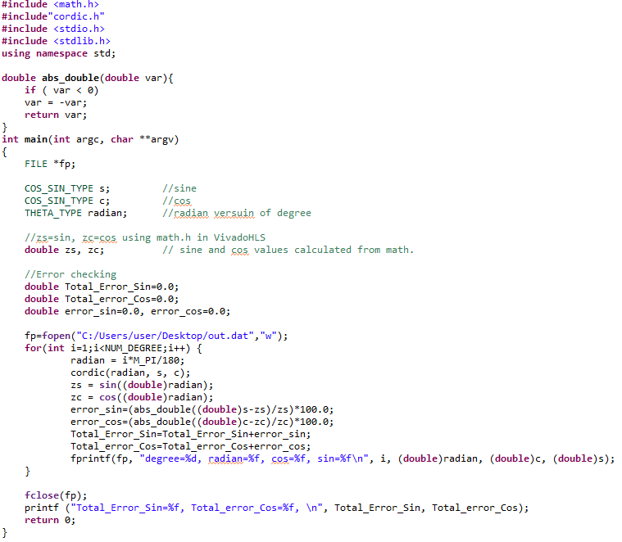
Generate IP by C++
Testbench
calculate the error

Slide 14
Outline
CORDIC
Algorithm
Rotation & Vector mode
Generate IP by C++
Performance
Verify on FPGA
Github Link
Question

Slide 15
Performance
Timing
Utilization
 | original | unroll
Latency (cycle) | 62 | 8
 | original | unroll
DSP | 2 | 0
FF | 205 | 289
LUT | 430 | 1086

Slide 16
Outline
CORDIC
Algorithm
Rotation & Vector mode
Generate IP by C++
Performance
Verify on FPGA
Github Link
Question

Slide 17
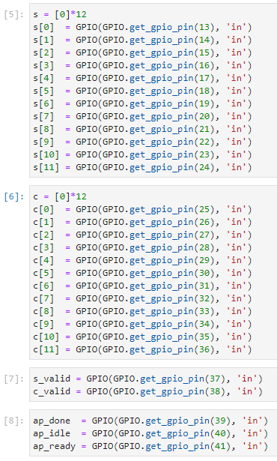
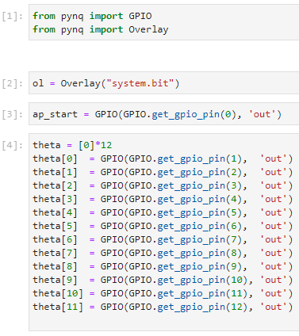
Verify on FPGA
Host code (Use GPIO)

Slide 18
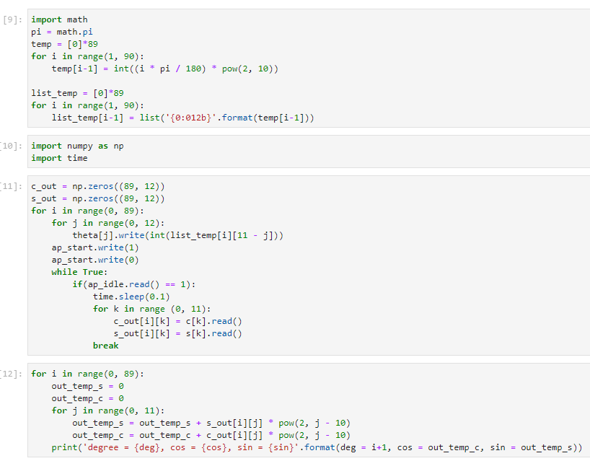
Verify on FPGA
Host code (Use GPIO)

Slide 19
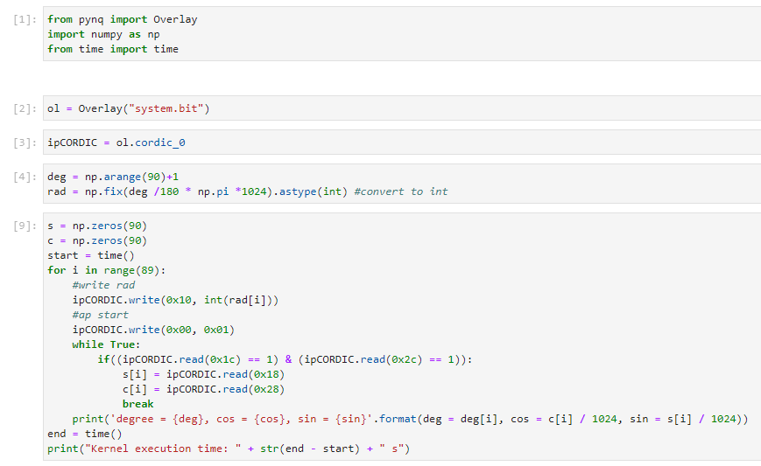
Verify on FPGA
Host code (Use AXI-Lite)

Slide 20
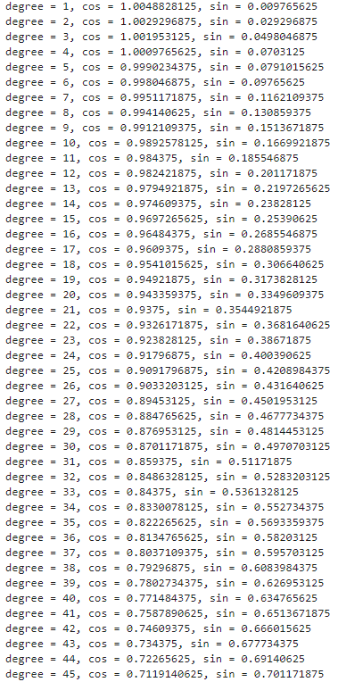
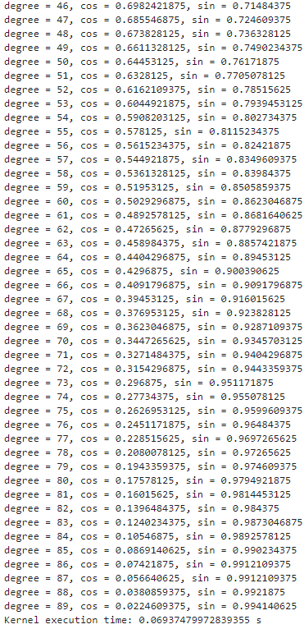
Verify on FPGA
Result

Slide 21
Outline
CORDIC
Algorithm
Rotation & Vector mode
Generate IP by C++
Performance
Verify on FPGA
Github Link
Question

Slide 22
Github Link
Link
https://github.com/SzuHsi/AAHLS_LabB_cordic

Slide 23
Outline
CORDIC
Algorithm
Rotation & Vector mode
Generate IP by C++
Performance
Verify on FPGA
Github Link
Question

Slide 24
Question
What is the main advantage of CORDIC
What other function CORDIC can do

