Slide 1
Discrete Fourier Transform
2022/3/30
Course: Application Acceleration with High-Level Synthesis
Student: Stan Teng
Professor:賴瑾
GitHub: https://github.com/StanTeng/AAHLS_labB_DFT

Slide 2
Outline
Introduction
-Brief Introduction of Discrete Fourier Transform
-DFT Matrix
Origin Design
-Baseline Implementation
-Simulation Result
Optimization
-How We Optimize the Design
-Comparison
References
Notes:
Pre:
D+R = 30ps
Post:
D + R = X
已知
Post_D – Pre_D = 14ps
則 X = 44ps
PS. Post_D – Pre_D 可以透過量測gamma resolution差異得知
Pre_D = Pre_D(49) – Pre_D(50) = [D(49) + R] – [D(50) + R] = D(49) – D(50) = resolution * gamma_range
Post_D = Post_D(38) – Post_D(39) = [D(38) + R] – [D(39) + R] = D(38) – D(39) = resolution_post * gamma_range

Slide 3
Outline
Introduction
-Brief Introduction of Discrete Fourier Transform
-DFT Matrix
Origin Design
-Baseline Implementation
-Simulation Result
Optimization
-How We Optimize the Design
-Comparison
References
Notes:
Pre:
D+R = 30ps
Post:
D + R = X
已知
Post_D – Pre_D = 14ps
則 X = 44ps
PS. Post_D – Pre_D 可以透過量測gamma resolution差異得知
Pre_D = Pre_D(49) – Pre_D(50) = [D(49) + R] – [D(50) + R] = D(49) – D(50) = resolution * gamma_range
Post_D = Post_D(38) – Post_D(39) = [D(38) + R] – [D(39) + R] = D(38) – D(39) = resolution_post * gamma_range

Slide 4
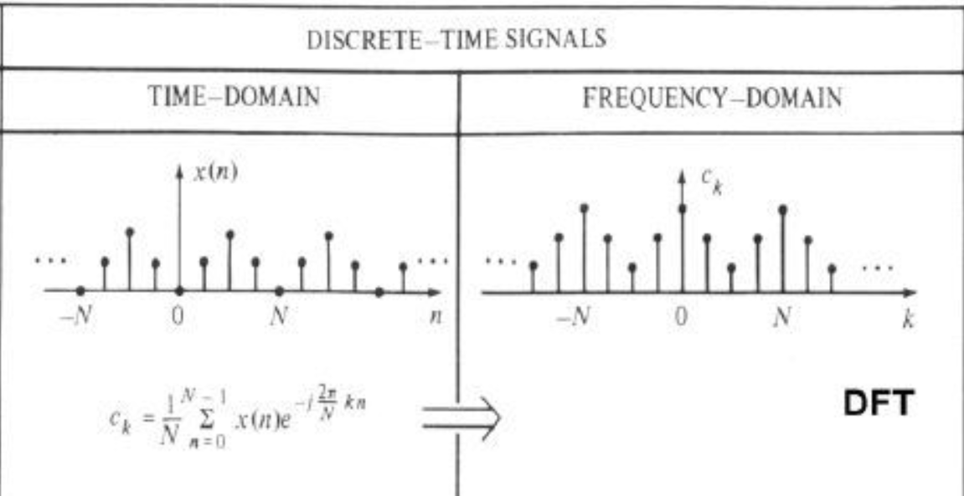
Brief Introduction of Discrete Fourier Transform
Brief introduction of DFT
After DFT, the output is a complex number. The real number part is the frequency, and the imaginary number part is the amplitude.
source: https://pic2.zhimg.com/v2-6ce5a2bb690a16f8fbb417f9c1f6a1e1_180x120.jpg
Notes:
Pre:
D+R = 30ps
Post:
D + R = X
已知
Post_D – Pre_D = 14ps
則 X = 44ps
PS. Post_D – Pre_D 可以透過量測gamma resolution差異得知
Pre_D = Pre_D(49) – Pre_D(50) = [D(49) + R] – [D(50) + R] = D(49) – D(50) = resolution * gamma_range
Post_D = Post_D(38) – Post_D(39) = [D(38) + R] – [D(39) + R] = D(38) – D(39) = resolution_post * gamma_range

Slide 5
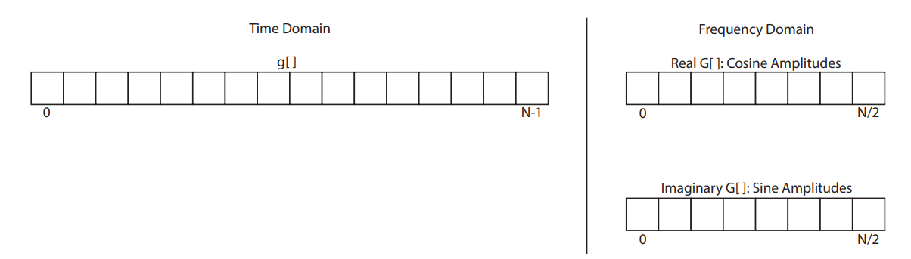
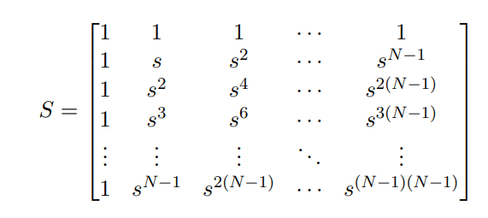

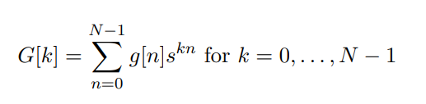

DFT Matrix
DFT Matrix
A real valued discrete function g[] (inputs) in the time domain with N points has a frequency domain representation with N/2 + 1 samples(outputs).
Notes:
Pre:
D+R = 30ps
Post:
D + R = X
已知
Post_D – Pre_D = 14ps
則 X = 44ps
PS. Post_D – Pre_D 可以透過量測gamma resolution差異得知
Pre_D = Pre_D(49) – Pre_D(50) = [D(49) + R] – [D(50) + R] = D(49) – D(50) = resolution * gamma_range
Post_D = Post_D(38) – Post_D(39) = [D(38) + R] – [D(39) + R] = D(38) – D(39) = resolution_post * gamma_range

Slide 6
Outline
Introduction
-Brief Introduction of Discrete Fourier Transform
-DFT Matrix
Origin Design
-Baseline Implementation
-Simulation Result
Optimization
-How We Optimize the Design
-Comparison
References
Notes:
Pre:
D+R = 30ps
Post:
D + R = X
已知
Post_D – Pre_D = 14ps
則 X = 44ps
PS. Post_D – Pre_D 可以透過量測gamma resolution差異得知
Pre_D = Pre_D(49) – Pre_D(50) = [D(49) + R] – [D(50) + R] = D(49) – D(50) = resolution * gamma_range
Post_D = Post_D(38) – Post_D(39) = [D(38) + R] – [D(39) + R] = D(38) – D(39) = resolution_post * gamma_range

Slide 7
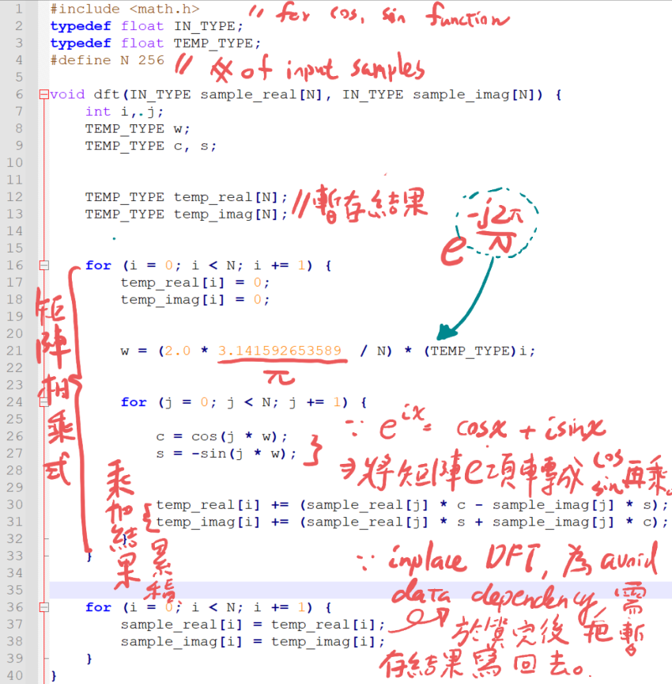
Origin Design
Baseline Implementation
The figure shown below is the origin code and the description.
Notes:
Pre:
D+R = 30ps
Post:
D + R = X
已知
Post_D – Pre_D = 14ps
則 X = 44ps
PS. Post_D – Pre_D 可以透過量測gamma resolution差異得知
Pre_D = Pre_D(49) – Pre_D(50) = [D(49) + R] – [D(50) + R] = D(49) – D(50) = resolution * gamma_range
Post_D = Post_D(38) – Post_D(39) = [D(38) + R] – [D(39) + R] = D(38) – D(39) = resolution_post * gamma_range

Slide 9
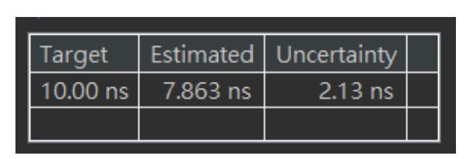
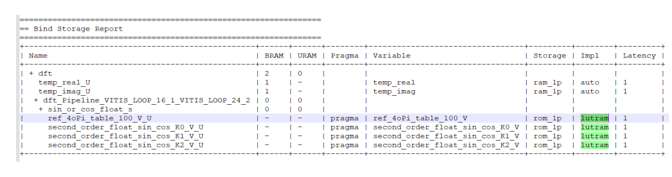
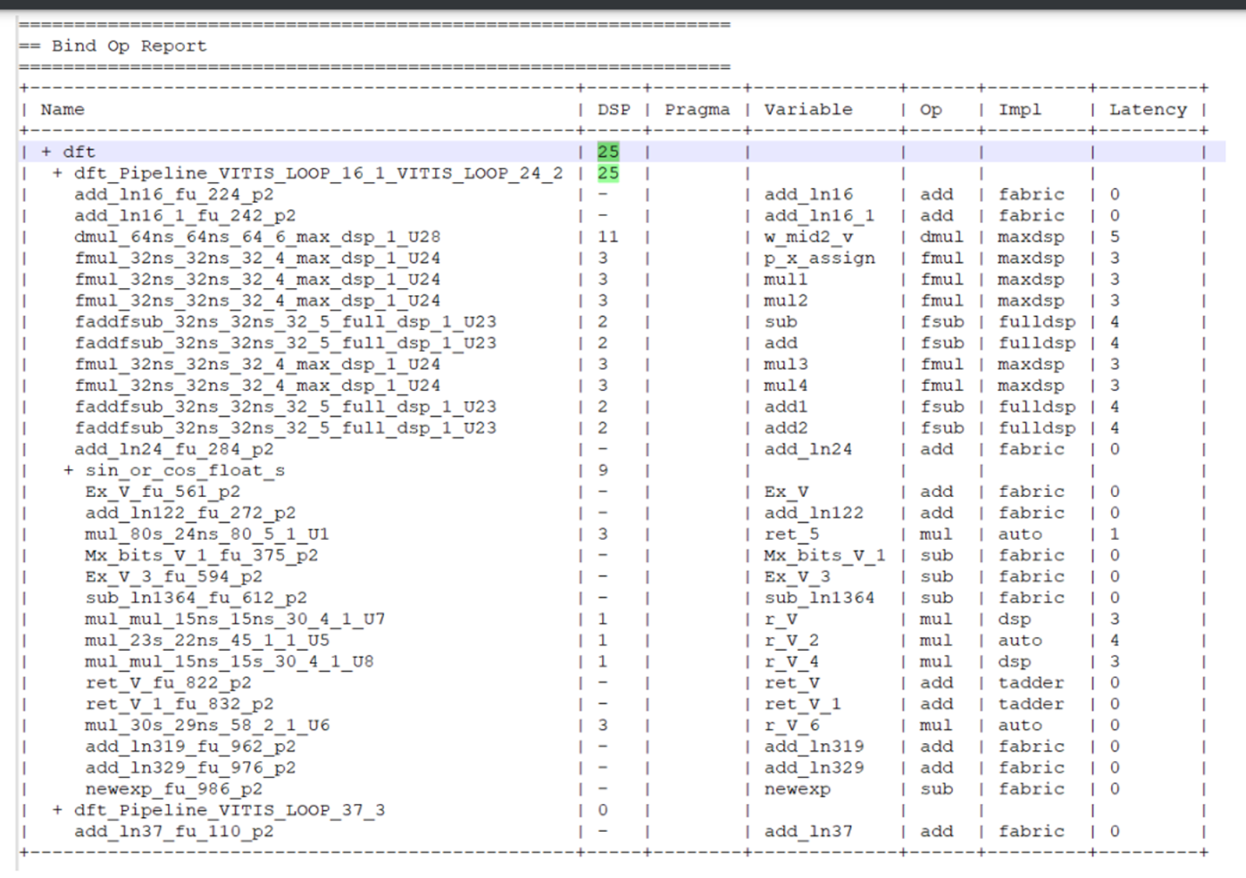
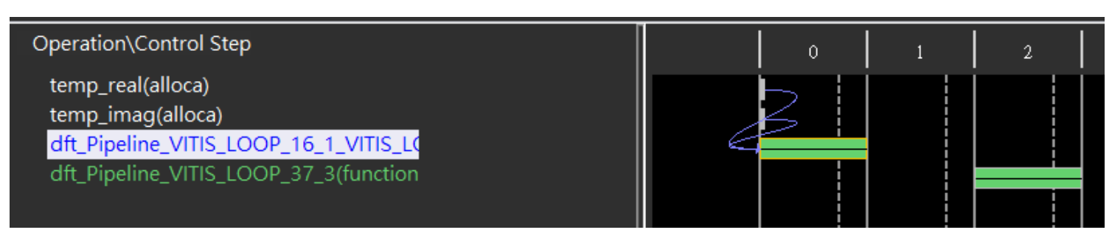
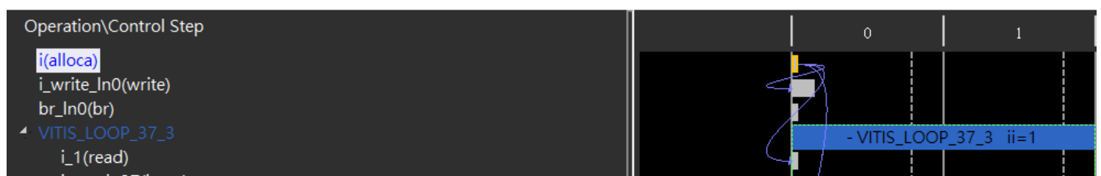
Simulation Result
C Synthesis Summary Reports
Bind Op Report
Bind Storage Report
Schedule Viewer(whole design)
Schedule Viewer(second for-loop)
Notes:
Pre:
D+R = 30ps
Post:
D + R = X
已知
Post_D – Pre_D = 14ps
則 X = 44ps
PS. Post_D – Pre_D 可以透過量測gamma resolution差異得知
Pre_D = Pre_D(49) – Pre_D(50) = [D(49) + R] – [D(50) + R] = D(49) – D(50) = resolution * gamma_range
Post_D = Post_D(38) – Post_D(39) = [D(38) + R] – [D(39) + R] = D(38) – D(39) = resolution_post * gamma_range

Slide 10
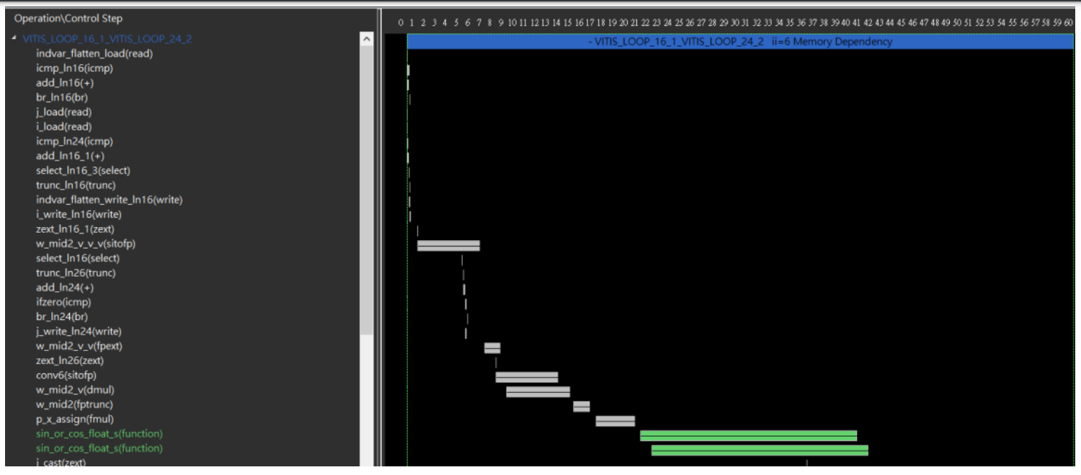
Simulation Result
Schedule Viewer(first for-loop)
(1)sin/cos function takes the longest clock cycles.(LUTRAM, floating point computation)
(2)II = 6
Notes:
Pre:
D+R = 30ps
Post:
D + R = X
已知
Post_D – Pre_D = 14ps
則 X = 44ps
PS. Post_D – Pre_D 可以透過量測gamma resolution差異得知
Pre_D = Pre_D(49) – Pre_D(50) = [D(49) + R] – [D(50) + R] = D(49) – D(50) = resolution * gamma_range
Post_D = Post_D(38) – Post_D(39) = [D(38) + R] – [D(39) + R] = D(38) – D(39) = resolution_post * gamma_range

Slide 11
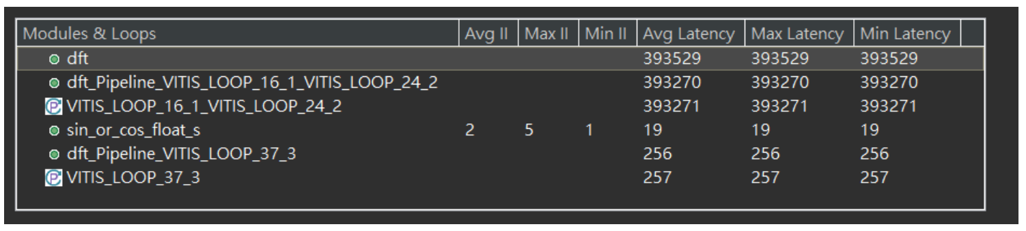
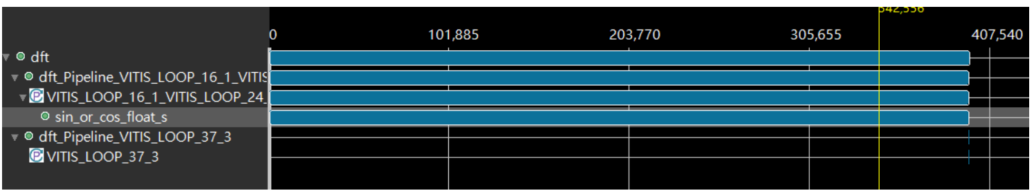
Simulation Result
Cosimulation report
(1)Avg Latency: 393529 cycles(3935290 ns)
(2)sin/cos function takes the longest clock cycles.(LUTRAM, floating point computation)
Notes:
Pre:
D+R = 30ps
Post:
D + R = X
已知
Post_D – Pre_D = 14ps
則 X = 44ps
PS. Post_D – Pre_D 可以透過量測gamma resolution差異得知
Pre_D = Pre_D(49) – Pre_D(50) = [D(49) + R] – [D(50) + R] = D(49) – D(50) = resolution * gamma_range
Post_D = Post_D(38) – Post_D(39) = [D(38) + R] – [D(39) + R] = D(38) – D(39) = resolution_post * gamma_range

Slide 12
Outline
Introduction
-Brief Introduction of Discrete Fourier Transform
-DFT Matrix
Origin Design
-Baseline Implementation
-Simulation Result
Optimization
-Way to Optimize the Design
-Comparison
References
Notes:
Pre:
D+R = 30ps
Post:
D + R = X
已知
Post_D – Pre_D = 14ps
則 X = 44ps
PS. Post_D – Pre_D 可以透過量測gamma resolution差異得知
Pre_D = Pre_D(49) – Pre_D(50) = [D(49) + R] – [D(50) + R] = D(49) – D(50) = resolution * gamma_range
Post_D = Post_D(38) – Post_D(39) = [D(38) + R] – [D(39) + R] = D(38) – D(39) = resolution_post * gamma_range

Slide 13
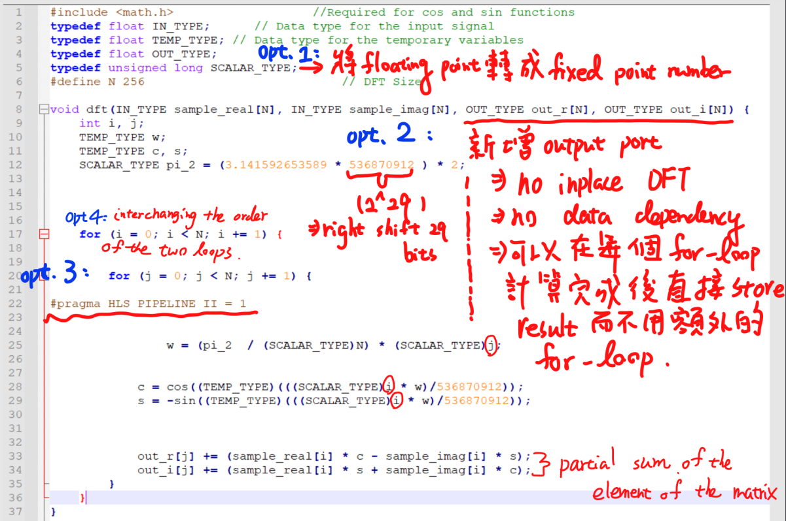
Way to Optimize the Design
Optimization
The graph shown below briefly shows how I optimize this program.
Notes:
Pre:
D+R = 30ps
Post:
D + R = X
已知
Post_D – Pre_D = 14ps
則 X = 44ps
PS. Post_D – Pre_D 可以透過量測gamma resolution差異得知
Pre_D = Pre_D(49) – Pre_D(50) = [D(49) + R] – [D(50) + R] = D(49) – D(50) = resolution * gamma_range
Post_D = Post_D(38) – Post_D(39) = [D(38) + R] – [D(39) + R] = D(38) – D(39) = resolution_post * gamma_range

Slide 15
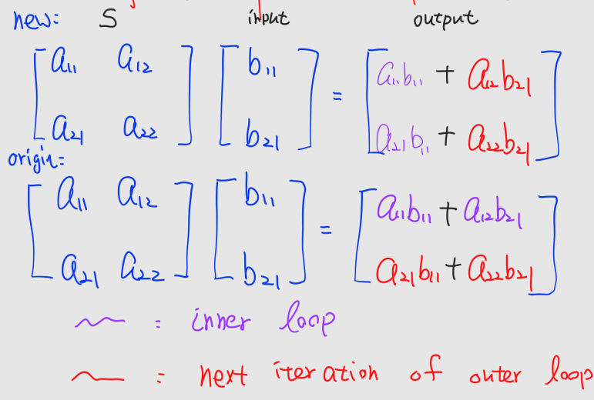

Slide 16
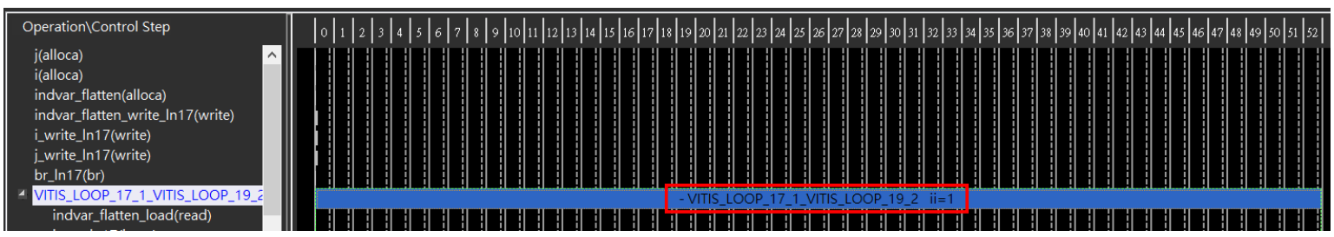
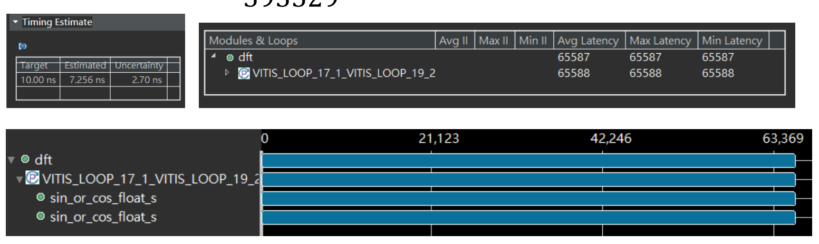
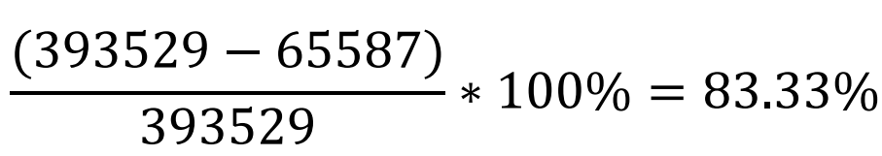
Comparison
Schedule Viewer(whole design)
Latency & Reduction Ratio
Notes:
Pre:
D+R = 30ps
Post:
D + R = X
已知
Post_D – Pre_D = 14ps
則 X = 44ps
PS. Post_D – Pre_D 可以透過量測gamma resolution差異得知
Pre_D = Pre_D(49) – Pre_D(50) = [D(49) + R] – [D(50) + R] = D(49) – D(50) = resolution * gamma_range
Post_D = Post_D(38) – Post_D(39) = [D(38) + R] – [D(39) + R] = D(38) – D(39) = resolution_post * gamma_range

Slide 17
Thank You

