Slide 1

Prefix Sum and Histogram
通訊所
110064521
江威霖

Slide 2
Outline
Prefix Sum
Code
Synthesis Report
Jupyter Result
Histogram
Code
Synthesis Report
Jupyter Result
Github
Question
Conclusion
Reference

Slide 3
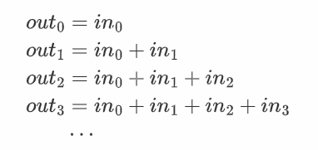


Prefix Sum
The prefix sum is the cumulative sum of a sequence of numbers.
Given a sequence of inputs ${in}_{n}$, the prefix sum ${out}_{n}$ is the summation of the first n inputs.
The following shows the computation:
It can be written as:

Slide 4
Code
Original
Improved
#define SIZE 128
void prefixsum(int in[SIZE], int out[SIZE]) {
#pragma HLS INTERFACE s_axilite port=return
#pragma HLS INTERFACE s_axilite register port=in
#pragma HLS INTERFACE s_axilite register port=out
out[0]=0;
for(int i=1; i < SIZE; i++) {
out[i] = out[i-1] + in[i];
}
}
#define SIZE 128
void prefixsum(int in[SIZE], int out[SIZE]) {
#pragma HLS INTERFACE s_axilite port=return
#pragma HLS INTERFACE s_axilite register port=in
#pragma HLS INTERFACE s_axilite register port=out
int A=in[0];
out[0] = A;
for(int i=1; i < SIZE; i++) {
#pragma HLS UNROLL
A = A +in[i];
out[i] = A;
}
}

Slide 5
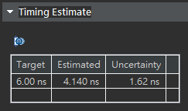
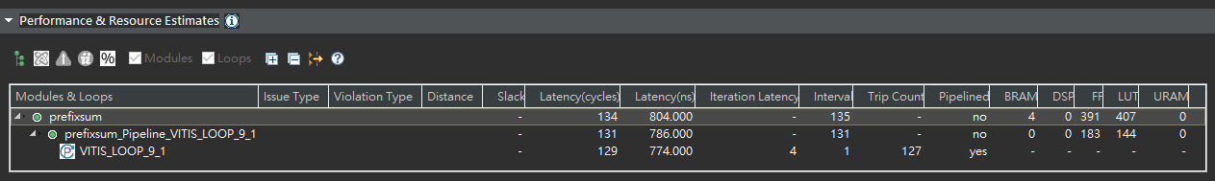
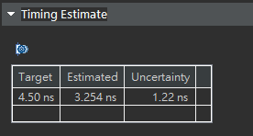
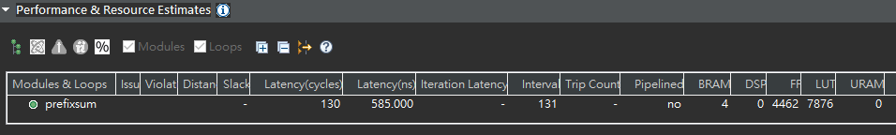
Synthesis Report
Original
Improved
 | Latency (cycles) | Latency (ns) | FF | LUT
Original | 134 | 804 | 391 | 407
Improved | 130 | 585 | 4462 | 7876

Slide 6
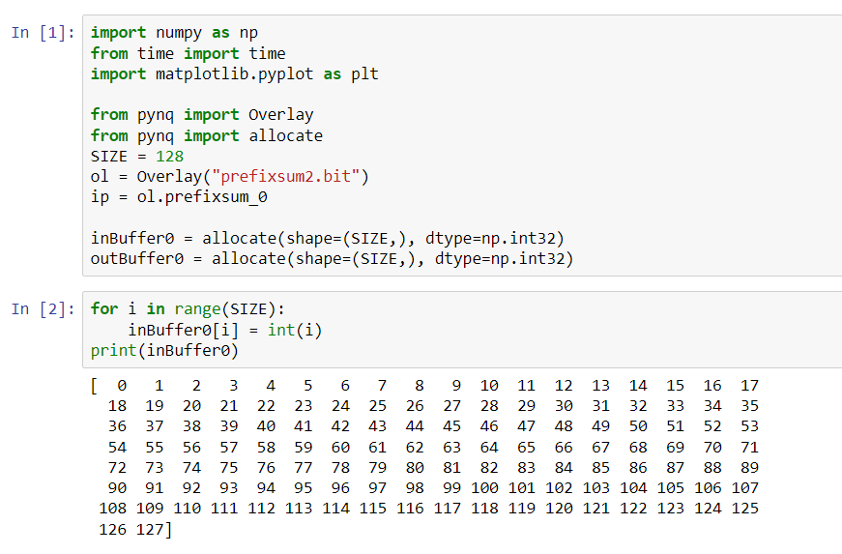
Jupyter Result(1)

Slide 7
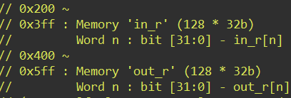
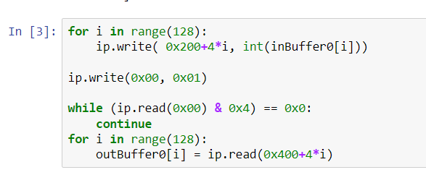
Jupyter Result(2)
Information from hw.h file

Slide 8
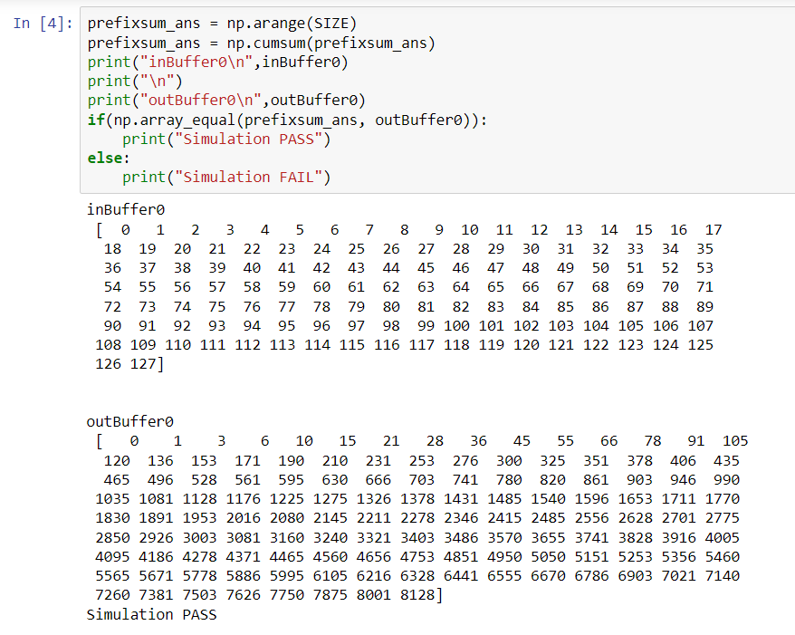
Jupyter Result(3)

Slide 9
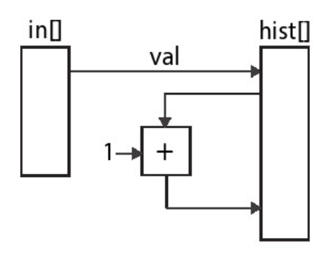
Histogram
A Histogram models the probability distribution of a discrete signal.
Given a sequence of discrete input values, the histogram counts the number of times each value appears in the sequence.

Slide 10
code
Original
Improved
#include "histogram.h"
void histogram(int in[INPUT_SIZE], int hist[VALUE_SIZE]) {
#pragma HLS INTERFACE s_axilite port=return
#pragma HLS INTERFACE s_axilite register port=in
#pragma HLS INTERFACE s_axilite register port=hist
int val;
for(int i = 0; i < INPUT_SIZE; i++) {
#pragma HLS PIPELINE II=2
val = in[i];
hist[val] = hist[val] + 1;
}
}
#include "histogram.h"
void histogram(int in[INPUT_SIZE], int hist[VALUE_SIZE]) {
int acc = 0;
int i, val;
int old = in[0];
#pragma HLS DEPENDENCE variable=hist intra RAW false
for(i = 0; i < INPUT_SIZE; i++) {
#pragma HLS PIPELINE II=1
val = in[i];
if(old == val) {
acc = acc + 1;
} else {
hist[old] = acc;
acc = hist[val] + 1;
}
old = val;
}
hist[old] = acc;
}

Slide 11
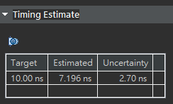
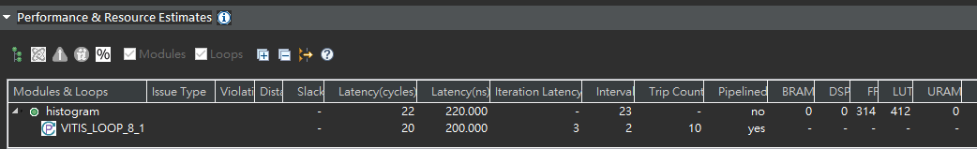
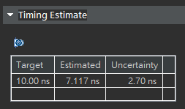
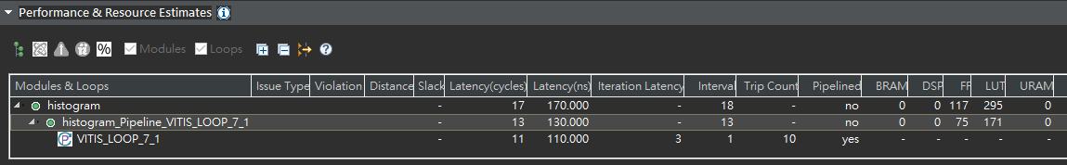
Synthesis Report
Original
Improved
 | Latency (cycles) | Latency (ns) | FF | LUT
Original | 22 | 220 | 314 | 412
Improved | 17 | 170 | 117 | 295

Slide 12
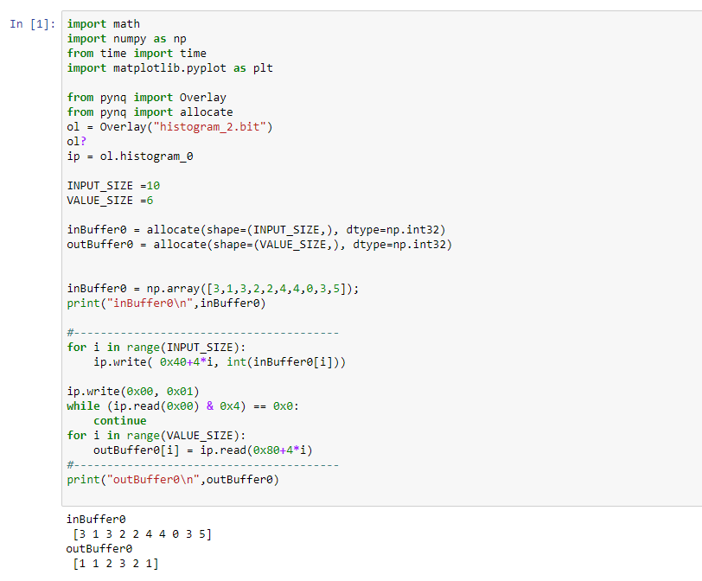
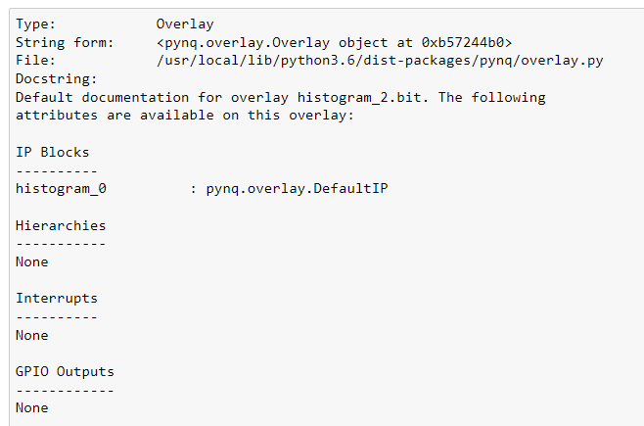
Jupyter Result(1)

Slide 13
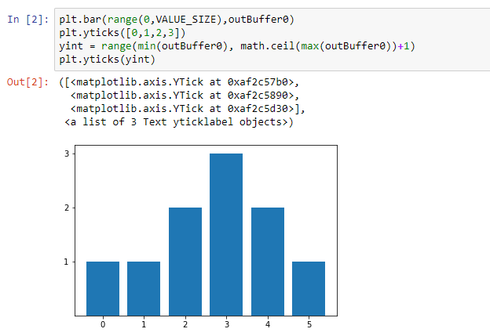
Jupyter Result(2)

Slide 14

gITHUB
https://github.com/caota985107/prefix-sum-and-histogram

Slide 15
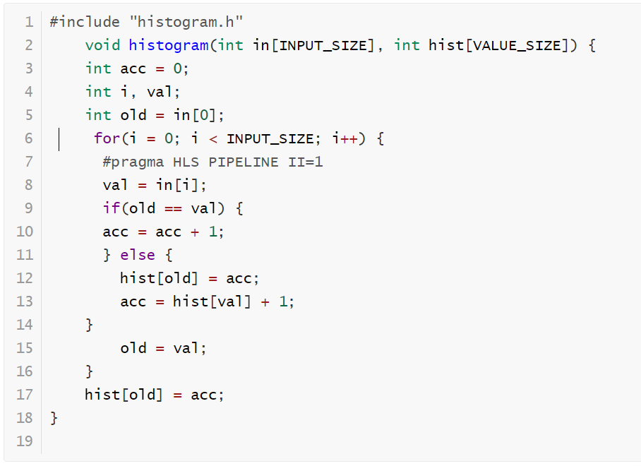
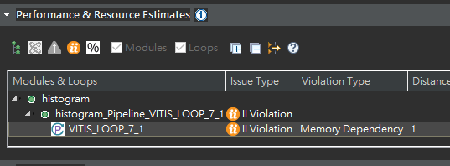
Question
1. 左方為histogram的主程式，經合成後為何會發生violation，該如何解決?。

Slide 16


ANS
Loop-independent dependence: The same element is accessed in the same loop iteration.
Loop-carry dependence: The same element is accessed in a different loop iteration.

Slide 17
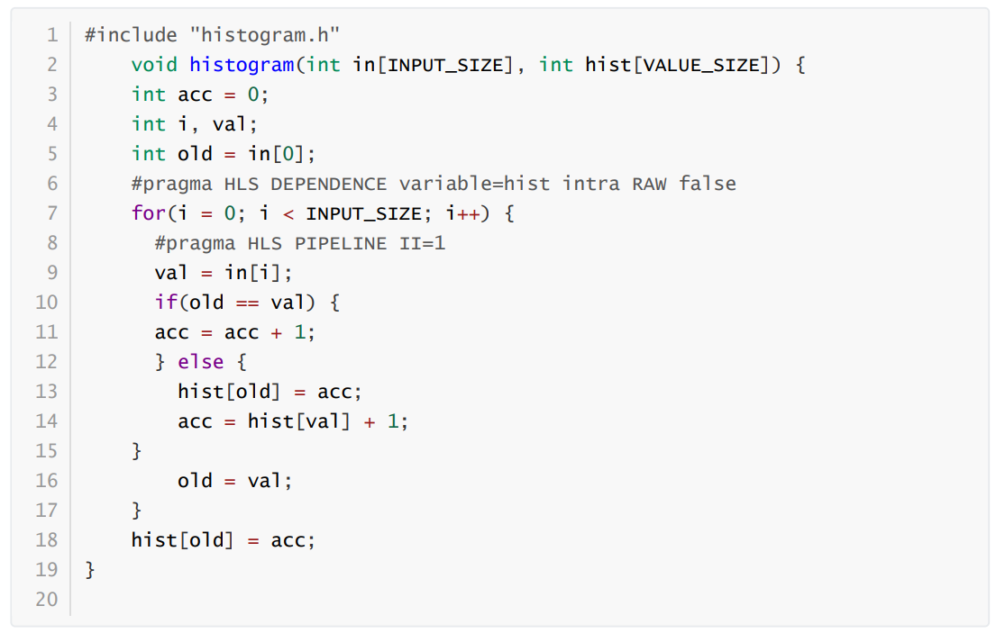
ANS
Removes the dependence between in the same iterations of in function .

Slide 18
conclusion
在Prefix sum 與Histogram 都發生重複存取記憶體，如果記憶體的存取不是pipeline將會限制throughput。
Prefix Sum 只執行一次的累加，而Histogram中需為每個直條計算一次的累加。因此Prefix sum的存取記憶體模式是固定的，而Histogram必須改寫code以避免data dependency問題發生，解決重複存取記憶體的狀況。
結果顯示，透過UNROLL可以在resources與latency之間trade-off。

Slide 19
reference
[1] Parallel Programming for FPGAs Ryan Kastner, Janarbek Matai, and Stephen Neuendorffer
[2] https://github.com/KastnerRG/pp4fpgas
[3] pragma HLS dependence (xilinx.com)

