Slide 1
Sorting Algorithm
Insertion sort, merge sort
110061560 吳秉豐
2022/03/29

Slide 2
Outline
Insertion Sort
Merge Sort
C++ Code
Verify on PYNQ
Performance Compare
Github
Question
Reference

Slide 3
Outline
Insertion Sort
Merge Sort
C++ Code
Verify on PYNQ
Performance Compare
Github
Question
Reference

Slide 4
Insertion Sort
Insertion sort is a simple sorting algorithm that builds the final sorted array one item at a time.
It is much less efficient on large lists than more advanced algorithms such as quicksort, heapsort, or merge sort.
advantages:
Simple implementation
Efficient for (quite) small data sets
only requires a constant amount O(1) of additional memory space
Notes:
Quicksort快速排序, heapsort堆疊排序, 講解操作方法，對於一個尚未排序的資料，我們要在已經排序過的資料中找到正確的位置放入，選取、比較、移動或者放入，放入的情況:比到最左邊的位置(表示此數字是目前的最小值)、比較的對象小於等於手上的數字

Slide 5
Outline
Insertion Sort
Merge Sort
C++ Code
Verify on PYNQ
Performance Compare
Github
Question
Reference

Slide 6
Merge Sort
Merge sort is an efficient, general-purpose, and comparison-based sorting algorithm.
advantages:
The same amount of data with the same number of running cycles
Efficient for (quite) large data sets
Notes:
相較於插入排序法，在數字較亂時會有較高的效率，因為合併排序對於相同的資料量會有相同的運作cycle時間

Slide 7
Outline
Insertion Sort
Merge Sort
C++ Code
Verify on PYNQ
Performance Compare
Github
Question
Reference

Slide 8
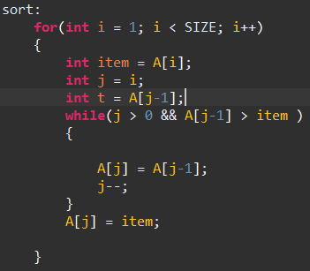
C++ Code
Insertion Sort
Notes:
分段說明，上方是把每一輪要比的數值與起始點定義好
後面則是比較的過程，如果手上的數字比較小就會再繼續向左找

Slide 9
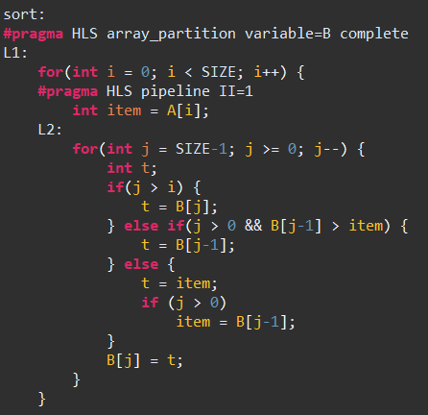
C++ Code
Insertion Sort improved
Notes:
Array_partition是用來把每一個記憶體位置拆開，所以就能夠分別對每個記憶體要求讀值或寫值

Slide 10
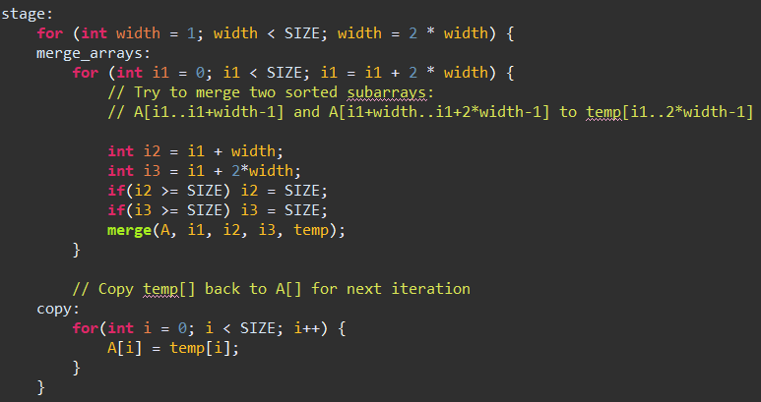
C++ Code
Merge Sort

Slide 11
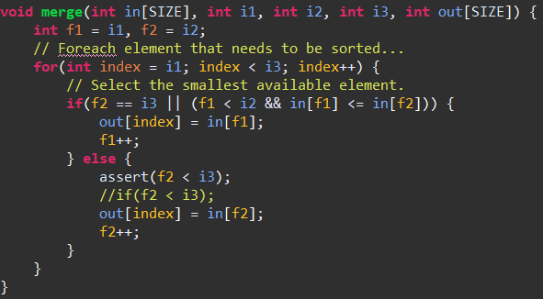
C++ Code
Merge Sort
i1 |  | i2 |  | i3
Notes:
這裡舉個例子，寬度為2
在圖三中，會找目前兩組中最小的數值(最左邊的數值)
某一組的數字全部被排完，也就是f1跑到i2或f2跑到i3這兩種狀況，會會把剩下的的數字全部依序塞入新的群組，直到數字全部被放完。

Slide 12
Outline
Insertion Sort
Merge Sort
C++ Code
Verify on PYNQ
Performance Compare
Github
Question
Reference

Slide 13
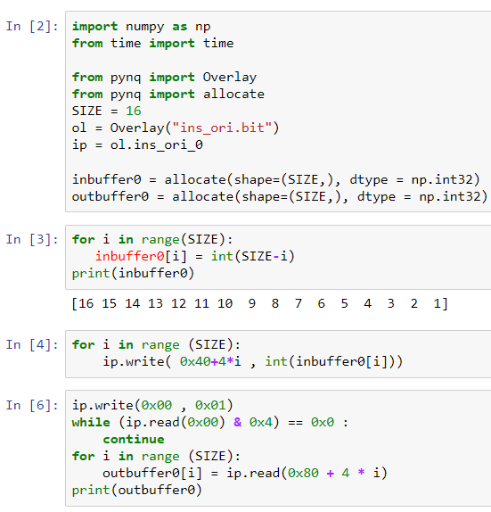
Verify on PYNQ
Python code

Slide 14
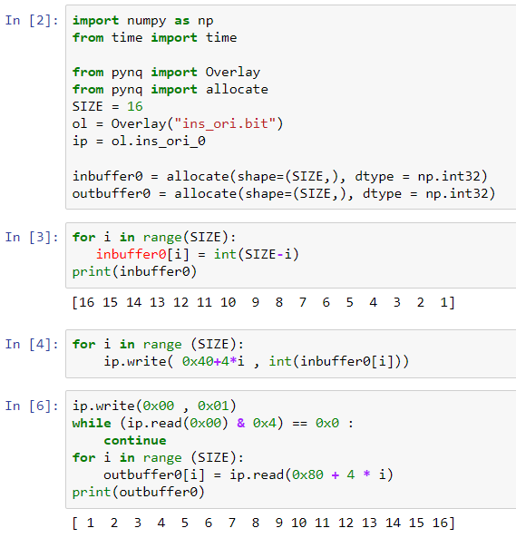
Verify on PYNQ
Result

Slide 15
Outline
Insertion Sort
Merge Sort
C++ Code
Verify on PYNQ
Performance Compare
Github
Question
Reference

Slide 16



Performance Compare
Insertion Sort VS Merge Sort
Test data 1 :
Test data 2 :

Slide 17
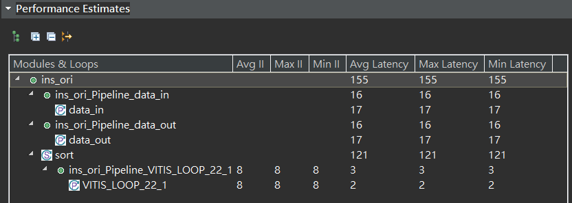
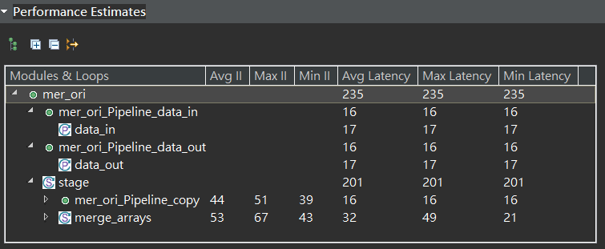
Performance Compare 1
Insertion Sort V.S Merge Sort Test data 1

Slide 18
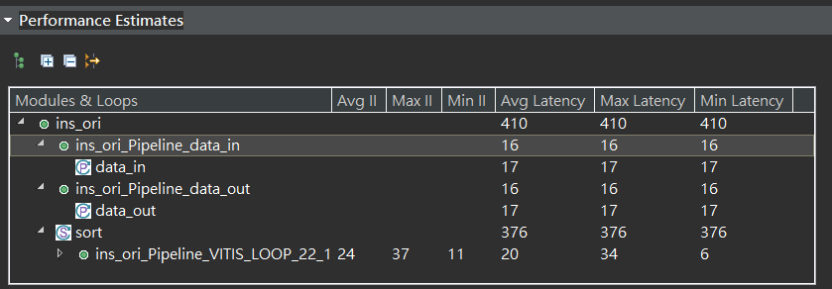
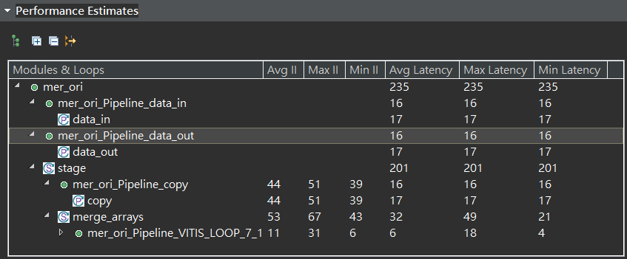
Performance Compare 1
Insertion Sort V.S Merge Sort Test data 2

Slide 19
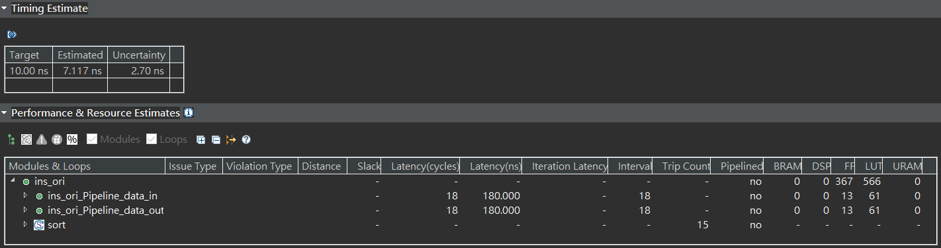
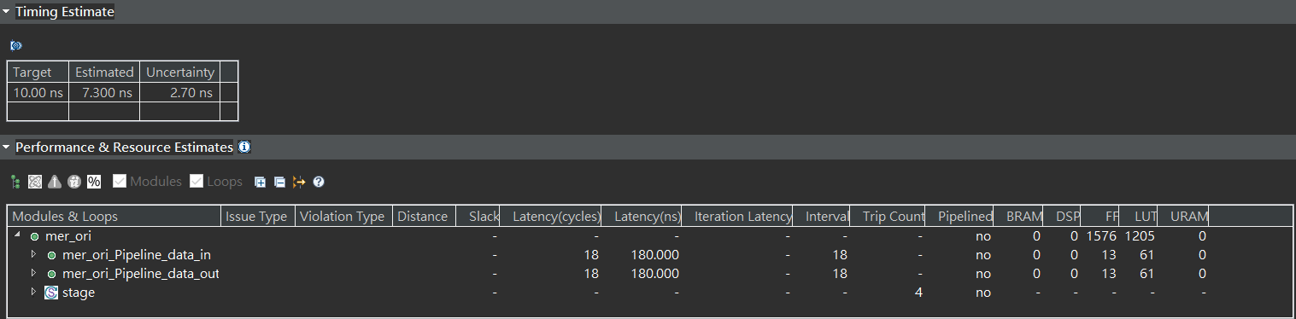
Performance Compare 1
Insertion Sort V.S Merge Sort – Performance

Slide 20
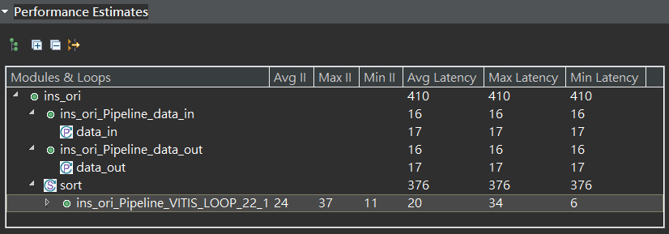
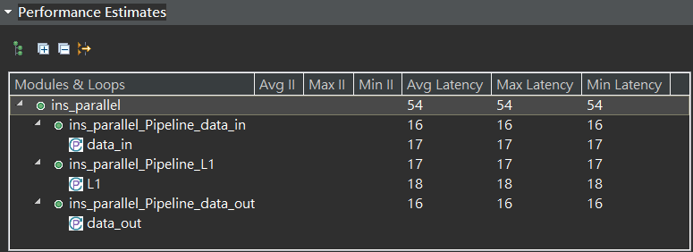
Performance Compare 2
Insertion Sort V.S Insertion Sort Improved – Run cycle time

Slide 21
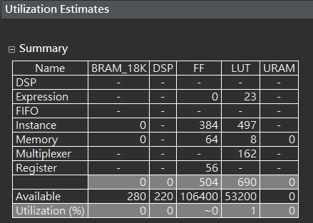
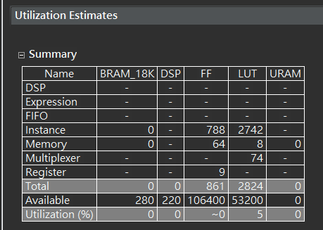
Performance Compare 2
Insertion Sort V.S Insertion Sort Improved – Utilization

Slide 22
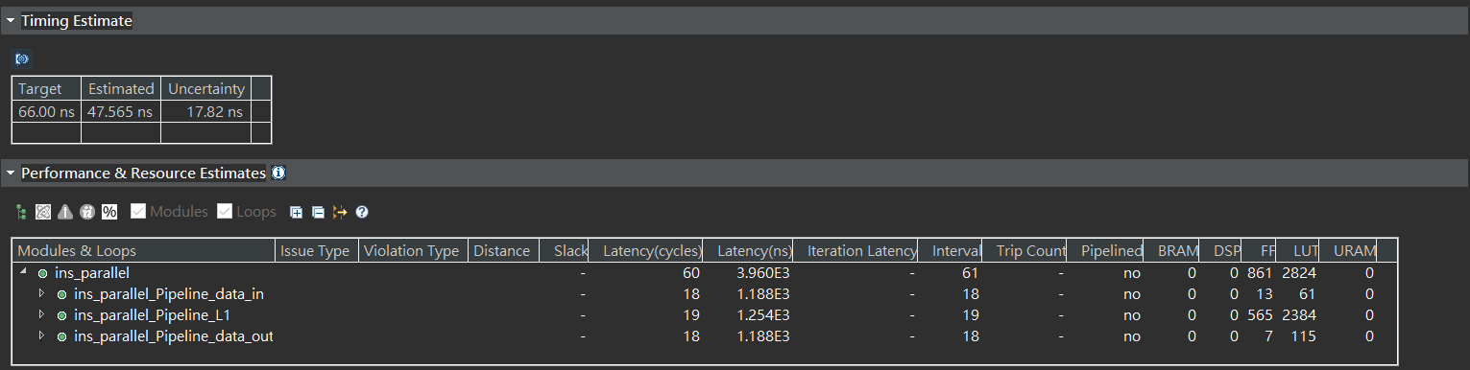
Performance Compare 2
Insertion Sort V.S Insertion Sort Improved - Performance

Slide 23
Performance Compare
Insertion Sort V.S Insertion Sort Optimize – Cycle time
Insertion Sort : 10ns
Insertion Sort Optimize: 66ns

Slide 24
Outline
Insertion Sort
Merge Sort
C++ Code
Verify on PYNQ
Performance Compare
Github
Question
Reference

Slide 25
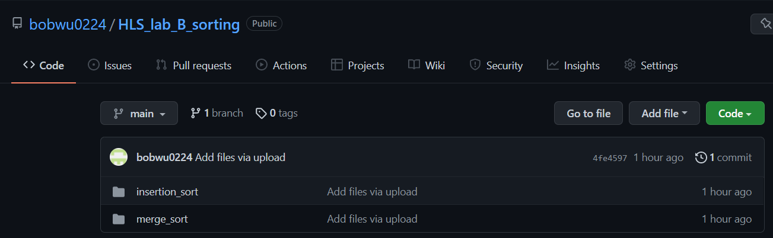
Github
https://github.com/bobwu0224/HLS_lab_B_sorting

Slide 26
Outline
Insertion Sort
Merge Sort
C++ Code
Verify on PYNQ
Performance Compare
Github
Question
Reference

Slide 27
Question
{3 , 1 , 6 , 2 , 8 , 4 , 7 , 5}用哪一種排序法所需要的步驟比較少?

Slide 28
Question
{3 , 1 , 6 , 2 , 8 , 4 , 7 , 5}用哪一種排序法所需要的步驟比較少?
3 | 1 | 6 | 2 | 8 | 4 | 7 | 5
13 |  | 26 |  | 48 |  | 57
1236 |  |  |  | 4578
12345678
2x4=8
4x2=8
8x1=8
8+8+8=24

Slide 29
Question
{3 , 1 , 6 , 2 , 8 , 4 , 7 , 5}用哪一種排序法所需要的步驟比較少?
3(3)
33(1)
13
136(6)
1366(2)
1336
1236
12368(8)
123688(4)
123668
123468
1234688(7)
1234678
12346788(5)
12346778
12346678
12345678
一共17

Slide 30
Outline
Insertion Sort
Merge Sort
C++ Code
Verify on PYNQ
Performance Compare
Github
Question
Reference

Slide 31
Reference
https://en.wikipedia.org/wiki/Insertion_sort
https://en.wikipedia.org/wiki/Merge_sort
pp4fpgas/examples at master · KastnerRG/pp4fpgas · GitHub

