Slide 1
Application Acceleration with High-Level Synthesis LabB
Systolic Array
電機系 110061555 李冠霈

Slide 2
Outline
Introduction
- Systolic array
Code & Pragma
Time & Utilization
- Original
- Unroll and array partition
- Software emulation
- Hardware emulation
- Hardware
Question
Github

Slide 3
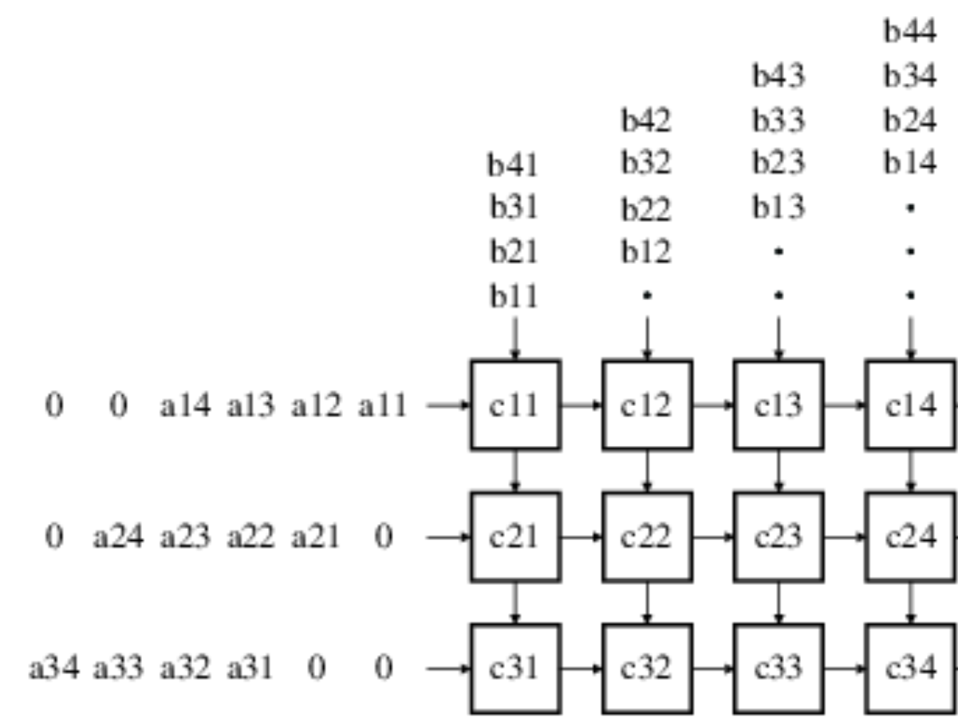
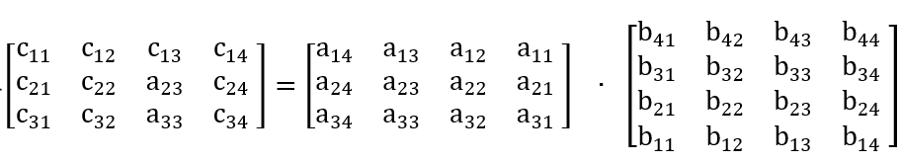
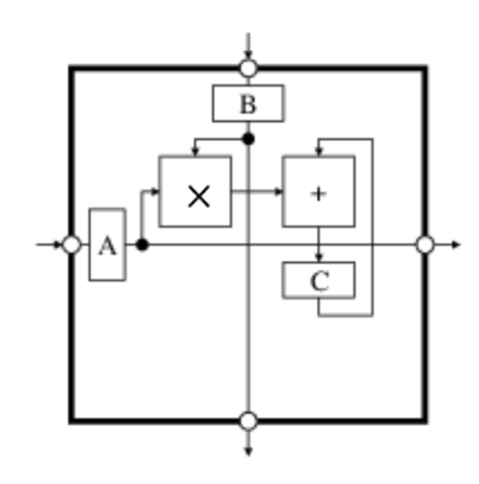
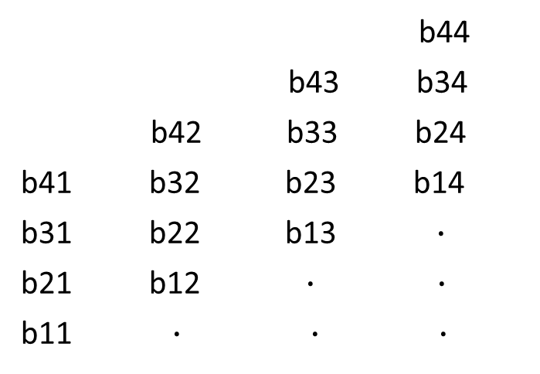
Introduction
Systolic Array
b44
b43 b34
b42 b33 b24
b41 b32 b23 b14
b31 b22 b13 $∙$
b21 b12 $∙$ $∙$
b11 $∙$ $∙ ∙$
0 0 a14 a13 a12 a11
0 a24 a23 a22 a21 0
a34 a33 a32 a31 0 0

Slide 4
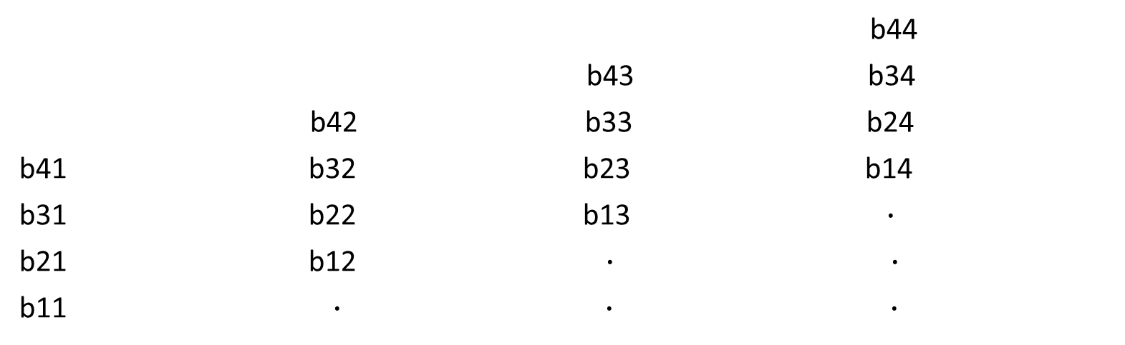
Systolic Array
b44
b43 b34
b42 b33 b24
b41 b32 b23 b14
b31 b22 b13 $∙$
b21 b12 $∙ ∙$
b11 $∙$ $∙ ∙$
0 0 a14 a13 a12 a11
0 a24 a23 a22 a21 0
a34 a33 a32 a31 0 0

Slide 5

Systolic Array
b44
b43 b34
b42 b33 b24
b41 b32 b23 b14
b31 b22 b13 $∙$
b21 b12 $∙ ∙$
b11
a11*b11 a11
0 0 a14 a13 a12
0 a24 a23 a22 a21
a34 a33 a32 a31 0

Slide 6

Systolic Array
b44
b43 b34
b42 b33 b24
b41 b32 b23 b14
b31 b22 b13 $∙$
b21 b12
b11
a11*b11 a12 a11*b12 a11
a12*b21
a21*b11 a21
0 0 a14 a13
0 a24 a23 a22
a34 a33 a32 a31

Slide 7
Systolic Array
b44
b43 b34
b42 b33 b24
b41 b32 b23 b14
b31 b22 b13
b21 b12
a11*b11 a13 a11*b12 a12 a11*b13 a11
a12*b21 a12*b22
a13*b31
a21*b11 a22 a21*b12 a21
a22*b21
a31*b11 a31
0 0 a14
0 a24 a23
a34 a33 a32

Slide 8
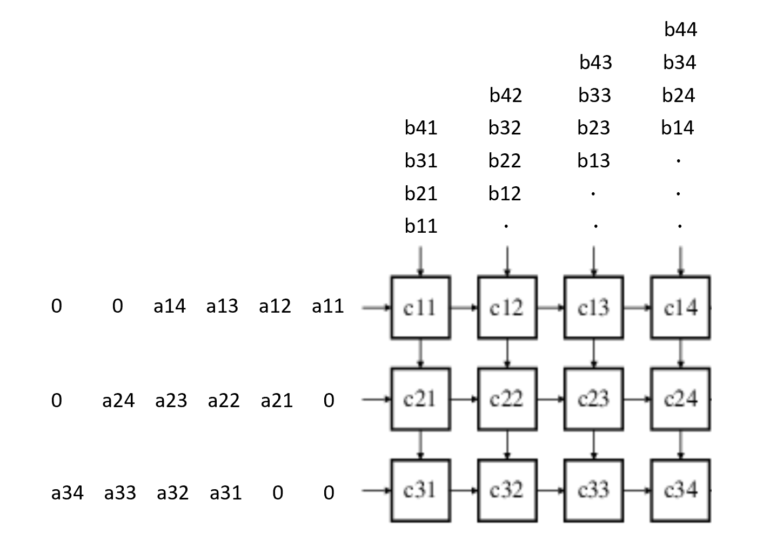
Systolic Array
a11*b11 a11*b12 a11*b13 a11*b14
a12*b21 a12*b22 a12*b23 a12*b24
a13*b31 a13*b32 a13*b33 a13*b34
a14*b41 a14*b42 a14*b43 a14*b44
a21*b11 a21*b12 a21*b13 a21*b14
a22*b21 a22*b22 a22*b23 a22*b24
a23*b31 a23*b32 a23*b33 a23*b34
a24*b41 a24*b42 a24*b43 a24*b44
a31*b11 a31*b12 a31*b13 a31*b14
a32*b21 a32*b22 a32*b23 a32*b24
a33*b31 a33*b32 a33*b33 a33*b34
a34*b41 a34*b42 a34*b43 a34*b44

Slide 9
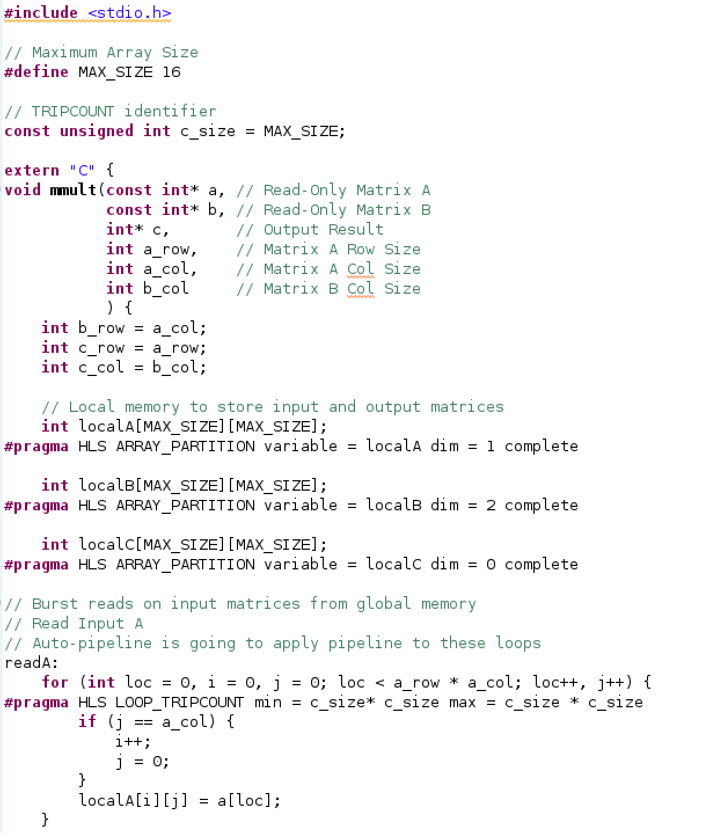
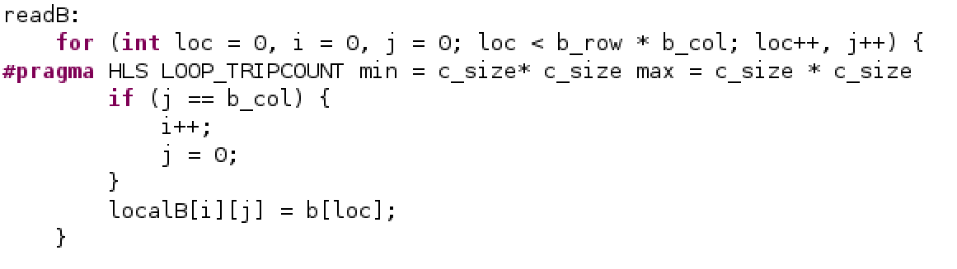
Code & Pragma

Slide 10
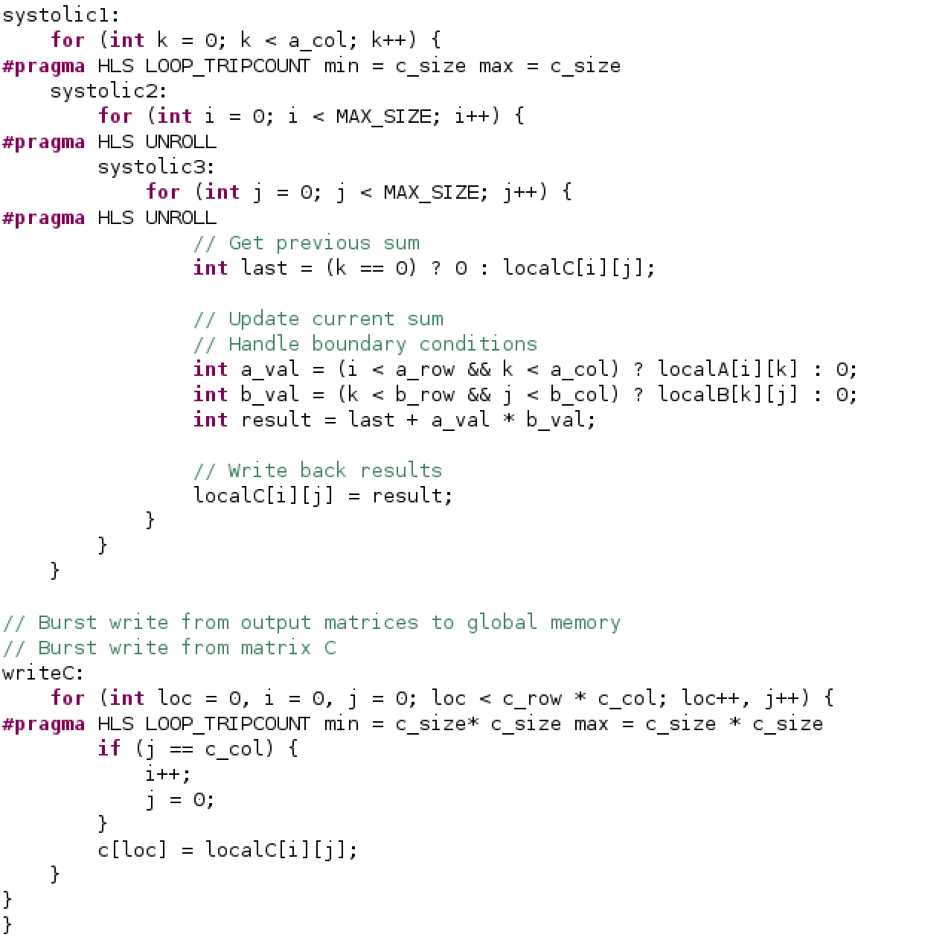

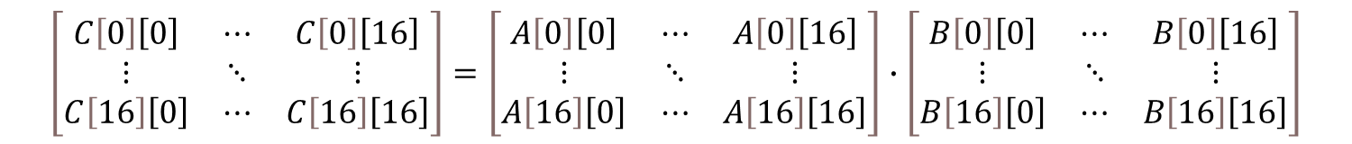
Code & Pragma
$$\left[\begin{matrix}C\left[0\right]\left[0\right] & ⋯ & C\left[0\right]\left[16\right] \\ ⋮ & ⋱ & ⋮ \\ C\left[16\right]\left[0\right] & ⋯ & C\left[16\right]\left[16\right]\end{matrix}\right]=\left[\begin{matrix}A\left[0\right]\left[0\right] & ⋯ & A\left[0\right]\left[16\right] \\ ⋮ & ⋱ & ⋮ \\ A\left[16\right]\left[0\right] & ⋯ & A\left[16\right]\left[16\right]\end{matrix}\right]∙\left[\begin{matrix}B\left[0\right]\left[0\right] & ⋯ & B\left[0\right]\left[16\right] \\ ⋮ & ⋱ & ⋮ \\ B\left[16\right]\left[0\right] & ⋯ & B\left[16\right]\left[16\right]\end{matrix}\right]$$
B[0][0] B[0][1] $⋯$ B[0][16]
A[0][0] $⋯$
A[1][0] $⋯$
$⋮$ $⋮ ⋮ ⋮$ $⋮$
A[16][0] $⋯$
Partial sum

Slide 11
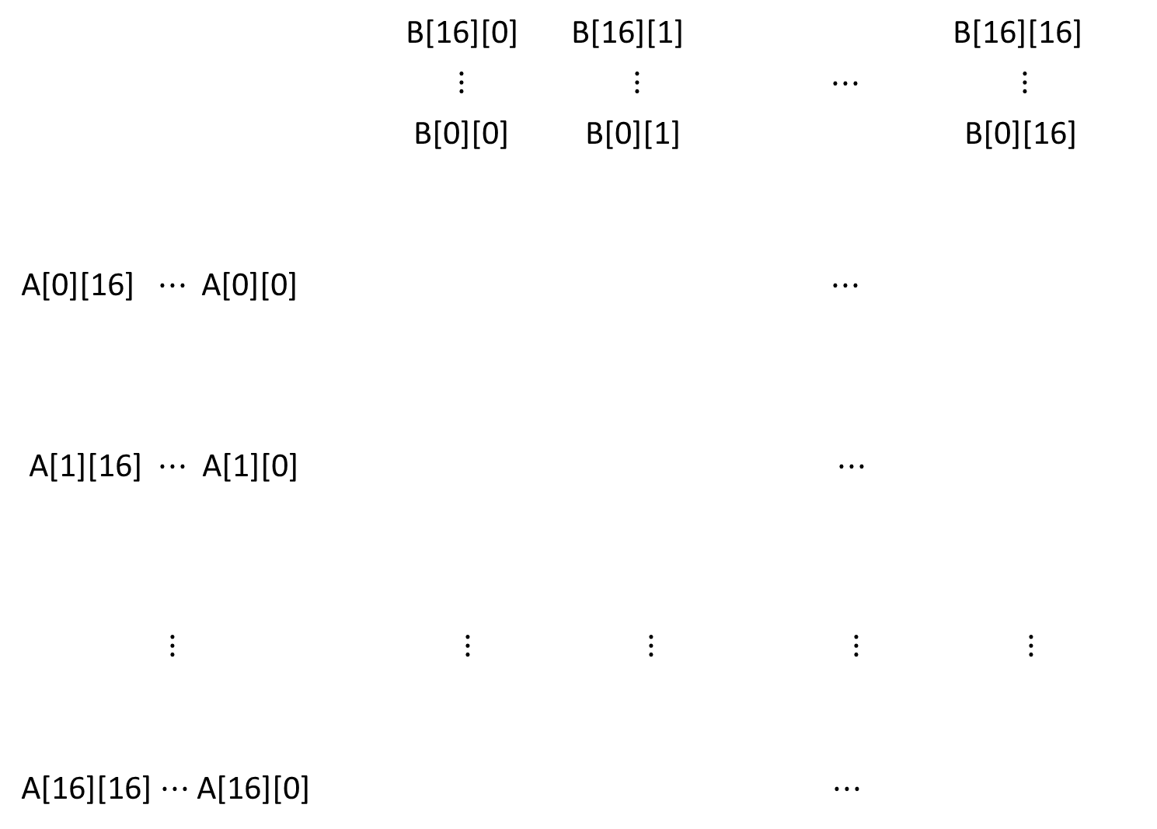
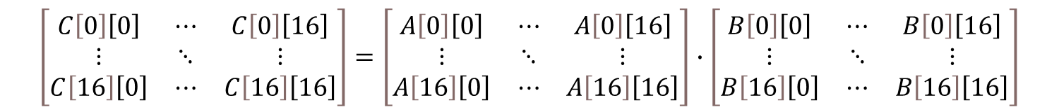
Code & Pragma
$$\left[\begin{matrix}C\left[0\right]\left[0\right] & ⋯ & C\left[0\right]\left[16\right] \\ ⋮ & ⋱ & ⋮ \\ C\left[16\right]\left[0\right] & ⋯ & C\left[16\right]\left[16\right]\end{matrix}\right]=\left[\begin{matrix}A\left[0\right]\left[0\right] & ⋯ & A\left[0\right]\left[16\right] \\ ⋮ & ⋱ & ⋮ \\ A\left[16\right]\left[0\right] & ⋯ & A\left[16\right]\left[16\right]\end{matrix}\right]∙\left[\begin{matrix}B\left[0\right]\left[0\right] & ⋯ & B\left[0\right]\left[16\right] \\ ⋮ & ⋱ & ⋮ \\ B\left[16\right]\left[0\right] & ⋯ & B\left[16\right]\left[16\right]\end{matrix}\right]$$
B[16][0] B[16][1] B[16][16]
$⋮$ $⋮$ $⋯$ $⋮$
B[0][0] B[0][1] B[0][16]
A[0][16] $⋯$ A[0][0] $⋯$
A[1][16] $⋯$ A[1][0] $⋯$
$⋮$ $⋮ ⋮ ⋮$ $⋮$
A[16][16]$⋯$A[16][0] $⋯$
Partial sum

Slide 12
Code & Pragma

Slide 13
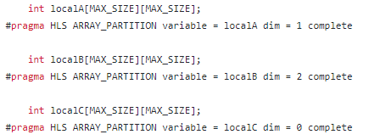
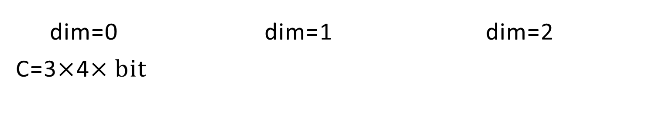
Code & Pragma
dim=0 dim=1 dim=2
C=3$×$4$×bit$

Slide 14
Time & Utilization
mmult |  | Original | Unroll and array partition
Software emulation | Total application run time | 70.6691ms | 65.903ms
 | Device execution time | 0.52ms | 0.48ms
 | CU utilization | 0.469ms (86%) | 0.426ms (87%)
Hardware emulation | Total application run time | 43069ms | 42703.5ms
 | Device execution time | 0.022ms | 0.01ms
 | CU utilization | 0.018ms (84%) | 0.004ms (69%)
Hardware | Total application run time | 5674.54ms | 4926.1201ms
 | Device execution time | 0.35ms | 0.028ms

Slide 15

Question
How many cycles does it take to use a systolic array to complete the A[3][4]$∙B[4][4]$ operation?

Slide 16
Systolic Array
Answer: 9 cycles
a11*b11 a11*b12 a11*b13 a11*b14
a12*b21 a12*b22 a12*b23 a12*b24
a13*b31 a13*b32 a13*b33 a13*b34
a14*b41 a14*b42 a14*b43 a14*b44
a21*b11 a21*b12 a21*b13 a21*b14
a22*b21 a22*b22 a22*b23 a22*b24
a23*b31 a23*b32 a23*b33 a23*b34
a24*b41 a24*b42 a24*b43 a24*b44
a31*b11 a31*b12 a31*b13 a31*b14
a32*b21 a32*b22 a32*b23 a32*b24
a33*b31 a33*b32 a33*b33 a33*b34
a34*b41 a34*b42 a34*b43 a34*b44

Slide 17
Hithub
https://github.com/kuanpei/Lab_B_Systolic_array

Slide 18
Thanks for listening

