Slide 1

traveling salesman problem (tsp)
journal
Application Acceleration with High-Level Synthesis
National Tsing Hua University

Slide 2
Introduction

Slide 3
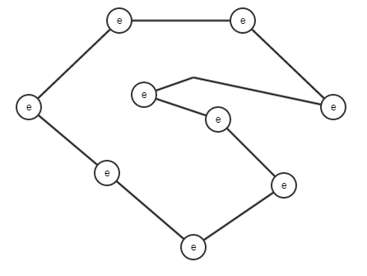
What is TSP?
Given a list of cities and the distances between each pair of cities
Find the shortest possible route that visits each city exactly once and returns to the origin city

Slide 4
Environment setup and source code by Xilinx
install xilinx_u200_gen3x16_xdma_1_202110_1 as in lab 3 on Ubuntu https://www.xilinx.com/products/boards-and-kits/alveo/u200.html#gettingStarted
git clone https://github.com/Xilinx/Vitis-Tutorials
cd Vitis-Tutorials/Hardware_Acceleration/Design_Tutorials/04-traveling-salesperson

Slide 5
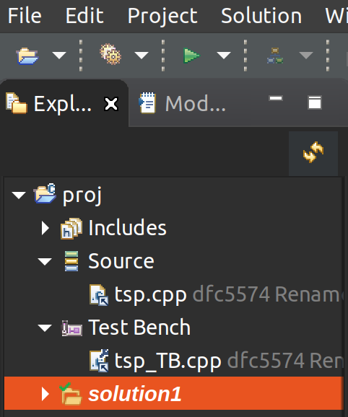
Automatic setup in Vitis_HLS
cd ./build
vitis_hls -p hls.tcl &
City coordinates (input)
–tsp_TB.cpp–>
Distances
–tsp.cpp–>
shortest (output)

Slide 6
Design structure

Slide 7
tsp function recieved N*N distances
void tsp(hls::stream<uint16_t>& streamDistances, unsigned int& shortestDistance)
{
// defines our input as coming from an AXI-Stream via the INTERFACE pragma
#pragma HLS INTERFACE axis port=streamDistances

Slide 8
Normalize Distances[N*N] (float) to Distances[N*N] (int)
// Normalizing distances to get the maximum precision on 16-bit integers
uint16_t maxUint = std::numeric_limits<uint16_t>::max();
for ( int i = 0; i < N*N; ++i ) {
cout << "Distance (fp32): " << distances[i] << " Norm. (uint16): " << (uint16_t)((distances[i]/maxDist) * maxUint);
inputDistances.write((distances[i]/maxDist) * maxUint);
}

Slide 9
Hardware Acceleration tricks
distances are stored into an internal array rather than dedicated memory blocks (When N < 48, N*N*16 < 36,000 (BRAM size))
Lookups performed with on-chip memory are fast

Slide 10
create route permutations "on-the-fly"
// Represent "i" in factorial base:
// N = 4, i = 5 = 0 * 3! + 2 * 2! + 1 * 1! + 0 * 0 = 0210
for (int k = 0; k < N; ++k) {
perm[k] = i / factorial(N - 1 - k);
i = i % factorial(N - 1 - k);
}

Slide 11
create route permutations "on-the-fly"
// Transform the factorial representation into an inversion vector
// 0100 -> 0101 -> 0102 -> 0103 -> 0103 -> 0113 -> 0123
for (char k = N - 1; k > 0; --k)
for (char j = k - 1; j >= 0; --j)
perm[k] += (perm[j] <= perm[k]);

Slide 12
create route permutations "on-the-fly" : N = 4
0: 0000 -> 0(0 + 1)(0 + 2)(0 + 3) -> 0123
1: 0010 -> 0(0 + 1)(1 + 2)(0 + 2) -> 0132
2: 0100 -> 0(1 + 1)(0 + 1)(0 + 3) -> 0213
3: 0110 -> 0(1 + 1)(1 + 2)(0 + 1) -> 0231
4: 0200 -> 0(2 + 1)(0 + 1)(0 + 2) -> 0312
5: 0210 -> 0(2 + 1)(1 + 1)(0 + 1) -> 0321

Slide 13
lookup permutation from Distances (small, onto on-chip)
template<typename T>
unsigned int getDistance(const T perm[N], const uint16_t distances[N][N])
{
#pragma HLS INLINE
unsigned int ret = 0;
for(int i = 0; i < N-1; ++i)
ret += distances[perm[i]][perm[i+1]];
return ret;
}

Slide 14
Compare to get the shortest distance
loop_compute: for( unsigned long int i_ = 0; i_ < factorialN; i_ += 1 )
{
#pragma HLS pipeline II=1
candidate = std::min(candidate, compute(i_, distances));
}
// Last candidate from loop above holds the shortest distance
shortestDistance = candidate;

Slide 15
Result

Slide 16
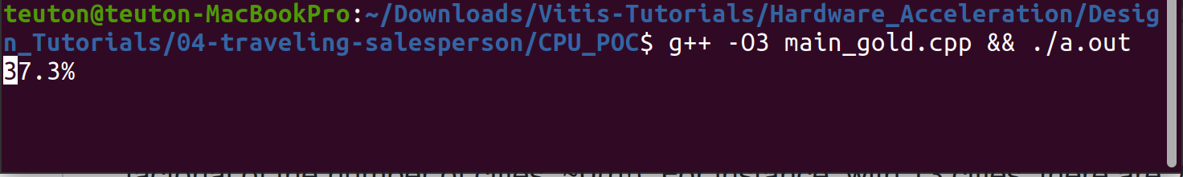
Algorism and first attempt
Test each possible combination of cities with a recursive loop
cd CPU_POC
g++ -O3 main_gold.cpp && ./a.out
Without hardware accelerator, this takes over a minute.

Slide 17
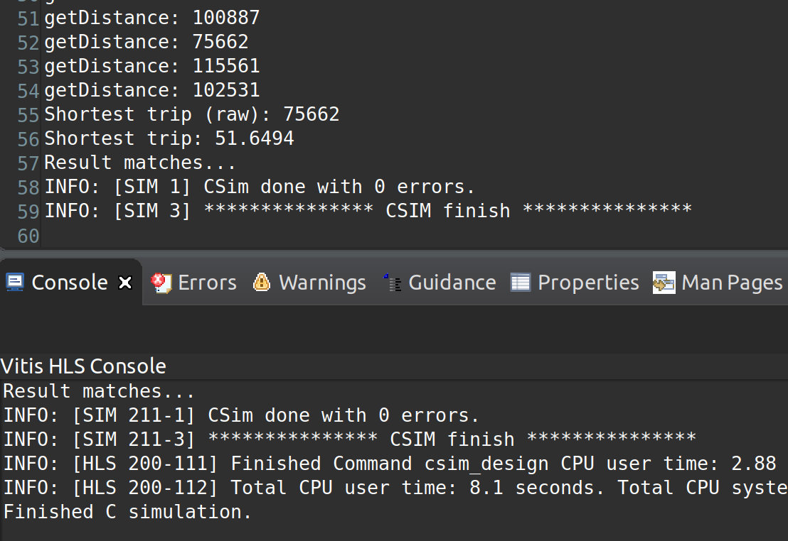
Run Vitis HLS C Simulation (N = 5)

Slide 18
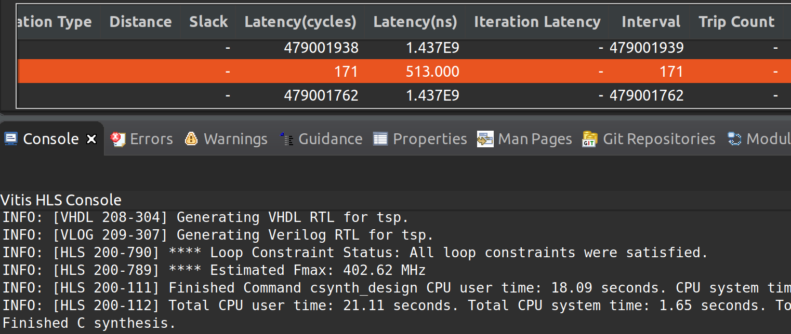
Run Vitis HLS C Synthesis (N = 13)

Slide 19
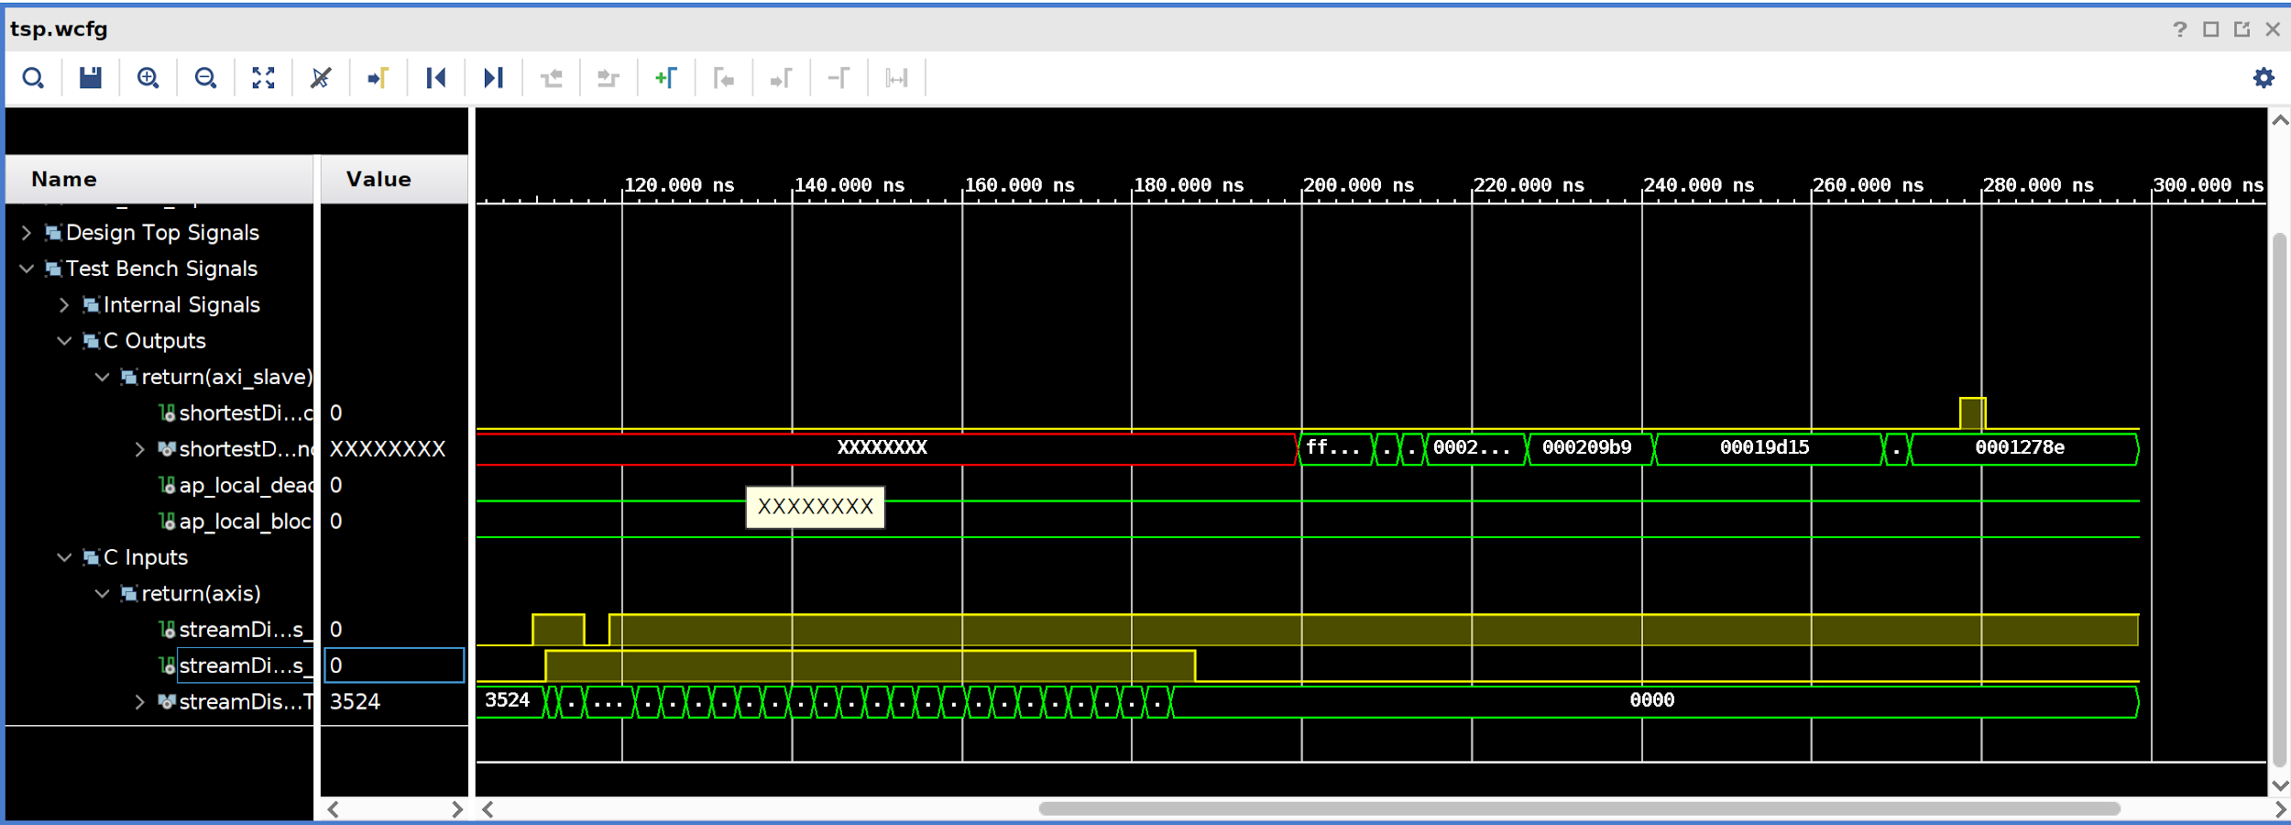
Run the Co-Simulation (N = 5)
Something is missing?

Slide 20
implemented with 4 parallel memory lookups
cd ./build
vitis_hls -p hls_opt.tcl &
loop_compute: for( unsigned long int i_ = 0; i_ < factorialN; i_ += 4 )
{
#pragma HLS pipeline II=1
candidate0 = std::min(candidate0, compute(i_+0, distances_0));
candidate1 = std::min(candidate1, compute(i_+1, distances_1));
candidate2 = std::min(candidate2, compute(i_+2, distances_2));
candidate3 = std::min(candidate3, compute(i_+3, distances_3));
}

Slide 21
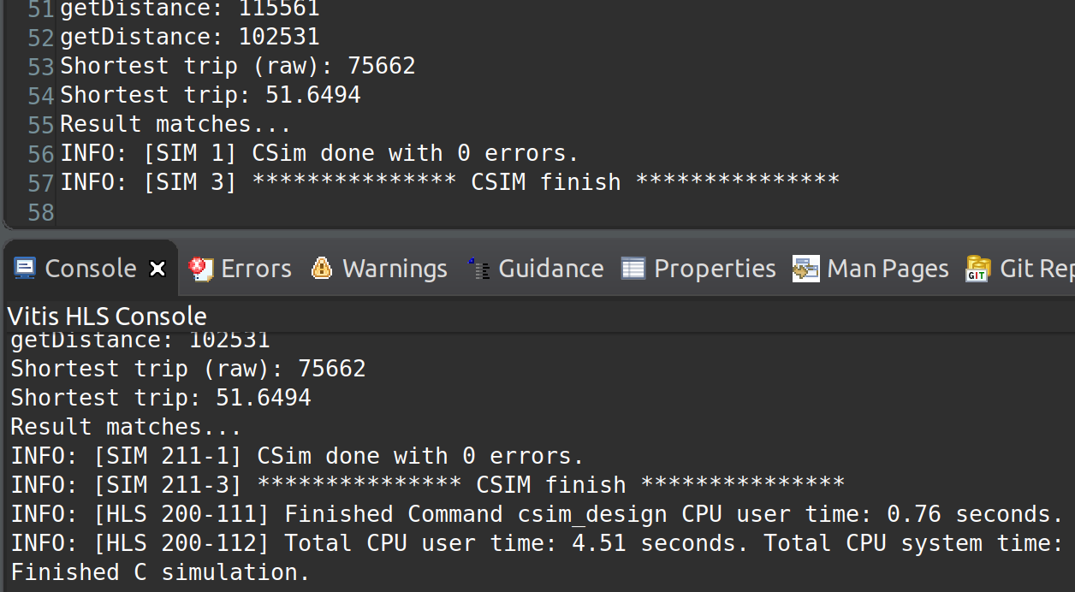
Run Vitis HLS C Simulation (N = 5)

Slide 22
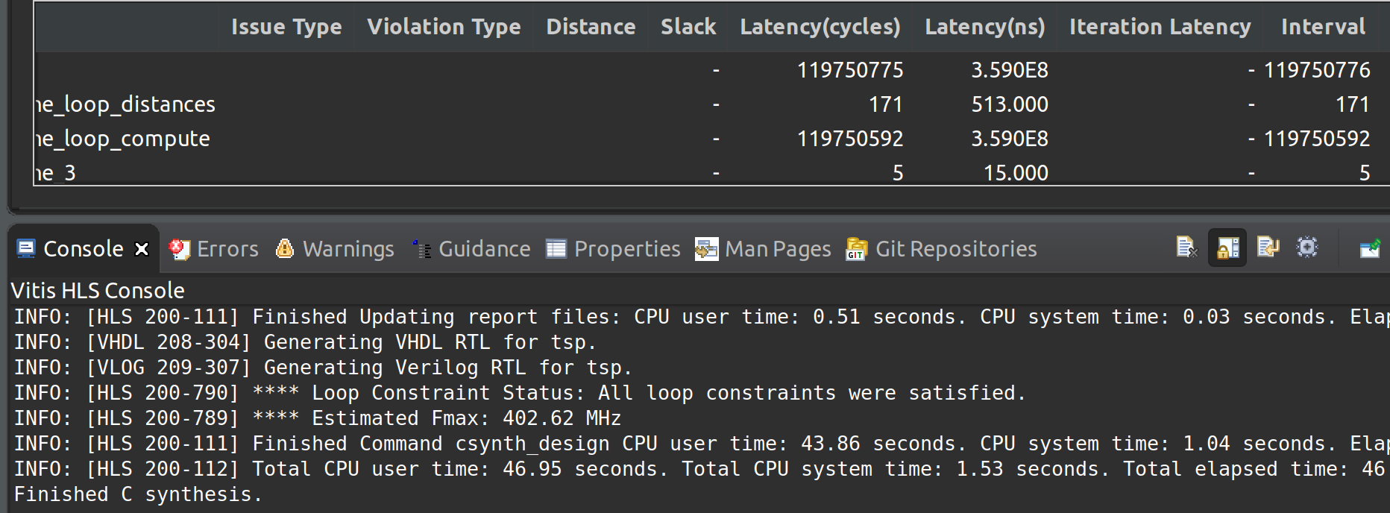
Run Vitis HLS C Synthesis (N = 13)

Slide 23

Related topic: Google map algorism
Shortest time from A to B?

Slide 24
Thanks for your attention
https://github.com/teutoniclongboat/traveling-salesperson

