Slide 1
Video System
110061562 呂依凡
Github: https://github.com/EvanLu0815/HLS/tree/main/LABB_video_processing

Slide 2

Outline
System Intro
Kernel
Video_2dfilter
Algorithm
Optimize
Video_2dfilter_linebuffer
Algorithm
Optimize
Video_2dfilter_linebuffer_extended
Algorithm
Optimize
Video_2dfilter_linebuffer_extended_constant
Algorithm
Optimize

Slide 3
System Introduction
host
Main.cpp
kernel
pixel_in 20* 20
PixelIni
Video_2dfilter
3*3 window
filter
video_filter_rescale
1*1 pixel
pixel_out 20* 20
PrintPixel

Slide 4
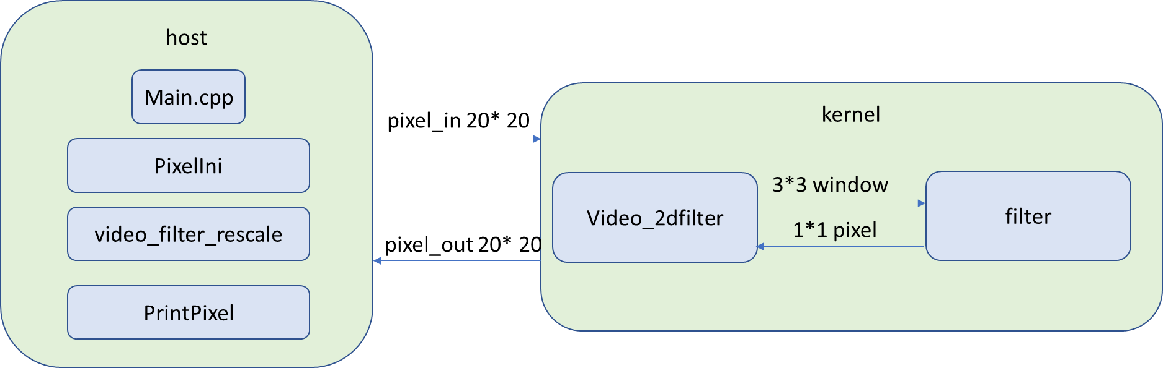
System Introduction
Host
Kernel
Generate pixel_in
Print the pixel_in
Rescale pixel_in
Print the rescaled pixel_in
Pass the pixel_in to kernel
Print the kernel results, pixel_out
Video_2dfilter: prepare 3*3 window for filter
Filter: Do MAC (multiply accumulate)

Slide 5
Introduction to Algorithm filter
window
h
*
=

Slide 6
Introduction to Algorithm video_2dfilter
(0, 0) | (0, 1) | (0, 2) | … | … | (0, 19)
(1, 0) | (1, 1) | (1, 2) | … | … | (1, 19)
(2, 0) | (2, 1) | (2, 2) | … | … | (2, 19)
… | … | … | … | … | …
(19, 0) | (19, 1) | (19, 2) | … | … | (19, 19)
Lots of memory access!
Pipeline part: from pixel access to competing filter

Slide 7
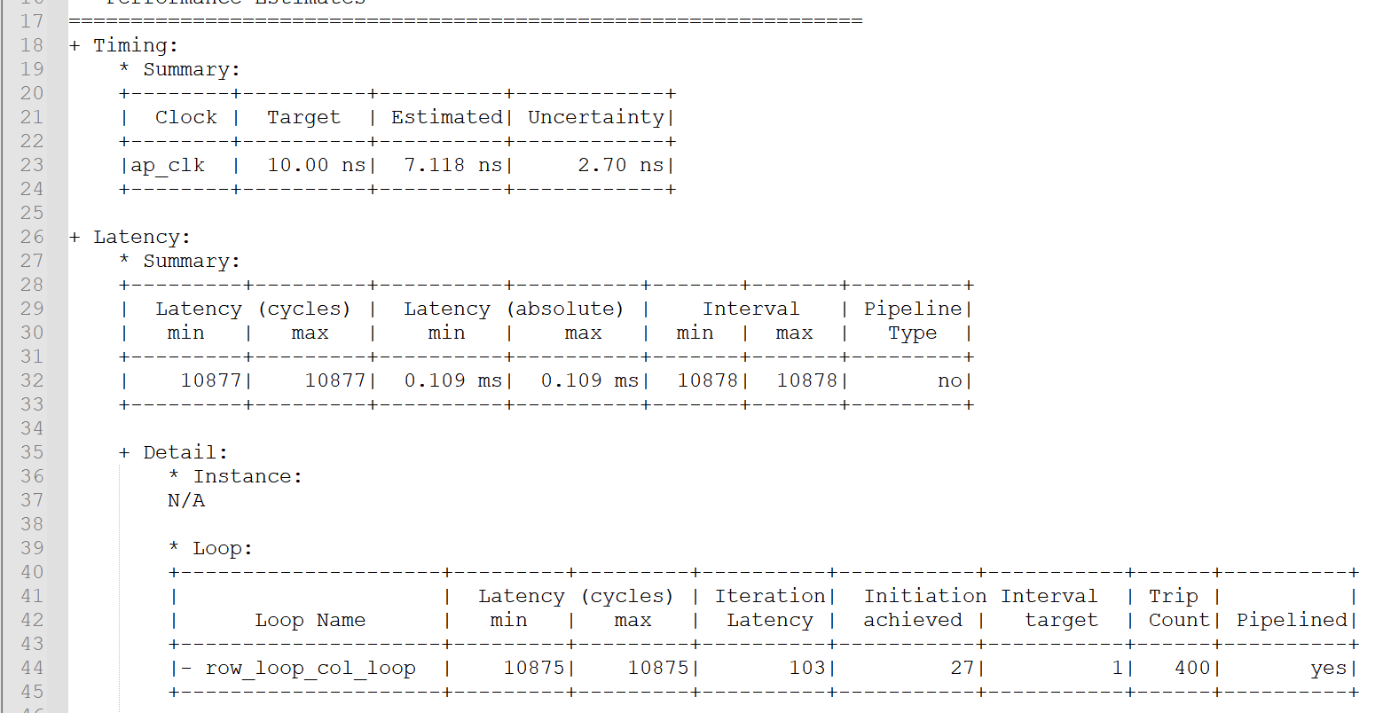
Synthesis Report Timing
The clk frequency 10ns has been met.
Top function spend 10877 cycles to complete write all outputs
Initiation interval is 27 row_loop_col_loop has been pipelined.

Slide 8
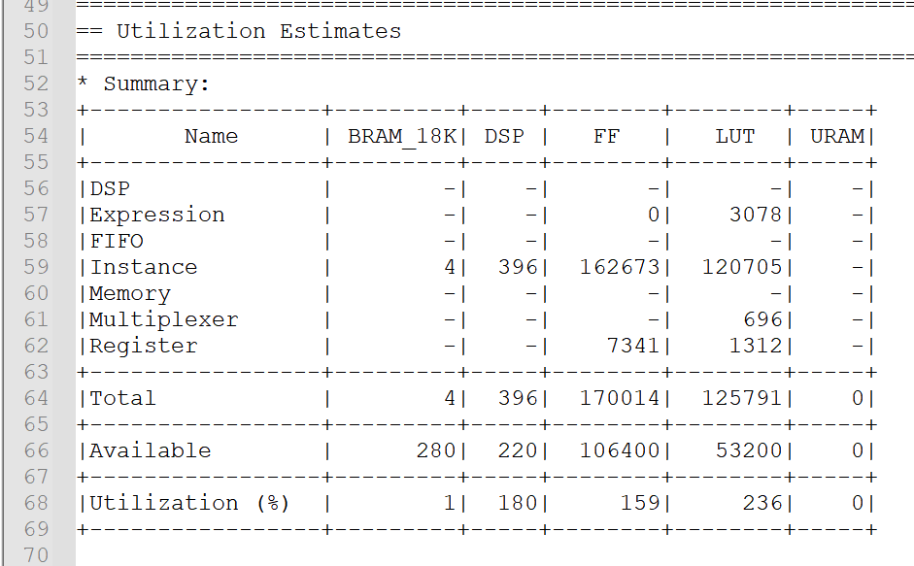
Synthesis Report Utilization

Slide 9
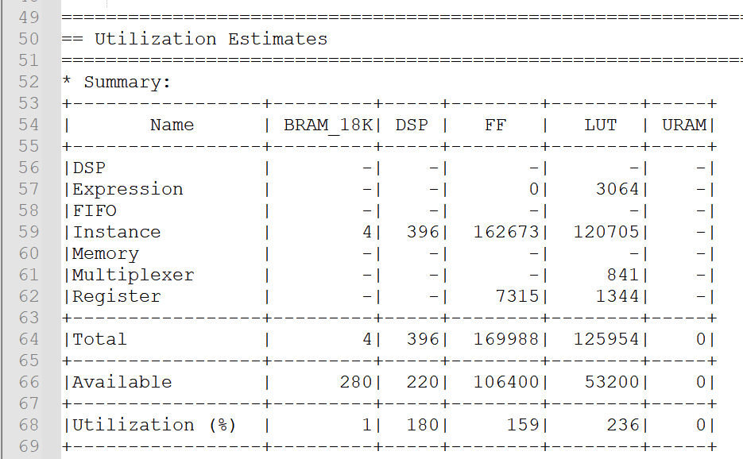
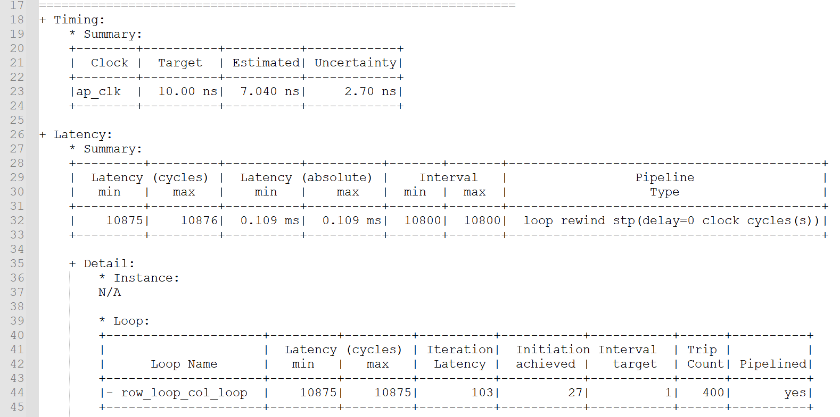
Optimize Design 1 rewind
Top function has prepared for next input after 10800 cycles

Slide 10
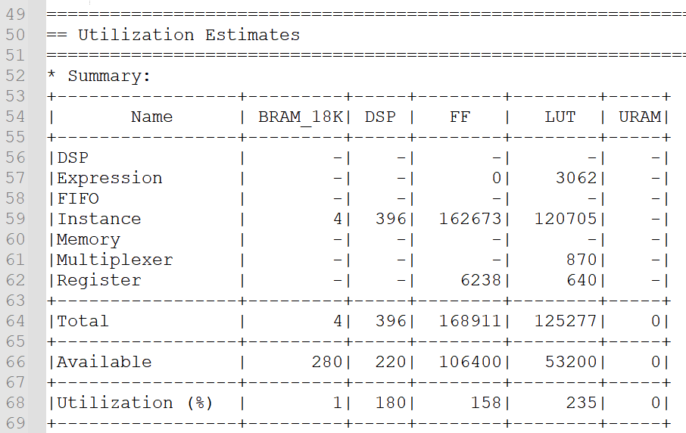
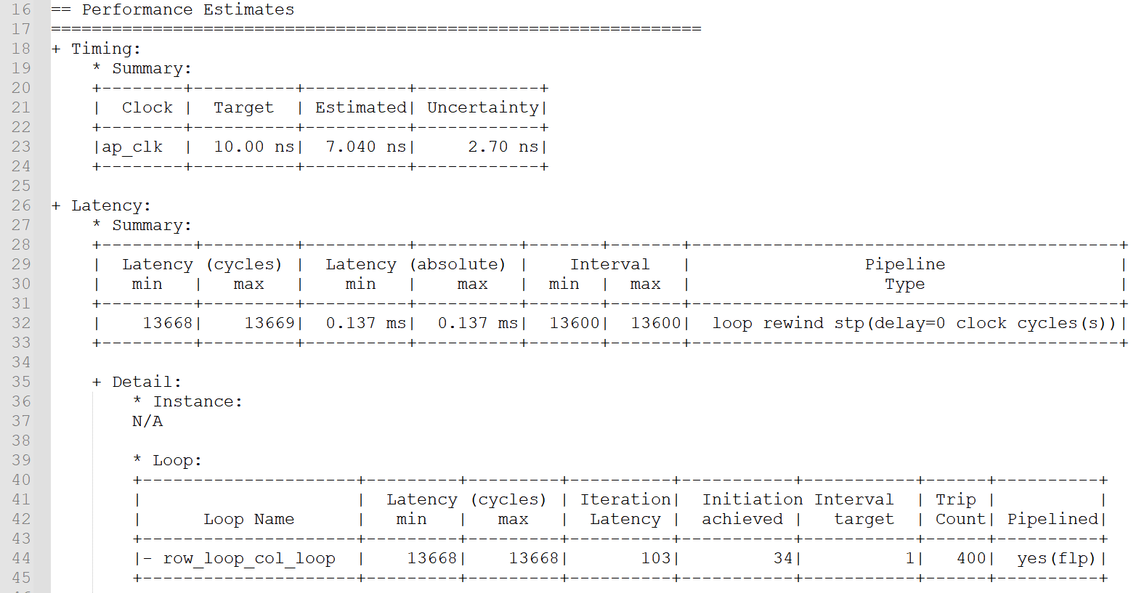
Optimize Design 1 enable_flush
Number of registers decreases
II increases!
→ Pipeline shuts down

Slide 11
Optimize Design 2 Using Line Buffer
col - 1
col
col + 1
Line buffer
Access only one pixel!
Pixel_in[row][col]

Slide 12
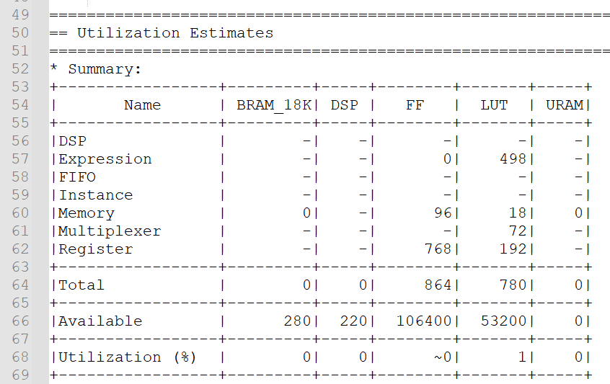
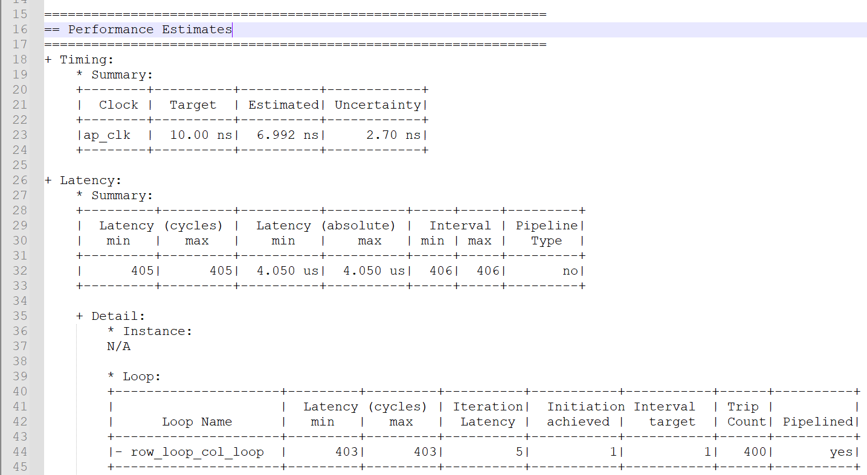
Optimize Design 2 Timing/ Utilization
II=1 has achieved!

Slide 13
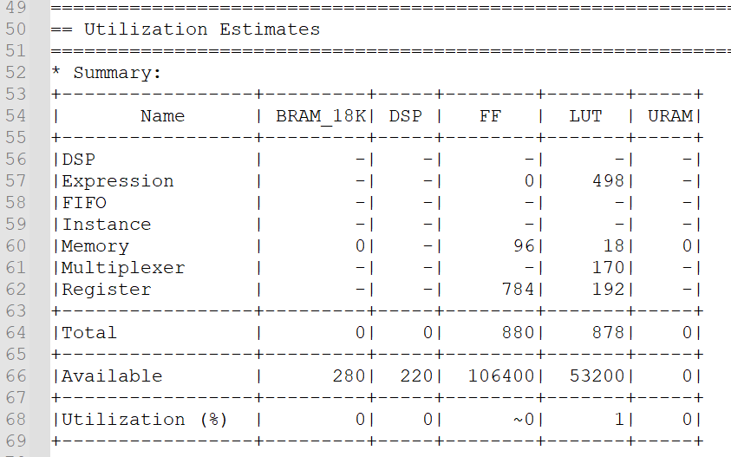
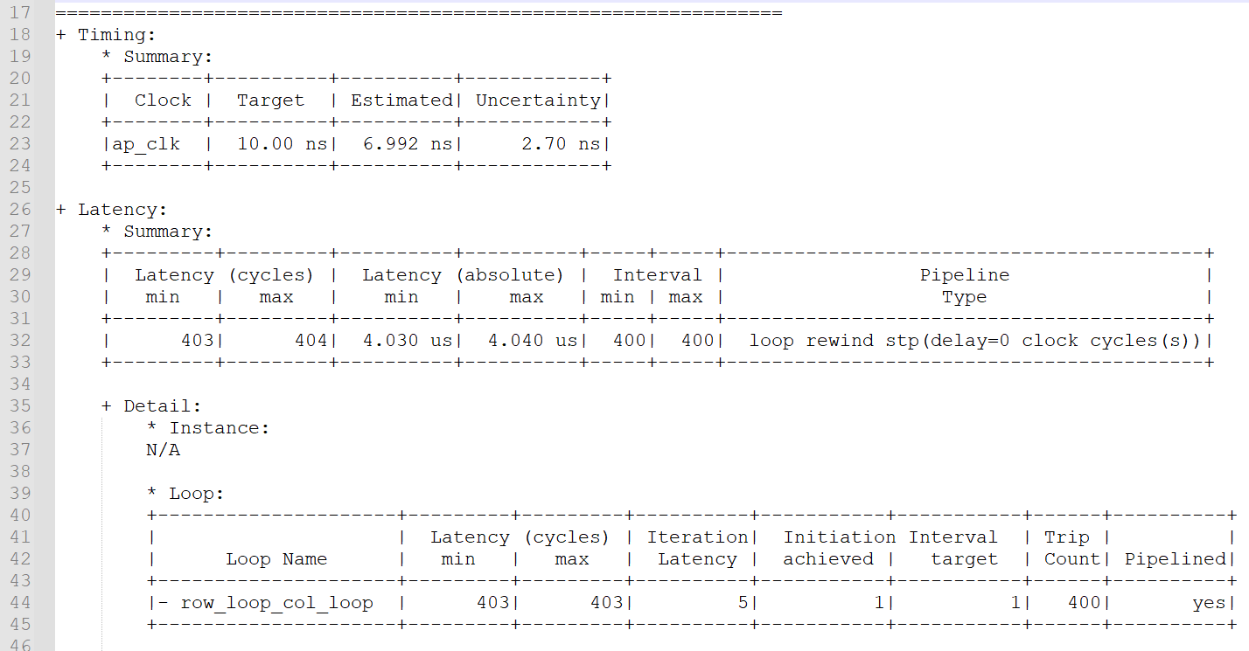
Optimize Design 2 rewind
Top function has prepared for next input after 400 cycles

Slide 14
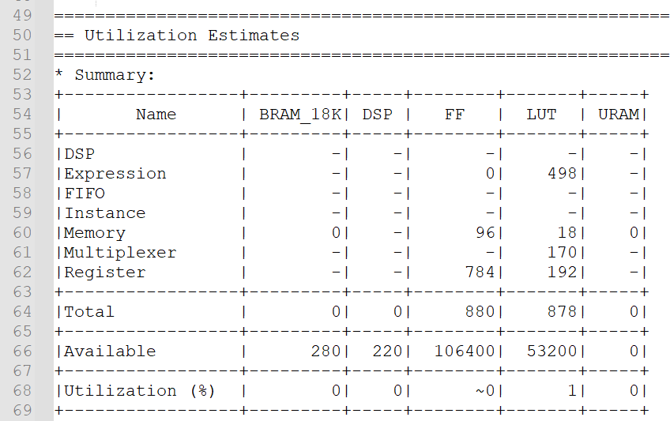
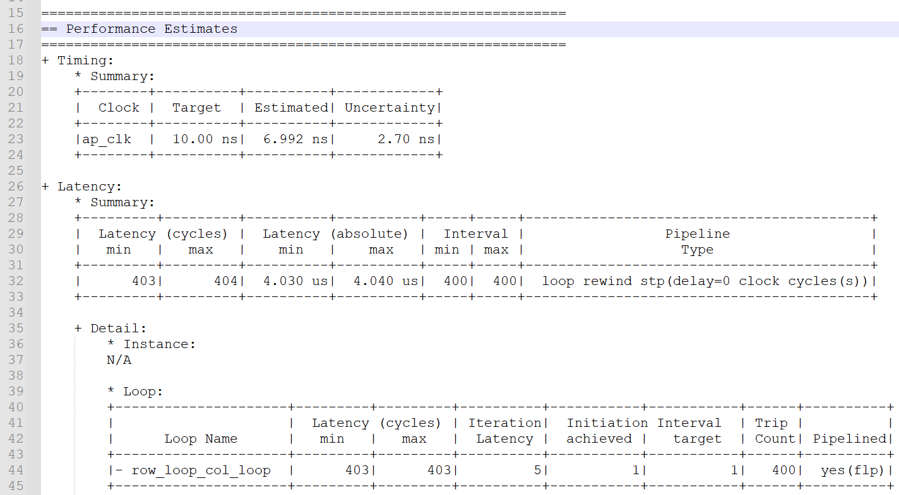
Optimize Design 2 enable_flush
The report remains the same.
→ Loop never stall

Slide 15
Optimize Design 3 Extending the iteration domain
Loop bound is increased by 1 in this case
Read the first pixel in the first iteration, but write the first output in the next iteration.
→ Allow the filter to be implemented without spatial shift.
Prepare window in the previous iteration

Slide 16
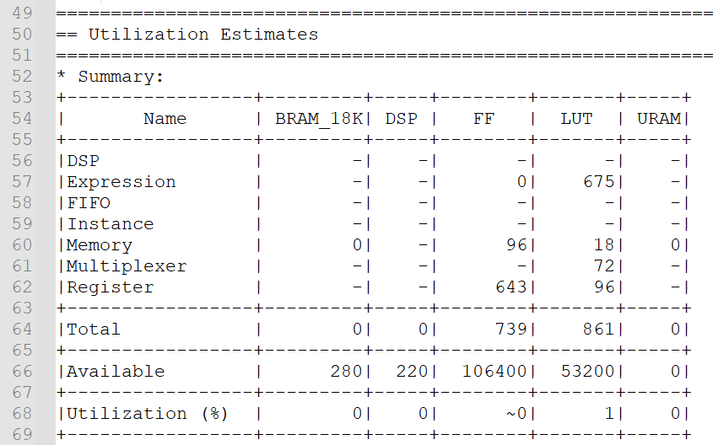
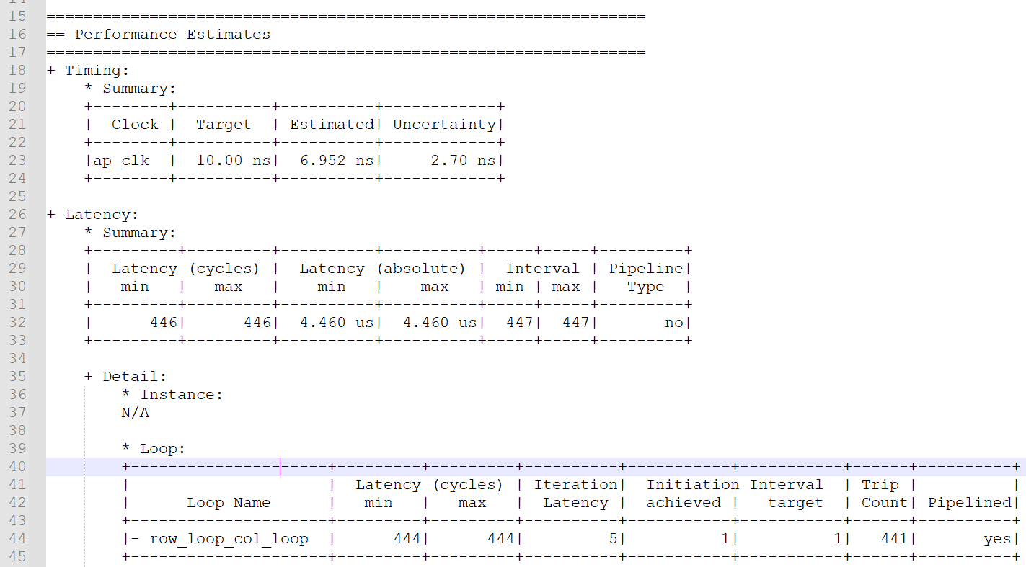
Optimize Design 3 Timing/ Utilization

Slide 17

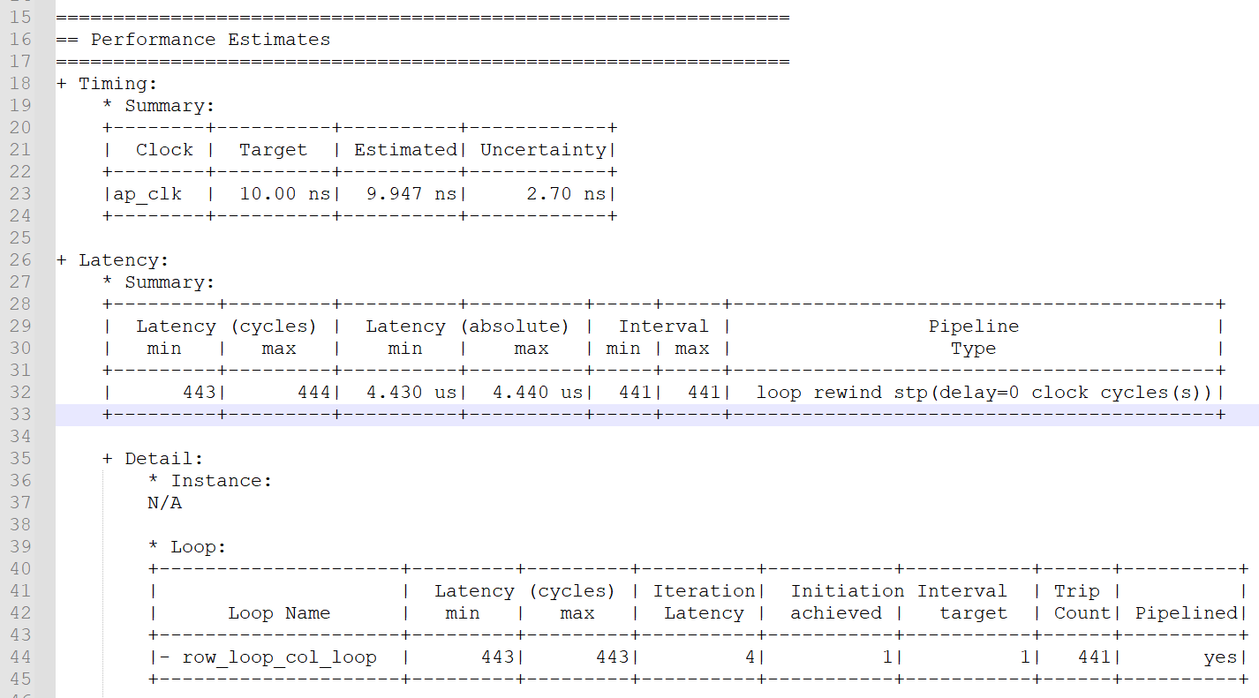
Optimize Design 3 rewind
Timing violation occurs! 9.947 + 2.70 = 12.647 > 10ns

Slide 18
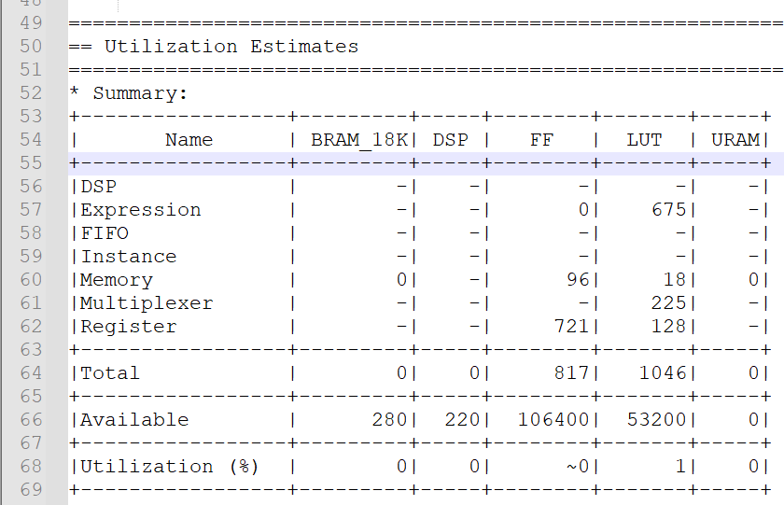
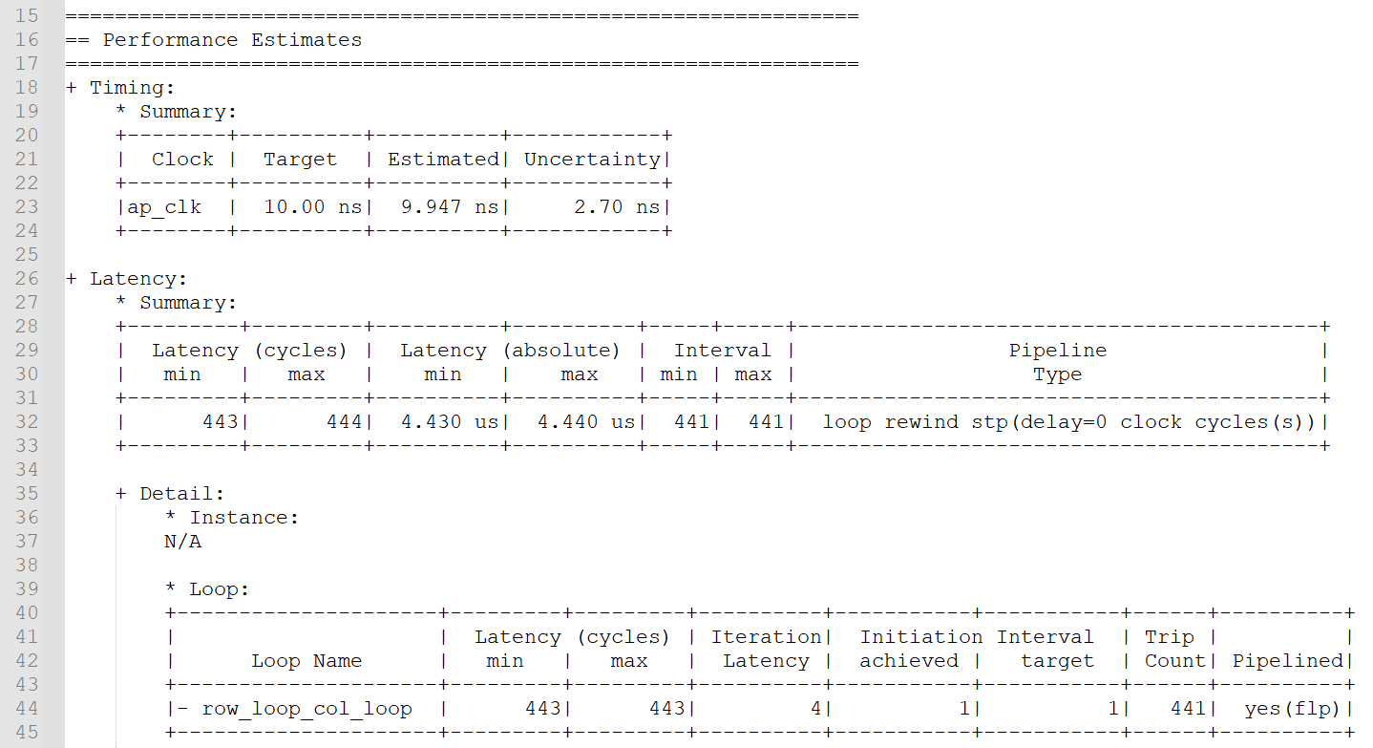
Optimize Design 3 enable_flush
Timing violation remains!
I find that the widow prepared for the previous pixel_out is the current one.

Slide 19
Optimize Design 3_2 Adjust the Operation Order
Move the function call of filter() to the beginning of the pipeline body
→ Truly realize avoiding spatial shift

Slide 20
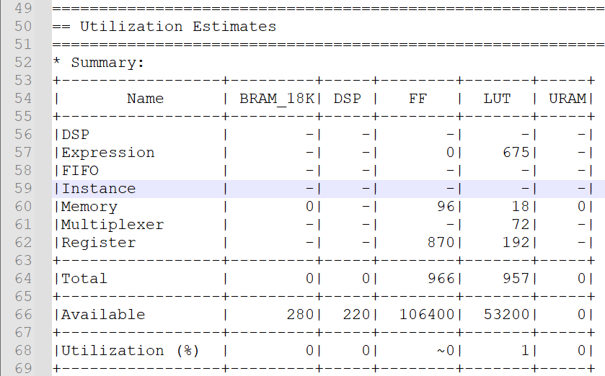
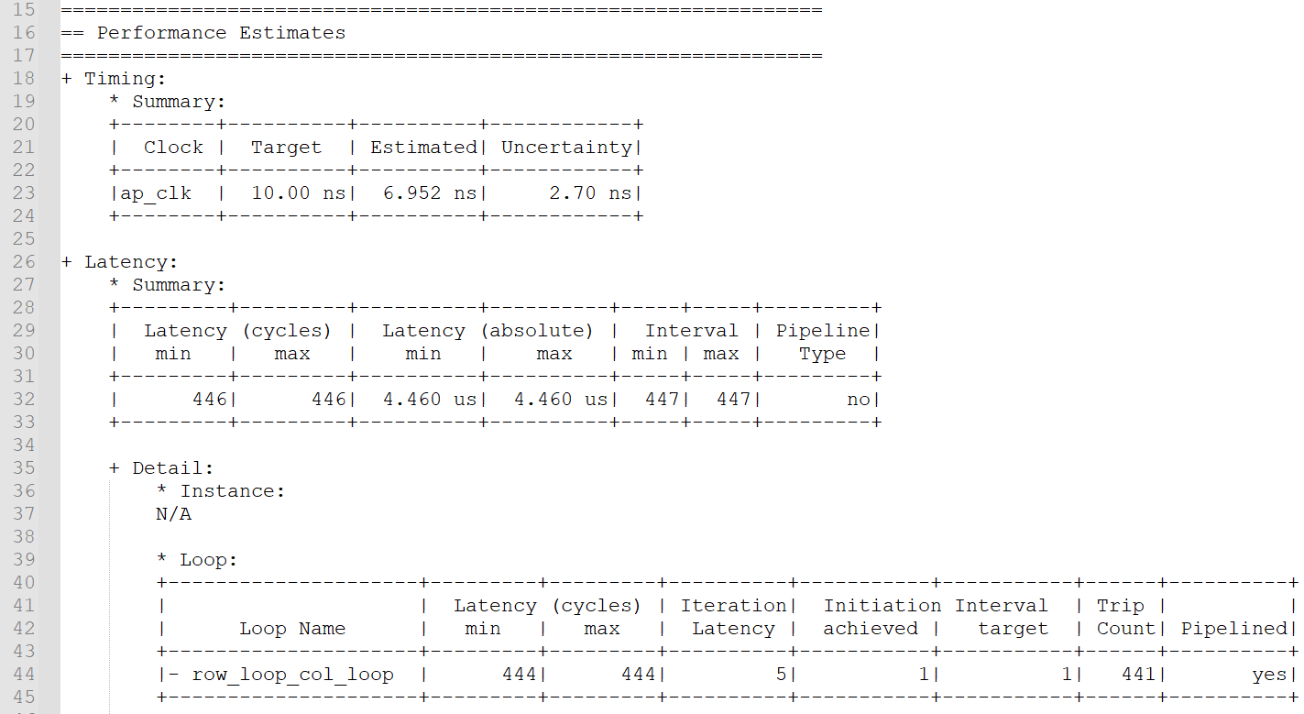
Optimize Design 3_2 Timing/ Utilization
Results are worse

Slide 21
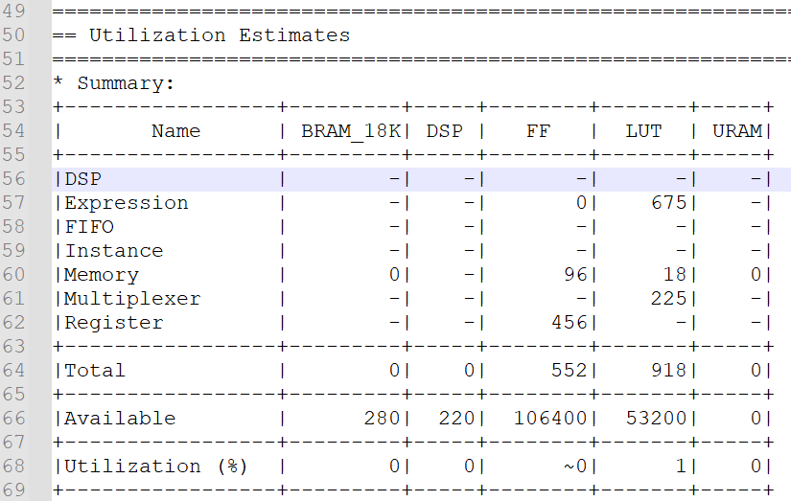
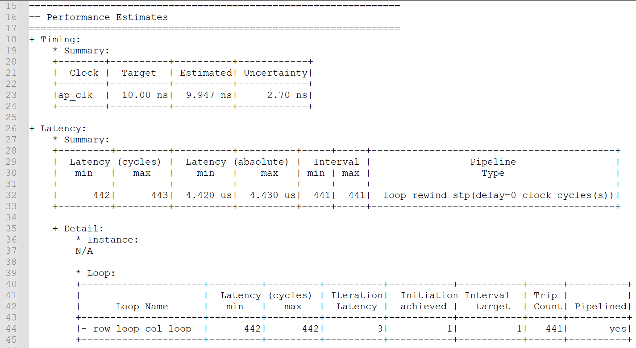
Optimize Design 3_2 rewind
Timing violation occurs! 9.947 + 2.70 = 12.647 > 10ns

Slide 22
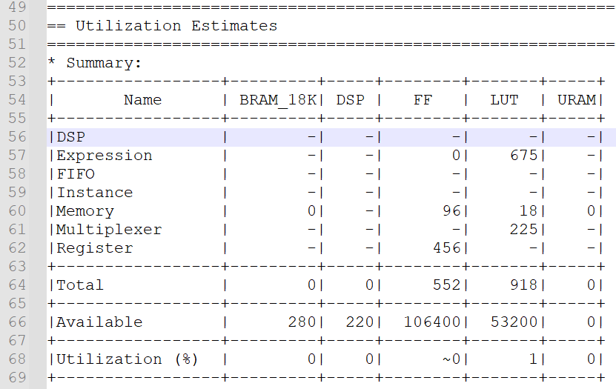
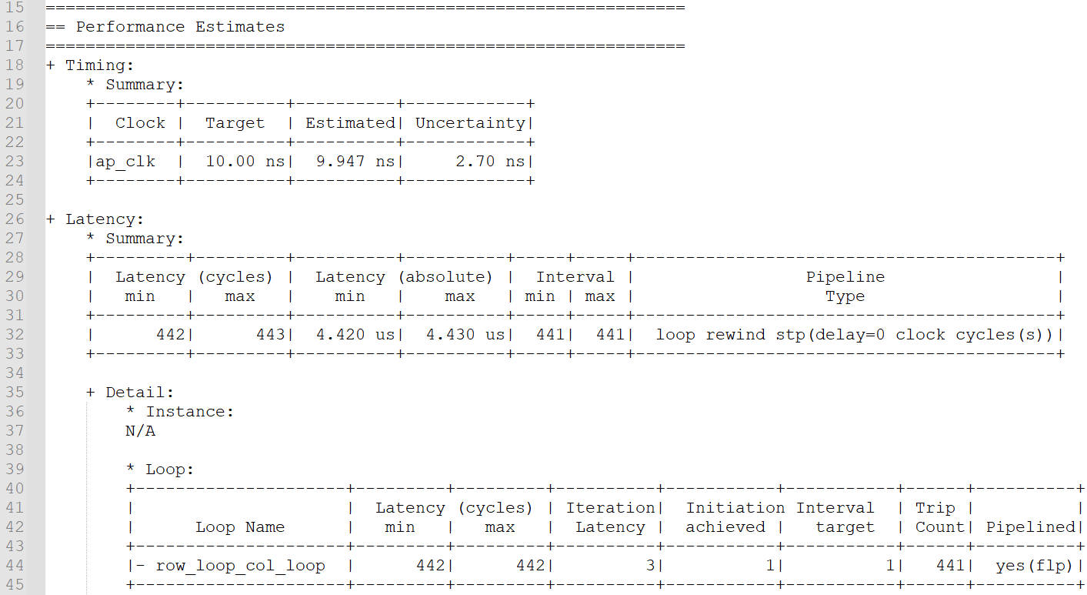
Optimize Design 3_2 enable_flush
Timing violation occurs! 9.947 + 2.70 = 12.647 > 10ns
Results are worse:
For hardware implementing the if-statement, it needs to prepared all the results and stores the final results according to the if-condition.
→ Suspending memory access causes trouble

Slide 23
Optimize Design 4 Handle Boundary Condition
Avoid the window access beyond boundary
Re-access the pixel on the boundary when window will access those beyond boundary pixels.
Handling the boundary condition causes the hardware more complex and time consuming.

Slide 24
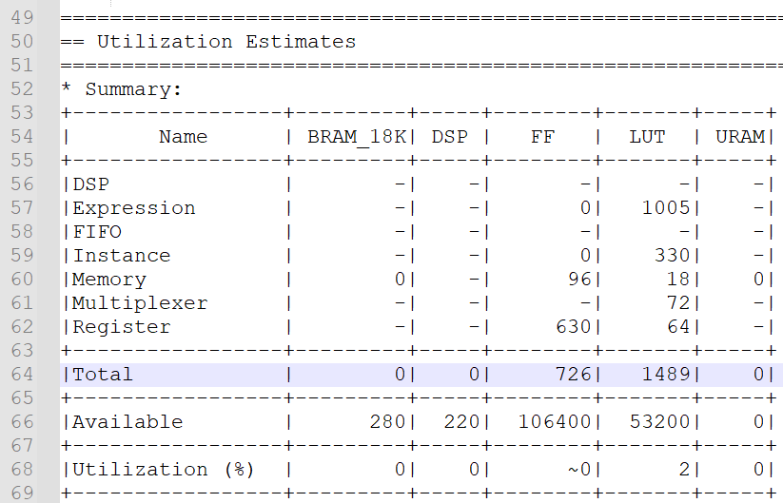
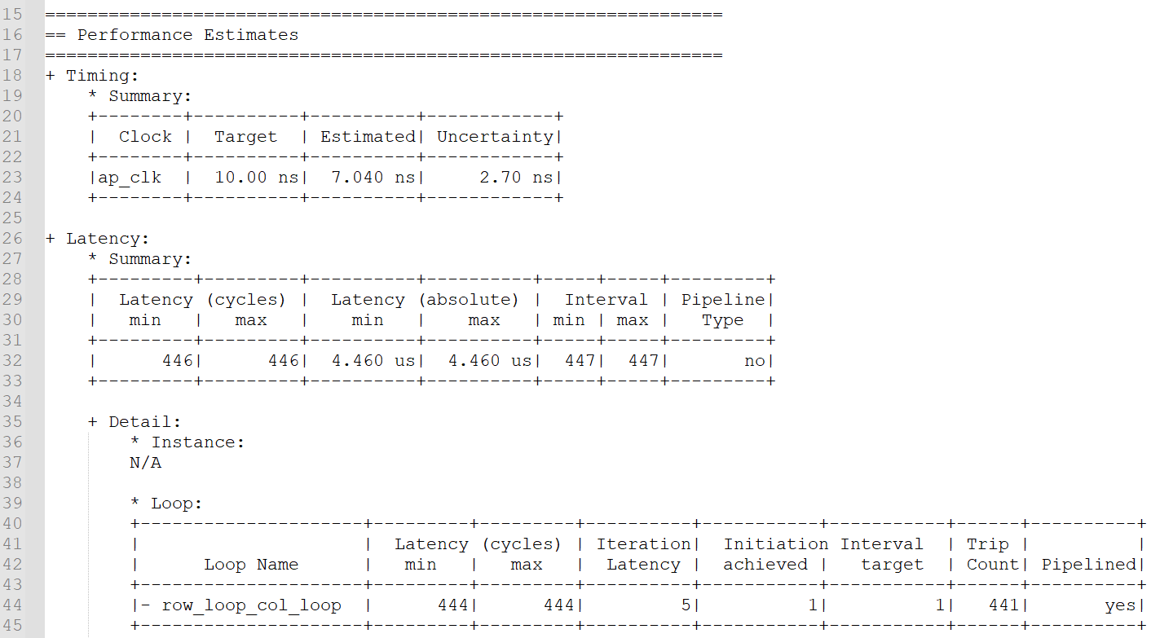
Optimize Design 4 Timing/ Utilization
Estimated time is larger than before:
the address of pixel on the boundary will be re-accessed for window in different iteration

Slide 25
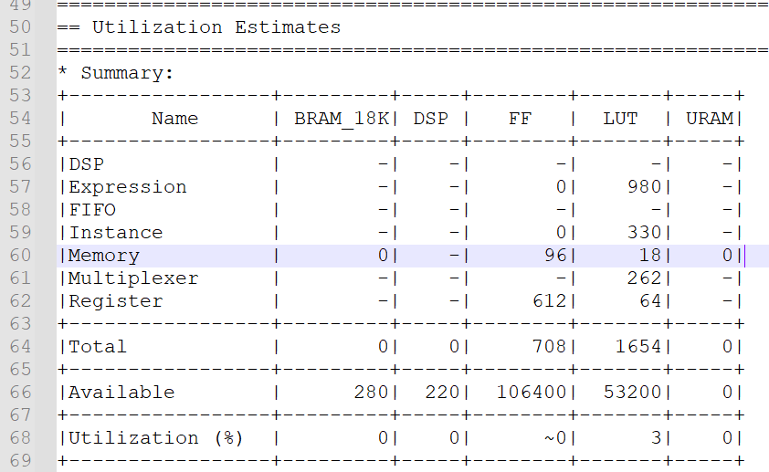
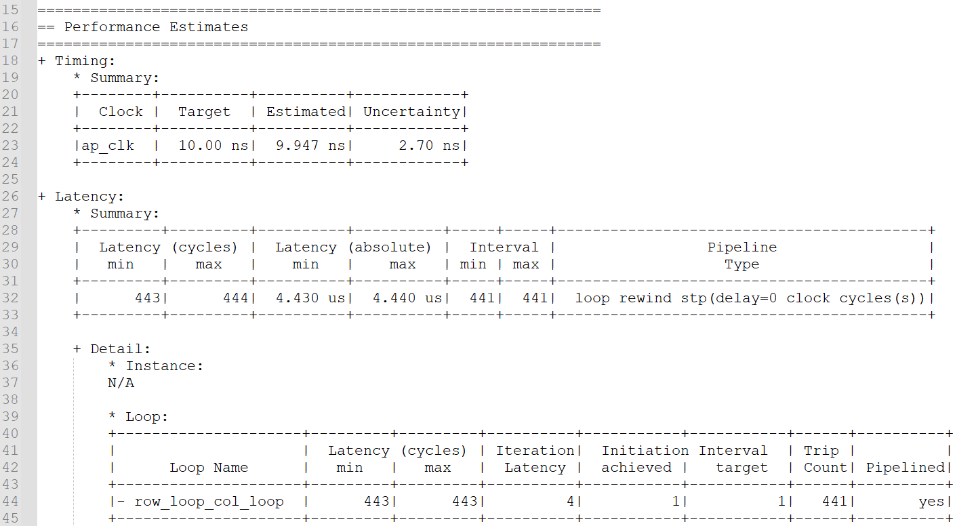
Optimize Design 4 rewind
Timing violation occurs! 9.947 + 2.70 = 12.647 > 10ns

Slide 26
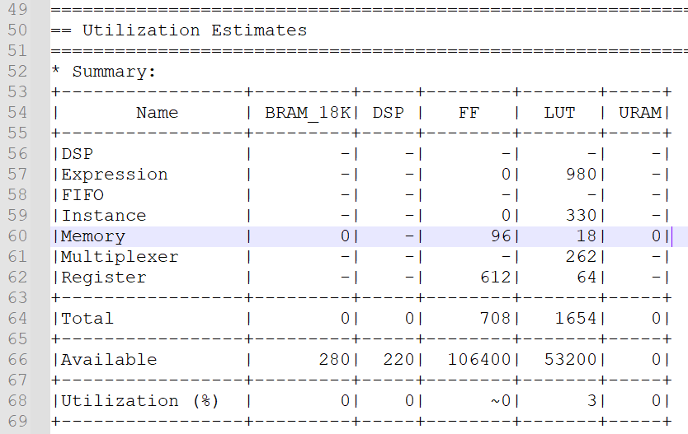
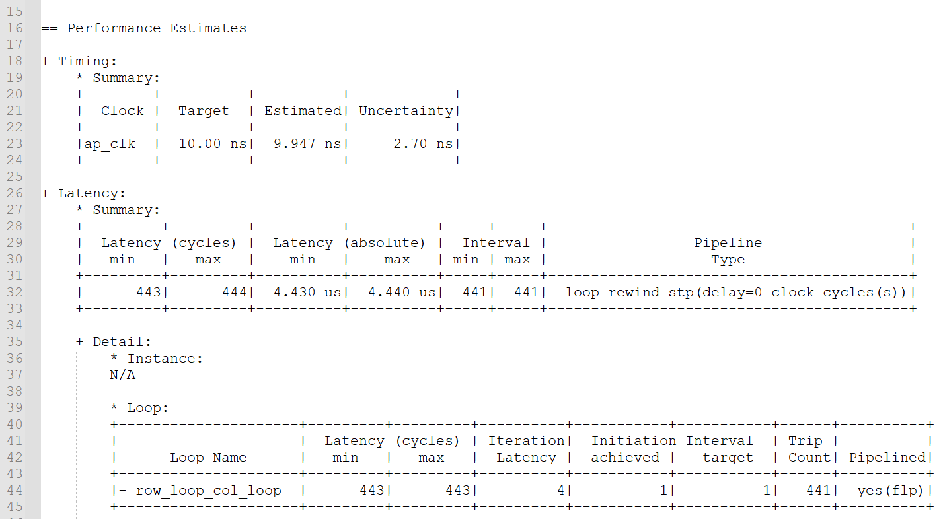
Optimize Design 4 enable_flush
Timing violation occurs! 9.947 + 2.70 = 12.647 > 10ns

Slide 27
Observation and Learning
We cannot achieve II = 1 when we access 3x3 pixels from pixel_in for each time we call filter.
We can achieve II = 1 when we access only one pixel from pixel_in for each time we call filter.
Rewind will help to decrease the latency that top function prepares to access the next input.
enable_flush will not help to decrease the loop latency in some cases.
When flush the pipeline, the pipeline will shut down all the successive stage until the final input has been processed.
→ If the time of pipeline stalling is shorter than or equals to that of completing all the older inputs and resume pipeline, enable_flush is not a good choice.
When the if-statement containing memory access, rewind and enable_flush are useless. They will cause timing violation.

Slide 28
Problem
I had no background knowledge about video processing. I spent lots of time to understand the must-known knowledge about video.
When I did this lab, I quickly find that I did not "fully" understand the pipeline rewind and flush. I looked up for those information that I am not quite familiar with.
Additionally, I utilized my understanding about memory access to analyze the timing violation about the 3rd and 4th algorithm, which I really spent lots of time to analyze.

Slide 29
Question
What’s the main problem in video process?

