Slide 1
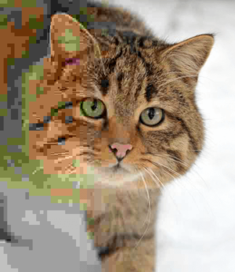
Codec
JPEG decoder
^{110064521 江威霖}
^{110064513 陳思熙}
^{110061560 吳秉豐}
JPEG

Slide 2
Outline
Introduction
Algorithm
Development process
HLS Implementation
Conclusion
Reference

Slide 3
Outline
Introduction
Algorithm
Development process
HLS Implementation
Conclusion
Reference

Slide 4
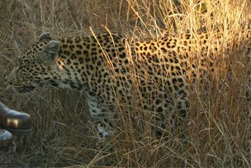
JPEG
JPEG
Joint Photographic Expert Group — an international standard since 1992.
Commonly used method of lossy compression for digital images.
Principles of JPEG
Changes in brightness are more important than changes in color.
Low-frequency changes are more important than high-frequency changes.
The human eye is less sensitive to fidelity in higher-frequency.
Notes:
亮度的變化比顏色的變化更重要：人類視網膜包含大約 1.2 億個對亮度敏感的視桿細胞，但只有大約 600 萬個對顏色敏感的視錐細胞。
低頻變化比高頻變化更重要。人眼擅長判斷低頻光的變化，比如物體的邊緣。它在判斷高頻光線變化時不太準確，例如繁忙圖案或紋理中的精細細節。花豹(leopard)偽裝之所以起作用，部分原因是高頻模式破壞了被偽裝事物的低頻邊緣。
The human eye is less sensitive to delity in higher-frequency components.

Slide 5
Outline
Introduction
Algorithm
Development process
HLS Implementation
Conclusion
Reference

Slide 6
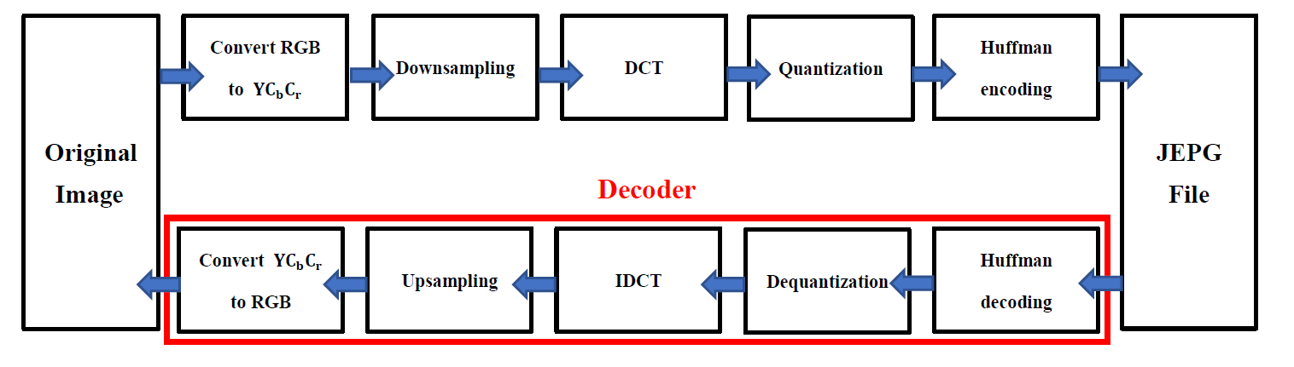
JPEG Encoder/Decoder Flow

Slide 7
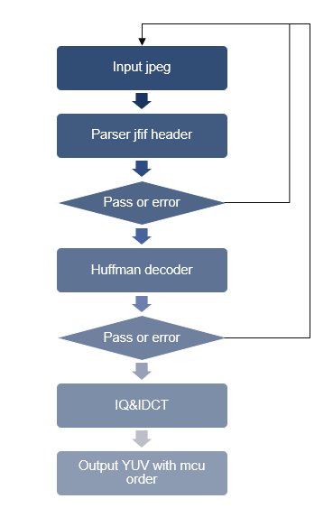
Major steps in JPEG decoder
Parser JFIF header
Huffman decoding (Entropy decoding)
IQ ( Inverse Quantization )
Zig-Zag Scan
IDCT (Inverse Discrete Cosine Transform)
Output YUV data.

Slide 8
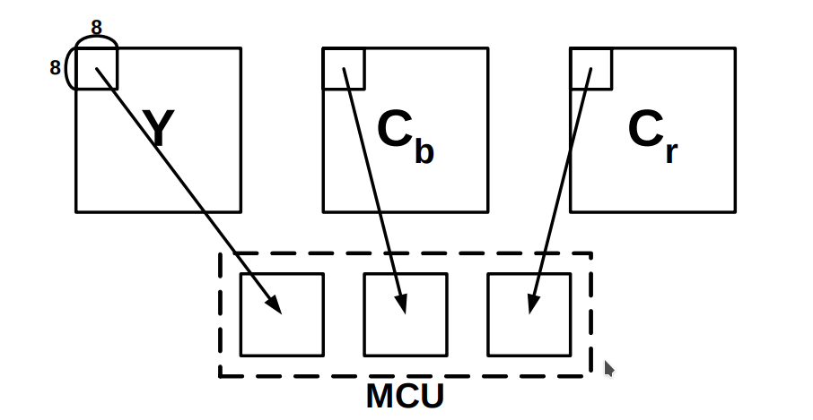
What is MCU?
The JPEG data is divided into number of blocks called Minimum Coded Unit .
MCU size
MCU width = 8px * max of horizontal sampling facors ( YCbCr )
MCU height = 8px * max of vertical sampling facors ( YCbCr )
For exmaple with sample factor 4:1:1
MCU width = 8px * 2 = 16px
MCU heigh = 8px * 2 = 16px
Can't be exactly divided
add pixel to fill up a MCU
cause distortion
Notes:
These sampling factors dictate how many 8x8 pixel sections are to be placed within an MCU.
注意，MCU 的寬、高並不固定爲 16 px，甚至未必是正方形，而是取決於顏色分量的採樣率。

Slide 9
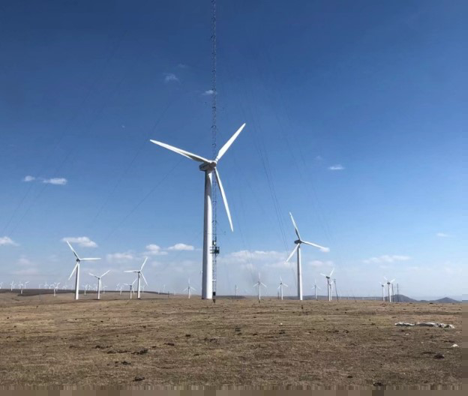
Distortion due to filling up a mcu

Slide 10


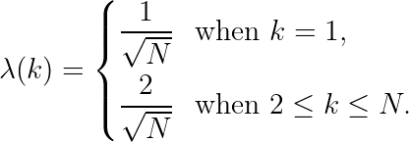
DCT & IDCT
DCT (Discrete Cosine Transform) is similar to the DFT since it decomposes a signal into a series of harmonic (cosine) functions.
Only the real part of DFT
Computationally simpler than DFT
DCT :
IDCT :
Normalization factor:
Notes:
latex:
url : https://latex.codecogs.com/eqneditor/editor.php
F(k) = \lambda (k) \sum_{i=1}^{N}cos(\frac{\pi}{\2N}(2n-1)(k-1)), k=1,2,...,N
f(n) = \sum_{k=1}^{N}\lambda (n)cos(\frac{\pi}{\2N}(2n-1)(k-1)), n=1,2,...,N
\lambda(k) = \left \{
\begin{aligned}
&\frac{1}{\sqrt{N}} && \text{when}\ k=1, \\
&\frac{2}{\sqrt{N}} && \text{when}\ 2\leq k\leq N.
\end{aligned} \right.

Slide 11
DCT & IDCT
For most images, much of the signal energy lies at low frequencies.
These appear in the upper left corner of the DCT.
Compression is achieved since the lower right values represent higer frequencies, and are often small.
Small enough to be neglected with little visible distortion.
Notes:
https://users.cs.cf.ac.uk/dave/Multimedia/PDF/10_DCT.pdf

Slide 12
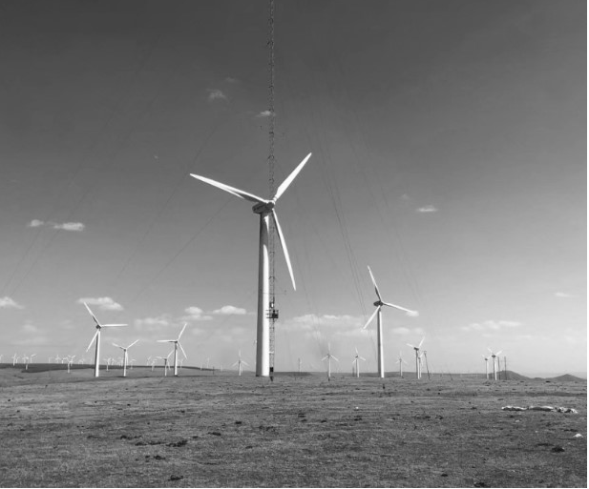
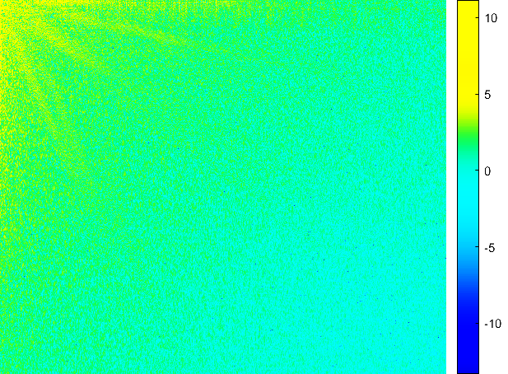
DCT & IDCT
Original Grayscale Image
Image data after 2D-DCT with log scale

Slide 13
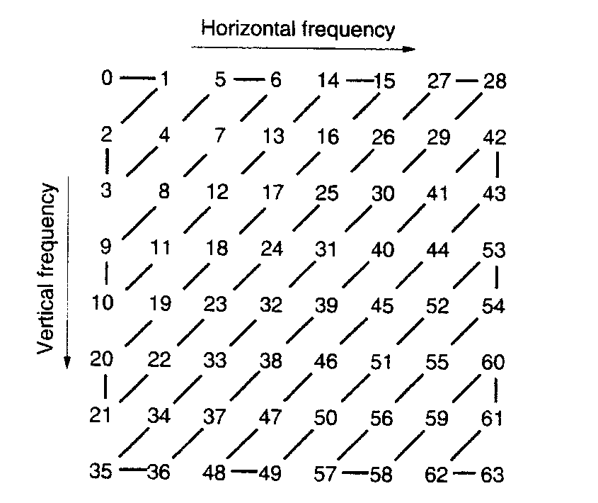
Zig-Zag Scan
This ordering helps to facilitate entropy coding by
placing low-frequency coefficients (which are more
likely to be nonzero) before high-frequency
coefficients.
Low
frequency
High frequency
Notes:
ref:https://ieeexplore.ieee.org/stamp/stamp.jsp?tp=&arnumber=125072
http://home.elka.pw.edu.pl/~mmanowie/psap/neue/1%20JPEG%20Overview.htm
RLE
講完ZIG ZAG講parser
Till now, We already know how JPEG compress the data.
But we haven’t introduce how we get Tables & image Data.

Slide 14
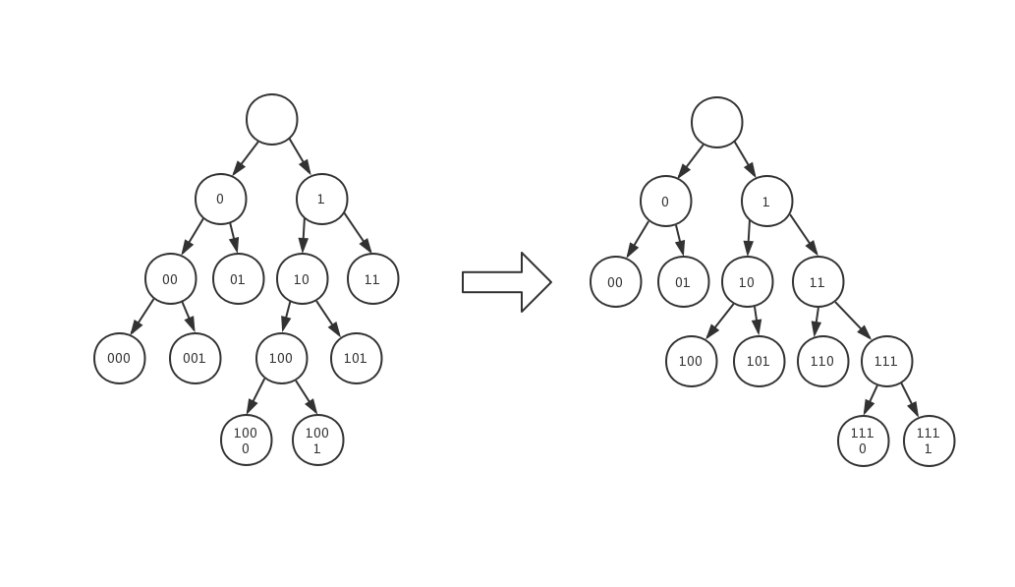
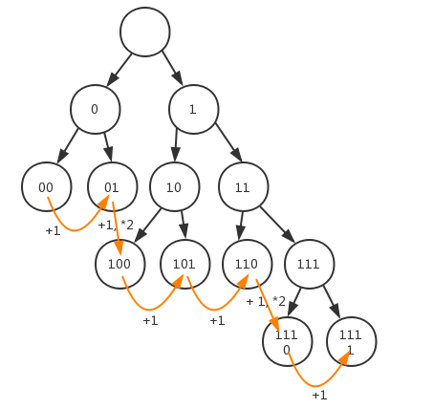
DHT (Define Huffman Table)
The higher the probability of symbol occurrence, the shorter the encoded codeword length.
In JPEG coding, there are Huffman tables for DC values and AC values, and Huffman tables for luminance and chroma respectively.
Notes:
介紹table特性

Slide 15
JFIF header parser
Above all, we can know the JPEG file is composed of sampling fators, Quantize Tables, Huffman Tables, Compressed Data.
These data are parsed by identifying marker
( e.g. 0xFFD8 stands for image data start)
Segment Name | Marker | Have data
SOI | 0xFFD8 | X
EOI | 0xFFD9 | X
APP0 | 0xFFE0 | X
Segment Name | Marker | Have data
SOF0 | 0xFFC0 | O
DQT | 0xFFDB | O
DHT | 0xFFC4 | O
SOS | 0xFFDA | O
Notes:
SOF0: start of frame 0, 0代表baseline
APP0: JFIF 持有資訊
無數據區段：長度只有 2 bytes
有數據區段：在標記碼之後，會緊跟着 2 bytes ，表示整個區段扣除那 2 bytes 標記碼之後的長度。

Slide 16


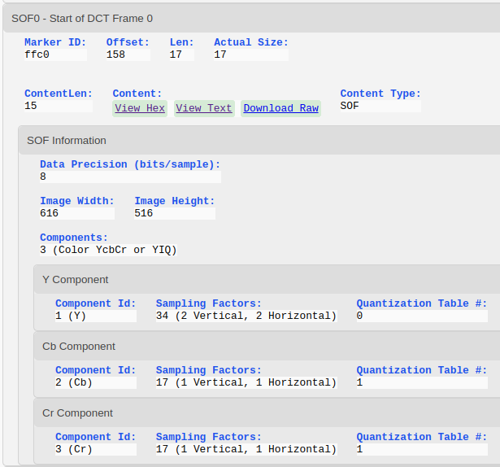
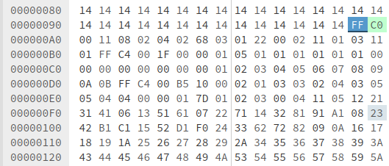
SOF0(0xFFC0):Start of DCT Frame 0
Height
Width

Slide 17
DQT (Define Quantization Table)
Usually the quantization table has two tables, namely the luminance table and the chrominance table.
FF DB 00 43 00 03 02 …… Quantization table data
luminance (Y)
FF DB 00 43 01 01 04 …… Quantization table data
chrominance (C_{b}C_{r} )
marker
length

Slide 18
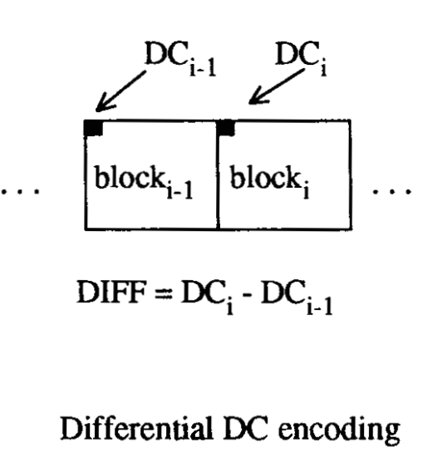
Differential DC encoding
The quantized DC coefficient is encoded as the
difference from the DC term of the previous block
in the encoding order (defined in the following), as shown below.

Slide 19
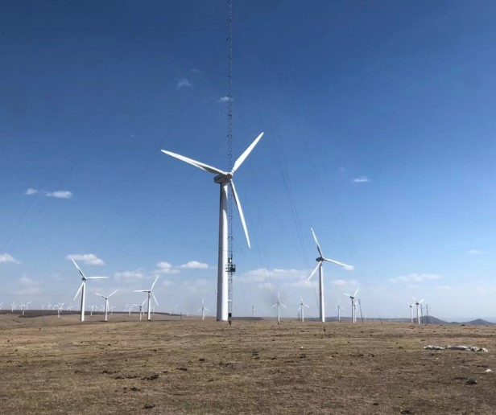
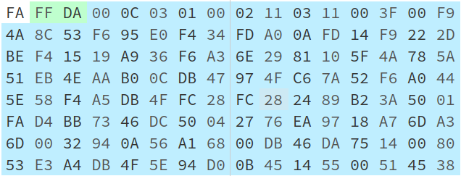
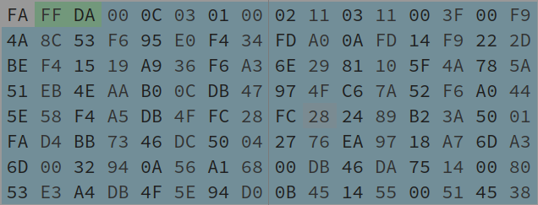
Huffman decoding

Slide 20
Huffman decoding
FF DA = start of scan

Slide 21
Huffman decoding
0C = 12 components

Slide 22
Huffman decoding
example

Slide 23
Huffman decoding
Value of corresponding Huffman table | Mapping value
0、1 | -1、1
00、01、10、11 | -3、-2、2、3
000…011、 100…111 | -7…-4、4…7
0000…0111、1000…1111 | -15…-8、8…15
00000…01111、10000…11111 | -31…-16、16…31
000000…011111、100000…111111 | -63…-32、32…63
...etc | ...etc

Slide 24
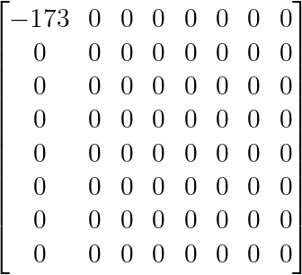
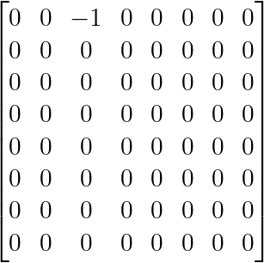
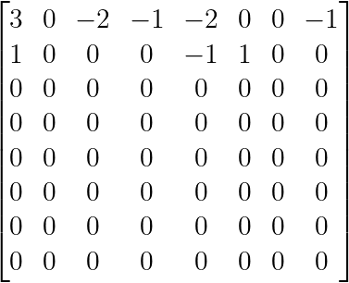
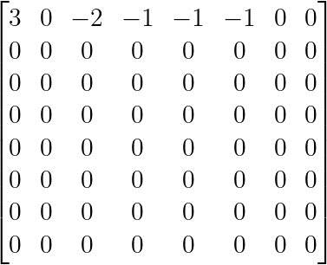
Huffman decoding
表示後面全零要換下一張Y table
DC table:
00 0x00
010 0x01
011 0x02
100 0x03
101 0x04
110 0x05
1110 0x06
11110 0x07
111110 0x08
1111110 0x09
11111110 0x0A
111111110 0x0B
AC Table:
00 0x01
01 0x02
100 0x03
1010 0x00
1011 0x04
1100 0x11
11010 0x05
11011 0x12
11100 0x21
111010 0x31
111011 0x41
1111_1001_0100_1010_1000_1100_0101_0011_1111_0110_1001_0101
Y0
Y1
Y2
Y3
0x(連續零的數量)(向後讀位元數)
Notes:
\begin{bmatrix}
-173 & 0 & 0 & 0 & 0 & 0 & 0 & 0 \\
0 & 0 & 0 & 0 & 0 & 0 & 0 & 0 \\
0 & 0 & 0 & 0 & 0 & 0 & 0 & 0 \\
0 & 0 & 0 & 0 & 0 & 0 & 0 & 0 \\
0 & 0 & 0 & 0 & 0 & 0 & 0 & 0 \\
0 & 0 & 0 & 0 & 0 & 0 & 0 & 0 \\
0 & 0 & 0 & 0 & 0 & 0 & 0 & 0 \\
0 & 0 & 0 & 0 & 0 & 0 & 0 & 0 \\
\end{bmatrix}

Slide 25
Huffman decoding
表示後面全零要換下一張Y table
DC table:
00 0x00
010 0x01
011 0x02
100 0x03
101 0x04
110 0x05
1110 0x06
11110 0x07
111110 0x08
1111110 0x09
11111110 0x0A
111111110 0x0B
AC Table:
00 0x01
01 0x02
100 0x03
1010 0x00
1011 0x04
1100 0x11
11010 0x05
11011 0x12
11100 0x21
111010 0x31
111011 0x41
1110_0000_1111_0100_0011_0100_1111_1101_1010_0000_0000_1010
Y0
Y1
Y2
Y3
0x(連續零的數量)(向後讀位元數)

Slide 26
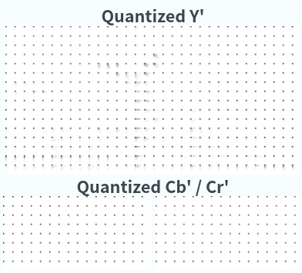
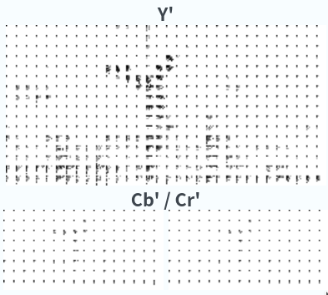
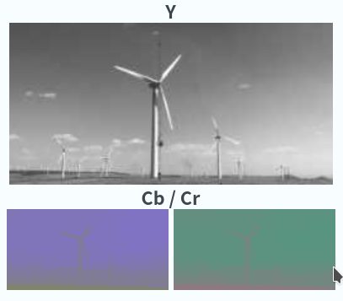
Decoding process
Inverse Quantization
Convert to
spatial domain
Input Data

Slide 27
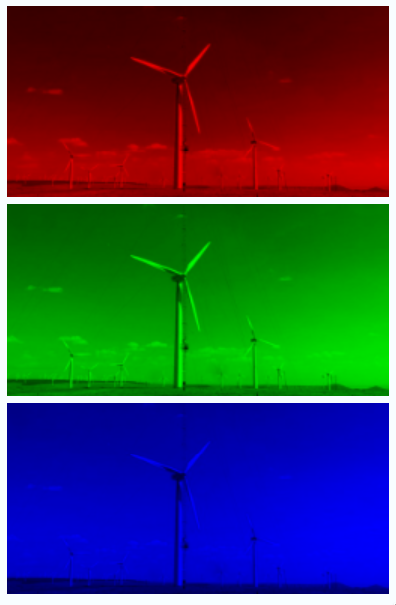
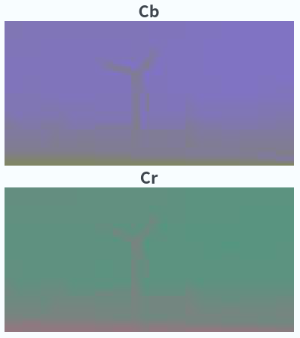
YCbCr to RGB
Notes:
Fill in missing colour information

Slide 28
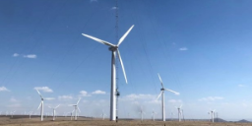

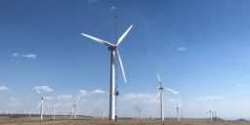
Output image & comparison
Input
Difference
Output
Darker pixels mean the output varies more from the input at that location

Slide 29
Outline
Introduction
Algorithm
Development process
HLS Implementation
Conclusion
Reference

Slide 30
L1 Developement process
Make sure you are in the right shell environment:
> echo $0
bash
If not, type below
> bash
> make run CSIM=1 CSYNTH=1 COSIM=1

Slide 31
L2 Developement process - 1
Build Process
make build TARGET={sw_emu/ hw_emu/ hw}
Run Host Program (Hardware)
> export LC_ALL=C
> export XCL_EMULATION_MODE={sw_emu / hw_emu}
> ./build_dir.sw_emu.xilinx_u50_gen3x16_xdma_201920_3/host.exe -xclbin
./build_dir.hw.xilinx_u50_gen3x16_xdma_201920_3/kernelJpegDecoder.xclbin -JPEGFile images/t0.jpg

Slide 32
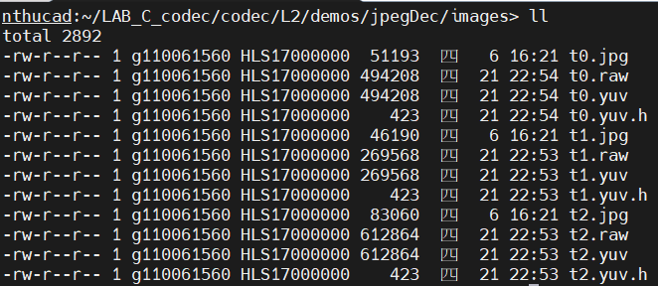
L2 Developement process - 2
在執行host program 後，在images資料夾中得到yuv 跟yuv.h檔案

Slide 33
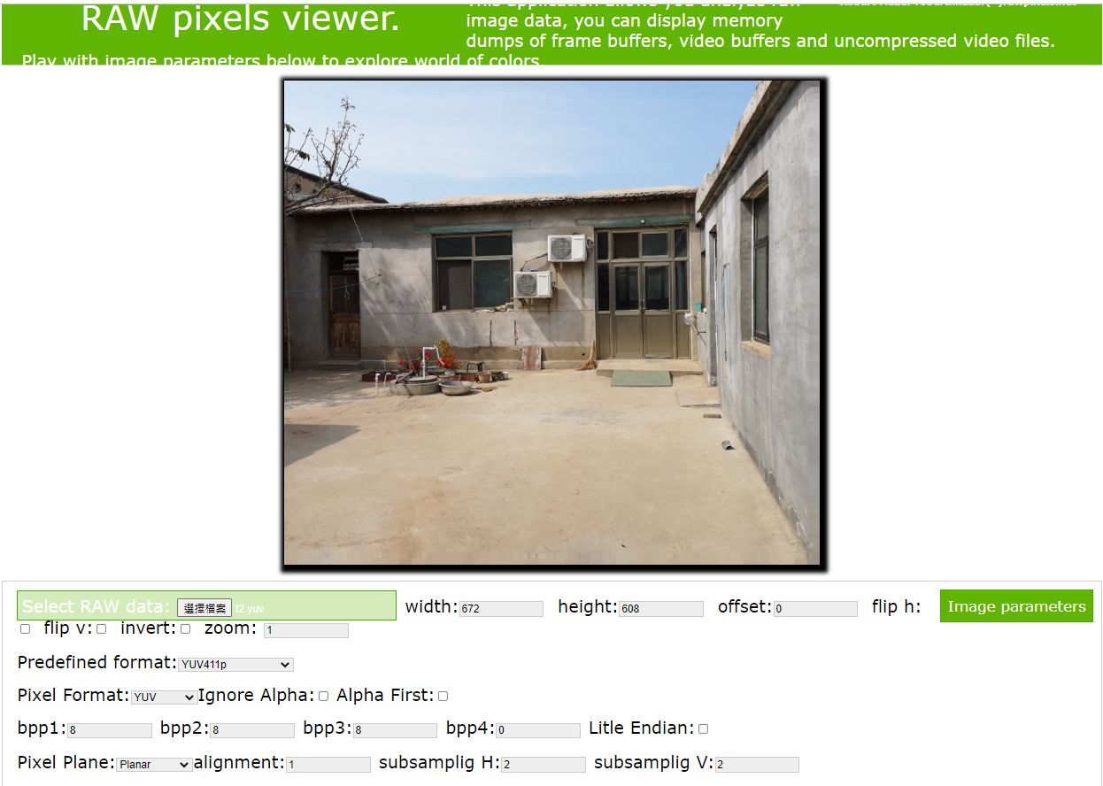
L2 Developement process - 3 (YUV viewer)

Slide 34
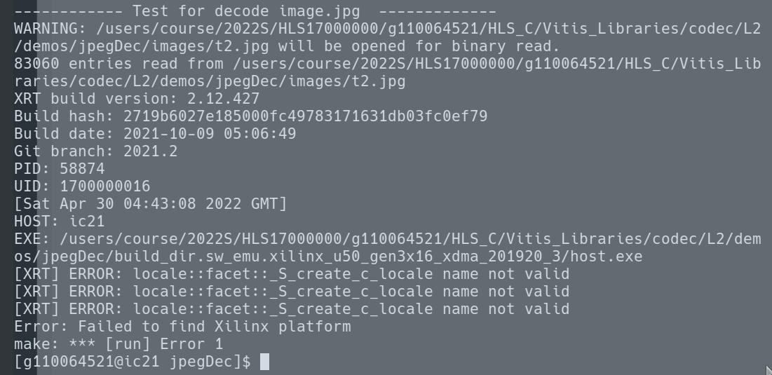
Debugging Developement process
1.Having some problems running the Makefile:
>vim Makefile
=> go to Keyword “DEVICE” and change the default, device u200 → u50
2. If an error like the picture on
the right occurs, set the variable
=> export LC_ALL=C

Slide 35
Outline
Introduction
Algorithm
Development process
HLS Implementation
Conclusion
Reference

Slide 36
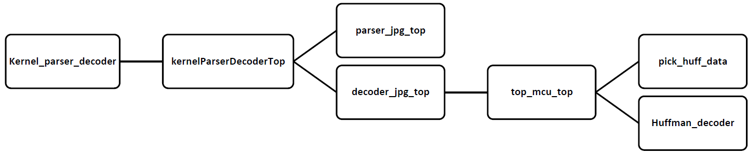
Function Structure

Slide 37
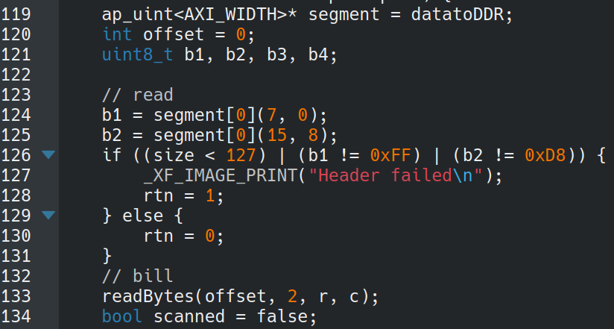
JFIF Parser_0xFFD8
Seg.Name | SOI | EOI | APP0 | SOF0 | DQT | DHT | SOS
Marker | 0xFFD8 | 0xFFD9 | 0xFFE0 | 0xFFC0 | 0xFFDB | 0xFFC4 | 0xFFDA
parser_jpg_top
Functions to parser the header.
rtn: the flag of the decode fail

Slide 38
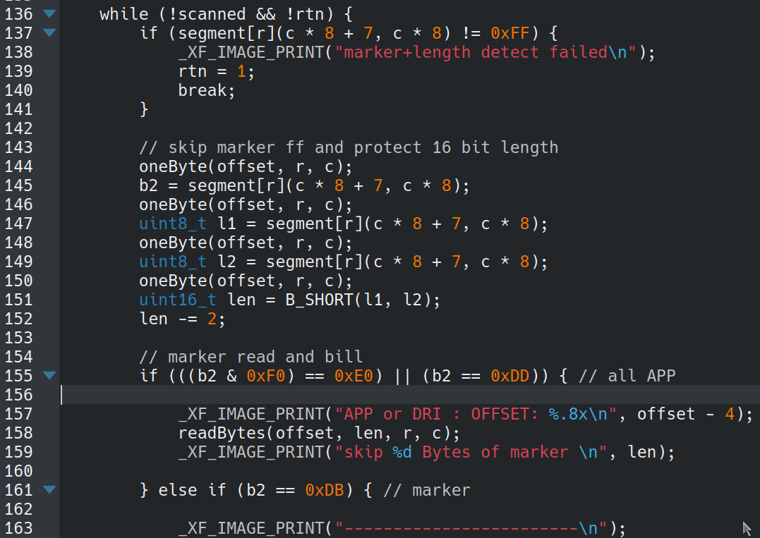
JFIF Parser_0xFFE0
Seg.Name | SOI | EOI | APP0 | SOF0 | DQT | DHT | SOS
Marker | 0xFFD8 | 0xFFD9 | 0xFFE0 | 0xFFC0 | 0xFFDB | 0xFFC4 | 0xFFDA
Scan Loop
每一次scan須重新計算區段的lengh
Loop中黃線以下使用byte 2當marker找尋對應區段的code
例如:FF C4為DHT

Slide 39
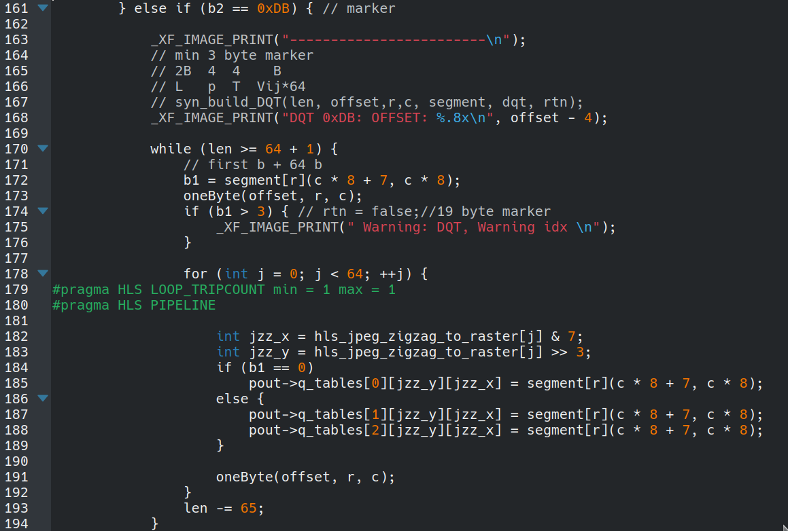
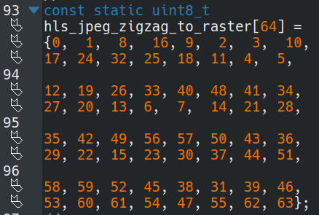
JFIF Parser_0xFFDB
Seg.Name | SOI | EOI | APP0 | SOF0 | DQT | DHT | SOS
Marker | 0xFFD8 | 0xFFD9 | 0xFFE0 | 0xFFC0 | 0xFFDB | 0xFFC4 | 0xFFDA

Slide 40
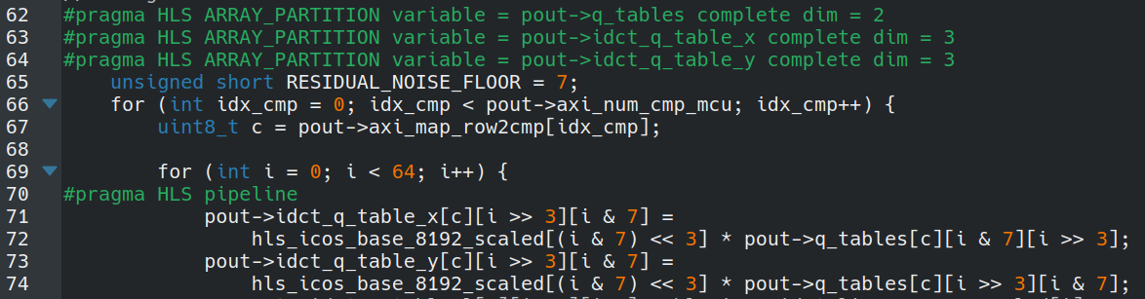
Optimization-1(Loop Merge)
Inverse quantization and IDCT are combined into one for loop,we called inverse quantization IDCT (IQIDCT), such that the decoded coefficients do not need to be inverse quantized prior to inverse transform. Thus, the computations related to inverse quantization are omitted. Among them, both IDCT and inverse quantization are calculated in loops, so merge can save the wasteful loops entering and exiting other loops, and thus become more efficient.
ref: https://ieeexplore.ieee.org/stamp/stamp.jsp?tp=&arnumber=7077268

Slide 41
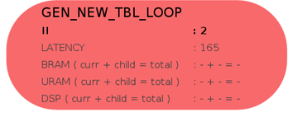
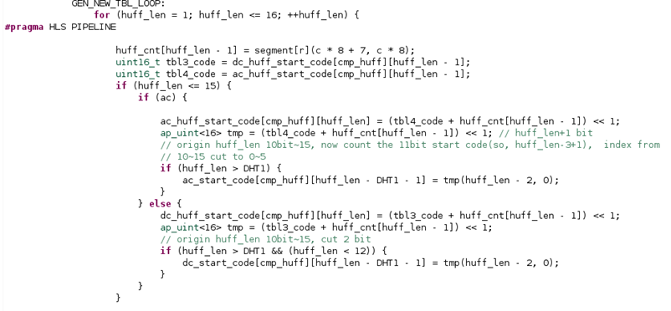
Optimization-2 (Inter LOOP RAW)

Slide 42
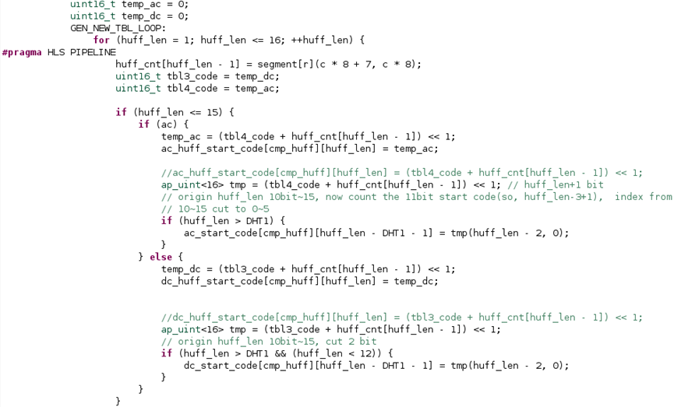
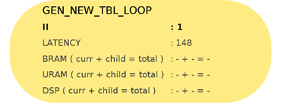
Optimization-2 (With data forwarding)

Slide 43
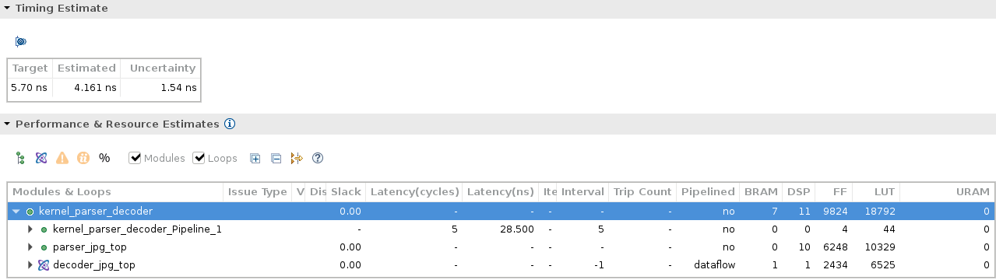
Synthesis Report (Software)
The estimated throughput of the Synthesis Report = 240.327MHz
parser_jpg_top contains parsing Table and data, so it needs space to store, resulting in a lot of FF and LUT

Slide 44
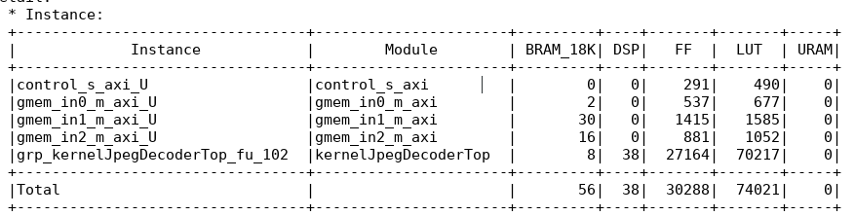
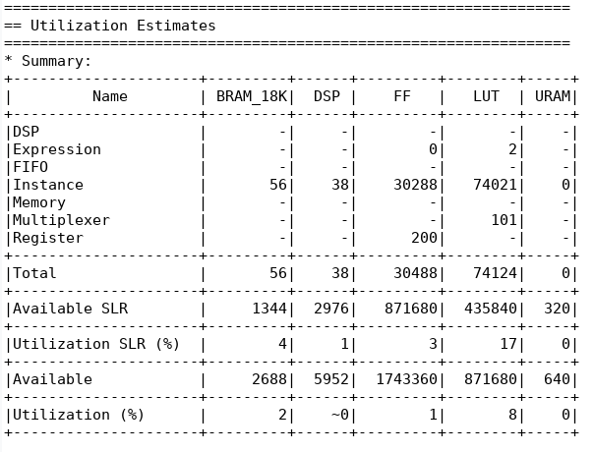
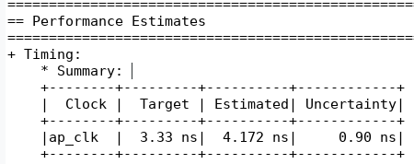
Synthesis Report (Hardware)
The estimated throughput of the Synthesis Report = 239.693MHz

Slide 45
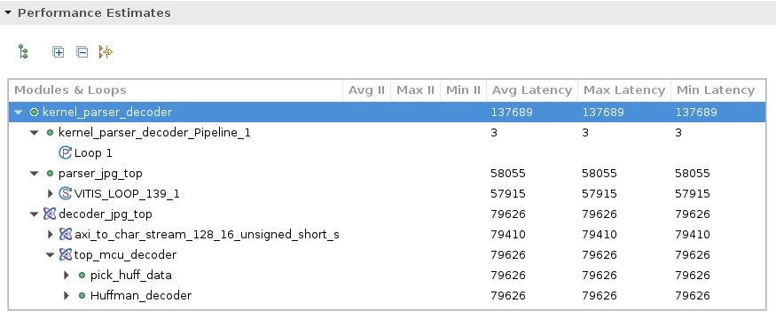
Co-SIM Performance

Slide 46
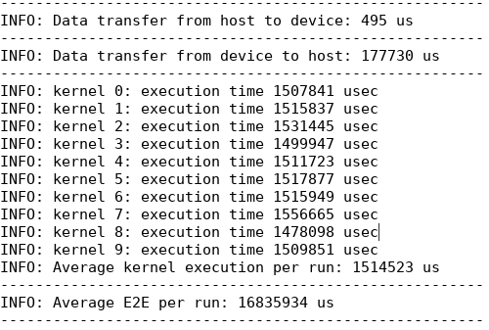
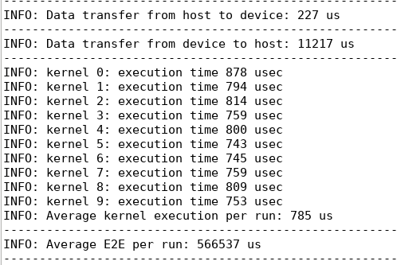
Timing Result (SW v.s. HW)
Software emulation
Hardware

Slide 47
Outline
Introduction
Algorithm
Development process
HLS Implementation
Conclusion
Reference

Slide 48
Conclusion
JPEG algorithm provides a method with high compression ratio, and has good performance in restoring images.
There are a lot of repetitive operations caused by the JPEG algorithm, so the decoding performance can be improved with the paralleled computing hardware.
HLS can be useful with optimizing loops, pragma PIPELINE help us to speed up development process.

Slide 49
Outline
Introduction
Algorithm
Development process
HLS Implementation
Conclusion
Reference

Slide 50
Reference
[1]https://github.com/Xilinx/Vitis_Libraries
[2]https://zh.m.wikipedia.org/zh-tw/JPEG
[3]https://ieeexplore.ieee.org/stamp/stamp.jsp?tp=&arnumber=7077268
[4]https://github.com/MROS/jpeg_tutorial
[5]http://twins.ee.nctu.edu.tw/courses/soclab_04/lab_hw_pdf/proj1_jpeg_introduction.pdf?fbclid=IwAR2Gu2K17iUQ6HBCnA_EciUFAAWZQMPjbZoJ0tlEY2SWJoNpdf3k7wprY4M

Slide 51
Github Link
https://github.com/bobwu0224/HLS_lab_C_Codec

