Slide 1
Lab#A Streaming_free_running_k2k
0850298 王晨峰
ChenFengWang/AAHLS_LabA_streaming_free_running_k2k (github.com)

Slide 2
Objective
Demonstrate how to use and configure a free running kernel
There are three sub lab to demonstrate streaming
Stream Free Running Kernel
Stream Kernel to Kernel Memory Mapped
Control and Status Register access continuously streaming kernel

Slide 3
Stream Free Running Kernel
Free-running kernels have no control signal ports, and cannot be started or stopped. The no-control signal feature of the free-running kernel results in the following characteristics:
The free-running kernel has no memory input or output port, and therefore it interacts with the host or other kernels (other kernels can be regular kernel or another free-running kernel) only through streams.
When the FPGA is programmed by the binary container (xclbin), the free-running kernel starts running on the FPGA, and therefore it does not need to be started from the host code.
The kernel works on the stream data as soon as it starts receiving from the platform I/O or other kernels, and it stalls when the data is not available.

Slide 4
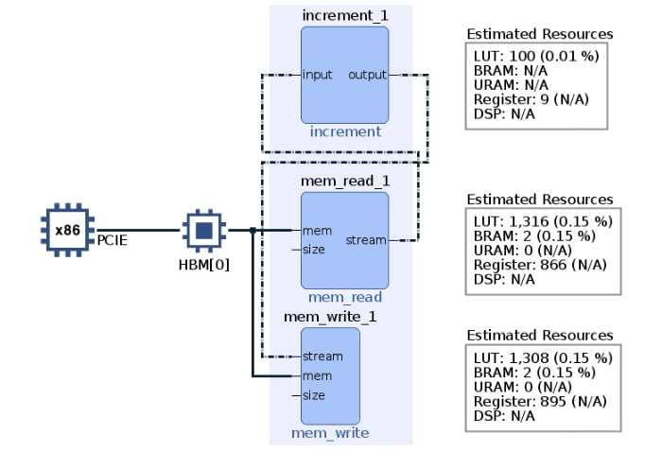
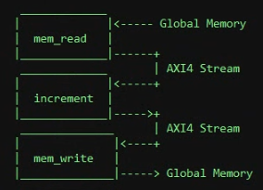
System Introduction

Slide 5
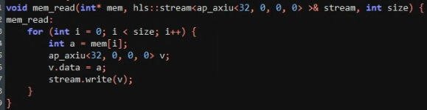
Code Snapshot

Slide 6
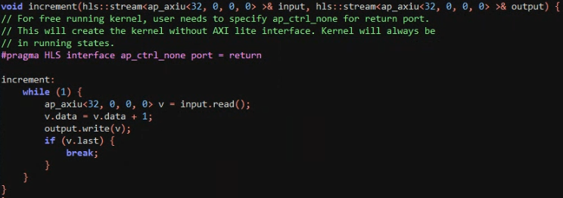
Code Snapshot

Slide 7
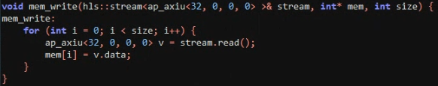
Code Snapshot

Slide 8

Stream Connect
Producer kernel mem_read streaming output port needs to be connected to consumer kernel increment stream input port during v++ using krnl_incr.cfg file as below:
The connectivity of kernels is defined when processing v++ linking. Hence, software emulation is not supported for free-running kernels.

Slide 9
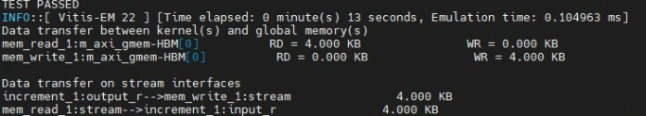
Result - test

Slide 10
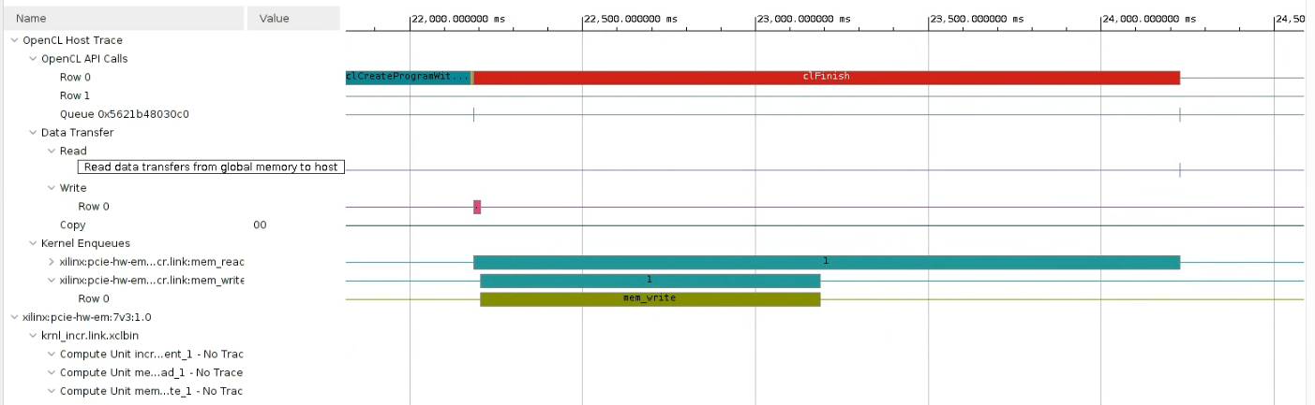
Result - timeline

Slide 11
Stream Kernel to Kernel Memory Mapped
This example demonstrates how kernels can have memory mapped inputs along with stream interface from one kernel to another.
kernel_stream_vadd has two memory mapped inputs and one stream output. kernel_stream_vmult has one memory mapped input along with kernel to kernel stream from kernel_stream_vadd which acts as its second input.
out1 = in1 + in2
out2 = in3 + out1

Slide 12
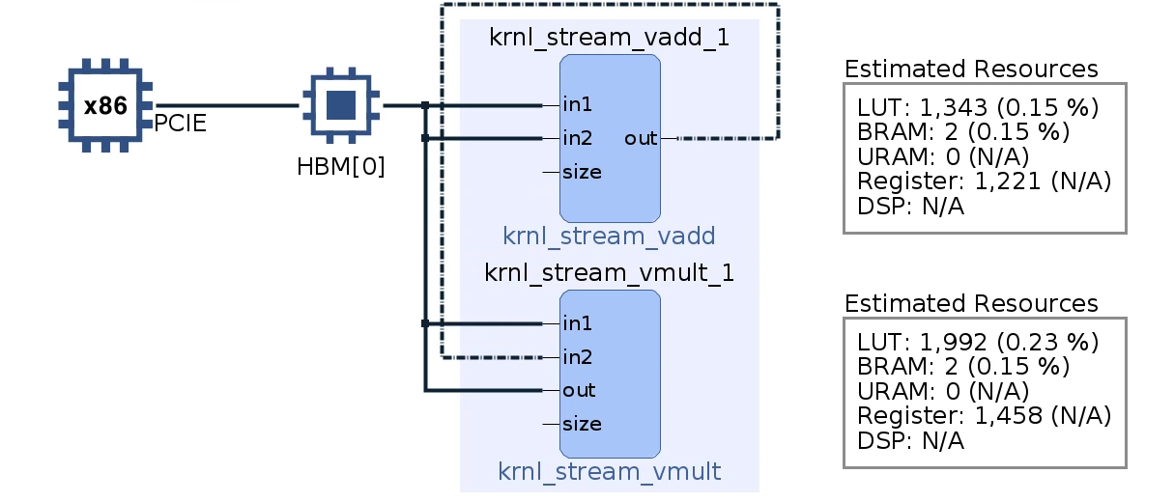
System Introduction
out1 = in1 + in2
out2 = in3 + out1

Slide 13
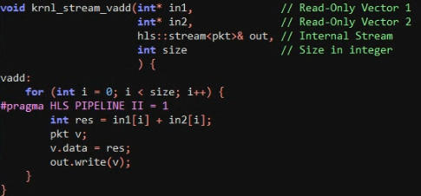
Code Snapshot

Slide 14
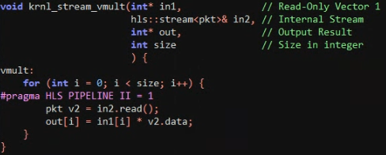
Code Snapshot

Slide 15
Stream Connect
Producer kernel stream output port must be connected to consumer kernel stream input port during the v++ linking stage.

Slide 16
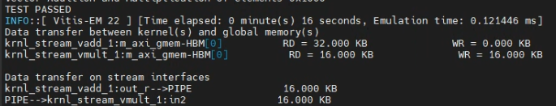
Result - test

Slide 17
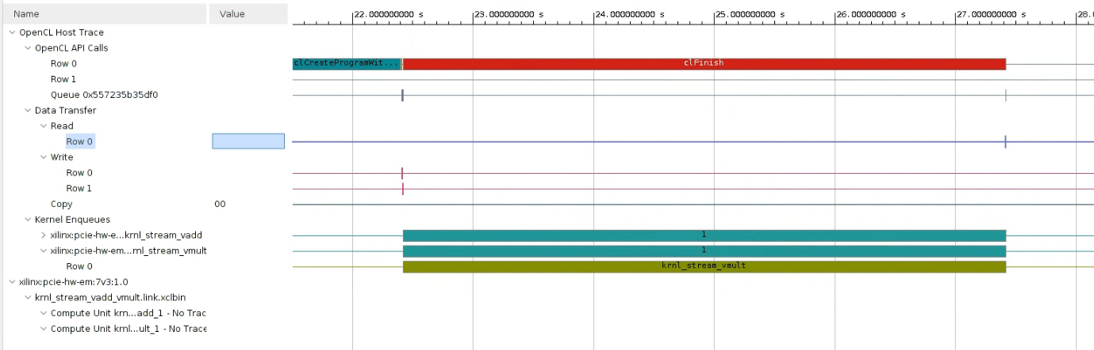
Result - timeline

Slide 18
Control and Status Register access continuously streaming kernel
This is simple example which demonstrate streaming free-running kernel with scalar input and output.
Consider a kernel with AP_CTRL_NONE only when it has no memory mapped input and output.There is no need to start the kernel by clEnqueueTask or clEnqueueNDRangeKernel from the host. Host communicates with a continuously running kernel by the stream read and write requests, if necessary.Dont use clSetKernelArg to pass scalar argument to ap_ctrl_none kernel, only use xclRegWrite (API implemented in 2019.2) API.

Slide 19
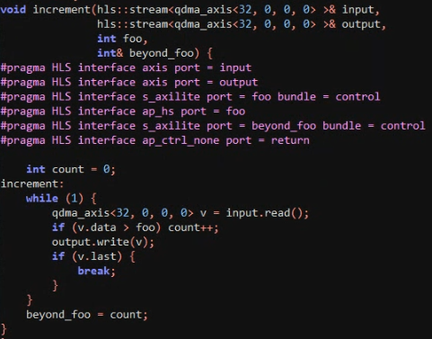
Code Snapshot

Slide 20
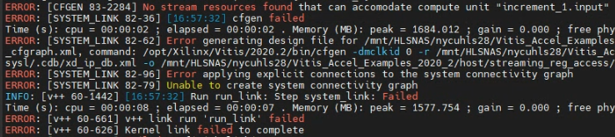
Failed reason
This lab is designed for qdma structure, but our u50 is the structure of xdma.

Slide 21
Observation and Learning
The cost of register of free running kernel is much less than normal kernel.
The free running kernel does not support software emulation.
Using terminal cmd to build the project.

