Slide 1
LABC: Data Compression
宋乃仁

Slide 2
Outline
L3 system hierarchy
Compress & Decompress
L2 kernel
L1 kernal
Host function
Vitis analysis

Slide 3
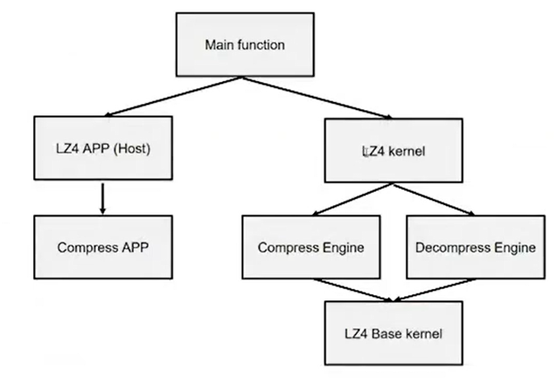
Host function hierarchy

Slide 4
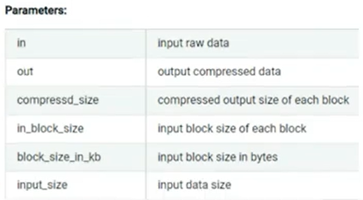
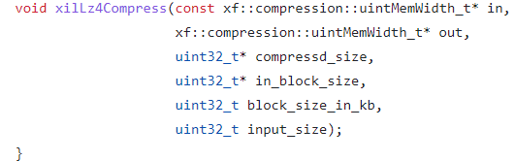
L2 kernel global function
xiiLz4Compress

Slide 5
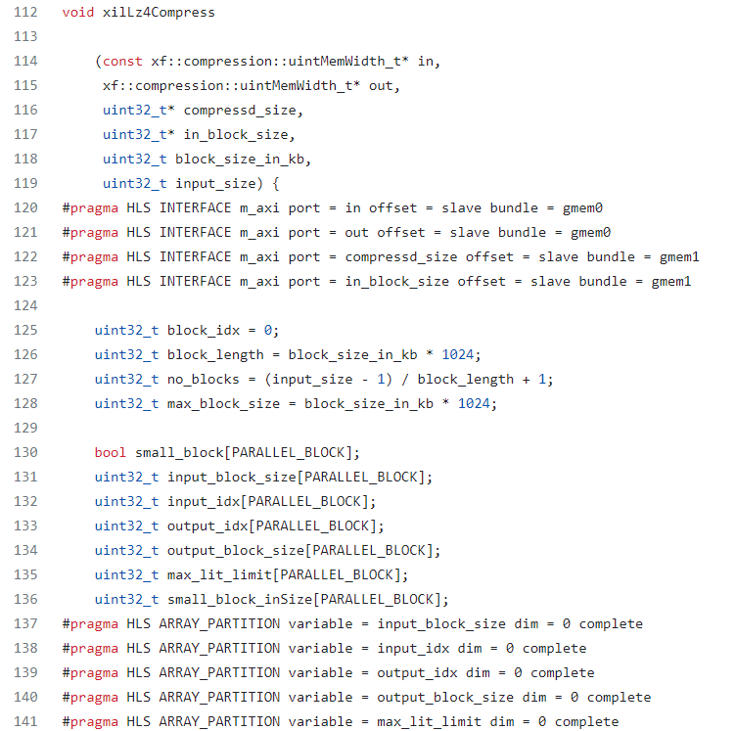
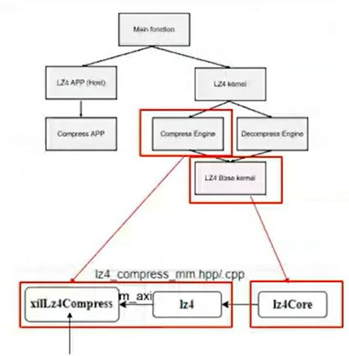
L2 kernel global function

Slide 6
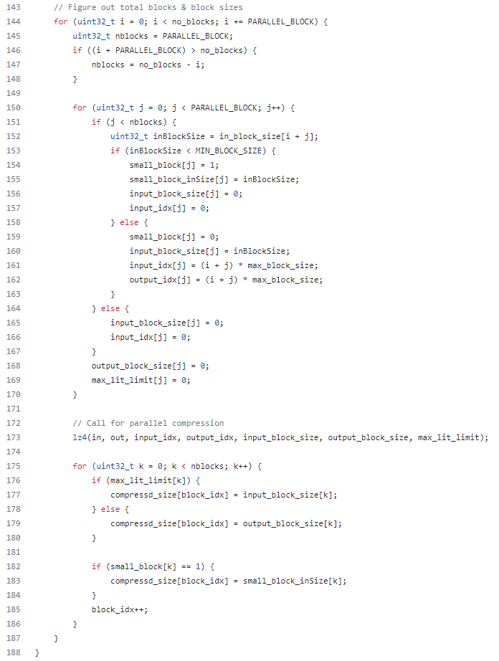
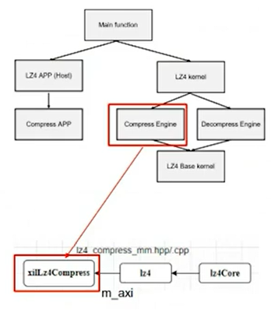
L2 kernel global function

Slide 7
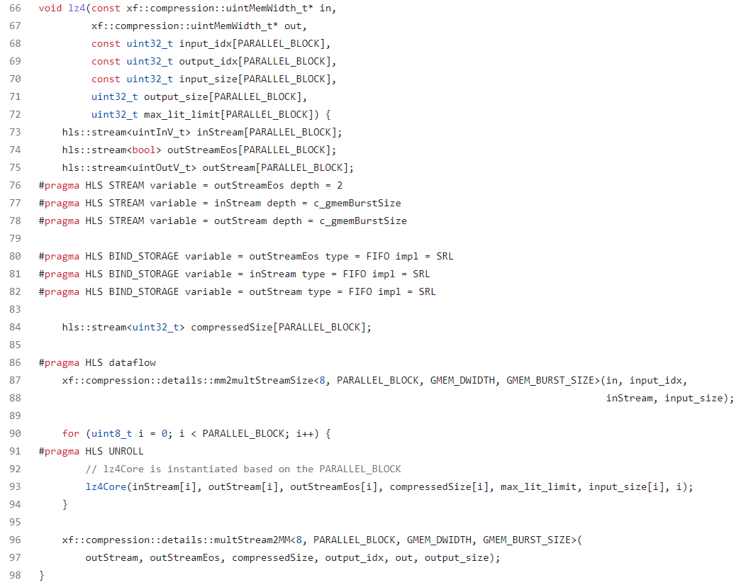
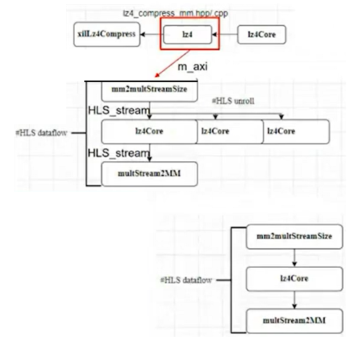
L2 kernel global function

Slide 8
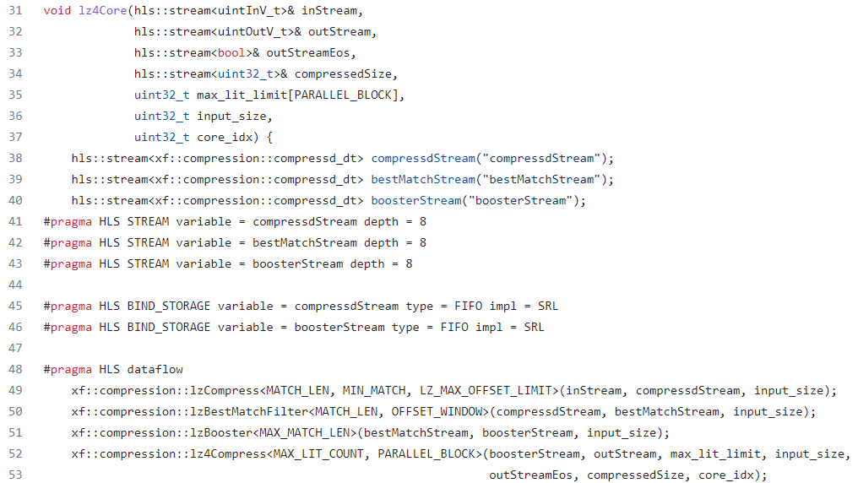
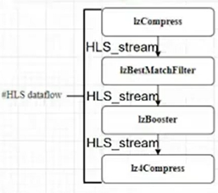
lz4Core

Slide 9
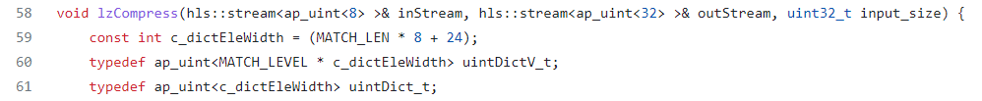
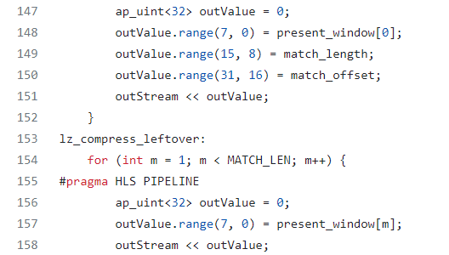
L1 Primitive APIs in xf::compression

Slide 10
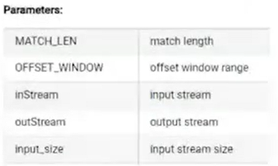
L1 Primitive APIs in xf::compression

Slide 11
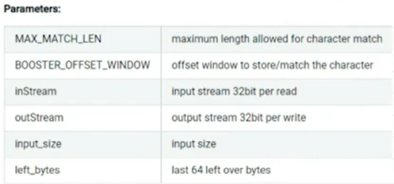
L1 Primitive APIs in xf::compression

Slide 12
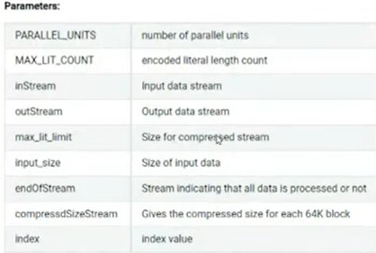
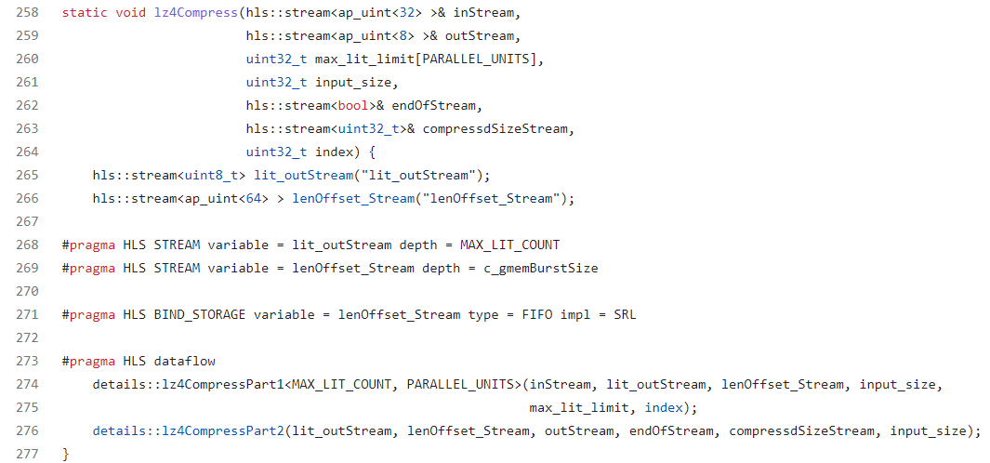
L1 Primitive APIs in xf::compression

Slide 13
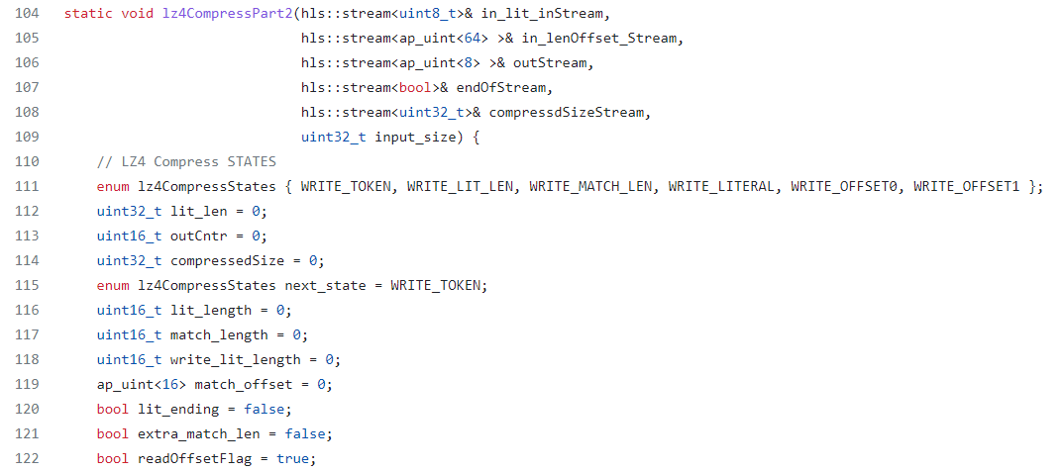
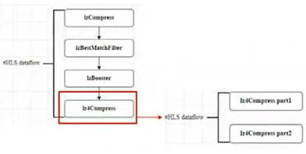
L1 Primitive APIs in xf::compression

Slide 14
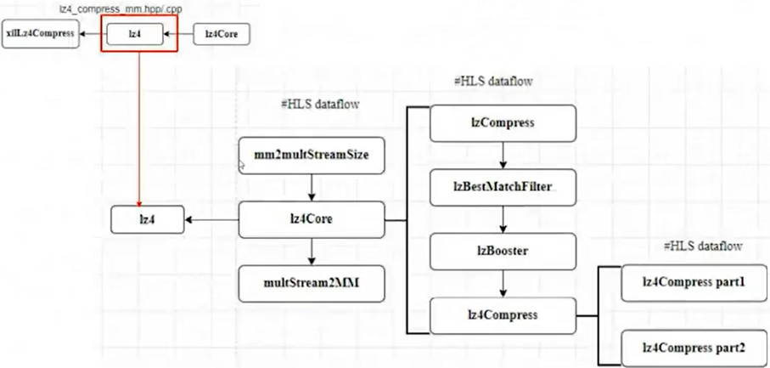
Review

Slide 15
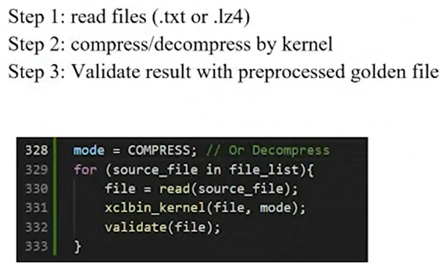
Host function

Slide 16
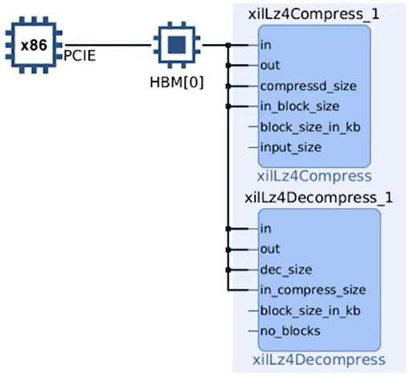
Vitis system overview
Use single HBM bank
Two kernel modules

Slide 17
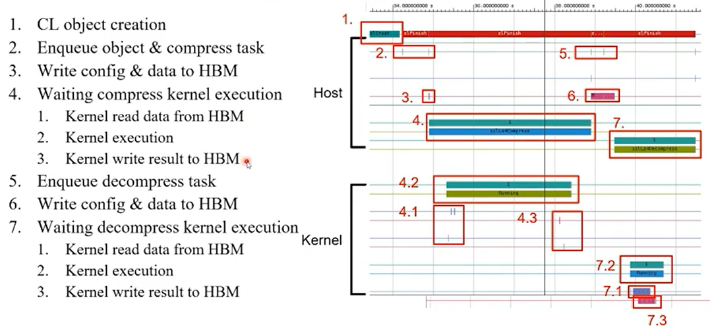
Timeline

Slide 18
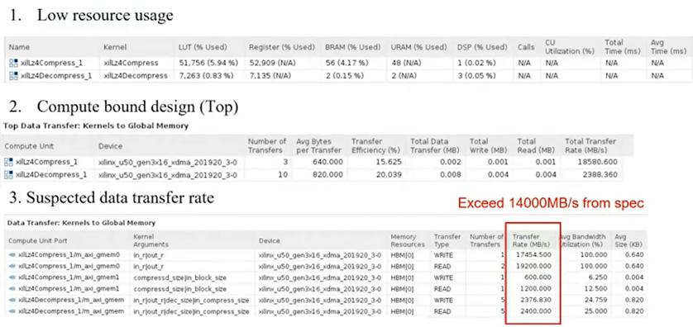
Analysis

Slide 19
Improvement
Pipeline for tasks
Multiple file processing instead of single one
More parallel kernels
Top level only use 20% memory bandwidth

Slide 20
Thanks for listening

