Slide 1
Lab B-FFT
Freud L. Lewis Piercius

Slide 2
Overview
What is FFT?
Software code
Optimized code for hardware
Performance estimation
PYNQ Demo

Slide 3
What is FFT?
Fast Fourier transform is an algorithm widely used for computing Discrete Fourier transform and its inverse.
The FFT utilizes symmetry in the DFT coefficients to provide a recursive implementation, to reduce runtime from O(N^2) to O(NlogN), N being the number of simple.
A N-points FFT has log2(N) stages.
Our goal? Create an optimized functional core to achieve a throughput of 2000 clock cycles with AXI4 burst mode
Optimization technique: Pipeline, Array reshaping, Loop unrolling

Slide 4
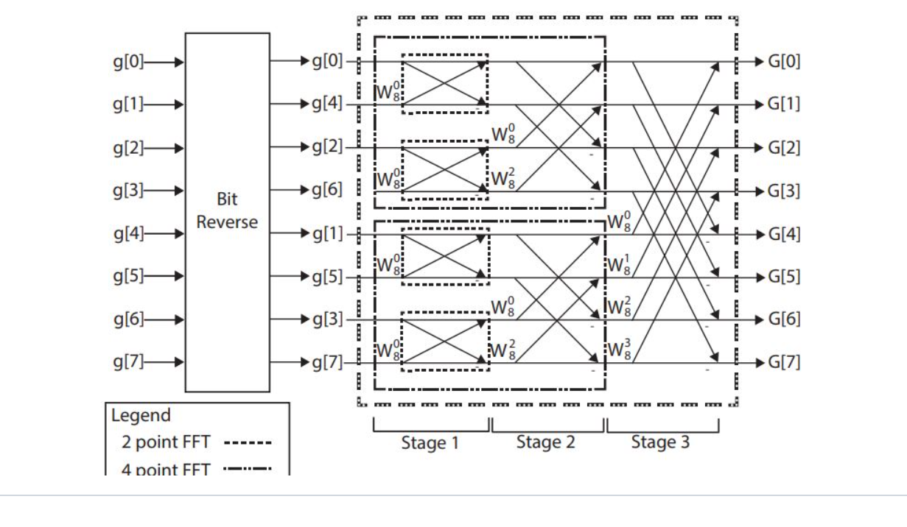
Algorithm of FFT

Slide 5
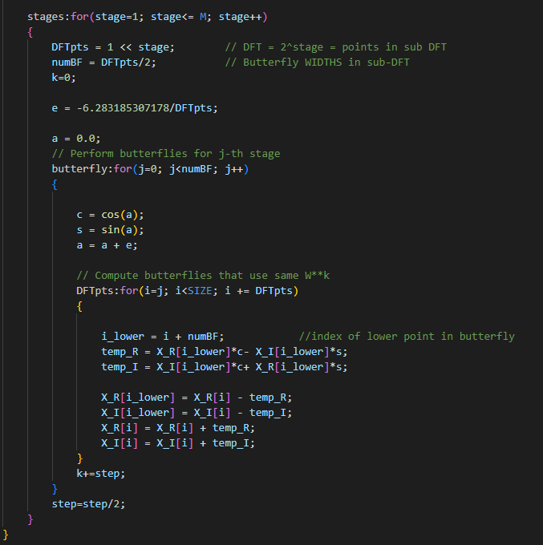
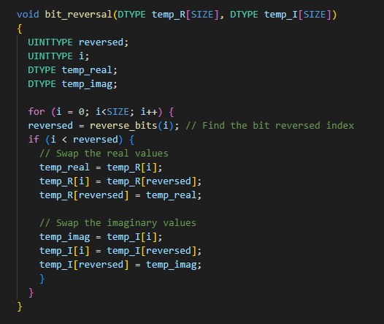
Software code

Slide 6
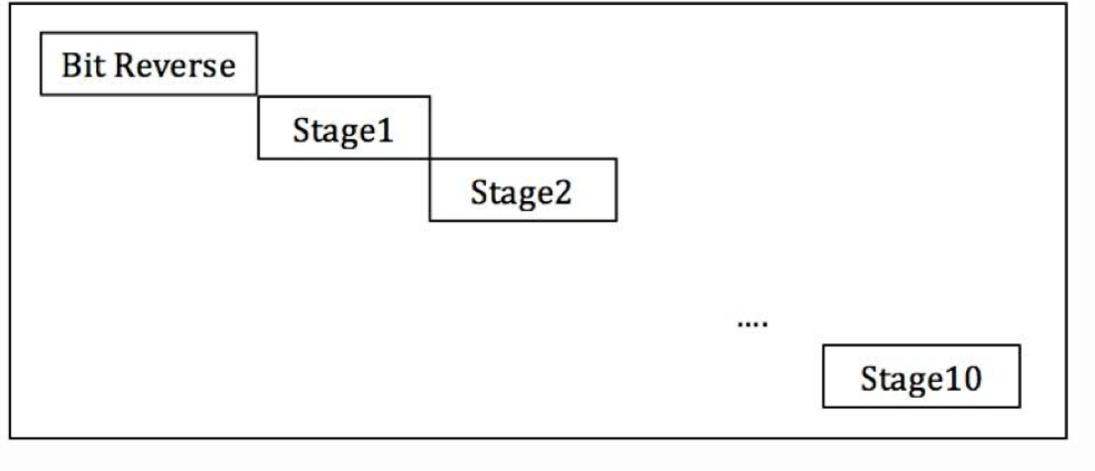
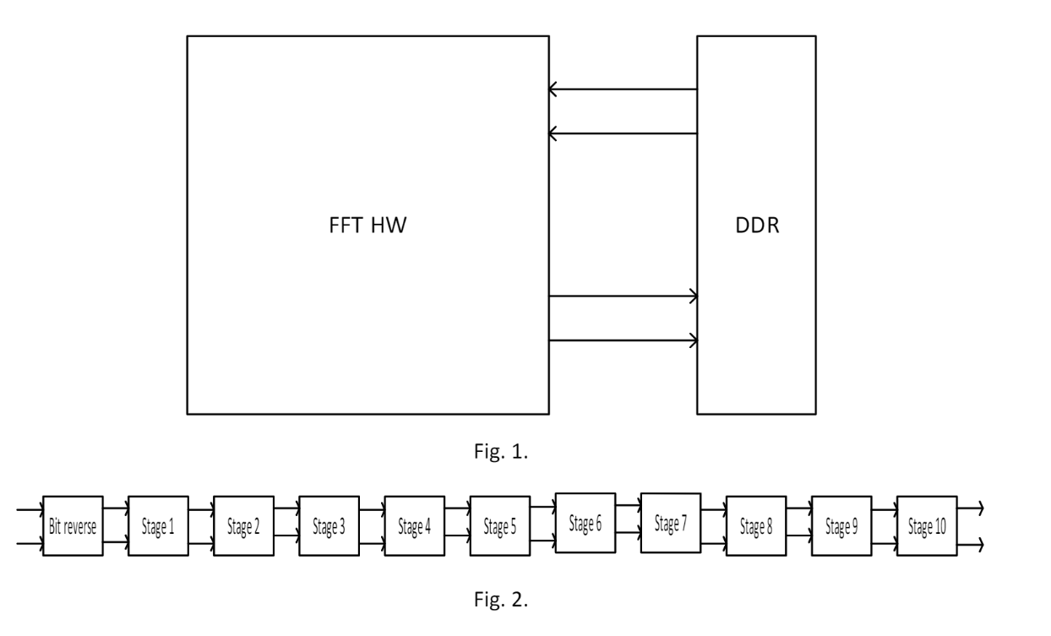
Hardware Architecture
Restructure the code following the architecture.
Pipeline within and across stages is possible.

Slide 7
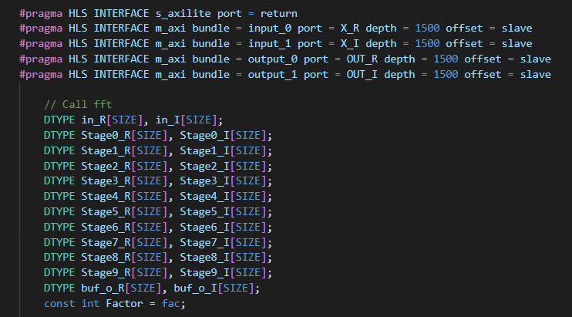
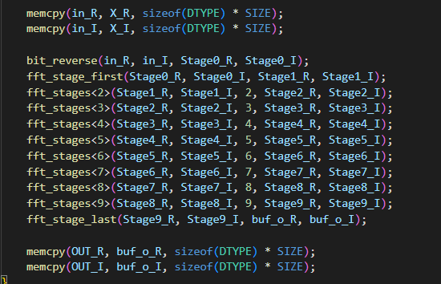
Code snippet 1
Define the inputs and outputs with m_axi interface.
Use memcpy to force vitis hls to use burst to transfer the data
Array repartition with factor of 2 for the internal buffers.

Slide 8
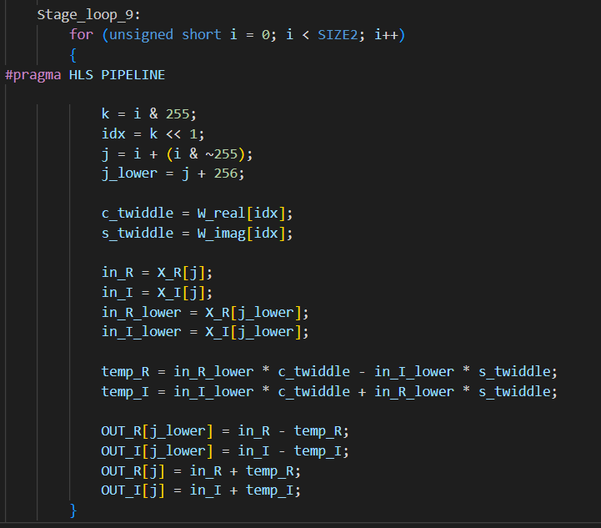
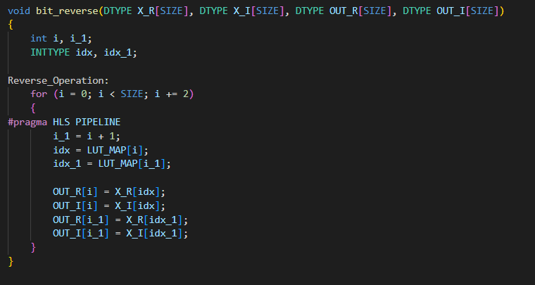
Code snippet 2

Slide 9
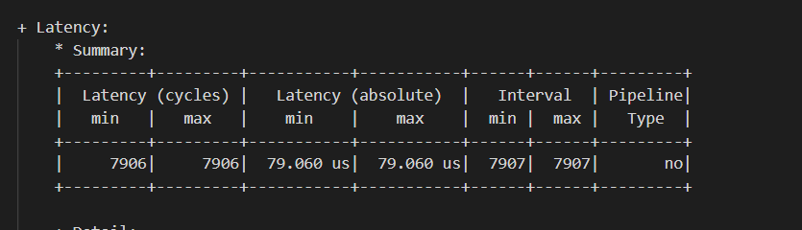
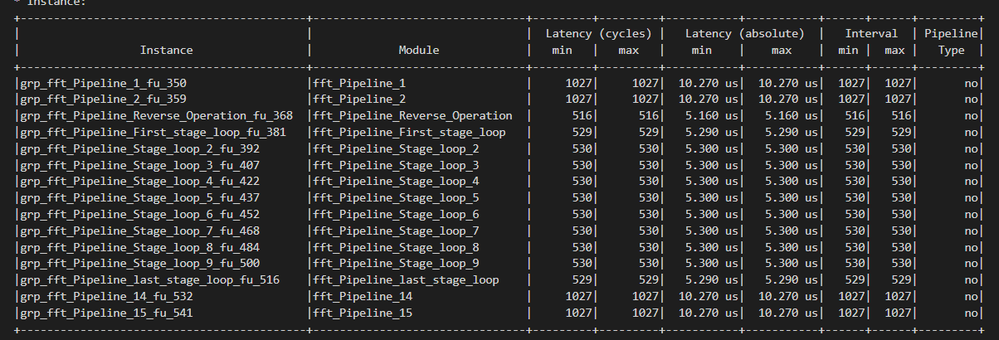
Performance estimation

Slide 10
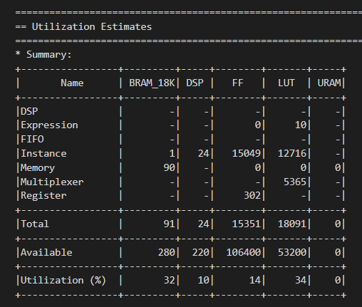
Resources utilization
Roughly 34% of LUTs and 32% of BRAM
Less than 15% of FF
10% of DSP

Slide 11
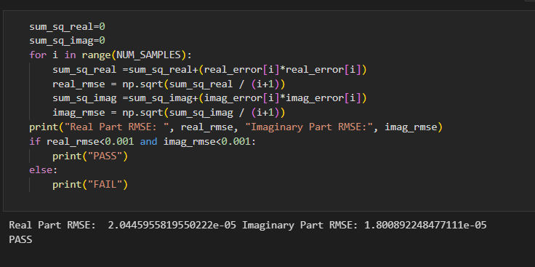
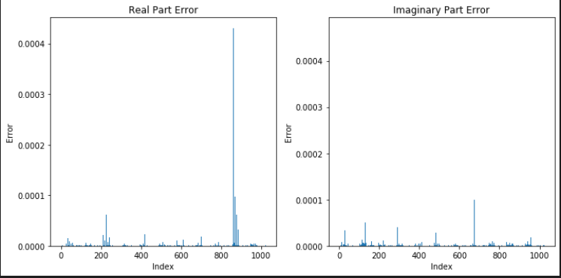
PYNQ demo

Slide 12
Thank You

