Slide 1
Lab #B-Convolution Filtering
111061545 陳揚哲

Slide 2
Outline
Introduction to convolution
Performance requirement of 1080 HD video
Software implementation
Hardware Estimation and Implementation
Performance analysis
Explain what we learn from this lab

Slide 3
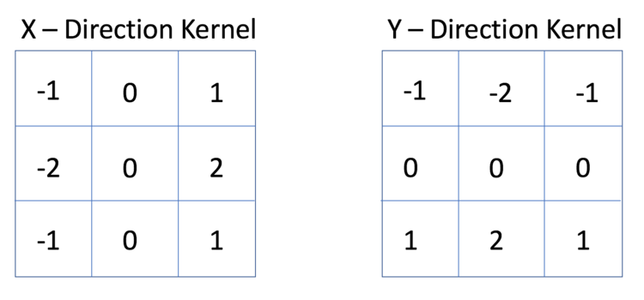
Introduction to convolution
Implement sum-of-product with the matrix
Different filter has different application.
(edge detection, noise filtering, and so on.)
The matrix of Sobel Edge Detection

Slide 4
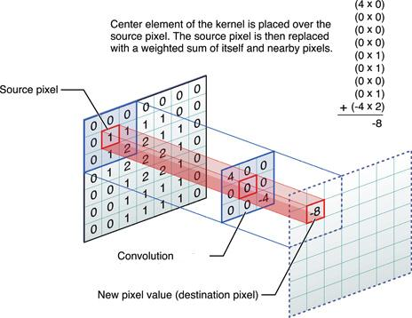
Filtering the image
Select the input pixel
Extracting the matrix whose size is same as the filter matrix.
Calculating the sum-of-product with two matrix.
The result is the output pixel value.

Slide 5
Performance requirement of 1080 HD video
Video resolution(Width * Height)：1920x1080
Frame rate(FPS)：60
Pixel depths(Bits)：8
Color Channels(YUV)：3
Throughputs (Pixel/s, output)：1920 x 1080 x 3 x 60 = 373 MB/s

Slide 6
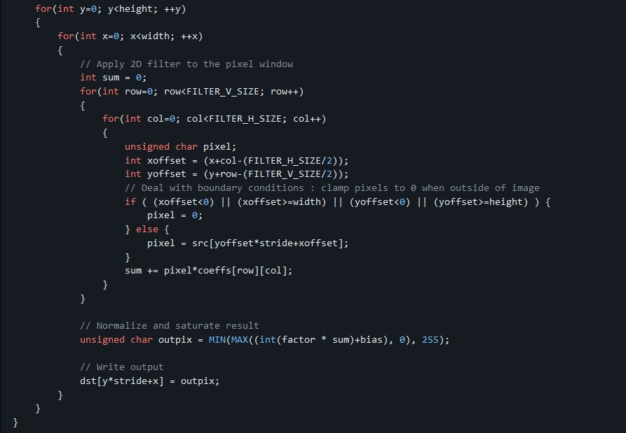
Software implementation
There’re 4 for-loops in code.
Outer two loops：
Define the pixel required to be processed.
Inner two loops：
Performing sum-of-product calculation.

Slide 7
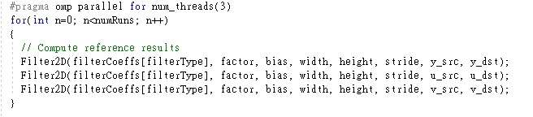
Software implementation
We have 3 channel (YUV) for calculation.
Using OpenMP to apply parallel operation.

Slide 8

Software implementation
To generate 1080 HD video, the throughput need to be 373 MB/s.
Acceleration factor = $\frac{Throughput(requirement)}{Throughtput(sw)}$ = $\frac{373}{20.15}$ = 18.5

Slide 9
Hardware Estimation
The core compute is done in a 4-level nested loop
Inner two loops are doing the sum-of-product on a coefficient matrix and image.
The matrix sizes are defined by the coefficient matrix, which is 15x15.
The inner two loops are performing a dot product of size 225(15x15).
In other words, the two inner loops perform 225 multiply-accumulate (MAC) operations for every output pixel produced.

Slide 10
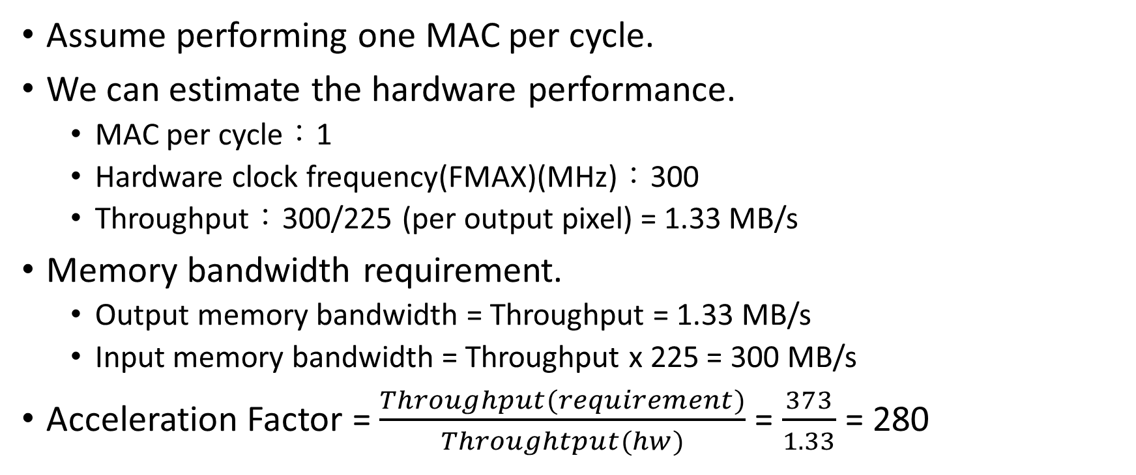
Hardware Estimation - Baseline
Assume performing one MAC per cycle.
We can estimate the hardware performance.
MAC per cycle：1
Hardware clock frequency(FMAX)(MHz)：300
Throughput：300/225 (per output pixel) = 1.33 MB/s
Memory bandwidth requirement.
Output memory bandwidth = Throughput = 1.33 MB/s
Input memory bandwidth = Throughput x 225 = 300 MB/s
Acceleration Factor = $\frac{Throughput(requirement)}{Throughtput(hw)}$ = $\frac{373}{1.33}$ = 280

Slide 11
Hardware Estimation - Optimized
We can unrolled the inner two loop to increase the performance by 225 (generate 1 output pixel per cycle)
Estimate the hardware performance.
Throughput = FMAX x Pixel produced per cycle = 300 x 1 = 300 MB/s
Memory bandwidth requirement.
Output memory bandwidth = Throughput = 300 MB/s
Input memory bandwidth = Throughput x 225 = 300 x 225 = 67.5 GB/s
This input memory bandwidth is too large. Using caching scheme to reduce bandwidth to around 300 MB/s.

Slide 12
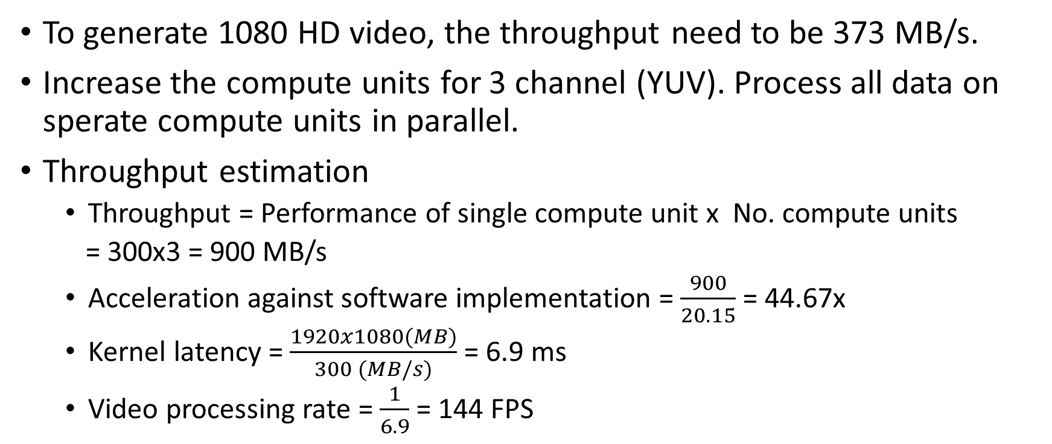
Hardware Estimation – Compute units
To generate 1080 HD video, the throughput need to be 373 MB/s.
Increase the compute units for 3 channel (YUV). Process all data on sperate compute units in parallel.
Throughput estimation
Throughput = Performance of single compute unit x No. compute units
= 300x3 = 900 MB/s
Acceleration against software implementation = $\frac{900}{20.15}$ = 44.67x
Kernel latency = $\frac{1920x1080(MB)}{300 (MB/s)}$ = 6.9 ms
Video processing rate = $\frac{1}{6.9}$ = 144 FPS

Slide 13
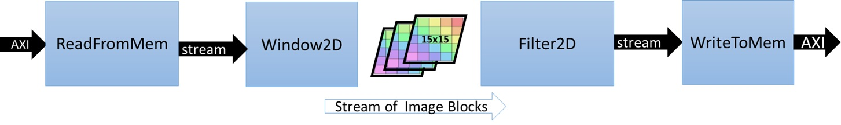
Hardware implementation - Dataflow
Functions in dataflow
ReadFromMem: reads pixel data or video input from main memory
Window2D: local cache with wide(15x15 pixels) access on the output side
Filter2D: core kernel filtering algorithm
WriteToMem: writes output data to main memory

Slide 14
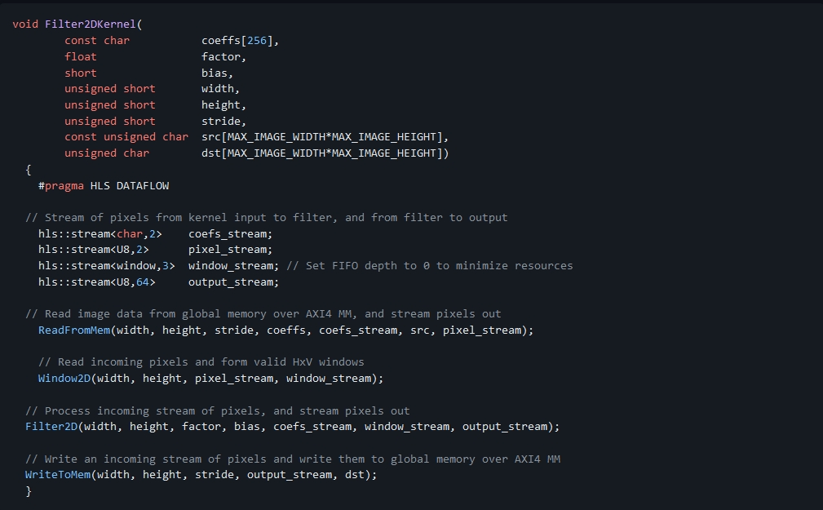
Hardware implementation-Top-level function
#pragma HLS DATAFLOW
Dataflow process enables task-level pipelining, allowing functions and loops to overlap in their operation

Slide 15
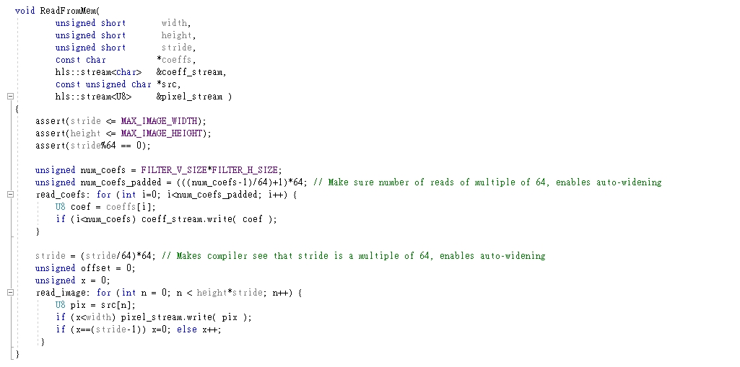
Hardware implementation – ReadFromMem
Read the data from main memory

Slide 16
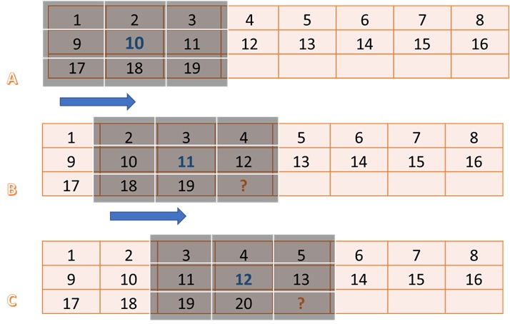
Hardware implementation – Window2D
We build two basic block：”Window” and “line buffer”
"Window" block holds FILTER_V_SIZE * FILTER_H_SIZE pixels.
“line buffer” block holds (FILTER_V_SIZE-1) * MAX_IMAGE_WIDTH pixels.

Slide 17
Hardware implementation – Window2D
“Window” holds the FILTER_V_SIZE * FILTER_H_SIZE pixels
Once we calculate the next pixel, since there’s a large overlap area, only a column moves out from the left, and a column moves in from the right.
From line buffer
From window 10
From ReadFromMem

Slide 18
Hardware implementation – Window2D
“line buffer” holds (FILTER_V_SIZE-1) * MAX_IMAGE_WIDTH pixels.
In general, it requires FILTER_V_SIZE lines, but a line is reduced.

Slide 19
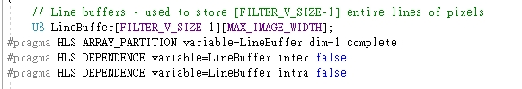
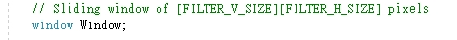
Hardware implementation – Window2D
#pragma HLS ARRAY_PARTITION variable=LineBuffer dim=1 complete
Full partition of LineBuffer
#pragma HLS DEPENDENCE variable=LineBuffer inter false
LineBuffer has no data dependency between loops
#pragma HLS DEPENDENCE variable=LineBuffer intra false
LineBuffer has no data dependency in loop

Slide 20
Hardware implementation – Window2D
#pragma HLS LOOP_TRIPCOUNT max=max_iterations
Define max iteration for loops, using for analysis
#pragma HLS PIPELINE II=1
Set II (initiation interval) to be 1

Slide 21
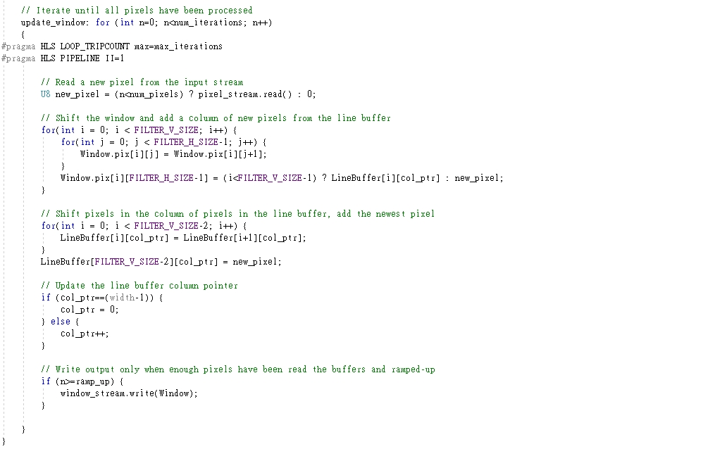
Hardware implementation – Window2D

Slide 22
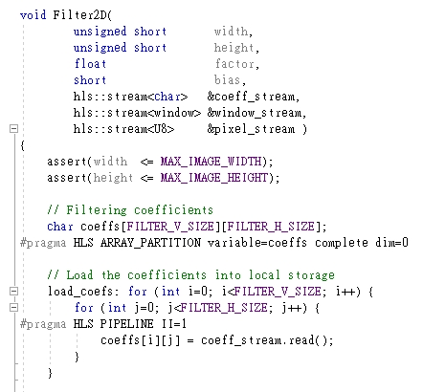
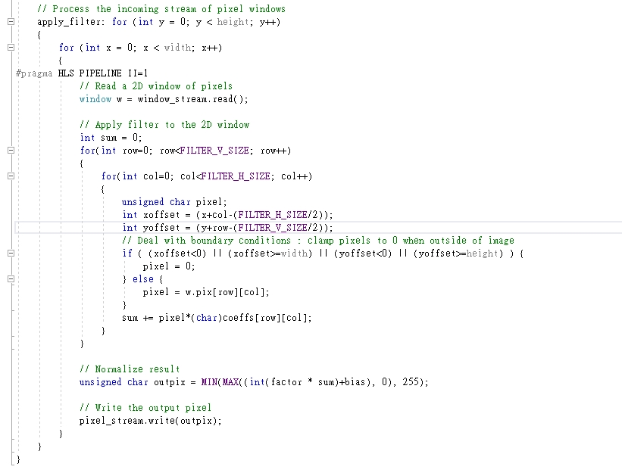
Hardware implementation – Filter 2D
Load filter matrix from ReadFromMem and matrix form Window2D

Slide 23
Hardware implementation – Filter 2D
#pragma HLS ARRAY_PARTITION variable=coeffs complete dim=0
Full partition to perform convolution calculation
#pragma HLS PIPELINE II = 1
Set II (initiation interval) to be 1

Slide 24
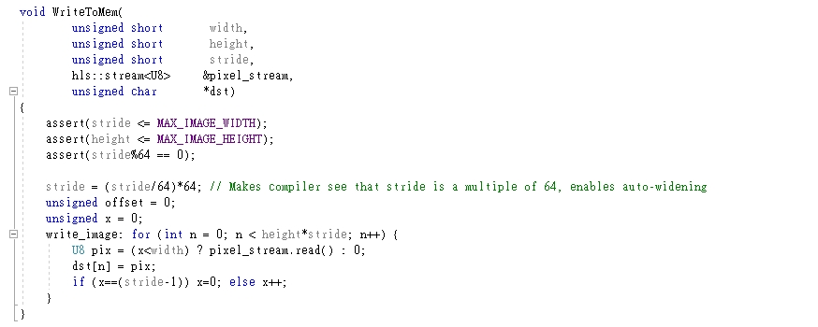
Hardware implementation – WriteToMem
Write output to main memory

Slide 25
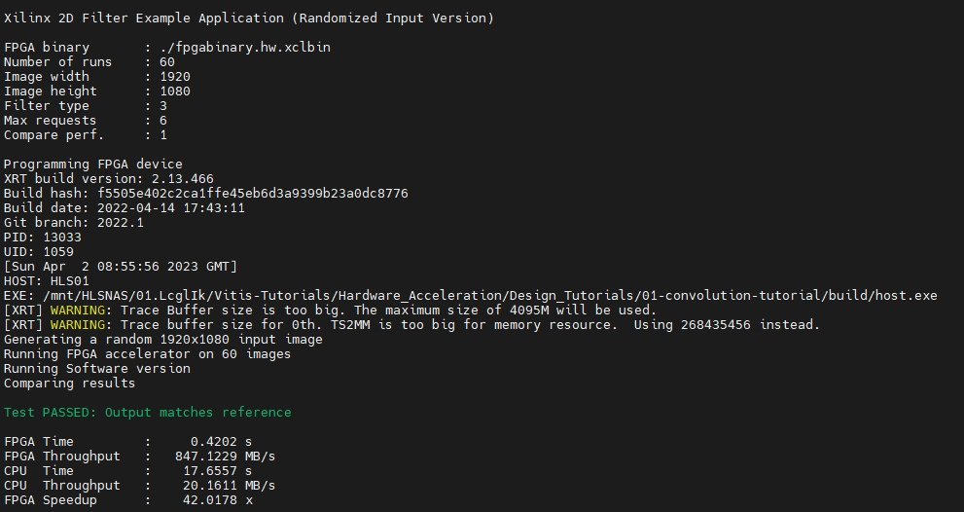
Performance analysis
Find out the throughput = 847 MB/s, closed to estimation 900 MB/s

Slide 26
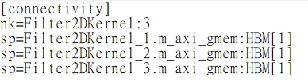
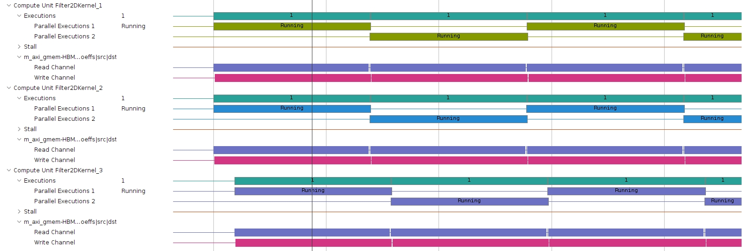
Performance analysis – Compute unit

Slide 27
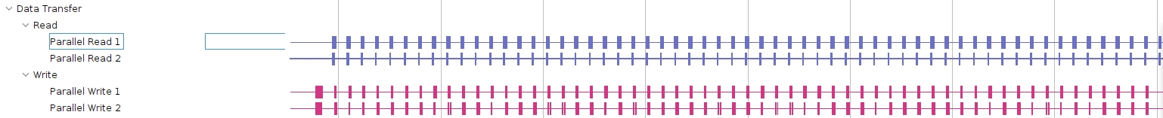
Performance analysis - data transfer
It can be seen that the host read and write bandwidth is not fully utilized as there are gaps.

Slide 28
Conclusion
Understand how to build, run, analyze the convolution filter
Estimate performance and compare it with actual performance

