Slide 1
Sobel Filter
第四組
組長 : 周聖平
組員 : 蔡以心 張煒侖 李承澔

Slide 2
Problem Statement
Issue: In Lab2.2, we implemented edge detection using a 1D derivative filter. However, the input image may have different situations:
1. Noise sources: Salt and pepper noise :Median Filter Gaussian noise :Gaussian Filter
2. Image edges: Significant edge variation (narrow transition band) :Sobel Filter Small edge variation :Laplacian Filter
Objective: Therefore, in order to deal with different situations, we want to design a flexible filter.

Slide 3
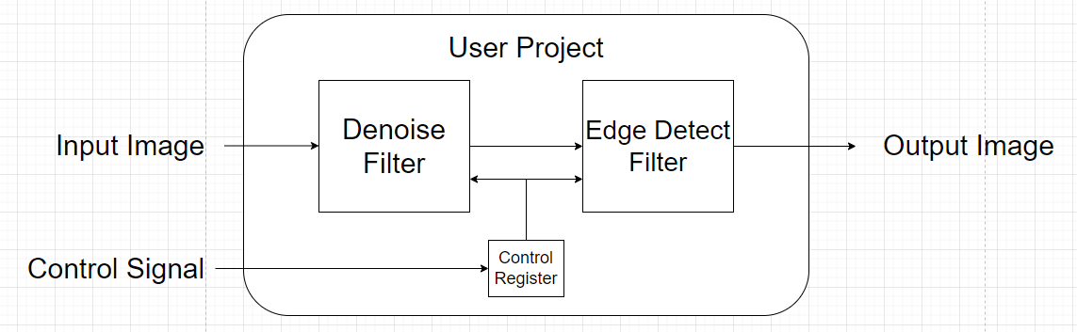
System block diagram

Slide 4
Target Specification
Goal
Try to share components as much as possible to reduce the area.
Mode
Bypass
Sobel Filter
Laplacian Filter
Gaussian Filter
Median Filter
Gaussian Filter + Sobel Filter
Median Filter + Sobel Filter
Gaussian Filter + Laplacian Filter
Median Filter + Laplacian Filter

Slide 5
Denoise Filiter
Gaussian Filter
Median Filter
Bubble sort
Merge sort

Slide 6

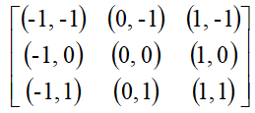
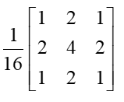
Gaussian Filter
2維高斯
2維高斯中心點(x,y)假設為(0,0)
近似結果

Slide 7
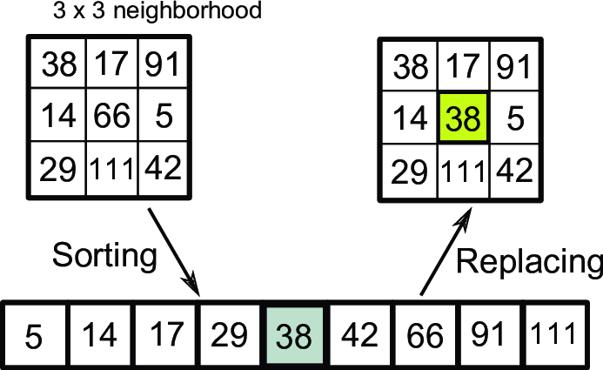
Medium filter

Slide 8
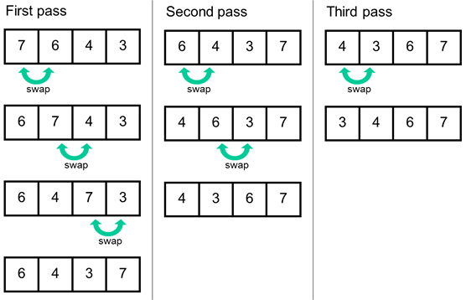
Medium filter
Bubble sort

Slide 9
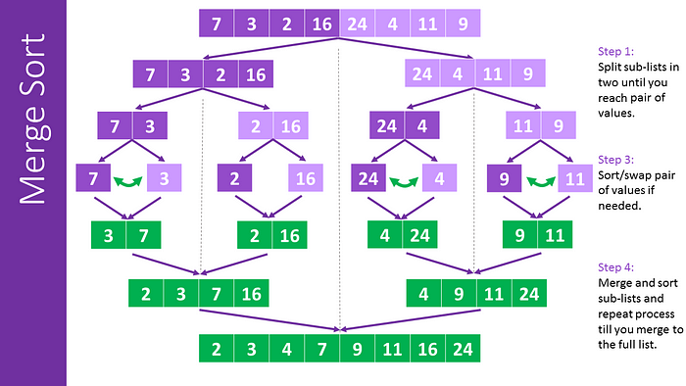
Medium filter
Merge sort

Slide 10

Sobel Filter
Laplacian Operator
對X軸微分
進行二次微分
令x+1 = x
同理，對Y軸二次微分
合併兩個軸的二次微分得到Laplacian Operator

Slide 11
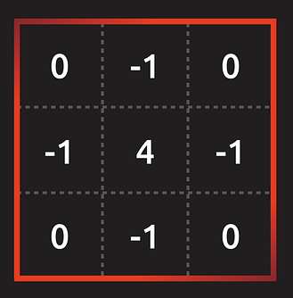
Laplacian Operator Mask
Reference : https://medium.com/%E9%9B%BB%E8%85%A6%E8%A6%96%E8%A6%BA/%E9%82%8A%E7%B7%A3%E5%81%B5%E6%B8%AC-%E6%8B%89%E6%99%AE%E6%8B%89%E6%96%AF%E7%AE%97%E5%AD%90-laplacian-operator-ea877f1945a0

Slide 12
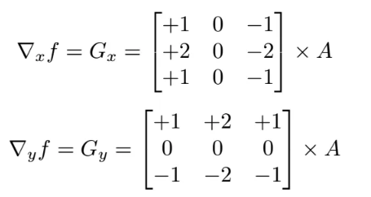
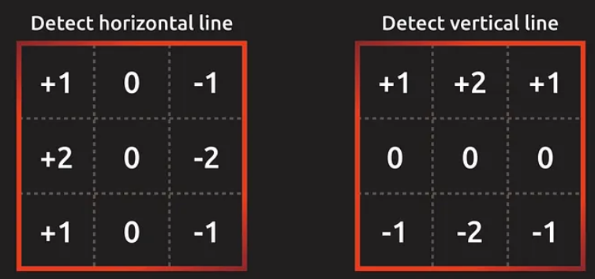
Sobel Operator Mask
索伯算子對應到的面罩分為上圖的左右兩個，左邊負責偵測水平向的邊界，右邊負責偵測垂直向的邊界。所以 A 表示輸入影像，G 表示梯度，則公式如下：
與Laplacian Operator相比，Sobel
Operator對噪音容忍度更高，且
可偵測邊緣方向性

Slide 13
Workflow
C Code (Testbench、Algorithm) - 5/19
Laplacian Filter –張煒侖
Gaussian Filter – 蔡以心
Median Filter – 周聖平
Integrate - 李承澔
Kernel HLS implementation, Host implementation - 5/26
Kernel(Caravel inputs the image to user prj) - 周聖平、蔡以心
Host(Recv. the output image from user prj) - 李承澔、張煒侖
Individual Kernel FPGA validation/integration test - 6/11
Kernel and Host Optimization - 6/18

Slide 14
Reference
1.https://medium.com/@bob800530/python-gaussian-filter-%E6%A6%82%E5%BF%B5%E8%88%87%E5%AF%A6%E4%BD%9C-676aac52ea17
2.https://www.researchgate.net/figure/Concept-of-median-filtering-in-image-processing_fig17_281534044
3.https://www.computersciencebytes.com/sorting-algorithms/bubble-sort/
4.https://oldmo860617.medium.com/js%E5%AD%B8%E8%B3%87%E6%96%99%E7%B5%90%E6%A7%8B%E8%88%87%E6%BC%94%E7%AE%97%E6%B3%95-2-%E5%90%88%E4%BD%B5%E6%8E%92%E5%BA%8F%E6%B3%95-merge-sort-cf1a8457c9e0
5. 數位影像處理基礎(NTU) Dr. L. C. Chen (陳亮嘉)

Slide 15
Thank you

