Slide 1
Final Project Proposal:
Optical Flow Accelerator
Group 6
111061545 陳揚哲、112501538 葉承泓
(*註: This powerpoint slide template is from Slidesgo.)

Slide 2
Table of contents
01
04
Block Diagram
FIR throughput
02
05
Firmware latency
Data flow & control flow
06
03
Measurement of QOS
Hardware Matmul
07
Insights
Synthesis report
Latency calculating in testbench

Slide 3
Outline
Final project proposal –– optical flow accelerator
Project Title
Team
Problem statement
Project Scope
Project plan
Reference

Slide 4
Latency performance
FIR (with hardware & DMA & SDRAM)：
總共 3058 個clock cycles
Compare to lab4-2：FIR with software：1510415個clock cycles
Compare to lab4-2：FIR with hardware：551675個clock cycles
MM (hardware accelerator)
總共 195 個clock cycles
ideally：48個clock cycles
Compare to lab6：MM with software：203852個clock cycles
Qsort (firmware)
總共 8305 個clock cycles
Compare to lab6： Qsort with software (without improvement techniques)：97082個clock cycles

Slide 5
Final project proposal –– optical flow accelerator
https://github.com/cornell-zhang/rosetta/tree/master/optical-flow

Slide 6
01
Block Diagram

Slide 7
Final project proposal –– optical flow accelerator
Project Title: HLS implementation for optical flow accelerator
Team: (Team 6) 111061545 陳揚哲、112501538 葉承泓
Problem statement:
Context: The target application is “optical flow” used in image signal processing (ISP).
Issue:
Objective (target to achieve):
The problem for optical flow computation is usually its computational complexity. Therefore it often needs large latency with software, and hard to implement in real time.
The problem for optical flow computation is usually its computational complexity. Therefore it often needs large latency with software, and hard to implement in real time.

Slide 8
Final project proposal –– optical flow accelerator
Project Title: HLS implementation for optical flow accelerator
Team: (Team 6) 111061545 陳揚哲、112501538 葉承泓
Problem statement:
Context: The target application is “optical flow” used in image signal processing (ISP).
Issue:
Objective:
The problem for optical flow computation is usually its computational complexity. Therefore it often needs large latency with software, and hard to implement in real time.
We would like to improve the computational latency and throughput of optical flow, in order to implement it in real time.

Slide 9
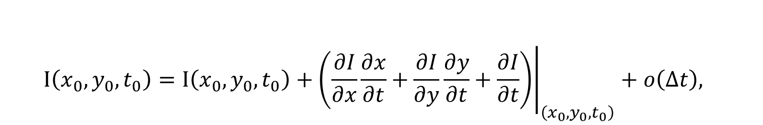
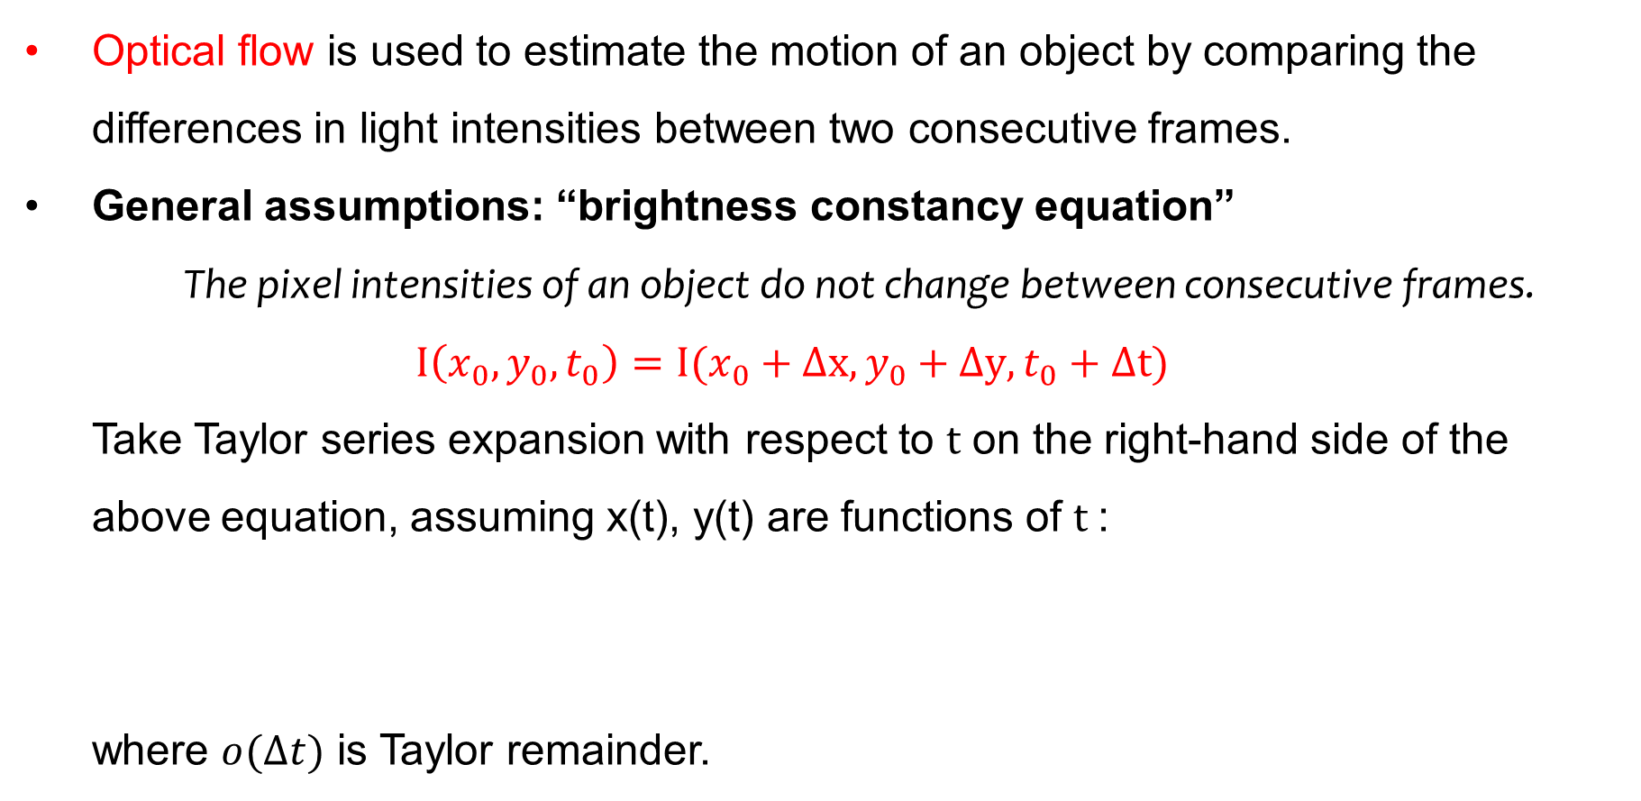
Optical-flow algorithm
Optical flow is used to estimate the motion of an object by comparing the differences in light intensities between two consecutive frames.
General assumptions: “brightness constancy equation”
The pixel intensities of an object do not change between consecutive frames.
$$I\left(x_{0},y_{0},t_{0}\right)=I(x_{0}+Δx,y_{0}+Δy,t_{0}+Δt)$$
Take Taylor series expansion with respect to $t$ on the right-hand side of the above equation, assuming x(t), y(t) are functions of $t$:
where $o(Δt)$ is Taylor remainder.
$$I\left(x_{0},y_{0},t_{0}\right)=I\left(x_{0},y_{0},t_{0}\right)+{\left.\left(\frac{∂I}{∂x}\frac{∂x}{∂t}+\frac{∂I}{∂y}\frac{∂y}{∂t}+\frac{∂I}{∂t}\right)\right|}_{\left(x_{0},y_{0},t_{0}\right)}+o\left(Δt\right),$$

Slide 10
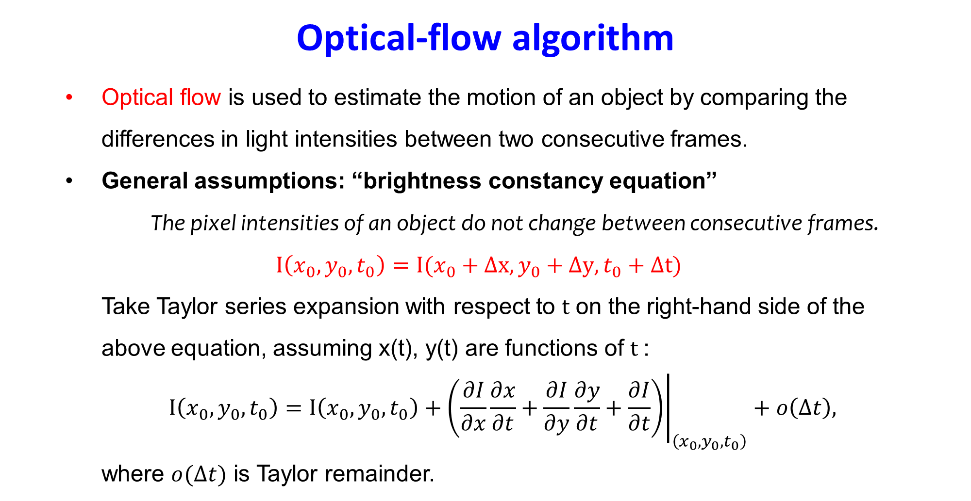
Final project proposal –– optical flow accelerator
Project Scope:
Background Introduction:

Slide 11
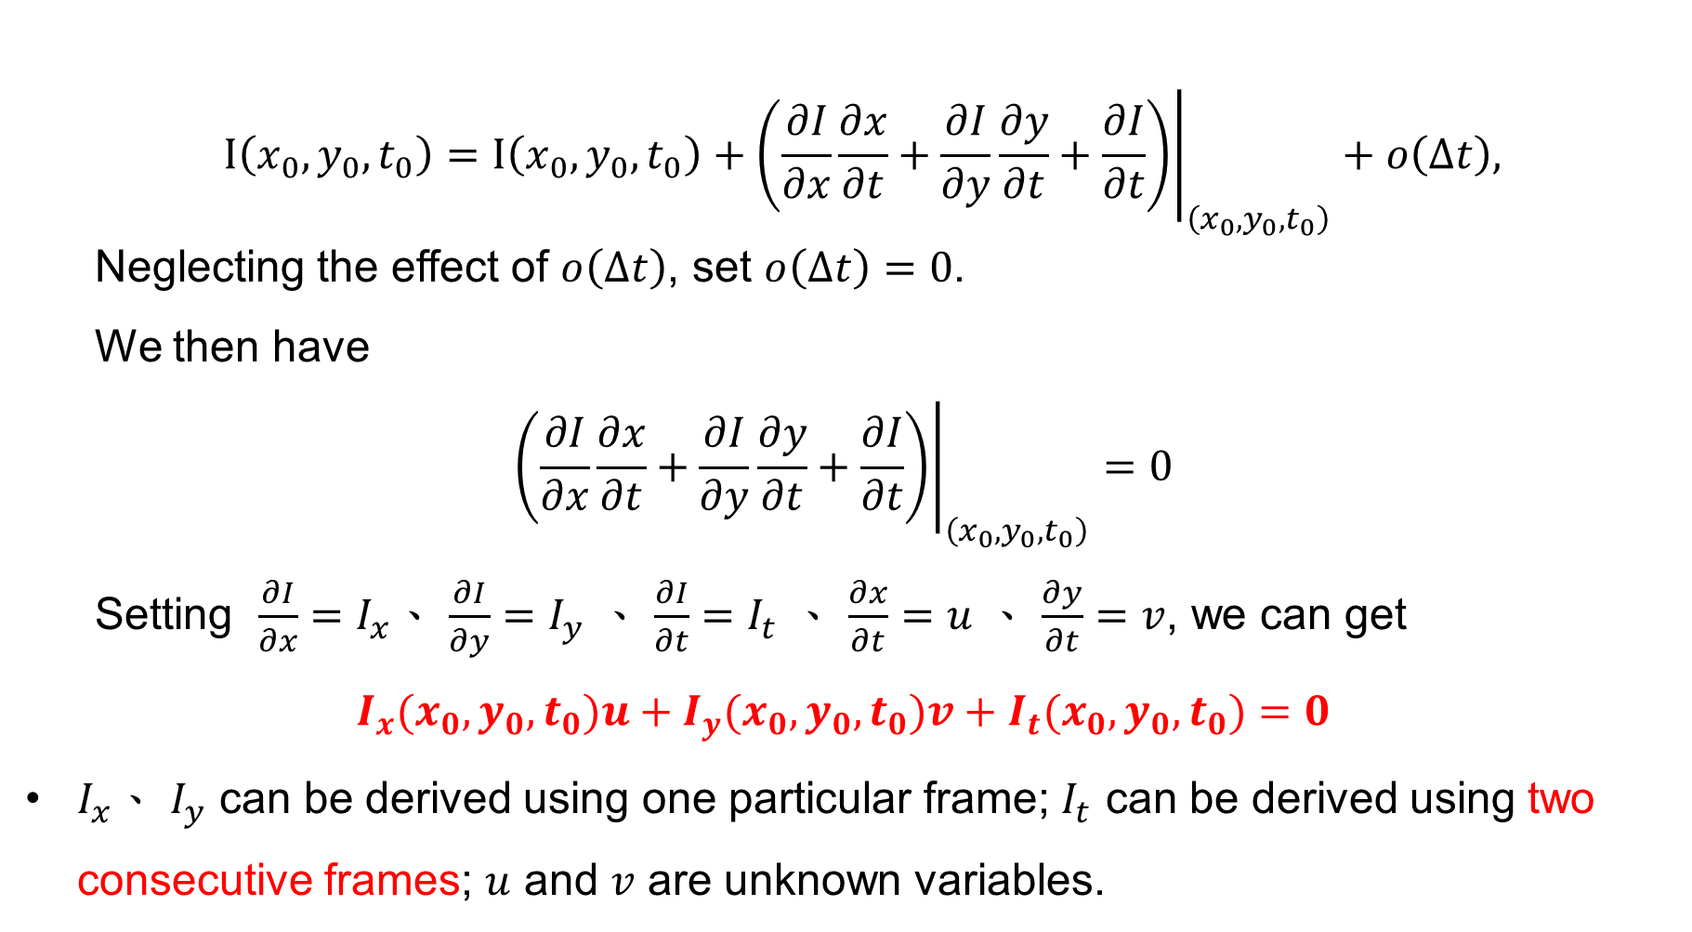
Final project proposal –– optical flow accelerator
Project Scope:
Background Introduction:

Slide 12
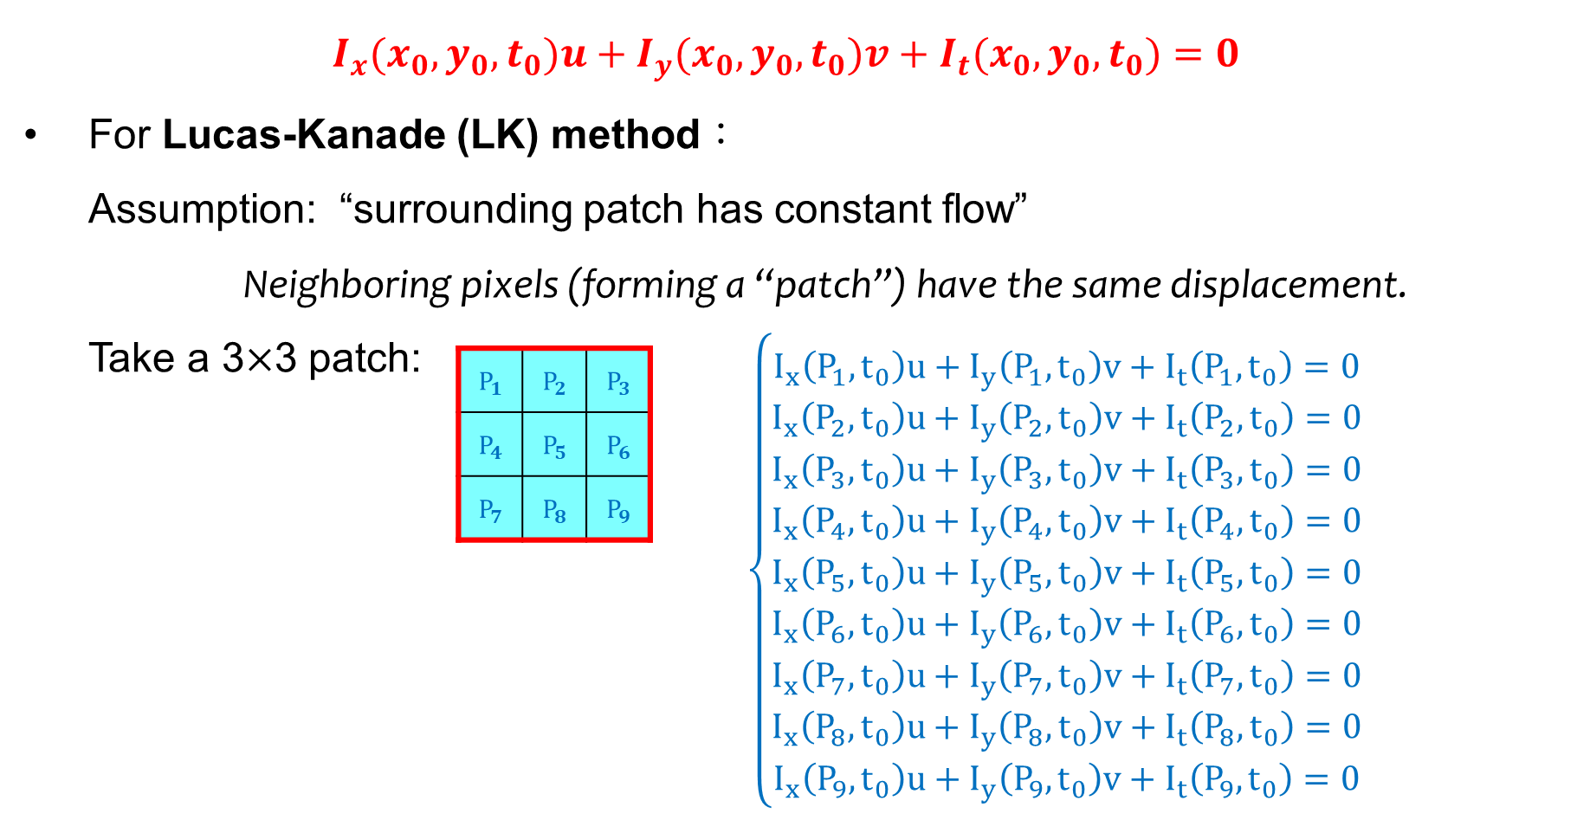
Final project proposal –– optical flow accelerator
Project Scope:
Background Introduction:

Slide 13
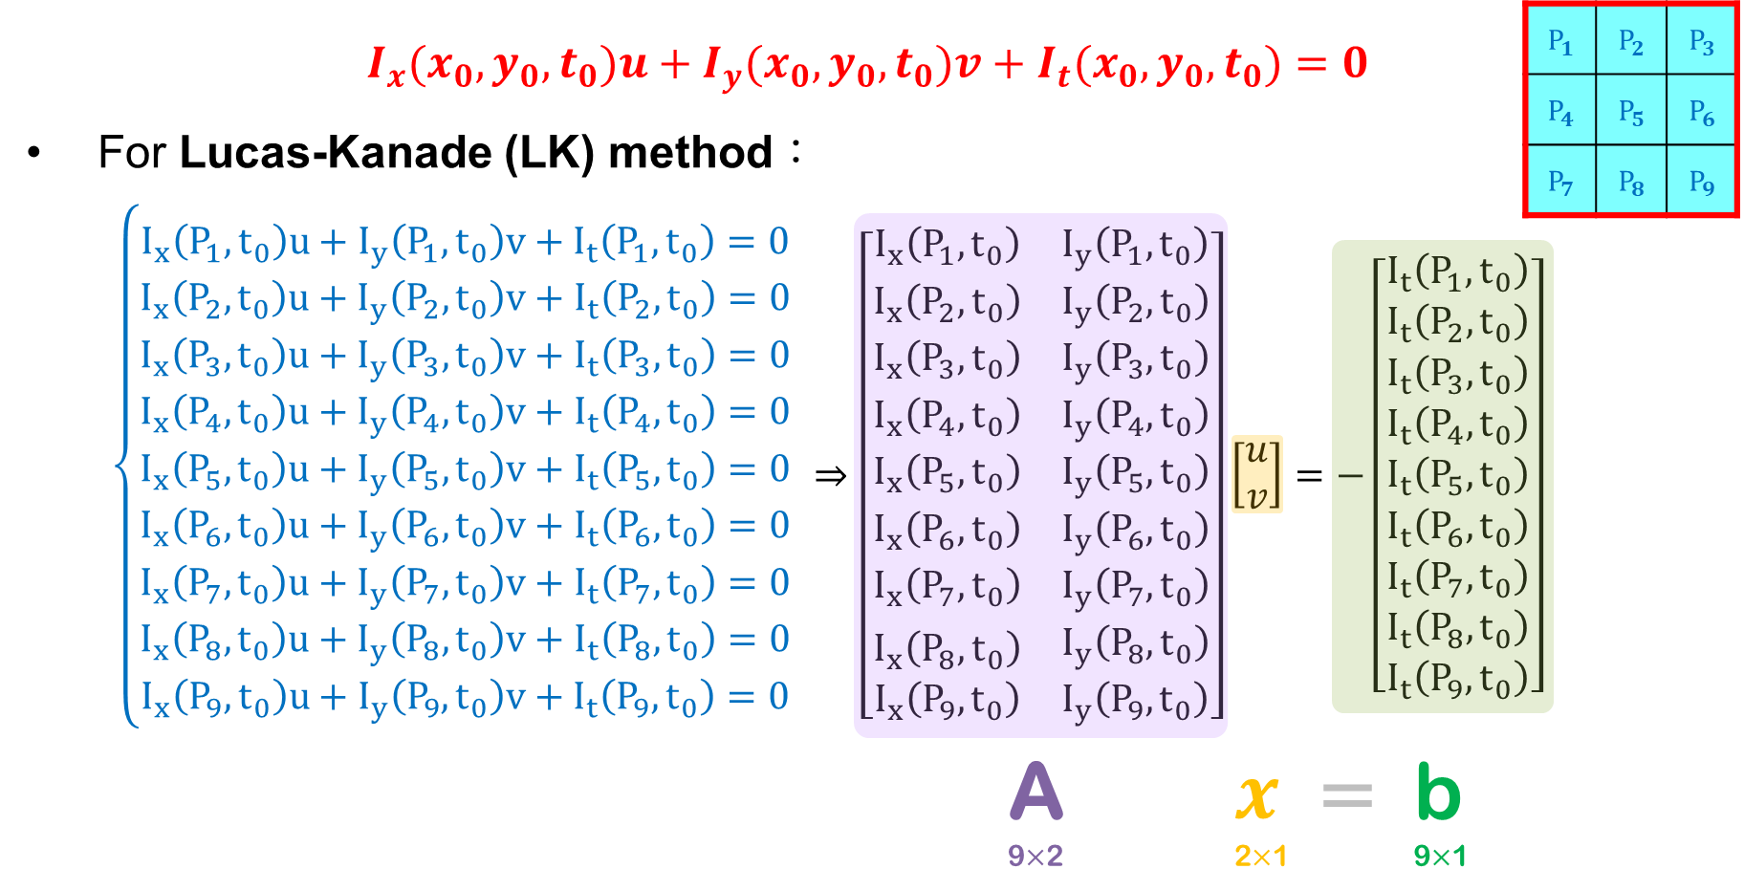
Final project proposal –– optical flow accelerator
Project Scope:
Background Introduction:

Slide 14
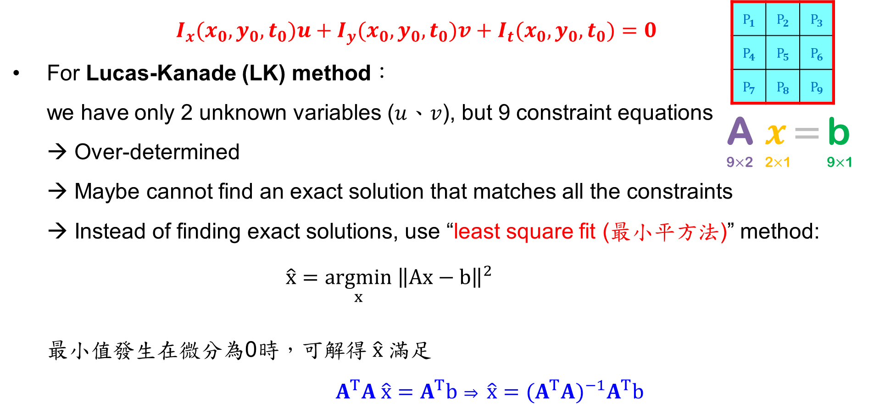
Final project proposal –– optical flow accelerator
Project Scope:
Background Introduction:

Slide 15
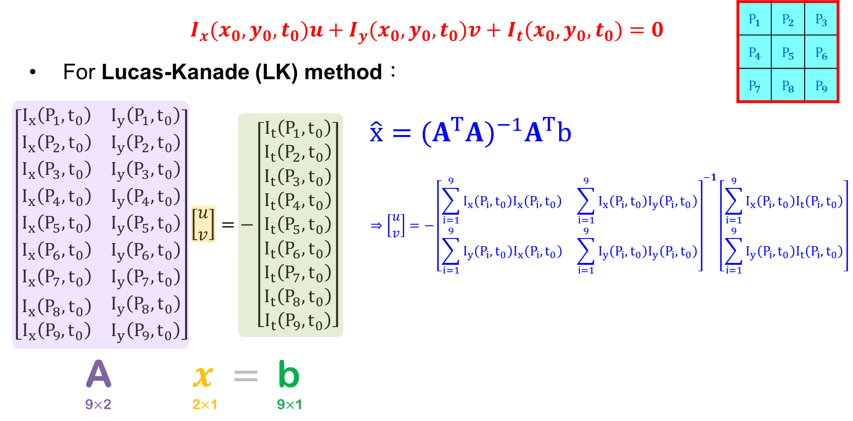
Final project proposal –– optical flow accelerator
Project Scope:
Background Introduction:

Slide 16
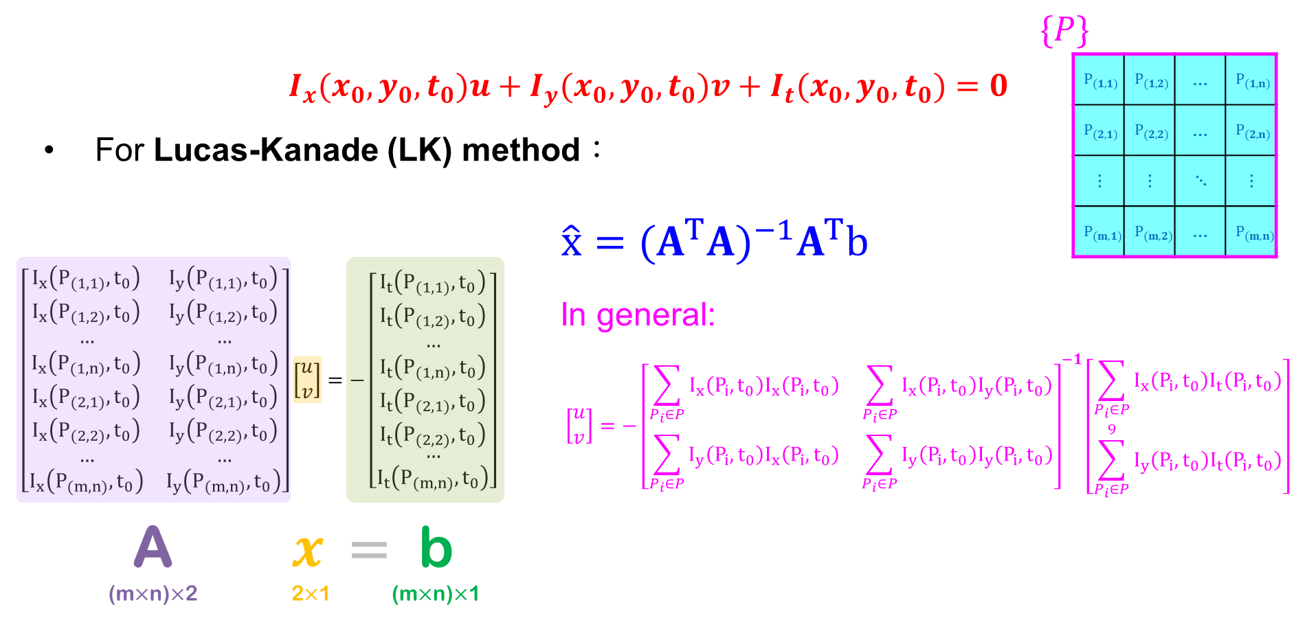
Final project proposal –– optical flow accelerator
Project Scope:
Background Introduction:

Slide 17
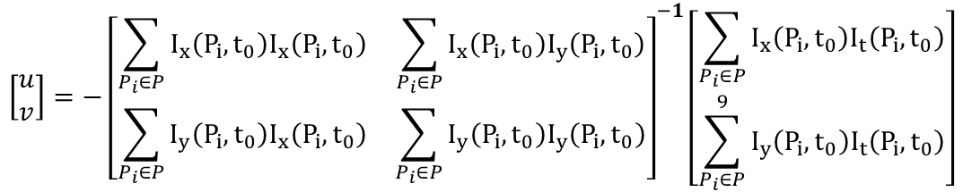
Final project proposal –– optical flow accelerator
Project Scope:
Background Introduction:
$$\left[\begin{matrix}u \\ v\end{matrix}\right]=−{\left[\begin{matrix}\sum_{P_{i}∈P}{I_{x}\left(P_{i},t_{0}\right)I_{x}\left(P_{i},t_{0}\right)} & \sum_{P_{i}∈P}{I_{x}\left(P_{i},t_{0}\right)I_{y}\left(P_{i},t_{0}\right)} \\ \sum_{P_{i}∈P}{I_{y}\left(P_{i},t_{0}\right)I_{x}\left(P_{i},t_{0}\right)} & \sum_{P_{i}∈P}{I_{y}\left(P_{i},t_{0}\right)I_{y}\left(P_{i},t_{0}\right)}\end{matrix}\right]}^{−1}\left[\begin{aligned}\sum_{P_{i}∈P}{I_{x}\left(P_{i},t_{0}\right)I_{t}\left(P_{i},t_{0}\right)} \\ \sum_{P_{i}∈P}^{9}{I_{y}\left(P_{i},t_{0}\right)I_{t}\left(P_{i},t_{0}\right)}\end{aligned}\right]$$

Slide 18
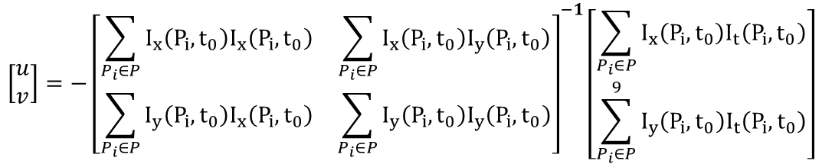
Final project proposal –– optical flow accelerator
Project Scope:
Background Introduction:
$$\left[\begin{matrix}u \\ v\end{matrix}\right]=−{\left[\begin{matrix}\sum_{P_{i}∈P}{I_{x}\left(P_{i},t_{0}\right)I_{x}\left(P_{i},t_{0}\right)} & \sum_{P_{i}∈P}{I_{x}\left(P_{i},t_{0}\right)I_{y}\left(P_{i},t_{0}\right)} \\ \sum_{P_{i}∈P}{I_{y}\left(P_{i},t_{0}\right)I_{x}\left(P_{i},t_{0}\right)} & \sum_{P_{i}∈P}{I_{y}\left(P_{i},t_{0}\right)I_{y}\left(P_{i},t_{0}\right)}\end{matrix}\right]}^{−1}\left[\begin{aligned}\sum_{P_{i}∈P}{I_{x}\left(P_{i},t_{0}\right)I_{t}\left(P_{i},t_{0}\right)} \\ \sum_{P_{i}∈P}^{9}{I_{y}\left(P_{i},t_{0}\right)I_{t}\left(P_{i},t_{0}\right)}\end{aligned}\right]$$

Slide 19
Frame 0
Frame 1
Frame 2
Frame 3
Frame 4
gradient_xy_calc
gradient_xy_calc
gradient_xy_calc
gradient_t_calc
gradient_z_calc
gradient_t_calc
gradient_x
gradient_y
gradient_t
gradient_weight_y
gradient_weight_y
gradient_weight_y
gradient_weight_x
gradient_weight_x
y_filtered
outer_product
gradient_weight_x
outer_product
filtered_gradient
tensor_weight_y
tensor_weight_y
outer_product
tensor_weight_x
tensor_weight_x
out_product
flow_calc
flow_calc
tensor_weight_y
tensor_y
tensor_weight_x
tensor
flow_calc
outputs

Slide 20
(computed in specialized sensor)
gradient_x
gradient_y
gradient_t
gradient_weight_y
y_filtered
gradient_weight_x
filtered_gradient
outer_product
out_product
tensor_weight_y
tensor_y
tensor_weight_x
tensor
flow_calc
outputs

Slide 21
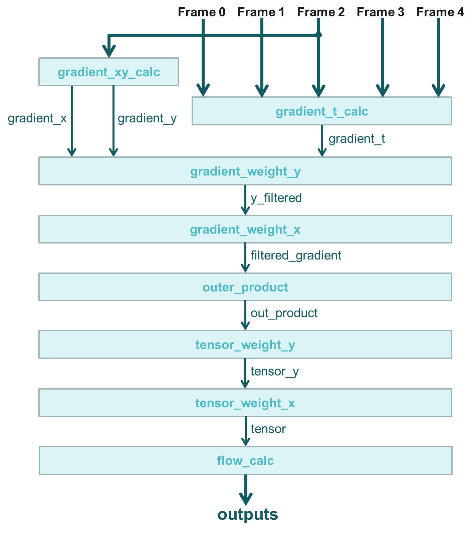
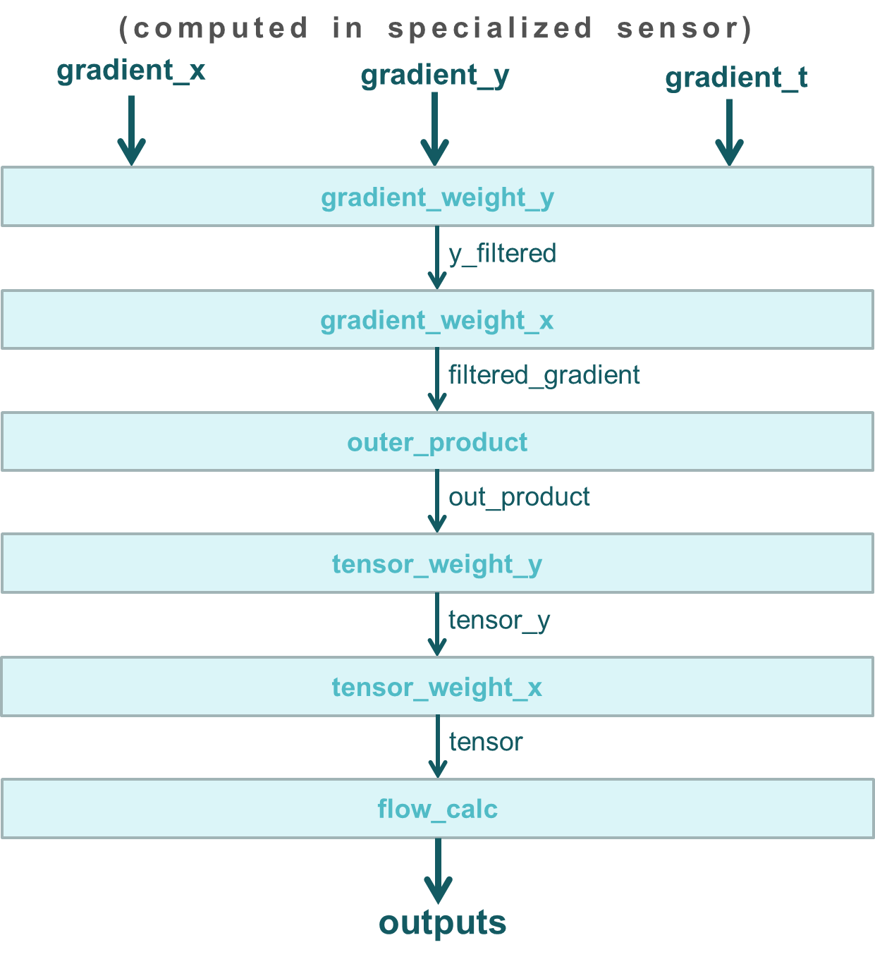
Final project proposal –– optical flow accelerator
Project Scope:
System block diagram, with its operation flow:
Software (reference code):
Proposed:

Slide 22
Final project proposal –– optical flow accelerator
Project Scope:
The area of work: improving the latency of optical flow computation
FPGA platform to implement on: KV260
Target Specification:
Throughput: better than reference benchmark, Rosetta benchmark (41.2 frames/s)
Accuracy: can use estimation to speed up the computation
Speedup: better than Rosetta benchmark (runtime = 24.3 ms)
Area: resource usage less than Rosetta benchmark (LUTs = 42878; FFs = 61078; BRAMs = 54; DSPs = 454)
Proposed design methodology: using dataflow design

Slide 23
Final project proposal –– optical flow accelerator
Project plan:
Workflow definition:
The role of each member:
Checkpoint:

Slide 24
Final project proposal –– optical flow accelerator
Project plan:
Workflow definition:
task | description
Block design (gradient_weight_y、gradient_weight_x、outer_product) | Design and simulate “gradient_weight_y,” ”gradient_weight_x,” and ”outer_product” blocks.
Block design (tensor_weight_y、tensor_weight_x、flow_calc) | Design and simulate “tensor_weight_y,” ”tensor_weight_x,” and ” flow_calc” blocks.
Integrate all blocks | Integrate all the above blocks together and do simulation to verify the functional correctness.
HLS synthesis & RTL synthesis | Do HLS synthesis and then RTL synthesis.
FPGA | Run on onlineFPGA platform.

Slide 25
Final project proposal –– optical flow accelerator
Project plan:
The role of each member:
Checkpoint:
task | Role | checkpoint
Block design (gradient_weight_y、gradient_weight_x、outer_product) | 陳揚哲 | 5/26
Block design (tensor_weight_y、tensor_weight_x、flow_calc) | 葉承泓 | 5/26
Integrate all blocks | Together | 6/2
HLS synthesis & RTL synthesis | Together | 6/8
FPGA | Together | 6/15

Slide 26
Final project proposal –– optical flow accelerator
Reference:
Y. Gong et al., "A Real-Time and Efficient Optical Flow Tracking Accelerator on FPGA Platform," in IEEE Transactions on Circuits and Systems I: Regular Papers, vol. 70, no. 12, pp. 4914-4927, Dec. 2023, doi: 10.1109/TCSI.2023.3298969.
Open source (C code & reference HLS): https://github.com/cornell-zhang/rosetta/tree/master/optical-flow

Slide 27
Thank you!

Slide 29
01
02
03
Jupiter
Venus
Saturn
Jupiter is a gas giant and the biggest planet in the Solar System. It's the fourth-brightest object in the night sky. It was named after the Roman god of the skies and lightning
Venus has a beautiful name and is the second planet from the Sun. It’s terribly hot and its atmosphere is poisonous. It’s the second-brightest natural object in the night sky
Saturn is a gas giant and has several rings. It's composed mostly of hydrogen and helium. It was named after the Roman god of wealth and agriculture. It’s the sixth planet from the Sun

