Slide 1
Soc Design
FIR Workbook (lab_3)

Slide 2
Revision
Revision 1-20-2025
Add four steps (datapath, interface, testbench, optimization)
# of Tap is a programmable parameter
Revise: 7-8-2024
- Elaborate more on testbench function
- Write one to clear ap_done
Revise: 10-14-2024
- Add Multiplication and Addition are run in separate pipeline cycle
- Add # of tap
- Tap parameters start at 0x80

Slide 3
Function specification
void fir_n11_strm(stream_t* pstrmInput, stream_t* pstrmOutput,
int32_t an32Coef[MAP_ALIGN_4INT], reg32_t regXferLeng)
{
#pragma HLS INTERFACE s_axilite port=regXferLeng
#pragma HLS INTERFACE s_axilite port=an32Coef
#pragma HLS INTERFACE axis register both port=pstrmOutput
#pragma HLS INTERFACE axis register both port=pstrmInput
#pragma HLS INTERFACE s_axilite port=return
static int32_t an32ShiftReg[N];
n32NumXfer4B = (regXferLeng + (sizeof(int32_t) - 1)) / sizeof(int32_t);
XFER_LOOP:
for (n32XferCnt = 0; n32XferCnt < n32NumXfer4B; n32XferCnt++) {
n32Acc = 0;
value_t valTemp = pstrmInput->read();
n32Temp = valTemp.data;
SHIFT_ACC_LOOP:
for (n32Loop = N - 1; n32Loop >= 0; n32Loop--) {
if (n32Loop == 0) {
an32ShiftReg[0] = n32Temp;
n32Data = n32Temp;
} else {
an32ShiftReg[n32Loop] = an32ShiftReg[n32Loop - 1];
n32Data = an32ShiftReg[n32Loop];
}
n32Acc += n32Data * an32Coef[n32Loop];
}
valTemp.data = n32Acc;
pstrmOutput->write(valTemp);
if (valTemp.last) break;
}
return;
}
Same as course-lab_2(FIRN11stream)
https://github.com/bol-edu/course-lab_2
y[t] = Σ (h[i] * x[t - i]）
Reference C-code
https://github.com/bol-edu/course-lab_2/blob/2022.1/hls_FIRN11Stream/FIR.cpp

Slide 4
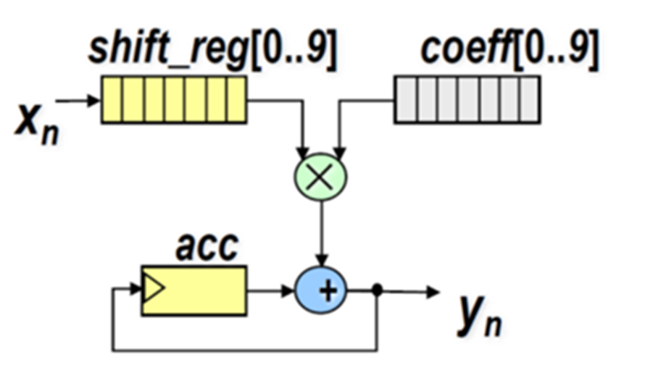
Design specification
Data_Width 32bit (integer)
Tap_Num max 32
# of Tap is a programmable parameter
Maximum storage of Tap and Data RAM is 32 DW
Data_Num programmable parameter – Based on the size of the data file
Interface
axilite: configuration data_in:
axi-stream: stream ( Xn ), stream (Yn)
Using one Multiplier and one Adder:
Note: Multiplication and Addition are run in separate pipeline cycle
Note: Don’t use DSP, use Xilinx directive (* use_dsp = "no" *)
Shift registers implemented with SRAM ( Shift_RAM, size = 10 DW)
Tap coefficient implemented with SRAM ( Tap_RAM = 11 DW ), initialized by axilite write
Operation ( Refer to: Configuration Register Address map )
Program ap_start to initiate FIR engine
Stream in Xn. The rate is varied by testbench. axi-stream tvalid/tready for flow control.
Stream out Yn, the rate of output transfer is varied by testbench. axi-stream tvalid/tready for flow control.

Slide 5
Block Diagram
axi-stream in
axi-lite
axi-stream out
Configuration Registers

Slide 6
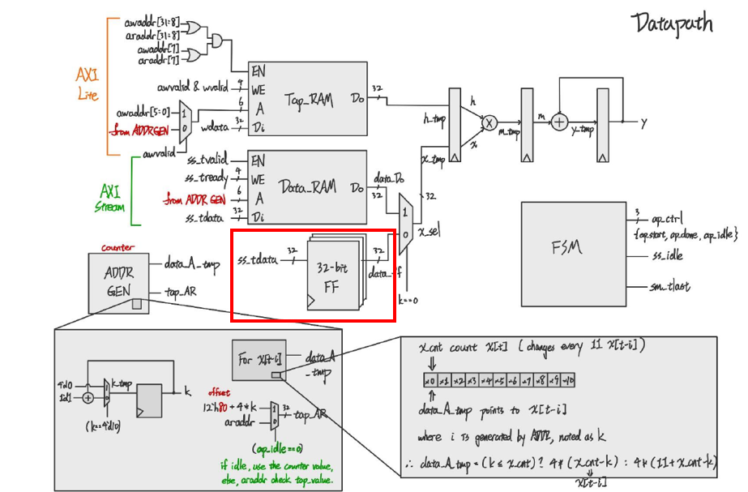
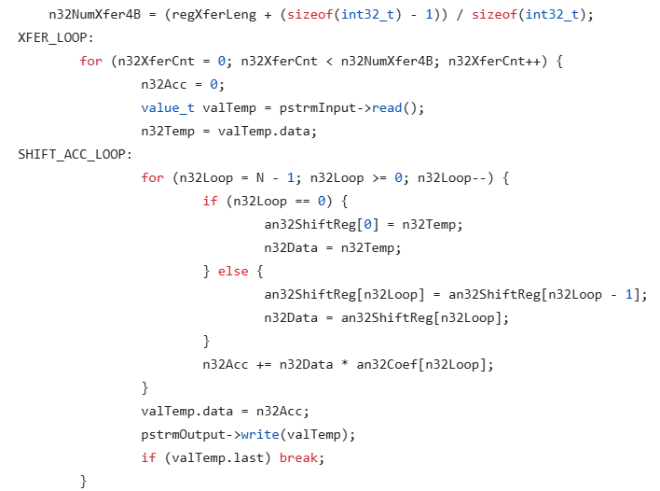
Step#1 – Implement the FIR compute Engine
Implement the FIR core Compute Engine
Datapath: RAM, MUX, Multiplication, Addition
FSM to control the datapath component,
RAM (FIFO) control and address generation
https://github.com/bol-edu/course-lab_2/blob/2022.1/hls_FIRN11Stream/FIR.cpp

Slide 7
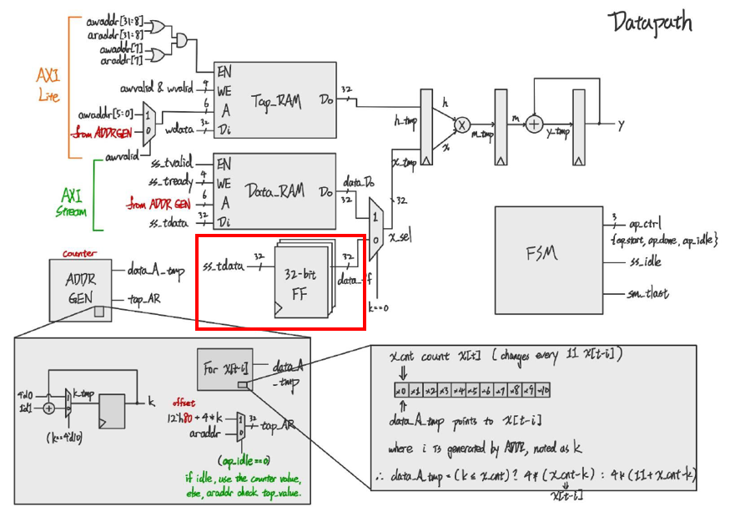
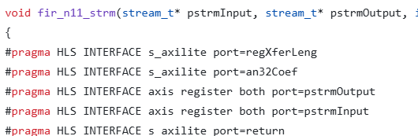
Step#2 – Add the AXI Bus interface
Add AXI Interface
AXI-Lite for configuration registers, and TapRAM
AXI-Stream in for X[n]
AXI-Stream out for Y[n]
AXI-Stream

Slide 8
Step#3 – Develop Testbench
Programming sequence. Refer to Configuration Register Access Protocol
Refer to TestBench Specification

Slide 9
Step#4 : Enhance Design Robustness and Performance
With the testbench validation, the varied input/output latency will reveal the design weakness and the need for performance enhancement.
After synthesizing the design and analyzing the timing, you will find a critical path and try to improve its critical timing.
You will develop your idea to improve the above two areas.
Those improvements will help in Lab#4 (HW-SW codesign)

Slide 10
Step#4 : Possible Improvement
You will consider adding some buffer on the X-input and Y-output.
To improve speed, you will consider adding a pipeline on Multiplier.
Using Vivado IP generator, and incorporate the IP into your design

Slide 11
You will implement - fir.v ( design ) - fir_tb.v (testbench) Lab Github: https://github.com/bol-edu/caravel-soc_fpga-lab/tree/main/lab-fir

Slide 12
Background ( AXI ) Refer to lecture: Interconnect - axi

Slide 13
FIR module interface (AXI-Lite, AXI-Stream)
AXI-lite:
https://www.realdigital.org/doc/a9fee931f7a172423e1ba73f66ca4081
https://docs.xilinx.com/r/en-US/pg202-mipi-dphy/AXI4-Lite-Interface
AXI-stream:
https://developer.arm.com/documentation/ihi0051/latest/
https://docs.xilinx.com/r/en-US/pg256-sdfec-integrated-block/AXI4-Stream-Interface
BRAM Interface: Synchronous read/write

Slide 14
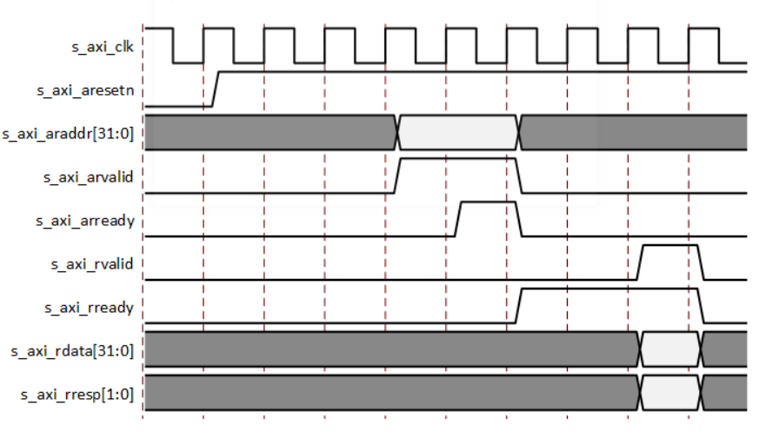
AXI4-Lite Read Transaction

Slide 15
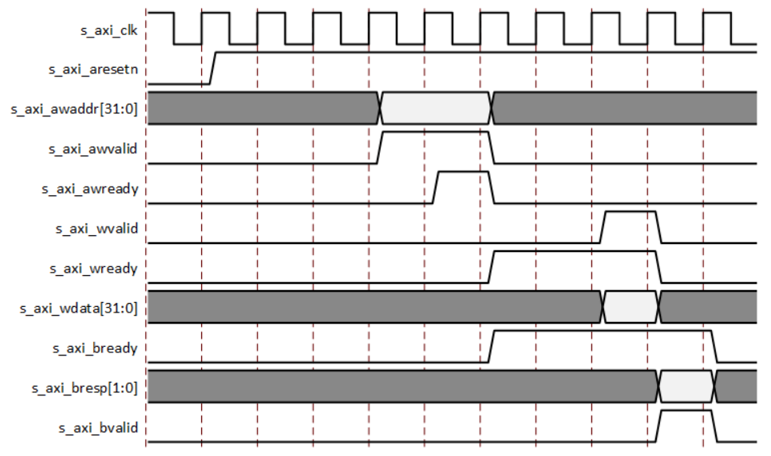
AXI4-Lite Write Transaction

Slide 16
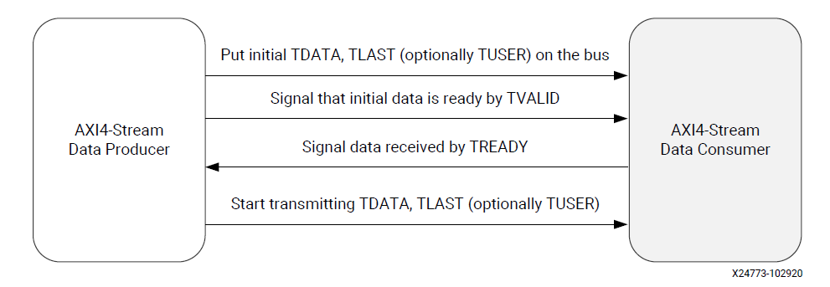
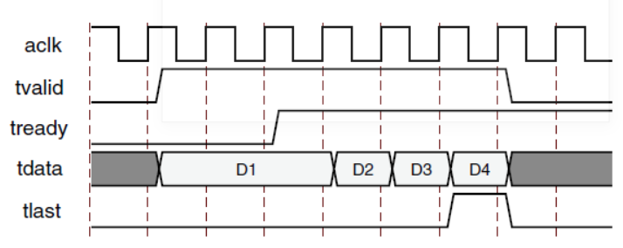
AXI4-Stream Transfer Protocol

Slide 17
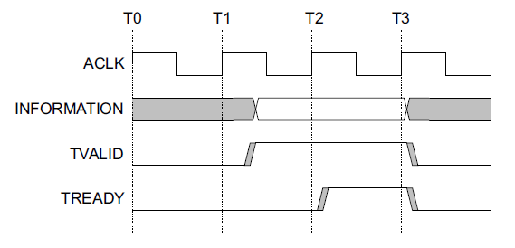
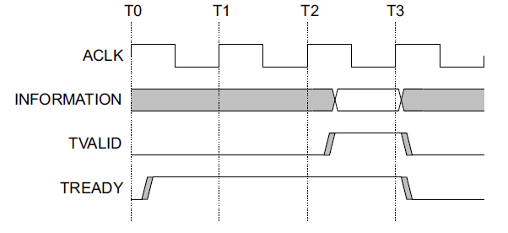
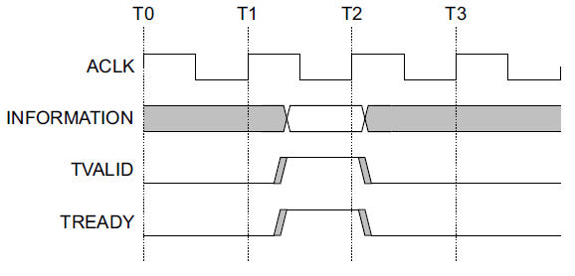
Data Transfer Handshake : TVALID, TREADY
For a transfer to occur, both TVALID and TREADY must be asserted
A Transmitter is not permitted to wait until TREADY is asserted before asserting TVALID
Once TVALID is asserted, it must remain asserted until the handshake occurs
A Receiver is permitted to wait for TVALID to be asserted before asserting TREADY
TVALID asserted before TREADY
TREADY asserted before TVALID
TVALID and TREADY asserted simultaneously

Slide 18
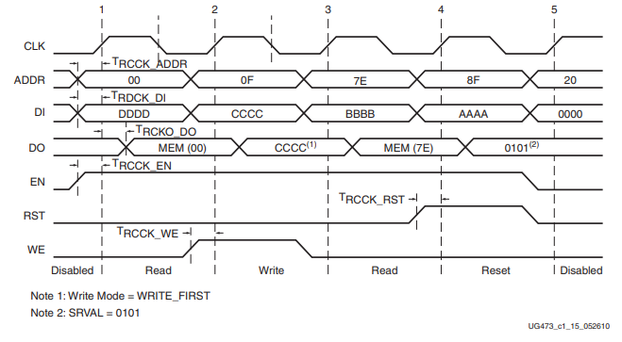
SRAM Access Timing
Write data is written when WE/EN is sampled
Read data is available in next cycle, when EN is sampled
x
x
x
x
x
x
x
x
SRAM access has different modes, refer to https://docs.xilinx.com/r/en-US/am007-versal-memory/Read-Operation?tocId=VRYu0HURA1U147fufYDMNQ

Slide 19
You are given the module header
// axi-stream slave for X[n] input – SS bus
input wire ss_tvalid,
input wire [(pDATA_WIDTH-1):0] ss_tdata,
input wire ss_tlast,
output wire ss_tready,
Use simplified AXI-lite and AXI-stream protocol, interface defined in the module.
Use parameter for resource allocation.
bram model
// axi-stream master for Y[n] output – SM bus
input wire sm_tready,
output wire sm_tvalid,
output wire [(pDATA_WIDTH-1):0] sm_tdata,
output wire sm_tlast,
// bram for tap RAM
output wire [3:0] tap_WE,
output wire tap_EN,
output wire [(pDATA_WIDTH-1):0] tap_Di,
output wire [(pADDR_WIDTH-1):0] tap_A,
input wire [(pDATA_WIDTH-1):0] tap_Do,
module fir
#( parameter pADDR_WIDTH = 12,
parameter pDATA_WIDTH = 32,
parameter Tape_Num = 11 )
)
(
begin
// write your code here!
end
// axi-lite for configuration, tap-RAM
output wire awready,
output wire wready,
input wire awvalid,
input wire [(pADDR_WIDTH-1):0] awaddr,
input wire wvalid,
input wire [(pDATA_WIDTH-1):0] wdata,
output wire arready,
input wire rready,
input wire arvalid,
input wire [(pADDR_WIDTH-1):0] araddr,
output wire rvalid,
output wire [(pDATA_WIDTH-1):0] rdata,
// bram for data RAM
output wire [3:0] data_WE,
output wire data_EN,
output wire [(pDATA_WIDTH-1):0] data_Di,
output wire [(pADDR_WIDTH-1):0] data_A,
input wire [(pDATA_WIDTH-1):0] data_Do,
https://github.com/bol-edu/caravel-soc_fpga-lab/blob/main/lab-fir/fir/rtl/fir.v
https://github.com/bol-edu/caravel-soc_fpga-lab/blob/main/lab-fir/bram/bram11.v

Slide 20
Configuration Register Access Protocol

Slide 21
Configuration Register Address map
0x00 –
[0] - ap_start (r/w) command
When ap_start is programmed one, the FIR engine starts.
[1] – ap_done (rwc) status
1: indicate FIR has processed all the dataset, i.e. receive last data X, and the last Y is transferred.
[2] – ap_idle (ro) status
1: indicate FIR is idle. 0: FIR is actively processing data
0x10-14 - data-length
0x14-18 - number of taps (Max: 32)
0x80-7F – Tap parameters, (e.g., 0x40-43 Tap0, 0x44-0x47 Tap1 .. in sequence …)
Note: Tap parameters set at 0x40 can directly use a lower address bit for the SRAM address.

Slide 22
ap_start protocol and implementation
ap_start is a read/write registers
When ap_start is programmed one, the FIR engine starts.
Host Software or testbench can program ap_start
When ap_idle is one.
After data-length, tap parameters are programmed
If ap_start is programmed one when ap_idle is zero (i.e. engine is running), the programming the ap_start is not effective, i.e. ignored
ap_start is set by software/testbench, and reset by engine
Engine resets ap_start when engine is not idle, i.e. engine starts processing data
set by host program, when axilite write to 0x00[0]
reset, when starting data transfer, i.e. 1st axi-stream data come in

Slide 23
ap_done protocol and implementation
It is a read/write-one-clear register (rwc)
ap_done is asserted when the engine completes the last data processing, and data is transferred
ap_done is reset in the following condition
Reset signal is asserted
After a task is complete, the ap_done is cleared by
When ap_done is read, i.e. address 0 is read
Write one to ap_done register bit to clear
=> Choose one implementation

Slide 24
ap_idle protocol and implementation
ap_idle is set to 1 when reset
ap_idle is set to 0 when ap_start is sampled, and the first data is sampled
ap_idle is set to 1 when the FIR engine processes the last data and last data is transferred

Slide 25
Handle Configuration read/write while the engine is active
It is an illegal operation, but we must handle it.
Configuration read:
AccessTapRAM read, you have two options
Return ‘hffffffff (invalid value, software can check). Note: TapRAM is accessed by the engine when it is active.
Return valid value. The design is more complicated. You can latch the request and access the TapRAM at the appropriate time.
Other address, return a valid value ( it does not interfere the engine operation )
Configuration write: Ignore it, i.e., drop the write transaction. It is illegal.

Slide 26
Testbench Specification

Slide 27
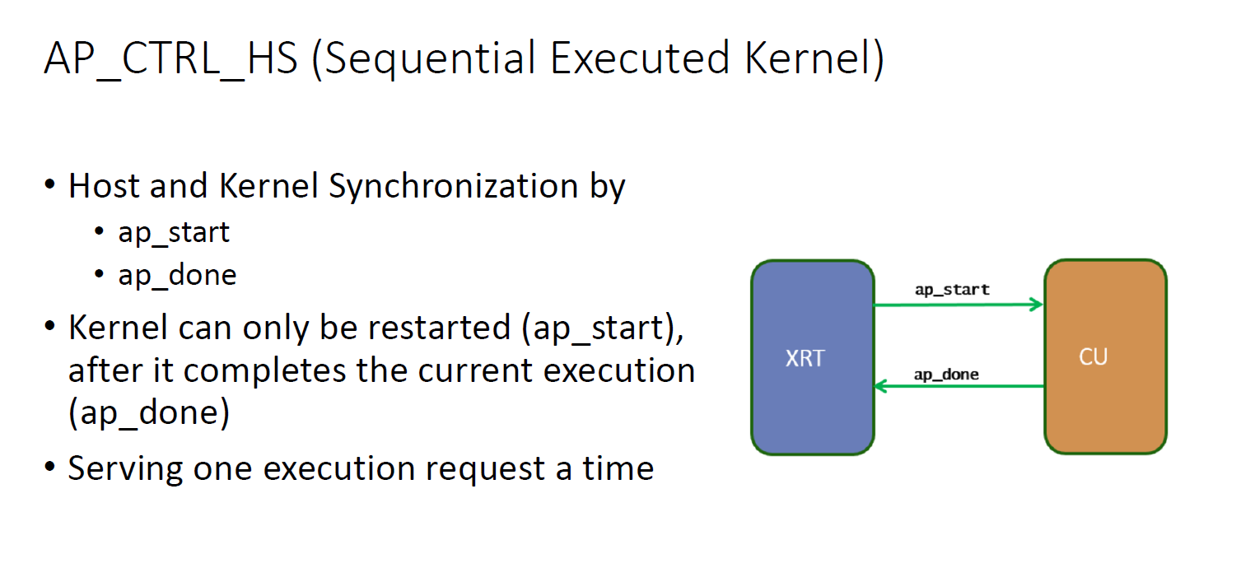
Testbench
fir_tb(Please name your top module same as fir for simulation)
The testbench should keep in the same directory with Makefile
Block-level Protocol (ap_start, ap_done):

Slide 28
Host software / Testbench Programming Sequence
Host Software / Testbench
Check FIR is idle, if not, wait until FIR is idle
Program length, and tap parameters
Program ap_start -> 1
Fork
Transmit Xn,
Receive Yn
Polling ap_done
When ap_done is sampled, compare Yn with golden data
FIR Engine
Wait for ap_start
Set ap_idle = 0
Process data
If reach data-length, set ap_done
Note: Transmit Xn (stream-in), Receive Yn (stream-out) and Polling ap_done (axilite) are running concurrently. They are using different interface and do not interfere each other

Slide 29
Testbench – Develop your own testbench
Setup phase
Load datafile, and count # of data = data_length
Program tap_parameters and data_length, read back and check it is correctly programmed
Compute Yn expected value, or load golden data into Yn buffer
Read and check ap_start, ap_idle, ap_done are in proper state
Execution phase
Program ap_start
Start latency timer
Fork the following operations, run concurrently
Task1(axis-in): Stream_in_Xn
Task2(axis_out): Stream_out_Yn and save into Yn buffer
Task3(axilite):
Polling ap_done, when ap_done is sampled, disable tasks (stream_in_Xn, stream_out_Yn, and Polling)
Read/write tap_parameters: make sure it does not corrupt fir computation
Read return invalid value, e..g. ‘hffffffff
Write ignored
Checking Phase
Report latency
Compare Yn buffer with golden data
Repeat 2 – 3 for three times
Note: You may print message to assist debugging

Slide 30
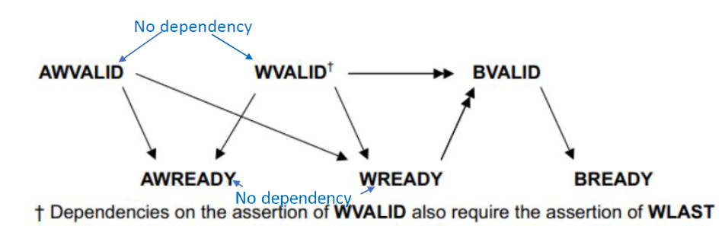
TestBench – Axilite write
Axilite write
Spawn two processes: aw_proc (address) , w_proc (data)
Each process has random initial delay 0 – 5T ( so address / data can be out-of-order )
Asserts awaddr (wdata) when awvalid (wvalid) asserts
Wait for awready (wready)
Once awready (wready) is sampled active, invalidate awaddr (wdata)
Optionally wait for bvalid ( in our case, no bvalid – not implement )

Slide 31
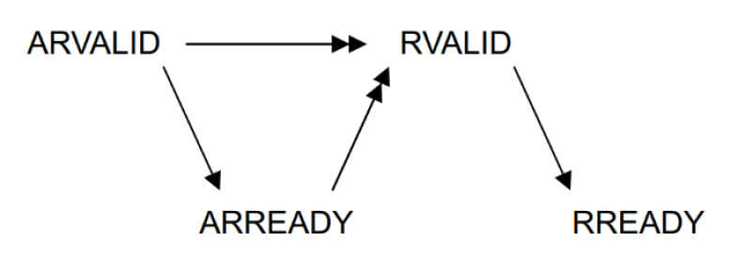
TestBench – Axilite read
Axilite read
Spawn two processes: ar_proc (address), r_proc (data)
Each process has a random initial delay 0 - 5T
Asserts araddr, arvalid and rready
Once arready is sampled active, invalidate araddr
Check rvalid is only asserted after arvalid and arready are asserted

Slide 32
TestBench – axi-stream X input
Protocol
For a transfer to occur, both TVALID and TREADY must be asserted
A Transmitter is not permitted to wait until TREADY is asserted before asserting TVALID
Once TVALID is asserted, it must remain asserted until the handshake occurs
A Receiver is permitted to wait for TVALID to be asserted before asserting TREADY
Testbench
Randomize tvalid initial delay
Case1: short latency [0-5]
Case2: long latency [0-2 x Filter latency]
Once sampled tready, deasserts tdata

Slide 33
Testbench: axi-stream Y output
spawn a task ->task_sm_tready
randomize sm_tready delay
Short latency: delay [0-5]
Long latency: delay [0- 2* filter latency]
when both sm_tready and sm_tavlid sampled asserted,
Check data
finish the task
Note: sm_tready could be asserted before sm_tvalid asserted

Slide 34
Test dataset
Samples_triangular_wave.dat
out_gold.dat

Slide 35
SRAM Interface Implementation
Refer to verilog-sram.pdf - Use memory for ASIC flow
Github updated - https://github.com/bol-edu/caravel-soc_fpga-lab/tree/main/lab-fir
Implement SRAM without .db/.lib
Use external SRAM (bram.v). fir.v provides ports to interface with the external SRAM. So, the fir.v can be synthesized with BRAM
Two size of bram.v ( you choose either one to fit your design)
bram11.v (11 x 32) – depth 11
bram12.v (12 x 32) – depth 12
fir
axilite
axis_slave (Xn)
axis_master(Yn)
tap_RAM
data_RAM

Slide 36
Peer Evaluation
Designer#A – Testbench fir_tb.v designer
Designer#B – Design fir.v designer
Evaluations
Coding Style evaluation by Designer#A
Design (fir.v) evaluation by Designer#A
Testbench (fir_tb) evaluation by TA
Designer#A runs a simulation against fir.v from designer#B
Designer#A writes an evaluation form
For every bug found or coding style violation, designer#A gains a point, and designer#B loses a point

Slide 37
Submission (1/2) – Github - TBD by TA
Github should contain at the following
fir.v （the fir design）
fir_tb.v ( the testbench )
Log files including : synthesis, simulation, static timing report
Synthesis report – area usage, Including FF, LUT (Note: there should be no BRAM because BRAM is an external model, not in the RTL design)
Timing Report, including slack, and max delay path
Waveform – show
Configuration write
ap_start, ap_done ( measure # of clock cycles from ap_start to ap_done)
Xn stream-in, and Yn stream-out
Report in HackMD
README.md

Slide 38
Submission (2/2) – Report (HackMD) - TBD
Block Diagram
Datapath – dataflow
Control signals
Describe the operation, e.g.
How to receive data-in and tap parameters and place into SRAM
How to access DataRAM and tapRAM to do the computation
How ap_done is generated.
…..
Resource usage: including FF, LUT, BRAM
Performance report: latency & throughput (# of clock to generate a Y output)
Timing Report
Synthesize the design with a maximum frequency
Report timing on the longest path, slack
Simulation Waveform, show
Coefficient program, and read back
Data-in stream-in
Data-out stream-out
RAM access control

Slide 39
Supplement

Slide 40
Refer hls-kernel-io-interface Block Level Protocol

Slide 41
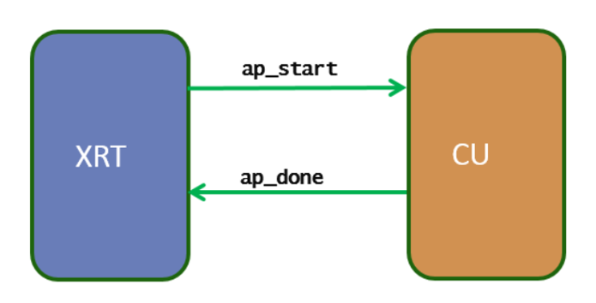
AP_CTRL_HS (Sequential Executed Kernel)
Host and Kernel Synchronization by
ap_start
ap_done
Kernel can only be restarted (ap_start), after it completes the current execution (ap_done)
Serving one execution request a time
https://xilinx.github.io/XRT/master/html/xrt_kernel_executions.html

Slide 42
AP_CTRL_HS Protocol
ap_start (i): set 1 to start until ap_ready asserted.
ap_ready (o): design is ready to accept new input
ap_done (o): design completes all operation.
Indicates data on ap_return is valid
ap_idle (o): indicate design is idle if high.
(ap_return): return data
Pipeline/Nonpipeline depends on ap_ready timing
latency
II
Ug902,p#78: https://www.xilinx.com/support/documentation/sw_manuals/xilinx2018_3/ug902-vivado-high-level-synthesis.pdf

Slide 43
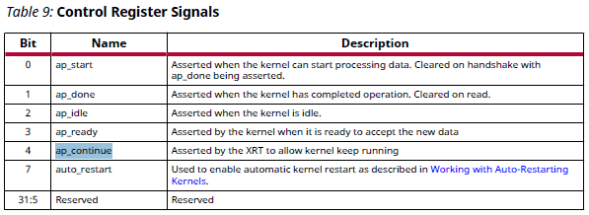
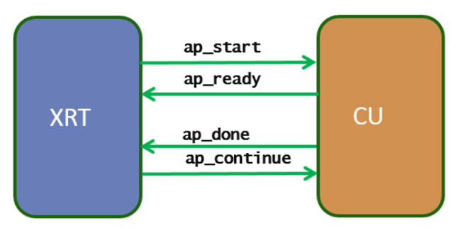
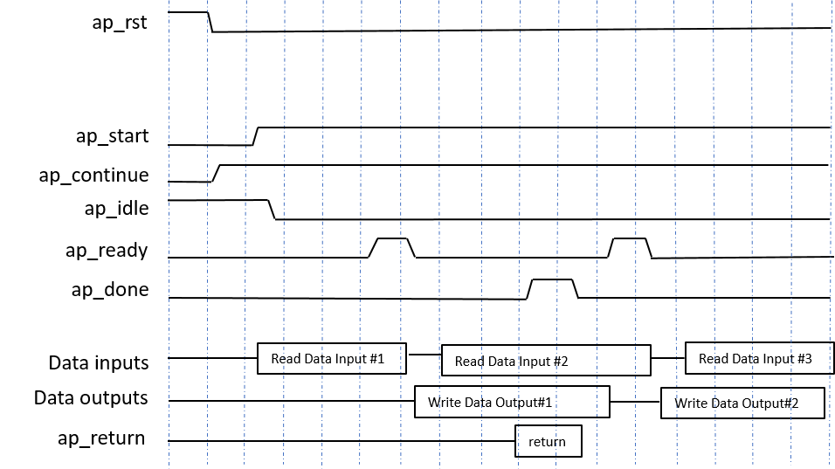
Host Control Pipeline Kernel Execution
Input Synchronization(ap_start, ap_ready)
XRT writes a 1 in ap_start to start the kernel
XRT waits for ap_ready
XRT write 1 in ap_start to start the kernel again
Output Synchronization (ap_done, ap_continue)
XRT waits for ap_done asserted by the kernel ( output data is produced)
XRT write1 a 1 in ap_continue to keep kernel running.
The two processes (Input Synchronization, Output Synchronization) run asynchronously)
Enqueue multiple requests, and data buffers ahead of time, e.g. clEnqueueMigrateMemObjects
https://docs.xilinx.com/r/en-US/ug1393-vitis-application-acceleration/Control-Requirements-for-XRT-Managed-Kernels

Slide 44
Use Memory in ASIC Flow

Slide 45
Memory Inference in ASIC
ASIC Synthesis tool does not infer memories from RTL in the way FPGA synthesis tools do.
Use Memory Compiler
Generate memory block with the specification (bitwidth, depth, # of port)
(.lef) – Library Exchange Format – containing placement information
Schematic & Netlist (for LVS and functional verification)
(.v) Function model (verilog) with timing check – for RTL simulation and gate-level simulation
(.lib/.db) – Liberty Timing File – containing Timing delay Dynamic/Static timing analysis, and synthesis
(.gds) – Graphical Database System – containing final layout information
In RTL code, explicitly instantiate the memory, and design its control signals, e.g. Enable, read/write, address, input/output data

Slide 46
Note on ASIC Implementation with SRAM
RTL design use memory instance directly. Need to provide sram synthesis library, either .lib, or .db (synospsy design-compiler). There is no particular inference method. (note: Xilinx FPGA can use inference)
If there is no sram .lib, or .db, you may put the sram outside using module ports. In this case, you can simulate with post-synthesis gate with sram behavior model. To get sram interface timing optimization, you will need to specify sram interface timing constraints, for example, output delay, input delay.

Slide 47
SRAM with .db/.lib
// RTL module
module your_design( …) begin
// instantiate SRAM
SRAM32X32 (CLK, WE, EN, ADDR, DI, DO)
endmodule
RTL Simulation
RTL code with instance of SRAM
Simulate with functional model
Synthesis
Refer to .lib for SRAM timing/area information
Optimize timing for SRAM interface timing
Post-Synthesis Gate-level Simulation
Post layout gate-level timing simulation
Use functional model with timing check (specify/endspecify)
// Functional Model with timing check
module SRAM32X32( … ) begin
specify // timing check
endspecify
end
// Timing model : .lib

Slide 48
SRAM without .lib/.db
// RTL module
module your_design(
// SRAM interface ports
SRAM_EN,
SRAM_ADDR,
…) begin
// No SRAM instance
// SRAM32X32 (CLK, WE, EN, ADDR, DI, DO)
endmodule
SRAM instance could not be in RTL design for synthesis, instead, provide ports to interface with SRAM
RTL simulation
Simulate with SRAM model
Synthesis
Provide timing constrains (e.g. output delay, input delay ) for SRAM interface ports
Post Synthesis with gate-level simulation
Simulate with SRAM functional model with timing check
// Functional Model with timing check
module SRAM32X32( … ) begin
specify // timing check
endspecify
end

Slide 49
Timing Check Tasks in Verilog
Specify block can be used to specify setup and hold times for signals
specify and endspecify (Use specparam to define parameters in specify block)
$setup (data, clock edge, limit)–Displays warning message if setup timing constraint is not met
$setup(d, posedge clk, 10)
$hold (clock edge, data, limit)–Displays warning message if hold timing constraint is not met
$hold(posedge clk, d, 2)
$width (pulse event, limit)–Displays warning message if pulse width is shorter than limit
$width(posedge clk, 20) –specify start edge of pulse
$period (pulse event, limit)–Check if period of signal is sufficiently long
$period(posedge clk, 50)

Slide 50
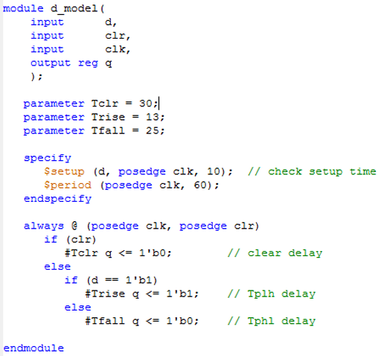
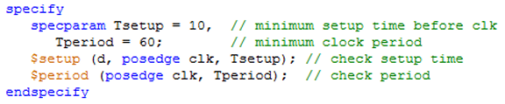
Specify Block Example

Slide 51
SRAM Access in behavior model and Synthesizable Hardware Design ref : spiflash-vip.v v.s. spiflash.v

Slide 52
Example: spiflash design
spiflash-vip.v - spiflash behavior model
access sram as an model
bram.v – BlockRAM behavior model
spiflash.v
Adapt from spiflash-vip.v, synthesizable verilog design
Generate bram interface signal to access data
Reference code:
https://github.com/bol-edu/caravel-soc_fpga-lab/tree/main/spiflash

Slide 53
SRAM Access Timing
Write data is written when WE/EN is sampled
Read data is available in next cycle, when EN is sampled
x
x
x
x
x
x
x
x
SRAM access has different modes, refer to https://docs.xilinx.com/r/en-US/am007-versal-memory/Read-Operation?tocId=VRYu0HURA1U147fufYDMNQ

Slide 54
BRAM Model
module bram #( parameter FILENAME = "firmware.hex")
(
input wire CLK;
input wire [3:0] WE0;
input wire EN0;
input wire [31:0] Di0;
output reg [31:0] Do0;
input wire [31:0] A0
)
reg [7:0] RAM[0:4*1024*1024-1]; // Declare Memory Storage
always @(posedge CLK)
if(EN0) begin
Do0 <= {RAM[{A0[31:2],2'b11}],
RAM[{A0[31:2],2'b10}],
RAM[{A0[31:2],2'b01}],
RAM[{A0[31:2],2'b00}]} ;
if(WE0[0]) RAM[{A0[31:2],2'b00}] <= Di0[7:0];
if(WE0[1]) RAM[{A0[31:2],2'b01}] <= Di0[15:8];
if(WE0[2]) RAM[{A0[31:2],2'b10}] <= Di0[23:16];
if(WE0[3]) RAM[{A0[31:2],2'b11}] <= Di0[31:24];
end
else
Do0 <= 32'b0;
@(posedge CLK) if EN0 is sampled, output its memory content to Do0
@(posedge CLK) if WE[3:0] is sampled, RAM is written with Di0 per byte
initial begin
$display("Reading %s", FILENAME);
$readmemh(FILENAME, RAM);
$display("%s loaded into memory", FILENAME);
$display("Memory 5 bytes = 0x%02x 0x%02x 0x%02x 0x%02x 0x%02x",
RAM[0], RAM[1], RAM[2], RAM[3], RAM[4]);
end

Slide 55
spiflash-vip – behavior model to access RAM
Memory defined and initialization
reg [7:0] memory [0:16*1024*1024-1]; // 16MB
initial begin // memory content loaded data from file
$readmemh(FILENAME, memory);
end
Memory data is available the same time address is supplied. This is not feasible in the actual memory system.
memory read access
buffer = memory[spi_addr]; // memory read
memory write access
memory[spi_addr] = buffer;

Slide 56
spiflash.v – Synthesizable hardware design
BRAM RAM
Addr
EN
WEN
Din
Dout
Clk
Rst
Generate SRAM interface signals
Addr, EN, WEN, Din, Dout
The interface signal is generated from internal control logic (FSM) Interface signals follows the interface timing specification, e.g. read data is available in next clock cycle
// BRAM Interface
assign romcode_Addr_A = {8'b0, spi_addr};
assign romcode_Din_A = 32'b0;
assign romcode_EN_A = (bytecount >= 4);
assign romcode_WEN_A = 4'b0;
assign romcode_Clk_A = ap_clk;
assign romcode_Rst_A = ap_rst;
wire [7:0] memory;
assign memory =
(spi_addr[1:0] == 2'b00) ? romcode_Dout_A[7:0] :
(spi_addr[1:0] == 2'b01) ? romcode_Dout_A[15:8] :
(spi_addr[1:0] == 2'b10) ? romcode_Dout_A[23:16] :
romcode_Dout_A[31:24] ;

Slide 57
DataRAM Usage
DataRAM depth is 32, the # of tap is 32 maximum or less.
For # of tap is less than 32, use it for input data buffers.
fifo_rptr
mux
Keep tap# of data in the fifo
X
latch
fifo_wptr
filter-start
The one level latch is used to decouple the X axis input from interfering dataRAM accessed by the fir engine
dataRAM operate as a X data FIFO, however, always keep the oldest tap# of data
fifo_rptr advanced after tap# of data is filled
Data for filter
Data fifo

