Slide 1
SoC final project
team 7
R12943006 謝郡軒 R12943012 蔡東翰 R12943031 李允恩

Slide 2
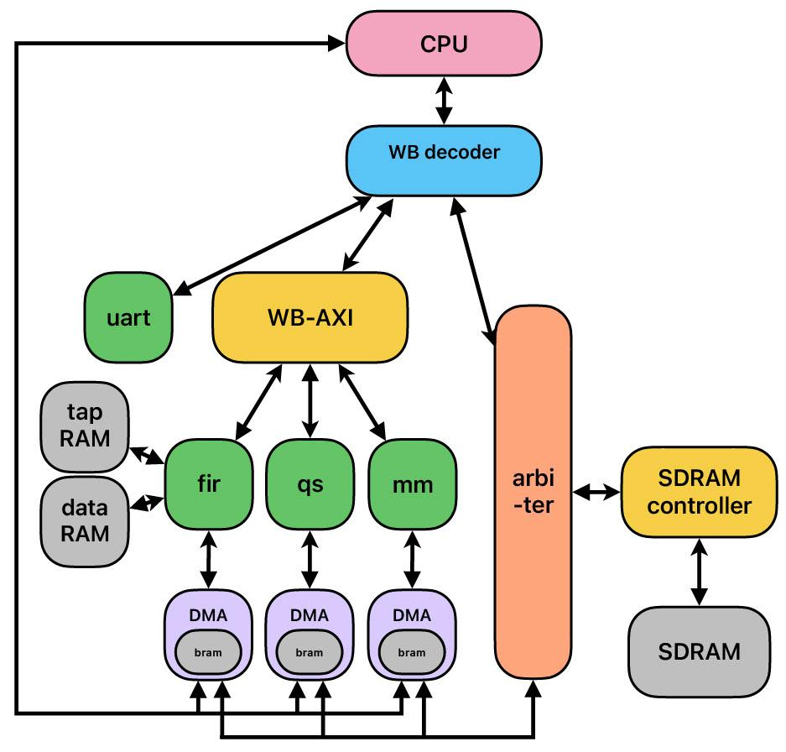
Block Diagram

Slide 3
FIR
Block diagram
axi_lite
indata
(axi-stream)
CPU
tap bram (11)
data bram (16)
FIR
DMA
wishbone
signals
clk
+
*
rst
outdata
(valid/data)
ap_start
FIR module

Slide 4
FIR
Our work
Use only 1 multiplier and 1 adder.
CPU first sends coefficients, and FIR saves coefficients in BRAM. After that, DMA sends input data
FIR receive a new data when previous answer is outputed
FIR produces 1 data per 12 cycles
If DMA is fast enough to send and receive the input/output data, the FIR process in our design totally costs about 132 cycles (excluding coef receiving time).

Slide 5
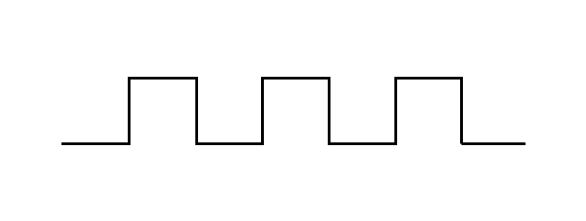
Matmul
Block diagram
CPU
clk
indata
(axi-stream)
matmul
DMA
input array (16)
input
buffer
wishbone
signals
rst
+
*
outdata
(valid/data)
ap_start
output array (16)
matmul module
Schedule
…
………
INPUT
A1
A2
A16
B1
B2
B16
MULTIPLIER
B1
* A1
B1
* A5
B1
* A9
B1
* A13
B2
* A1
B2
* A5
B2
* A9
B2
* A13
B16
* A4
B2
* A8
B2
* A12
B2
* A16
ADDER
add to
C1
add to
C5
add to
C9
add to
C13
add to
C2
add to
C6
add to
C10
add to
C14
add to
C4
add to
C8
add to
C12
add to
C16
OUTPUT
…
C1
C2
C16

Slide 6
Matmul
Our work
Use only 1 multiplier and 1 adder.
After we read the 4*4 A matrix, we read the elements in B matrix one by one and calculate all the results related to the current B element before asking for the next B element, we don’t need to save the whole B matrix in our design so therefore we can save about 14 registers.
If DMA is fast enough to send and receive the input/output data, the matrix multiplication process in our design totally costs about 16 (receiving A) + 64 (receiving B and calculating C) + 16 (returning C) = 96 cycles.

Slide 7
“Quick” insertion sort
Block diagram
CPU
clk
indata
(axi-stream)
sort
DMA
output
array
input
buffer
comp
wishbone
signals
rst
start / end
outdata
(valid/data)
ap_start
sort module
Schedule
………
INPUT
X1
X2
X3
X4
X16
INSERTION
insert
X1
insert
X2
insert
X3
insert
X4
insert
X16
…
OUTPUT
Y1
Y2
Y16

Slide 8
“Quick” insertion sort
Our work
use only 1 comparator
although quicksort may be more efficient and powerful in C++, however, in this project, we use verilog code for coding and the input sequence comes in serial, so we think using insertion sort will be more suitable.
because insertion sort is also in-place, we can use about only 12 registers to sort 10 elements (2 more for buffering)
If DMA is fast enough to send and receive the input/output data, the insertion sort process in our design totally costs about 53 cycles.

Slide 9
UART
Block diagram
user_irq
wishbone signals
UART
count-down
counter
rx counter
wishbone decoder
uart_ctrl
rx buffer
tx buffer
uart_rx
uart_tx
rx signals
tx signals

Slide 10
UART
Our work
We add buffers at both rx and tx sides, so that (1) we don’t need to enter ISR as soon as one interrupt happens, and (2) we can send another data to be transmitted without waiting for the previous one to finish its transmission.
Besides, to prevent unsettled interrupts, we have a count-down counter to check if the rx buffer is empty periodically.
Therefore, we can set two parameters n and m, which the UART generates an irq signal if there has been total n unsettled interrupts or m cycles since the last time entering ISR.

Slide 11
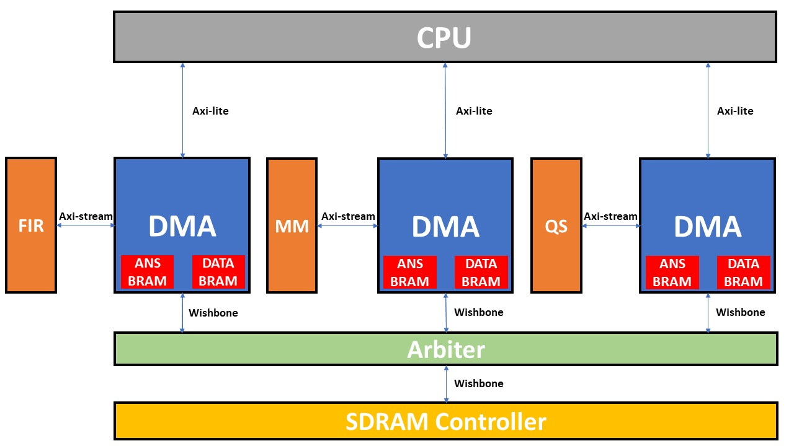
Direct Memory Access
Block diagram

Slide 12
Direct Memory Access
Our work
There are 3 DMAs for FIR, MM, and QS respectively.
Each of them will receive five data through axi-lite protocol from CPU, including information of data_len, data_addr, ans_len, ans_addr, ap_start, and DMAs have to return the ap_done signal back to CPU when necessary.
After receiving all data above, DMAs will ask for input data for FIR/MM/QS engines through wishbone protocol from SDRAM controller according to the given data_addr and data_len, and save them into DATA BRAM in order.
However, we need an arbiter between DMAs and SDRAM controller to avoid collision of data requests.

Slide 13
Direct Memory Access
Our work
After saving all input data into DATA BRAM, DMAs will start sending input data into FIR/MM/QS engines through axi-stream protocol with a view to activating the corresponding computations.
When FIR/MM/QS engines finish the operations, they will send the answers back to DMAs through axi-stream protocol, which will be saved in ANS BRAM in order by DMAs.
After saving all answer data into ANS BRAM, DMAs will start sending answer data to arbiter through wishbone protocol. Eventually, arbiter and SDRAM controller will save those data into SDRAM properly.

Slide 14
Arbiter
Block diagram
FIR
DMA
matmul
DMA
sort
DMA
CPU
wishbone signals
wishbone signals
wishbone signals
wishbone signals
Arbiter
selector
FIFO
wishbone signals
SDRAM controller

Slide 15
Arbiter
Our work
Arbiter collects the wishbone signals of DRAM access from 3 DMAs and CPU together, putting them in a FIFO, and then arbiter will access the DRAM according the output of FIFO and send back the corresponding wishbone signals to DMA.
Since wishbone signals cannot be pipelined, arbiter will receive a new request from one source only when the last request from the same source has been fulfilled. Therefore, we only need a FIFO of size 4 to accommodate all the requests from 4 different sources.
To accelerate the whole process, if two requests comes in at the same time, the priority will be CPU > FIR > matmul > sort

Slide 16
SDRAM controller
Block diagram
FSM (our different part)
Arbiter
fetch data
data is in cache
prefetch data
of (addr + 8)
wishbone signals
SDRAM controller
IDLE
FSM
data is not in cache
cache 0
cache 1
READ_RES
READ
receive data
from SDRAM
SDRAM signals
WAIT
SDRAM
wait for 3T

Slide 17
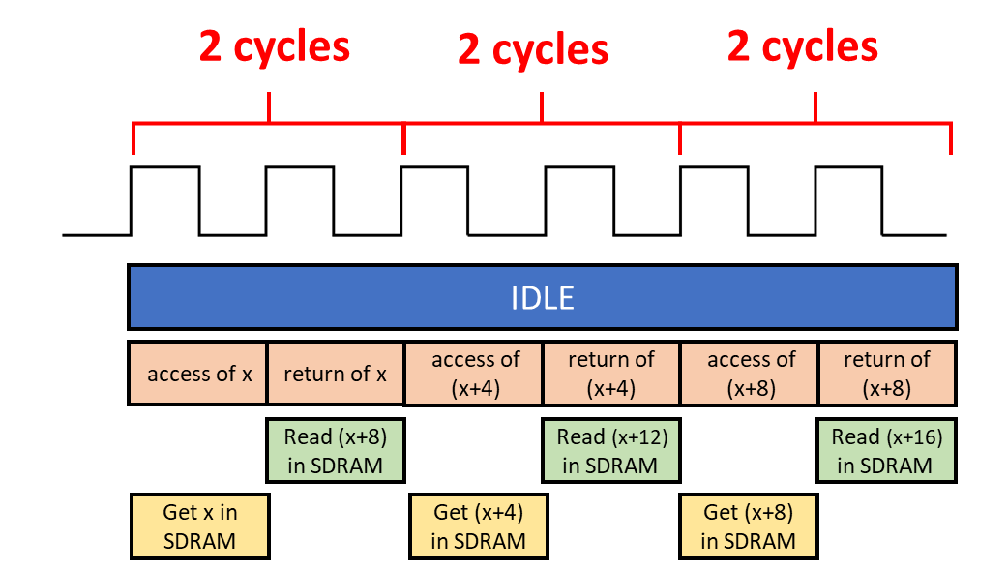
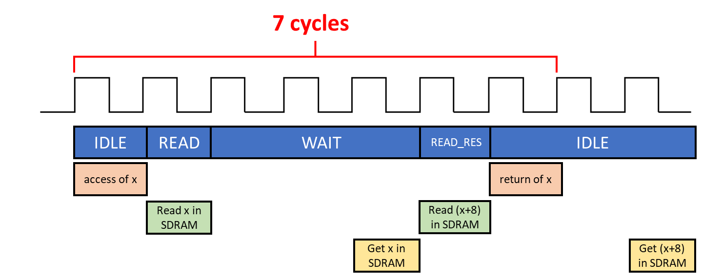
SDRAM controller
Schedule
Data isn’t in cache
Data is in cache

Slide 18
SDRAM controller
Our work
We observe that if this cycle CPU is accessing address “x” then the next cycle CPU will likely access address “x+4”.
Since it costs 3 cycles from we send a request to SDRAM to we get the data, we need to have at least 2 caches to store the prefetch datas.
Therefore, we use 2 caches where cache n (n = 0, 1) saves the data whose addr[2] == n, and every time we send back a data of address “x” to arbiter we will immediately go prefetch the data of address “x+8” and save it in the corresponding cache.
At the best situation (we’ve guessed the prefetch address correctly), the latency of accessing a data from SDRAM will be shortened to 2 CYCLES.

Slide 19
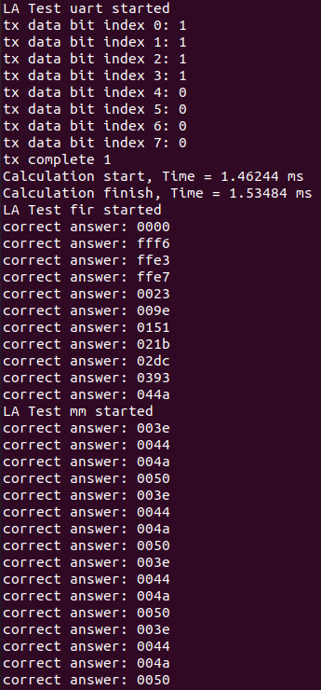
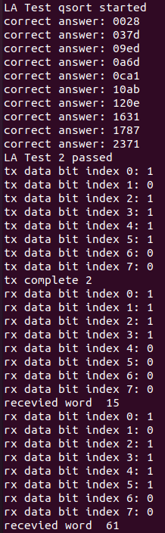

Simulation
FIR + MM + QSORT
Compile optimization: O3
mprj == AB00_0000
Calculation start
mprj == AB10_0000
Calculation finish

Slide 20
Result (Hardware)
Original (Lab6)
(1) Setup: 2.93 ms
(2) Calculation: 4.81(fir) - 0.98(uart) + 2.95(mm) - 0.97(uart) + 0.77(qs) = 6.58ms
(3) Check answer: 0.68(fir) + 0.24(mm) + 0.62(qs) = 1.54
Our work
(1) Setup: 1.46ms
(2) Calculation: 0.07ms
(3) Check answer: 0.12 ms
Calculation improvement: 9300%
Calculation cycle: 2800
(including sending FIR coefficients, sending DMA configurations, DMA transporting data from SDRAM, calculation of 3 functions, and DMA sending back data to SDRAM)

Slide 21
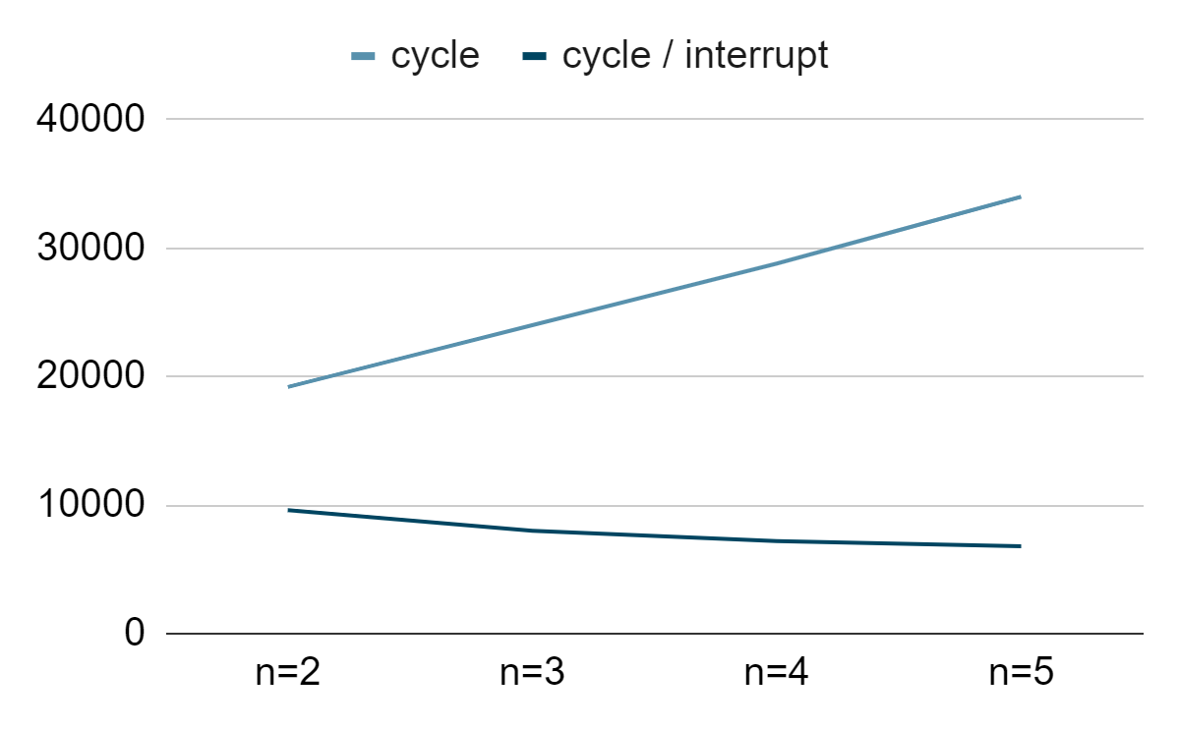
Result (UART)
Original
(1) interrupts to trigger ISR : 1
(2) time spent in one ISR : 0.9 (ms) = 36000 (cycles)
Our work
(1) interrupts to trigger ISR : n
(2) time spent in one ISR :
n | time | cycle | cycle / interrupt
2 | 0.48 (ms) | 19200 | 9600
3 | 0.60 (ms) | 24000 | 8000
4 | 0.72 (ms) | 28800 | 7200
5 | 0.85 (ms) | 34000 | 6800

