Slide 1
Catapult FPGA (Edge Detect) workflow
TA:陳揚哲

Slide 2
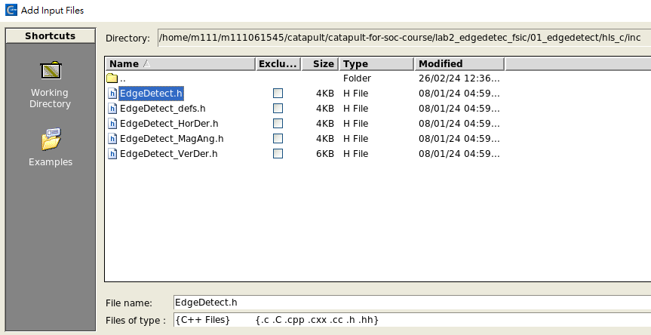
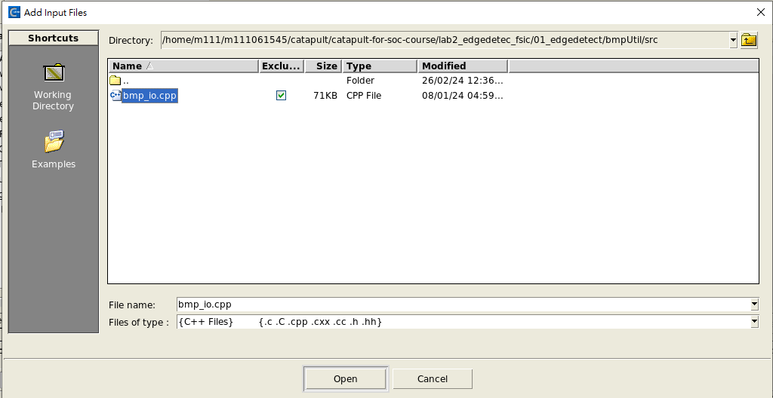
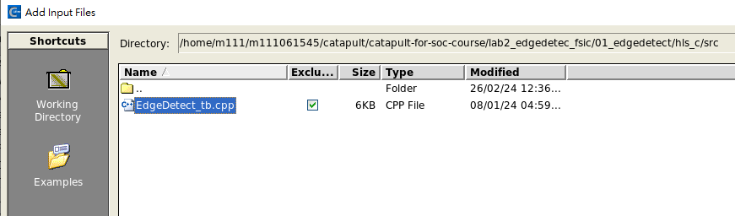
Add input file
Add EdgeDetect.h(hls_c/inc), EdgeDetect_tb.cpp(hls_c/src), and bmp_io.cpp(bmpUtil/src)
Note: these file should be set as excluded

Slide 3
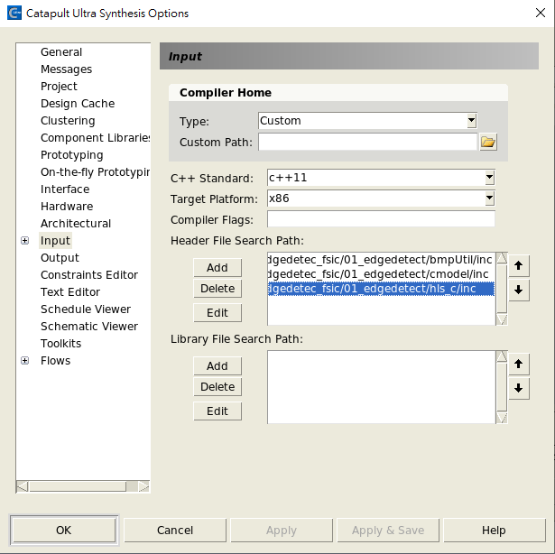
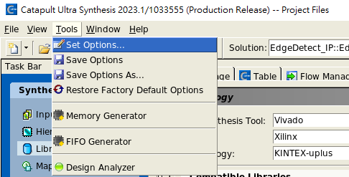
Add include path

Slide 4
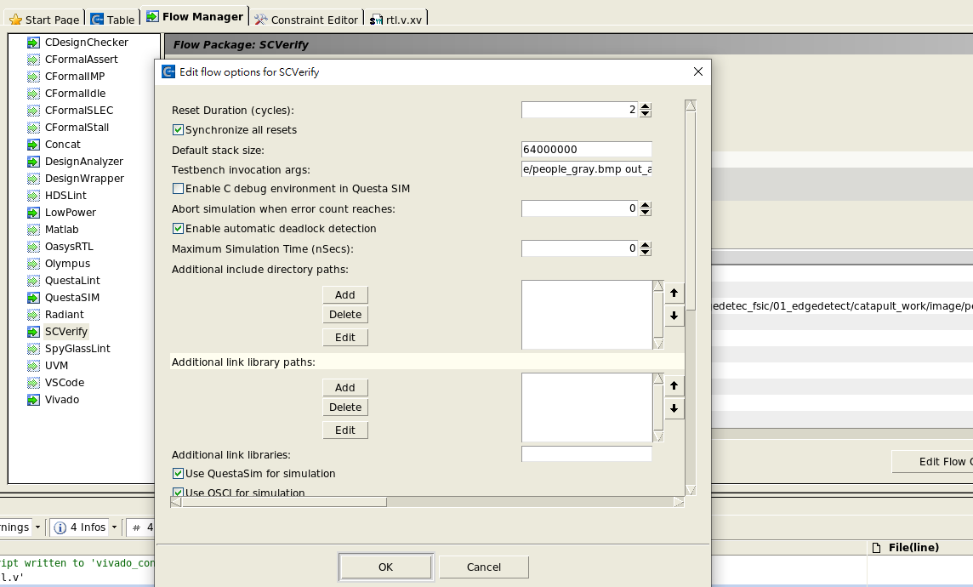
Add testbench invocation args
Add the directory (~/image/people_gray.bmp out_algorithm.bmp out_hw.bmp)

Slide 5
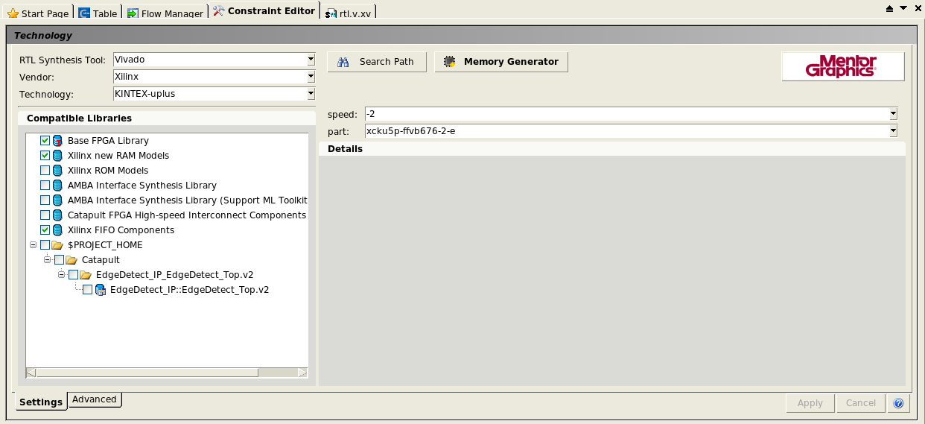
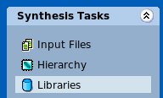
Choose library (FPGA board)
You can choose your own FPGA board for catapult project
Here I use KCU116 board for example
Check Xilinx new RAM Model, Xilinx FIFO Components
choose vivado
Choose your FPGA board series
Base on FPGA speed find board

Slide 6
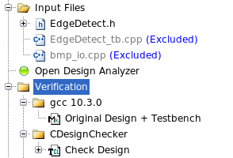
GCC and CDesignChecker
Double click Original Design + Testbench and Check Design

Slide 7
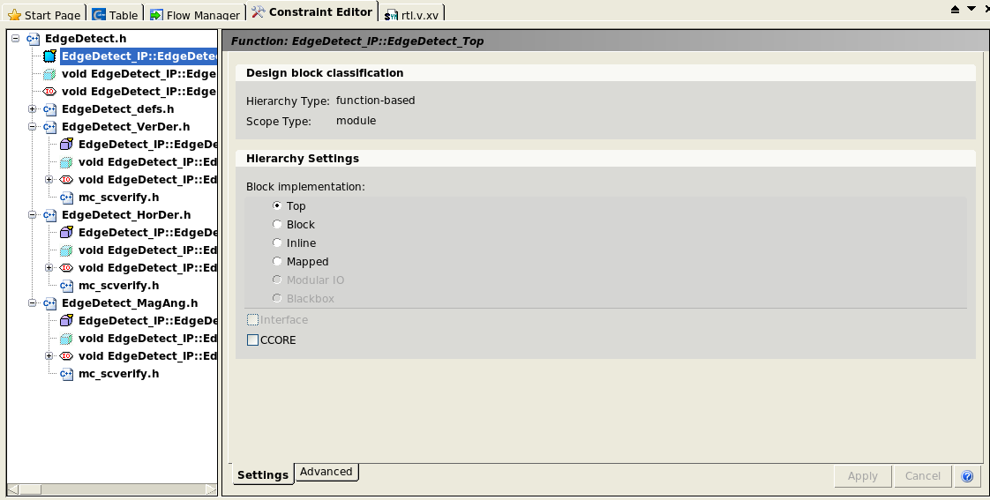
Top-down Process
Here use Top-down process for example
Choose top module as top in block implementation
Suggest bottom-up process. (Step_by_step_lab2_EdgeDetect.pdf)
*_Ver -> *_Hor-> *_Mag -> *_Top

Slide 8
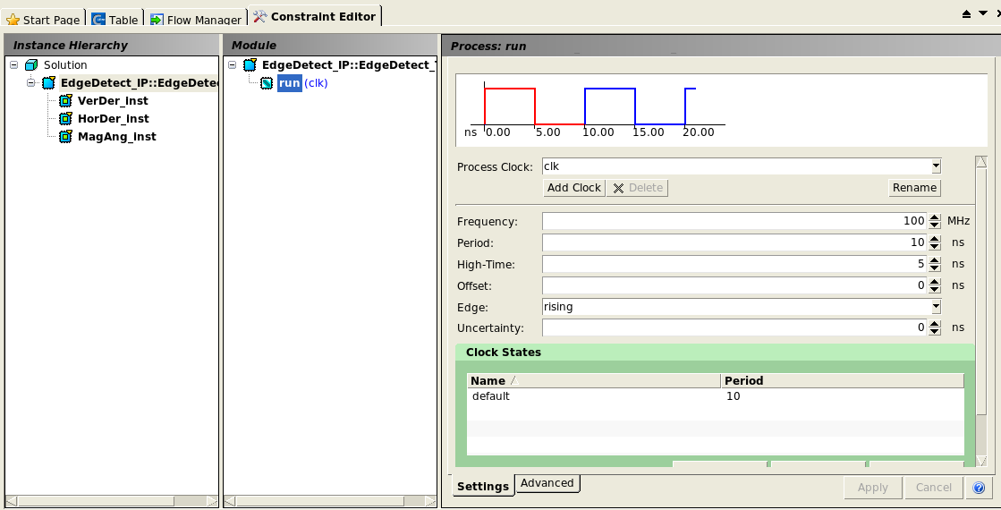
Mapping
Set clock as 100 MHz

Slide 9
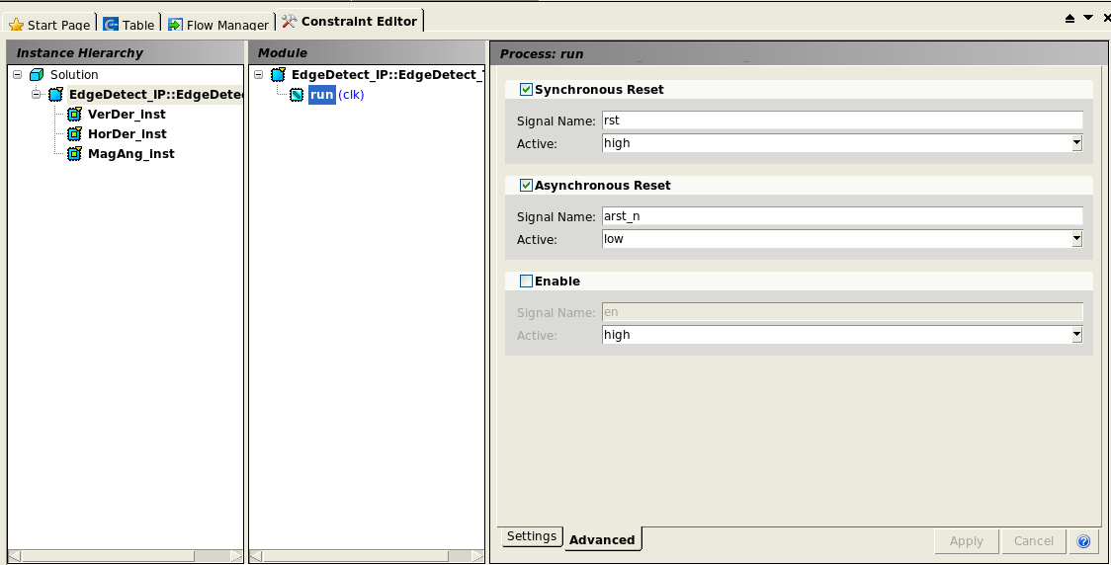
Mapping
Check Asynchronous Reset

Slide 10
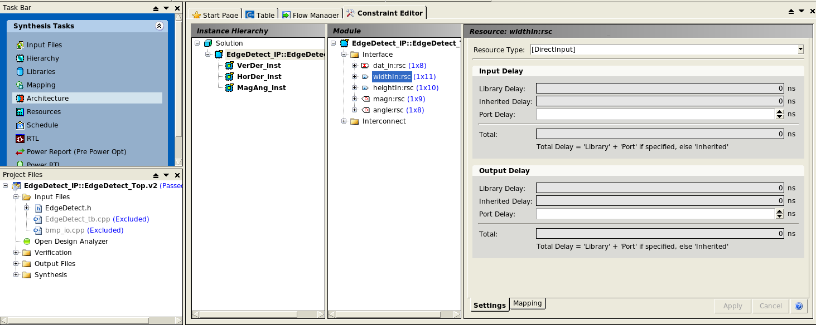
Architecture

Slide 11
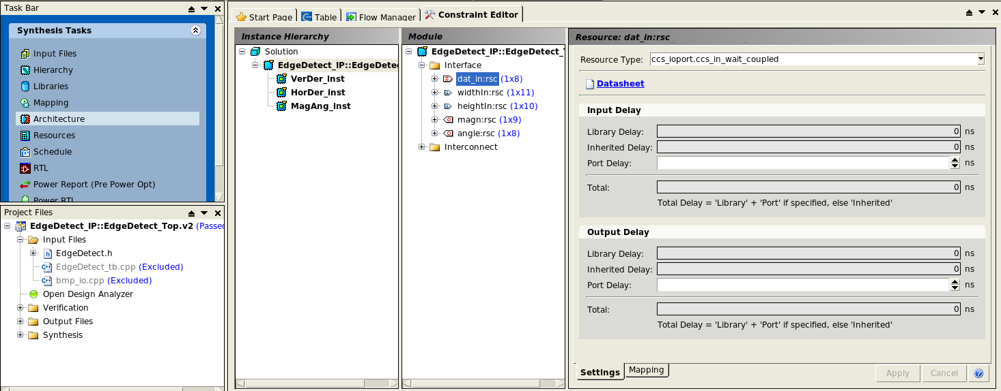
Architecture

Slide 12
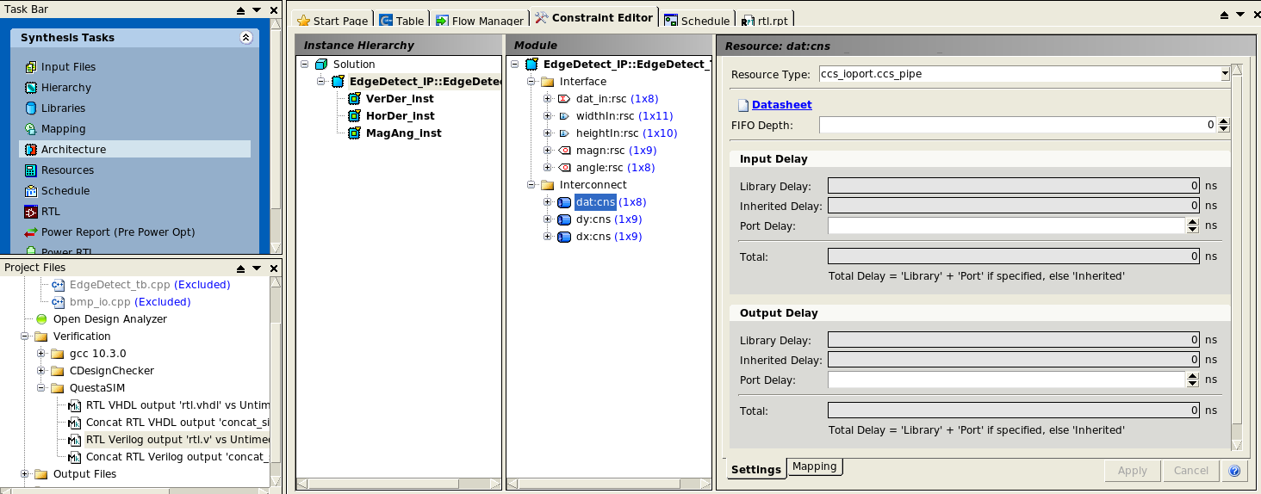
Architecture
Set FIFO depth base on your design delay(By bottom-up step)

Slide 13
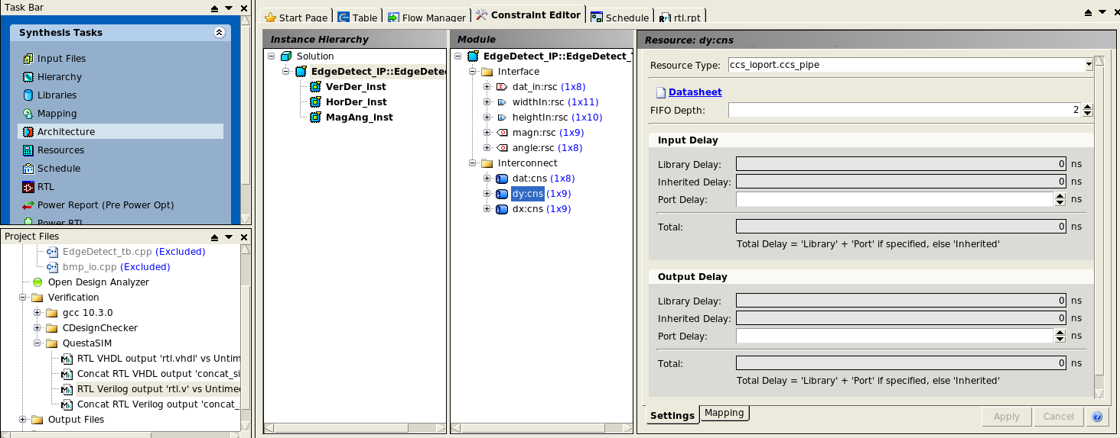
Architecture

Slide 14
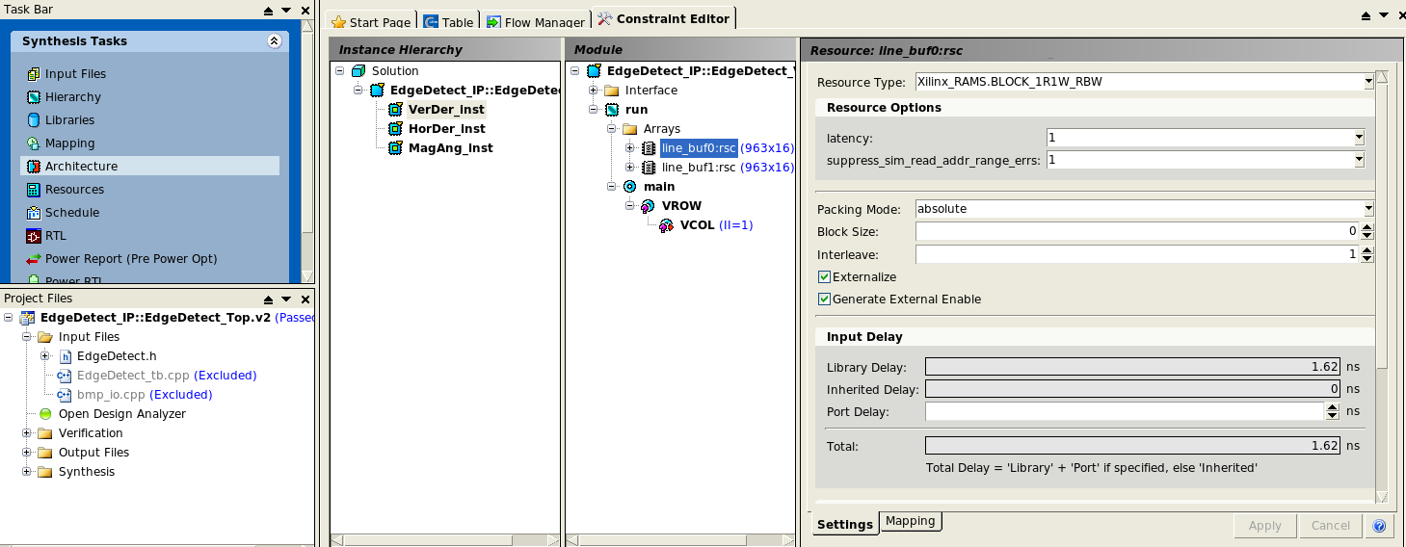
Architecture

Slide 15
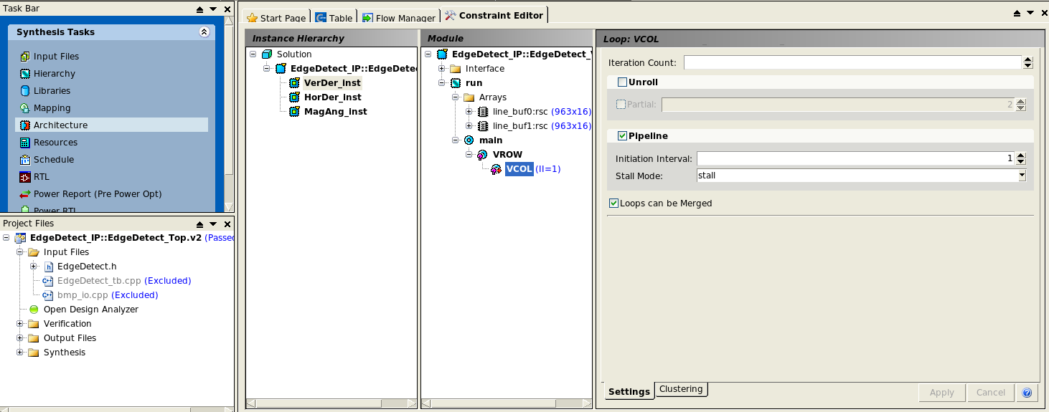
Architecture

Slide 16
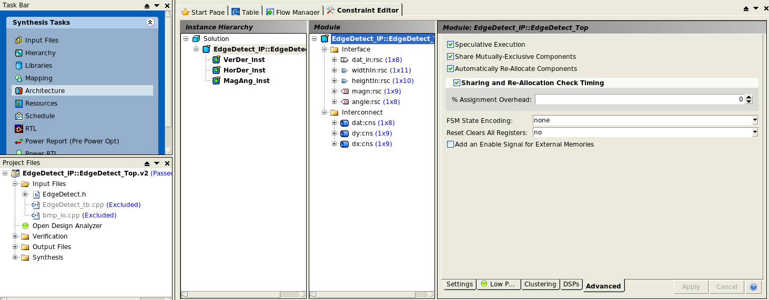
Architecture

Slide 17
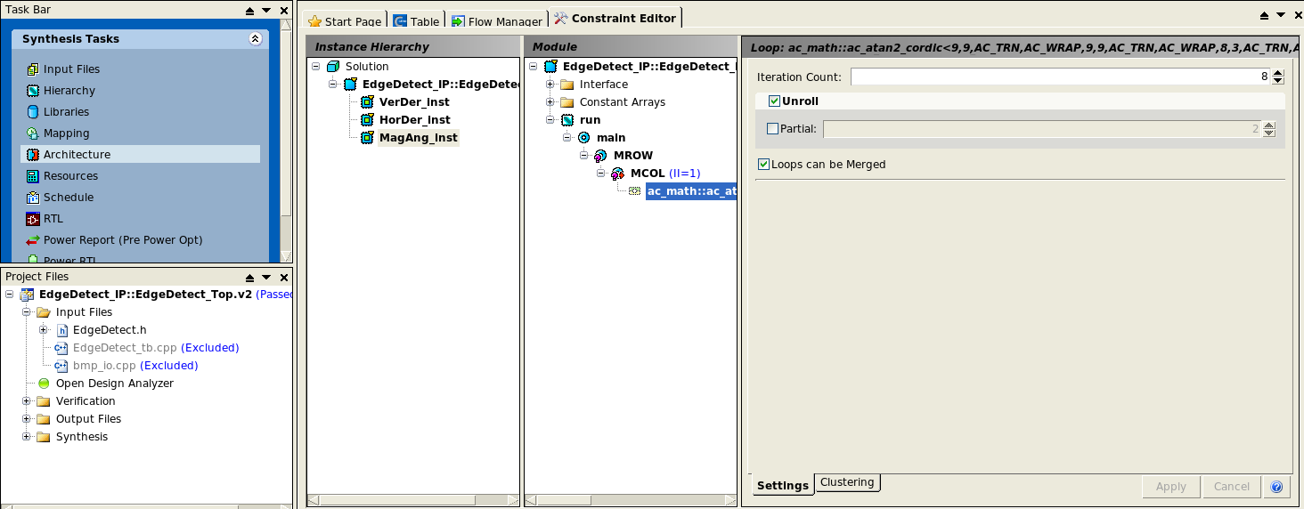
Architecture

Slide 18
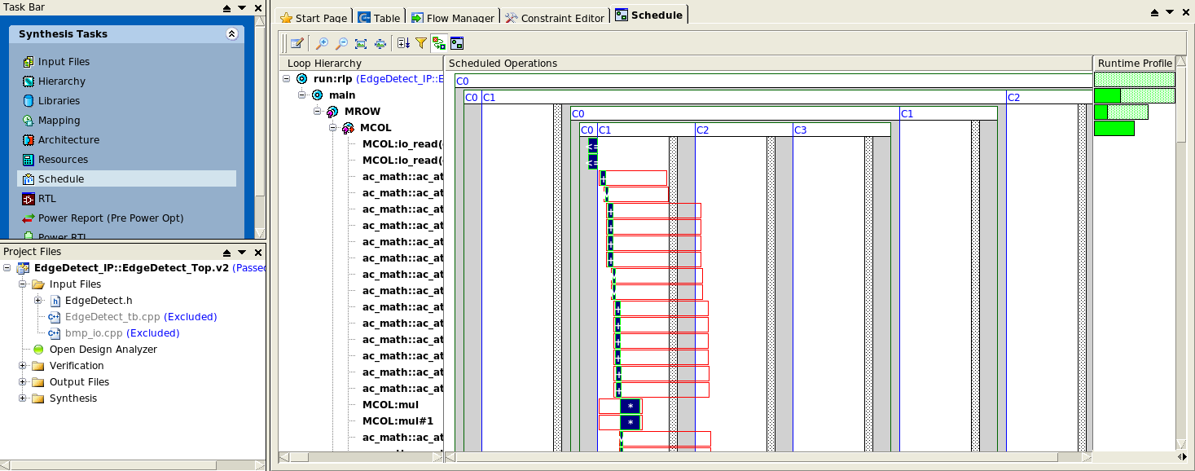
Schedule

Slide 19
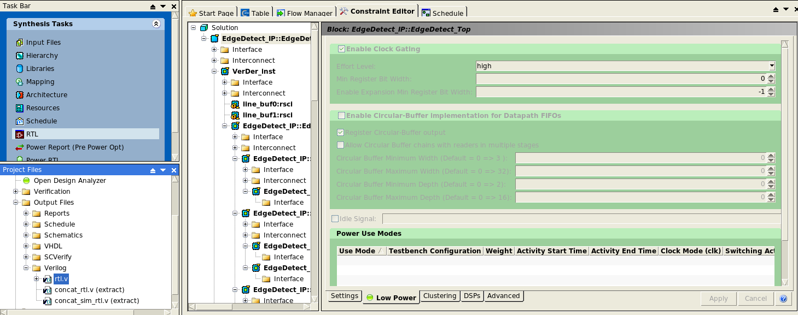
Generate RTL

Slide 20
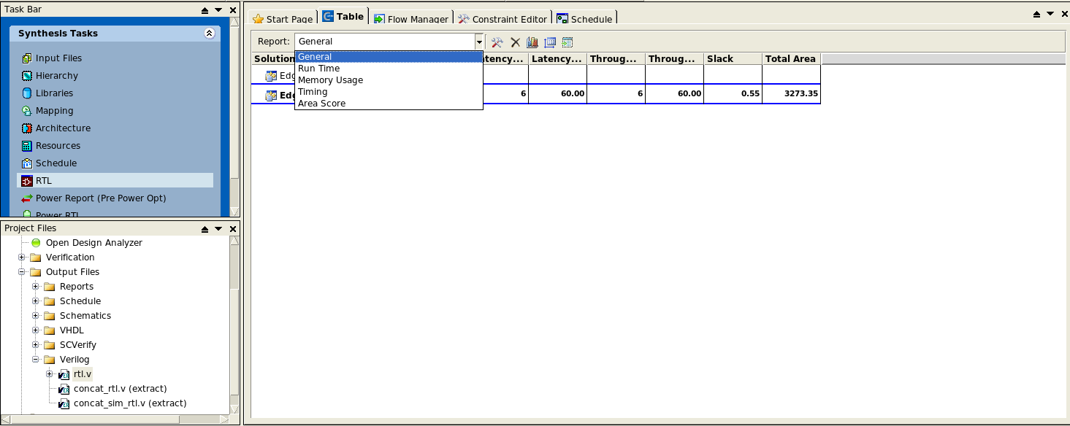
Synthesis report

Slide 21
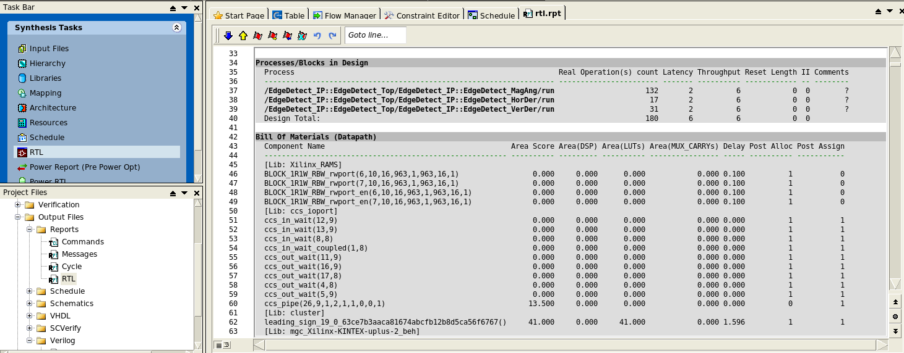
Synthesis report

Slide 22
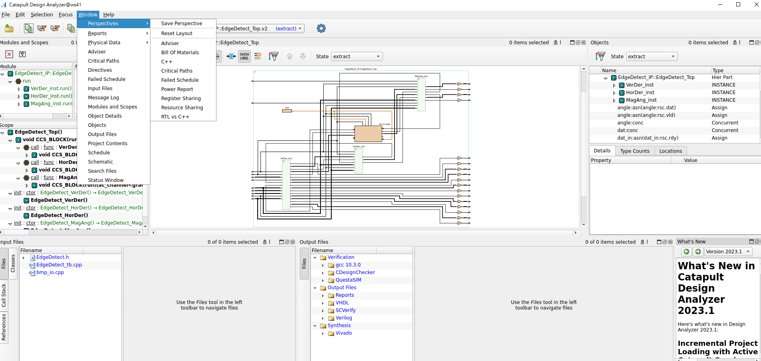
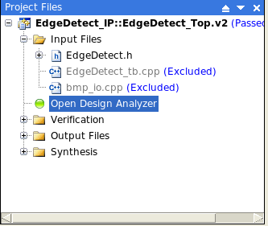
Design Analyzer

Slide 23
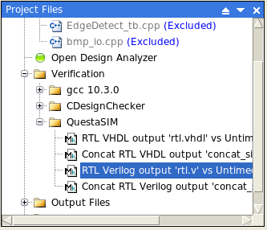
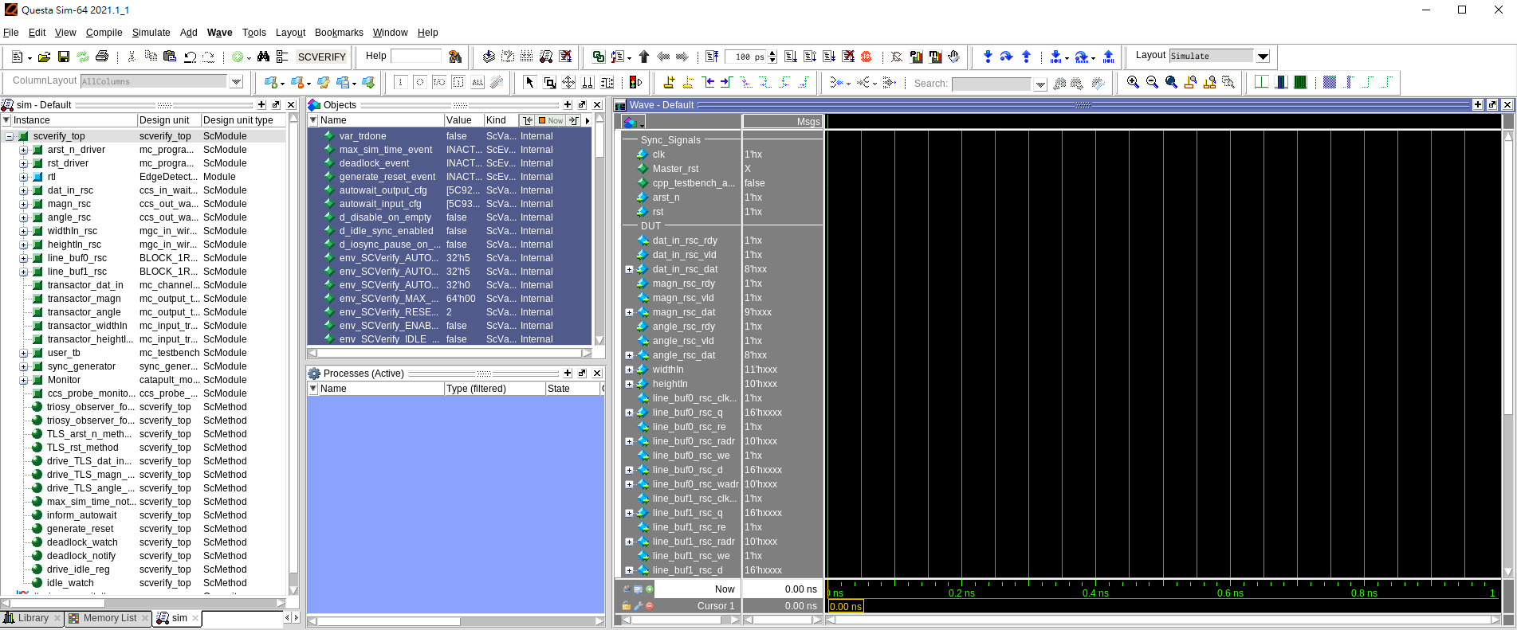
RTL Verification (Cont.)
Run all

Slide 24
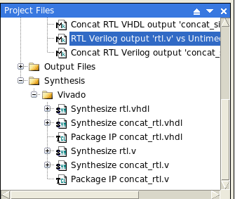
Synthesis workflow (Catapult GUI)
If your environment have Vivado project, set up Vivado directory and double click Synthesize concat_rtl.v
If not, follow the synthesis workflow

Slide 25
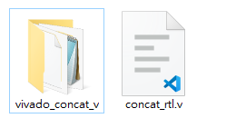
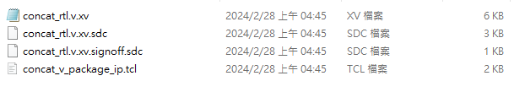
Synthesis workflow (Vivado)
Download the file of concat_rtl.v and the folder of vivado_concat_v
File under vivado_concat_v folder

Slide 26
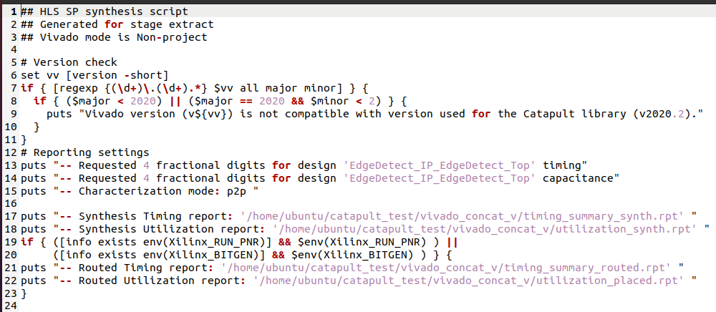
Change all of the directory in xv file

Slide 27
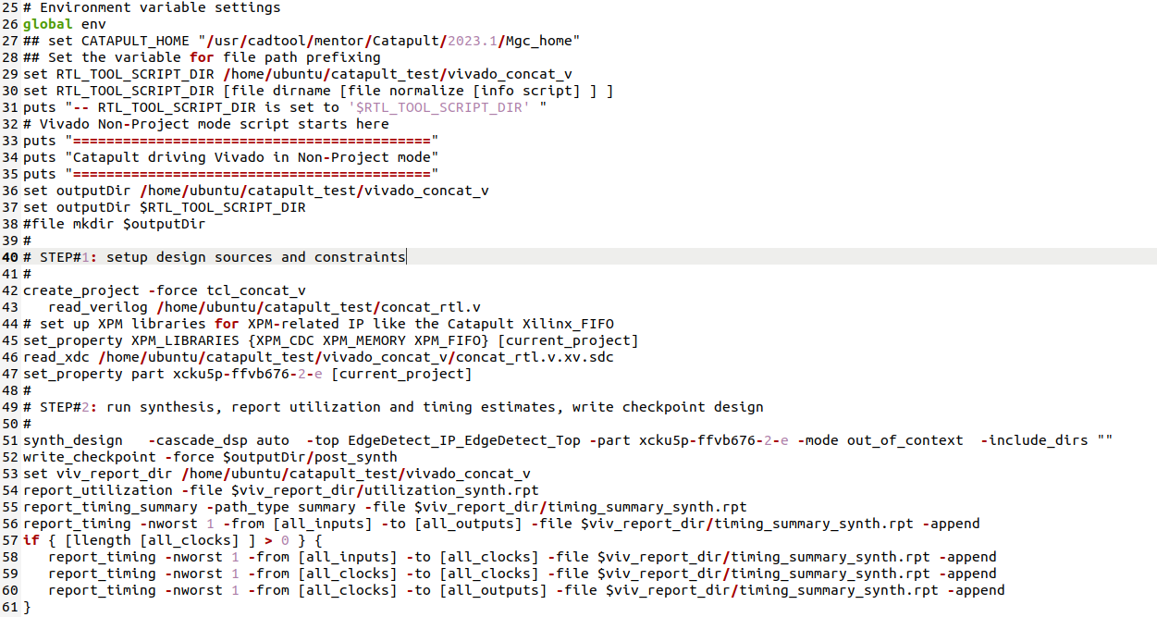
Change all of the directory in xv file

Slide 28
Synthesis by GUI
Open Vivado
Create a project with any board
Execute xv file, (or the command in xv file), in tcl console
It will generate the design of the board you choose in catapult

Slide 29
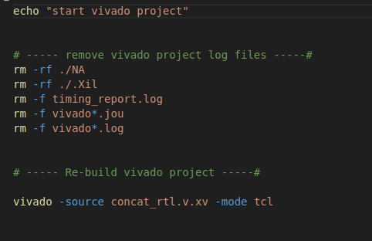
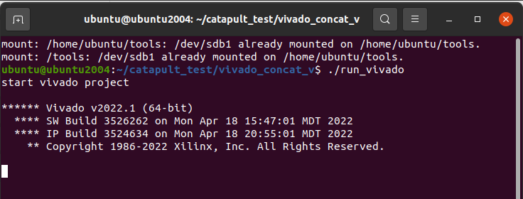
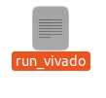
Synthesis by Command Shell (Linux)
Create file named run_vivado.
Specify the directory of xv file and source it by vivado command.
Then execute run_vivado.

Slide 30
For implement and bitstream (opt.)
For implement and generate bitstream, you need specify the constraints.
You can specify the constraints on your own, or assigned by vivado
Note: If you change the design board, you need to make sure the timing is satisfied.

Slide 31
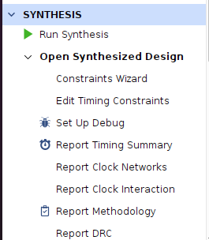
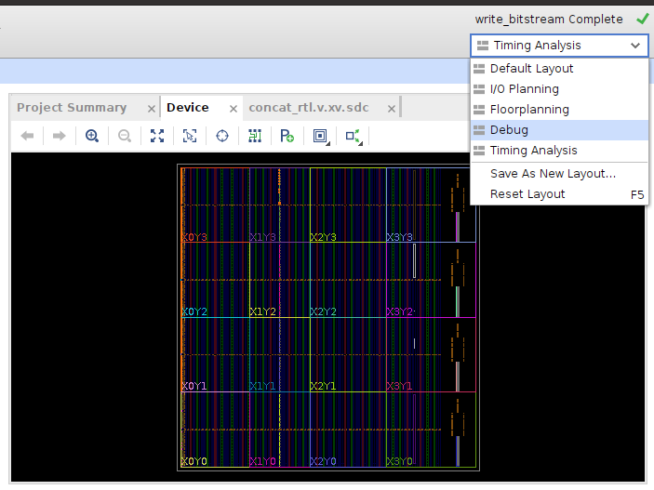
Set up constraints
Set up the arst_n constraints
Open synthesis design, and choose I/O planning for set up constraints

Slide 32
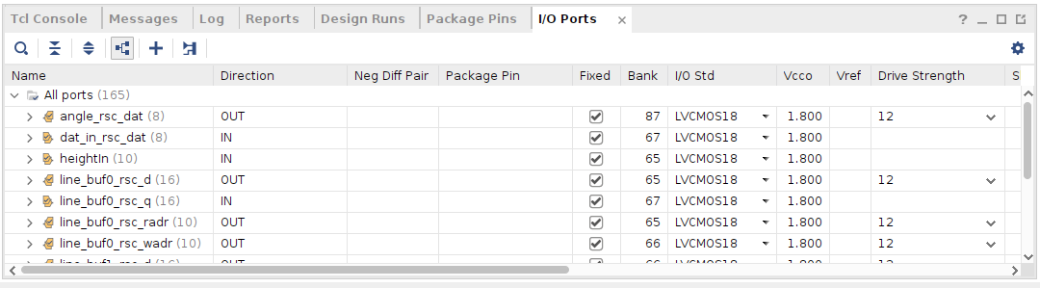
Check Fixed and set I/O standard

Slide 33
Generate bitstream
Click generate bitstream, it will generate the bitstream file under the directory of project_name.runs/impl_1/design.bit

