Slide 1
Catapult Setup Guide(NTHU)
Jiin Lai

Slide 2
Catapult
High-level synthesis (HLS) creates RTL implementations from abstract specifications described with C / C++.

Slide 3
Tool setup
You need to setup Catapult and Questasim in IC lab account.
Run “run_catapult” to check the tool is correctly installed.
You also need to setup the directory of some environment variables to run up our sample code.
Run “lab1_fir” to check the environment variables is setup correctly.
You may need to create “bin” folder to save execution file.
TA will give you another tool setup guide for tool setup.

Slide 4
Setup Catapult HLS and QuestaSim
Add the following source file in .tcshrc

Slide 5
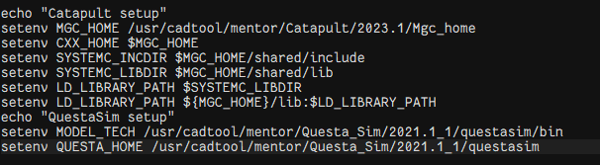
Add the environment variable
Add the following command file in .tcshrc

Slide 6
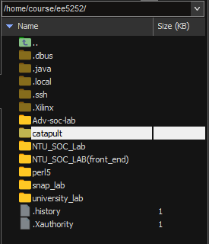
Lab file access
For NTHU student, you can access the file in the following directory
/home/course/ee5252/catapult

