Slide 1
FIR Workbook (lab_3)
SOC Design
Revise: 7-8-2024
- Elaborate more on testbench function
- Write one to clear ap_done

Slide 2
Function specification
Same as course-lab_2(FIRN11stream)
y[t] = Σ (h[i] * x[t - i]）

Slide 3
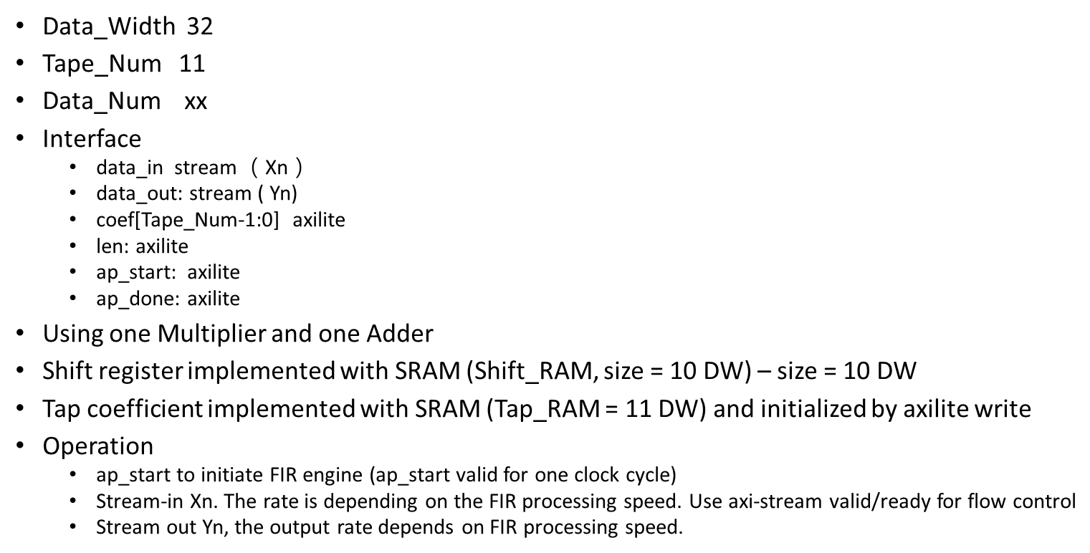
Design specification
TBD – Based on size of data file

Slide 4
You will implement - fir.v - fir_tb.v (testbench – you can reference and modify from Github fir_tb.v) Lab Github: https://github.com/bol-edu/caravel-soc_fpga-lab/tree/main/lab-fir

Slide 5
FIR module interface (AXI-Lite, AXI-Stream)
AXI-lite:
https://www.realdigital.org/doc/a9fee931f7a172423e1ba73f66ca4081
https://docs.xilinx.com/r/en-US/pg202-mipi-dphy/AXI4-Lite-Interface
AXI-stream:
https://developer.arm.com/documentation/ihi0051/latest/
https://docs.xilinx.com/r/en-US/pg256-sdfec-integrated-block/AXI4-Stream-Interface
BRAM Interface: Synchronous read/write

Slide 6
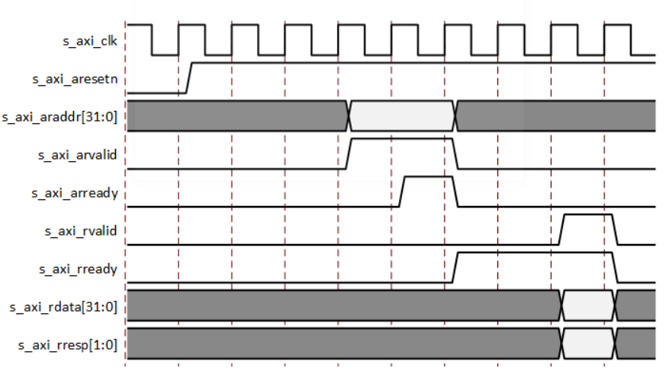
AXI4-Lite Read Transaction

Slide 7
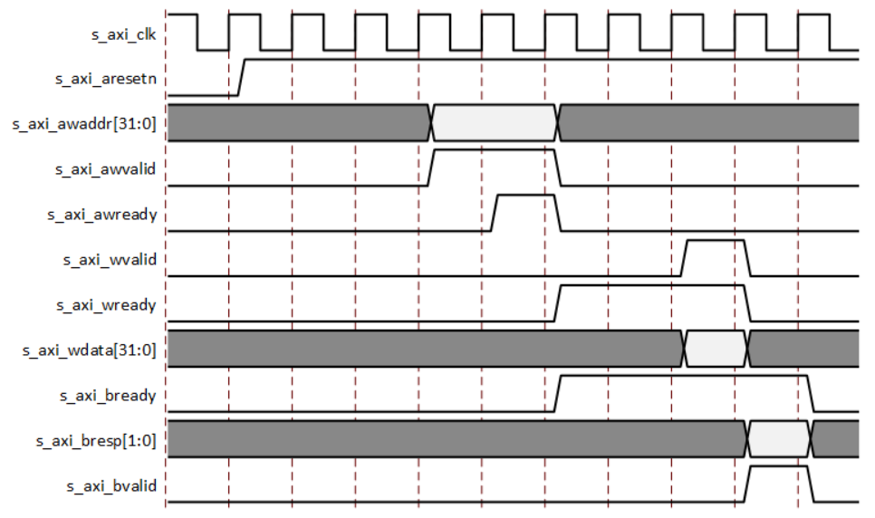
AXI4-Lite Write Transaction

Slide 8
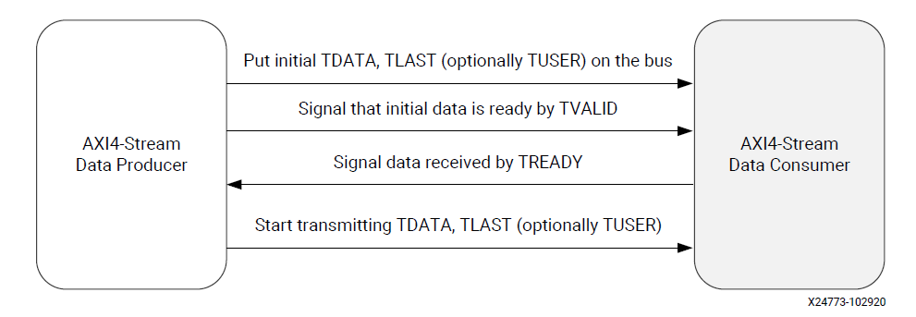
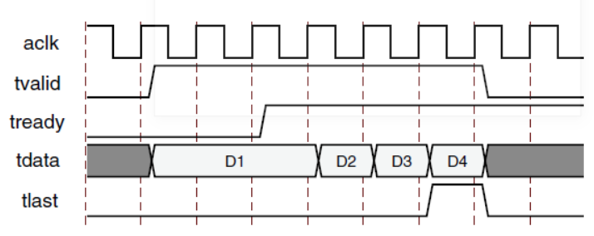
AXI4-Stream Transfer Protocol

Slide 9
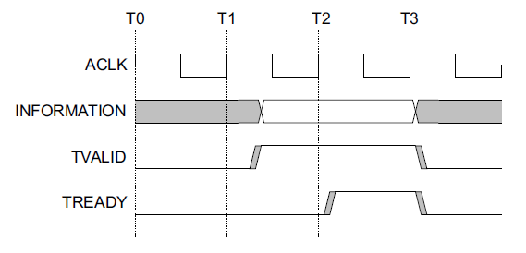
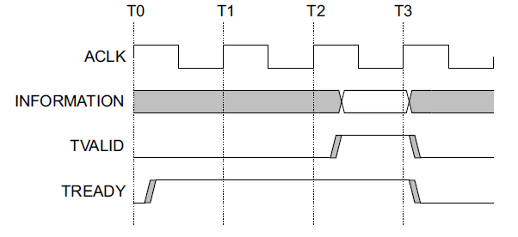
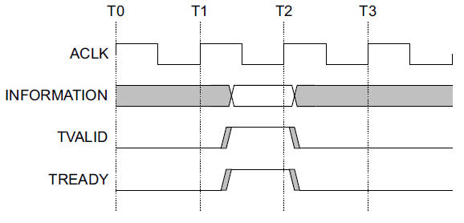
Data Transfer Handshake : TVALID, TREADY
For a transfer to occur, both TVALID and TREADY must be asserted
A Transmitter is not permitted to wait until TREADY is asserted before asserting TVALID
Once TVALID is asserted, it must remain asserted until the handshake occurs
A Receiver is permitted to wait for TVALID to be asserted before asserting TREADY
TVALID asserted before TREADY
TREADY asserted before TVALID
TVALID and TREADY asserted simultaneously

Slide 10
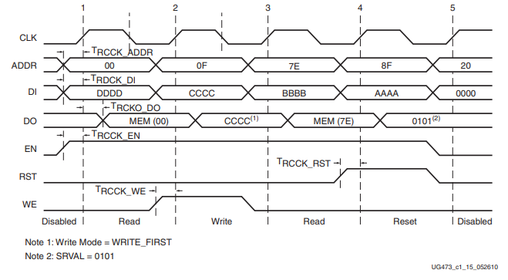
SRAM Access Timing
Write data is written when WE/EN is sampled
Read data is available in next cycle, when EN is sampled
x
x
x
x
x
x
x
x
SRAM access has different modes, refer to https://docs.xilinx.com/r/en-US/am007-versal-memory/Read-Operation?tocId=VRYu0HURA1U147fufYDMNQ

Slide 11
Deliver module header
The I/O signals are listed in fir.v.
You are requested to use simplified AXI-lite and AXI-stream protocol.

Slide 12
Configuration Register Access Protocol

Slide 13
Configuration Register Address map
Address
0x00 – [0] - ap_start (r/w)
set when ap_start signal assert
reset, when start data transfer, i.e. 1st axi-stream data come in
[1] – ap_done (ro) -> when FIR process all the dataset, i.e. receive tlast, and last Y is generated and transferred
[2] – ap_idle (ro) -> indicate FIR is actively processing data
0x10-14 - data-length
0x20-FF – Tap parameters, (e.g., 0x20-23 Tap0, 0x24-0x27 Tap1 .. in sequence …)
Note: Tap parameters set at 0x80 can use lower address bit directly for SRAM address.

Slide 14
ap_start protocol and implementation
ap_start is a read/write registers
When ap_start is programmed one, the FIR engine starts.
Host Software or testbench can program ap_start
When ap_idle is one.
After data-length, tap parameters are programmed
If ap_start is programmed one when ap_idle is zero (i.e. engine is running), the ap_start is not effective
ap_start is set by software/testbench, and reset by engine
Engine resets ap_start when engine is not idle, i.e. engine starts processing data

Slide 15
ap_done protocol and implementation
It is read/write-one-clear register
ap_done is reset in the following condition
Reset signal is asserted
After a task complete, the ap_done is cleared by
When ap_done is read, i.e. address 0 is read
Write one to ap_done register bit to clear
=> Choose one implementation
ap_done is asserted when engine completes last data processing and data is transferred

Slide 16
ap_idle protocol and implementation
ap_idle is set to 1 when reset
ap_idle is set to 0 when ap_start is sampled
ap_idle is set to 1 when FIR engine processes the last data and last data is transferred

Slide 17
Handle Configuration read/write while engine is active
It is illegal operation, but we still need to handle it.
Cfg read: TapRAM read return ‘hffffffff (invalid value, software can check), other address, return valid value
Cfg write: ignore, illegal action

Slide 18
Testbench Specification

Slide 19
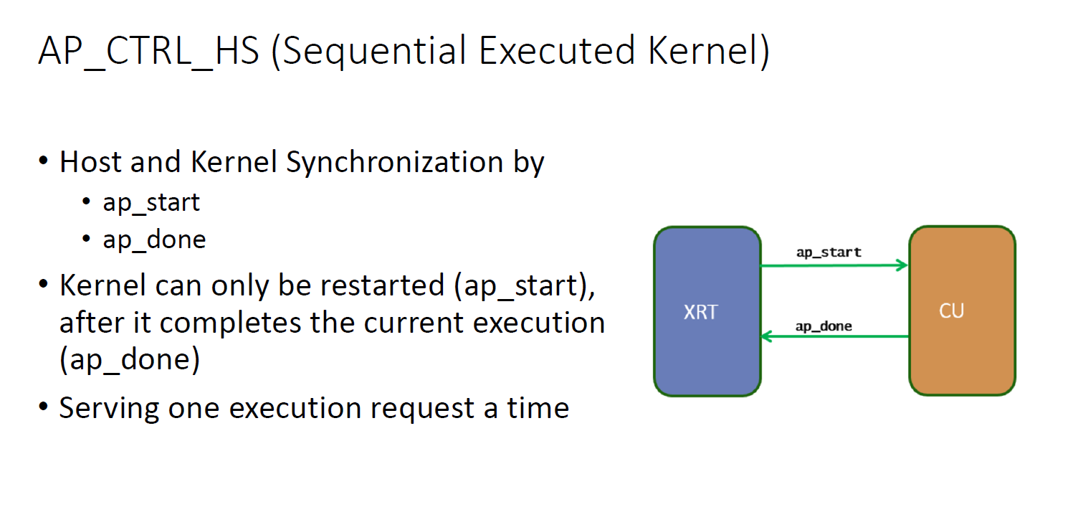
Testbench
fir_tb(Please name your top module same as fir for simulation)
The testbench should keep in the same directory with Makefile
Block-level Protocol (ap_start, ap_done):

Slide 20
Host software / Testbench Programming Sequence
Host Software / Testbench
Check FIR is idle, if not, wait until FIR is idle
Program length, and tap parameters
Program ap_start -> 1
Fork
Transmit Xn,
Receive Yn
Polling ap_done
When ap_done is sampled, compare Yn with golden data
FIR Engine
Wait for ap_start
Set ap_idle = 0
Process data
If reach data-length, set ap_done
Note: Transmit Xn (stream-in), Receive Yn (stream-out) and Polling ap_done (axilite) are running concurrently. They are using different interface and do not interfere each other

Slide 21
Testbench – Develop your own testbench
Setup phase
Load datafile, and count # of data = data_length
Program tap_parameters and data_length, read back and check it is correctly programmed
Compute Yn expected value, or load golden data into Yn buffer
Read and check ap_start, ap_idle, ap_done are in proper state
Execution phase
Program ap_start
Start latency timer
Fork the following operations, run concurrently
Task1(axis-in): Stream_in_Xn
Task2(axis_out): Stream_out_Yn and save into Yn buffer
Task3(axilite):
Polling ap_done, when ap_done is sampled, disable tasks (stream_in_Xn, stream_out_Yn, and Polling)
Read/write tap_parameters: make sure it does not corrupt fir computation
Read return invalid value, e..g. ‘hffffffff
Write ignored
Checking Phase
Report latency
Compare Yn buffer with golden data
Repeat 2 – 3 for three times
Note: You may print message to assist debugging

Slide 22
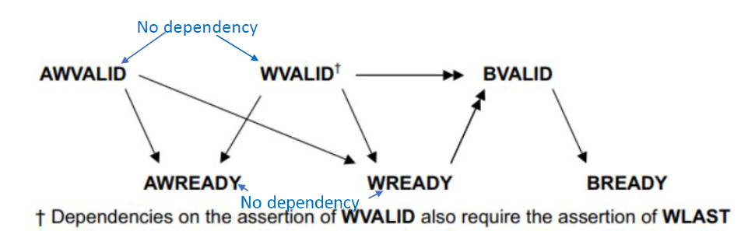
TestBench – Axilite write
Axilite write
Spawn two processes: aw_proc, w_proc
Each process has random initial delay 0 – 5T
Asserts awaddr (wdata) when awvalid (waddr) asserts
Wait for awready (wready)
Once awready (wready) is sampled active, invalidate awaddr (wdata)
Optionally wait for bvalid ( in our case, no bvalid)

Slide 23
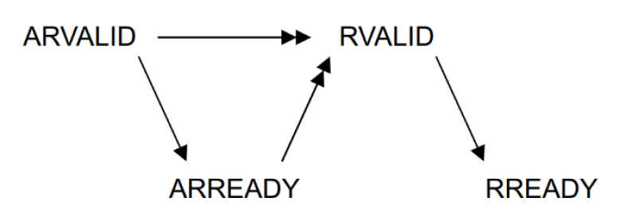
TestBench – Axilite read
Axilite read
Spawn two processes: ar_proc, r_proc
Each process has random initial delay 0-5T
Asserts araddr, and rready
Once arready is sampled active, invalidate araddr
Check rvalid is only asserted after arvalid and arready are asserted

Slide 24
TestBench – axi-stream X input
Protocol
For a transfer to occur, both TVALID and TREADY must be asserted
A Transmitter is not permitted to wait until TREADY is asserted before asserting TVALID
Once TVALID isasserted , it must remain asserted until the handshake occurs
A Receiver is permitted to wait for TVALID to be asserted before asserting TREADY
Testbench
Randomize tvalid initial delay
Case1: short latency [0-1]
Case2: long latency [0-2 x Filter latency]
Once sampled tready, deasserts tdata

Slide 25
Testbench: axi-stream Y output
spawn a task ->task_sm_tready
randomize sm_tready delay
Short latency: delay [0-5]
Long latency: delay [0- 2* filter latency]
when both sm_tready and sm_tavlid sampled asserted,
Check data
finish the task
Note: sm_tready could be asserted before sm_tvalid asserted

Slide 26
Test dataset
Samples_triangular_wave.dat
out_gold.dat

Slide 27
SRAM Interface Implementation
Refer to verilog-sram.pdf - Use memory for ASIC flow
Github updated - https://github.com/bol-edu/caravel-soc_fpga-lab/tree/main/lab-fir
Implement SRAM without .db/.lib
Use external SRAM (bram.v). fir.v provides ports to interface with the external SRAM. So, the fir.v can be synthesized with BRAM
Two size of bram.v ( you choose either one to fit your design)
bram11.v (11 x 32) – depth 11
bram12.v (12 x 32) – depth 12
fir
axilite
axis_slave (Xn)
axis_master(Yn)
tap_RAM
data_RAM

Slide 28
Submission (1/2)
Hierarchy:
StudentID_lab3/
Waveform
Simulation.log
Report.pdf
Synthesis report
Github link
Your Github link should attach the file
fir.v （the fir design）
fir_tb.v ( the testbench )
Log files including : synthesis, simulation, static timing report
Synthesis report – area usage, Including FF, LUT (Note: there should be no BRAM because BRAM is an external model, not in the RTL design)
Timing Report, including slack, and max delay path
Waveform – show
Configuration write
ap_start, ap_done ( measure # of clock cycles from ap_start to ap_done)
Xn stream-in, and Yn stream-out
Report
Location of design (If use vivado to design)
hostproject/hostproject.srcs/sources_1/new/

Slide 29
What is included in the report
Block Diagram
Datapath – dataflow
Control signals
Describe operation, e.g.
How to receive data-in and tap parameters and place into SRAM
How to access shiftram and tapRAM to do computation
How ap_done is generated.
…..
Resource usage: including FF, LUT, BRAM
Timing Report
Try to synthesize the design with maximum frequency
Report timing on longest path, slack
Simulation Waveform, show
Coefficient program, and read back
Data-in stream-in
Data-out stream-out
RAM access control
FSM

Slide 30
Submission (2/2)
Compress all above files in a single zip file named
StudentID_lab3.zip (e.g., 111061545_lab3.zip)
Submit to NTHU eeclass
Deadline:
‐ 20% off for the late submission penalty within 3 days

Slide 31
Supplement

Slide 32
Refer hls-kernel-io-interface Block Level Protocol

Slide 33
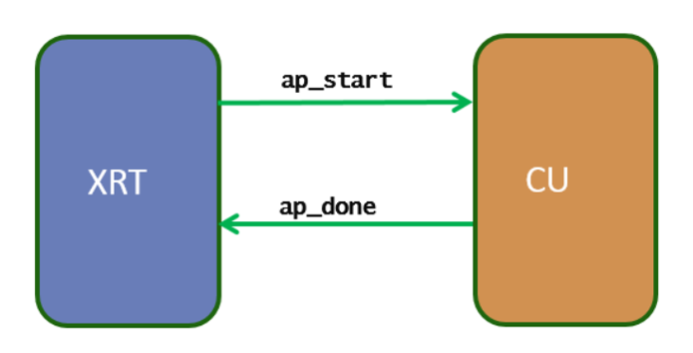
AP_CTRL_HS (Sequential Executed Kernel)
Host and Kernel Synchronization by
ap_start
ap_done
Kernel can only be restarted (ap_start), after it completes the current execution (ap_done)
Serving one execution request a time
https://xilinx.github.io/XRT/master/html/xrt_kernel_executions.html

Slide 34
AP_CTRL_HS Protocol
ap_start (i): set 1 to start until ap_ready asserted.
ap_ready (o): design is ready to accept new input
ap_done (o): design completes all operation.
Indicates data on ap_return is valid
ap_idle (o): indicate design is idle if high.
(ap_return): return data
Pipeline/Nonpipeline depends on ap_ready timing
latency
II
Ug902,p#78: https://www.xilinx.com/support/documentation/sw_manuals/xilinx2018_3/ug902-vivado-high-level-synthesis.pdf

Slide 35
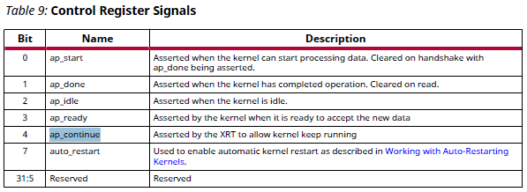
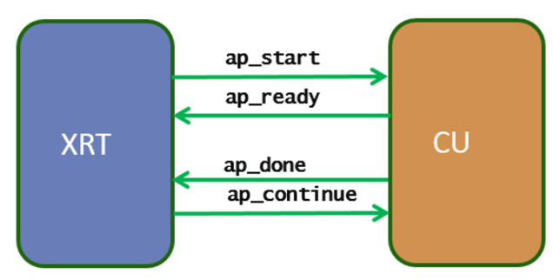
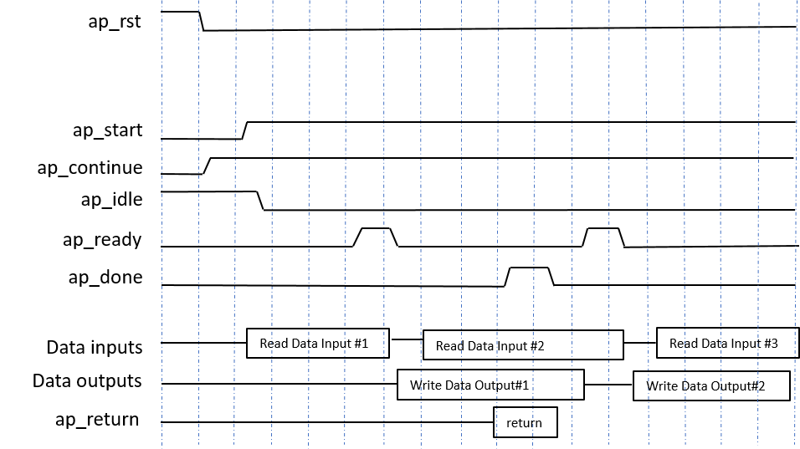
Host Control Pipeline Kernel Execution
Input Synchronization(ap_start, ap_ready)
XRT writes a 1 in ap_start to start the kernel
XRT waits for ap_ready
XRT write 1 in ap_start to start the kernel again
Output Synchronization (ap_done, ap_continue)
XRT waits for ap_done asserted by the kernel ( output data is produced)
XRT write1 a 1 in ap_continue to keep kernel running.
The two processes (Input Synchronization, Output Synchronization) run asynchronously)
Enqueue multiple requests, and data buffers ahead of time, e.g. clEnqueueMigrateMemObjects
https://docs.xilinx.com/r/en-US/ug1393-vitis-application-acceleration/Control-Requirements-for-XRT-Managed-Kernels

Slide 36
Use Memory in ASIC Flow

Slide 37
Memory Inference in ASIC
ASIC Synthesis tool does not infer memories from RTL in the way FPGA synthesis tools do.
Use Memory Compiler
Generate memory block with the specification (bitwidth, depth, # of port)
(.lef) – Library Exchange Format – containing placement information
Schematic & Netlist (for LVS and functional verification)
(.v) Function model (verilog) with timing check – for RTL simulation and gate-level simulation
(.lib/.db) – Liberty Timing File – containing Timing delay Dynamic/Static timing analysis, and synthesis
(.gds) – Graphical Database System – containing final layout information
In RTL code, explicitly instantiate the memory, and design its control signals, e.g. Enable, read/write, address, input/output data

Slide 38
Note on ASIC Implementation with SRAM
RTL design use memory instance directly. Need to provide sram synthesis library, either .lib, or .db (synospsy design-compiler). There is no particular inference method. (note: Xilinx FPGA can use inference)
If there is no sram .lib, or .db, you may put the sram outside using module ports. In this case, you can simulate with post-synthesis gate with sram behavior model. To get sram interface timing optimization, you will need to specify sram interface timing constraints, for example, output delay, input delay.

Slide 39
SRAM with .db/.lib
// RTL module
module your_design( …) begin
// instantiate SRAM
SRAM32X32 (CLK, WE, EN, ADDR, DI, DO)
endmodule
RTL Simulation
RTL code with instance of SRAM
Simulate with functional model
Synthesis
Refer to .lib for SRAM timing/area information
Optimize timing for SRAM interface timing
Post-Synthesis Gate-level Simulation
Post layout gate-level timing simulation
Use functional model with timing check (specify/endspecify)
// Functional Model with timing check
module SRAM32X32( … ) begin
specify // timing check
endspecify
end
// Timing model : .lib

Slide 40
SRAM without .lib/.db
// RTL module
module your_design(
// SRAM interface ports
SRAM_EN,
SRAM_ADDR,
…) begin
// No SRAM instance
// SRAM32X32 (CLK, WE, EN, ADDR, DI, DO)
endmodule
SRAM instance could not be in RTL design for synthesis, instead, provide ports to interface with SRAM
RTL simulation
Simulate with SRAM model
Synthesis
Provide timing constrains (e.g. output delay, input delay ) for SRAM interface ports
Post Synthesis with gate-level simulation
Simulate with SRAM functional model with timing check
// Functional Model with timing check
module SRAM32X32( … ) begin
specify // timing check
endspecify
end

Slide 41
Timing Check Tasks in Verilog
Specify block can be used to specify setup and hold times for signals
specify and endspecify (Use specparam to define parameters in specify block)
$setup (data, clock edge, limit)–Displays warning message if setup timing constraint is not met
$setup(d, posedge clk, 10)
$hold (clock edge, data, limit)–Displays warning message if hold timing constraint is not met
$hold(posedge clk, d, 2)
$width (pulse event, limit)–Displays warning message if pulse width is shorter than limit
$width(posedge clk, 20) –specify start edge of pulse
$period (pulse event, limit)–Check if period of signal is sufficiently long
$period(posedge clk, 50)

Slide 42
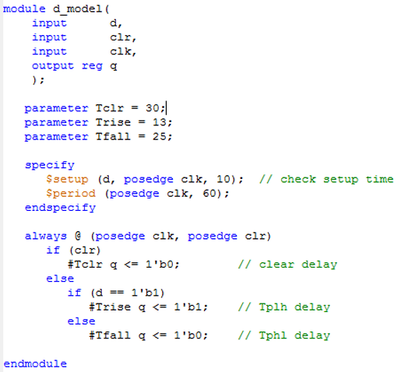
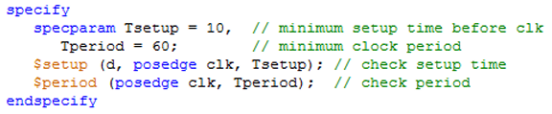
Specify Block Example

Slide 43
SRAM Access in behavior model and Synthesizable Hardware Design ref : spiflash-vip.v v.s. spiflash.v

Slide 44
Example: spiflash design
spiflash-vip.v - spiflash behavior model
access sram as an model
bram.v – BlockRAM behavior model
spiflash.v
Adapt from spiflash-vip.v, synthesizable verilog design
Generate bram interface signal to access data
Reference code:
https://github.com/bol-edu/caravel-soc_fpga-lab/tree/main/spiflash

Slide 45
SRAM Access Timing
Write data is written when WE/EN is sampled
Read data is available in next cycle, when EN is sampled
x
x
x
x
x
x
x
x
SRAM access has different modes, refer to https://docs.xilinx.com/r/en-US/am007-versal-memory/Read-Operation?tocId=VRYu0HURA1U147fufYDMNQ

Slide 46
BRAM Model
module bram #( parameter FILENAME = "firmware.hex")
(
input wire CLK;
input wire [3:0] WE0;
input wire EN0;
input wire [31:0] Di0;
output reg [31:0] Do0;
input wire [31:0] A0
)
reg [7:0] RAM[0:4*1024*1024-1]; // Declare Memory Storage
always @(posedge CLK)
if(EN0) begin
Do0 <= {RAM[{A0[31:2],2'b11}],
RAM[{A0[31:2],2'b10}],
RAM[{A0[31:2],2'b01}],
RAM[{A0[31:2],2'b00}]} ;
if(WE0[0]) RAM[{A0[31:2],2'b00}] <= Di0[7:0];
if(WE0[1]) RAM[{A0[31:2],2'b01}] <= Di0[15:8];
if(WE0[2]) RAM[{A0[31:2],2'b10}] <= Di0[23:16];
if(WE0[3]) RAM[{A0[31:2],2'b11}] <= Di0[31:24];
end
else
Do0 <= 32'b0;
@(posedge CLK) if EN0 is sampled, output its memory content to Do0
@(posedge CLK) if WE[3:0] is sampled, RAM is written with Di0 per byte
initial begin
$display("Reading %s", FILENAME);
$readmemh(FILENAME, RAM);
$display("%s loaded into memory", FILENAME);
$display("Memory 5 bytes = 0x%02x 0x%02x 0x%02x 0x%02x 0x%02x",
RAM[0], RAM[1], RAM[2], RAM[3], RAM[4]);
end

Slide 47
spiflash-vip – behavior model to access RAM
Memory defined and initialization
reg [7:0] memory [0:16*1024*1024-1]; // 16MB
initial begin // memory content loaded data from file
$readmemh(FILENAME, memory);
end
Memory data is available the same time address is supplied. This is not feasible in the actual memory system.
memory read access
buffer = memory[spi_addr]; // memory read
memory write access
memory[spi_addr] = buffer;

Slide 48
spiflash.v – Synthesizable hardware design
BRAM RAM
Addr
EN
WEN
Din
Dout
Clk
Rst
Generate SRAM interface signals
Addr, EN, WEN, Din, Dout
The interface signal is generated from internal control logic (FSM) Interface signals follows the interface timing specification, e.g. read data is available in next clock cycle
// BRAM Interface
assign romcode_Addr_A = {8'b0, spi_addr};
assign romcode_Din_A = 32'b0;
assign romcode_EN_A = (bytecount >= 4);
assign romcode_WEN_A = 4'b0;
assign romcode_Clk_A = ap_clk;
assign romcode_Rst_A = ap_rst;
wire [7:0] memory;
assign memory =
(spi_addr[1:0] == 2'b00) ? romcode_Dout_A[7:0] :
(spi_addr[1:0] == 2'b01) ? romcode_Dout_A[15:8] :
(spi_addr[1:0] == 2'b10) ? romcode_Dout_A[23:16] :
romcode_Dout_A[31:24] ;

