Slide 1
Advanced SOC Design Lab catapult
Jiin Lai

Slide 2
Catapult
High-level synthesis (HLS) creates RTL implementations from abstract specifications described with C / C++.

Slide 3
Tool setup
You need to setup Catapult and Questasim in IC lab account.
Run “run_catapult” to check the tool is correctly installed.
You also need to setup the directory of some environment variables to run up our sample code.
Run “lab1_fir” to check the environment variables is setup correctly.
You may need to create “bin” folder to save execution file.
TA will give you another tool setup guide for tool setup.

Slide 4
Content
In this lab, we will provide the example code of lab1_fir and part of Lab2_edgedetect_fsic .
Lab1_fir is for you to understand how to use catapult.
Lab2_edgedetect_fsic needs rewrite the code to meet the spec.
Note: we will provide you a sample code in 01_edgedetect.

Slide 5
Lab1-fir work
3 subdirectory
Walkthrough
Memory
Multblk
Work content
Run through the example – make
Study the HLS code to understand the catapult HLS

Slide 6
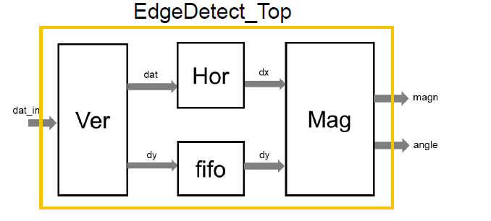
02_edgedetect block design

Slide 7
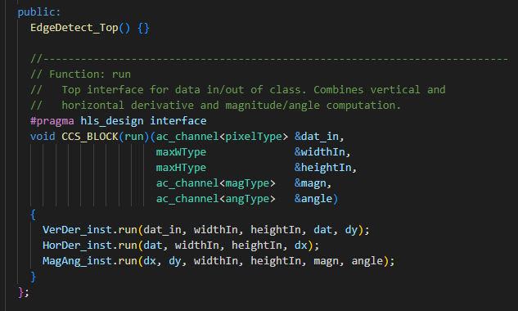
02_edgedetect

Slide 8
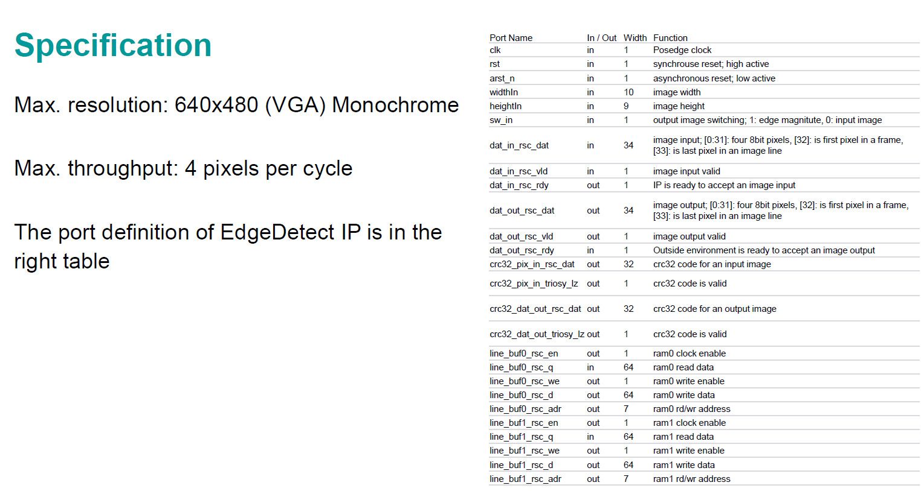
Lab work

Slide 9
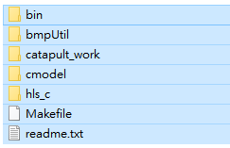
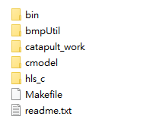



Folder Structure
01_edge_detect
02_edgedetect_fsic
03_fsic_prj
Testbench is provided
Generate it on your own
(modify the code base on 01_edge_detect)
integrate to fsic

Slide 10
Lab work - Few Modifications of Original EdgeDetect
Folder:Lab1_edgedetect - Run through the example
Folder:Lab2_edgedetect : Based on 1-lab1_edgedect code base, modify and implement the following (under hls_c)
Process four pixels per clock cycle.
Change input data type to compress four 8-bit pixels data read in one read cycle.
Use sum of absolute difference (SAD) for edge magnitude calculation.
Originally, we use square root in sample code.
Add two crc32 calculation on image input / output.
We will provide you the crc32 code, you need to use it in your design.
Select the output source from input image or the calculated magnitude.
Add mux on the top of design.
Remove the angle calculation.
Use path/concat_rtl.v to integrate with FSIC and run verification (refer to lab1-fsic-sim)
About four pixels per clock cycle, you can check the file “hls_bluebook.pdf” page 102.

Slide 11
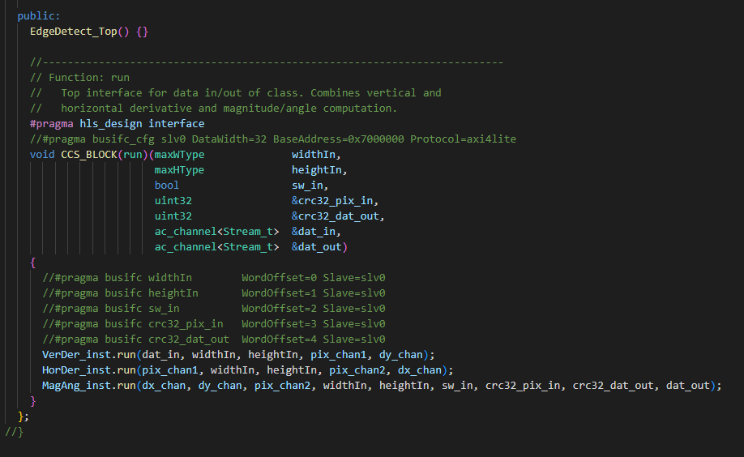
Modified top design in 02_edgedetect_fsic (for your reference)

Slide 12
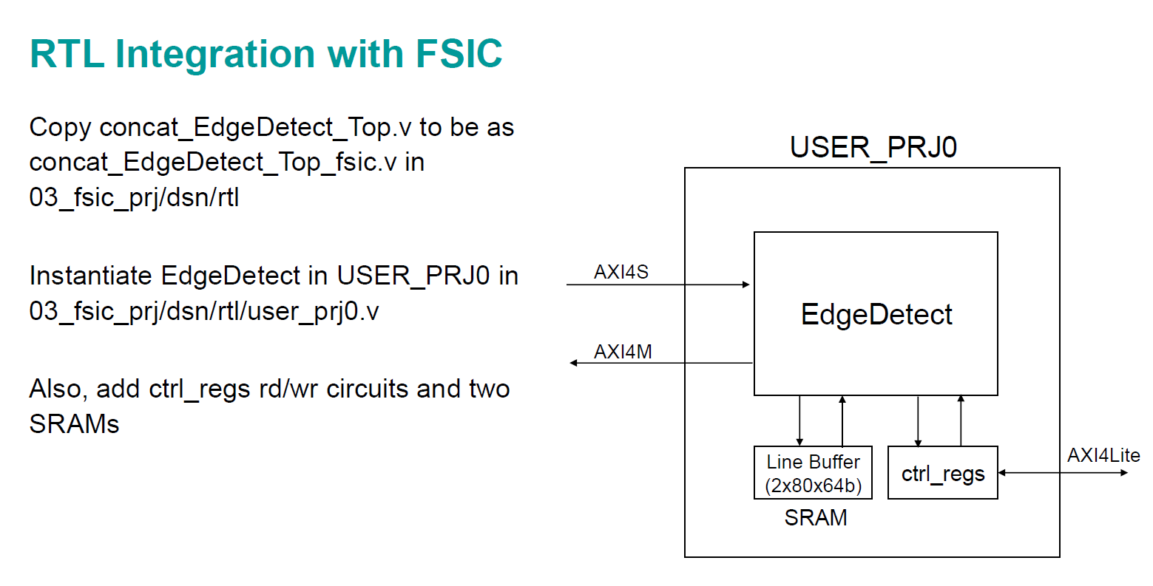
Integrate to FSIC

Slide 13
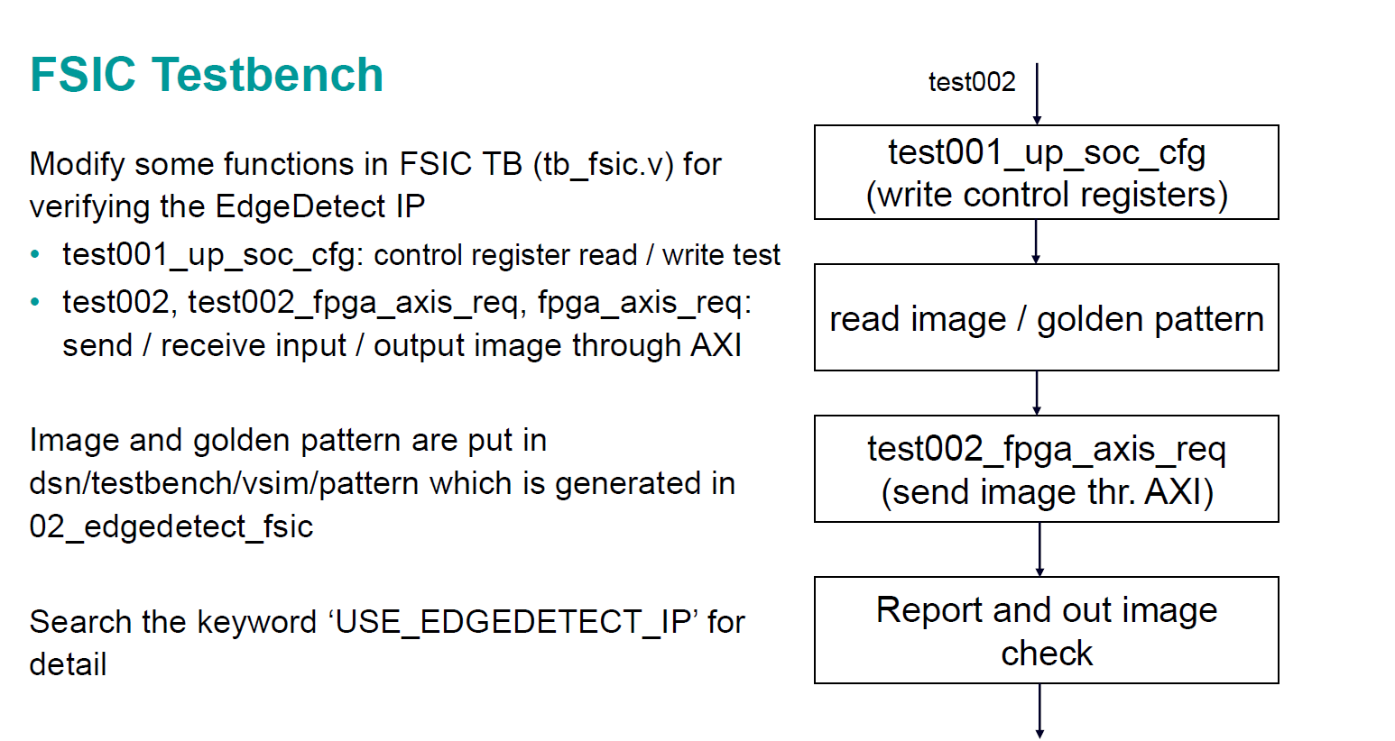
Integrate to FSIC

Slide 14
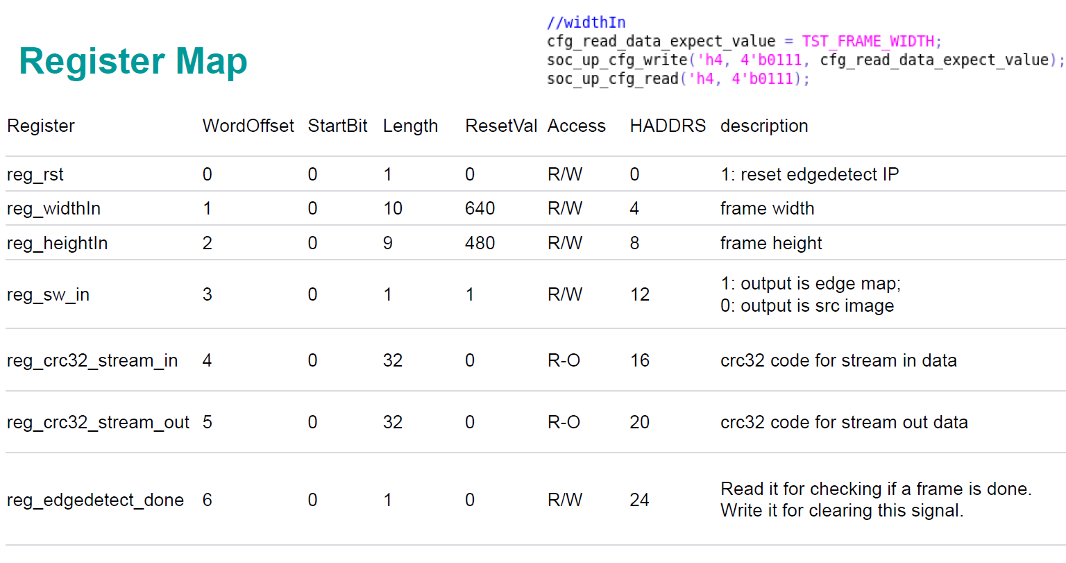
Integrate to FSIC

Slide 15
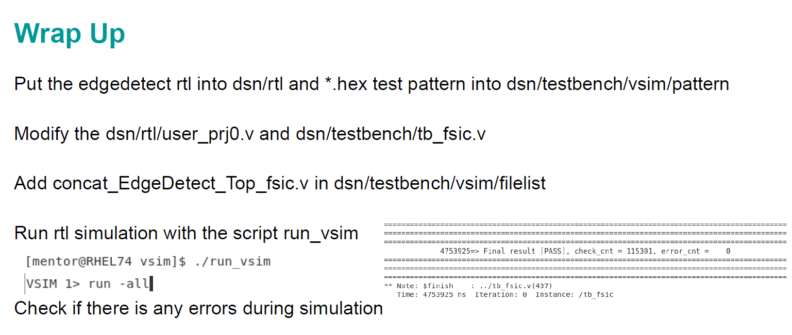
Integrate to FSIC

Slide 16
Provided Content
All content of lab1_fir(walkthrough, mem_ifc, multi_blks)
lab2_edgedetec_fsic
All content of 01_edgedetect
Only provide the testbench of 02_edgedetect_fsic, you need to modify the code of 01_edgedetect to satisfy specification.
crc32.cpp can be accessed by github, which should be used in your design
https://github.com/bol-edu/caravel-soc_fpga-lab/tree/main/catapult_hls
03_fsic_prj, after you generate the rtl design of 02_edgedetect_fsic, integrate it to FSIC and save all design into this folder.
Note: This lab didn’t need to do synthesis, only need simulation.

Slide 17
Lab2-1(FIR) Submission
Please submit the following files to {NTHU eeclass / NTU COOL / NYCU E3}
You only need to submit the screenshot of Questasim result of Lab2-1 (FIR)
(This lab is only for getting familiar with catapult)
Note: Since the authorization of these lab content, don’t upload the file which is not mentioned above to Github.

Slide 18
Lab2-2 Submission
Please submit the following files to {NTHU eeclass / NTU COOL / NYCU E3}
hls code of 02_edgedetect_fsic
C simulation log
Synthesis report of hardware design
Screen shot of table in catapult (including general, run time, memory usage, timing, and area score)
The file of rtl report (rtl.rpt)
Questasim simulation result
tcl file generate by catapult (directives.tcl)
Integrate to FSIC (rtl design and testbench)
Simulation result of FSIC
report_StudentID.pdf (Describe the 5 modification made)
Github_link.txt
Note: Since the authorization of these lab content, don’t upload the file which is not mentioned above to Github.

Slide 19
Report
How you design your work ( 5 modifications)
What’s the test result of catapult design(C design checker, testbench)
How to integrate your design in FSIC
What’s the simulation result of FSIC

