Slide 1
Catapult Setup Guide(NTHU)
Jiin Lai

Slide 2
Catapult
High-level synthesis (HLS) creates RTL implementations from abstract specifications described with C / C++.

Slide 3
Tool setup
You need to setup Catapult and Questasim in IC lab account.
Run “run_catapult” to check the tool is correctly installed.
You also need to setup the directory of some environment variables to run up our sample code.
Run “lab1_fir” to check the environment variables is setup correctly.
You may need to create “bin” folder to save execution file.
TA will give you another tool setup guide for tool setup.

Slide 4
Setup Catapult HLS and QuestaSim
Add the following source file in .tcshrc

Slide 5
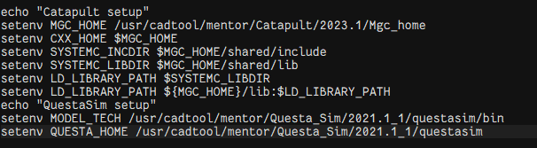
Add the environment variable
Add the following command file in .tcshrc

Slide 6
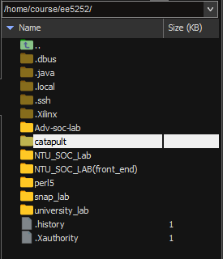
Lab file access
For NTHU student, you can access the file in the following directory
/home/course/ee5252/catapult

Slide 7
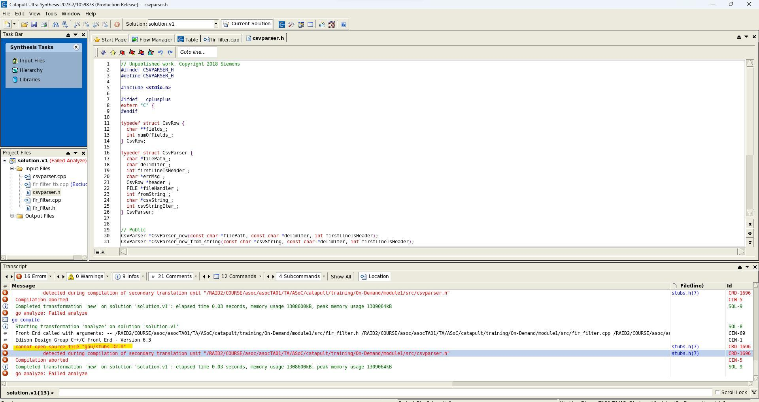
Error: cannot open source file "gnu/stubs-32.h"

Slide 8
Probable solution:
Install glibc-devel.i686 tool
You can check the server has installed the tool or not.
However, it needs root permission to install this tool.

Slide 9
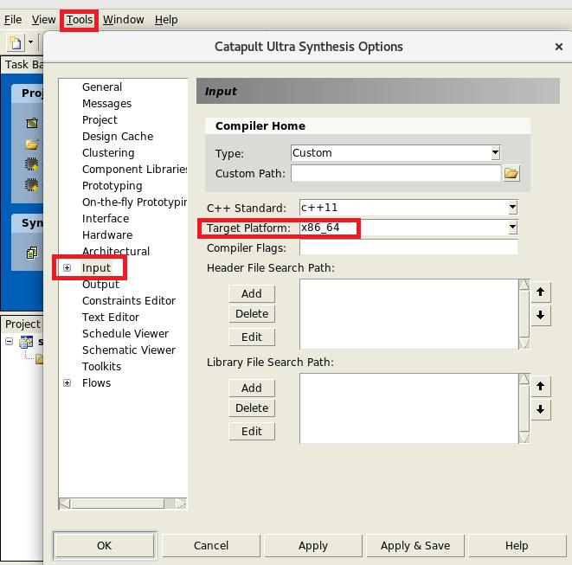
Probable solution:
Set tools in Catapult GUI
Set target platform of input (x86_64)
In NYCU ICLab server, it doesn’t work.

Slide 10
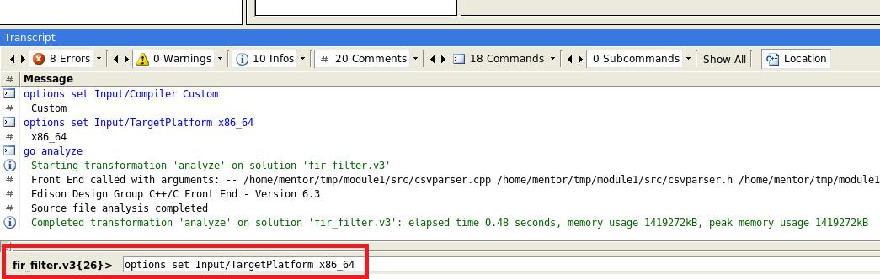
Probable solution:
Type the command in Catapult GUI
Options set Input/TargetPlatform x86_64
It works in NYCU ICLab server

