Slide 1
Lab4 Report
R13943009 鄭至盛
R13943021 陳品睿
TODO

Slide 2
Outline
WB transaction between firmware, user project and tb (waveform)
Waveform and analysis of the hardware/software behavior
What is the FIR engine theoretical throughput, i.e. data rate? Actually measured throughput?
What is latency for firmware to feed data? Is it longer compared to FIR engine
Analyze firmware assembly code, code size, code sequence
How do you improve the throughput?

Slide 3
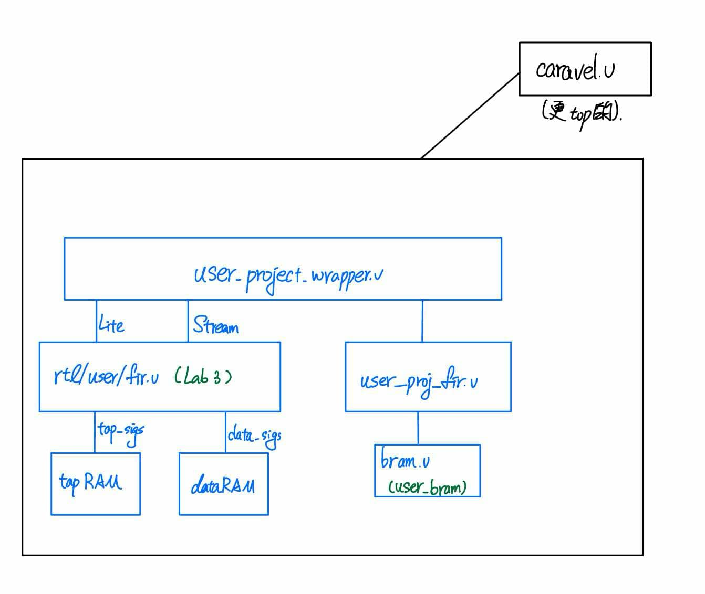
WB Transaction: Architecture

Slide 4
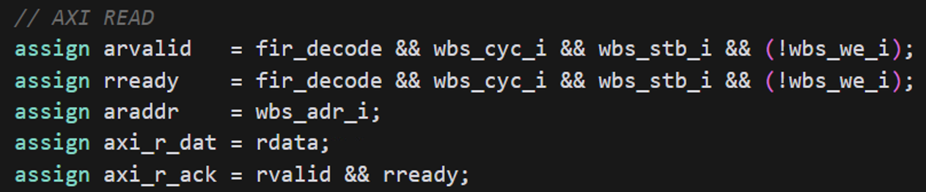
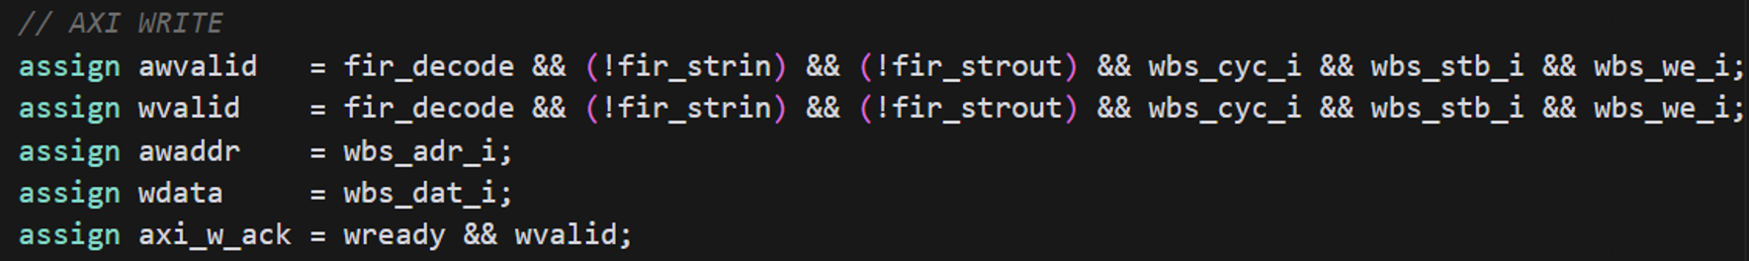
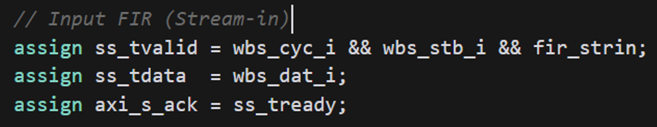
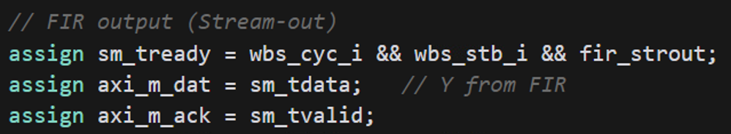
WB Transaction: Architecture
Inside user_project_wrapper.v
Enable usr when wbs_adr_i is 3800xxxx and fir when wbs_adr_i is 3000xxxx
AXI-L Read
AXI-L Write
AXI-S In
AXI-S Out

Slide 5
WB Transaction: Firmware, mprj, Testbench

Slide 6
Outline
WB transaction between firmware, user project and tb (waveform)
Waveform and analysis of the hardware/software behavior
What is the FIR engine theoretical throughput, i.e. data rate? Actually measured throughput?
What is latency for firmware to feed data? Is it longer compared to FIR engine
Analyze firmware assembly code, code size, code sequence
How do you improve the throughput?

Slide 7
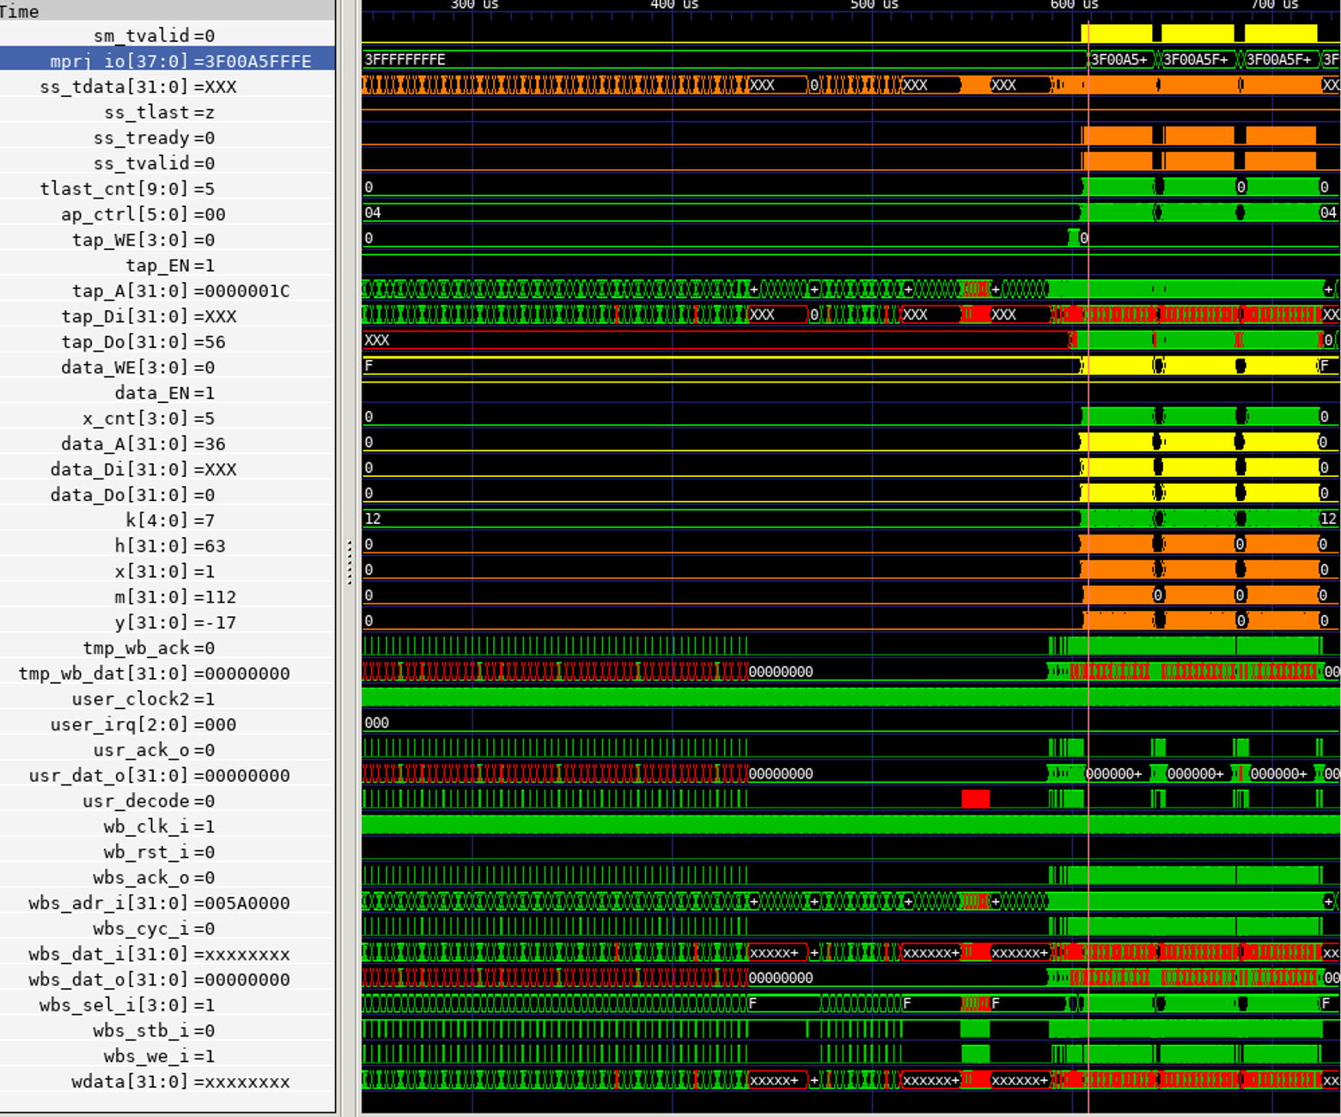
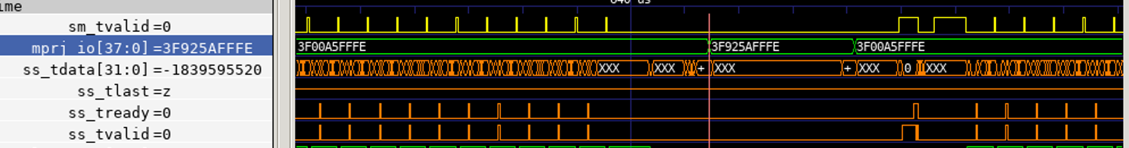
Hardware / Software Behavior
當mprj_io[31:16]為00A5時，
engine 開始運作
當mprj_io[23:16]為5A時，
engine 計算完成，並且等待
下一輪

Slide 8
Outline
WB transaction between firmware, user project and tb (waveform)
Waveform and analysis of the hardware/software behavior
What is the FIR engine theoretical throughput, i.e. data rate? Actually measured throughput?
What is latency for firmware to feed data? Is it longer compared to FIR engine
Analyze firmware assembly code, code size, code sequence
How do you improve the throughput?

Slide 9
Theoretical / Actual Throughput
理論的throughput應為13cycles。
從下兩頁的圖中，data_ff是暫存輸入ss_tdata的地方，並且data_ff的更新頻率與ss_tready(ss_tvalid)相同。
兩根cursor的位置分別為607887.5ns, 608437.5ns，且clock頻率為25ns，所以平均一筆資料實際的運算時間為22cycles。
所以有額外的9個cycles被浪費在firmware

Slide 10
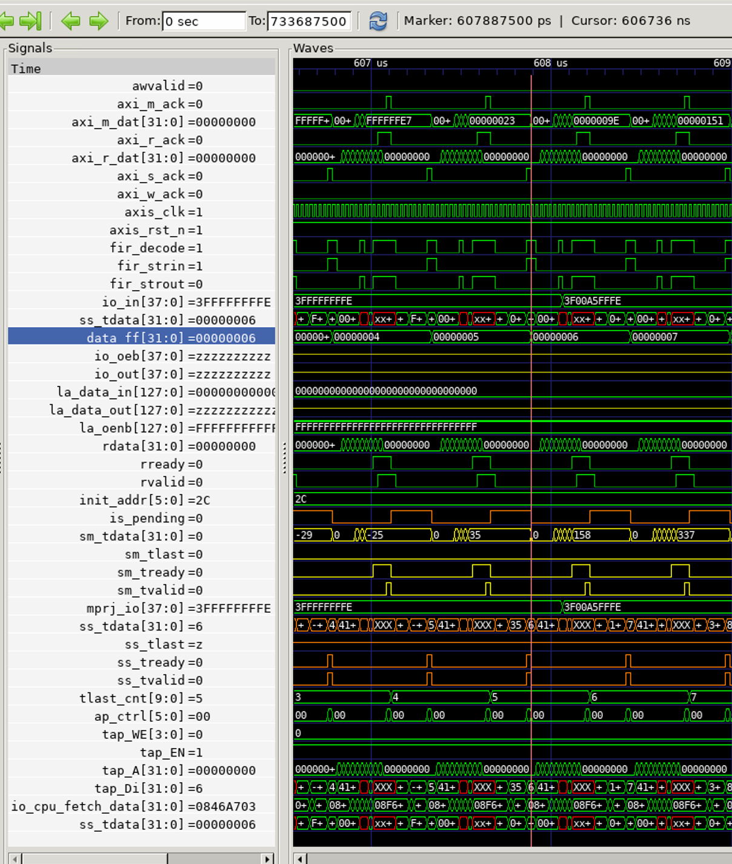

Slide 11
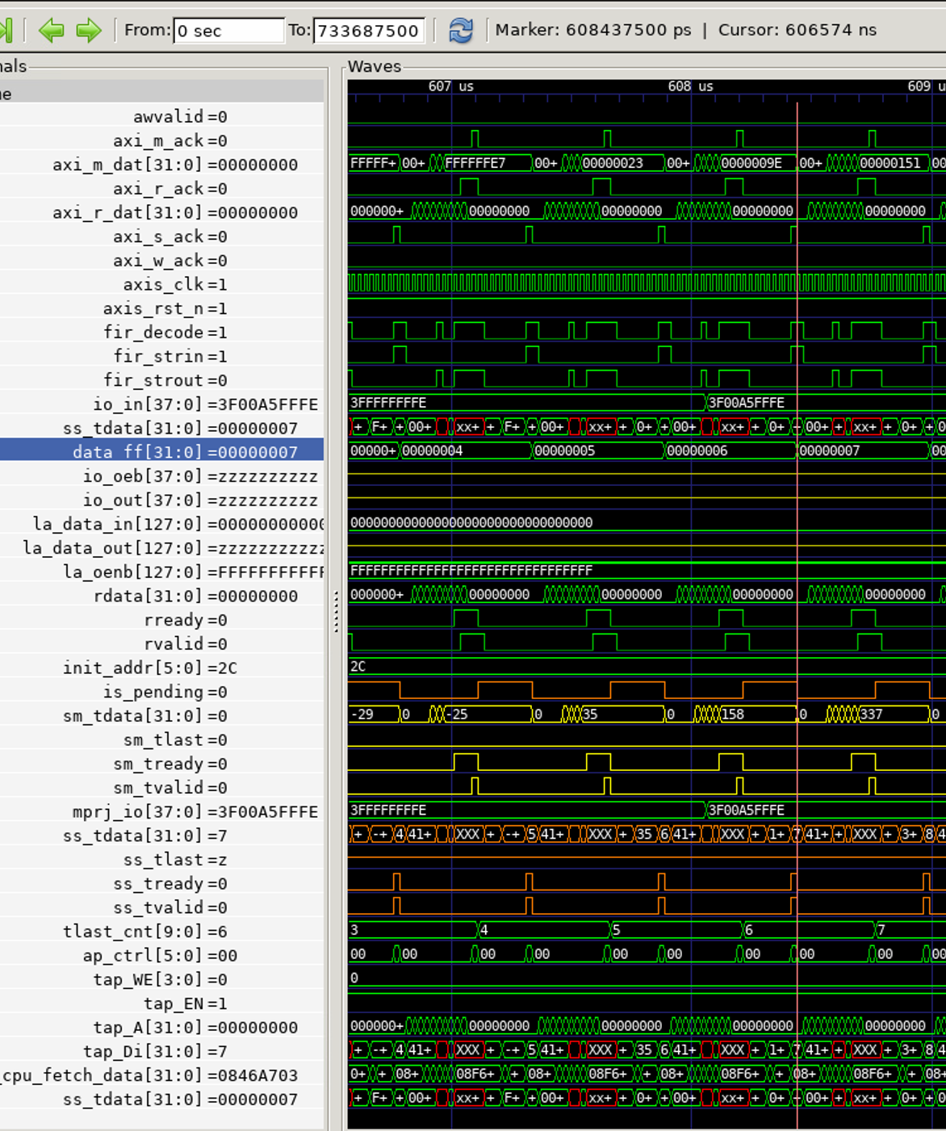

Slide 12
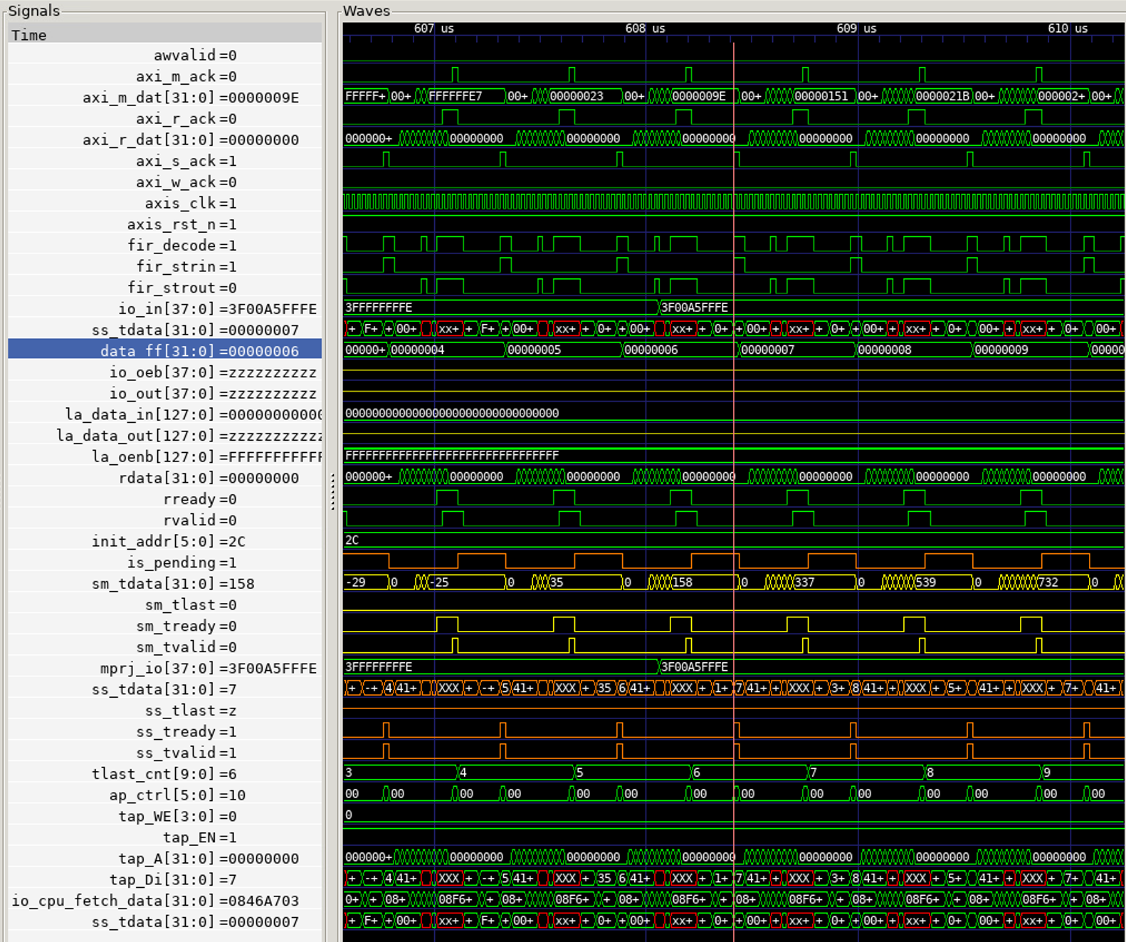
A brief overview

Slide 13
Outline
WB transaction between firmware, user project and tb (waveform)
Waveform and analysis of the hardware/software behavior
What is the FIR engine theoretical throughput, i.e. data rate? Actually measured throughput?
What is latency for firmware to feed data? Is it longer compared to FIR engine
Analyze firmware assembly code, code size, code sequence
How do you improve the throughput?

Slide 14
Latency of Data Forwarding

Slide 15
Outline
WB transaction between firmware, user project and tb (waveform)
Waveform and analysis of the hardware/software behavior
What is the FIR engine theoretical throughput, i.e. data rate? Actually measured throughput?
What is latency for firmware to feed data? Is it longer compared to FIR engine
Analyze firmware assembly code, code size, code sequence
How do you improve the throughput?

Slide 16
Firmware Assembly code

Slide 17
Outline
WB transaction between firmware, user project and tb (waveform)
Waveform and analysis of the hardware/software behavior
What is the FIR engine theoretical throughput, i.e. data rate? Actually measured throughput?
What is latency for firmware to feed data? Is it longer compared to FIR engine
Analyze firmware assembly code, code size, code sequence
How do you improve the throughput?

Slide 18
Improvement of Throughput

