Slide 1
Lab 4 report
R13943009 鄭至盛
R13943021 陳品睿

Slide 2
進展
Last week:
FIR engine throughput: 13 cycles
Actual caravel SOC throughput: 22 cycles
This week:
FIR engine throughput: 13 cycles
Actual caravel SOC throughput: 13 cycles

Slide 3
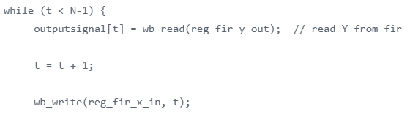
Orignial code - C
Read output Y from FIR engine
Store received Y at outputsignal array
Get next data
Put the next data X to FIR engine

Slide 4
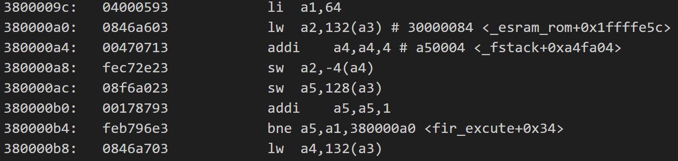
Original code - RISCV
Bne: check t < N – 1
Lw a2, 132(a3): wb_read
Addi a4, a4, 4: outputsignal array offset
Sw a2, -4 (a4): store value to outputsinal array
Sw a5, 128(a3): wb_write
We have load-use hazard at a2 => extra 9 cycles happens

Slide 5
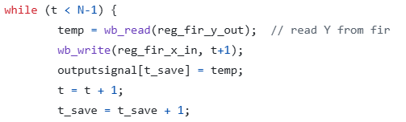
Modified code - C
After reading output Y from FIR engine, store to temp register temporary
取消直接存入array
Then, send next data to FIR engine
After sending next data, start store output Y to array
Do FIR engine and store output to array simultaneously

Slide 6
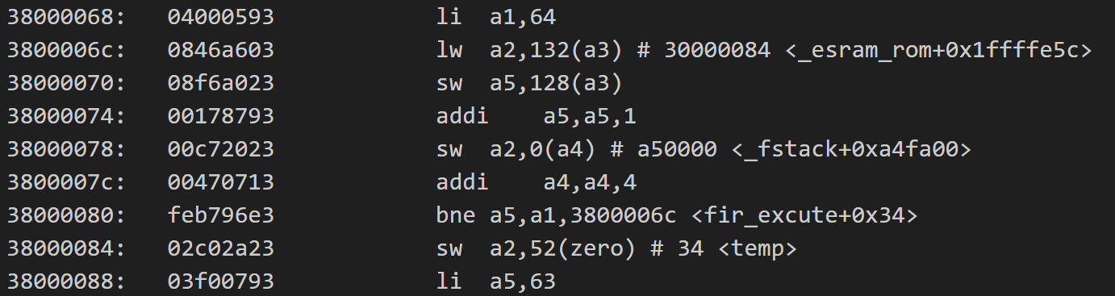
Modified code - RISCV
While fetching output Y from a2 (lw a2, 132(a3))
we can send X to engine first (sw a5, 128(a3))
a5 means t(data)
Notice that load-use hazard still exist, but the reordering make the two time-consuming tasks do together

Slide 7
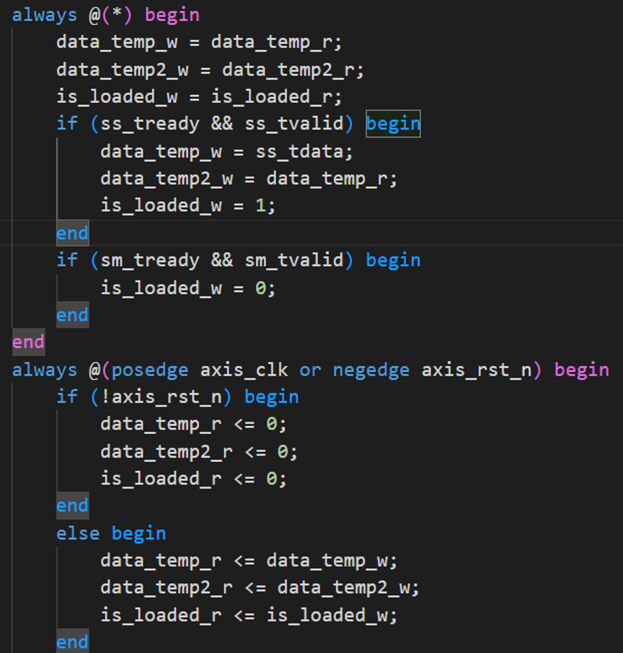
Modification in Verilog code
Add input buffer
When s-in handshake, the input X
stores to buffer (temp) first
assign data_Di = (init_addr_r != 6'd44)?
0 : data_temp2_r;

Slide 8
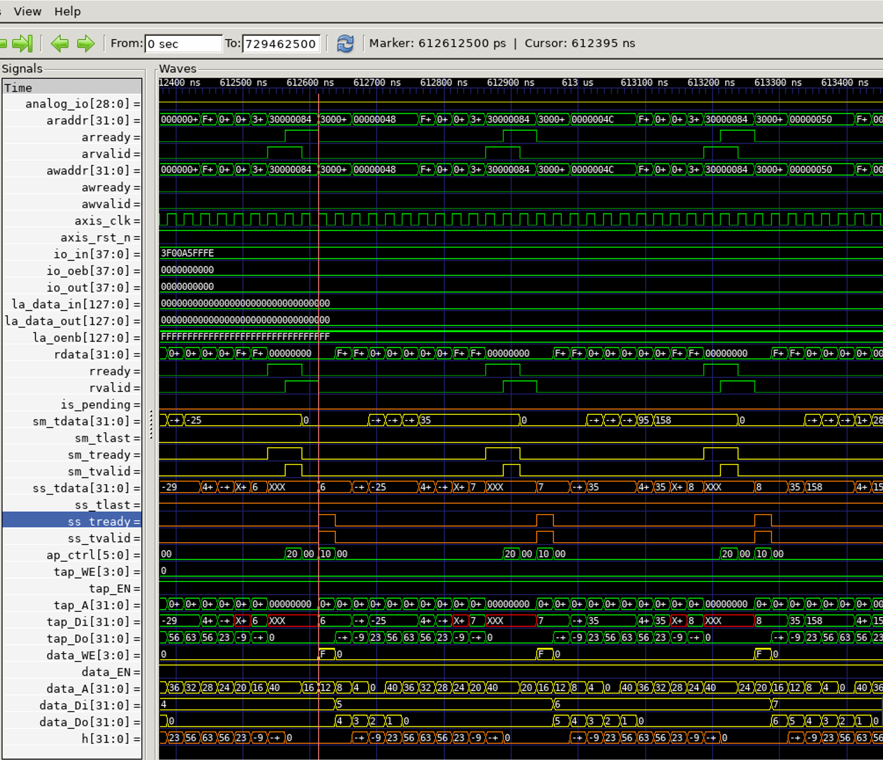
Wave analysis

Slide 9
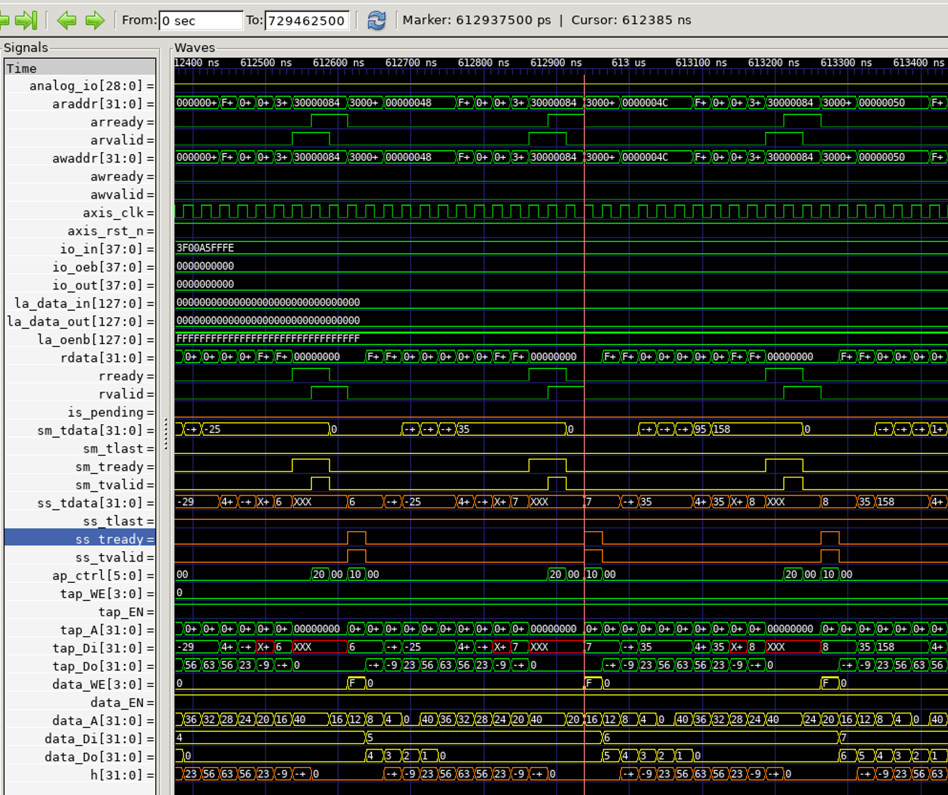
Wave analysis
937500-612500
= 325000
3250/250=13

Slide 10
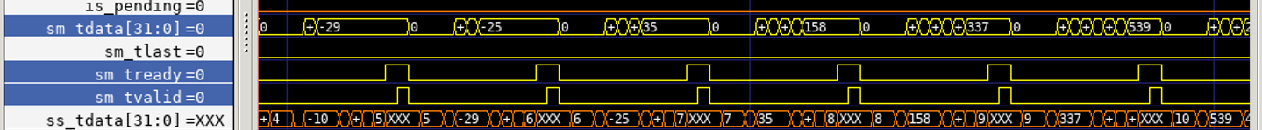

Wave analysis
Output Y is correspondant with golden

