Slide 1
Advanced SOC Design Lab 1 – FSIC-SIM
(individual work)
Jiin Lai

Slide 2
FSIC-SIM - FSIC Simulation
A simulation environment dedicated for FSIC design verification

Slide 3
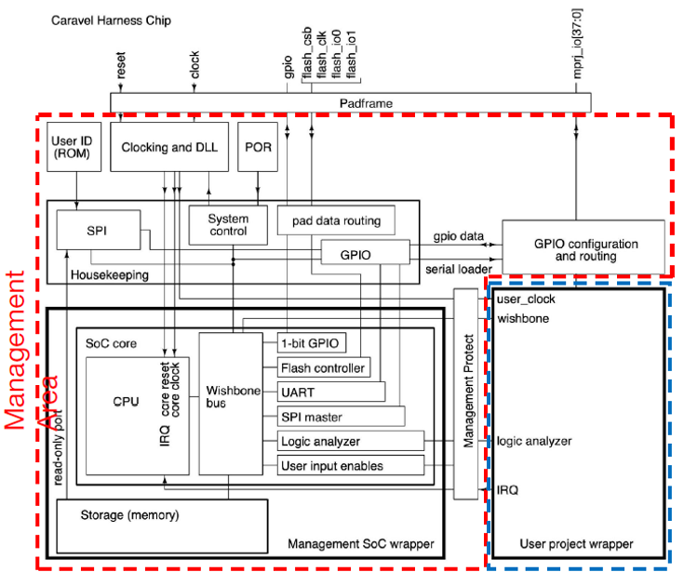
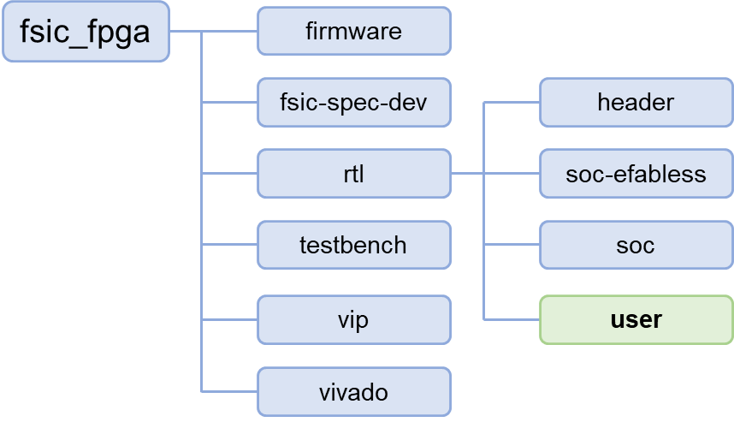
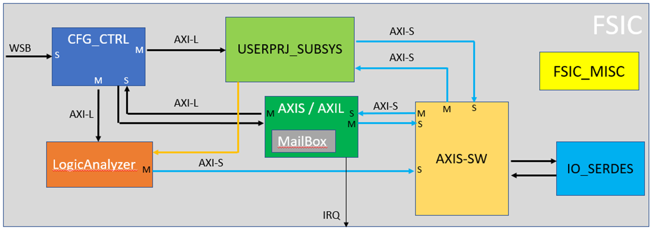
Location in Caravel SOC - in User Project Wrapper
FSIC
mprj
Put FSIC into Caravel SoC user project area
wishbond

Slide 4
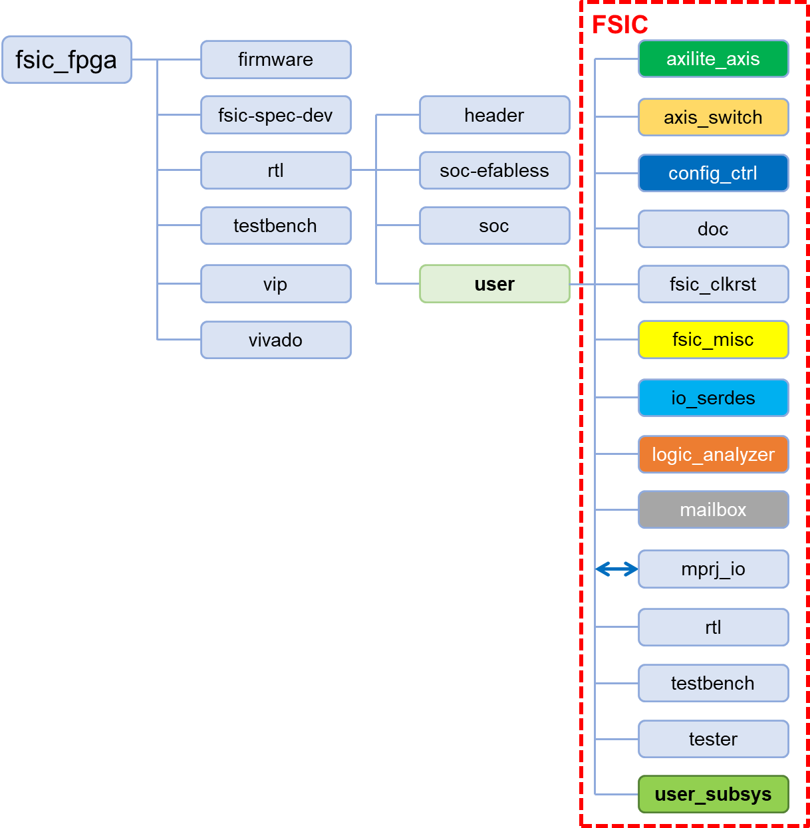

Modules in FSIC
Where you put your Application Accelerator
From Caravel/SOC
(WB)
mprj

Slide 5
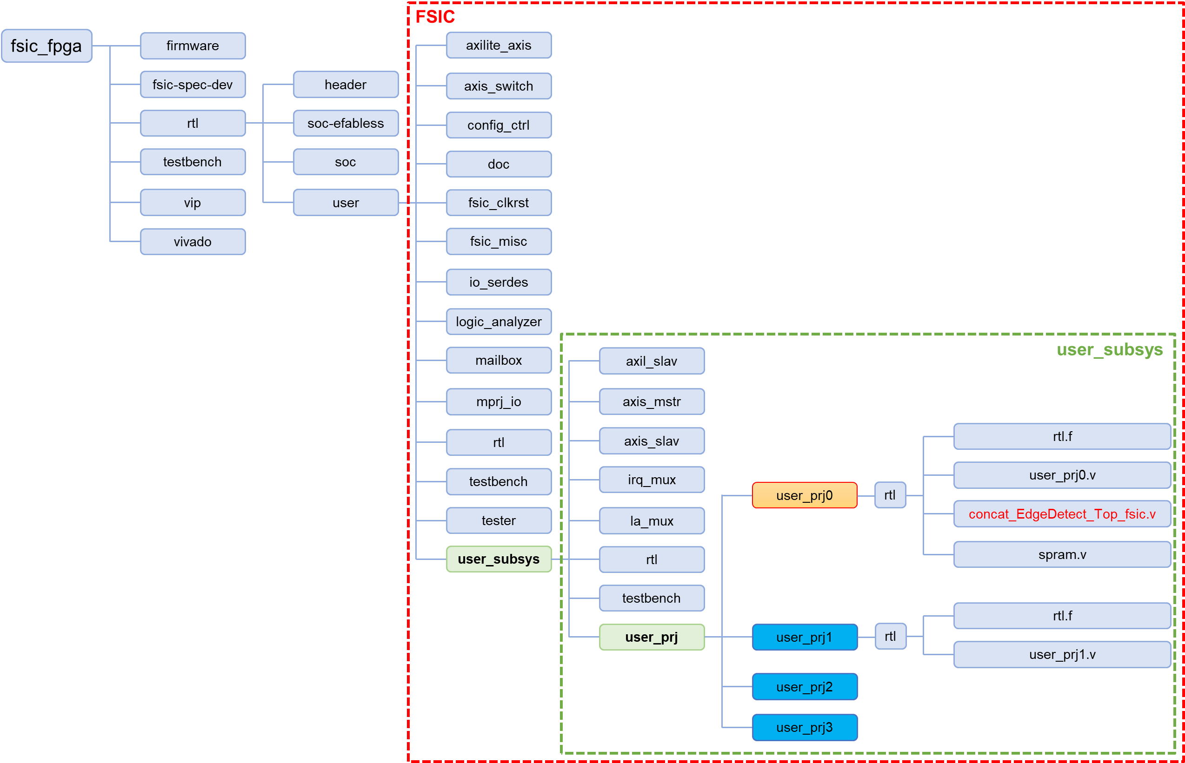
in User_Subsys:
[4: 0] user_prj_sel
(defined in config_ctrl module, 32‘h3000_5000)
user_subsys
Mux out the selected user_proj
user_prj0
user_prj0.v
concat_EdgeDetect_Top_fsic.v
spram.v
axil_slav
in “filelist”:
../../user_subsys/rtl/user_subsys.v
../../user_subsys/axil_slav/rtl/axil_slav.v
../../user_subsys/axis_mstr/rtl/axis_mstr.v
../../user_subsys/axis_slav/rtl/axis_slav.v
../../user_subsys/irq_mux/rtl/irq_mux.v
../../user_subsys/la_mux/rtl/la_mux.v
../../user_subsys/user_prj/user_prj0/rtl/user_prj0.v
../../user_subsys/user_prj/user_prj0/rtl/concat_EdgeDetect_Top_fsic.v
../../user_subsys/user_prj/user_prj0/rtl/spram.v
../../user_subsys/user_prj/user_prj1/rtl/user_prj1.v
../../user_subsys/user_prj/user_prj2/rtl/user_prj2.v
../../user_subsys/user_prj/user_prj3/rtl/user_prj3.v
axis_mstr
user_subsys
axis_slav
user_prj1
irq_mux
user_prj2
a_mux
user_prj3
Currently, we only have user_prj0 ( EdgeDetect IP generated from Catapult HLS)

Slide 6
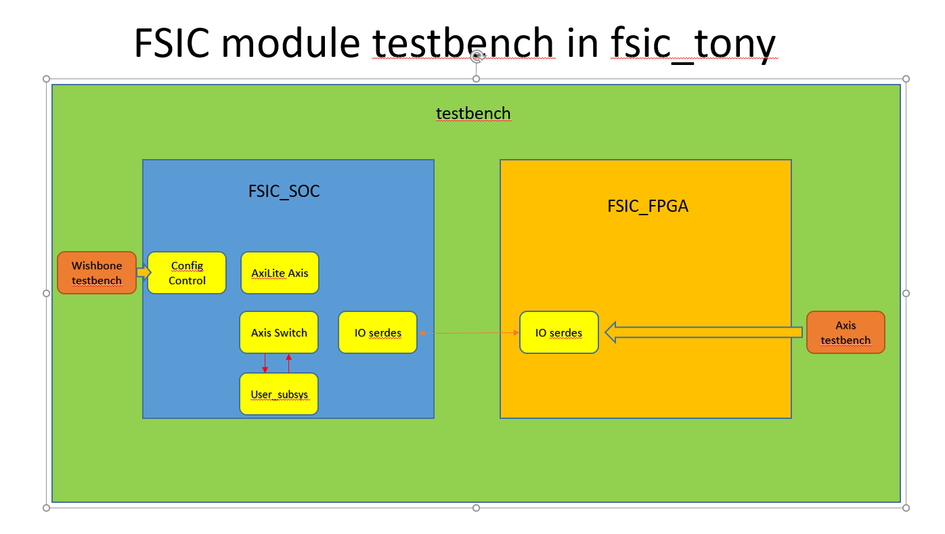
Testbench
run_xsim :
xvlog -sv -i ../ ../tb_fsic.v -f filelist
xelab tb_fsic -debug typical --snapshot tb_fsic_xelab --timescale 1ns/1ns
xsim tb_fsic_xelab --tclbatch log_wave.tcl
in “filelist”:
../fpga.v
../fsic_clock.v
../../rtl/fsic.v
../../axilite_axis/rtl/axi_ctrl_logic.sv
../../axilite_axis/rtl/axil_axis.sv
../../axilite_axis/rtl/axilite_master.sv
../../axilite_axis/rtl/axilite_slave.sv
../../axilite_axis/rtl/axis_master.sv
../../axilite_axis/rtl/axis_slave.sv
../../axis_switch/rtl/sw_caravel.v
../../config_ctrl/rtl/config_ctrl.v
../../fsic_clkrst/rtl/fsic_clkrst.v
../../io_serdes/rtl/fsic_coreclk_phase_cnt.v
../../io_serdes/rtl/fsic_io_serdes_rx.v
../../io_serdes/rtl/io_serdes.v
../../logic_analyzer/rtl/LogicAnalyzer.v
../../logic_analyzer/rtl/Sram.v
../../mprj_io/rtl/fsic_mprj_io.v
../../user_subsys/rtl/user_subsys.v
../../user_subsys/axil_slav/rtl/axil_slav.v
../../user_subsys/axis_mstr/rtl/axis_mstr.v
../../user_subsys/axis_slav/rtl/axis_slav.v
../../user_subsys/irq_mux/rtl/irq_mux.v
../../user_subsys/la_mux/rtl/la_mux.v
../../user_subsys/user_prj/user_prj0/rtl/user_prj0.v
../../user_subsys/user_prj/user_prj0/rtl/concat_EdgeDetect_Top_fsic.v
../../user_subsys/user_prj/user_prj0/rtl/spram.v
../../user_subsys/user_prj/user_prj1/rtl/user_prj1.v
../../user_subsys/user_prj/user_prj2/rtl/user_prj2.v
../../user_subsys/user_prj/user_prj3/rtl/user_prj3.v
fsic
FSIC dut()
(This is the same module as FSIC in p.4)
fpga fpga_fsic()
user_subsys
soc_coreclk
fpga_coreclk
Fsic_clock_div
HackMD:
https://hackmd.io/@TonyHo/rk6Siw0k6
https://github.com/TonyHo722/fsic_tony

Slide 7
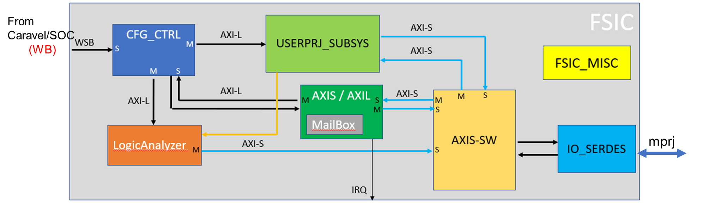
Test Items in tb_fsic.v
test001(); //soc cfg write/read test
test002(); //test002_fpga_axis_req
test003(); //test003_fpga_to_soc_cfg_read
test004(); //test004_fpga_to_soc_mail_box_write
test005(); //test005_aa_mailbox_soc_cfg
test006(); //test006_fpga_to_soc_cfg_write
test007(); //test007_mailbox_interrupt test

Slide 8
Testbench –– Task Definition
fsic_system_initial()
FSIC dut()
fpga fpga_fsic()
fpga_axis_req()
fpga_is_as_data_valid()
soc_cfg_write()
soc_cfg_read()
fpga_axilite_write_req()
fpga_axilite_read_req()
soc_coreclk
fpga_coreclk
Fsic_clock_div
HackMD:
https://hackmd.io/@TonyHo/rk6Siw0k6
https://github.com/TonyHo722/fsic_tony

Slide 9
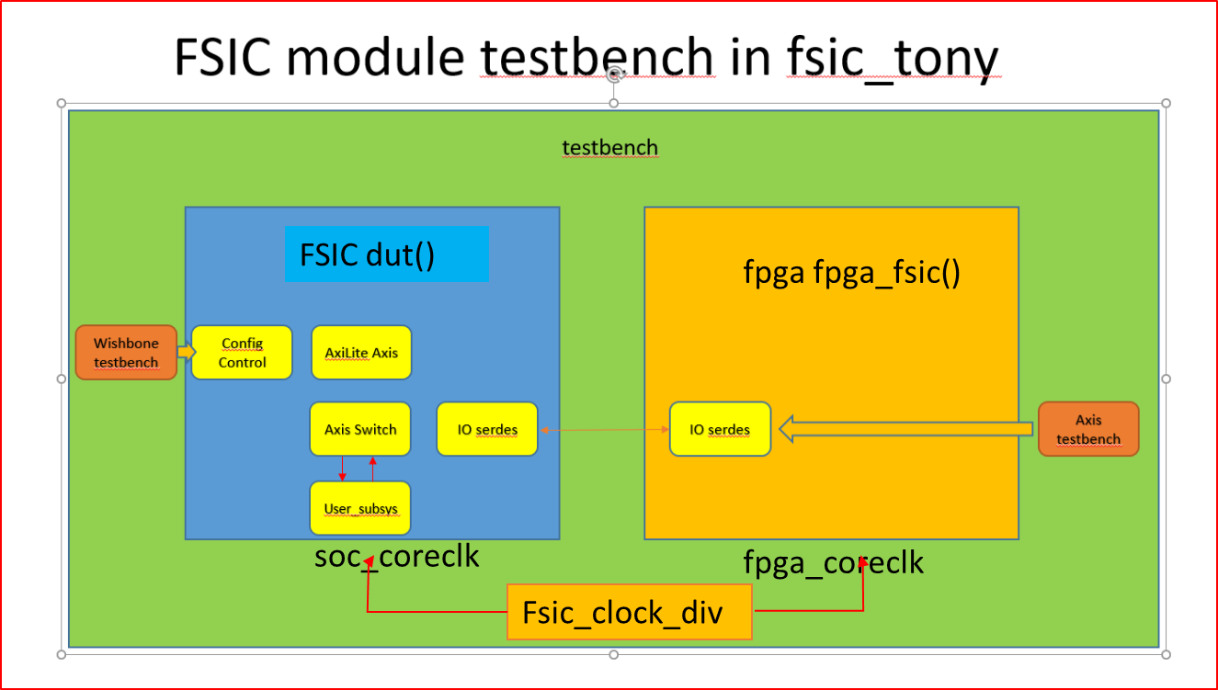
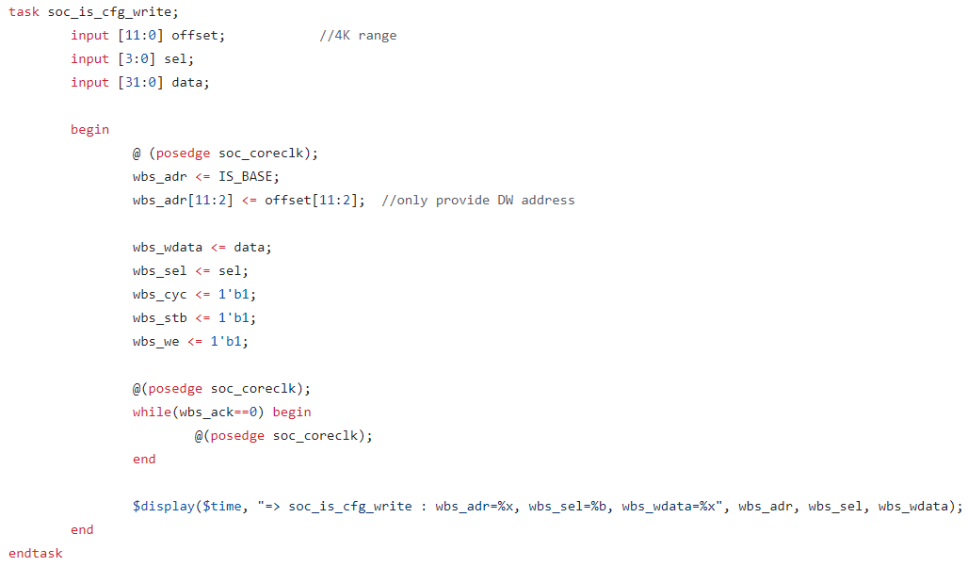
Task Definition: fsic_system_initial() –– Explained
// SOC & FPGA Reset
fork
soc_apply_reset(40, 40); //change coreclk phase in soc
fpga_apply_reset(40,40); //fix coreclk phase in fpga
join
#40;
fpga_as_to_is_init();
//soc_cc_is_enable=1;
fpga_cc_is_enable=1;
// Enable RX on SOC and FPGA side
fork
soc_is_cfg_write(0, 4'b0001, 1); //ioserdes rxen
fpga_cfg_write(0,1,1,0);
join
// Enable TX on SOC and FPGA side #400;
fork
soc_is_cfg_write(0, 4'b0001, 3); //ioserdes txen
fpga_cfg_write(0,3,1,0);
join
soc rxen_ctl=1
fpga rxen_ctl=1
soc txen_ctl=1
fpga txen_ctl=1

Slide 10
Task Definition – SOC Side Configuration Tasks
You may use or modify these tasks in tb_fsic.v to achieve your goal in this lab!
(including soc_is_cfg_write/soc_aa_cfg_write/soc_up_cfg_write)
task soc_cfg_write // soc side configuration write - using wb
input [3:0] target; // 4 bit for AA, IS, CC, register range
input [11:0] offset; //4K range
input [3:0] sel; // byte enable
input [31:0] data;
IS: io-serdes
AA: AXIS-AXIL
UP: User Project
(including soc_is_cfg_read/soc_aa_cfg_read/soc_up_cfg_read)
task soc_cfg_read // with auto check value
input [3:0] target; // 4 bit for AA, IS, CC
input [11:0] offset; //4K range
input [31:0] expected; // expected_value
input [31:0] mask; // bit set to 1 for expected value comparison

Slide 11
Task Definition – FPGA Side Configuration Cycle (AxiLite)
You may use or modify these tasks in tb_fsic.v to achieve your goal in this lab!
task fpga_axilite_write_req; // axilite-> axis conversion to io_serdes
input [27:0] address; // address
input [3:0] BE; // byte-enable
input [31:0] data; // data
task fpga_axilite_read_req; // axilite read -> axis conversion to io_serdes
input [31:0] address;
input [31:0] expect; // expected value
input [31:0] mask; // bit set to 1 for exepected value comparision

Slide 12
Task Definition – FPGA Side Data Transfer (AXI Stream)
You may use or modify these tasks in tb_fsic.v to achieve your goal in this lab!
task fpga_axis_req; // switch to io_serdes : downstream transfer
input [31:0] data;
input [1:0] tid;
input mode; //0 for noram, 1 for random data
reg [31:0] tdata;
`ifdef USER_PROJECT_SIDEBAND_SUPPORT
reg [pUSER_PROJECT_SIDEBAND_WIDTH-1:0]tupsb;
`endif
reg [3:0] tstrb;
reg [3:0] tkeep;
reg tlast;
task fpga_is_as_data_valid; // io serdes to switch : upstream transfer
input [31:0] expect; // expected value to check
input [31:0] mask; // bit set to 1 for expected value comparison

Slide 13
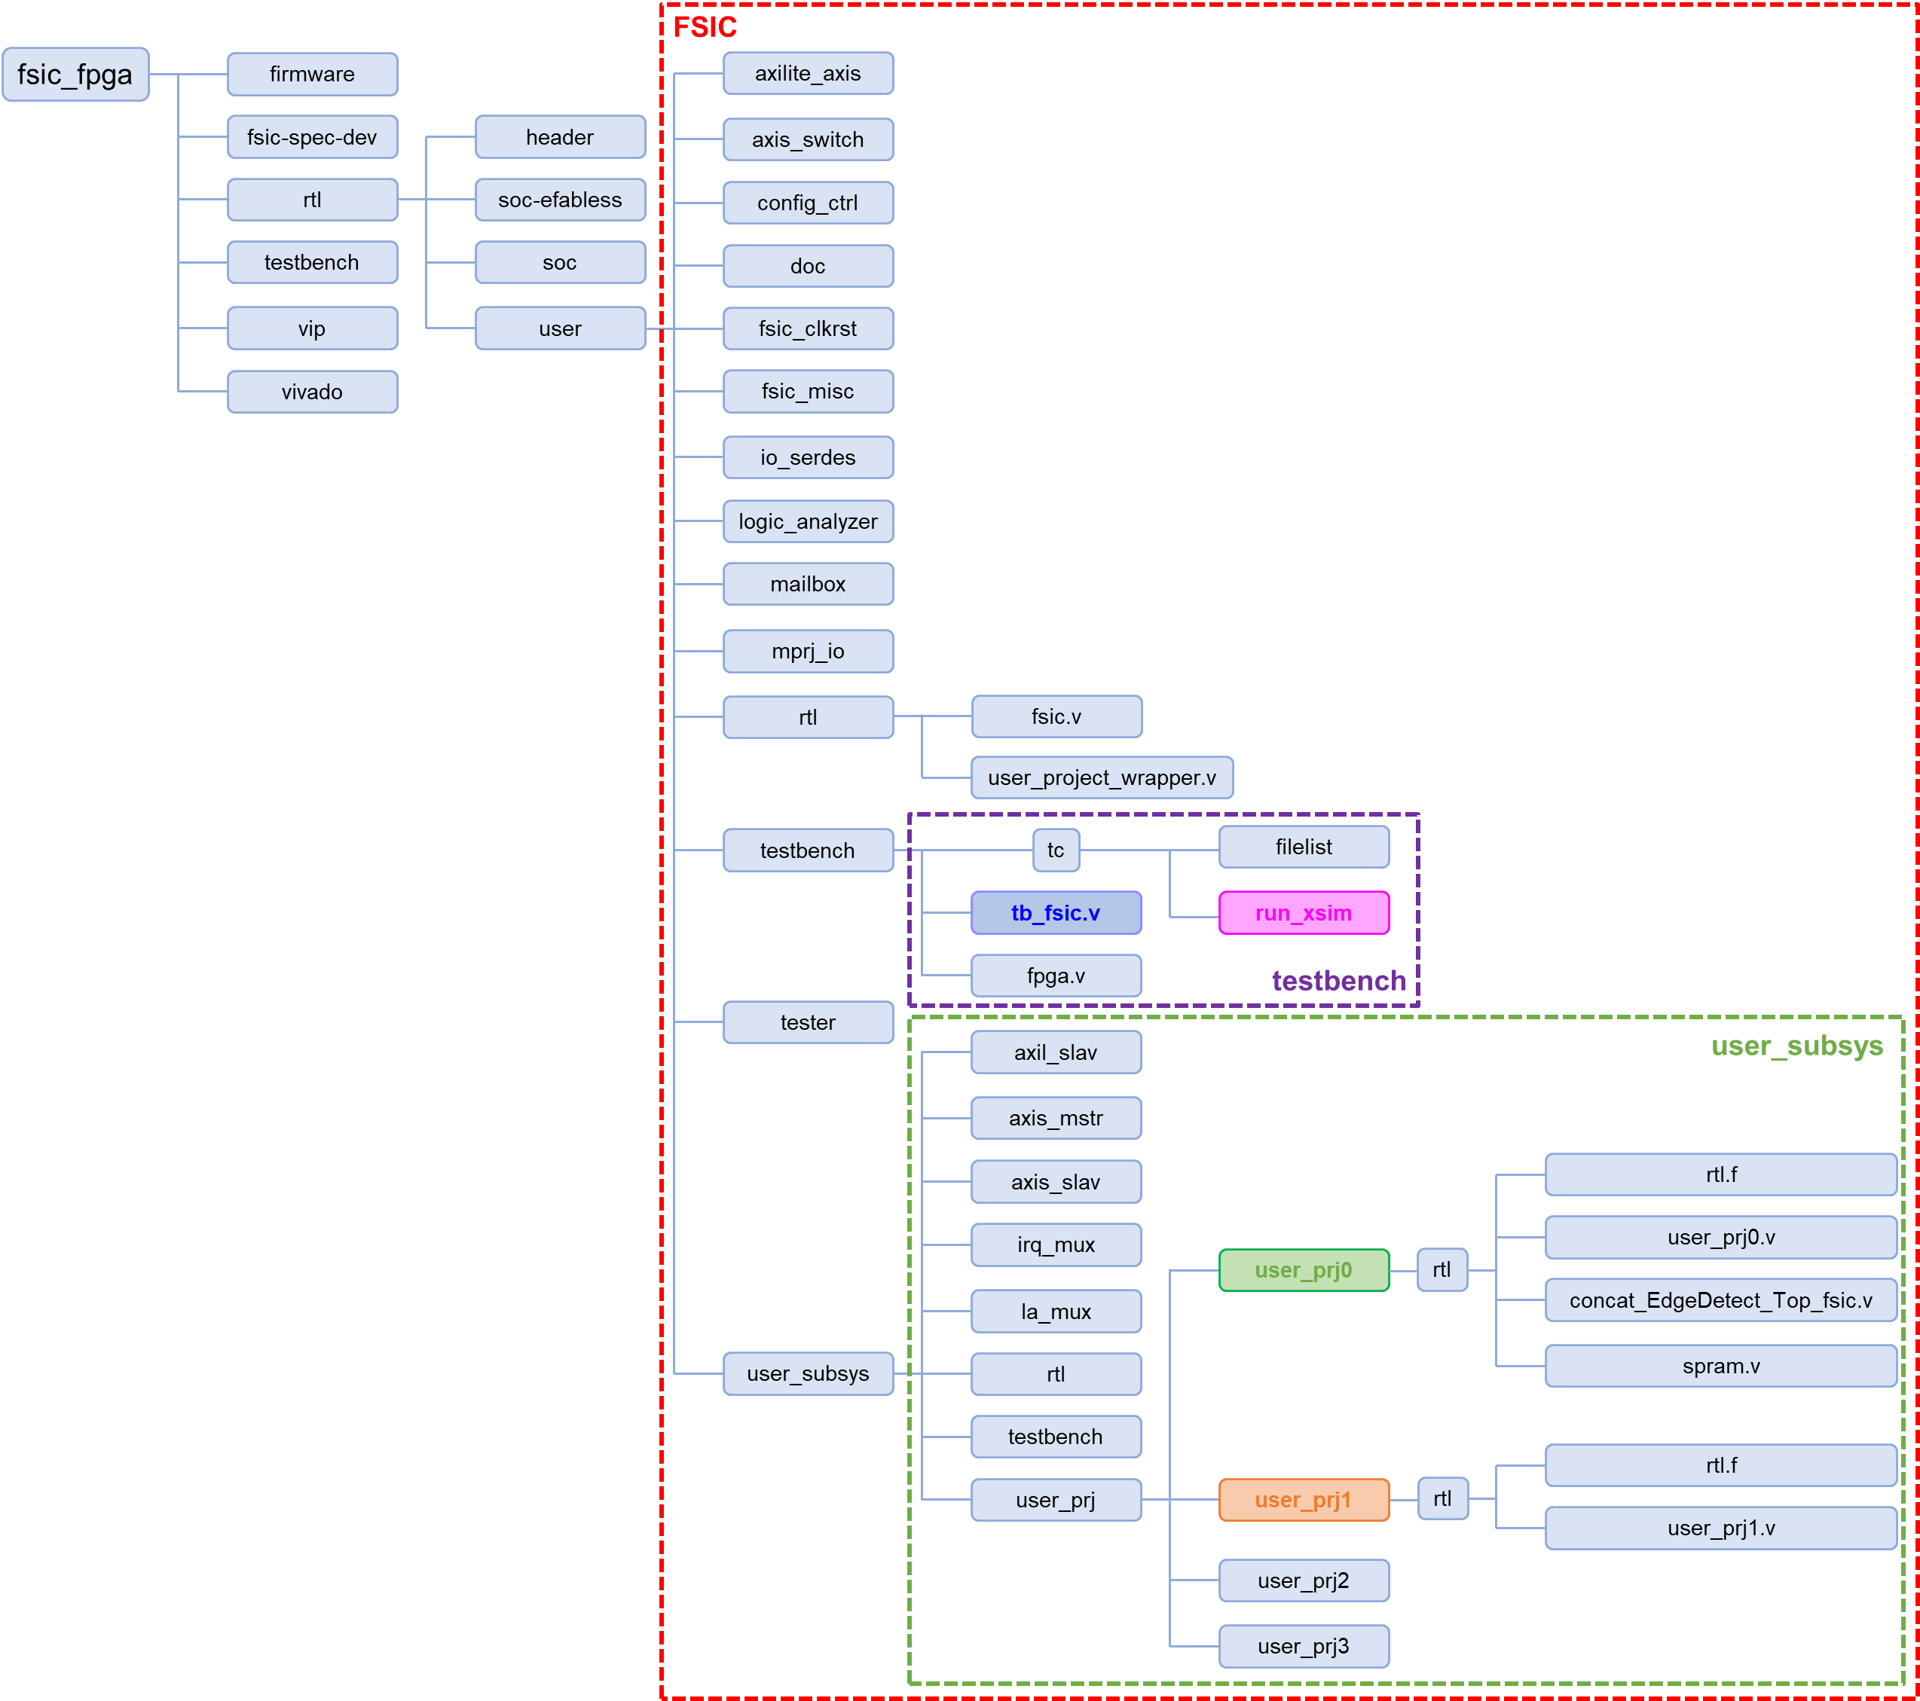
FSIC Simulation Environment –– Github Folder (1/2)
Github of this lab (FSIC Design)
https://github.com/bol-edu/caravel-soc_fpga-lab/tree/main/fsic-sim
run_xsim (Script for Running Simulation)
user_prj0 (for your reference)
user_prj1 (where you put your design)
Testbench (tb_fsic.v)

Slide 14
FSIC Simulation Environment –– Github Folder (2/2)
user_project_wrapper
From Caravel/SOC
FSIC
FSIC Modules
mprj

Slide 15
Lab work

Slide 16
Lab-fsic-sim : Lab Work
Goal:
Setup FSIC simulation environment
Integrate your FIR into FSIC
Write a testbench to feed FIR input data & take FIR output data
Detailed implementation will be described in the next page.
You don’t need to do synthesis in this lab, just simulation!

Slide 17
Lab-fsic-sim : Lab Work (detail) (1/3)
Implementation:
Setup FSIC simulation environment
Use the following command:
Wait for a few minutes to finish simulation.
Check whether there exists any simulation error. The information printed on screen should be almost the same as https://github.com/bol-edu/caravel-soc_fpga-lab/blob/main/fsic-sim/fsic_fpga/rtl/user/testbench/tc/log/xsim.log
Integrate FIR into PRJ1 (axilite, axi-stream in/out)
TestBench (modify fsic_tb.v)
$
$
$
$
git clone https://github.com/bol-edu/caravel-soc_fpga-lab.git
cd caravel-soc_fpga-lab/fsic-sim
cd fsic_fpga/rtl/user/testbench/tc
./run_xsim

Slide 18
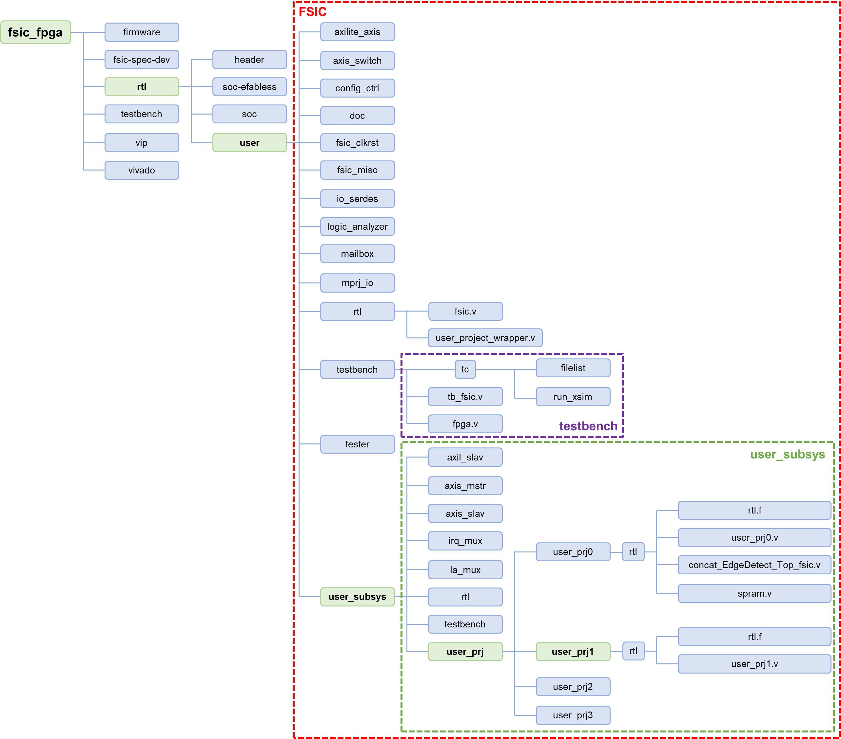
Lab-fsic-sim : Lab Work (detail) (2/3)
Implementation:
Setup FSIC simulation environment
Integrate FIR into PRJ1 (axilite, axi-stream in/out)
Please see the next page for more information.
TestBench (modify fsic_tb.v)

Slide 19
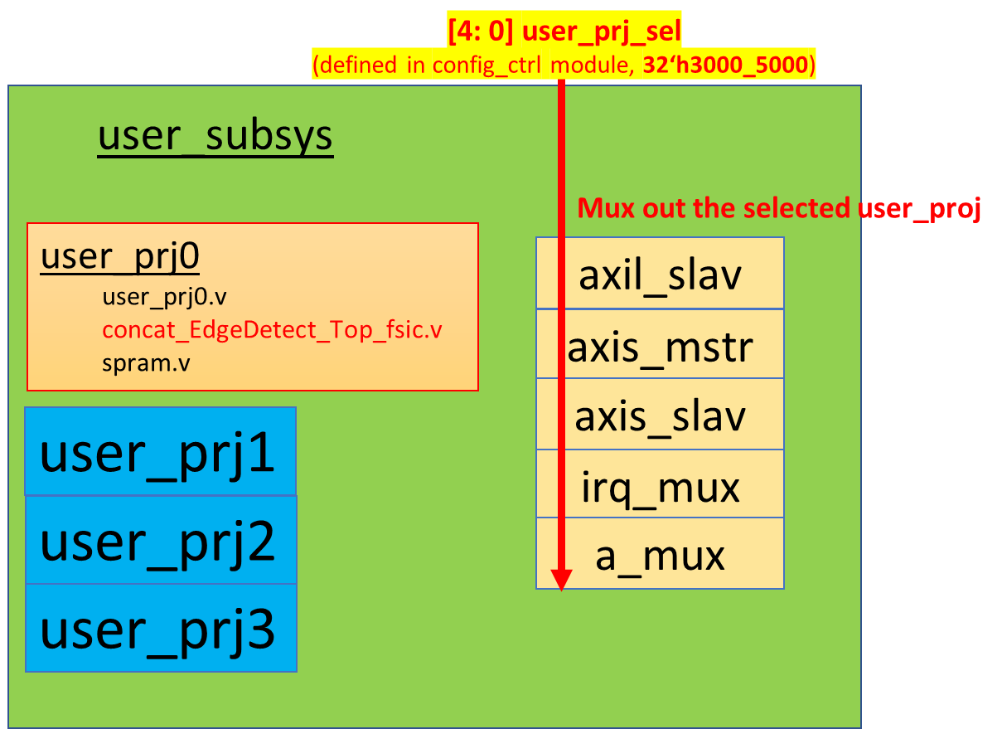
How to integrate your design in PRJ1
Use fir.v that you have designed in SoC-design course (last semester); for those who did not take last semester’s course, we have a reference fir.v in https://github.com/bol-edu/caravel-soc_fpga-lab/tree/main/fsic-sim/reference_FIR
user_prj1 folder
https://github.com/bol-edu/caravel-soc_fpga-lab/tree/main/fsic-sim/fsic_fpga/rtl/user/user_subsys/user_prj/user_prj1/rtl
Use user_prj1.v as your module top interface
Define all your submodule in rtl.f & filelist
Enable PRJ1 in Caravel SOC, in firmware code (Run in Caravel SOC)
Program [‘h3000_5000] = 32’h01;
This will direct all

Slide 20
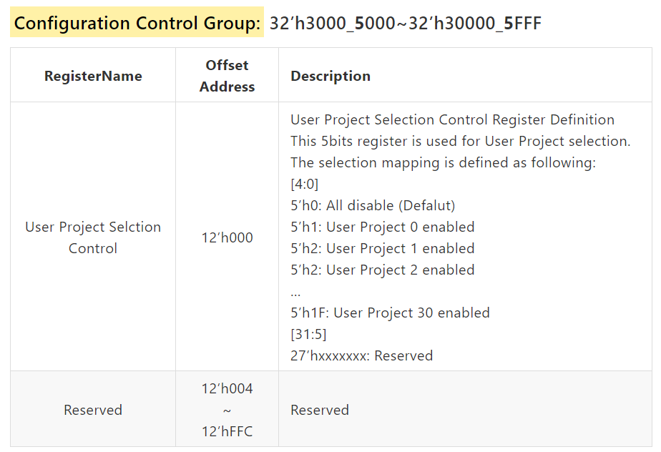
CC – Configuration Register
5’h0: User Project 0 enabled (Default)
5’h1: User Project 1 enabled
5’h2: User Project 2 enabled
5’h3: User Project 3 enabled
…

Slide 21
Lab-fsic-sim : Lab Work (detail) (3/3)
Implementation:
Setup FSIC simulation environment
Integrate FIR into PRJ1 (axilite, axi-stream in/out)
TestBench (modify tb_fsic.v)
Test#1 – FIR initialization (tap parameter, length) from SOC side
FIR initialization (tap parameter, length) from SOC side
Use Mailbox to notify FPGA side to start X, Y stream transfer
FIR data X, Y stream data from FPGA side
Check if output data Y are correct
Test#2 – FIR initialization from FPGA side
FIR initialization from FPGA side
FIR data X, Y stream data from FPGA side
Check if output data Y are correct
You can refer to:
test001(); //soc cfg write/read test
test002(); //test002_fpga_axis_req
test003(); //test003_fpga_to_soc_cfg_read
test004(); //test004_fpga_to_soc_mail_box_write
test005(); //test005_aa_mailbox_soc_cfg
test006(); //test006_fpga_to_soc_cfg_write
test007(); //test007_mailbox_interrupt test
task soc_{is/aa/up}_cfg_write;
task soc_{is/aa/up}_cfg_read;
task fpga_axilite_write_req;
task fpga_axilite_read_req;
task fpga_axis_req;
task fpga_is_as_data_valid;
Modify them to finish Test#1 and Test#2 !!
IS: io-serdes
AA: AXIS-AXIL
UP: User Project
Don’t forget to call task fsic_system_initial() at the beginning of each Test !!!

Slide 22
Submission
Please submit the following files to {NTHU eeclass / NTU COOL / NYCU E3} before 2024/3/14 :
report_StudentID.pdf
Github_link.txt
Please check the next pages for more detailed information.

Slide 23
What should be included in report_StudentID.pdf (1/2)
Show the code that you use to program configuration address [‘h3000_5000].
Explain why “By programming configuration address [‘h3000_5000], signal user_prj_sel[4:0] will change accordingly”? (Hint: trace code in config_ctrl.v)
Briefly describe how you do FIR initialization (tap parameter, length) from SOC side (Test#1).
Briefly describe how you do FIR initialization (tap parameter, length) from FPGA side (Test#2).
Briefly describe how you feed in X data from FPGA side.
Briefly describe how you get output Y data in testbench, and how to do comparison with golden values.

Slide 24
What should be included in report_StudentID.pdf (2/2)
Screenshot simulation results printed on screen, to show that your Test#1 & Test#2 complete successfully
Screenshot simulation waveform:
Configuration cycle (when we program [‘h3000_5000] = 32’h01, signal user_prj_sel changes accordingly)
AXI-Lite transaction cycles (feed in tap parameters, data_length)
Stream-in, Stream-out
(optional) Debug experience (bug found, and how to fix it)

Slide 25
What should be uploaded to Github
Design_sources
All files in “/fsic_fpga/rtl/user/user_subsys/user_prj/user_prj1/rtl/”
Testbench
filelist (located at /fsic_fpga/rtl/user/testbench/tc/filelist)
tb_fsic.v (located at /fsic_fpga/rtl/user/testbench/tb_fsic.v)
xsim.log (after integrating your FIR) (located at /fsic_fpga/rtl/user/testbench/tc/xsim.log)

Slide 26
Supplement

Slide 27
How to generate .vcd wave file for debugging?
If you’d like to use GTKWave to see waveform, you can follow the following steps:
Add these codes into tb_fsic.v:
After simulation, it will generate a waveform file named “FSIC_FIR.vcd”, which can be read by GTKWave.
initial begin
$dumpfile("FSIC_FIR.vcd");
$dumpvars(0, tb_fsic);
end

Slide 28
Review: tb_fsic.v
Address mapping table: SOC -> FPGA, FPGA -> SOC
Explain macro definition
USE_EDGEDETECT_IP
USER_PROJECT_SIDEBAND_SUPPORT
`USE_POWER_PINS
Clocking scheme:
Ioclk_source -> soc_coreclk, fpga_coreclk
Interface FSIC + FPGA
FPGA Internal block Diagram
Test Items
https://github.com/bol-edu/caravel-soc_fpga-lab/blob/main/fsic-sim/fsic_fpga/rtl/user/testbench/tb_fsic.v

Slide 29
What is this for?
task fpga_cfg_write // confguration write from fpga side
input [pADDR_WIDTH-1:0] awaddr;
input [pDATA_WIDTH-1:0] wdata;
input [3:0] wstrb;
// input [7:0] valid_delay; - removed

