Slide 1
Accelerated Algorithmic Trading (AAT)
Lecturer: Howard Zhao
Date: 2022/05/11

Slide 2
Outline
System Overview
Kernel Functions Overview
FeedHandler
OrderBook
PriceEngine
OrderEntry
Datamover
Interfaces
Host -> kernel (FPGA)
Streaming Interface between kernels
Verification System
Host Program
Lab

Slide 3
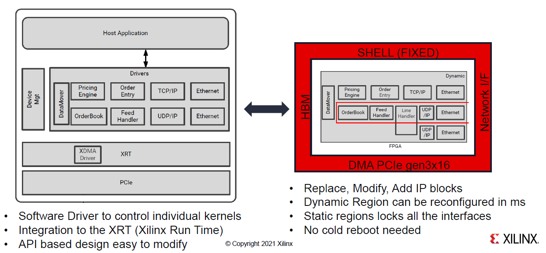
System Overview

Slide 4
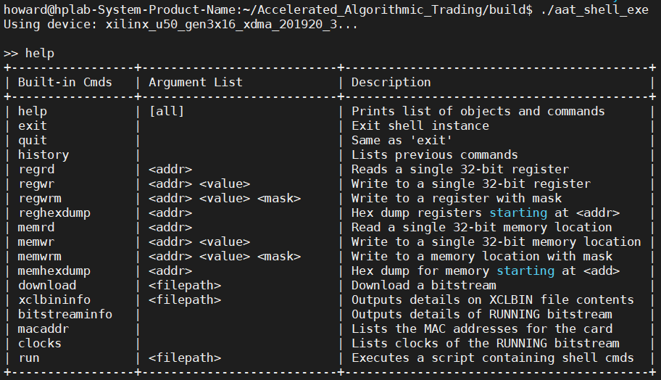
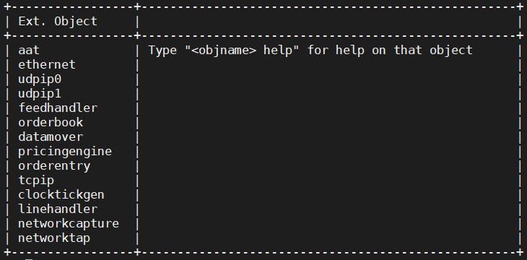
System Overview

Slide 5
System Overview

Slide 6
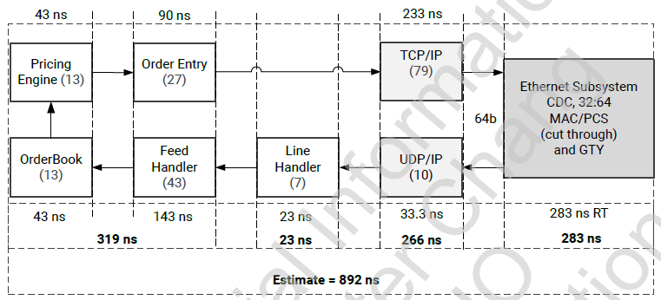
Kernel Functions Overview
Network Kernel
Ethernet
TCP/UDP/IP
Market Kernel
lineHandler
feedHandler
orderbook
orderEntry
Strategy Kernel
PricingEngine

Slide 7
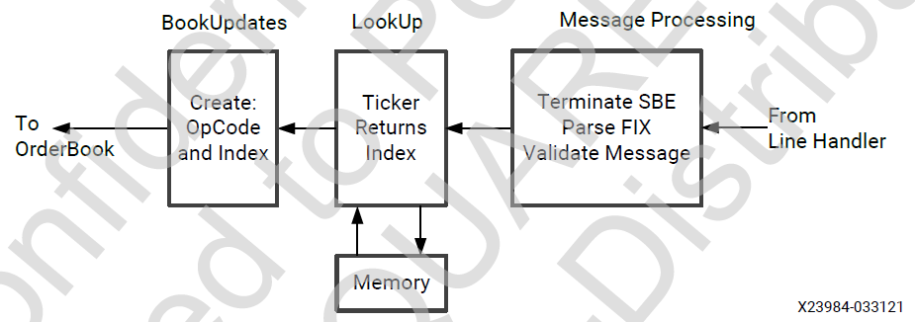
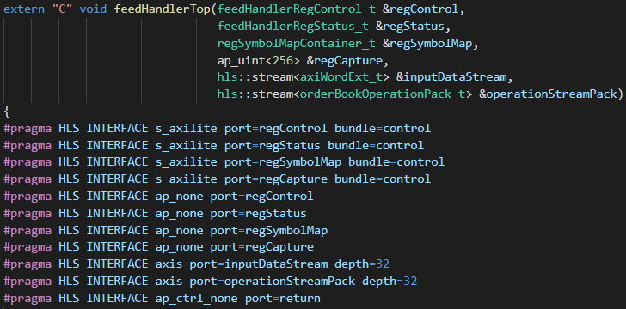
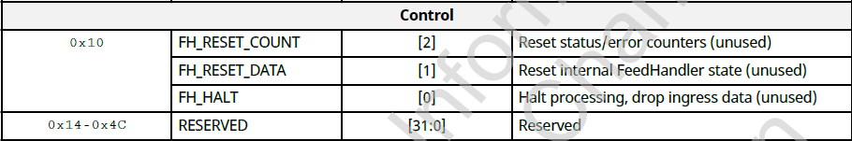
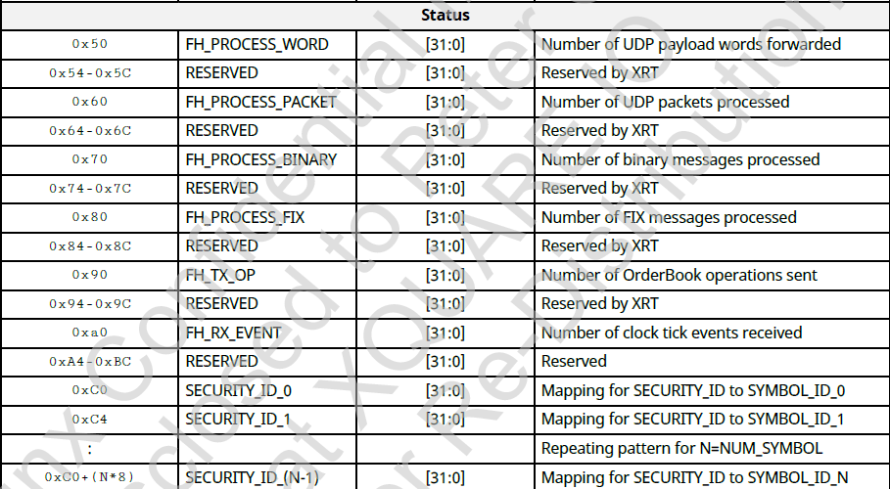
FeedHandler
Block Diagram
Top module
Register Map

Slide 8
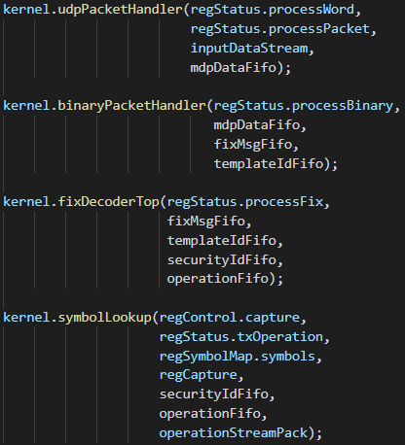
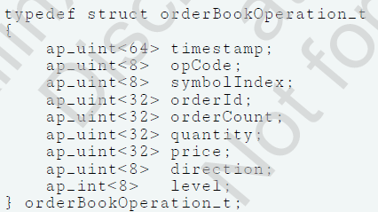
FeedHandler
#HLS DATAFLOW disable_start_propagation
disable_start_propagation : Optionally disables the creation of a start FIFO used to propagate a start token to an internal process. Such FIFOs can sometimes be a bottleneck for performance.
Submodule
mdpData, fixMsg: 64 bits
Template ID: message type
Security ID: symbol ID

Slide 9
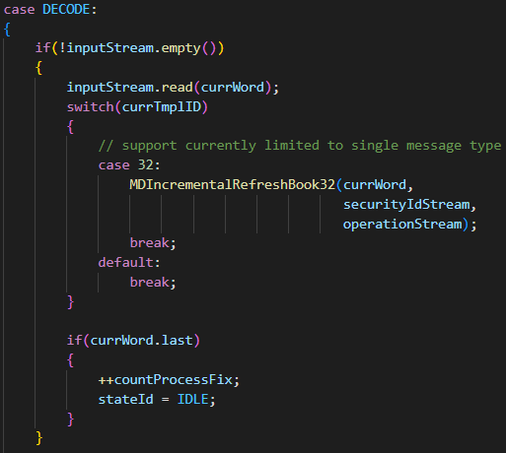
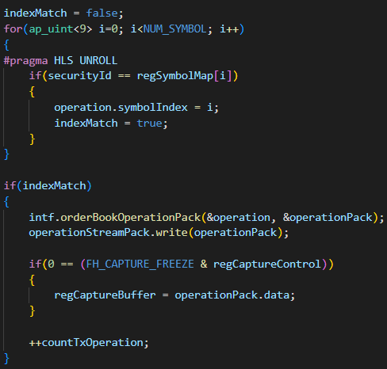
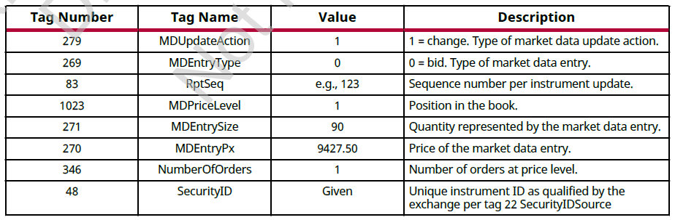
FeedHandler
fixDecoder
symbolLookup
X

Slide 10
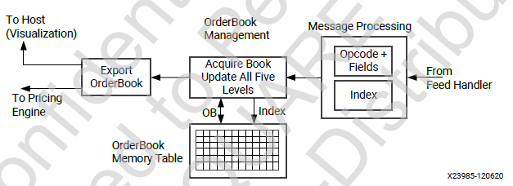
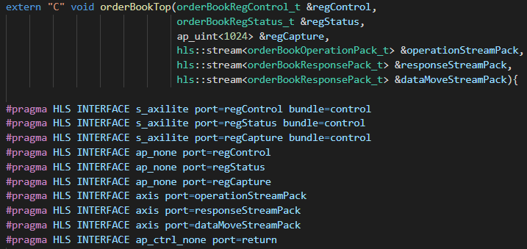
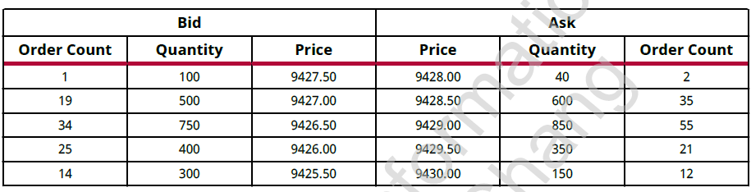
OrderBook
Block Diagram
Top module

Slide 11
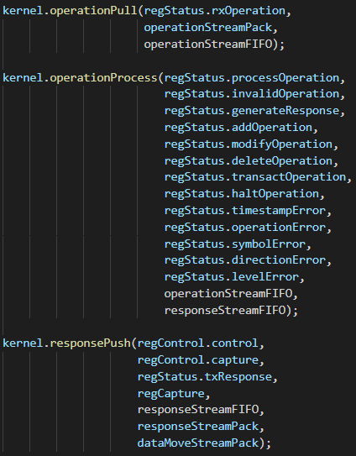
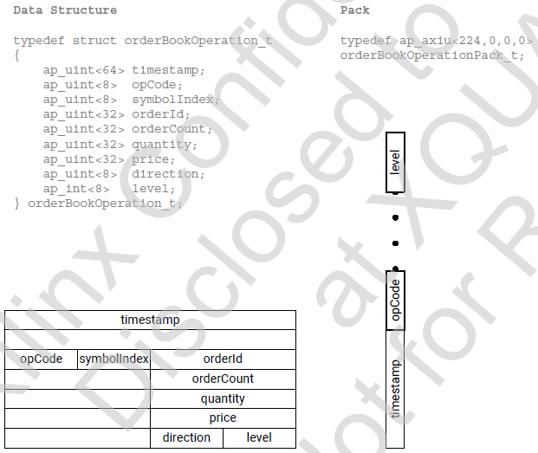
OrderBook
Pull
Submodule
Push

Slide 12
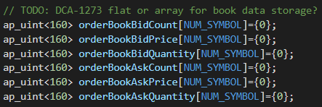
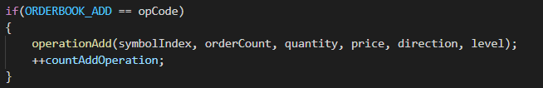
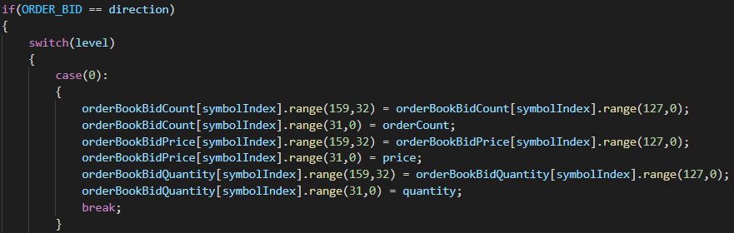
OrderBook
Order book in memory
operationProcess
<32 bits> 5th price | <32 bits> 4th price | <32 bits> 3rd price | <32 bits> 2nd price | <32 bits> 1st price
e.g. operationAdd

Slide 13
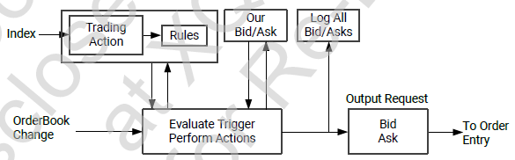
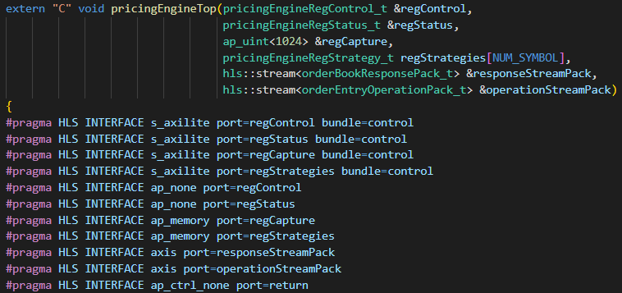
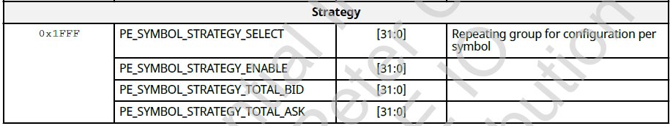
PriceEngine
Block Diagram
Top module

Slide 14
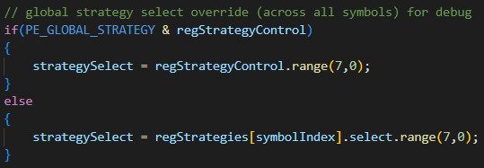
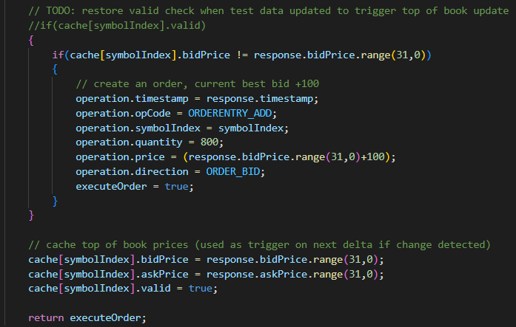
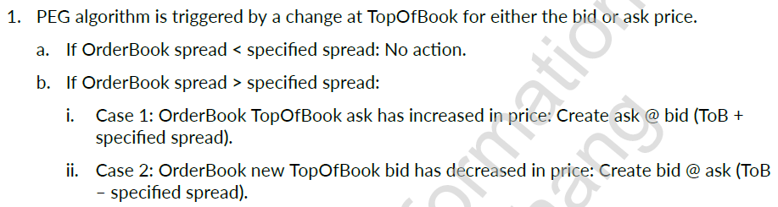
PriceEngine
Strategy select
PEG strategy (undone)
Order Entry operation

Slide 15
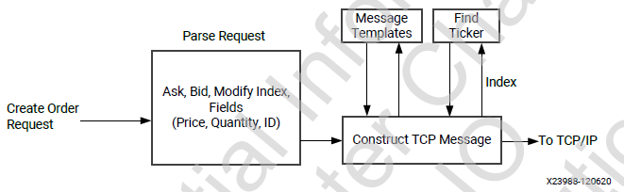
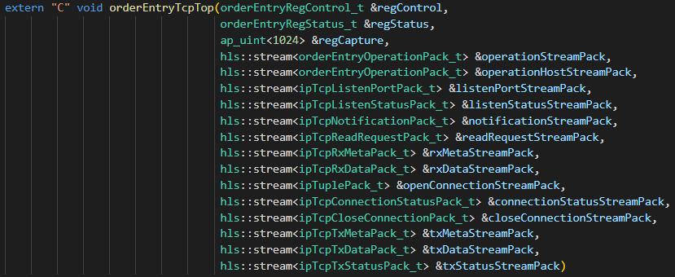
OrderEntry
Block Diagram
Top module
Operation from pricingEngine
Operation from Host
Connection-related

Slide 16
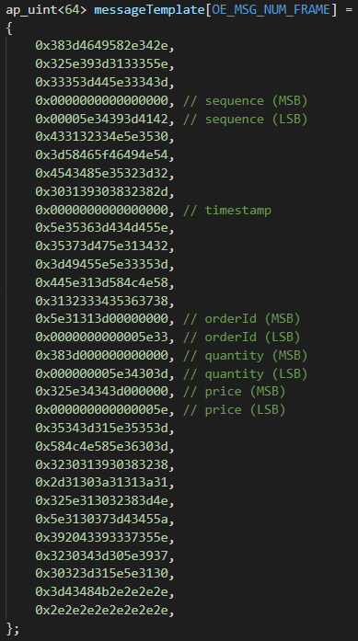
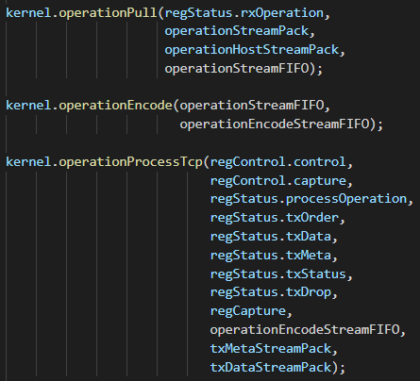
OrderEntry
Submodule
operationPull
operationEncode (uint32ToAscii)
operationProcessTcp

Slide 17
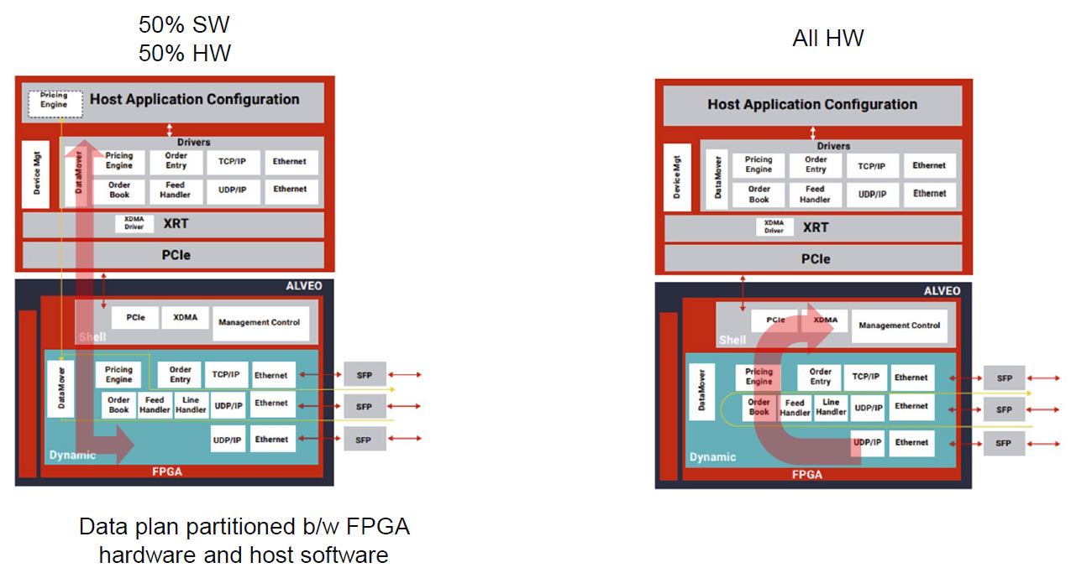
Datamover
Data plan partitioned b/w FPGA hardware and host software

Slide 18
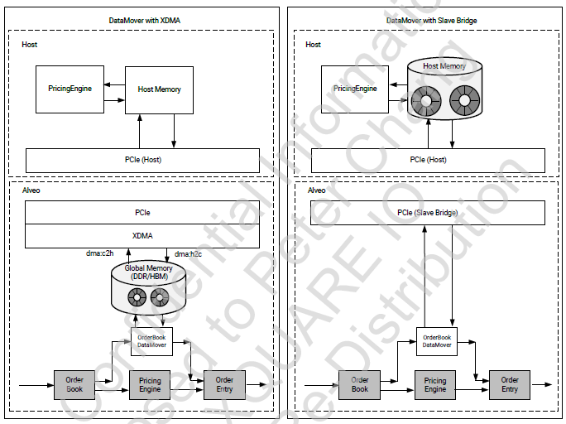
Datamover
XDMA: XDMA is used to transfer information between the host and DDR memory on the Alveo card. The OrderBook DataMover kernel transfers information between the hardware pipeline and the DDR memory.
Slave bridge: The PCIe slave bridge is used to transfer information between the OrderBook DataMover kernel and host memory. The OrderBook DataMover kernel transfers information between the hardware pipeline and the port on the PCIe slave bridge.

Slide 19
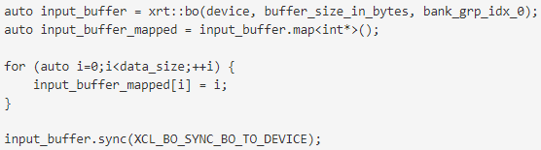
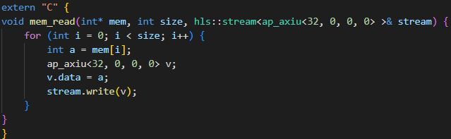
Interfaces
Read/Write kernel register
#pragma HLS INTERFACE s_axilite port=_______
Streaming Interface between kernels
#pragma HLS INTERFACE ap_ctrl_none port=return
Streaming data to kernel
Buffer map API
Reference: https://github.com/Xilinx/Vitis_Accel_Examples/tree/master/host_xrt/streaming_free_running_k2k_xrt
https://xilinx.github.io/XRT/2021.2/html/xrt_native_apis.html

Slide 20
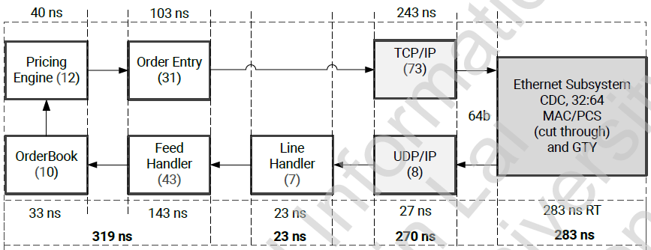
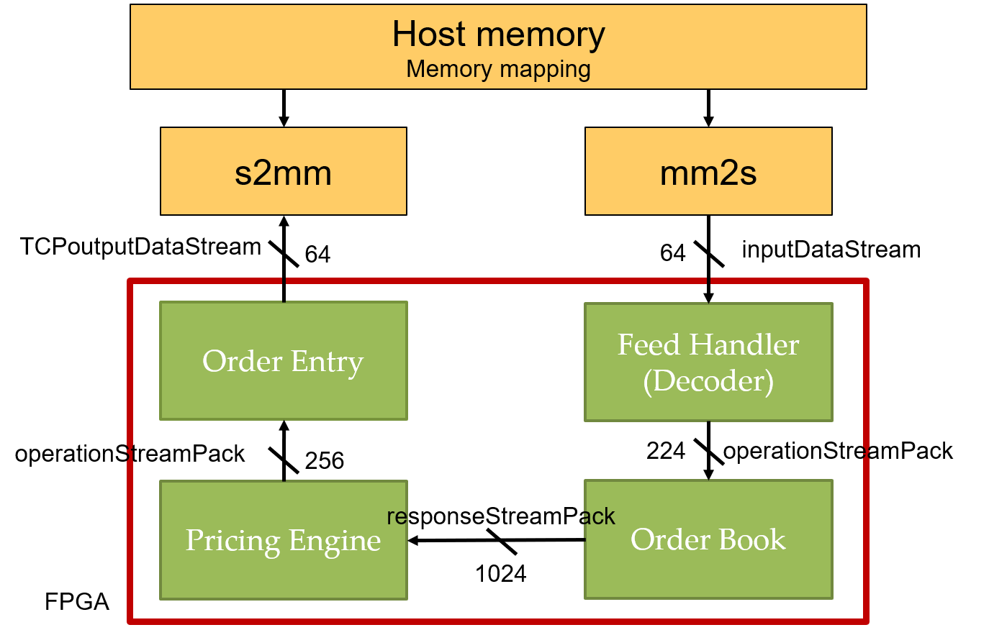
Verification System
Trading
Networking
Remove Network related module

Slide 21
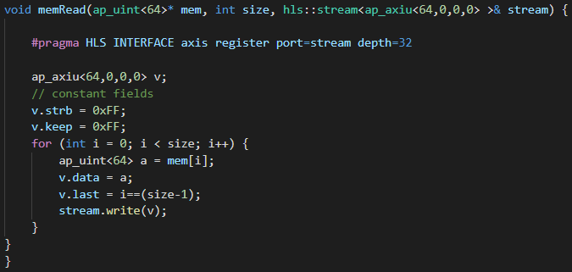
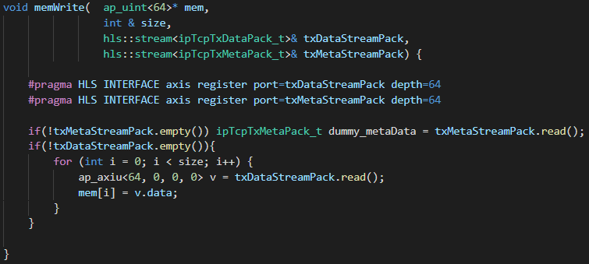
Verification System
mm2s (memRead)
S2mm (memWrite)

Slide 22
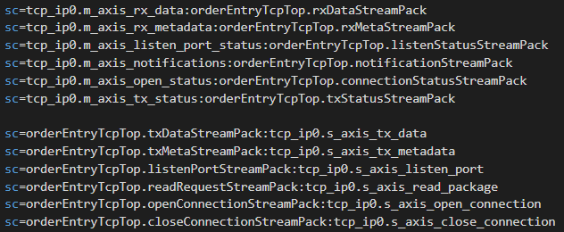
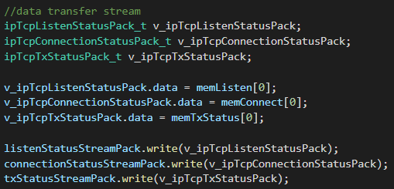
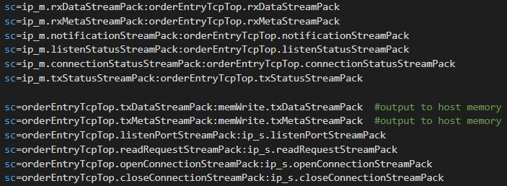

Verification System
Ip_m
Ip_s
Connectivity
Network setting
Connectivity
Network setting

Slide 23
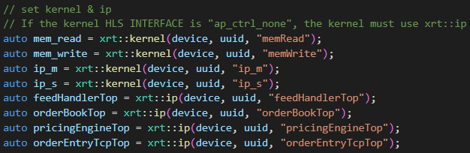
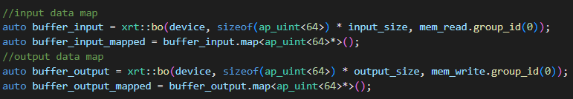
Host program
Set kernel & ip
Set Feed Handler symbols
Input / Output map

Slide 24
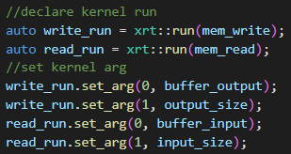
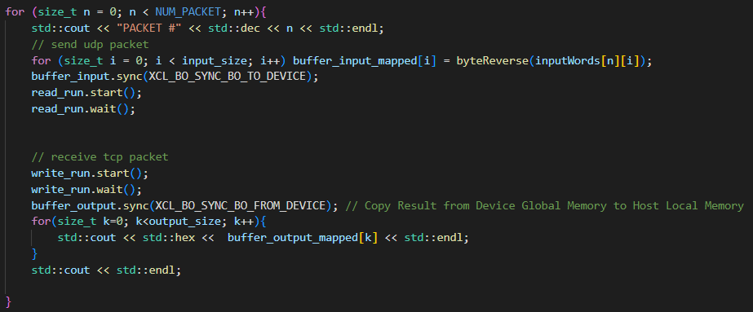
Host program
Declare kernel run
Data transfer

Slide 25
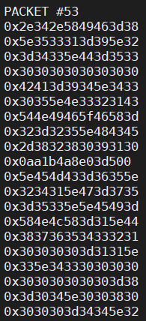
Lab
Build & Run
./run.sh >> output.log
Report
pricingStrategyPeg
Result analyzation
The packet number when the strategy is triggered
Whether the output packet matches to the operation of the pricing Engine

Slide 26
Lab
Submission
StudentID_Lab_AAT/
Output.log
StudentID_Report.pdf
※Compress all above files in a single zip file named StudentID_Lab_AAT.zip
Due: 2022/5/

