Slide 1
Accelerated Algorithmic Trading (AAT)
Lecturer: Howard Zhao
Date: 2022/05/11

Slide 2
Outline
System Overview
Kernel Functions Overview
FeedHandler
OrderBook
PriceEngine
OrderEntry
Datamover
Interfaces
Host -> kernel (FPGA)
Streaming Interface between kernels
Verification System
Host Program
Lab

Slide 3
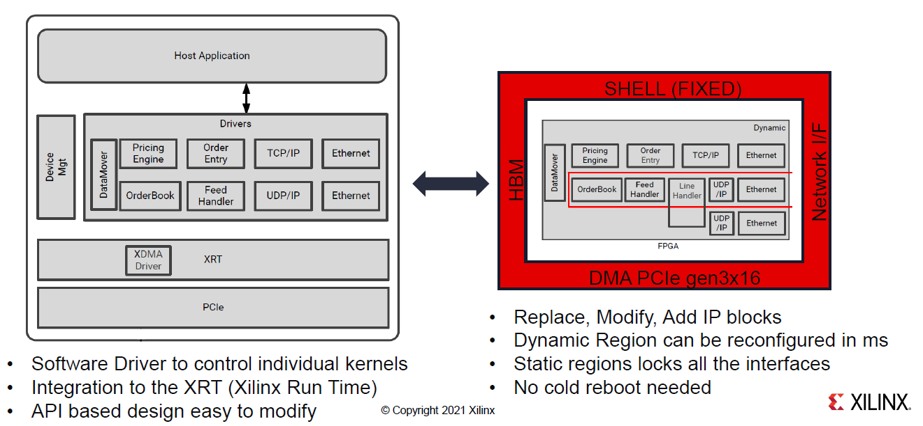
System Overview

Slide 4
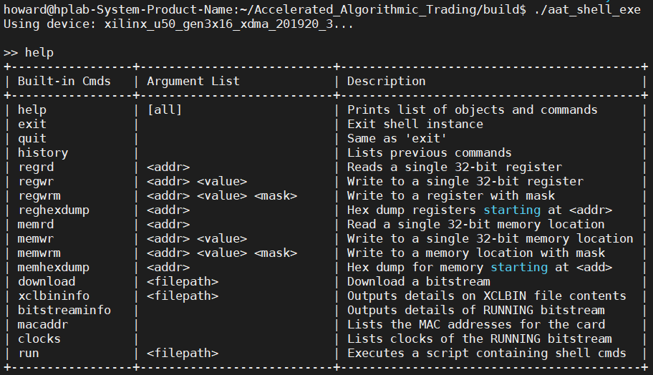
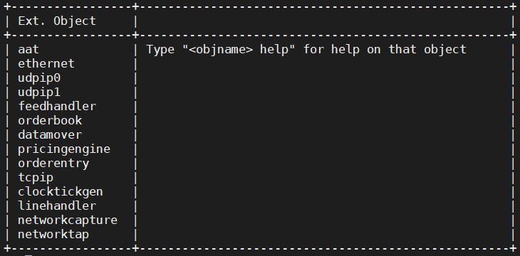
System Overview

Slide 5
System Overview

Slide 6
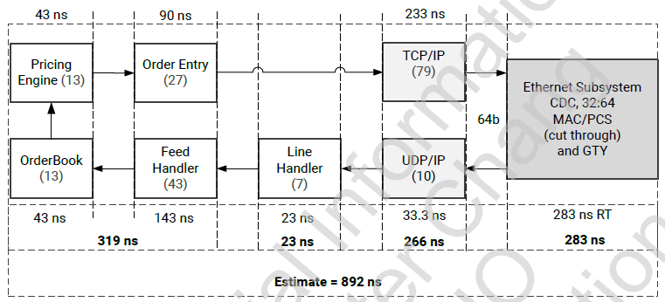
Kernel Functions Overview
Network Kernel
Ethernet
TCP/UDP/IP
lineHandler
Market Kernel
feedHandler
orderbook
orderEntry
Strategy Kernel
PricingEngine

Slide 7
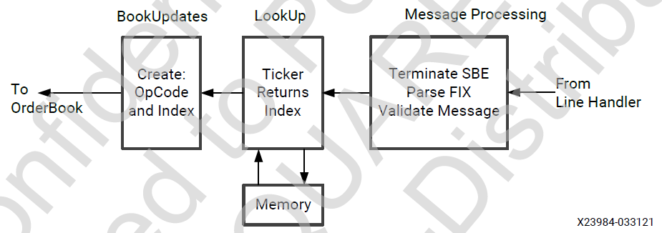
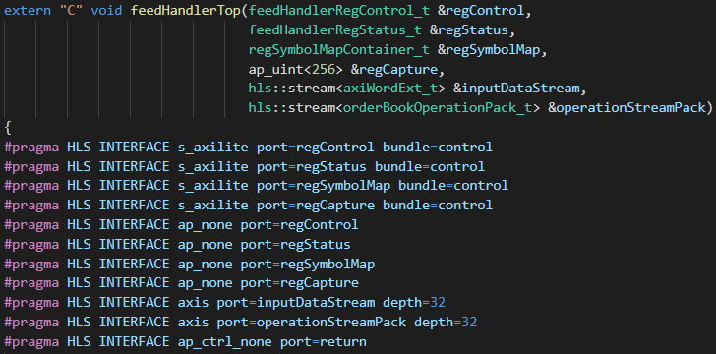
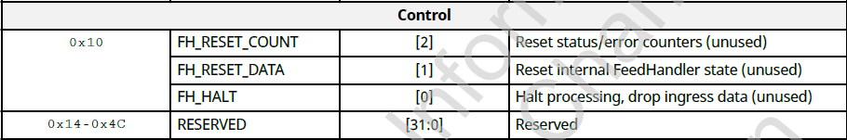
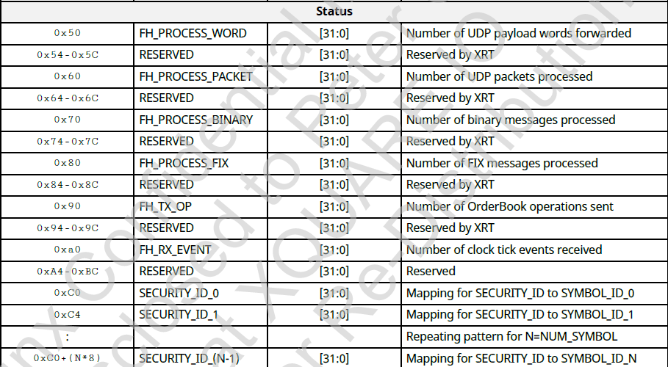
FeedHandler
Block Diagram
Top module
Register Map

Slide 8
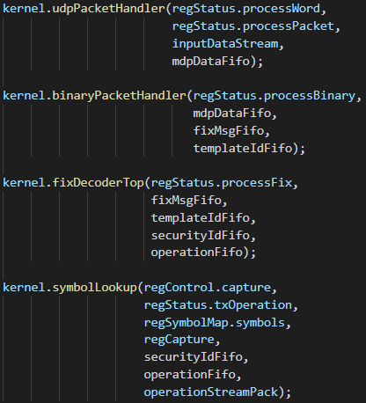
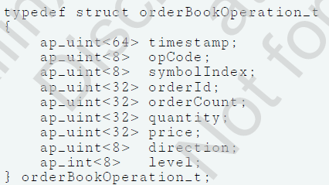
FeedHandler
#HLS DATAFLOW disable_start_propagation
disable_start_propagation : Optionally disables the creation of a start FIFO used to propagate a start token to an internal process. Such FIFOs can sometimes be a bottleneck for performance.
Submodule
mdpData, fixMsg: 64 bits
Template ID: message type
Security ID: symbol ID

Slide 9
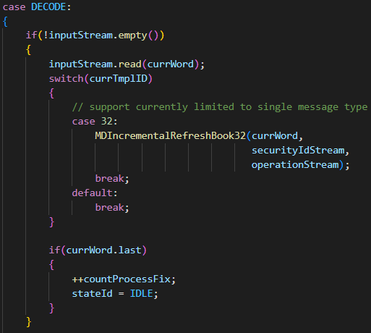
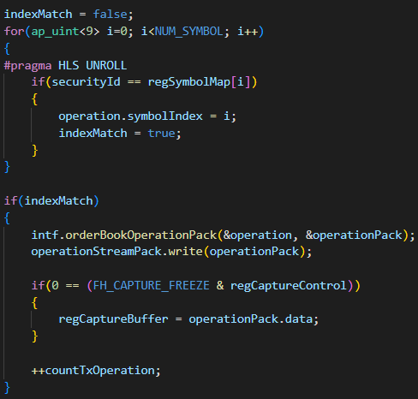
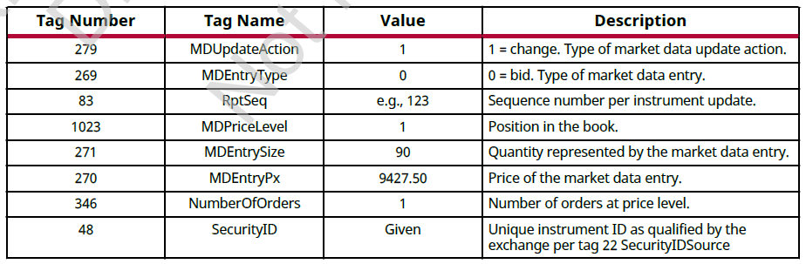
FeedHandler
fixDecoder
symbolLookup
X

Slide 10
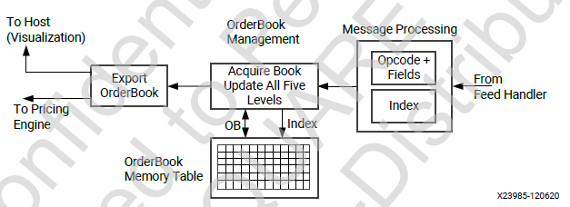
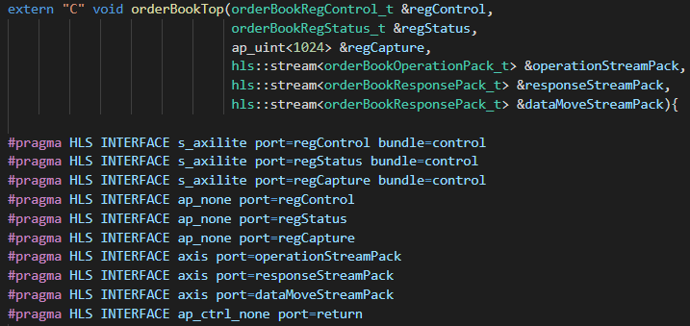
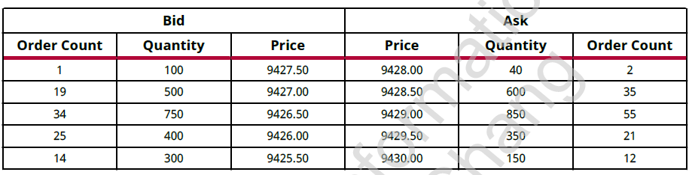
OrderBook
Block Diagram
Top module

Slide 11
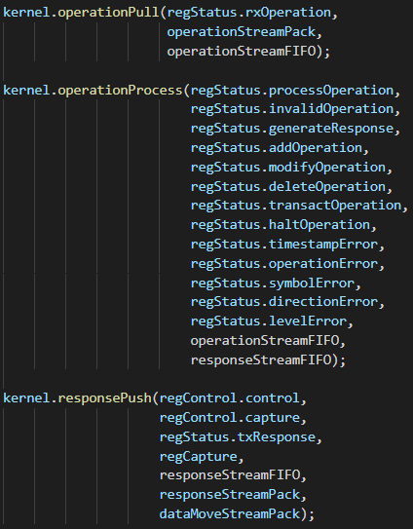
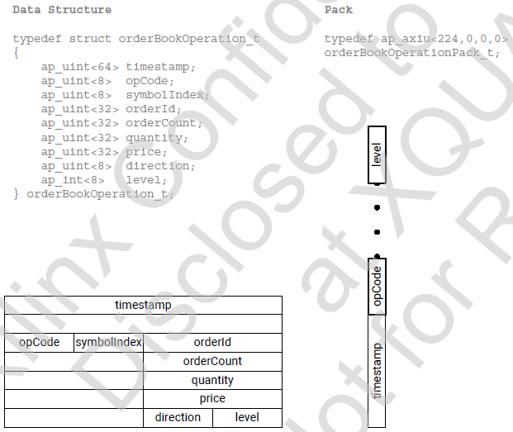
OrderBook
Pull
Submodule
Push
If the stream data type is an user-defined struct, the default procedure is to keep the struct aggregated and align the struct to the size of the largest data element to the nearest byte. The only exception to this rule is if the struct contains a hls::stream object. In this special case, the struct will be disaggregated and an axi stream will be created for each member element of the struct.

Slide 12
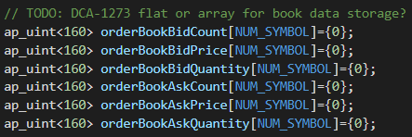
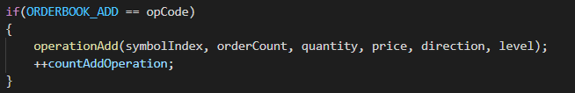
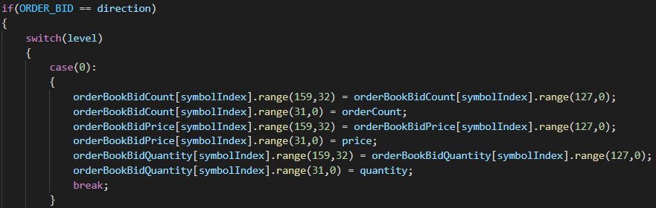
OrderBook
Order book in memory
operationProcess
<32 bits> 5th price | <32 bits> 4th price | <32 bits> 3rd price | <32 bits> 2nd price | <32 bits> 1st price
e.g. operationAdd

Slide 13
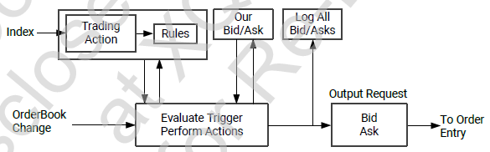
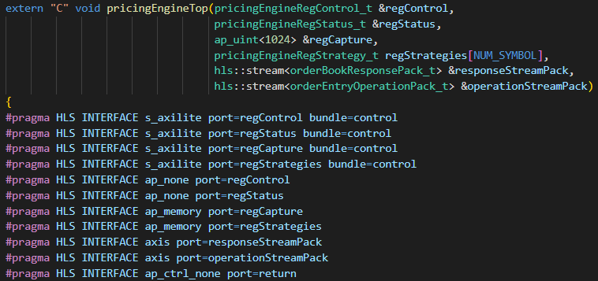
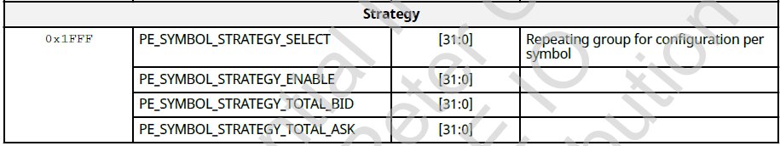
PriceEngine
Block Diagram
Top module

Slide 14
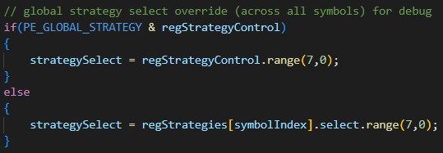
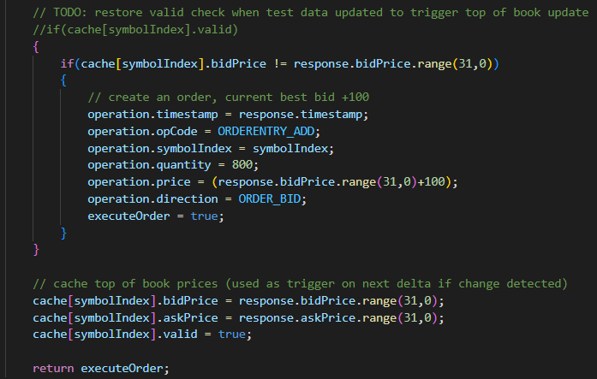
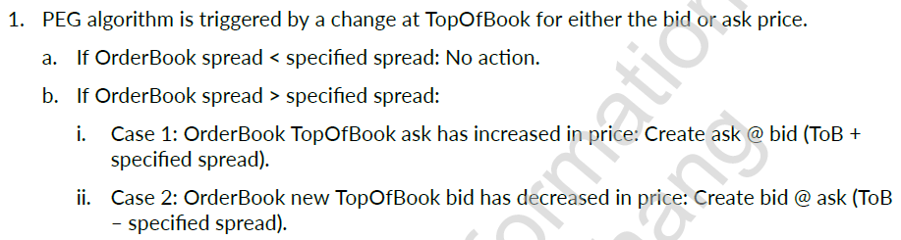
PriceEngine
Strategy select
PEG strategy (undone)
Order Entry operation

Slide 15
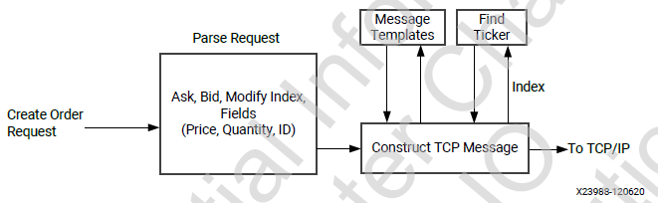
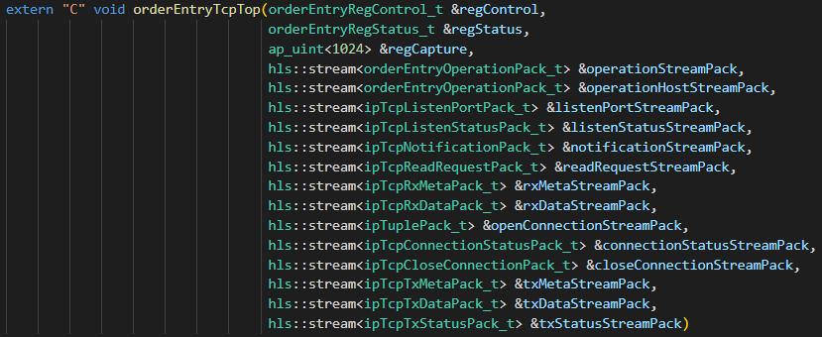
OrderEntry
Block Diagram
Top module
Operation from pricingEngine
Operation from Host
Connection-related

Slide 16
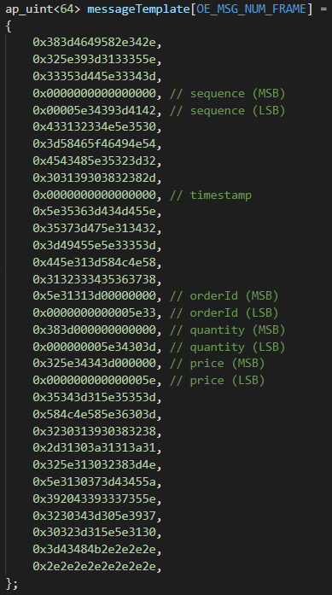
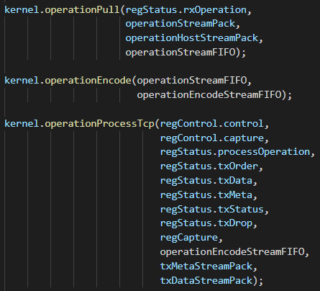
OrderEntry
Submodule
operationPull
operationEncode (uint32ToAscii)
operationProcessTcp

Slide 17
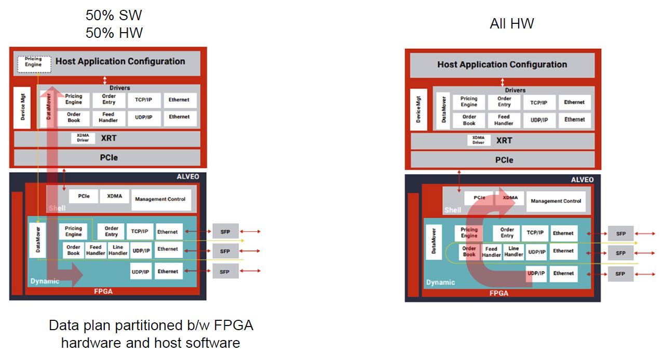
Datamover
Data plan partitioned b/w FPGA hardware and host software

Slide 18
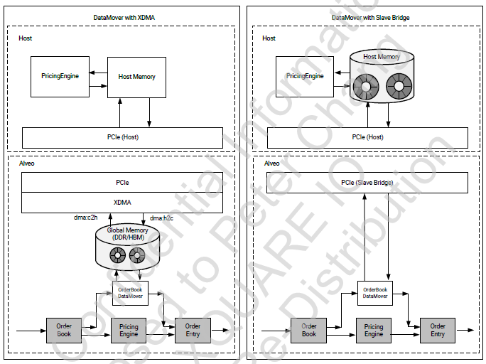
Datamover
XDMA: XDMA is used to transfer information between the host and DDR memory on the Alveo card. The OrderBook DataMover kernel transfers information between the hardware pipeline and the DDR memory.
Slave bridge: The PCIe slave bridge is used to transfer information between the OrderBook DataMover kernel and host memory. The OrderBook DataMover kernel transfers information between the hardware pipeline and the port on the PCIe slave bridge.

Slide 19
Datamover

Slide 20
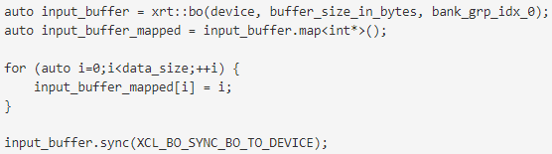
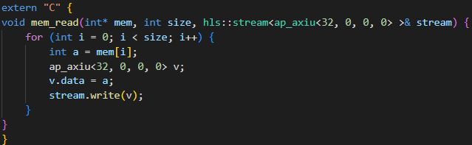
Interfaces
Read/Write kernel register
#pragma HLS INTERFACE s_axilite port=_______
Streaming Interface between kernels
#pragma HLS INTERFACE ap_ctrl_none port=return
Streaming data to kernel
Buffer map API
Reference: https://github.com/Xilinx/Vitis_Accel_Examples/tree/master/host_xrt/streaming_free_running_k2k_xrt
https://xilinx.github.io/XRT/2021.2/html/xrt_native_apis.html

Slide 21
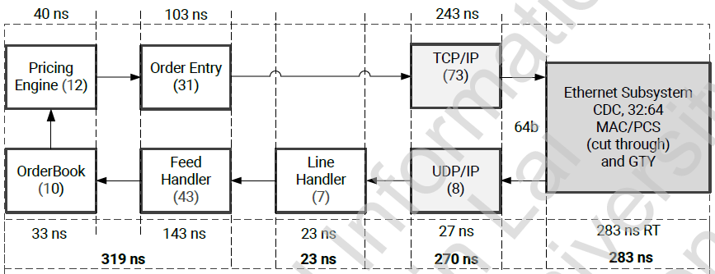
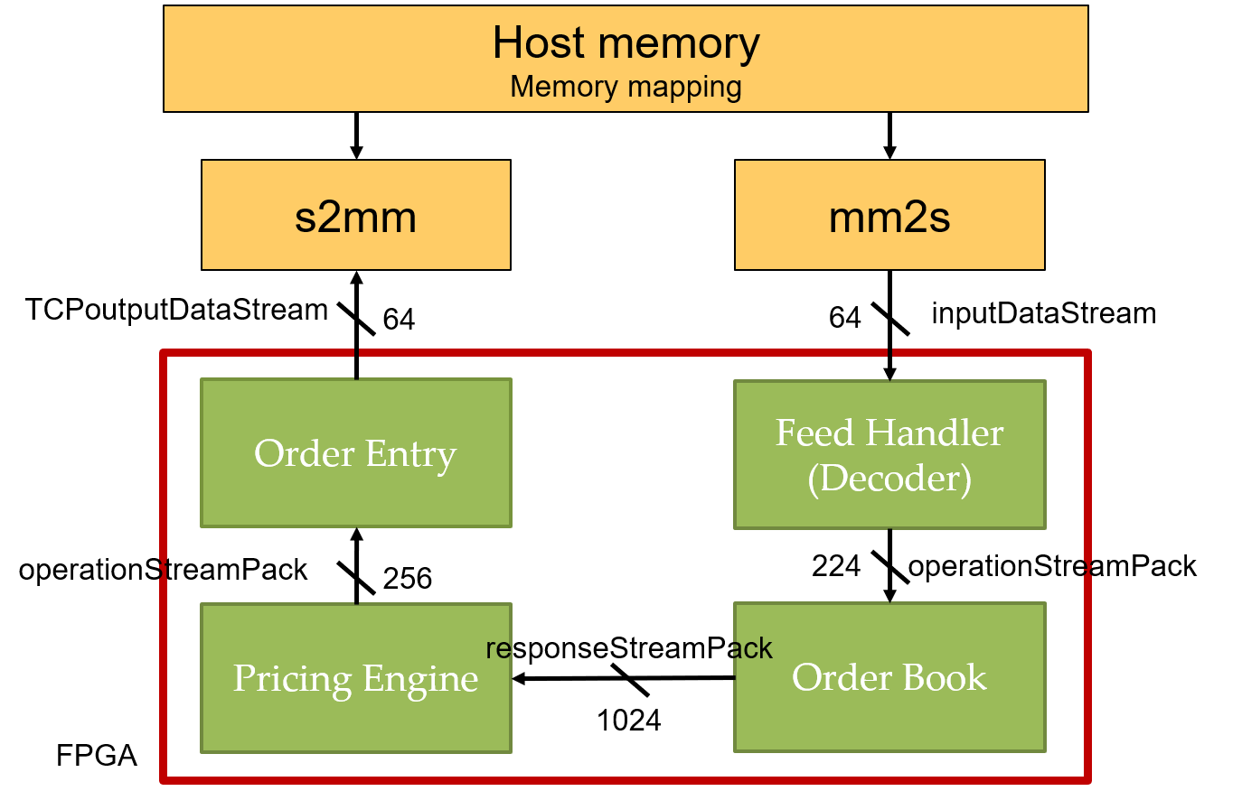
Verification System
Trading
Networking
Remove Network related module

Slide 22
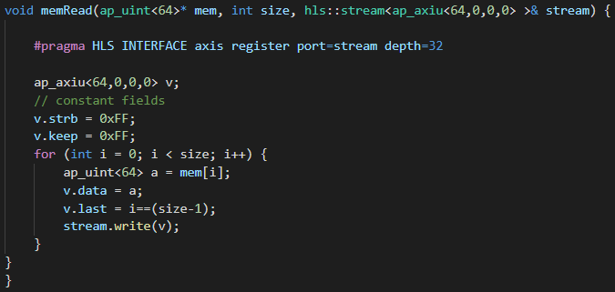
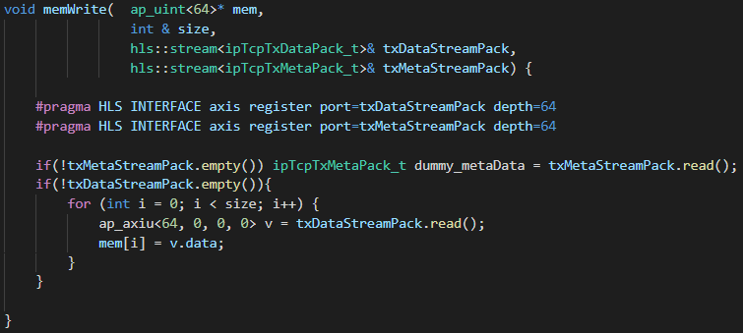
Verification System
mm2s (memRead)
S2mm (memWrite)

Slide 23
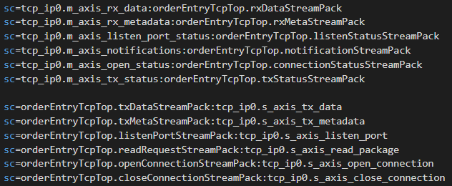
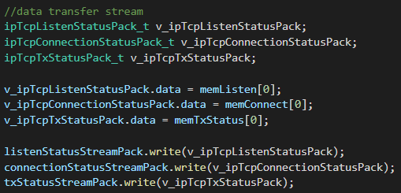
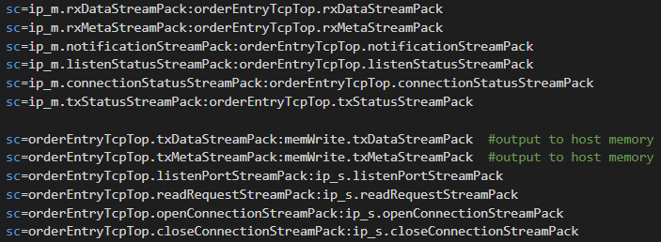

Verification System
Ip_m
Ip_s
Connectivity
Network setting
Connectivity
Network setting

Slide 24
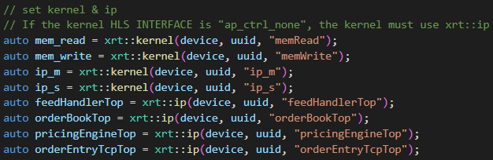
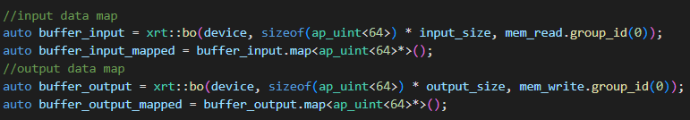
Host program
Set kernel & ip
Set Feed Handler symbols
Input / Output map

Slide 25
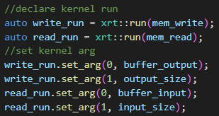
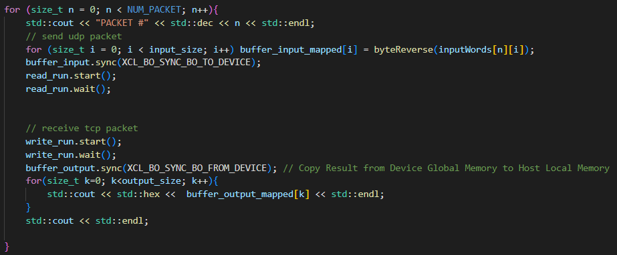
Host program
Declare kernel run
Data transfer

Slide 26
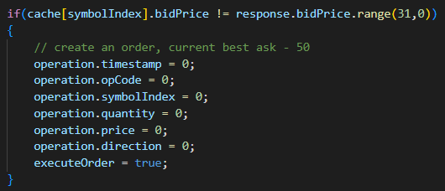
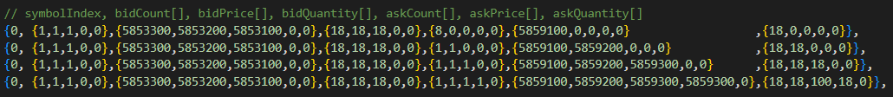
Lab
Pricing Strategy
AAT_demo\pricingEngine\pricingengine.cpp
pricingStrategyLimit
Run C simulation
$ cd AAT_demo/pricingEngine/test/
$ make
ORDER_ENTRY_OPERATION: {0,0,1,800,5853400,0}

Slide 27

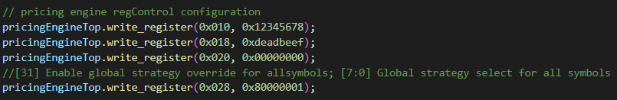
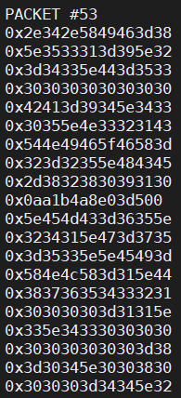
Lab
AAT_demo/pricingEngine/test/tb_pricingengine.cpp
AAT_demo/aat_host/host.cpp
HW result
Orderbook log

Slide 28
Lab
Build & Run
./run.sh >> output.log
Report
Code modification
Result analyze
Submission
StudentID_Lab_AAT/
pricingengine.cpp
Output.log
StudentID_Report.pdf
※Compress all above files in a single zip file named StudentID_Lab_AAT.zip
Due: 2022/6/24

