Slide 1
Verification - Testbench
Jiin Lai

Slide 2
Agenda
Scope of Verification
Testbench Basics

Slide 3
Reminder
Combinational / Sequential Verilog Lab & RISCV Upload to Github
Compare HLS v.s. Verilog Area & Timing
https://github.com/bol-edu/soclab-nthusp23/tree/main/students/allenlin-is-a-template
Build up your skill portfolio – Github
Write Study_journal.md – review after summer
Presentation use ppt instead of markdown document

Slide 4
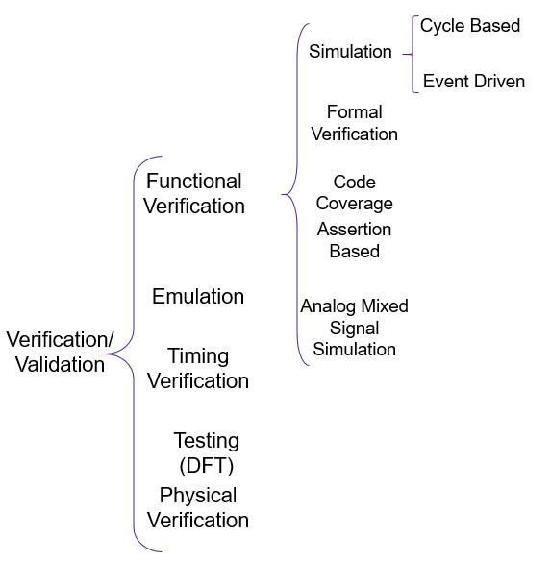
Scope of Verification

Slide 5
Testbench & DUT Structure
module top;
wire in;
wire out;
endmodule
module top;
reg in;
wire out;
endmodule
initial begin
#d1 in = a;
#d11
if(out != exp) begin
$display(“ERROR” ..);
#d2 in = b;
for ( i ) begin
#d3 in = c[i];
end
end
TestBench
Stimulus Generation
Output Checking
Design Under Test
(DUT)
Design Under Test
(DUT)
in
in
out
out
NTU CVSD – Verilog Part 3.pdf page#34 -

Slide 6
Applying Stimulus
Inline initial block
From a loop or always block
From an array of vectors or integer

Slide 7
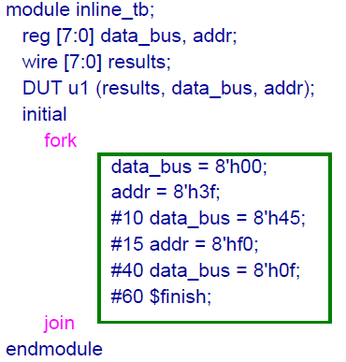
Inline

Slide 8
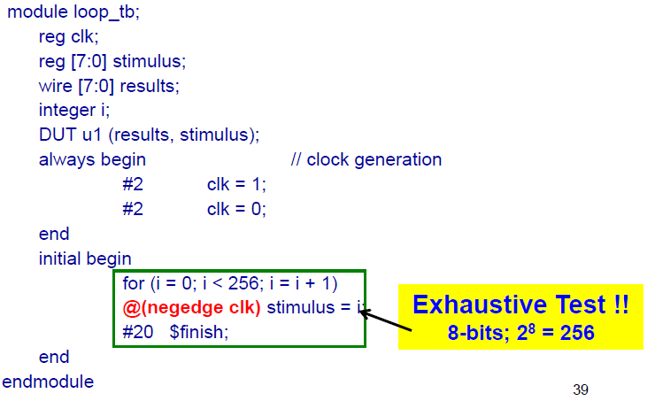
From Loops
Event Control
@<event_expression><statements>
Initial begin
@(ee) rega = regb;
@(posedge clk)
end

Slide 9
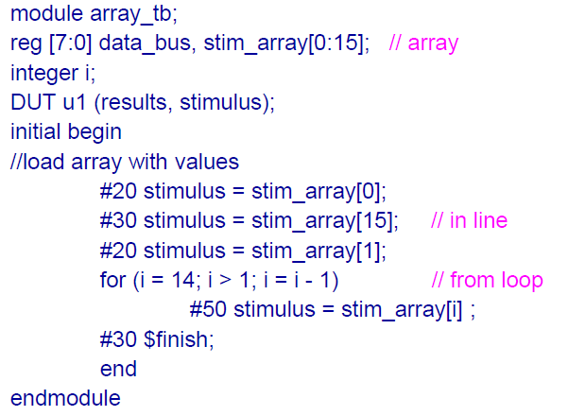
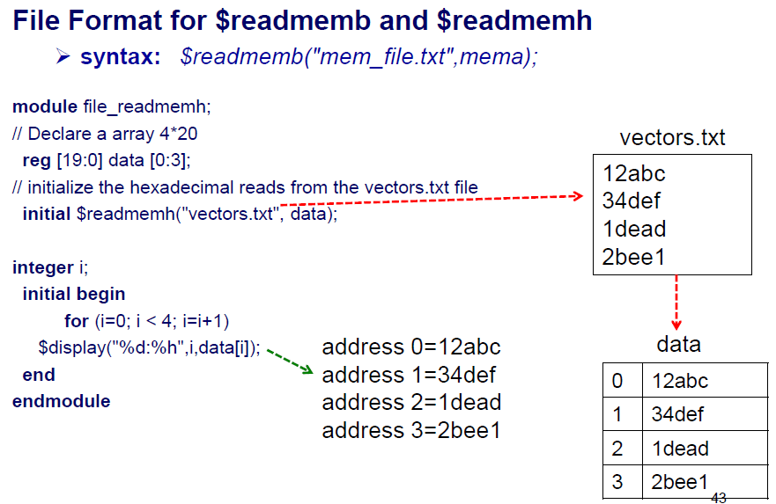
From Arrays ( from a file and read into an array)

Slide 10
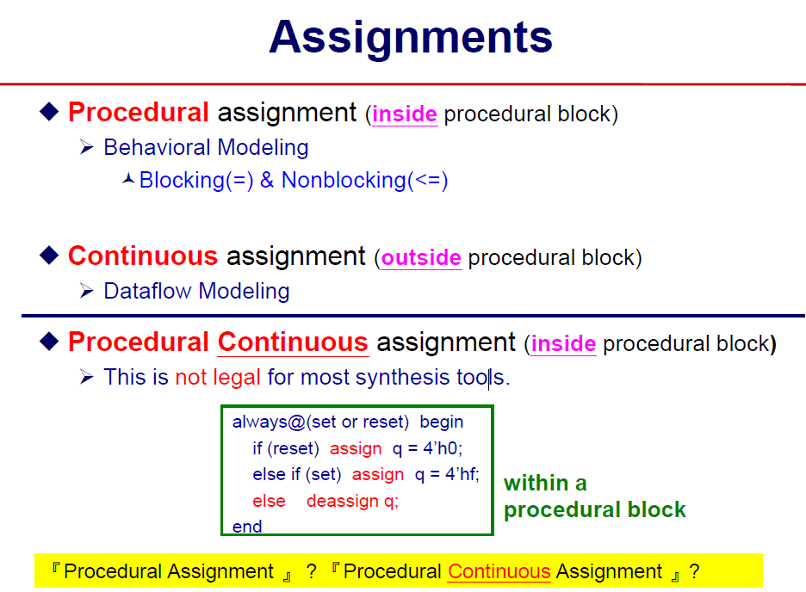
Assignments

Slide 11
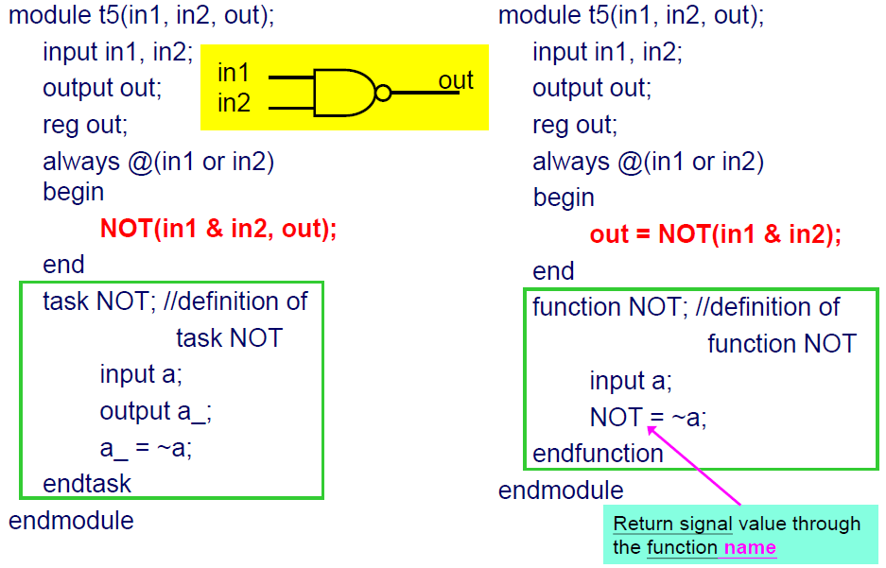
Task and Function

Slide 12
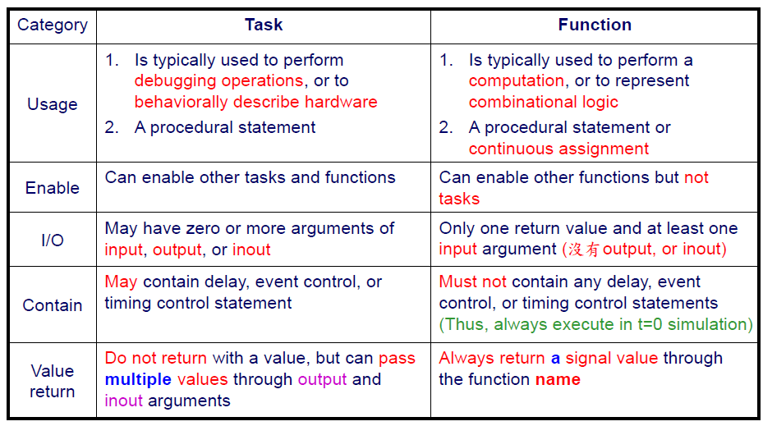
Function v.s. Task

Slide 13
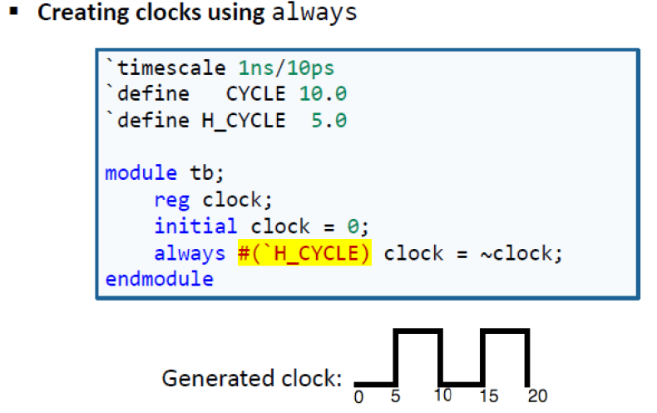
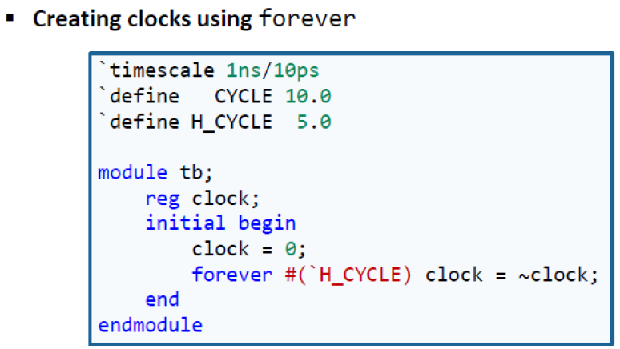
Creating Clock

Slide 14
Testbench Coding – System tasks explained
System tasks and Functions: $
$random (32-bit random number)
File Input: [$readmemb | $readmemh](“filename”, array);
$time (64-bit integer), $stime (32-bit integer), $realtime (64-bit real)
$monitor, $strobe, $display, $write
$finish, $stop
$dumpfile(“file.dump); $dumpvars(); $dumpflush; $dumpoff; $dumpon; $dumpall;
$fsdbDumpfile(“file”); $fsdbDumpvars;

Slide 15
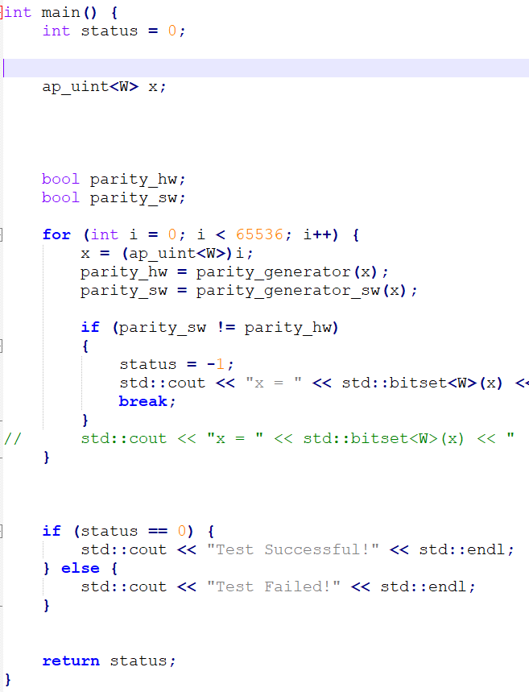
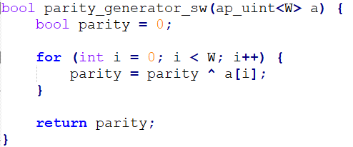
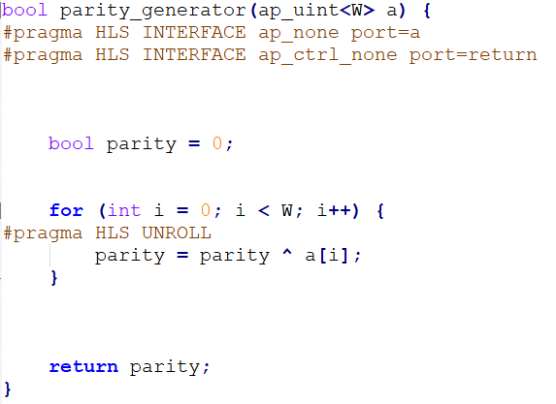
Example Testbench: parity generation

Slide 16
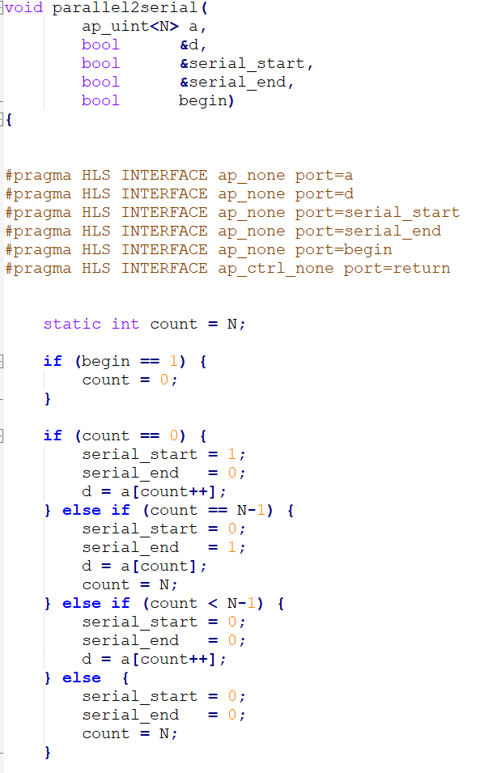
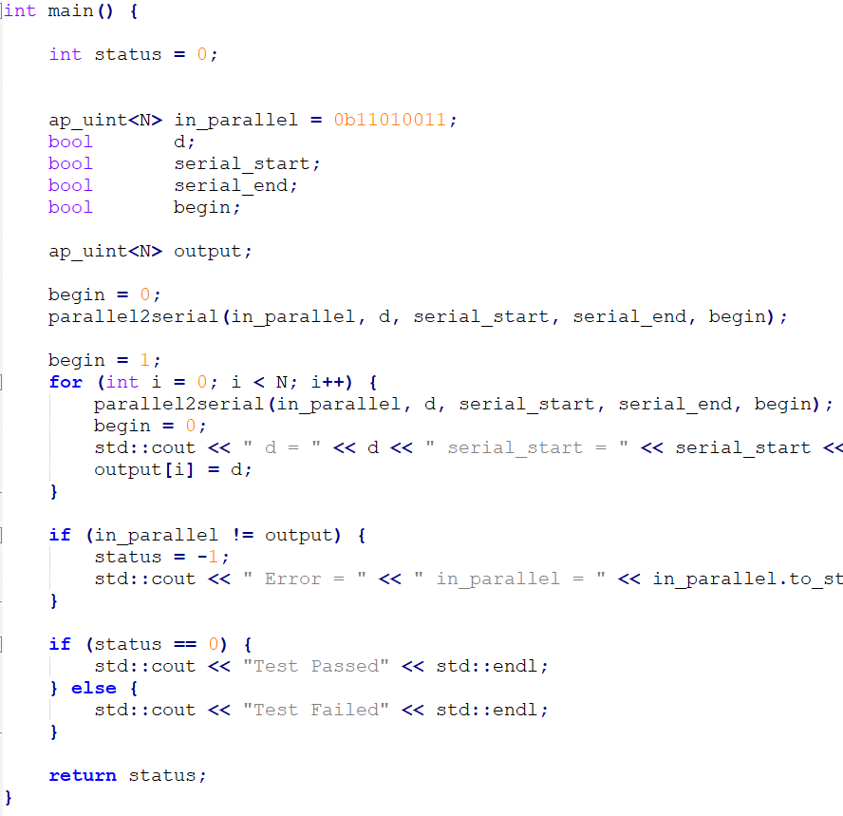
Example Testbench: parallel2serial

