Slide 1
Canberra Real Estate Sales 2007 - 2019
Benedict Laiman

Slide 2
Introduction
Data were obtained from HtAG®. HtAG® or Higher than Average Growth is an analytics portal that assists real estate professionals, investors and home buyers in making property-related decisions with the help of timely and actionable real estate market data. HtAG® leverages the benefits of machine learning to rank the growth potential of over 420 Local Government Areas and 6,200 suburbs, Australia wide.
https://www.htag.com.au/act
Canberra
Real Estate Sales 2007- 2019
Benedict Laiman

Slide 3
Column Description
- datesold = date when the property was sold
- price = price of the property when it was sold
- suburb = suburbs in Canberra, Australia
- postcode = postal code of a place
- lat = latitude of the location
- lon = longitude of the location
- parking = number of parking lots
- bathrooms = number of bathrooms
- bedrooms = number of bedrooms
- propertyType = type of the property
- suburbid = the id of the suburbs
Canberra
Real Estate Sales 2007- 2019
Benedict Laiman

Slide 4
Background Stories
The world was experiencing a global financial crisis around 2007 to 2008 due to excessive risk-taking by banks combined with the bursting of the United States housing bubble caused the values of securities tied to U.S. real estate to plummet, damaging financial institutions globally and culminating an international banking crisis. The crisis sparked the Great Recession, which at the time was the most severe global recession since the "Great Depression". Canberra as the capital city of Australia was no exception to this crisis.
Through this project, we hope to understand how the real estate market in Canberra responded to the global financial crisis and what is the aftermath pricing trend. We are also hoping to gain any valuable insight into the Canberra real estate market.
Canberra
Real Estate Sales 2007- 2019
Benedict Laiman

Slide 5
The Scope of the Research Problem
- Historical data from 2007 - 2019
- Maximum real estate price capped at 5M (for analysis and visualization)
Canberra
Real Estate Sales 2007- 2019
Benedict Laiman

Slide 6
Users
- Users & renters
- Property investors
- Renovators
Canberra
Real Estate Sales 2007- 2019
Benedict Laiman

Slide 7
Data Cleaning

Slide 8
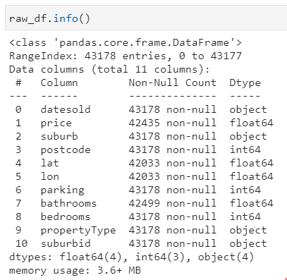
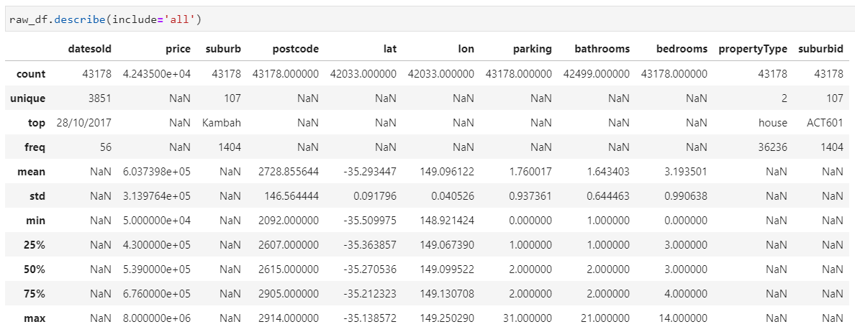
Descriptive Statistics of the Variables
Canberra
Real Estate Sales 2007- 2019
Benedict Laiman

Slide 9
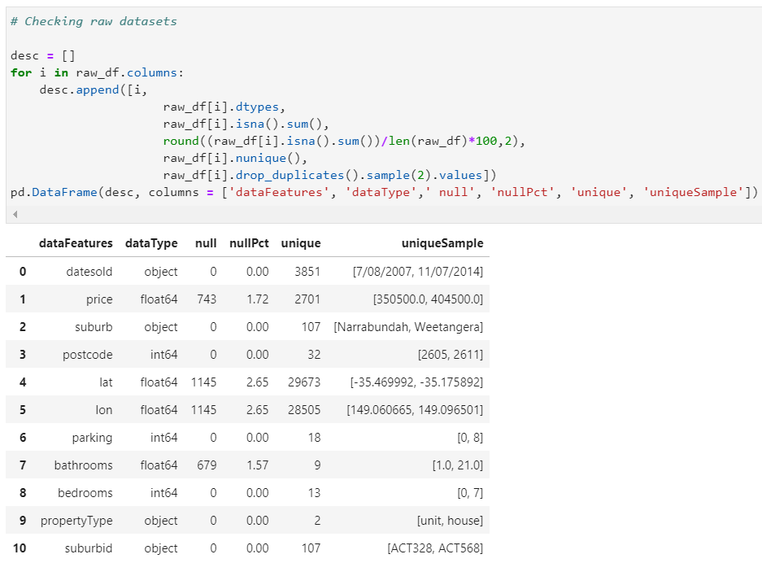
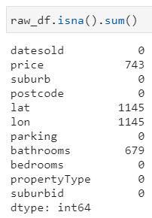
Descriptive Statistics of the Variables
Canberra
Real Estate Sales 2007- 2019
Benedict Laiman

Slide 10
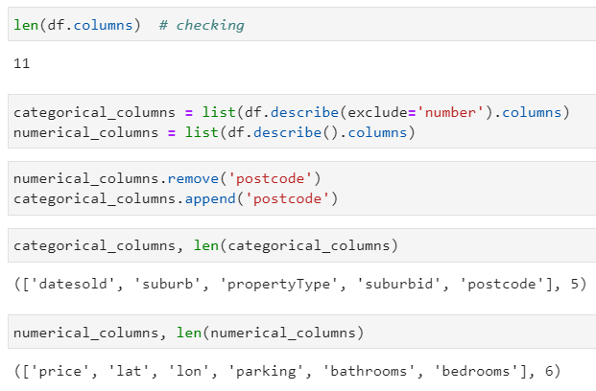
Determining Numerical and Categorical Features
Canberra
Real Estate Sales 2007- 2019
Benedict Laiman

Slide 11
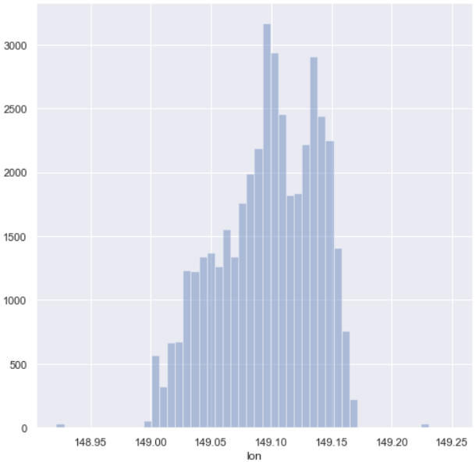
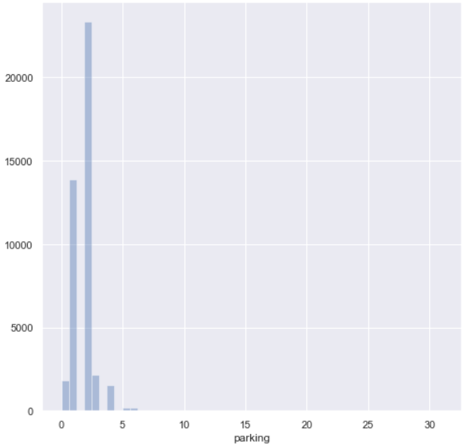
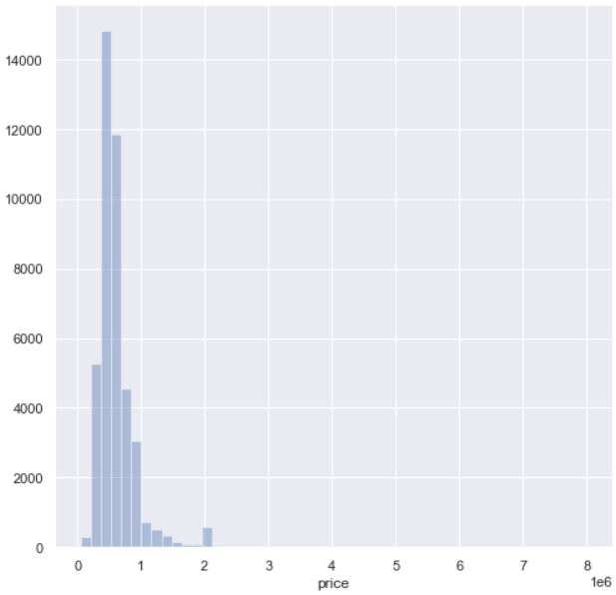
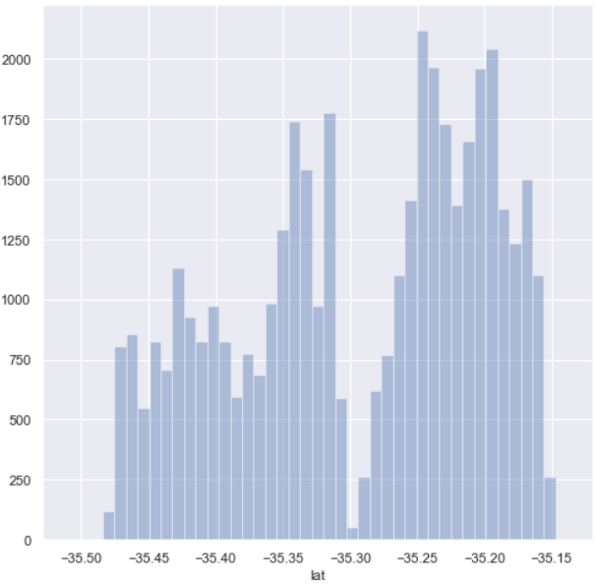
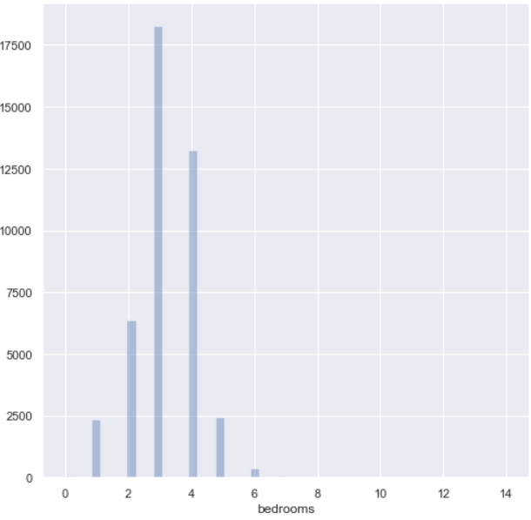
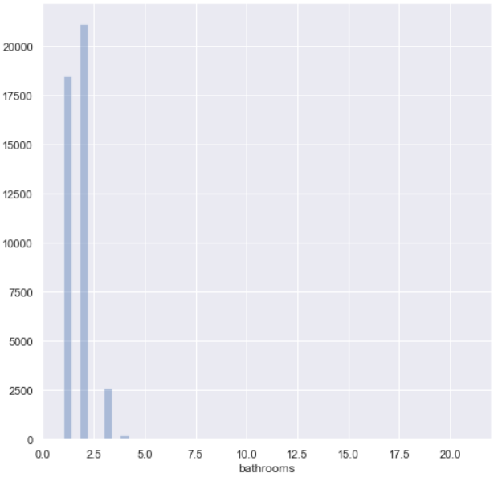

Checking the Distribution of the Datasets Numerical Features Through Bar Plots
Canberra
Real Estate Sales 2007- 2019
Benedict Laiman

Slide 12
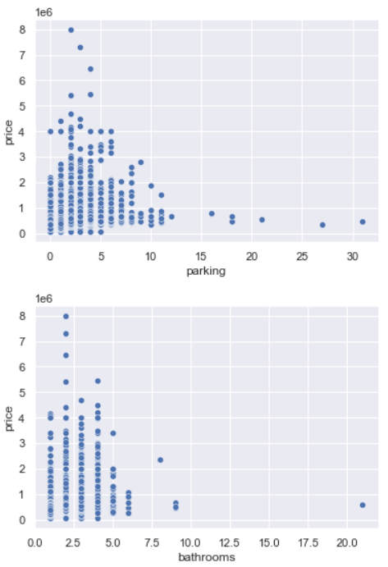
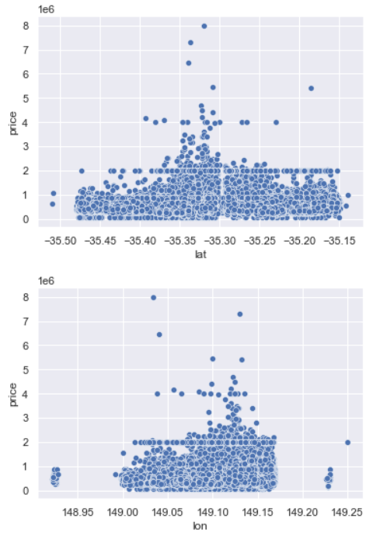
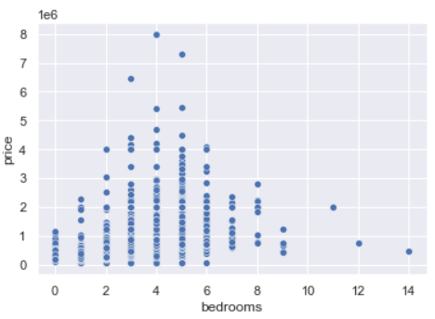

Using Scatter Plot to See the Relationship Between 'price' Column and Other Numerical Columns
Canberra
Real Estate Sales 2007- 2019
Benedict Laiman

Slide 13
Using Scatter Plot to See the Relationship Between 'price' Column and Other Numerical Columns
Canberra
Real Estate Sales 2007- 2019
Benedict Laiman

Slide 14
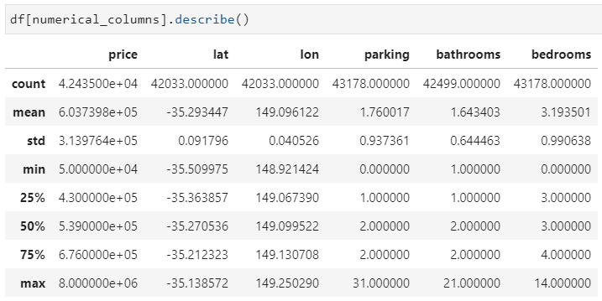
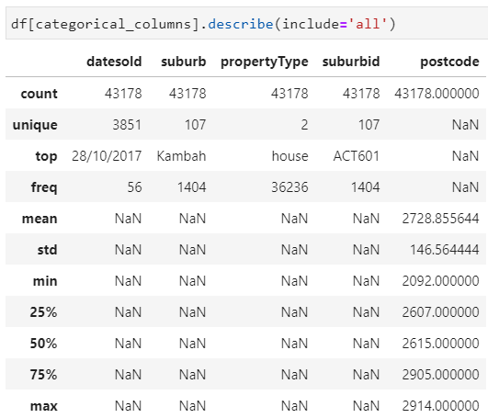
Describe
Checking Numerical Features Through Describe Method
Checking Categorical Features Through Describe Method
Canberra
Real Estate Sales 2007- 2019
Benedict Laiman

Slide 15
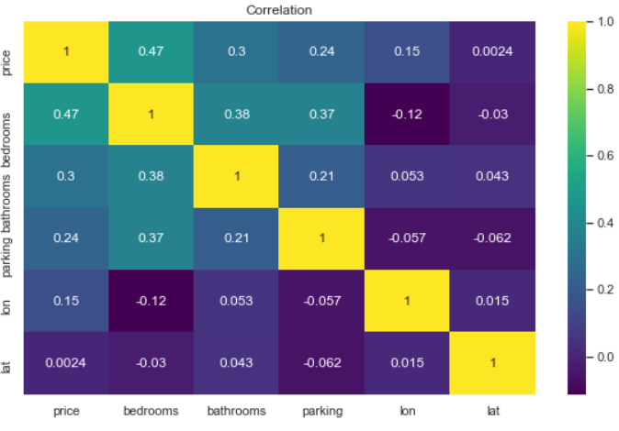
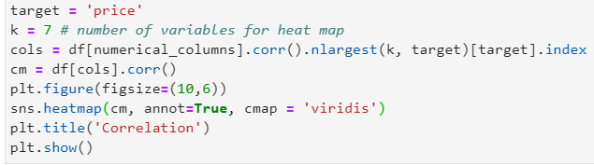
Correlation Inspection
Through this heat map it can be seen that 'lat', and 'lon' columns have relatively small correlation with the 'price' column, while 'bedrooms' has the highest.
Canberra
Real Estate Sales 2007- 2019
Benedict Laiman

Slide 16


Removing Features
Canberra
Real Estate Sales 2007- 2019
Benedict Laiman

Slide 17
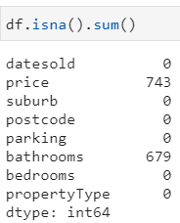
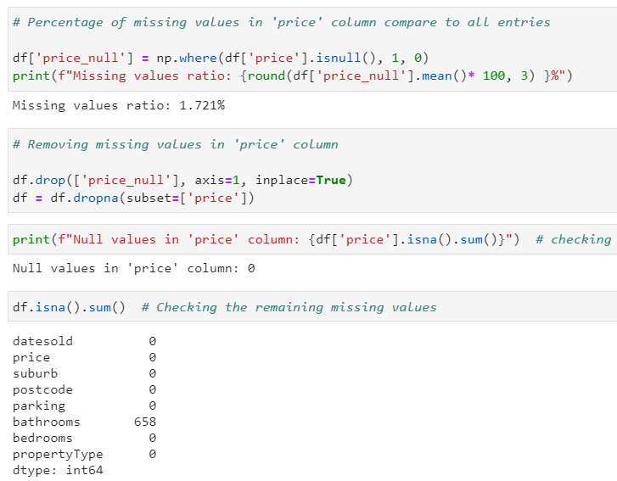
Dealing with Missing Values
Dropping missing values in ‘price’ column
Canberra
Real Estate Sales 2007- 2019
Benedict Laiman

Slide 18
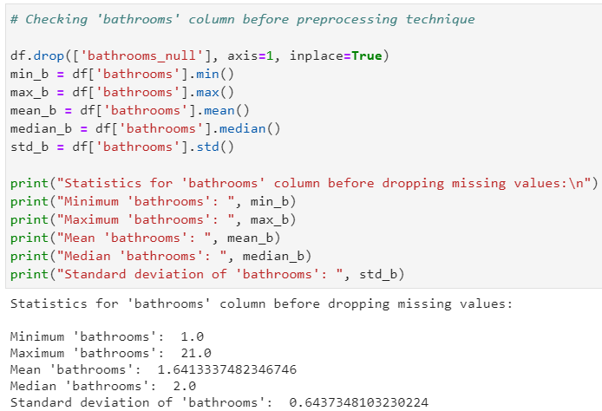
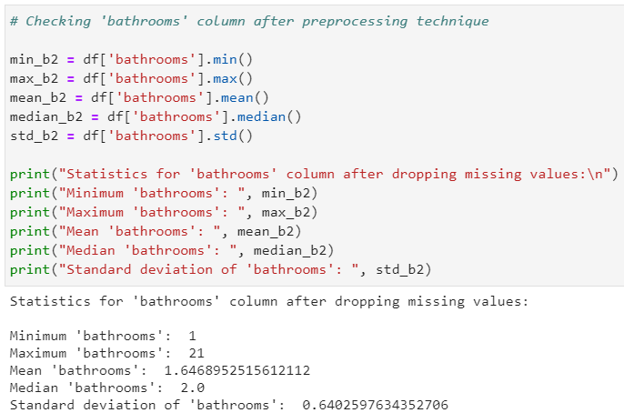
Dealing with Missing Values
Filling missing values in ‘bathrooms’ column
Canberra
Real Estate Sales 2007- 2019
Benedict Laiman

Slide 19
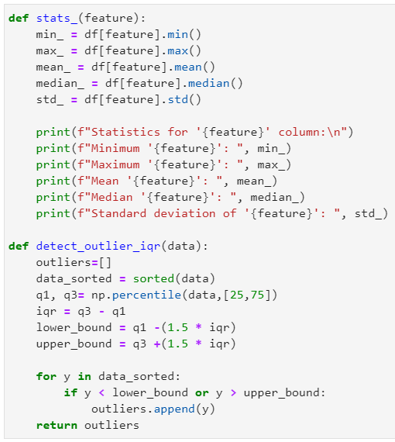
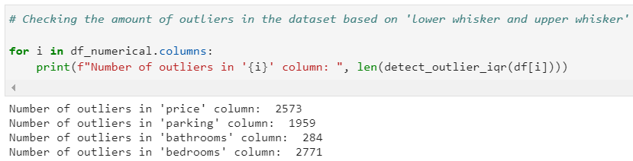
Dealing with Outliers
Dropping outliers based on 'lower whisker and upper whisker' is not the best decision, since the datasets are already heavily skewed and dropping it might reduce a lot of valuable information. It is a must to examine the dataset from feature to feature.
Canberra
Real Estate Sales 2007- 2019
Benedict Laiman

Slide 20
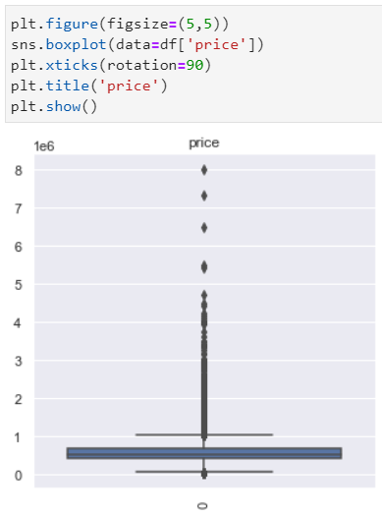
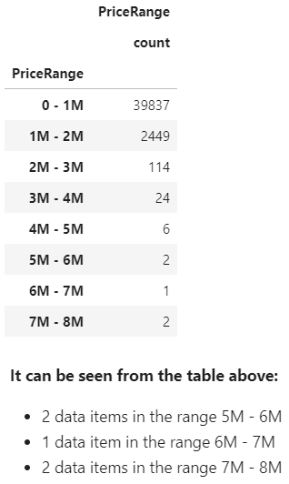
Checking Outliers in ‘price’ column
For the purpose of this analysis, all data that are mentioned above are going to be dropped. Hence, the maximum real estate price for this analysis is capped at 5M.
Canberra
Real Estate Sales 2007- 2019
Benedict Laiman

Slide 21
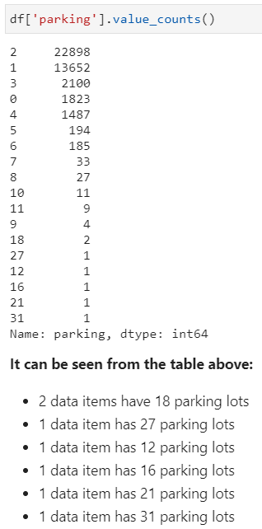
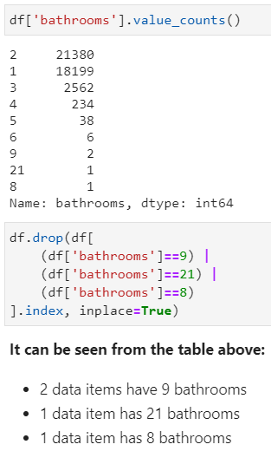
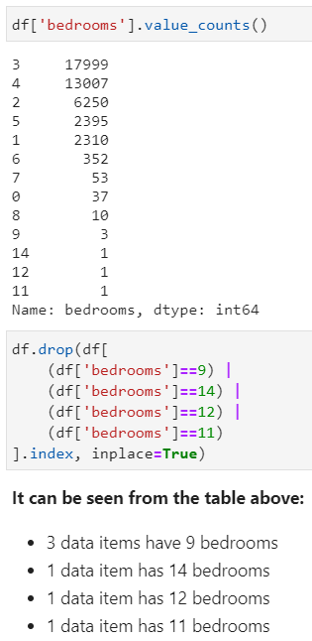
Checking Outliers in ‘parking’, ‘bathrooms’, and ‘bedrooms’ columns
For the purpose of this analysis, all data that are mentioned above are going to be dropped.
Canberra
Real Estate Sales 2007- 2019
Benedict Laiman

Slide 22
Data Visualization

Slide 23

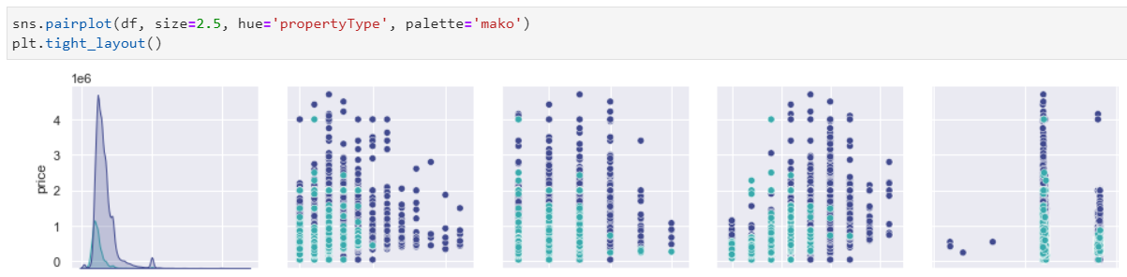
Pairplot
Filling missing values in ‘bathrooms’ column
Canberra
Real Estate Sales 2007- 2019
Benedict Laiman

Slide 24
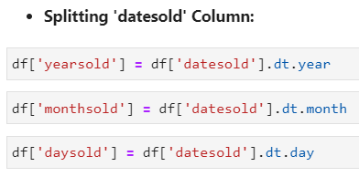
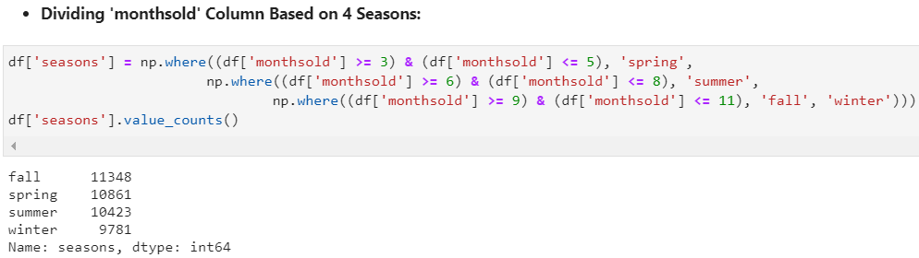
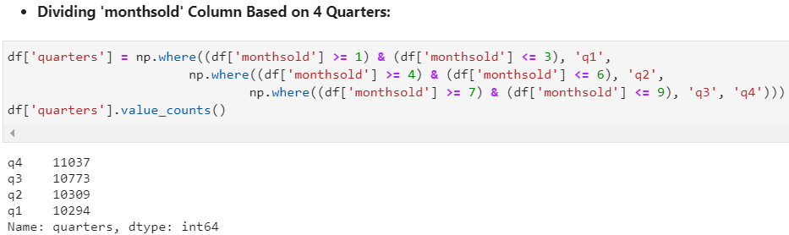
Quarters and Seasons
Canberra
Real Estate Sales 2007- 2019
Benedict Laiman

Slide 25
Pairplot
Filling missing values in ‘bathrooms’ column
Canberra
Real Estate Sales 2007- 2019
Benedict Laiman

Slide 26
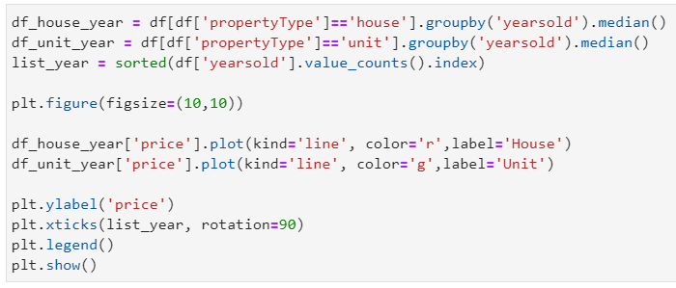
Canberra Real Estate Pricing Trend Throughout the Years Based on Its Property Type
Canberra
Real Estate Sales 2007- 2019
Benedict Laiman

Slide 27
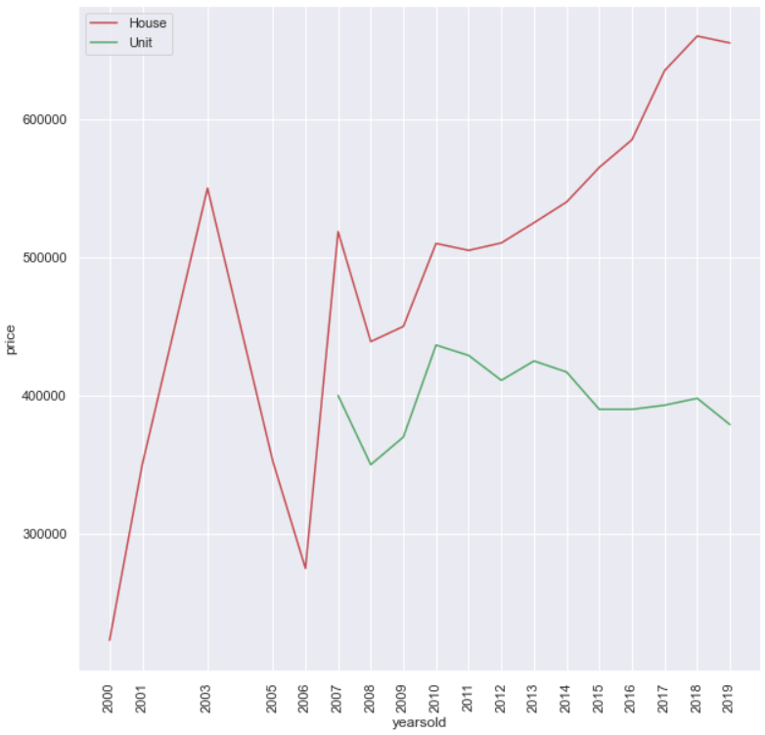
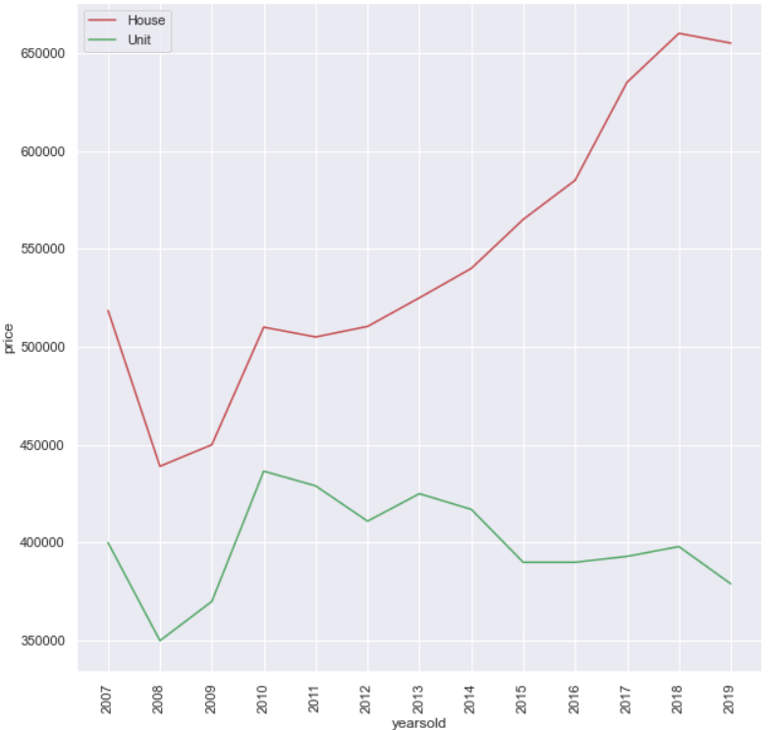
Canberra Real Estate Pricing Trend Throughout the Years Based on Its Property Type
Canberra
Real Estate Sales 2007- 2019
Benedict Laiman

Slide 28
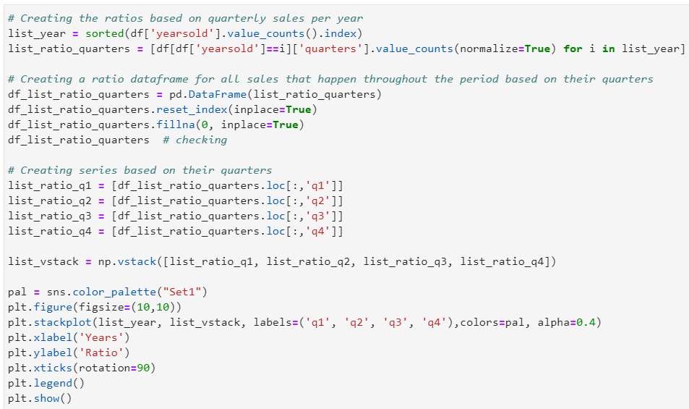
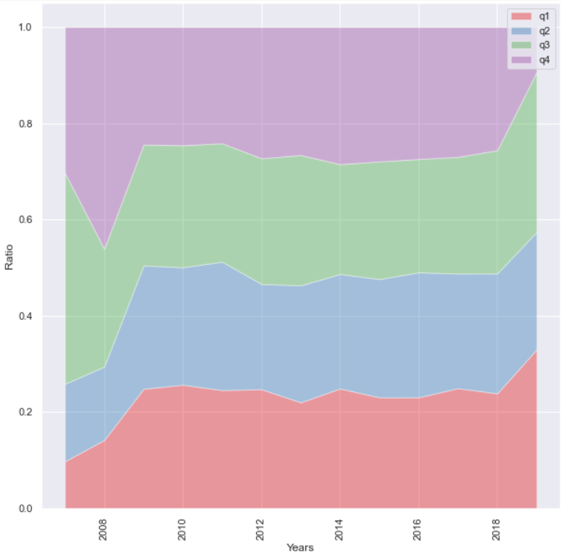
Performance of Real Estate Sales Based on Yearly Quarters
Throughout 2007 to 2019 there were some fluctuations in the amount of real estate sales per quarter. However, the ratios of sales among all quarters were relatively the same. In addition, only the 4th quarter experienced a decline in real estate sales in 2019.
Canberra
Real Estate Sales 2007- 2019
Benedict Laiman

Slide 29
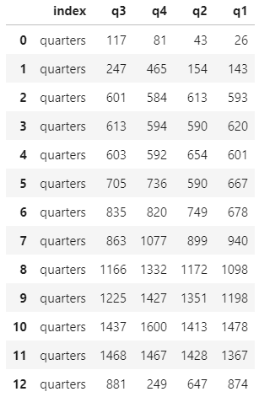
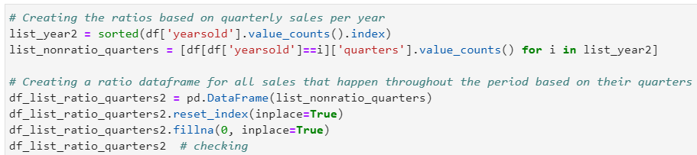
Hypothesis Testing Using Kruskal Wallis Test
Canberra
Real Estate Sales 2007- 2019
Benedict Laiman

Slide 30
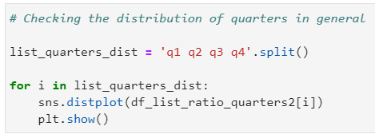
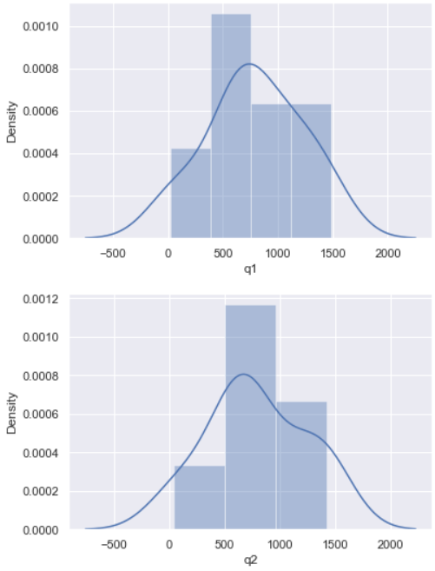
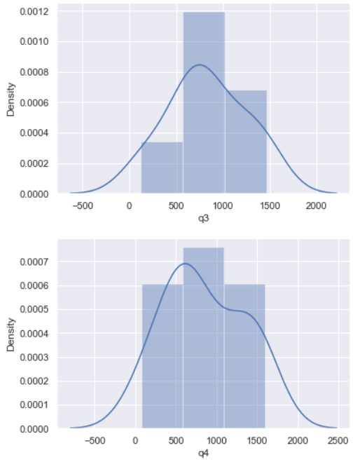
Hypothesis Testing Using Kruskal Wallis Test
Canberra
Real Estate Sales 2007- 2019
Benedict Laiman

Slide 31
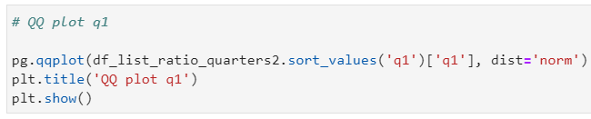
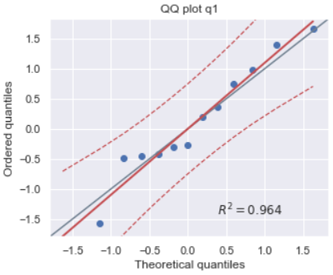
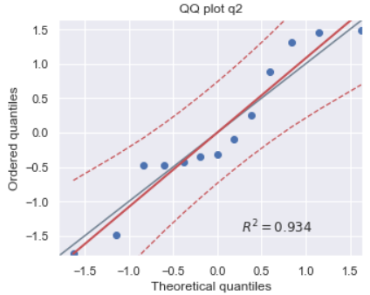
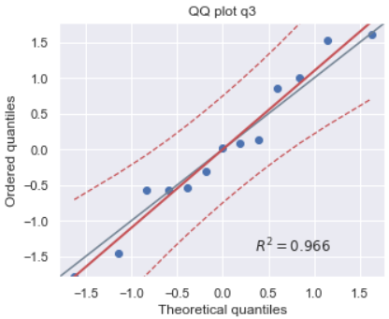
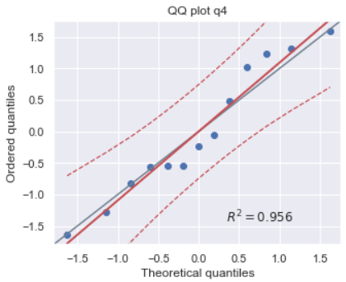
Hypothesis Testing Using Kruskal Wallis Test
Canberra
Real Estate Sales 2007- 2019
Benedict Laiman

Slide 32
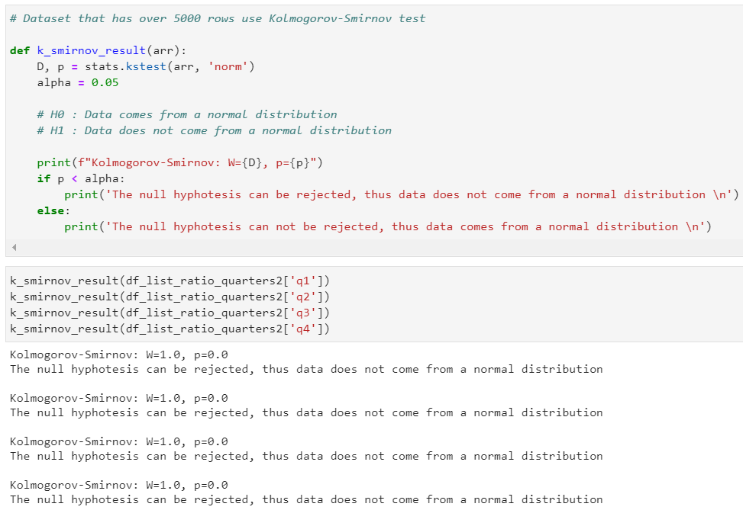
Hypothesis Testing Using Kruskal Wallis Test
The distribution for each quarter is relatively not normal.
Canberra
Real Estate Sales 2007- 2019
Benedict Laiman

Slide 33
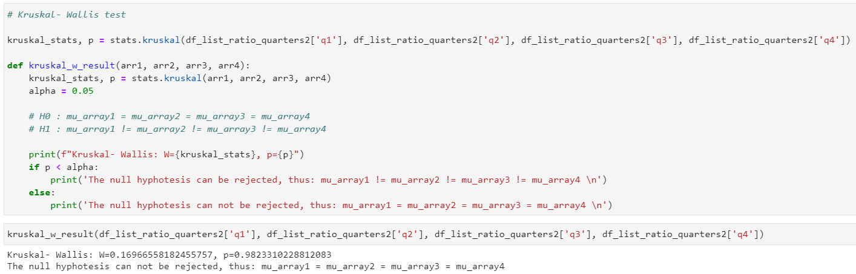
Hypothesis Testing Using Kruskal Wallis Test
Through this Kruskal- Wallis test it is proven that sales among all quarters were relatively the same.
Canberra
Real Estate Sales 2007- 2019
Benedict Laiman

Slide 34


Performance of Real Estate Sales Based on Yearly Seasons
It can be seen through the stack plot that the amount of real estate sales in the winter season was commonly lower than other seasons.
Canberra
Real Estate Sales 2007- 2019
Benedict Laiman

Slide 35

Ranking of Suburbs in Canberra Solely Based on Real Estate Sales Throughout the Period
Canberra
Real Estate Sales 2007- 2019
Benedict Laiman

Slide 36

Distribution of Suburbs Real Estate Sales Throughout the Period in Canberra Based on Property Type
Canberra
Real Estate Sales 2007- 2019
Benedict Laiman

Slide 37


20 Suburbs with the Highest Amount of Real Estate Sales Grouped By Their Property Type
Canberra
Real Estate Sales 2007- 2019
Benedict Laiman

Slide 38

Unit sales outweigh house sales
Canberra
Real Estate Sales 2007- 2019
Benedict Laiman

Slide 39

House sales outweigh unit sales
Canberra
Real Estate Sales 2007- 2019
Benedict Laiman

Slide 40

5 Suburbs with the Highest Amount of Real Estate Sales
Canberra
Real Estate Sales 2007- 2019
Benedict Laiman

Slide 41

5 Suburbs with the Least Amount of Real Estate Sales
Canberra
Real Estate Sales 2007- 2019
Benedict Laiman

Slide 42



Real Estate Pricing Trend Over the Years Based on Suburbs and Property Type
Canberra
Real Estate Sales 2007- 2019
Benedict Laiman

Slide 43

Real Estate Pricing Trend Over the Years Based on Suburbs and Property Type
Canberra
Real Estate Sales 2007- 2019
Benedict Laiman

Slide 44

Real Estate Pricing Trend Over the Years Based on Suburbs and Property Type
Canberra
Real Estate Sales 2007- 2019
Benedict Laiman

Slide 45

Real Estate Pricing Trend Over the Years Based on Suburbs and Property Type
Canberra
Real Estate Sales 2007- 2019
Benedict Laiman

Slide 46

Real Estate Pricing Trend Over the Years Based on Suburbs and Property Type
Canberra
Real Estate Sales 2007- 2019
Benedict Laiman

Slide 47

Real Estate Pricing Trend Over the Years Based on Suburbs and Property Type
Canberra
Real Estate Sales 2007- 2019
Benedict Laiman

Slide 48


Ideal Houses in Top 5 Suburbs with the Highest House Sales Throughout 2007 to 2019
Canberra
Real Estate Sales 2007- 2019
Benedict Laiman

Slide 49


Ideal Houses in Top 5 Suburbs with the Highest House Sales Throughout 2007 to 2019
Canberra
Real Estate Sales 2007- 2019
Benedict Laiman

Slide 50

Ideal Houses in Top 5 Suburbs with the Highest House Sales Throughout 2007 to 2019
Canberra
Real Estate Sales 2007- 2019
Benedict Laiman

Slide 51


Ideal Units in Top 5 Suburbs with the Highest Unit Sales Throughout 2007 to 2019
Canberra
Real Estate Sales 2007- 2019
Benedict Laiman

Slide 52


Ideal Units in Top 5 Suburbs with the Highest Unit Sales Throughout 2007 to 2019
Canberra
Real Estate Sales 2007- 2019
Benedict Laiman

Slide 53

Ideal Units in Top 5 Suburbs with the Highest Unit Sales Throughout 2007 to 2019
Canberra
Real Estate Sales 2007- 2019
Benedict Laiman

Slide 54

Ranking of Postal Codes in Canberra Solely Based on Real Estate Sales Throughout the Period
Canberra
Real Estate Sales 2007- 2019
Benedict Laiman

Slide 55

Distribution of Postal Codes Real Estate Sales Throughout the Period in Canberra Based on Property Type
Canberra
Real Estate Sales 2007- 2019
Benedict Laiman

Slide 56


20 Suburbs with the Highest Amount of Real Estate Sales Grouped By Their Property Type
Canberra
Real Estate Sales 2007- 2019
Benedict Laiman

Slide 57

Parking Lots and Price Relationship
Canberra
Real Estate Sales 2007- 2019
Benedict Laiman

Slide 58

Bathrooms and Price Relationship
Canberra
Real Estate Sales 2007- 2019
Benedict Laiman

Slide 59

Bedrooms and Price Relationship
Canberra
Real Estate Sales 2007- 2019
Benedict Laiman

Slide 60

Conclusion
It can be seen through this heat map that bedrooms and bathrooms are the top two features with the highest correlation value with the price. Meanwhile, parking and the rest of the features have fairly moderate and relatively low correlation values.
In addition, the exact day and month when the property was sold has no implication to the price of the property. On the other hand, the year when the property was sold and the location of the property that is conveyed through postal code have minor implications to the price.
Canberra
Real Estate Sales 2007- 2019
Benedict Laiman

