Slide 1
Insurance Company
Machine Learning and Insights
Benedict Laiman - October 2023

Slide 2
Project Structure
01
Introduction
04
Recommender System
02
Exploratory Data Analysis
05
Customer Segmentation
03
Binary Classification
06
Further Insights

Slide 3
Introduction
Project Goals
Raw Data
1. ID | 6. Insurance Type | 11. Policy Type
2. Customer ID | 7. Age | 12 Policy Category
3. City Code | 8. Married | 13. Premium Amount
4. Region Code | 9. Plan Code | 14. Response
5. Accomodation Ownership | 10. Policy Duration
Create a machine learning model to assist in selecting potential customers.
Develop a recommendation engine for new customers who share similar characteristics.
Segment customers based on their existing policies.
Extract insights from a given dataset.
01 - Introduction | 01-BenedictLaiman-DS-PP.ipynb

Slide 4
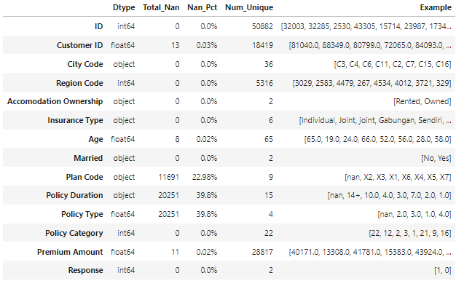
Exploratory Data Analysis
Preprocessing
1. Dropping 'ID' Column | 5. Fixing data types in certain columns
2. Removing missing values rows in several features namely 'Customer ID', 'Age', and 'Premium Amount' | 6. Dealing with multiple entries of customers
3. Categorizing variables in 'Insurance Type' column into 'Individual' and 'Joint' | 7. Organizing columns into numerical and categorical
4. Dealing with missing values in 'Plan Code,' 'Policy Duration,' and 'Policy Type' | 8. Descriptive Statistic Analysis & Feature Engineering
Raw Data
02 - EDA | 01-BenedictLaiman-DS-PP.ipynb

Slide 5
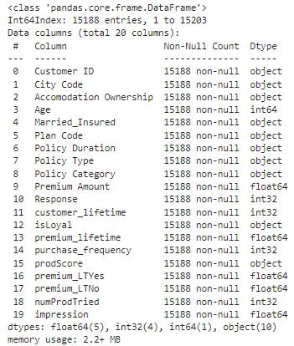
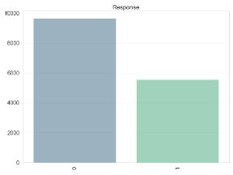
Exploratory Data Analysis
The numerical features are not normally distributed
The response label exhibits an imbalance
Engineered Features
After implementing various preprocessing techniques that give more emphasis to the class 1 variable, the 'Response' column is less imbalanced compared to its previous state.
02 - EDA | 01-BenedictLaiman-DS-PP.ipynb

Slide 6
Binary Classification
Assumptions
Features
H0
Married_Insured | Policy Category
Plan Code | Premium Amount
Policy Duration | premium_lifetime
Policy Type | impression
Customers do not buy the insurance product
H1
Customers buy the insurance product
Steps
False positives and false negatives play equally important roles in determining which customers are going to buy the insurance product.
1. Preprocessing | 3. Fine-tuning the Benchmark Classifier Models
2. Creating Benchmark Classifier Models | 4. Creating Final Classifier Model
Metric: F1 Score
03 - Binary Classification | 03-BenedictLaiman-DS-model-BC.ipynb
Notes:
Having more false positives means that more customers are assumed to buy the insurance product; however, in reality, none of them will buy the product, and the company has already spent marketing budget to try to acquire these customers. On the other hand, having more false negatives means that many customers are assumed not to buy the insurance product, while in reality, they are going to buy the product. Hence, potential revenues from these customers are lost.
Therefore, the metric to be used is the 'F1 score.' The F1 score is the harmonic mean between precision and recall, giving equal attention to both false positives and false negatives. It is also a suitable metric to use in an imbalanced dataset.
4 classifier models: Logreg, KNN, RFC, GBC
Xlist_num = X.select_dtypes(exclude='object').columns # numerical features | 'Premium Amount', 'premium_lifetime', 'impression'
Xlist_stdScaler = ['Premium Amount', 'impression'] # Standard scaler | 'Premium Amount', 'impression'
Xlist_robScaler = ['premium_lifetime'] # Robust scaler | 'premium_lifetime'
Xlist_cat = X.select_dtypes(include='object').columns # categorical features | 'Married_Insured', 'Plan Code', 'Policy Duration', 'Policy Type', 'Policy Category'
Xlist_ord = ['Policy Duration'] # ordinal encoding | 'Policy Duration'
Xlist_nom = [i for i in Xlist_cat if i not in Xlist_ord] # oneHot encoding | 'Married_Insured', 'Plan Code', 'Policy Category', 'Policy Type'
logreg_hparam = {
'clf__C':[100, 10, 1, 0.1, 0.01, 0.001],
'clf__penalty': ['l1', 'l2','elasticnet'],
'clf__solver': ['liblinear', 'newton-cg']
}
Logistic Regression Best Parameters: {'clf__C': 10, 'clf__penalty': 'l2', 'clf__solver': 'liblinear'}
knc_hparam = {
'clf__n_neighbors':[3, 5, 7, 9, 11, 13, 15],
'clf__weights': ['uniform', 'distance'],
'clf__metric': ['minkowski','euclidean','manhattan']
}
KNC Best Parameters: {'clf__metric': 'manhattan', 'clf__n_neighbors': 13, 'clf__weights': 'uniform'}
rfc_hparam = {
'clf__max_depth': [int(i) for i in np.linspace(10,150, 5)],
'clf__min_samples_split' : [2, 4],
'clf__min_samples_leaf' : [1, 3],
'clf__n_estimators' : [100, 300]
}
RFC Best Parameters: {'clf__max_depth': 45, 'clf__min_samples_leaf': 1, 'clf__min_samples_split': 4, 'clf__n_estimators': 300}
gbc_hparam = {
'clf__max_depth': [2, 3, 5],
'clf__min_samples_split' : [2, 4],
'clf__min_samples_leaf' : [1, 3],
'clf__n_estimators' : [100, 300]
}
GBC Best Parameters: {'clf__max_depth': 3, 'clf__min_samples_leaf': 3, 'clf__min_samples_split': 2, 'clf__n_estimators': 300}

Slide 7
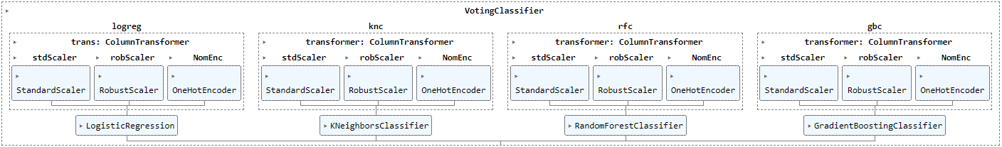
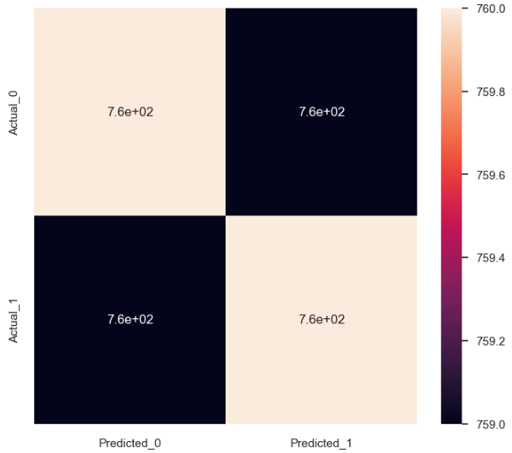
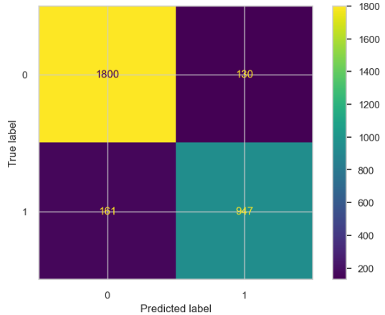
Final Classifier Model
F1
137%
83%
Marketing Expense
Misallocation Expense
0.90
79%
25%
No Skill
Final Classifier
Revenue Loss
Revenue
Overall, the final classifier model reduces marketing and sales expenses by 220% and increases revenue by 103% compared to the random-guessing model.
03 - Binary Classification | 03-BenedictLaiman-DS-model-BC.ipynb
Notes:
Macro Average F1: .90
Logistic Regression Best Parameters: {'clf__C': 10, 'clf__penalty': 'l2', 'clf__solver': 'liblinear'}
KNC Best Parameters: {'clf__metric': 'manhattan', 'clf__n_neighbors': 13, 'clf__weights': 'uniform'}
RFC Best Parameters: {'clf__max_depth': 45, 'clf__min_samples_leaf': 1, 'clf__min_samples_split': 4, 'clf__n_estimators': 300}
GBC Best Parameters: {'clf__max_depth': 3, 'clf__min_samples_leaf': 3, 'clf__min_samples_split': 2, 'clf__n_estimators': 300}

Slide 8
Recommender System
Preprocessing Steps
User-Based Collaborative Filtering
KNN & Cosine Distance | Pearson Correlation
Locating the closest items to the target item | Identifying the most similar customers to the target customers and providing recommendations based on their Pearson Correlation and ratings
1. Creating ‘Scoring’ column | 5. Mapping the 'prodScore'
2. Creating ‘prodScore’ column | 6. Dropping duplicate data
3. Selecting only customers who have tried the insurance product 'more than' once | 7. Selecting only data with positive ratings
4. Creating the MN matrix | 8. Standardizing the customers' ratings
04 - Recommender System | 04-BenedictLaiman-DS-model-RS.ipynb
Notes:
Creating ‘Scoring’ column
Creating ‘prodScore’ column
Selecting only customers who have tried the insurance product 'more than' once, as these customers can provide recommendations to other similar customers who have only purchased 1 product in the past
Creating the MN matrix, with M representing rows for customers and N representing columns for a list of unique insurance products ('Plan Code' items).
Mapping the 'prodScore', insurance products customers have tried and also the ratings to the 'custScoring' data frame
Dropping duplicate data
Selecting only data with positive ratings, as there is no point in recommending insurance products that other customers dislike
Standardizing the customers' ratings using their mean to mitigate variations in rating styles, such as customers who are 'tough critics' and those who are more generous in giving product ratings

Slide 9
Customer Segmentation
01
02
03
04
CS General
Based on ‘Plan Code’
Based on ‘Premium Amount’
Further Insights
Customer Segmentation Without Relying on Plan Code
Using groupby()
Using groupby()
Exploring in more detail…
Using KPrototypes Algo
05 - Customer Segmentation | 05-BenedictLaiman-DS-model-CS.ipynb

Slide 10
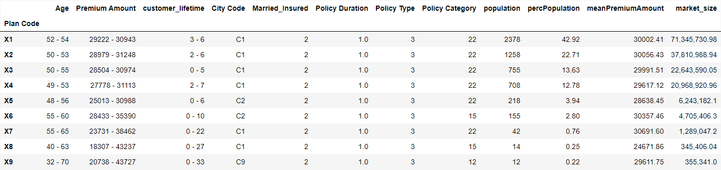
Customer Segmentation
Heterogen
Homogen
Highest
CS General
Plan Code-based CS
05 - Customer Segmentation | 05-BenedictLaiman-DS-model-CS.ipynb
Notes:
CS General
Without relying on the 'Plan Code' or predefined segments as the basis for customer segmentation, it becomes evident that Profile 2 holds the largest market size, even though its population percentage (approximately 36%) is smaller than that of the largest population holder, which is customers in Profile 0 (with a population percentage of around 42%).
All customer segments exhibit the same characteristics in the 'Married_Insured,' 'Plan Code,' 'Policy Duration,' 'Policy Type,' and 'Policy Category' features. This implies that the majority of customers are not married, they potentially purchase insurance products for themselves only, predominantly opt for the X1 insurance product, have short active policy durations (1 year only), and their 'Policy Type' and 'Policy Category' are 3 and 22, respectively.
The most notable differences among these segments, aside from their population variances, are observed in their 'Age', 'Premium Amount', 'Customer Lifetime', and 'City Code' features.
Let's see if the customers exhibit the same characteristics when customer segmentation is based on 'Plan Code', which represents the insurance products
Plan Code-based CS
It can be see that the majority of customers buy X1 product, around 43%, this percentage is almost equal to the total percentage of X2, X3, X4 customers, which is at around 49%. In contrast x5 and x6 products are considered a niche products because these customers are at approximately 4% and 3%, respectively. Furthermore, X8 and x9 products are for the super niche segments as the total customer percentage of these segments are around 0.5%.
Since the difference in the average premium amount for X1, X2, X3, and X4 is negligible, the company should prioritize focusing on X1, followed by X2, X3, and X4 products, as they have the largest market share among customers based on insurance products. X1 holds the biggest market size within the overall segments.
Marketers can use this profile as a guide for their marketing strategies, encompassing the 4Ps (price, place, product, promotion), to effectively target and engage with their customers while selecting the most profitable segments.
Furthermore, the same characteristics that were observed in the customer segmentation without relying on the 'Plan Code' (CS General) appear in this customer segmentation (Plan Code-based CS). In both cases, all segments exhibit the same traits in the 'Married_Insured,' 'Policy Duration,' and 'Policy Type' features. However, the characteristic found in CS General, where all segments exhibit the same traits in the 'Policy Category' column, is not present in this Plan Code-based CS.
The most notable differences among these segments, apart from their population variances, are observed in their 'Age,' 'Premium Amount,' 'Customer Lifetime,' and 'City Code' features, just as seen in CS General.
Let's investigate whether customers exhibit the same characteristics when customer segmentation is based on 'Premium Amount' that has been quantile-binned.

Slide 11
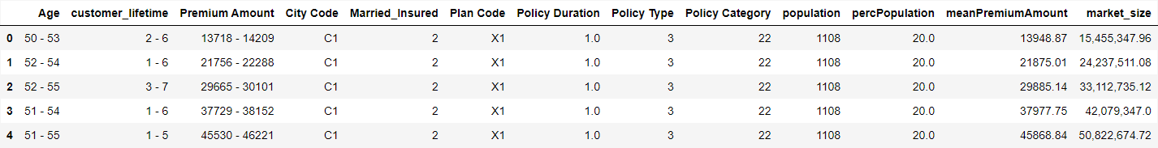
Customer Segmentation
Heterogen
Homogen
Highest
Premium Amount-based CS
Current Trend Findings
Notable Difference
Same Traits Exhibition
Marketing Strategies
'Age', 'customer_lifetime', 'Premium Amount' features
In most types of customer segmentation
'Married_Insured,' ‘Policy Duration’, 'Policy Type,' 'Policy Category', and/or 'Plan Code' features
4Ps Product, Price, Place, Promotion
05 - Customer Segmentation | 05-BenedictLaiman-DS-model-CS.ipynb
Notes:
Premium Amount-based CS
Since the customer segmentation based on 'Premium Amount' that has been quantile-binned results in the same frequency/population for each of the segments, the only factor influencing the market size in each segment is the average Premium Amount found in 'meanPremiumAmount'. The largest market size in this customer segmentation is in segment/cluster/profile 4, while the smallest market size is in segment 0.
Furthermore, the table above also reveals that the same characteristics found in CS General and Plan Code-based CS are also present in Premium Amount-based CS. In all these types of customer segmentation, all segments exhibit the same traits in the 'Married Insured,' 'Policy Type,' and 'Policy Category' features. Additionally, all segments display the same traits in the 'Married_Insured' feature, as seen in CS General.
The most notable differences among these segments, aside from their 'meanPremiumAmount' variances, are observed in their 'Age' and 'customer_lifetime' features.

Slide 12
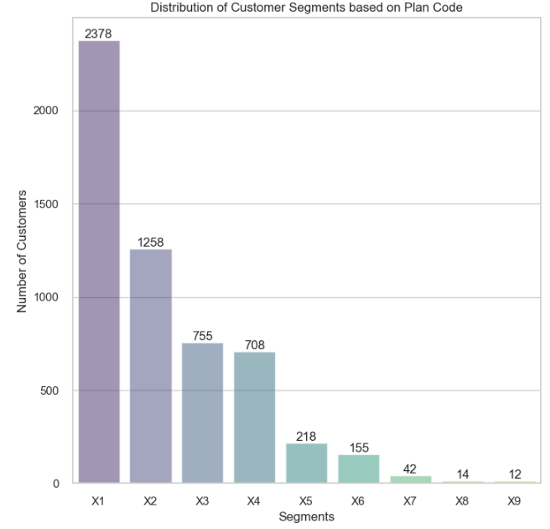
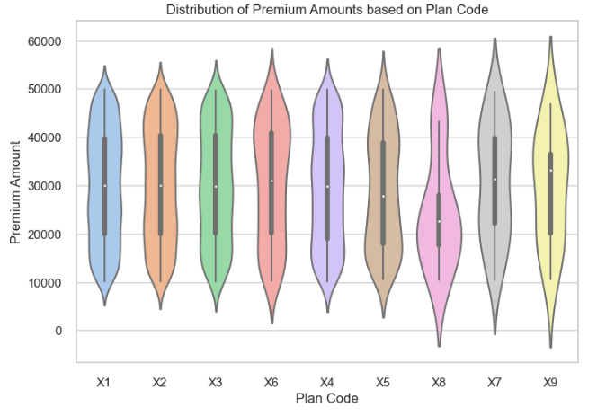
Further Insights
06 - Further Insights | 05-BenedictLaiman-DS-model-CS.ipynb
Notes:
This violin plot clearly indicates that nearly all segments have a similar distribution and median in the 'Premium Amount' feature, with the exception of the 'X8' segment

Slide 13
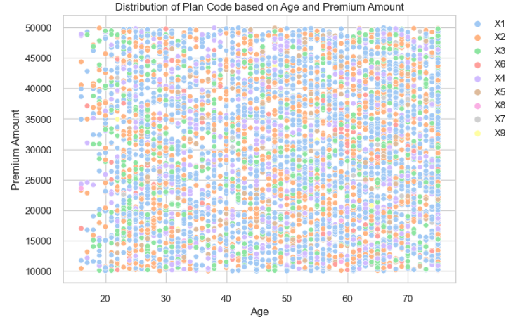
Further Insights
06 - Further Insights | 05-BenedictLaiman-DS-model-CS.ipynb
Notes:
The scatter plot above illustrates that the distribution of 'Plan Code' based on 'Age' and 'Premium Amount' is fairly consistent. Additionally, it reveals that X1, X2, X3, and X4 products dominate across various age groups and premium amounts.

Slide 14
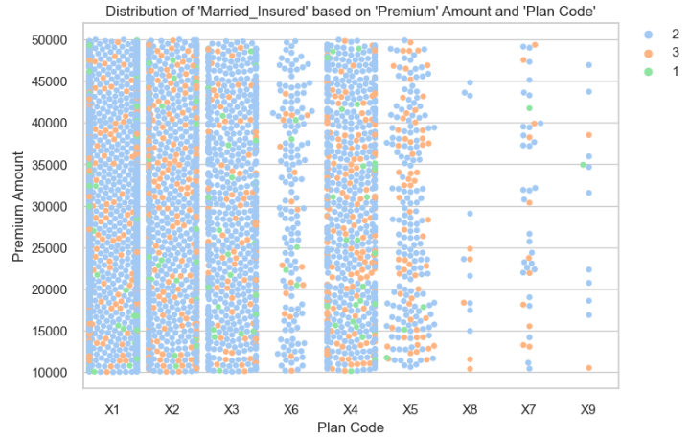
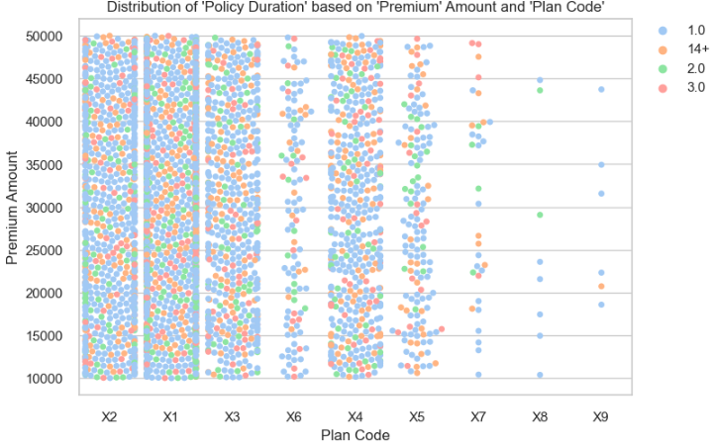
Further Insights
06 - Further Insights | 05-BenedictLaiman-DS-model-CS.ipynb
Notes:
By creating a swarm plot that displays 'Plan Code' against 'Premium Amount' and using the 'Married_Insured' column as the hue, underlying trends that were less visible before become evident.
Category 2 customers can be seen across the segments, confirming what the customer segmentation table has shown previously (Plan Code-based CS). However, it is also noticeable that there are several Category 3 and Category 1 customers in almost all of these segments. Category 3 customers are present in all segments, but they are more prominent in X1, X2, X3, X4, and X5 products. In contrast, Category 1 customers are more prominent in X1, X2, X3, and X4 products.
By plotting multiple swarm plots that display 'Plan Code' against 'Premium Amount' and using the 'Policy Duration' column as the hue, the underlying trend of the 'Policy Duration' variable distribution can be seen across the 'Plan Code' products
The 'Policy Duration' variables 1, 14+, 2, and 3 are prevalent in almost all insurance products, except for X8 and X9 products. These variables are more pronounced in all insurance products, except for X7, X8, and X9 products.
The remaining 'Policy Duration' variables are more noticeable in X1, X2, X3, and X4 products.

Slide 15
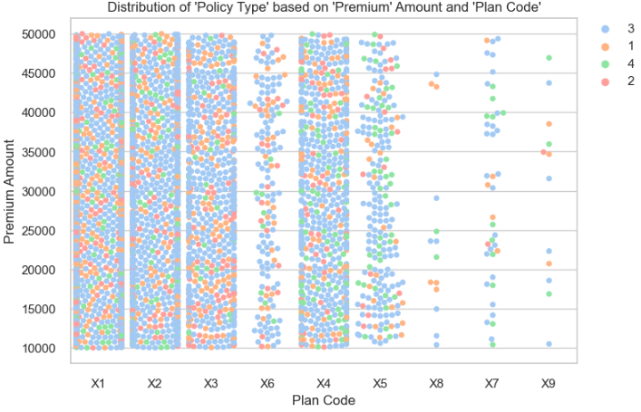
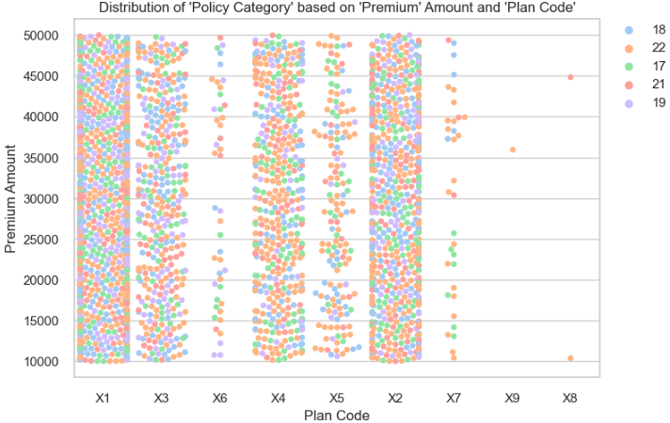
Further Insights
06 - Further Insights | 05-BenedictLaiman-DS-model-CS.ipynb
Notes:
Findings:
The trends for 'Married_Insured,' 'Policy Duration,' 'Policy Type,' and 'Policy Category,' which were previously unclear, have been revealed through these swarm plots. Most of the variables in these features are associated with the X1, X2, X3, and X4 products.
The most dominant variables in 'Plan Code,' 'Policy Duration,' 'Policy Type,' and 'Policy Category' are the X1 product, 1.0 year for policy duration, 3 for policy type, and 22 for policy category, respectively; these variables are found across all segments.
Marketers can utilize these plots as a guide to more effectively target their segments.

Slide 16
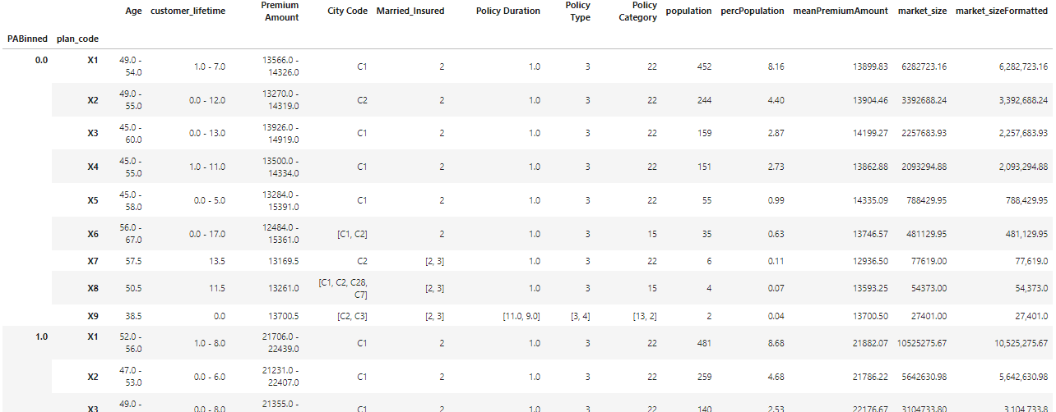
Conclusion
Takeaways
Swarm plots aid in visualizing data
Refined segmentation benefits marketing
Prioritize 'market_size' and tailor strategies
'Plan Code' and 'Premium Amount' that has been quantile-binned
06 - Further Insights | 05-BenedictLaiman-DS-model-CS.ipynb
Notes:
Conclusion:
By using a swarm plot, the underlying distribution of variables that might be difficult to discern in previous customer segmentation tables for various features can be observed more clearly
The customer segmentation table above is based on 'Premium Amount' that has been quantile-binned and the 'Plan Code' columns. Marketers could utilize this more refined customer segmentation and the swarm plots in their marketing strategies.
Furthermore, they could also prioritize the most profitable market segment by sorting the 'market_size' column and then employ the most suitable marketing strategies, including pricing strategies, media campaigns, and media channels, for each of the selected segments.

Slide 17
Thank you!

