Slide 1
Threshold Dynamics on Geometric Evolution Operators
Manuel Bolduc
Under the supervision of Professor Jean-Christophe Nave

Slide 2
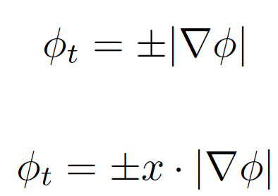
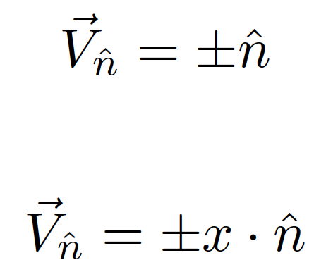
Flows of the type V=f(x,t,n)
Geometric Formulation
Level Set Formulation¹

Slide 3
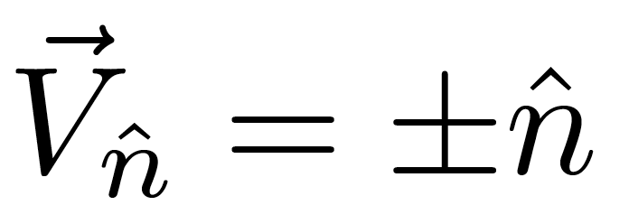


Slide 4
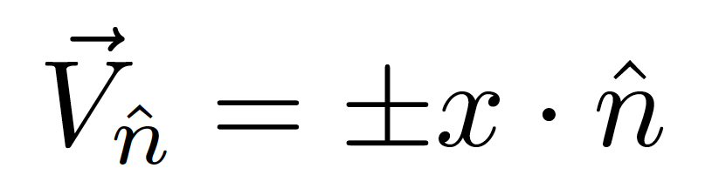
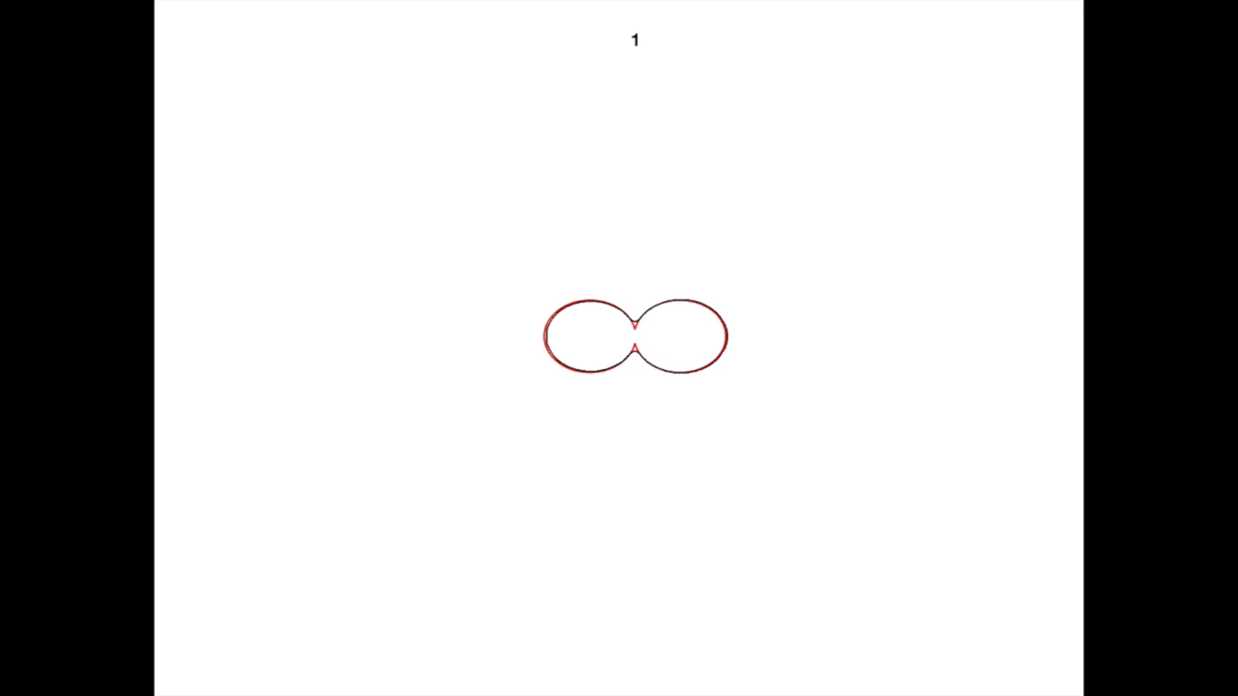

Slide 5
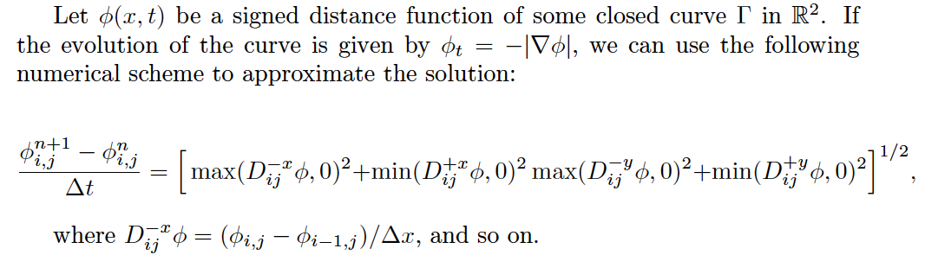
Numerical Scheme for the level set equation¹

Slide 6
Properties of the signed distance function
Can we use this to generate a more efficient numerical scheme?

Slide 7
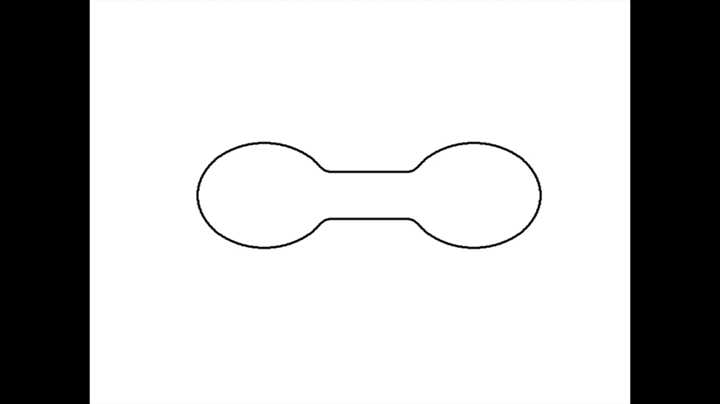
Simple Example of the MCF

Slide 8
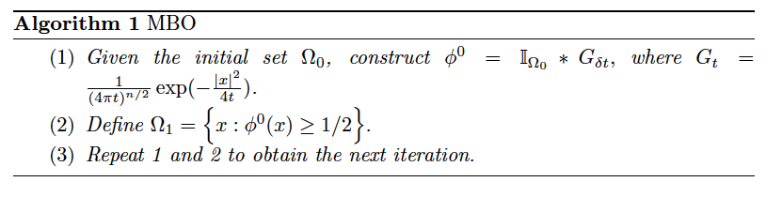
The MBO Algorithm²

Slide 9
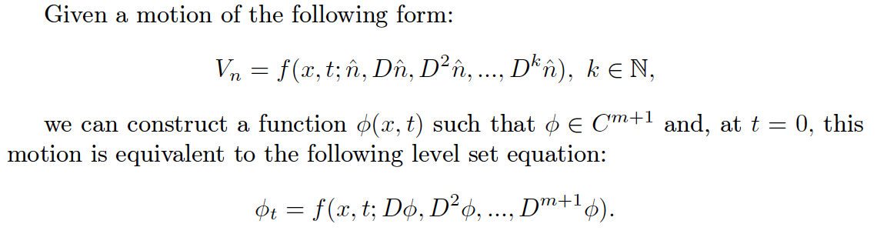

Generalizing this process

Slide 10
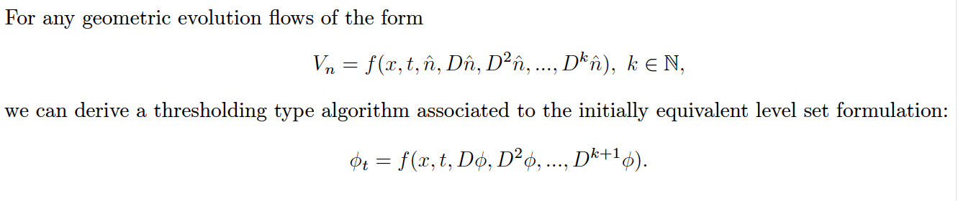
Main “Theorem”

Slide 11
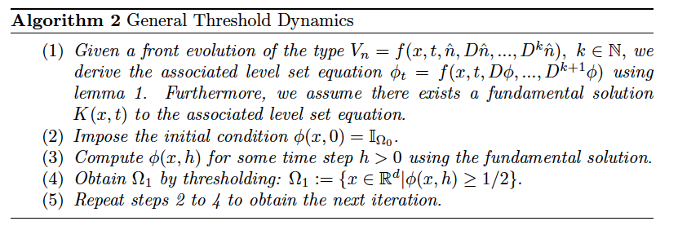
General Algorithm

Slide 12
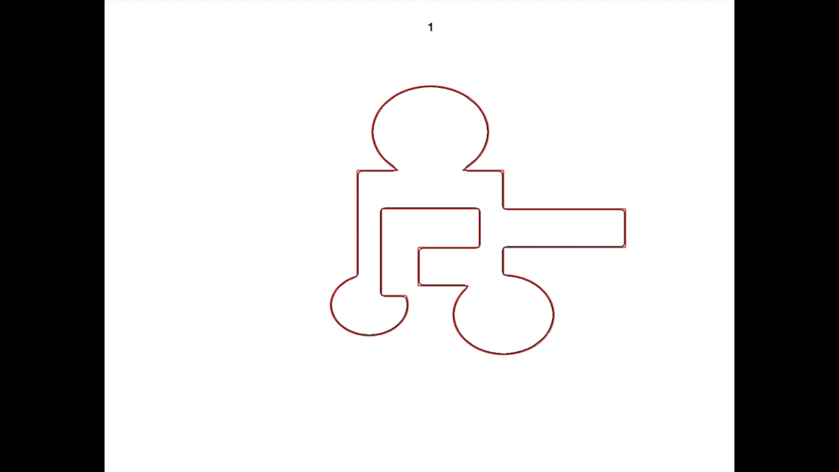
Examples:

Slide 13
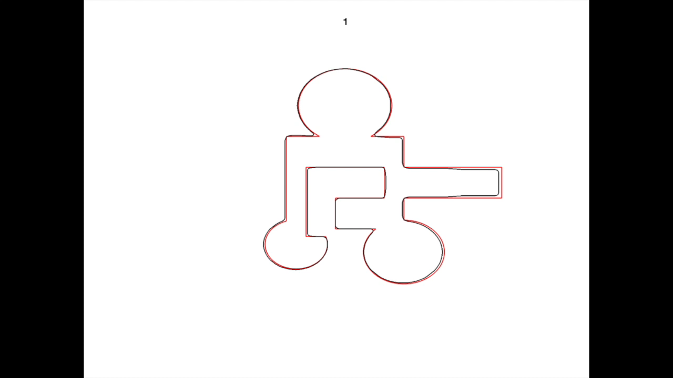

Slide 14
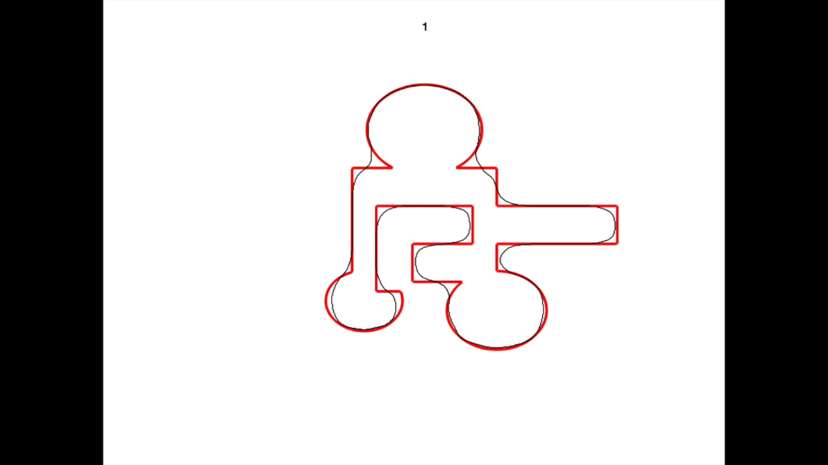
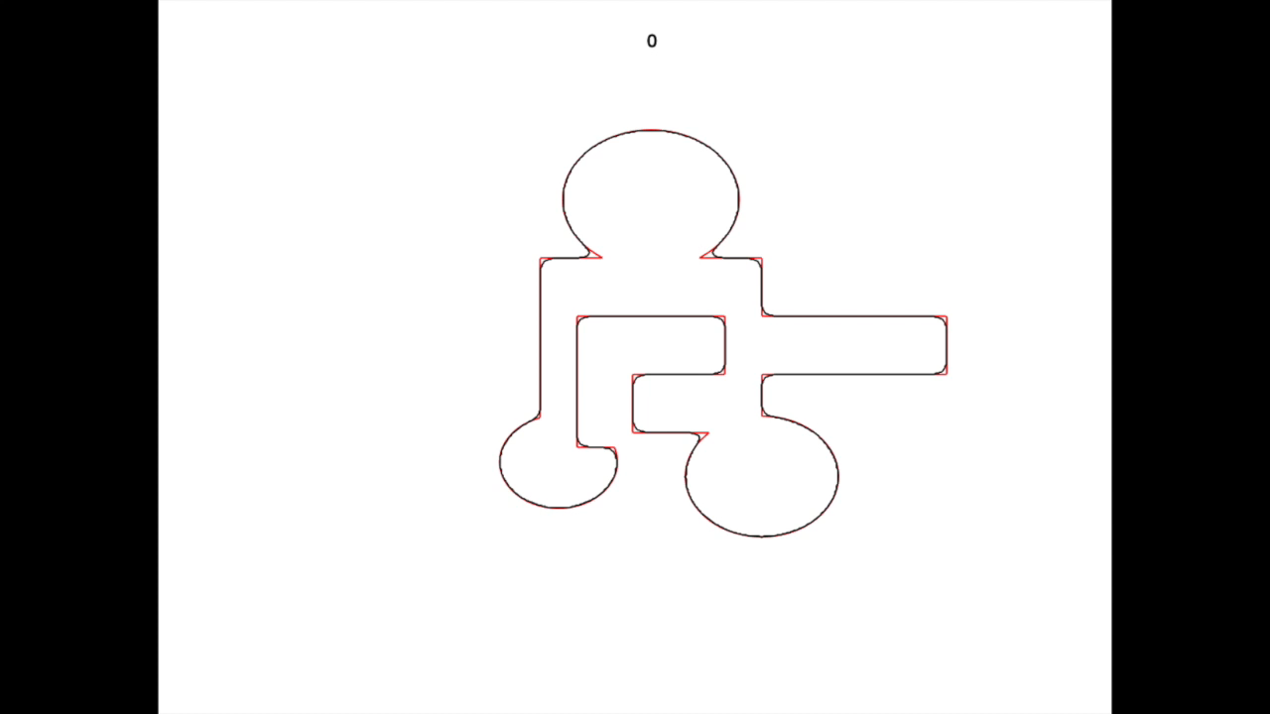
Gaussian Curvature Flow
Mean Curvature Flow

Slide 15
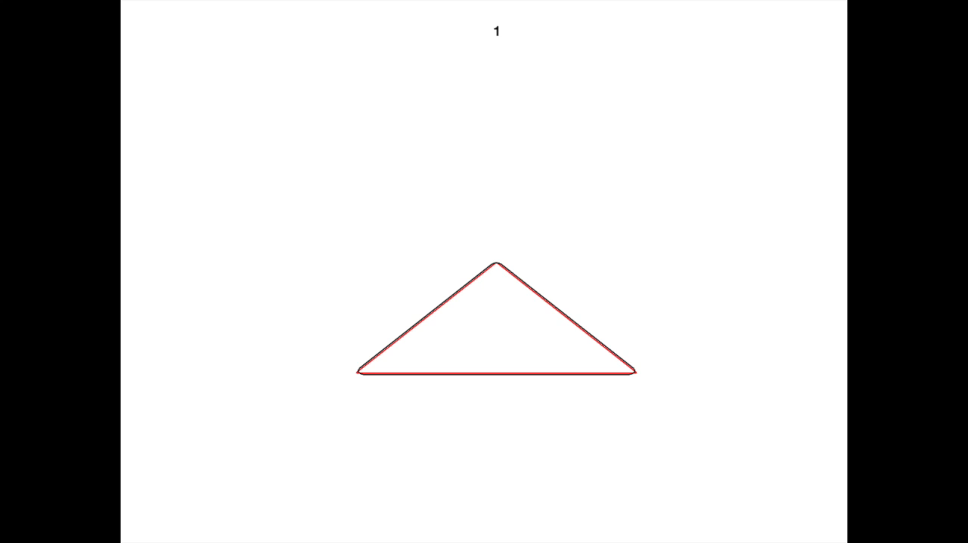
On the use of mollification

Slide 16
References
[1] Osher, S., Sethian, J.: Fronts Propagating with Curvature Dependent Speed: Algorithms Based on Hamilton-Jacobi Formulations. J. Comput. Phys. 79, 12-49 (1988)
[2] Merriman, B., Bence, J., Osher, S.: Diffusion Generated Motion by Mean Curvature. UCLA CAM Report 92-18 (1992)

