Slide 1
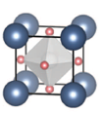
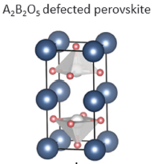
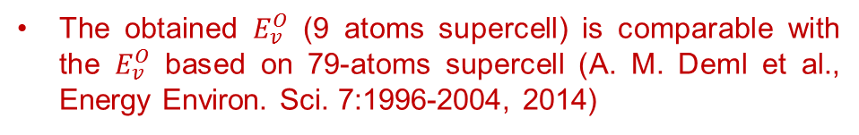
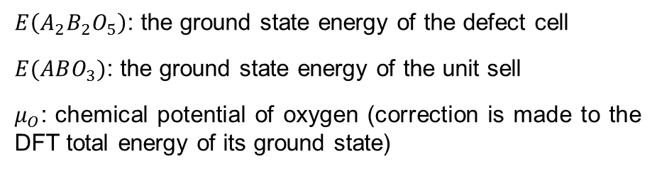

Training data
From: A. A. Emery and C. Wolverton, ‘High-throughput DFT calculations of formation energy, stability and oxygen vacancy formation energy of ABO3 perovskites’, Scientific Data, 4:170153, 2017.
ABO₃ perovskite unit cell
Oxygen vacancy formation energies are calculated using a cubic undistorted A₂B₂O₅ 9- atom supercell:
$$E_{v}^{O}=E\left(A_{2}B_{2}O_{5}\right)+μ_{O}−2E(ABO_{3})$$
(remove 1 O-atom)
$E\left(A_{2}B_{2}O_{5}\right)$: the ground state energy of the defect cell
$E(ABO_{3})$: the ground state energy of the unit sell
$μ_{O}$: chemical potential of oxygen (correction is made to the DFT total energy of its ground state)
5329 compositions
The obtained $E_{v}^{O}$ (9 atoms supercell) is comparable with the $E_{v}^{O}$ based on 79-atoms supercell (A. M. Deml et al., Energy Environ. Sci. 7:1996-2004, 2014)
2 cubic perovskite unit cells with an oxygen removed

Slide 2
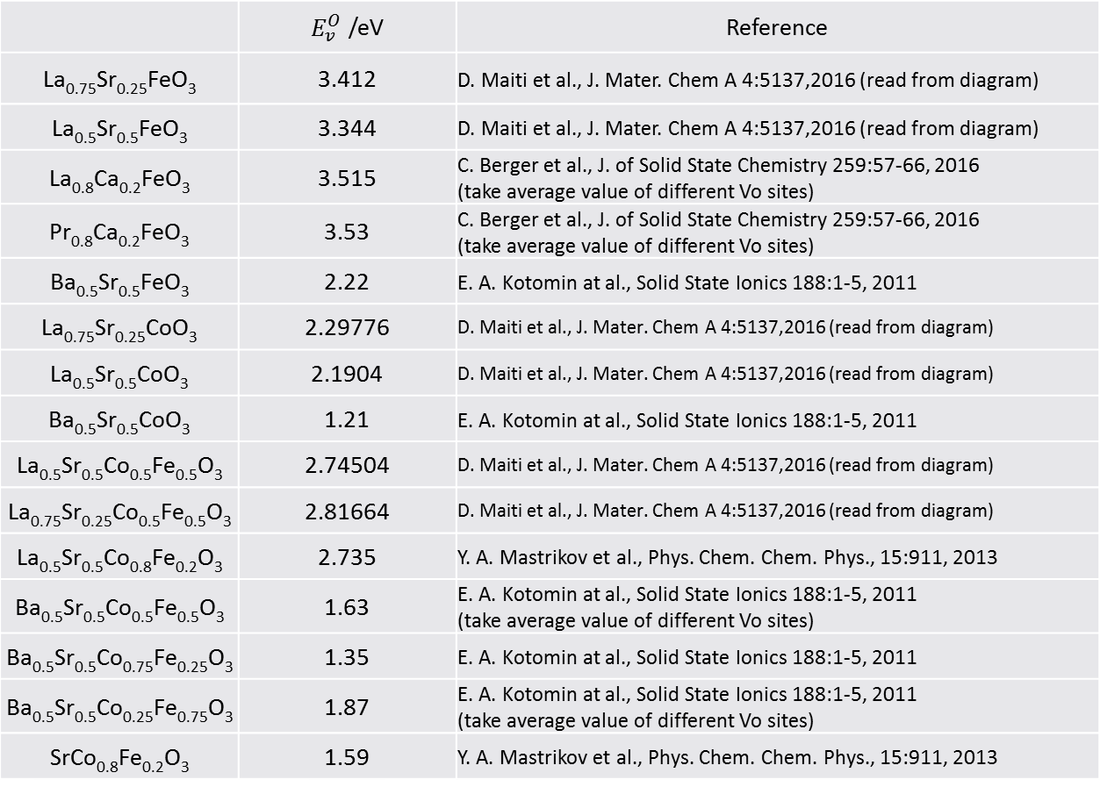
Validation and test data
Oxygen vacancy formation energy (removing 1 O-atom) calculated by DFT:
 |  | Reference
La_{0.75}Sr_{0.25}FeO₃ | 3.412 | D. Maiti et al., J. Mater. Chem A 4:5137,2016 (read from diagram)
La_{0.5}Sr_{0.5}FeO₃ | 3.344 | D. Maiti et al., J. Mater. Chem A 4:5137,2016 (read from diagram)
La_{0.8}Ca_{0.2}FeO₃ | 3.515 | C. Berger et al., J. of Solid State Chemistry 259:57-66, 2016 (take average value of different Vo sites)
Pr_{0.8}Ca_{0.2}FeO₃ | 3.53 | C. Berger et al., J. of Solid State Chemistry 259:57-66, 2016 (take average value of different Vo sites)
Ba_{0.5}Sr_{0.5}FeO₃ | 2.22 | E. A. Kotomin at al., Solid State Ionics 188:1-5, 2011
La_{0.75}Sr_{0.25}CoO₃ | 2.29776 | D. Maiti et al., J. Mater. Chem A 4:5137,2016 (read from diagram)
La_{0.5}Sr_{0.5}CoO₃ | 2.1904 | D. Maiti et al., J. Mater. Chem A 4:5137,2016 (read from diagram)
Ba_{0.5}Sr_{0.5}CoO₃ | 1.21 | E. A. Kotomin at al., Solid State Ionics 188:1-5, 2011
La_{0.5}Sr_{0.5}Co_{0.5}Fe_{0.5}O₃ | 2.74504 | D. Maiti et al., J. Mater. Chem A 4:5137,2016 (read from diagram)
La_{0.75}Sr_{0.25}Co_{0.5}Fe_{0.5}O₃ | 2.81664 | D. Maiti et al., J. Mater. Chem A 4:5137,2016 (read from diagram)
La_{0.5}Sr_{0.5}Co_{0.8}Fe_{0.2}O₃ | 2.735 | Y. A. Mastrikov et al., Phys. Chem. Chem. Phys., 15:911, 2013
Ba_{0.5}Sr_{0.5}Co_{0.5}Fe_{0.5}O₃ | 1.63 | E. A. Kotomin at al., Solid State Ionics 188:1-5, 2011 (take average value of different Vo sites)
Ba_{0.5}Sr_{0.5}Co_{0.75}Fe_{0.25}O₃ | 1.35 | E. A. Kotomin at al., Solid State Ionics 188:1-5, 2011
Ba_{0.5}Sr_{0.5}Co_{0.25}Fe_{0.75}O₃ | 1.87 | E. A. Kotomin at al., Solid State Ionics 188:1-5, 2011 (take average value of different Vo sites)
SrCo_{0.8}Fe_{0.2}O₃ | 1.59 | Y. A. Mastrikov et al., Phys. Chem. Chem. Phys., 15:911, 2013

Slide 3
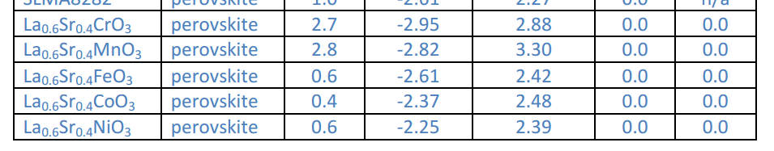

Slide 4
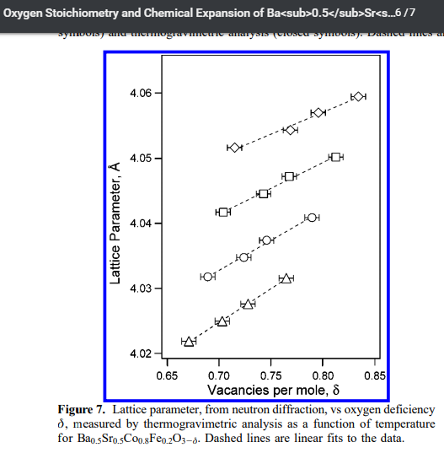
Validation and test data
Oxygen vacancy formation energy (removing 1 O-atom) calculated by DFT:

Slide 5
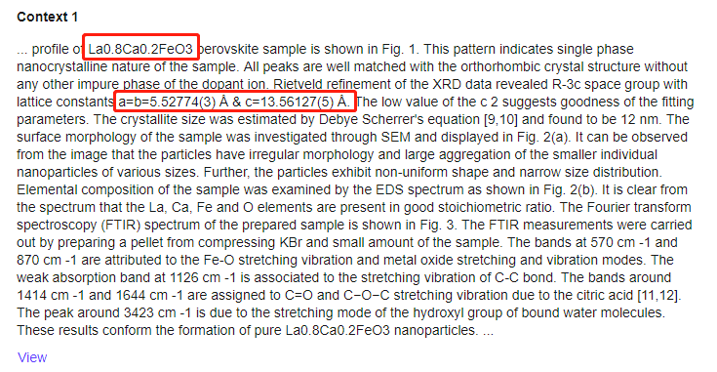

Slide 6
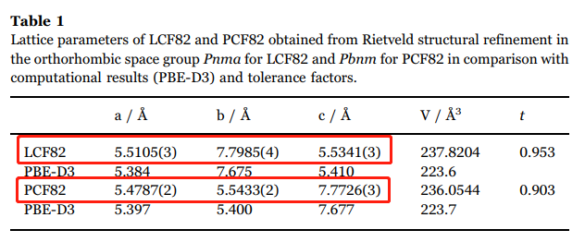

Slide 7
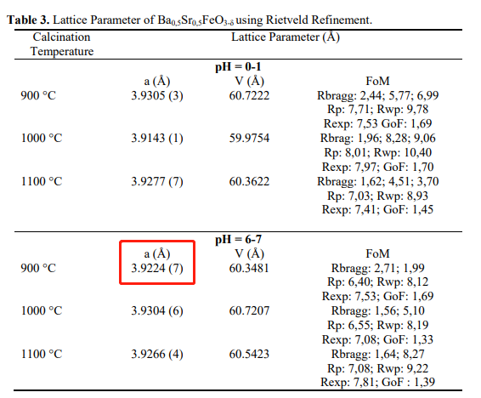

Slide 8
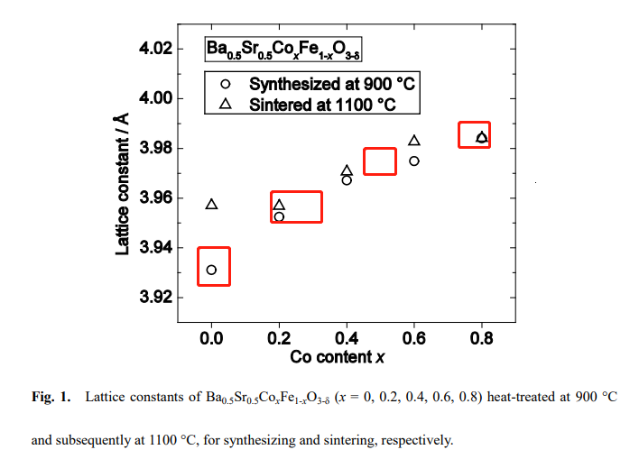

Slide 9
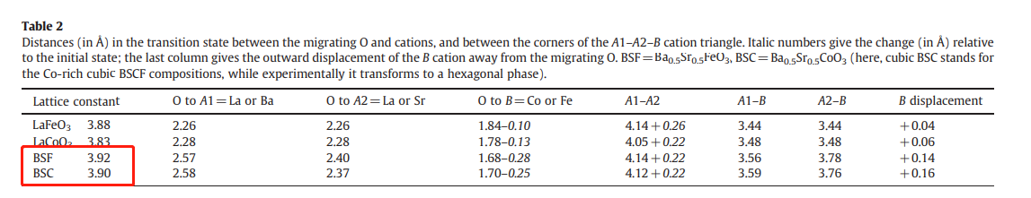

Slide 10
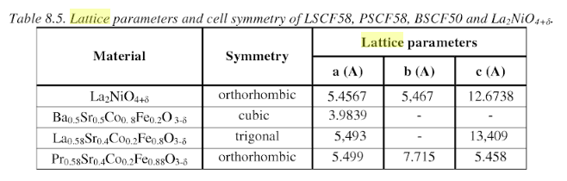

Slide 11
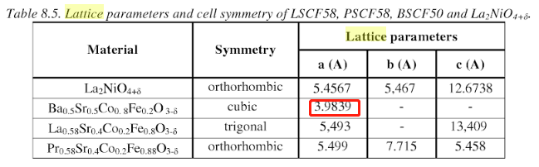

Slide 12
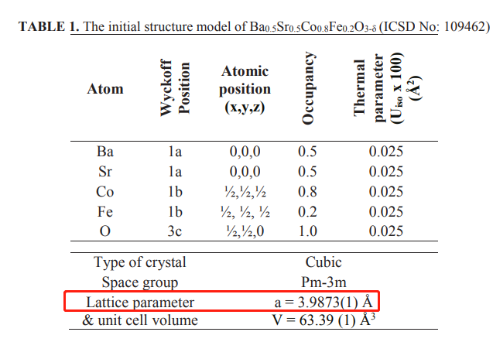

Slide 13
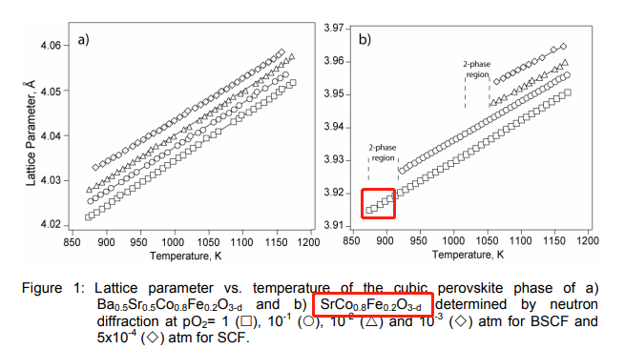

Slide 14
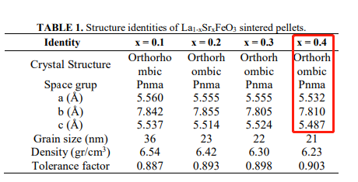

Slide 15
