Slide 1
Digital Modelling and Simulation
Team 3:
Jakub Błaszczyk
Przemysław Kozieł
Adam Kornacki
Tomasz Depta
Michał Szuścik
Olha Kalniei
Team 1:
Michał Witas
Adam Andrzejczak
Krzysztof Zieliński
Marcin Bojarski
Michał Danisz
Marcin Wojaczek
Switch controller project

Slide 2
Project goals
Create a simulated network topology according to the schema:
Create a semi-intelligent controller able to act as the gateway/firewall but working in parallel to the switch chain.
INTERNET (HOST) <-> GATEWAY/FIREWALL <-> SWITCH <-> ... <-> SWITCH <-> HOST

Slide 3
Project assumptions
Use the GNS (Graphical Network Simulator) to create the network with real (emulated*) machines (switches, routers if needed) to see the use of such a network in real life applications. * Emulated means that the machines run the real OS of machines (CISCO IOS)

Slide 4
Project architecture – GNS network
Use the GNS to build the network:
Hosts are simple VM hosts (created using Vagrant)
Switches are simple L2 machines
Controller is a more advanced VM (created using Vagrant)

Slide 5
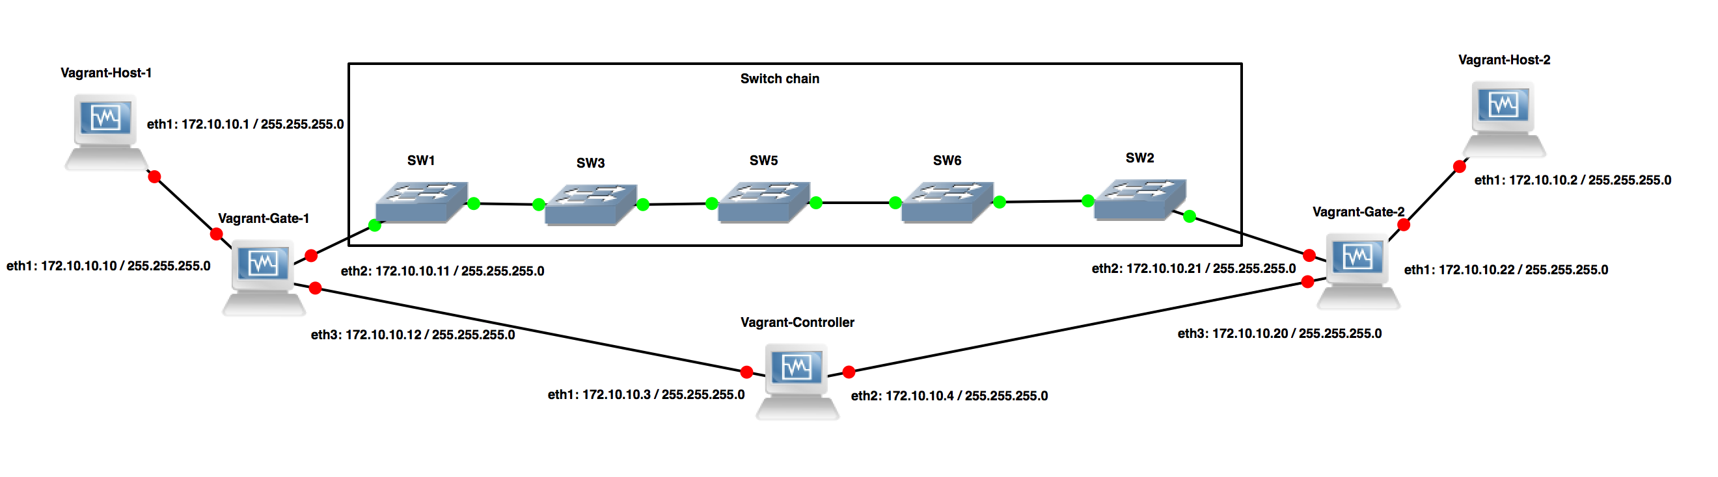
GNS network

Slide 6
GNS Solution outcome
Base network functions correctly (hosts are able to ping each other) and packets are copied to the controller.
This method has a great drawback: the packets are copied on the OS level creating a delay and using system resources
CISCO machines run by GNS do not support Openflow, requiring the controller to manage packets also on the OS level, which is not at all efficient.

Slide 7
GNS solution fix
To improve the performance we would need to incorporate the openflow mechanism into the network.
GNS offers a solution to this problem: use the Mininet VM as the controller + switch chain.
However this solution is not attractive as we can do the same using only Mininet.

Slide 8
Mininet solution

Slide 9
Project architecture
To properly develop the solution we have created a git repository: https://github.com/bolek117/mininet_sdn
We have used Vagrant to create a VM box to avoid downloading the reloading the whole VM each time.

Slide 10
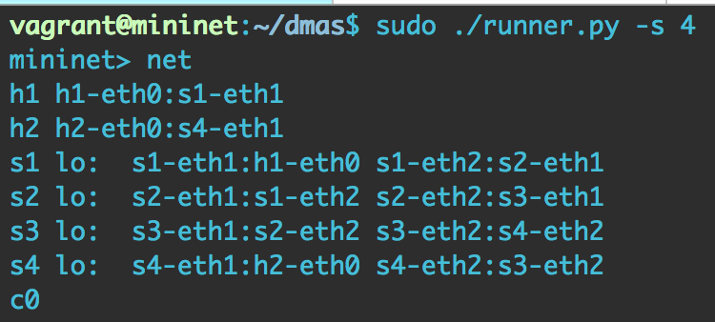
Mininet architecture

Slide 11
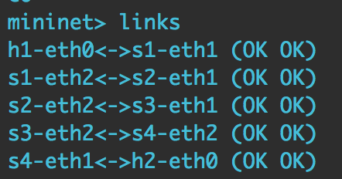
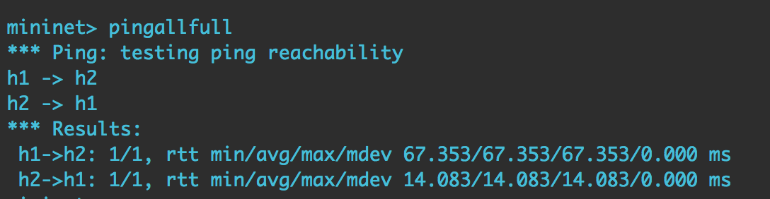
Connectivity

Slide 12
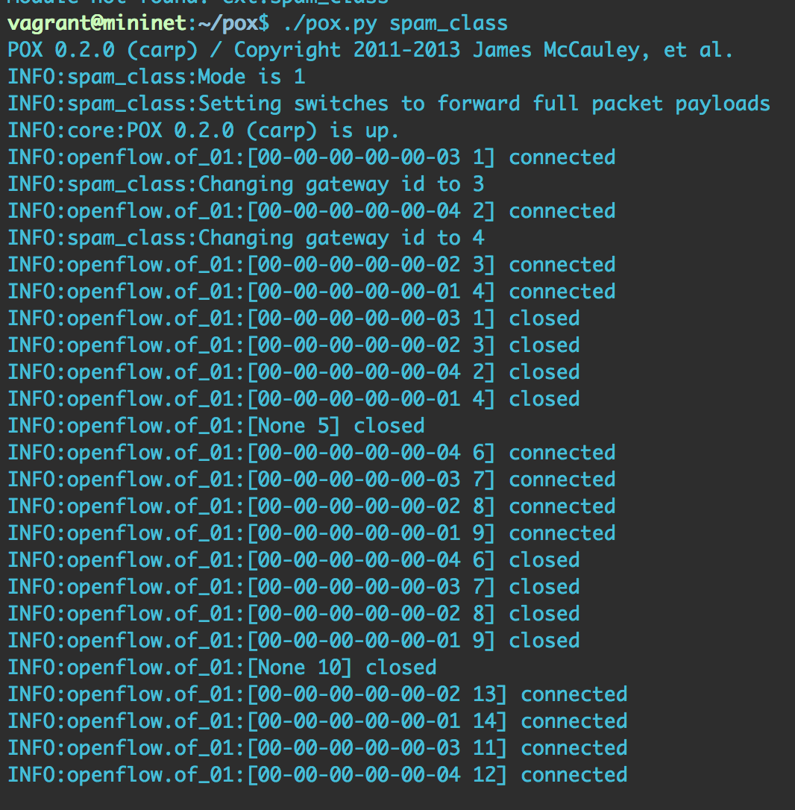
Mininet Controller

Slide 13
Main task: Spam filter
As spam filtering is relatively simple (we can search key-word in the email and judge the packets accordingly), so this task has been done in two ways:
1 – simple scanning in the controller basing on the email content and a banned word list.
2 – integration of a complex open source solution: SpamAssasin and Postfix (+ SMTP server)

Slide 14
Main task: Mail Scanner
This task however required the scanning of not the mail content but of the attachment. Because of this, it was to complex to implement it as a controller action (opening packets, searching of file parts, opening it and scanning).
Instead we implemented the ClamAV which is an open source standard for mail gateway scanning.

Slide 15
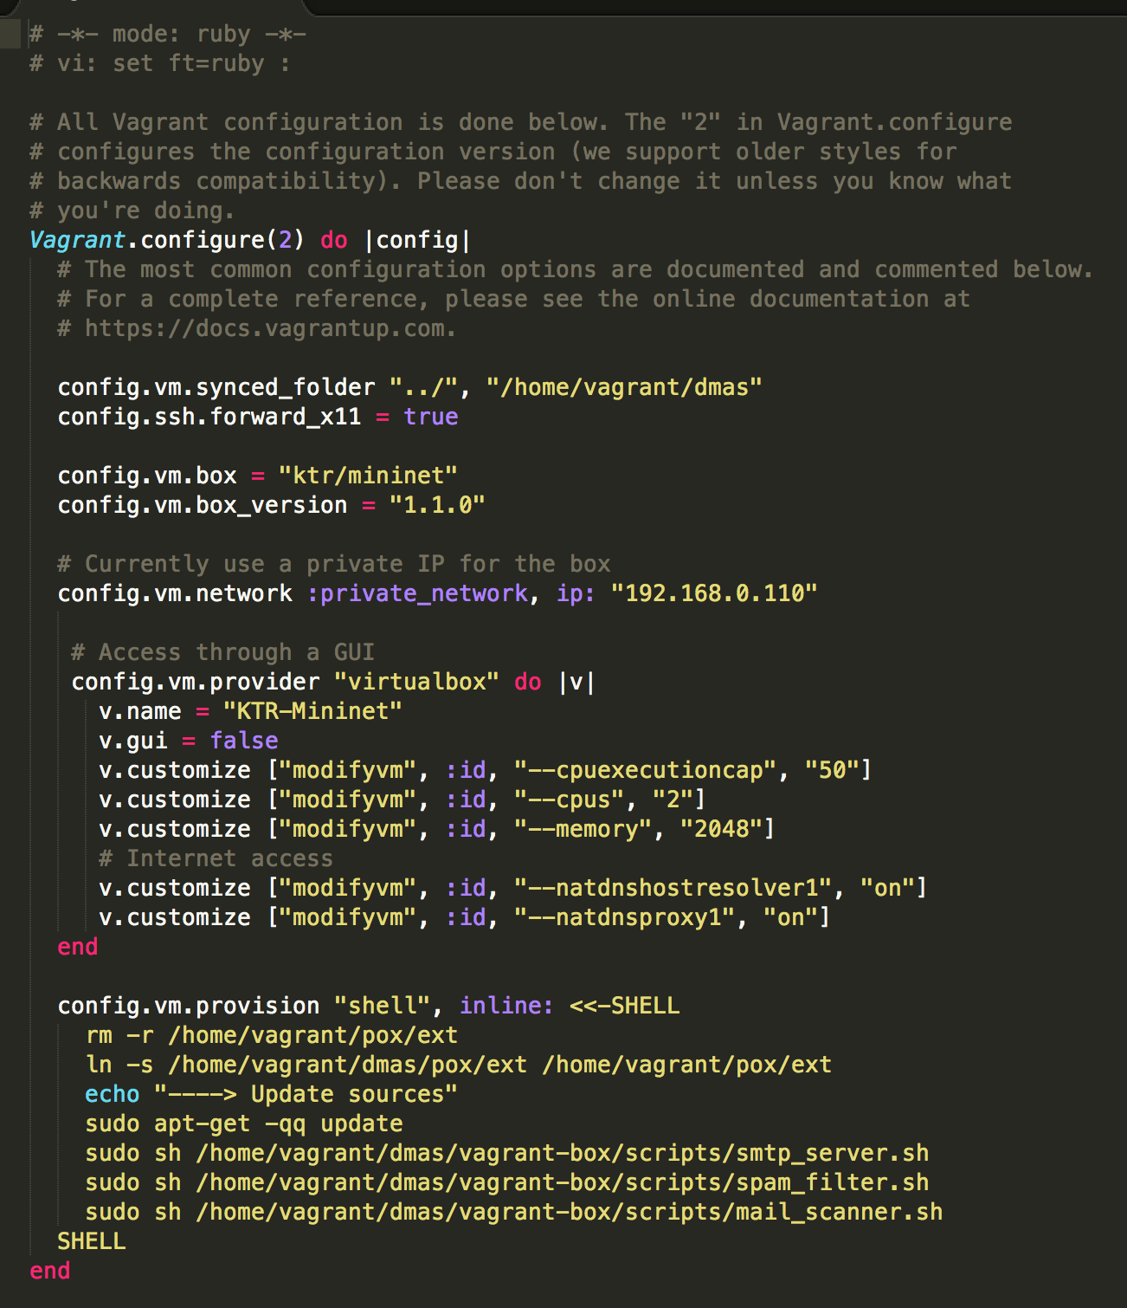
Machine preparation

Slide 16
Presentation

Slide 17
Thanks for your attention.

