Slide 1
RAPID SOFTWARE EVOLUTION
Breaking the Cognitive Barrier

Slide 2
Plan
Software is complex – beyond human abilities
Traditional tools are not enough
Idea: use a process inspired by biological evolution
The elements of a supporting platform – an ambitious monster
Demo of a practical toy

Slide 3
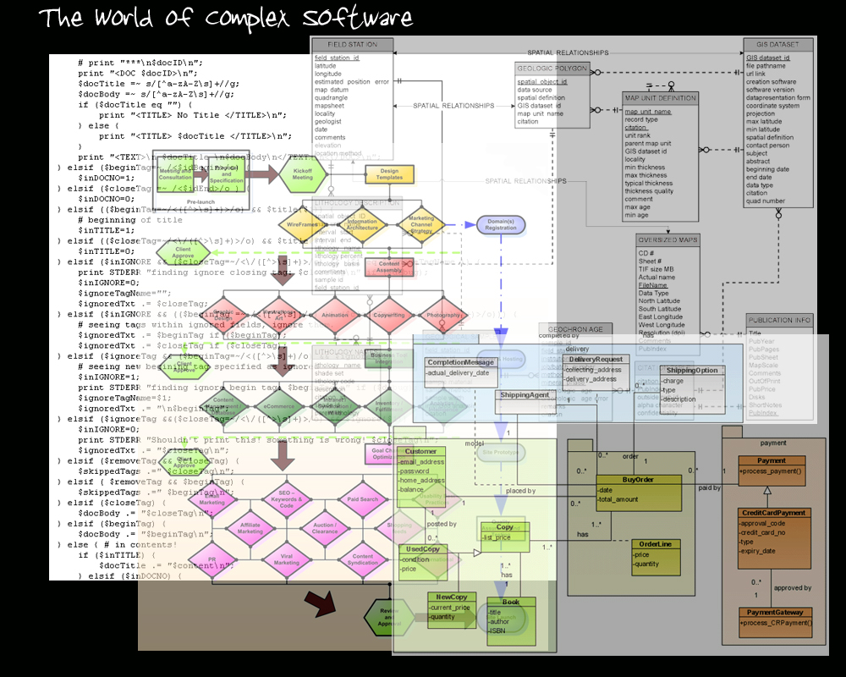

Slide 4
Why Is Software Complex?
Short answer: because the world is.
Long answer: because the world is very, very complex!
How to measure it?
Various program structure metrics?
  Lines of code
  Module dependencies
  Number of conditional branchings
Better: system behavioral complexity

Slide 5
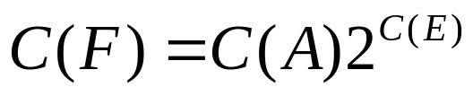
Functional Complexity
Algorithmic Complexity – minimal number of bits to describe something programmatically (Chaitin). Think compression!
Let:
  C(A) – number of bits to describe a single action of the system
  C(E) – number of bits to describe a single state of the environment
Then:

Slide 6
…meaning
Irreducible complexity, no matter what
Impossible to humanly comprehend (we are systems governed by the same formula)
Impossible to full test: too many possibilities
Extending program behavior for a fixed environment => increase in complexity by an exponential factor
Changing environment while maintaining same behavior => exponential increase in complexity!

Slide 7
Software Development
An abstraction-reification feedback loop
2
Models
Computers
1
3
Real World
We know a lot about 2
We know very little about 1
We barely realize how important 3 is!

Slide 8
Our Tools
From Science and Industrial Engineering:
Divide and Conquer, Modularity, Information Hiding, Encapsulation, Components, Reuse, Layers, Hierarchies, Stratification, Interfaces, Strict Boundaries, Abstraction, Separation of Concerns, Low-Coupling, High-Cohesion, etc., etc.
Essentially two core tools: abstraction and modularity
Problem: it only takes use so far
[Recent recognition that software is different: agile!]

Slide 9
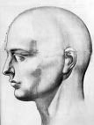
Abstraction
D
W
R
R
D
W
R
Abstraction of region D conditioned
by the abstraction of R – Lock In!

Slide 10
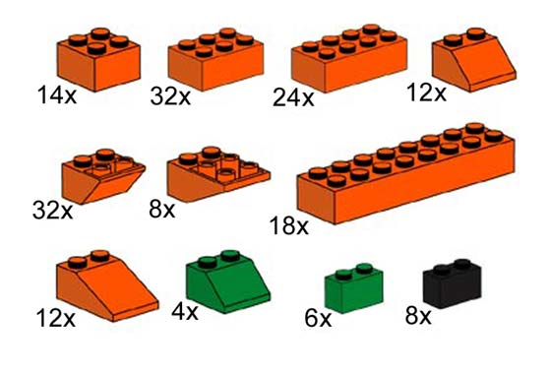
Modularity – Good!

Slide 11
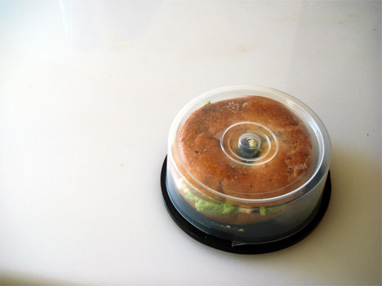
Reuse – Cool!

Slide 12
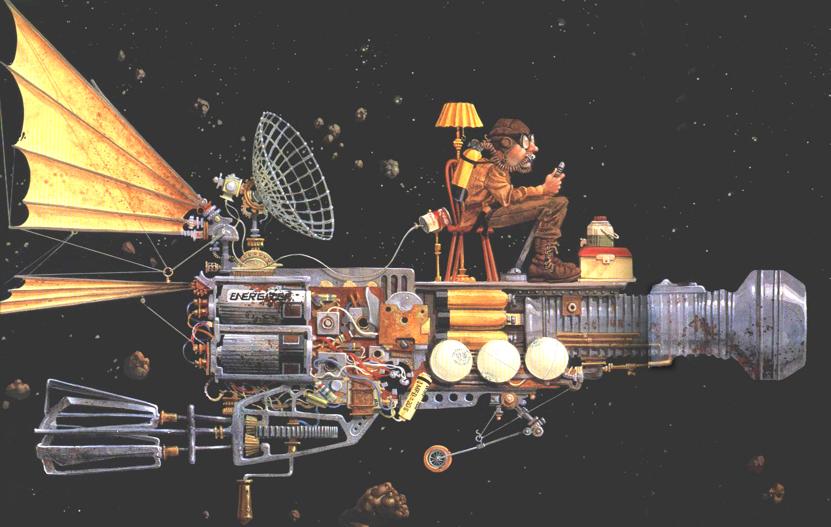
Modularity + Reuse=Hmm…

Slide 13
In Sum
Abstraction
  Based on ever increasing ignorance
  Always context-specific
  Details safely ignored in one part of the system become crucial at another part
Modularity
  Boundaries created during construction only help the creator, but are irrelevant at run-time – artificial constraint on system variability
  Assumes a complex system behavior can be reduced to the sum of its parts: false!

Slide 14
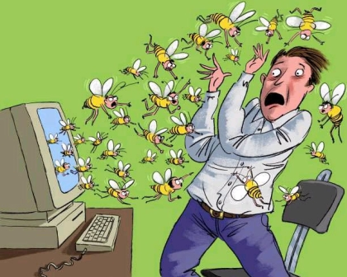
Computers are NOT digital

Slide 15
Why Evolution?
Realization of “goal-directed emergence”
Self-organization mechanism within the socio-technological landscape
Efficient search algorithm in a complex solution space
Universal Darwinism

Slide 16
Evolutionary Strategy
Granularity
GAs
Large solution space
Small time scale
No human participation
No control, fail most of the time
Evolutionary Engineering
Cognemes – cognitive units of engineering creation
  Data values
  Software abstractions
  Algorithms
  Modules
  Relationships
  UI components & design elements
  Behavioral implementation bits
Continuous human participation at diverse technical levels
Human “thinking” level time scale
Some control, failure acceptable
Market
Small solution space
Big time scale
Not for non-commodity software
Disjoint human participation
Full control, failure unacceptable

Slide 17
Towards an Evolutionary Platform
Live programming-interactive system
Mutli-paradigm development
Decentralized network of operating environments
Shared representation schema with knowledge representation capabilities

Slide 18
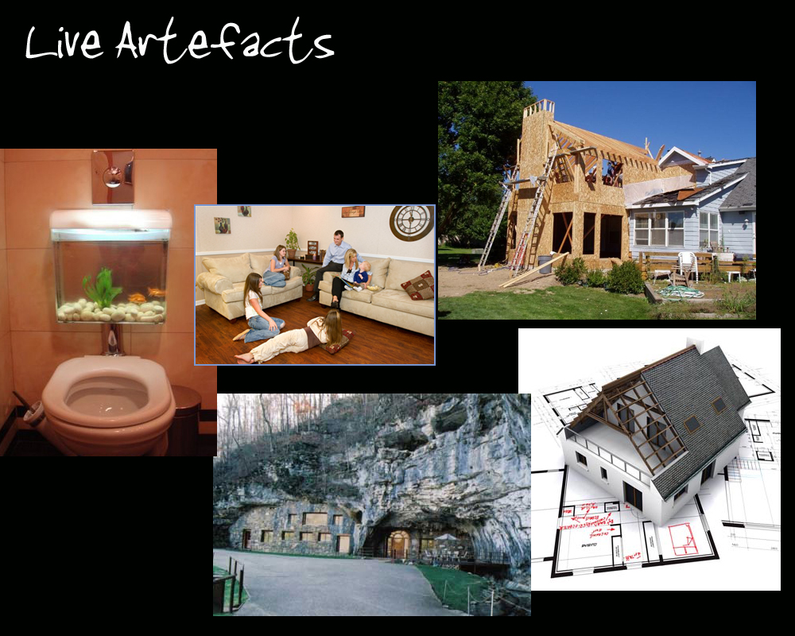
Alive, Living, Livable

Slide 19
Software Live Systems
Compile-time vs. Run-time distinction blurred
Reactive – changes take effect immediately
Total visibility of data/program structure
Transparent persistence of modifications
Users & programmers share the same computation medium
Examples: Smalltalk/Squeak, Self, more recently Newspeak by Java Guru Gilad Bracha

Slide 20
Multi-paradigm Programming
Programming languages = executable meta models
Any commitment to a particular abstraction framework severely constrains the engineering perceptual prism
Diversity in linguistic expression is a precondition to a large-scale participation
Interoperability through common representation

Slide 21
Decentralization
Networked exchange of fine-grained software artifacts
Local variations
Large-scale selective pressures
Opportunity for collaboration and competition at all scales
Increased connectivity within the human-machine cognitive continuum

Slide 22
Knowledge Management
Wild computation → Messiness
Knowledge manage the artifact space through a rich network of relationships
Light semantics
Reflexivity
Declarative, data-driven style of software construction
Blur distinction between core functionality and management aspects (e.g. robustness)
Optimization!

Slide 23
Distributed Memory Model
Universal addressing schema – UUIDs
Universal data representation schema and open storage
No commitment to any meta-model (e.g. objects, relations, rules or functions).
Two organizational principles only:
  Aggregation/linking/association
  Type vs. value distinction (semantic stratification)

Slide 24
Generalized Hypergraphs
Hypergraph – a graph where edges connect more than two nodes
Generalized hypergraph – a hypergraph where edges can be targets to other edges
Edges + nodes unified as atoms with arbitrary (≥ 0) number of targets
HyperGraphDB – a database of typed atoms, linked arbitrarily

Slide 25
Representation Schema
Atom → Type Value TargetSet
TargetSet → Target1 Target2 . . . TargetN
TargetSet →
Type → Atom
Value → Part1 Part2 ...
Value → RawData
Open type system embedded in the hypergraph
Types are responsible for managing values in permanent storage

Slide 26
Examples
Simple data: text, numbers
Object models & nested structures
Knowledge representation
- Logic facts, rules, relational data
- Semantic web formalisms, e.g. RDF & Topic Maps
Documentation text
Behavioral (user-interface) components
Source program artifacts – scripts, compilation units
Combinatory logic expressions
Modules
Bottom line : no preset level of granularity!

Slide 27
A Niche Network
function F(A, B, C) →
G(A.x, B)
H(A.y, C)
function F(A, B, C) →
S(A.x, B, C)
object A
- field X
- field Y
object A
- field X
Etc…
Both implementation and interface can vary
Backtracking based on change history
Updates & distribution triggered depending on the organizational context

Slide 28
Evolutionary Dynamics
Selection on:
- Atom presence
- Atom values
- Atom linkage
Mutation & Selection induced by the environment = programs+people
Cross-over on linkage structure
High-level Dynamics
  Stability vs. Chaos
  Variability vs. Uniformization

Slide 29
A Typical Software Product Business
Customer 4
Solutions Team A
Customer 3
Product Team
Customer 2
Solutions Team B
Customer 1
Strict hierarchical structure where core product must absorb nearly all variability.

Slide 30
A Niche Cluster
Customer 1
Customer 3
Solutions Team A
Solutions Team C
Solutions Team B
Solutions Team D
Customer 2
Customer 4
Uniformity abandoned – the decentralized network better reflects the variety of the (market/business) environment.

Slide 31
Thank You!
Borislav Iordanov
biordanov@acm.org
Kobrix Software Inc.
http://www.kobrix.com

